Slide 1


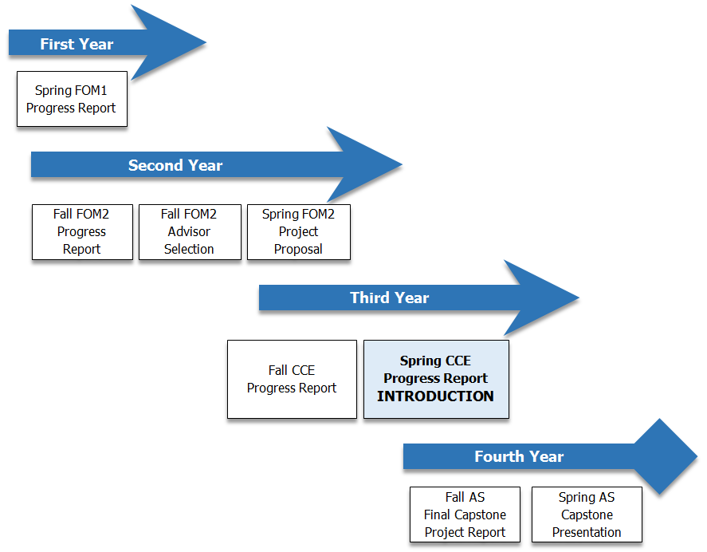
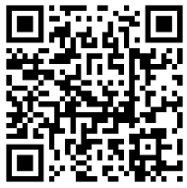
Capstone: Identifying the impact of advisor review on the quality of student scholarly writing
Colleen Burnham MBA, Caroline Alper MD, Melissa A. Fischer MD MEd
Background
Method
Results
Capstone Project Report
Rubric Development
Review
Scholarship courses are increasingly integrated into modern medical school curricula to enhance career guidance, focused mentoring, and development of skills of scholarship. The University of Massachusetts School of Medicine implemented the required Capstone Scholarship and Discovery course that culminates in the written presentation of a longitudinal four-year project. With no formal curricular time in the first three years of school, students work largely independently with guidance from Learning Communities mentors and then Capstone project advisors. Working with students, faculty, and library staff, course leadership have created tools in support of this independent work. Students complete semester progress reports designed to guide and evaluate effort, while generating draft components of the final project report. This study evaluates draft project report components to determine if quality of scholarly writing is impacted by advisor review in advance of submission.
  Course leaders reviewed and adapted published rubrics for scientific and scholarly writing, incorporating course objectives to create the 5-point , 4 category rubric (20 total possible points). Three members of the course leadership team independently applied the rubric to 3 introduction sections to determine consistency of scoring. Information regarding status of review by advisor was removed from submissions.
  Following the pilot 3-submission review, the course team members each independently reviewed 1/3 of all complete student draft Introduction submissions (N = 98). Total scores were sorted into 4 groups (1-5, 6-10, 11-15, 16-20) and compared to student-report of advisor review prior to submission. Scores of 11 and higher were considered acceptable, indicating the student had successfully accomplished the exercise.
Review of the draft student Introduction Sections revealed a wide variety of writing ability and technique; scores ranged from 1 – 20 (N = 98, µ=16, σ= 3.11), with only 4 of 98 in the ‘not acceptable’ range (1-10) and most (67) occurring in the top bracket (16-20).
  An Independent t-test was conducted to compare all “not advisor reviewed” and “advisor reviewed” writing samples.
  There was a statistically significant difference in the scores for introductions that were “not advisor reviewed” (n = 38; x̅ = 15.34) and “advisor reviewed” (n = 60, x̅ = 17.18); t(96)=1.99, p = 0.007.
Project Report Introduction Section
Scholarly Writing Rubric
Competency | Exemplary |  | Competent |  | Does Not Meet
 | 5 | 4 | 3 | 2 | 1 | 0
Analysis: Clarity of Scholarly Question | Clearly identifies the research question or project and its inherent complexities |  | Identifies a research question or project |  | Does not clearly identify a research question or line of study or project | Section not included
Background | Clearly and accurately provides background information relative to the research question or project. Includes full, relevant citations |  | Provides reasonable background information Partial inclusion of citations, or incomplete |  | Background information is not provided, is irrelevant, or is insufficient No citations | Section not included
Style & Scholarly Relevance | Written in narrative format with appropriate grammar Appropriate length Clearly articulates relevance or purpose of the project |  | Narrative format but excessively long or too short Identifies a general relevance or purpose of the project |  | Non-narrative format Incomplete sentences, bullets, poor grammar Reflective only Does not identify the relevance or purpose of the project | Section not included
Next Steps | Appropriate number & detail Relevant to work |  | Well-written but vague in scope |  | None or poorly articulated | Section not included
To support student success, scheduled project reports include questions and submission of drafts of final report sections. These sections are aligned with progress the student should have made to date. The Introduction section, which is submitted in fall of year 3:
describes the rationale for the project, including goals, and provides relevant supporting information (eg, bibliographic information) in 1000-1500 words
gives concise, appropriate background discussion of the project, including its significance, scope, and limits
Students are expected to request and respond to Advisor feedback before submission.
Progress reports submission assessments are formative; the final course and project are graded credit / no credit.
Conclusions
  Overall students’ writing met expectations (94 of 98 samples). Advisor review was associated with higher scores, with more samples (45 vs 21) in the exceptional range with respect to content and format having been reviewed by an advisor. However, these data do not imply causality. While we would hope the advisors provided feedback that improved writing, it is also possible that students who submit to their advisor in advance are more experienced or more dutiful and thus create initial drafts that are also higher quality without advisor input.
References and Acknowledgements
Next Steps
  Electronic Supplementary Material (ESI) for Chemistry Education Research and Practice This journal is © The Royal Society of Chemistry 2012
Thank you to students, faculty, IRB, IREA, ACS, Lamar Soutter Librarians, and staff for their continued support and enthusiasm as we implement this new longitudinal course.
  Next steps include increasing sample size, considering similar survey of advisors to determine level of effort in their pre-submission reviews of student work, and incorporating this information into student and faculty development.
University of Massachusetts Medical School | Capstone Scholarship & Discovery

