Slide 1
Research & Engagement at the
Commonwealth’s Public Medical School
Michael F. Collins, MD
Senior Vice President for the Health Sciences, UMass
Chancellor, UMass Medical School
Massachusetts High Tech Council
2014 CEO Roundtable Series
October 28, 2014
Notes:
Enjoyable process
Very collaborative
Appreciate the opportunity to present this and get your feedback

Slide 2
Research Funding: FY 2005 - 2014
NIH 2013 Rankings
44 out of all 2336 organizations receiving NIH research funding (2nd percentile)
4 out of 169 MA organizations receiving NIH funding (3rd percentile)
36 out of 139 Medical Schools receiving NIH research funding (26th percentile)
4 faculty in top 2 percent of all 35,124 NIH Investigators
Departmental rankings: 1st in Emergency Med; 12th in Genetics; 17th in Biochemistry; 18th in Family Med

Slide 3
UMMS Drives System’s Licensing Revenues
Year | 2005 | 2006 | 2007 | 2008 | 2009 | 2010 | 2011 | 2012 | 2013 | 2014
UMass System Licensing Revenue | 28,698 | 27,183 | 31,753 | 36,921 | 72,051 | 40,461 | 36,496 | 53,889 | 35,345 | 31,062
UMMS Licensing Revenue | 27,694 | 25,545 | 31,065 | 35,759 | 71,500 | 38,377 | 34,821 | 52,642 | 33,823 | 29,830
UMMS % of System’s Revenue | 97% | 94% | 98% | 97% | 99% | 95% | 95% | 98% | 96% | 96%
AUTM Ranking | 11 | 12 | 13 | 13 | 8 | 13 | 14 | 10 | 17 | N/A
Note: Revenue listed does not include stock sales

Slide 4
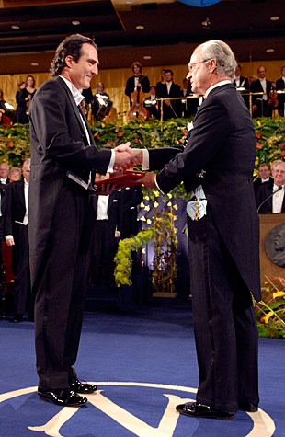
Internationally Recognized Faculty & World-class Research Strengths
Craig Mello, recipient of 2006 Nobel Prize for Medicine/Physiology
Victor Ambros 2008 Lasker Award
7 Howard Hughes Medical Institute Professors: Davis, Freeman, Green, Mello, Moore, Sassetti, Zamore
6 National Academy Members: Ambros, Green, Mello (NAS), Brown, Ware (IOM), Davis (Royal Society)
RNA Biology/RNA Therapeutics
Gene Therapy
Receptors and cell signaling
Neurodegenerative disorders
Cardiovascular
Diabetes
Immunology/Autoimmunity
Infectious diseases/Microbiome

Slide 5
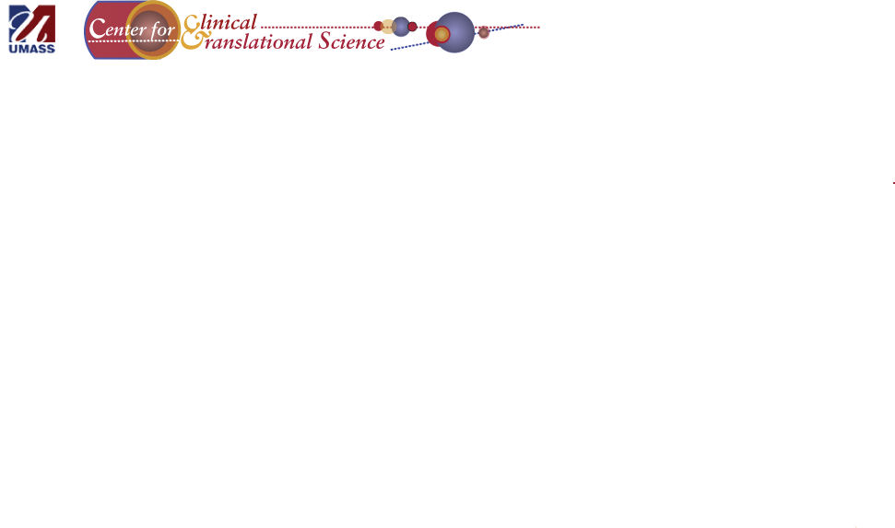
Create an ecosystem that drives innovation, quality, safety, and efficiency across the research pipeline
Capitalizes on scientific and programmatic strengths
Catalyzes multidisciplinary collaborations and partnerships
Creates product pipelines; supports their development with cores, services, funding
Creates education and training programs to advance translation of discoveries
Arose from 5-campus 2008 Life Sciences Strategic Plan to prepare for the Governor’s Life Sciences Initiative
Vehicle for sharing of library resources, Profiles Tool, other core usage
LSMF pilots stoked fires of collaboration
UMB on behavioral health
UML on engineering (medical devices)
UMA on medicine chemistry (polymers, plants)
Liaison for Large Programs
UMA Institute for Applied Life Sciences ($95M MLSC grant)
UML collaboration on M2D2
UMB on NIH-CHEIR Center

Slide 6

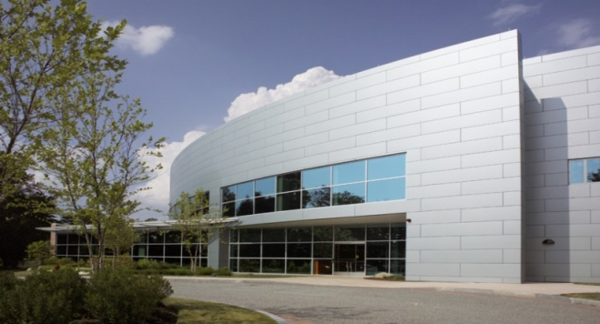
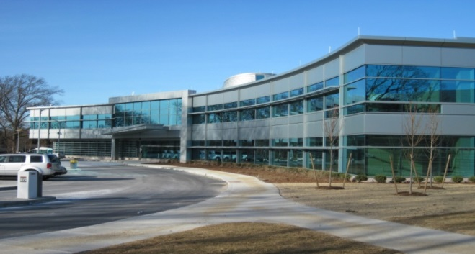
During 119 year history, MBL has delivered more than 100 million doses of vaccines to the people of the Commonwealth and the world
Only publicly owned, non-profit FDA-licensed manufacturer of vaccines and other biologic products in the U.S.
Incubator for innovation and improvement in the processes of vaccine and biologics development
Product discovery often focuses on needs of populations where commercial market is limited
MBL is pursuing new strategic ventures and partnerships (i.e. MassBiologics Southcoast; Viral Manufacturing Center; Next Hundred Million Doses Pilot Program)

Slide 7

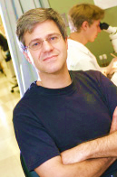
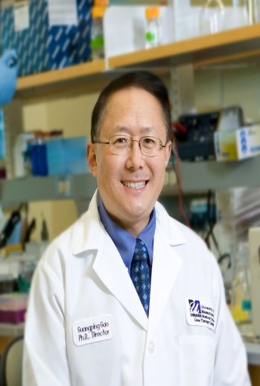
Examples of Strategic Partnerships
UMMS Co-Founders (Zamore, Gao)
Sponsor annual Research Retreat
Translational Research Fellowship
First-in-human clinical trials of AAV gene therapy for CNS disorders
UMMS research-grade vector production ($500K+)
MassBiologics GMP manufacturing
Tech Licensing payments
Pilot Grant Program through the UMass CCTS
Sponsored Research agreement with UMMS in therapeutics in Immunology and Infectious Diseases
Pilot Grant Program through the UMass CCTS

Slide 8

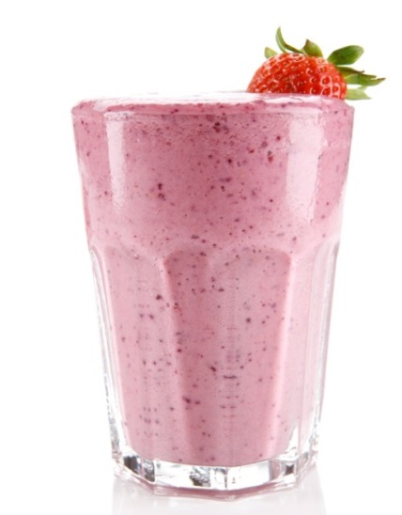
UMass Life Sciences Task Force 2014
Through Collaboration and Strategic Alignment,
Can the System Be Greater than the Sum of its Parts?
Moving from this…
To this…

Slide 9
LSTF: Strategic Goals
Develop a talent ecosystem that encourages interconnectedness among all stakeholders, ensures the highest educational quality at all levels and enables UMass graduates to find success in the state’s innovation economy.
Position the UMass campuses as hubs for industry engagement, technological innovation and regional development that drive the Commonwealth’s innovation ecosystem across all regions of the state.
Foster an innovative, collaborative and complementary research enterprise that will enhance the breadth, depth and impact of the University’s R&D efforts.
External Engagement & State-wide Innovation
Research
Talent

Slide 10
University’s Value to
External Partners
Industry’s Value to the University
UMass students will be the future workforce for the Commonwealth’s Innovation Economy
UMass Research Enterprise will help to advance the state’s global leadership position in life sciences
UMass campuses will serve as a hub for state-wide and regional innovation
Helping UMass tell its tremendous story
Working with UMass to develop robust internship programs and academic programs linked to industry needs
Advocating for programs and initiatives that benefit UMass (i.e. MLSC)
Facilitating the University’s emergence as the go-to institution for industry engagement in Massachusetts

Slide 11
Questions & Discussion
http://www.umassmed.edu/dean/MHTC-CEO-Forum/
Notes:
Enjoyable process
Very collaborative
Appreciate the opportunity to present this and get your feedback

