Slide 1
YOUTH & YOUNG ADULTS with SERIOUS MENTAL HEALTH CONDITIONS
REFLECTIONS ON 30 YEARS
Part 1 – Policy and Service
Brianne Masselli
Gwen White
May 12, 2025

Slide 2
Webinar Housekeeping
This webinar is being recorded and will be available on our website.
ASL Interpreters are available.
Live captions are being auto-generated by Zoom. The icon to enable them is in the control panel at the bottom of your Zoom window.
Participants are automatically muted with webcams off.
There will be a moderated Q&A session after the presentation. Please use the Q&A button or Chat to send questions to the presenters.
Problems? Send a DM to Dee Logan or an email at Deirdre.Logan@umassmed.edu

Slide 3
ACNKOWLEDGEMENT & DISCLOSURE

Slide 4

Why reflect on 30 years?

Slide 5
Policy and Service
SAMHSA RESPONSE TO
DAVIS / VANDER STOEP 1997 PAPER
SERIES OF GRANTS FOCUSED ON YOUNG PEOPLE
AGES 16-25 WITH SED/SMI
2002 Partnerships for Youth Transition
2009 Healthy Transition Initiative
2014 – 2020 Now Is The Time – Healthy Transitions
Notes:
speaks to SAMHSA- how they paid attention to the data and publications associated with the report
Intro: How we came to the work and how we started workign together
GW- 3 SOC grant – hooked on age group 2010, took position with TA.
BM- 2005 System of care- youth coordinator, 2009 HTI grantee, PD, and Youth MOVE National as a TA provider to HTI and NITT- grants

Slide 6






Service Approaches
Youth Guided
Youth Driven
Systems Support Young Adult TRANSITIONS
Systems of Care
Support Children and Youth
Redefine Family Role
Family Driven
New Partners;
Seamless Coordinated Care
Separate Child
& Adult Systems
Evidence Based
Evidence Informed
Notes:
Brie: Utilize this slide to start telling the shifting thinking for this work. We both came out of the System of Care work, so we know the core values of that framework, but they are not the same for this population.

Slide 7
Polling Question
Where are you in the cultural shift of the system to support to young adults?
Haven’t thought about it
Exploring age appropriate supports
Implementing age appropriate supports
Notes:
Gwen is to introduce

Slide 8
Reflections - Practice
Value based service delivery that is age appropriate and appealing to young adults
Engagement and enrollment are different
Culture is important
Life skills and Education Opportunities
Notes:
Gwen speaks First: The branch development of effective transition services that were developmentally and appealing.
PTY @ End we learned young adults in leadership and paid position, engagement with family, partnership with adult system, and lack of state/ federal policy changes
Pivot to 2009 grants included expanding upon lessons learned from prior grants- i.e Paid young adult roles, Family role, YMN
Brie: Speak to practices here in Maine, in 2009, the HTI grant included youth move work

Slide 9
Reflections - Policy
Formal or informal agreements between child and adult system
Age tailored services in each system
Young adult can access developmentally appropriate services
Notes:
Gwen: Policy informs practice, and practice informs Policy
Inclusion of the Adult system and other system partners in the discussion
Brie: effective transition and how the community defines age-tailored services and developmentally appropriate services.
Life skills, education opportunities, and workforce development
Branch- Development of Peer support, MOU between child and adult continuum

Slide 10
Three key policy questions
Are young adults identified in children’s services and provided age tailored services?
Is there a handshake between children’s services system and adult services system?
Can young adults access adult services and are developmentally appropriate services available?
Notes:
Gwen: Reflection points to consider in your local work

Slide 11
Reflections – Young Adult Involvement
Youth Driven Practices and Policies
Range of Peer Support Opportunities
Use of Young Adult Lived Expertise
Sustained Staff Positions
Notes:
Better term than “Involvement” goes way beyond that
Pivots of SAMHSA- PTY needed a youth coordinator
HTI- needed a youth coordinator and a Sustainability plan
NITT- Strong focus on youth & Peers
Brie will discuss young adult work at the local and federal levels.
Product development- Youth to youth advocate work

Slide 12
Poll -Where Are You in 2025
How is your community engaging with youth adults?
Young adults as recipients of services
Young adults on advisory councils and boards
Young adults hired to develop and oversee young adult programs
Young adults delivering peer services

Slide 13
Reflections – Families and Care Takers
Robust Family and Caretaker Engagement
Support of family role into adulthood
Notes:
Family transition – families as drivers shift from driver to navigational aid
Family groups developed publications on family transitions, groups, and peer support.
Brie- Institutional run between the family organization and the young adult organization, also, this was similar to the adult consumer organization.
Families and Caretakers
Family is self-defined by the individual

Slide 14
Reflections – Cross System Partnership
Coordinated Cross System Approach
Nurture non-traditional partnerships
Address system cultural differences
Notes:
Gwen
Brie

Slide 15
Pillars for Success
Leadership Sets Culture
Court Champions
Notes:
Brie to start: Give an example of what this means for the work locally and nationally
Gwen- Local level & state level Champion in Education & Juvenile Justice
Identify Champions Early
Trust & Relationship Building among system partners is Critical.

Slide 16
Pillars for Success cont’d
Community and Connection
Importance of networking for all
Notes:
Maybe local, maybe another state and or your TA provider, but you need to find them.

Slide 17
Pillars for Success cont’d
Look for The Helpers
Partners are Critical

Slide 18
Pillars for Success cont’d
Hope
Perception of Hope & Opportunity
Notes:
Perception of Hope and Opportunity
Data point critical for policy and practice – Individuals with complex trauma still had hope in transition vs. a lack of HOPE in older adults.
Brie- providers not seeing or understanding the system diminish opportunities due to Dx rather than seeing this as an opportunity to learn, grow, and advance

Slide 19
Critical Thirty-Year Partnerships
Funder
Evaluation
Research
Technical Assistance
Stay tuned for next webinar

Slide 20
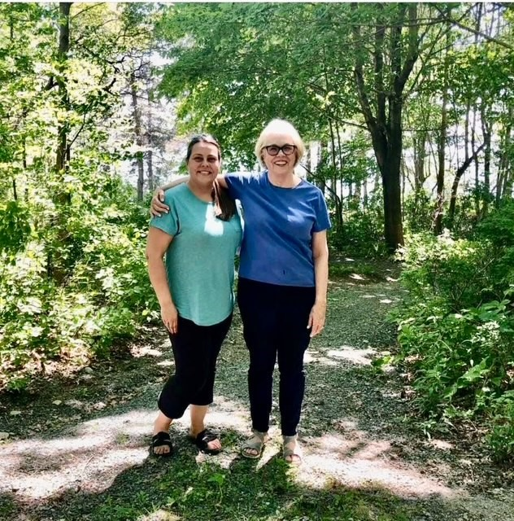
It’s About Changing Lives
Notes:
Johanna

Slide 21
Discussant Reflections
Policy evolution and remaining gaps
Implementation and the need for sustainable system transformation
Young adult leadership and future directions

Slide 22
Looking Ahead
What structures will help move us from promising pilots to truly transformed, sustainable systems, especially given today’s complex environment?
How do we embed youth leadership not as an optional enhancement, but as a foundational element of system design and evaluation?
And how do we ensure equity is not just a lens we apply, but a foundation we build from at every stage of our work?

Slide 23
Don’t Miss Part 2
June 2, 2025
12pm to 1:30pm EDT

Slide 24


CIRC Center Products
Podcasts
Reels
Tip Sheets
Webinars
www.umassmed.edu/transitionsacr/circ

Slide 25
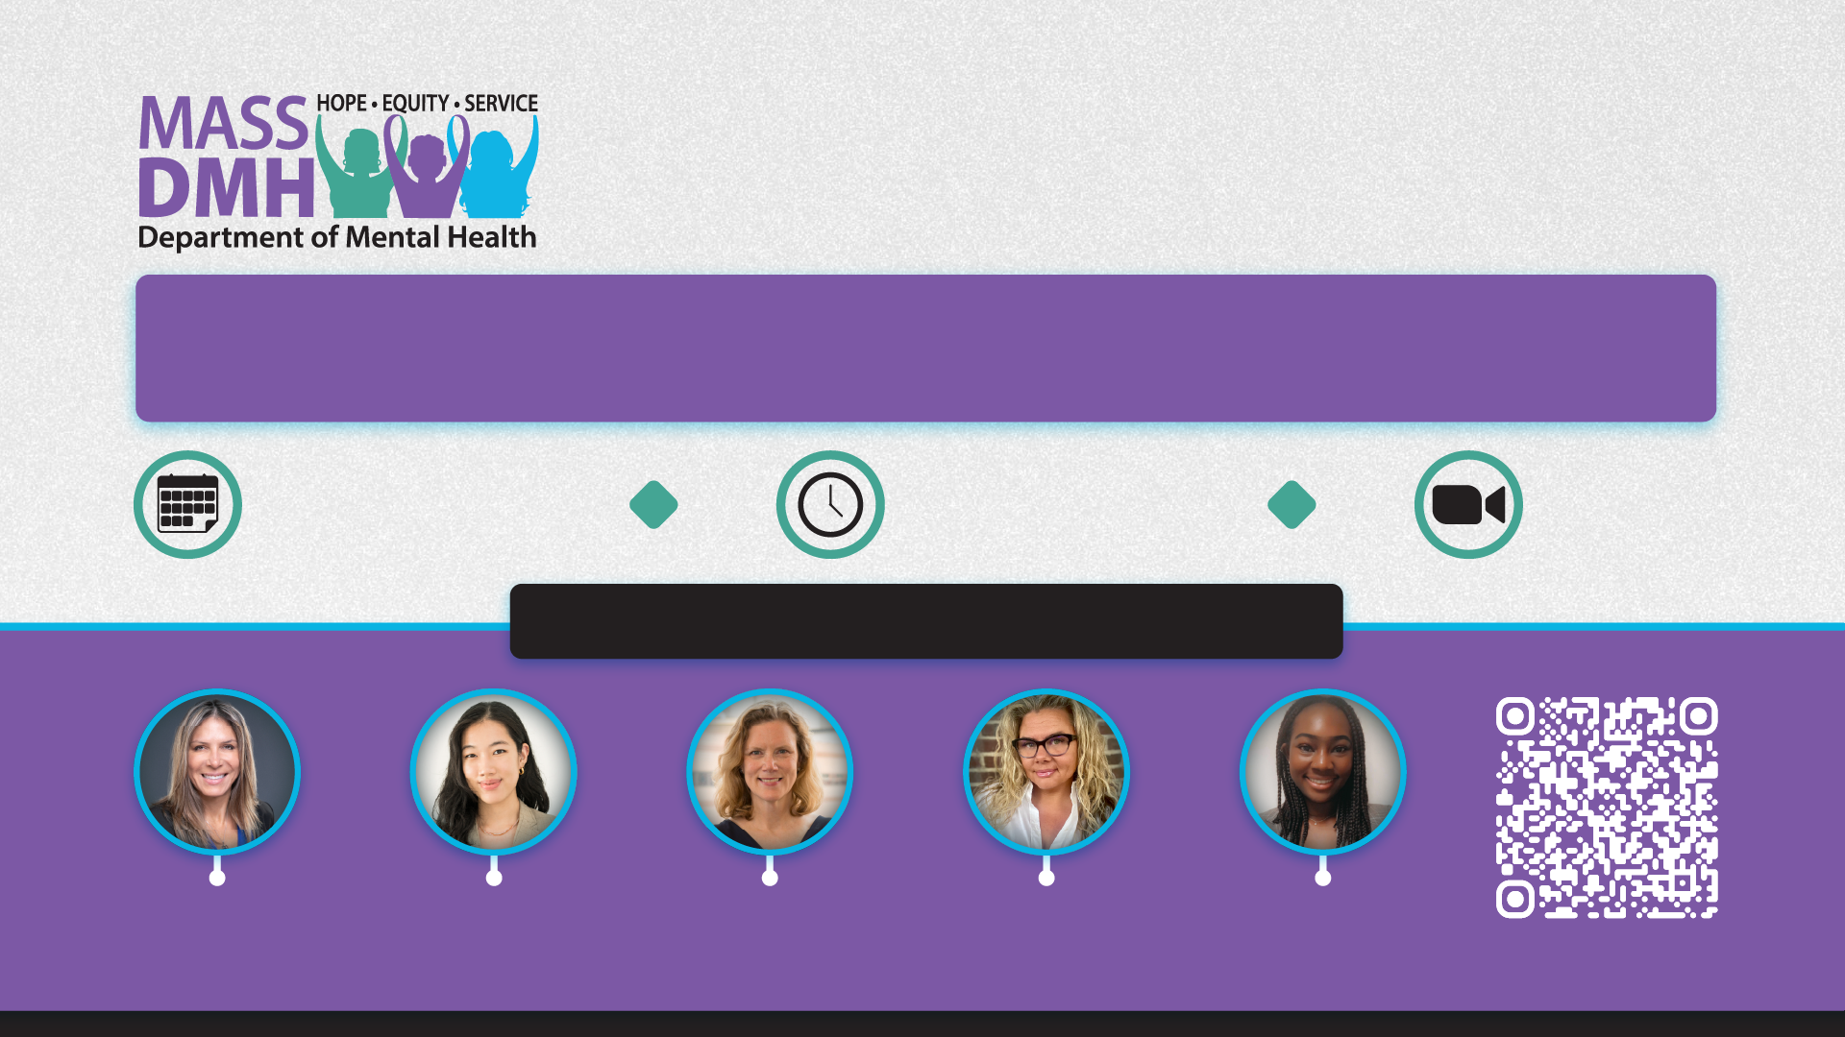
Research Centers of Excellence Conference
2025 ANNUAL
Promoting Youth Mental and Behavioral Health
Understanding and Addressing Risk and Protective Factors to Improve Youth Well-Being and Outcomes
Thursday
May 29, 2025
12:30 –
4:30 PM EDT
Zoom
Meeting
Featured Speakers & Registration
Gina
Vincent, PhD
UMass Chan
Medical School
Cheryl Y.S.
Foo, PhD
Mass General Brigham &
Harvard Medical School
Daphne
Holt, MD, PhD
Mass General Brigham &
Harvard Medical School
Michelle
Mullen, PhD
UMass Chan
Medical School
Vanessa
Iroegbulem, BA
Mass General
Brigham
https://umassmed.zoom.us/meeting/register/Ko0Fga0QRyuHIzLnxihWrQ
Notes:
Registration link: https://umassmed.zoom.us/meeting/register/Ko0Fga0QRyuHIzLnxihWrQ

