Slide 1
From Outreach to Shared Leadership: Expanding Collaborations with Young Adults with Lived Expertise
Presented by Joshua Calarino, Davy Yue, and Tracy Neville
Notes:
TRACY
Welcome and thank you for joining today’s webinar, “From Outreach to Shared Leadership: Expanding Collaborations with Young Adults with Lived Expertise.” My name is Tracy Neville, presenting on behalf of the Center for Community Inclusion and Reflective Collaboration (CIRC Center), a partnership between UMass Chan Medical School and Temple University.
Feel free to put your name and state in the chat.
A few housekeeping notes: As any questions arise throughout the presentation, please type them in the Zoom chat or hold them until the end of today’s presentation. We will have dedicated time for questions and answers before we close out today’s webinar.

Slide 2
Acknowledgement & Disclosure
The contents of this presentation were developed under a grant from the National Institute on Disability, Independent Living, and Rehabilitation Research (NIDILRR grant number 90RTCP0010) and co-funded by the Substance Abuse and Mental Health Services Administration (SAMHSA). NIDILRR is a Center within the Administration for Community Living (ACL), Department of Health and Human Services (HHS). The contents of this presentation do not necessarily represent the policy of NIDILRR, ACL, SAMHSA, or HHS, and you should not assume endorsement by the Federal Government.
The authors have no conflict of interest.
Notes:
TRACY
Today’s presentation describes work primarily associated with the CIRC Center, a Rehabilitation Research and Training Center awarded to UMass Chan Medical School in 2023, led by Principal Investigators Dr. Kathryn Sabella and Dr. Elizabeth Thomas. We are grateful to NIDILRR for their support and to SAMHSA who funds portions of our communications, training, and technical assistance activities. The contents of this presentation are ours alone, and do not represent the policy of NIDILRR, ACL, SAMHSA, or HHS and you should not assume endorsement by the Federal Government. We have no conflicts of interest to report.

Slide 3
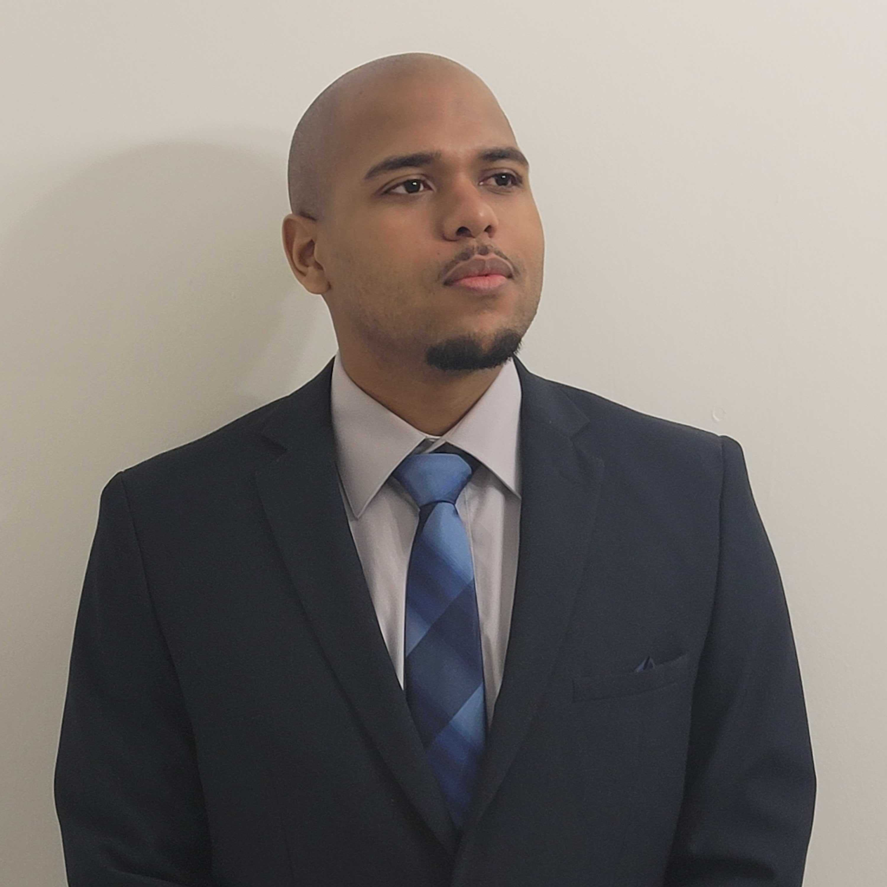
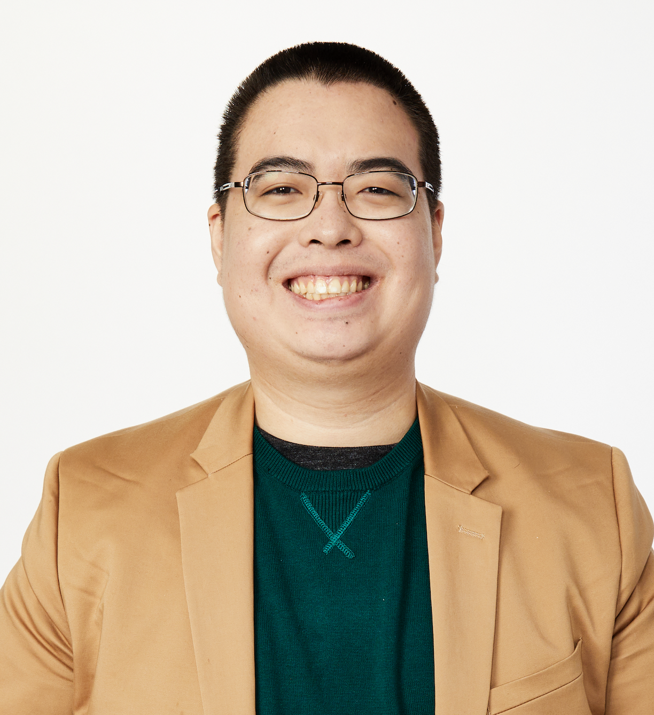
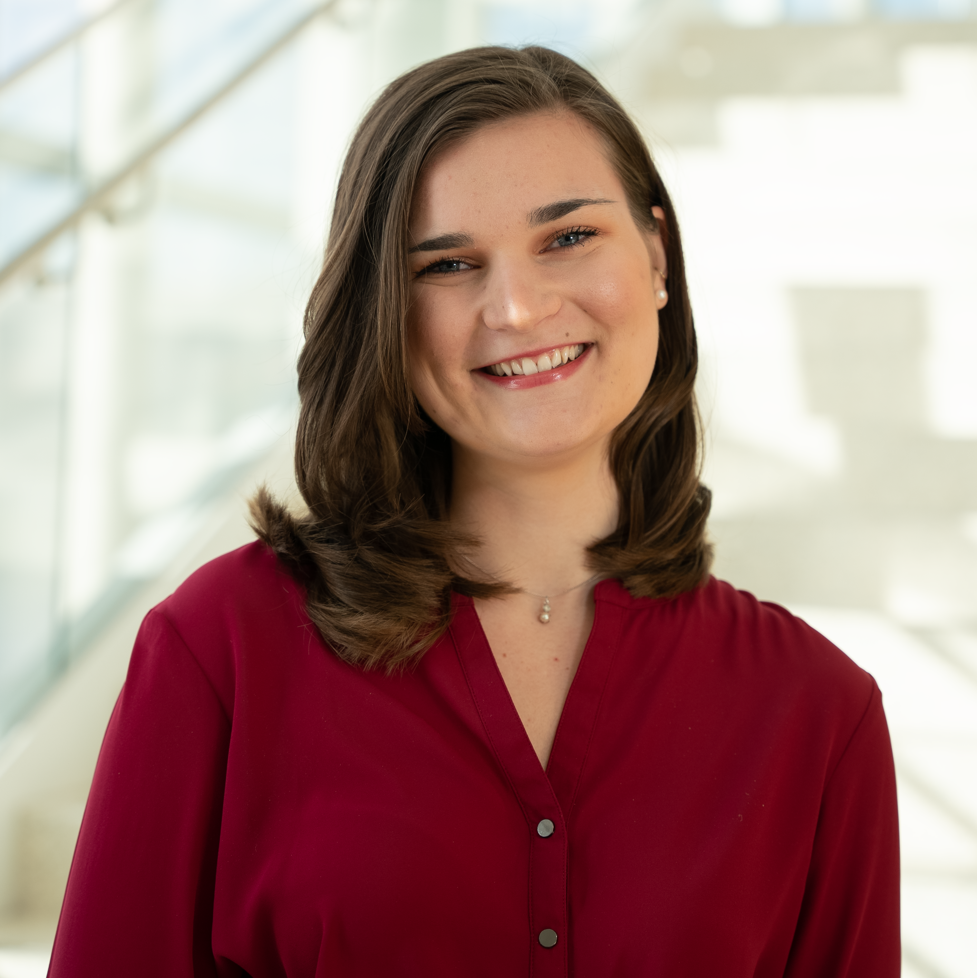
Meet the Presenters
Joshua Calarino
Davy Yue
Tracy Neville
Notes:
ALL
We’ll start be introducing our presenters, starting with Joshua Calarino
Each presenter will say a few words about themselves, role, background, etc.
Tracy: My name is Tracy Neville, she/her, Research Coordinator II at UMass Chan Medical School with over 3 years of experience. With expertise in project management, I ensure smooth day-to-day operations conducting research studies that are national in scope. I also co-facilitate the Young Adult Advisory Board along with my colleague, Mei Pearlstein.

Slide 4
Agenda
CIRC Center Introduction
What is Community-Engaged Research?
About the Young Adult Advisory Board (YAB)
“Leveling Up” YAB Involvement
Lessons Learned & Recommendations
Reflections on Personal Impact
Notes:
TRACY
Today’s presentation will begin with an introduction to the CIRC Center, followed by an introduction to Community-Engaged Research.
We will also provide a brief history of the Young Adult Advisory Board (YAB) housed within UMass Chan Medical School and its activities.
We will the describe how we have “leveled-up” our community-engaged research approach on CIRC Center projects, with practical recommendations and lessons learned based on our experiences over the past few years.
We will conclude with reflections on how we, as presenters and members of these project teams, have been personally impacted by this work.

Slide 5
The Center for Community Inclusion and Reflective Collaboration (CIRC Center)
Serves as a national leader in state-of-the-art research and knowledge translation activities to significantly advance community living and participation outcomes among young adults (14-26) with serious mental health conditions.
For more information, check out our website: umassmed.edu/transitionsacr/circ
Notes:
TRACY
The Center for Community Inclusion and Reflective Collaboration (CIRC Center) serves as a….read slide.
CIRC is truly a collaboration among multiple institutions of higher education, organizations that provide services to young adults with mental health conditions, and young adults with lived experience. CIRC was founded as a collaboration between two other longstanding RRTCs funded by NIDILRR:
The Learning and Working RRTC at UMass Chan Medical School which focuses on school and work outcomes among young adults with SMHC
Temple University’s RRTC on Community Living and Participation focused on adults with psychiatric disabilities.
Importantly, both of these RRTCs have long histories of community engaged and participatory approaches that involve individuals with lived experience in the design, conduct, and dissemination of research and training activities. CIRC wouldn’t be here without the pioneering work of these two centers. On the next slide, we provide some important background on the guiding principles that inform our approach to this work.

Slide 6
Guiding Principles, Assumptions, and Values
Disability justice
Social model of disability
Developmental theories and perspectives
Participatory research (especially YPAR – Youth Participatory Action Research)
Notes:
TRACY
Within CIRC, we have several guiding principles, assumptions, and values.
First, we approach our work from a disability justice perspective, which includes a focus on intersectionality and recognition that the experience of disability is shaped by a person’s multiple social identities and the social institutions and processes that contribute to oppression. All of our research projects attend to, and ultimately seek to address, the community participation needs of young adults with serious mental health conditions, especially those with the greatest support needs.
Second, we have adopted the social model of disability into our work, with many of our projects seeking to address environmental barriers to community living and participation such as stigma and discrimination and systemic barriers.
Third, we approach Center activities from a developmental perspective, recognizing the normative developmental milestones, needs, and experiences of young adulthood.
Finally, but perhaps most importantly, we employ methods and values of participatory action research, which fall under the umbrella of “community engaged research,” which we will discuss further on the next slide. What this means is that we employ young adults with lived expertise in full-time positions and also partner with young adult consultants through our Young Adult Advisory Board, which is the focus of today’s presentation. However, it’s also important to note that we involve members a Family Advisory Board (FAB) and Invested Community Partners Advisory Board (ICP).

Slide 7
What is Community-Engaged Research?
Engaging members of the community of focus in the research process can improve relevance, increase transparency, and accelerate the dissemination of evidence-based practices (Concannon et al., 2014)
Community-engaged research is a spectrum
Most existing engagement methods limited to outreach and consultative roles (e.g., advisory boards)
Engaging in co-research and co-leadership roles:
  Better and more impactful patient-centered outcomes
  Requires more intentionality, capacity building, and resources
Notes:
DAVY
Community Engaged Research is an umbrella term for the APPROACH to research that includes partnerships and collaborations among researchers and community organizations or individuals with lived expertise. There are different METHODS one can use when doing Community Engaged Research, Participatory Action Research is one such method. But for the sake of today’s presentation, we are talking broadly about ways to engage young adults with lived experience in our research, training, and dissemination activities; we will leave the academic debate over terms and definitions for another time.
Increasing rates of chronic diseases (e.g., depression, obesity, diabetes) among young adults (ages 18-29) in the United States have highlighted an ongoing need for CER
Last bullet – can list examples of co-research and co-leadership roles - (e.g., co-investigators, research interviewers, data analysts, or dissemination partners)

Slide 8
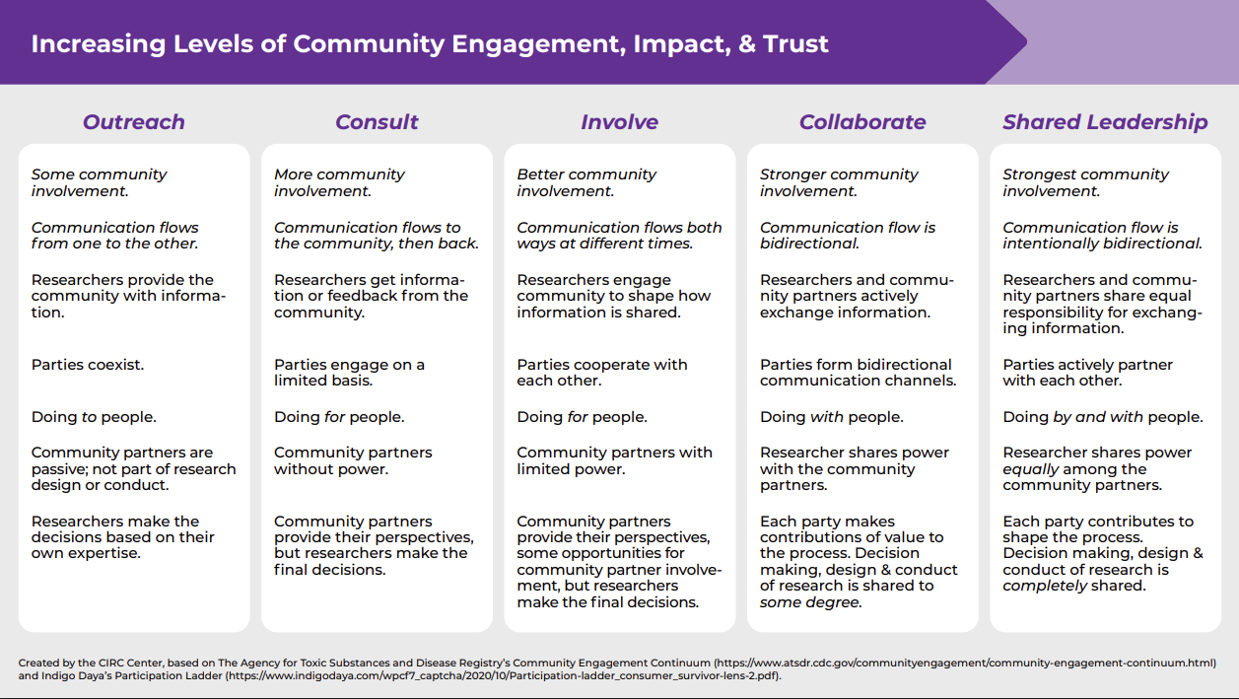
Increasing Levels of Community Engagement, Impact, & Trust
Notes:
DAVY
What I’m showing here is a diagram that displays increasing levels of community involvement, impact, trust, and communication flow and the associated characteristics with each level. This image represents our preferred way of thinking about community engagement and participatory approaches within CIRC. Importantly, this is an adaptation, or more accurately a merging, of two primary sources that we found ourselves going back to time and time again: A community engagement continuum previously published by the CDC and Indigo Daya’s Participation Ladder.
Looking at this image, Left to right, the levels of community involvement increase incrementally from: Outreach (lowest level), Consultation, Involvement, Collaboration, and Shared Leadership (highest level).
Over 15 years within the Learning and Working RRTC at UMass Chan, most of our community engaged work was done on the lower end of this spectrum and involved mostly Consultation and some Involvement. This is still important work, even though it’s on the lower end of involvement, it registers on the radar , is an important place to start, and requires extensive resources, care, and thought. However, when we proposed the CIRC Center, we wanted to elevate some of our existing community engagement practices by diversifying the young adults who we outreach, consult, and involve and also finding new ways to collaborate and share leadership with young adults in research and dissemination activities.

Slide 9
About the Young Adult Advisory Board
Established in 2014
Comprised of young adults with lived mental health experience, between the ages of 18-30, from across the US
Monthly Zoom meetings facilitated by young adult staff
Paid an hourly rate of $40
Notes:
DAVY

Slide 10
Types of YAB Consultations
Supporting the grant writing process
Identifying research questions of interest
Providing feedback on language for clarity and relevance
Advising on knowledge translation strategies to communities of focus
And more!
Notes:
DAVY

Slide 11
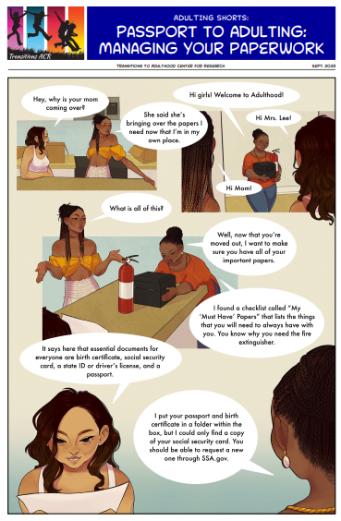
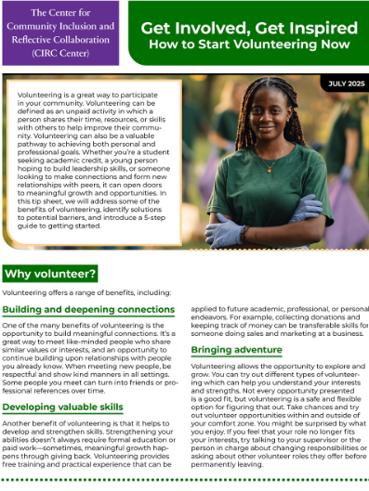
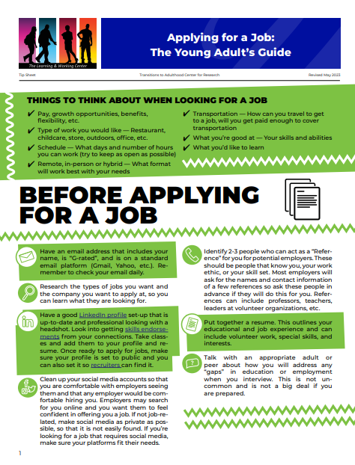
YAB Portfolio
NIDILRR-funded rehabilitation research and training center (RRTC) grants
“How Do You Do Community?” Mixed Methods Study
Tip Sheets on civic engagement, volunteering, accommodations at work, and applying for jobs
Engage Initiative: A Pilot Study to Advance Engagement Science – PCORI
Toolkit for Creating and Sustaining Youth Advisory Boards
Adulting Shorts: Comic series
Notes:
DAVY

Slide 12
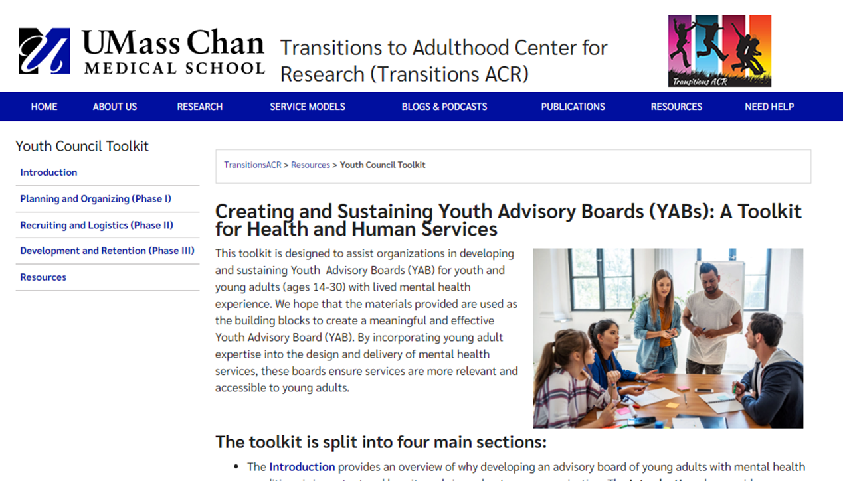
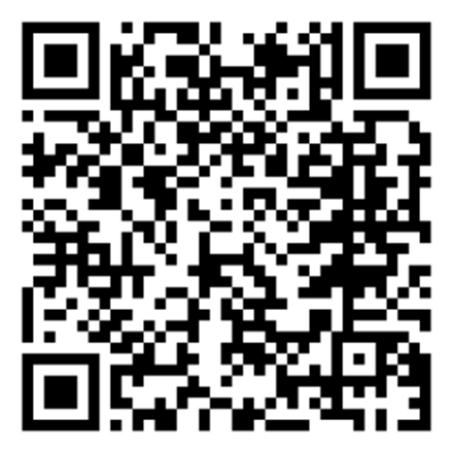
Youth Council Toolkit Available Online
umassmed.edu/TransitionsACR/resources/youth-council-toolkit/
Notes:
DAVY

Slide 13
The Impact of Co-Leadership
Embedding lived experience in leadership decisions
Designing methods through a trauma-informed and culturally competent lens
Ensuring deeper buy-in from the community when they see themselves in the research team
Shedding light upon the nuances of lived expertise
Notes:
DAVY
We’ve been doing all this great work with the YAB, but realized we could do better, i.e., shift towards more co-leadership or shared-leadership
These are the reasons why we would want to “level up”
Examples–
Designing interview questions so that they are more relevant to young adults. Sometimes there is a separation between the researchers conducting the study and the young adults participating. Co-production with young adults helps to bridge this gap.
Quality of the data from interviews conducted by interviewers with lived expertise
offering warmlines and other resources to all people who inquire regardless of eligibility status
dissemination products connecting more deeply with audiences, authenticity and relatability

Slide 14
“Leveling Up” YAB Involvement
The CIRC Center identified, defined, developed, and provided training for specific roles for YAB members embedded into co-leadership positions
Roles were further defined together between young adults and the leadership team through weekly work together
Ongoing check-ins on professional development as individuals and team members
Notes:
JOSHUA
Describe how co-leadership has been prioritized on CIRC Center projects during the grant writing phase and the plan that was set
Share key points on why leveling up is so important
**Distinguish how this is different from the YAB only – YAB is monthly, minimal feedback; these roles are more frequent and involved in scope.
In the CIRC center roles were identified, defined, developed, between Young ADULTS and the staff. Not only that but training was provided for each role to esure that all parties knew the what and how of their roles.
Once that was done roles were then furhter defined by revisting the topics and engaging in continual discussion and edits on each role until everyone was in agreement on it being satisfactory. This was done weekly keeping perspectives fresh and renewed.
Moreover, we had ongoing check-ins for continued professional development both as indiviuals and as a team. These soft and hard skills can transfer into work outside of the CIRC center as well.
This all happened because co-leadership has been prioritized on CIRC Center projects during the grant writing phase and the plan that was set before hand.
Distinguish how this is different from the YAB only – YAB is monthly, minimal feedback; these roles are more frequent and involved in scope.

Slide 15
CIRC Projects with Co-Leadership Roles
Instagram Reels & YouTube Shorts Project
How Do You Do Community? Research Study
Young Adult Blog Project
Notes:
JOSHUA
How Do You Do Community: A Mixed Methods Study of the Conceptualizations and Experiences of young adults with serious mental health conditions from marginalized or disadvantaged backgrounds (Phase 1: Qualitative interviews which are currently wrapping up with analysis underway; Phase 2: Will be a quantitative survey)
- On that project I am a interviewer and Davy is a co-investigator and we meet as a full team at least once or twice a month. That is not
Instagram Reels & YouTube Shorts Project: Translating research findings into engaging, short-from videos for social media to expand our reach and impact.
-This is how we connect to the community at large: youth, professional, and the general public. On this project I am a lead where I have a hand in the creation of our media in terms of script-writing, idea generation, edits, and production timelines.
Young Adult Blog Project: Our blog aims to give young adults an outlet for their voice as they navigate school, work and life while managing their mental health. Our Bloggers share and draw from their real-life journeys with lived experience.
-YAs have the ability to create blogs that are then shared though our official channels on topics that that choose that tie in and promote themselves to our projects goal of understanding community. Young adults have autonomy on the voice, topic, length, and audience for these blogs.

Slide 16
Young Adult Co-Leadership Roles
Social Media Content Creators
Co-Investigators
Data Analysts
Research Interviewers
STAY Tuned Podcast Guests
Blog Writers
Notes:
JOSHUA
Co-Investigators: In collaboration with the Principal Investigators, young adult Co-Investigators contribute to study design, analysis, and overall project management of research protocols for the “How Do You Do Community” study.
Research Interviewers: Perform aspects of data collection and data management, including conducting qualitative interviews with young adults for the “How Do You Do Community” study.
Data Analysts: work collaboratively and independently to perform qualitative data analysis tasks with participant transcripts for the “How Do You Do Community” study.
Blog writers: Write about their lived expertise on topics related to school, work, and community while navigating a mental health condition to inspire others.
Social Media Content Creators: Produce short-form video content for social media and participate in decisions related to content production. These videos highlight both research findings and lived experience navigating mental health challenges. -Reels
STAY Tuned Podcast Guests: Participate as guests on the STAY Tuned podcast by sharing their journey to resonate with, educate, and inspire our listeners. -Both Davy and I have podcast episodes

Slide 17

Co-Leadership Opportunities
Creating roles
Defining roles
Demystifying roles
Co-development along the way
Notes:
JOSHUA
YAB’s research opportunities
Creating them – Co-Investigator, Research Interviewer, Data Analyst, Reels Content Creator, Blog Writer
Defining them (e.g., we received suggestion from YAB members that we should have clearly defined “job descriptions” - which we developed based on that feedback)
Demystifying them – created in reality (e.g., individual meetings with people who were interested, discussions about expectations, skills needed, and time commitments) (e.g., LESSON LEARNED: co-investigator role – the team struggled to find resources/training materials out in the world that clearly defined what a Co-I does; developing the Co-I role during interview process and then further refining the role now)
Co-development along with way: Working collaboratively with leadership and young adults to refine the roles and the types of tasks that are involved. E.g., deciding on procedures related to quality assurance or coding; discussing feasible timelines for tasks.

Slide 18
Selection Process for Co-Leadership Roles
Assessing individual talents, skills, interest, and potential
Equitable application and interview process available to all YAB members
Thorough consideration and evaluation process
Collaborative, transparent process to fill roles fairly
Flexibility on scheduling and planning commitments
Notes:
JOSHUA
There were only a few roles, lots of interest; approached this process with mindfulness and consideration
We need to ensure that everyone went through a fair, and equtable application process that took into account many factors like role fit, skill set, and time avalibility.
That of course brings in the idea of how? (Read slide)

Slide 19
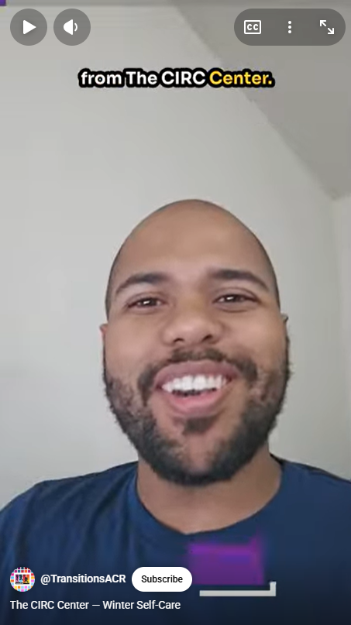
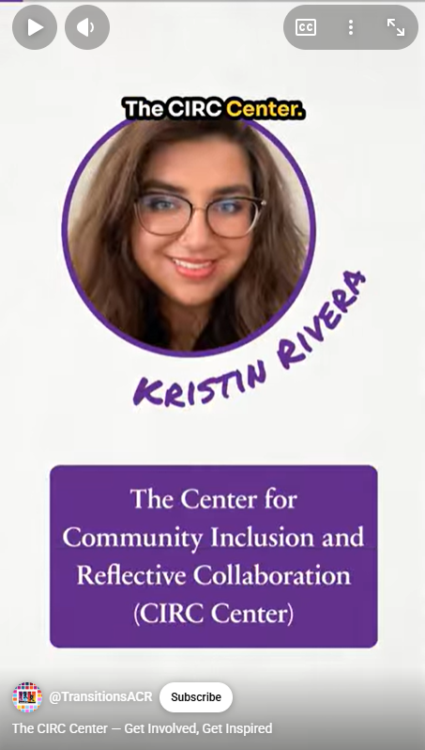
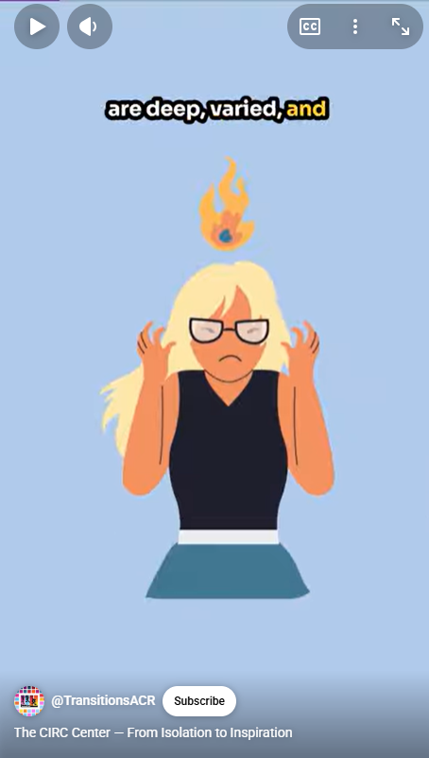
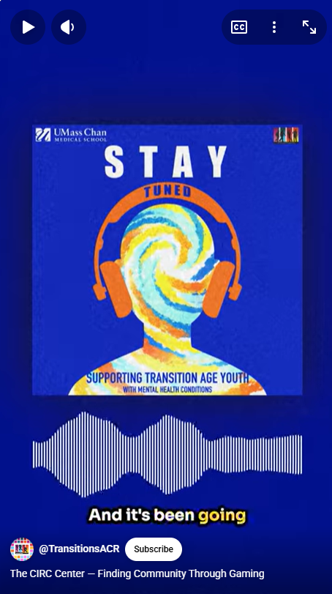
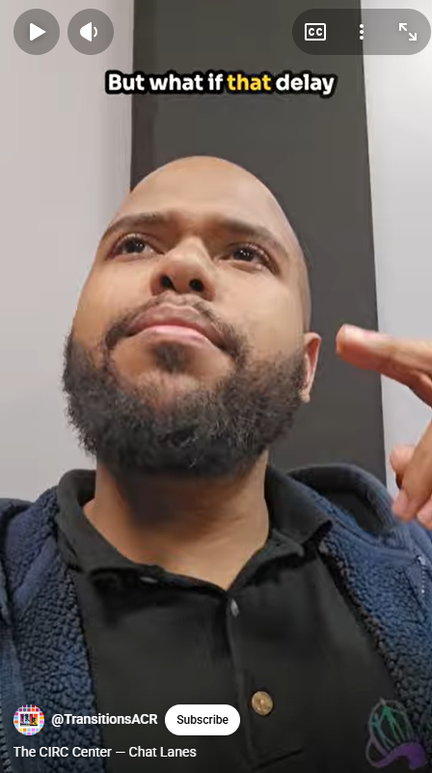
Training & Start Up
Orientation through team meetings
Qualitative interviewing & research best practices training
Support around data analysis and ATLAS.ti software
Reels video production and content idea generation
Blog writing across timely, relevant themes and topics
Preparation for features on STAY Tuned podcast
Notes:
JOSHUA
When the project was started we did not just hit the ground running, we met regularly, as we mentioned to go over roles.
I recall the interview training and having full length mock interviews. We received feedback from our interviewees who were on the team and we sat in the role of interviewer and interviewee sp we knew what both sides felt like.
We offered support to our team around data analysis and ho to use the software properly and efficiently. Do not just say "do it" show them how.
Reels – didn’t have specific training (already familiar with the social media platforms), but there was orientation to what the project would entail and the process. We had ongoing meeting to iron out what our "voice" should sound like, what was expected of me as the "face" of our reels. We spoke about the approval process for our reels: who would approve it, when it would be approved, where things would be posted.
Similarly with the Blog project, the team held orientation meetings to discuss the nature of the project, expectations, timelines, and content.
We allowed for ample time for podcast attendees to prepare for their appearances on the post cast.

Slide 20
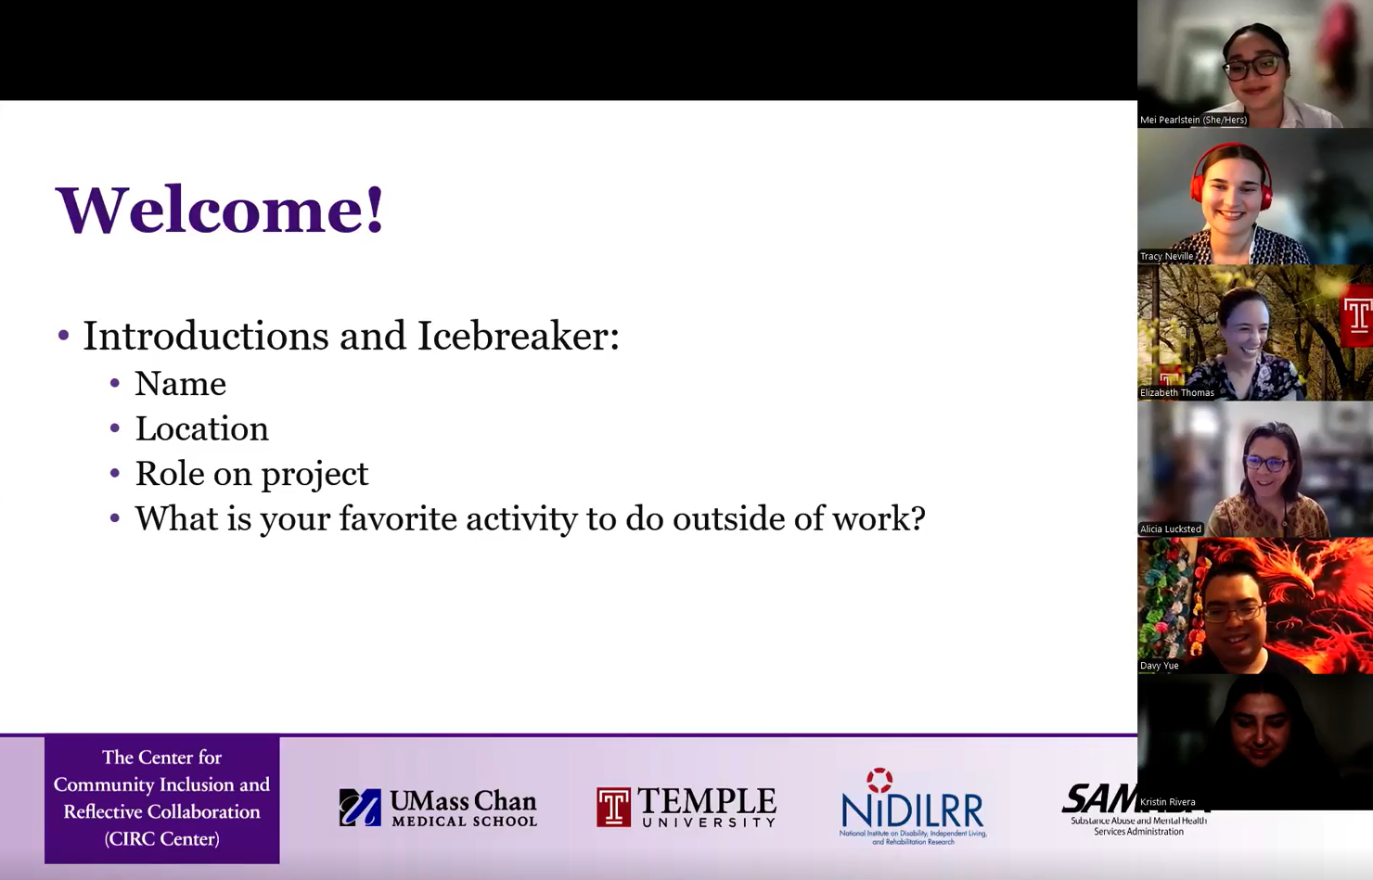
Ongoing Collaborative Teamwork
Knowledge Exchange
  Innovative approaches to embed lived experience
  Intentional engagement and curiosity sought after/ during project-management related meetings
Inclusive Working Partnerships
  Shared power when deciding together on essential questions related to project’s strategic direction
  Collectively thoughtful discussions
  Reciprocal partnership, each party gains
Notes:
JOSHUA
There was a knowledge exchange. Working in this was having youth and young adults be leaders in a project is not just beneficial to them. It is beneficial to all parties. We learn and practice innovative approaches to embed lived experience into our work. We learn to have trauma informed approches.
Intentional engagement and curiosity during meetings can lead to these exchanges happening organically and mantaining by-in from team members.

Slide 21



Lessons Learned & Recommendations
Adequate time for project coordination, planning, and logistics
Navigating bureaucratic processes and paperwork
Mindfulness with flexibility of roles and responsibilities
Importance of expanding communication mediums as needed – e.g., WhatsApp
Robust use of reminders, check-ins, and task trackers
Notes:
TRACY
We are always learning and seeking to improve the quality of our community engagement. Some of the lessons we have learned are described here.
First, it has become evident to us that community-engaged research requires intentionally slowing down and adequately budgeting for the additional time this intention requires. This includes time for project planning and coordination as well as navigating logistics and bureaucratic processes. For example, we had to decide how to set up these new roles, and we landed on consultant/contractor structure, which enabled us to offer a competitive compensation rate and offer flexible working hours given community partners’ commitments outside of their roles here. We also needed to budget time for completion of compliance trainings, CITI training on research ethics, IRB approval, and distributing equipment.
We learned there is a need for flexibility of roles and responsibilities as the team structure sharped up over time. With more team members, alignment of schedules can become more complicated, for example. We needed to sometimes pivot to accommodate everyone’s schedules.
We learned the importance of expanding communications mediums as needed. All of our community partners have been set up with umassmed.edu Microsoft accounts which allows them to access HIPAA-protected information in a secure cloud environment. However, to increase accessibility and convenience for our community partners, we implemented communication using phone calls, WhatsApp, and personal email addresses for timely, non-sensitive communications. As full-time employees, we had to unpack this assumption that email is the best means of communication and adapt over time.
Having two full-time staff members supporting this project and its coordination has been key to its success. I partner with my colleague, Mei Pearlstein, to make robust use of reminders, check-ins, and task trackers (in Microsoft Teams) to support the team and make sure everyone is clear on their expectations.
Overall, approaching this with flexibility and open-mindedness to alternative ways of working is key.

Slide 22
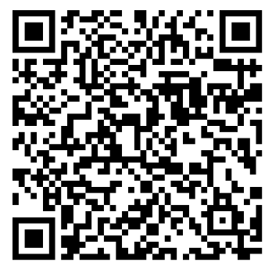
Looking Ahead
Applying lessons learned in co-leadership to future projects
Providing Technical Assistance to others in expanding shared leadership opportunities for young adults
Request Assistance Today!
https://www.umassmed.edu/TransitionsACR/need-help/technical-assistance/
Notes:
TRACY
As we look ahead and plan for what’s next, we are excited about future opportunities to apply the lessons we’ve learned on these projects to future projects that fall under the “co-leadership” wrung of the ladder of participation.
We also look forward to expanding the technical assistance we provide to agencies, organizations, and researchers who support young adults. Our TA ranges from simple resource referrals to longer-term implementation support (e.g., fact-finding, development of goals and timelines, and identifying evaluation measures)
If you are interested in Technical Assistance or would simply like to speak with a member of our team to learn more about what is available, please complete the Technical Assistance request form, which you can find using the QR code and hyperlink on this slide, and a member of our team will be in touch with you.

Slide 23


Reflections on Personal Impact
Training & investment in ongoing professional development
Community partners receiving ongoing support, trust, opportunities to learn together, skill development
Shared acknowledgment of mutual potential and worth through collaboration
Notes:
ALL
As we wrap up today’s presentation, we will each take a moment to reflect on the ways we have been personally impacted by doing this work.
** Training & Investment in ongoing professional development; community partners receiving ongoing support, trust, opportunities to learn together, skill development; sharing acknowledgment of mutual potential and worth through collaboration
TRACY: For me, being a part of the CIRC Center has expanded my perspective on community participation and how I am showing up in my life, both in-person and online. Seeing community as an important part of my wellness. I have also been impacted professionally; I have gained skills in project management, resource management, and coordination of a large team. I have had the opportunity to present at conferences and get connected with others both nationally and internationally with similar values and goals.
Next, Davy, would you please share your reflections?

Slide 24
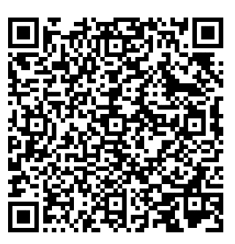
Thank You! Questions?
https://www.umassmed.edu/TransitionsACR/CIRC
@TransitionsACR
(Instagram and YouTube)
CIRC@umassmed.edu
Notes:
TRACY
10-15 minutes for Q&A
Use the prepared questions (from registration link) if there are no audience questions

Slide 25
References
Concannon TW, Fuster M, Saunders T, et al. A systematic review of stakeholder engagement in comparative effectiveness and patient-centered outcomes research. Journal of General Internal Medicine. 2014;29:1692-1701.
Narkewicz, E. L., McCaffrey, E., & Sudbrock, E. R. (2024). Creating and Sustaining Youth Advisory Boards (YABs): A Toolkit for Health and Human Services. Worcester, MA: UMass Chan Medical School, Department of Psychiatry, Implementation Science and Practice Advances Research Center (iSPARC), Transitions to Adulthood Center for Research.

