Slide 1
Wait...What’s Due Now???
Inside Cognitive Overload
&
White Knuckle Effect Among College Students
Michelle G. Mullen, PhD
April 30, 2026

Slide 2
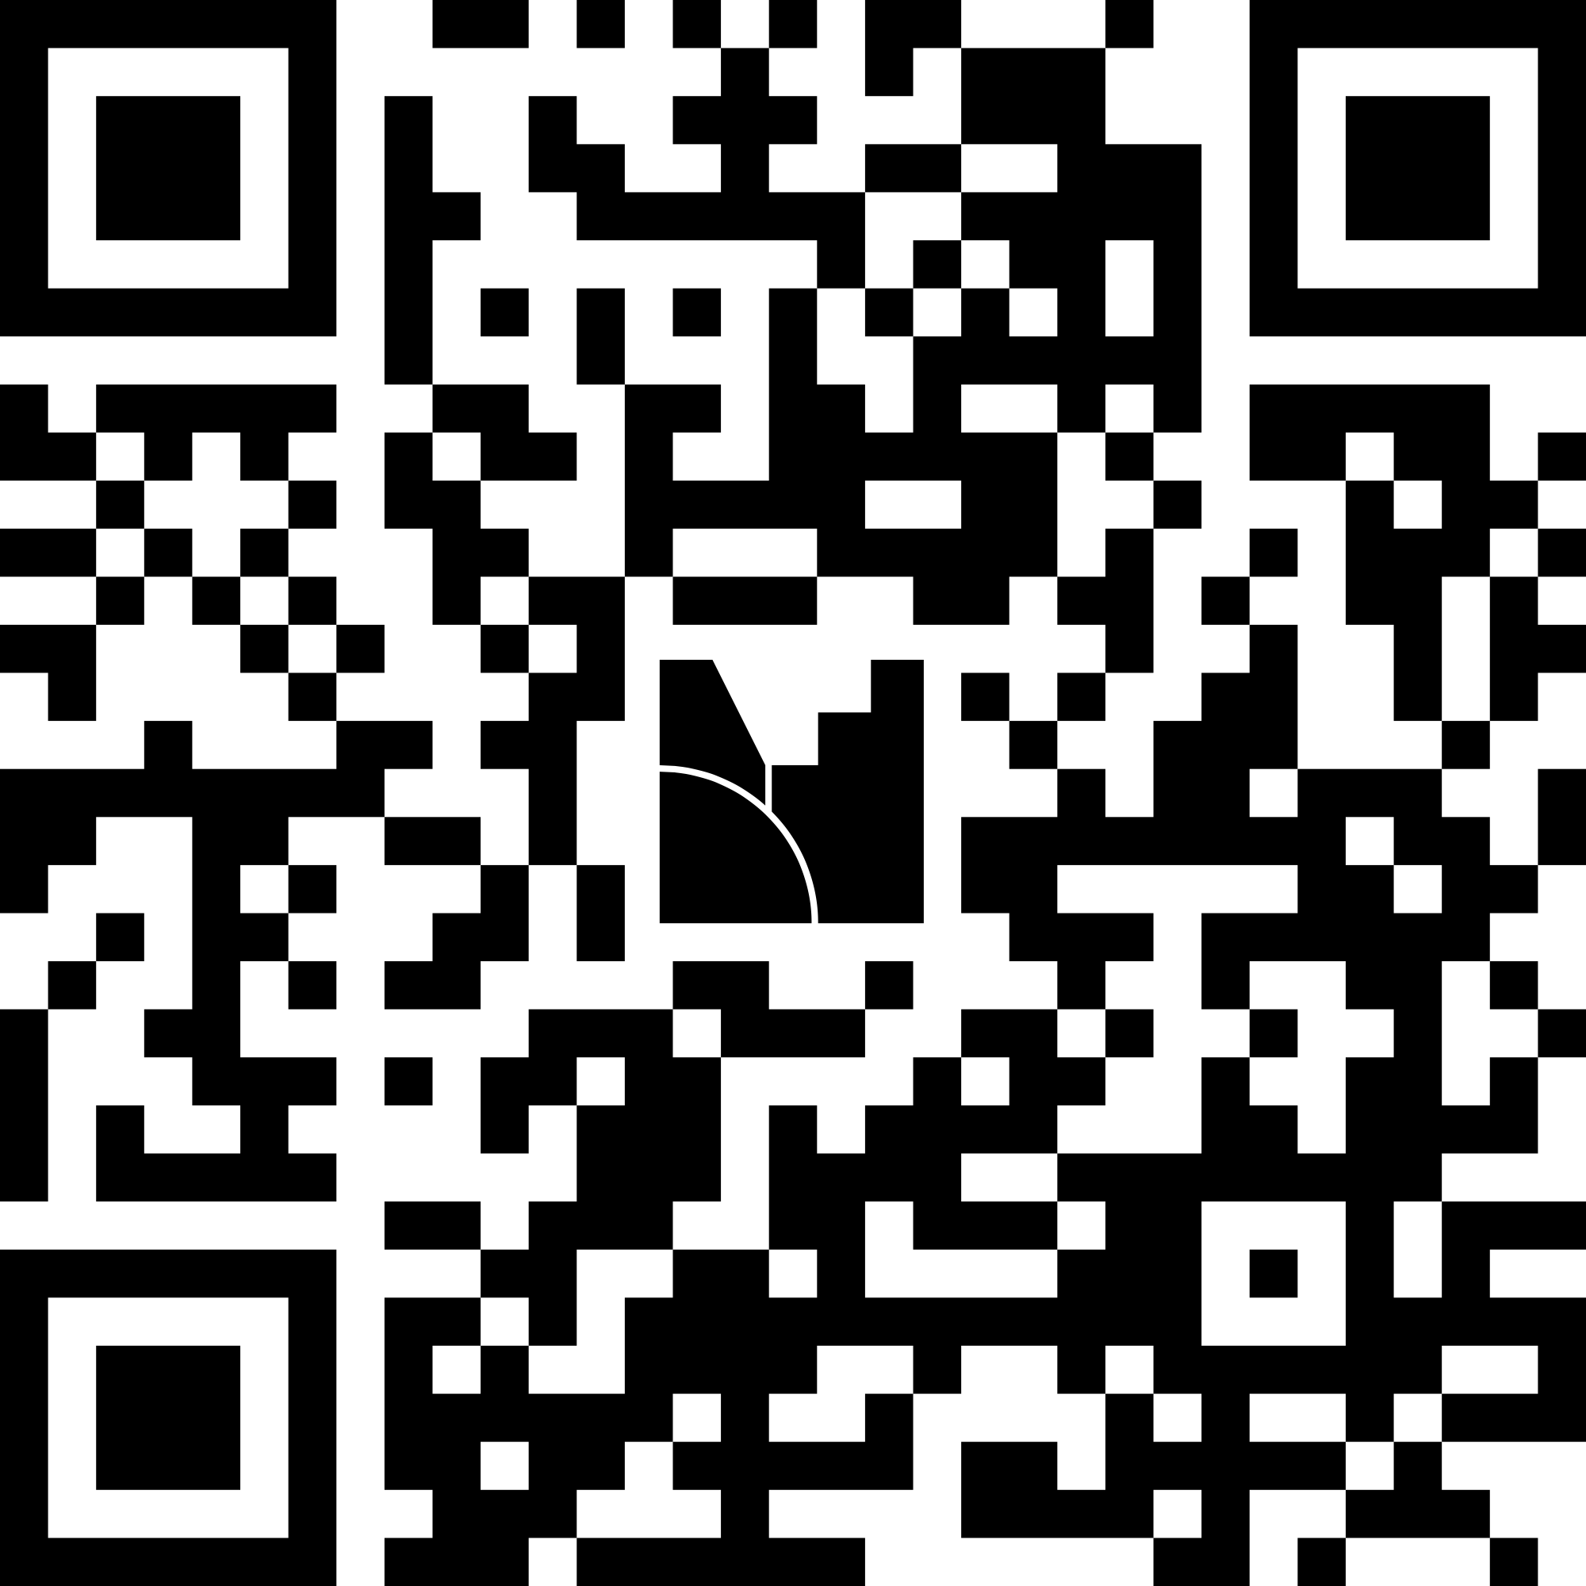
What are the most important skills that students require to be successful?
menti.com
5733 9007

Slide 3
Hold On! What’s Due???
Cognitive Overload
&
White Knuckle Effect
Michelle G. Mullen, PhD
February 17, 2026
First Year Experience Conference

Slide 4



Introduction
Translational Researcher
20+ years focusing on college student interventions
Reducing the research to practice & practice to research gaps
Clinical Developer of:
Helping Youth on the Path to Employment (HYPE) &
Focused Skills & Strategy Training (FSST)
Selected Areas of Interest:
Young adult career development
Enhancing career opportunities for marginalized and/or historically discriminated
against youth & young adults
College students
College students with mental health conditions (MHC)
Preventing “disability” among young adults with MHC
Academic and vocational persistence
Executive functioning development and use
Assisting in re-writing damaging narratives about people with MHC
System-level interventions to improve youth & young adult outcomes
Busy finding hobbies bc I am a mom of a teenager...scuba diving & salsa
Notes:
In 2003, my TTA life started as Masters-level clinician hired as a system-change consultant at a University
Aim: change the practices in community mental health, higher ed and employment for those with mental health conditions
Worked with IHEs, local non-profits, state systems, federal agencies, and internationally to implement, adopt, and sustain practices to support young adults with MHC in college
2003- 2018:
Rutgers University
Assistant Professor
Director of CSPR Research Group
Present
UMASS Chan Medical School
Dept of Psychiatry
Assistant Professor
The JED Foundation
Chief Design & Impact Officer

Slide 5


Acknowledgements
The mission of the Transitions to Adulthood Center for Research is to promote the full participation in socially valued roles of transition-age youth and young adults (ages 14-30) with serious mental health conditions. We use the tools of research and knowledge translation in partnership with this at-risk population to achieve this mission.
Visit us at umassmed.edu/TransitionsACR
The contents of this presentation were developed with funding from the National Institute on Disability, Independent Living, and Rehabilitation Research, (NIDILRR), United States Departments of Health and Human Services (90DPGE0008). NIDILRR is a Center within the Administration for Community Living (ACL), Department of Health and Human Services (HHS). The content of this presentation does not necessarily represent the policy of NIDILRR, ACL, and/or HHS and you should not assume endorsement by the Federal Government.

Slide 6
Presenting Problem: Attrition
Mental health conditions considered most rapidly growing diagnoses on campus (AUCCCD)
  20-30% of students report a diagnosed mental health condition (ACHA-NCHA)
Approximately one-third experience symptoms (Eisenberg et al.)
  Over last 10 years, campus service utilization increased each year (Lipson et al., 2018)
  During “COVID era” greater than 50% of students reported symptoms of clinical significance
Highest rate of attrition with an estimated dropout rate of 86%
  Higher than any other “disability” groups (Kessler et al., 1995)
  Triple the rate of freshmen at ~23%
Cycle of enrollment and dropout
  70% reported at least one failed attempt at school
    25% on second
    45% on third or more attempt (Gill, Mullen, et al., 2022)
Mental health and academic impacts of pandemic & post-pandemic “adjustments”

Slide 7
Commonly Cited Barriers for Students with MHC
Mental health symptoms
Poor grades
Lack of support
Financial aid issues
Lack of access to meaningful accommodations
Discrimination
  Avoidance of disclosure
Punitive IHE practices & procedures
Lack of access to specialized services
  (Mullen et al., 2017; Markoulakis & Kirsh, 2013; Collins & Mowbray, 2005; Mowbray et al., 2001; Manthey, et al., 2015, Salzer, 2008; Jefferies & Salzer, 2022)
Notes:
So, in our first study, we asked them...what gets in the way of staying in school...and you know what???

Slide 8

A Narrative of Convenience...with Devastating Consequences
Evidence does not support GPAs as reason for attrition
  Average GPA in a competitive university 3.2* (Eisenberg et al., 2009)
  Average GPA from our community samples 3.0, 2.9 (Gill, Mullen, et al., 2022)
Narrative of attrition due to poor grades and symptoms is
too simplistic
  Rooted in bias and discrimination associated with “mental
  illness”
Harmful narratives/mental models keep the problem in place
  “Mentally ill”
  “Too sick to...”
  “...is too stressful”
Significantly impacts:
  Types of services/interventions created, funded, and offered
  Perspectives of who is responsible
  Young adult identities
Notes:
Eisenberg, Golberstein, and Hunt’s (2009) study of students with psychiatric conditions at an academically rigorous and competitive university has provided a valuable citation to support this narrative,
this study is largely misinterpreted with their results being misunderstood.
The authors stated that depression and anxiety symptoms predicted lower GPA, which is true,
average GPA of these students was 3.22 as compared to the larger student population’s GPA of 3.36.
These students’ GPAs were, in fact, lower than the comparative sample, but not low enough to support the symptom-based attrition narrative.
Students with MHC cycle in and out of school
Our samples have had GPAs of 2.9-3.1
Our hypothesis is that symptoms and grades are not the cause of the staggering attrition rates of this group...

Slide 9
Let’s See What You Thought...

Slide 10
Student Reported Barriers
Over 70% of respondents:
Concentration (85%),
Time management (77%),
Stamina (75%),
Organization (71%),
Prioritizing tasks (70%)
Over 50% of respondents:
Difficulty memorizing information
Managing psychiatric symptoms
Studying for exams
Taking exams
Preparing for class
Writing papers
Taking notes
Researching information
Meeting deadlines
(Gill, Mullen, Murphy, Salzer, Davis, in process)
Notes:
264 students were asked about the barriers associated with maintaining matriculation in school, these were the results
This was my “ah-ha” moment
Students more commonly endorsed issues associated with executive functioning tasks than “classic” mental health symptoms
Students may not be failing out/dropping out of school because of their mental health symptoms per say, but because they had difficulty with executive functioning skills and academic self-management (self-regulated learning).

Slide 11

Ah Ha Moment
Notes:
This was my “ah-ha” moment
No wonder they fail out of class-

Slide 12
Executive Functioning Skills
Executive Functioning (EF; “cognitive control system”) is an umbrella term for the cognitive processes that facilitate thought and action (Friedman et al., 2008)
Foundational to orchestrating goal-directed behavior/self-regulated learning
Undergirds self-regulated learning (SRL):
  (1) planning and activation;
  (2) monitoring;
  (3) control; and
  (4) reaction, reflection (Pintrich et al., 2000)
Students who use greater numbers of SRL strategies have better academic outcomes than students who lack self-regulatory skills (Zimmerman, 2000).
Developmental phase (age), MH conditions, experiences/opportunities, and the MH system affect the development and refinement of EF skills
Notes:
How do I organize myself to accomplish this task/goal (planning),
What is my progress toward accomplishing this goal (monitoring),
How do I minimize distractions to achieve this goal (control), and
How do I feel about the process/how is this going (reaction, reflection).
Answering these questions helps to reinforce helpful behaviors/choices or to course correct

Slide 13
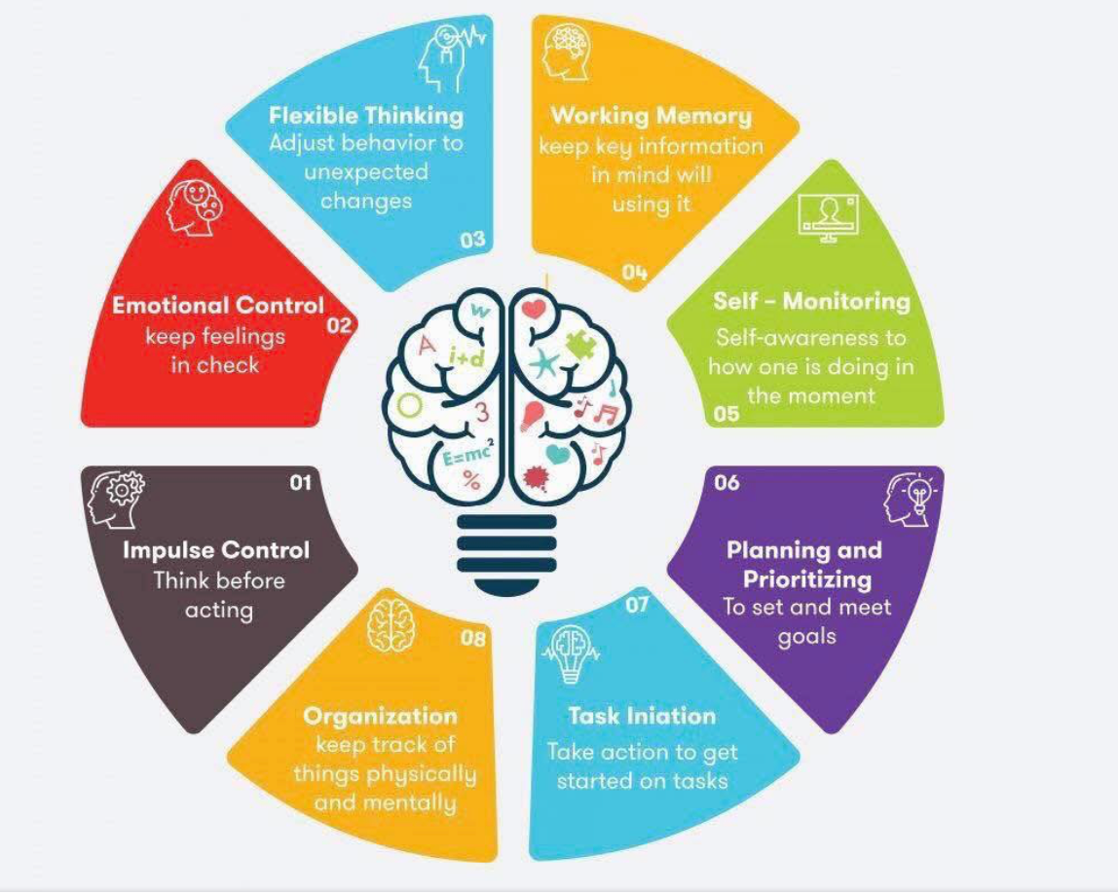
Executive Functioning Domains
Planning: plotting sequence of steps to achieve goal
  Difficulty meeting assignment deadlines
Reasoning: thinking through information in logical way
  Poor writing structure, difficulty with problem solving
Attentional control: choosing how one directs attention
  Staring off into space, repeating questions, unfinished
  assignments
Inhibiting automatic responses: resisting urges leading to undesired outcomes
  Interrupting, checking phone while reading, answering emails while writing a paper
Working memory: holding and processing information
  “What was the point I was trying to make?” (Diamond, 2014)
Notes:
These are the skills and strategies that help you to take notes, organize your stuff, remember appointments/meetings/class, start the assignment with enough time to finish it, identify that scrolling IG for 3 hours the night before a presentation when your presentation isn’t due is not the right choice, resisting the urge to check your phone when you are reading an article for homework
Managing distractions related to checking phone and surfing web during class/study time

Slide 14
EF Development & Importance
Develops through mid-20s
Hidden academic curriculum
  Not explicitly taught, but expected to develop
Trauma, toxic stress, and poverty negatively affect neurodevelopment & EF skill development
Opportunities impact EF development
  Achievement gap
EF predictors of educational achievement in primary & secondary school
  Equal to or better than IQ
Malleable & teachable (Lohnes 2022; Zhang, et al. 2019)
Budding research:
  EF as a protective factor
  Bridges that achievement gap seen in historically discriminated against communities
Notes:
Youth from lower SES families do not do as well as their peers from higher SES
Spencer Grant -> tailor interventions to match the demands of the environment- what do we need in 6th grade vs 10, 12 16th
Research says EF skill development it starts to slow down at 15, but that also seems to coincide with the literature -> as students need to self-regulate more, we teach less- what we’ve heard is college is too late

Slide 15
What would happen if I collected
Your Calendars?
Your To-Do Lists?
Would you know what you were doing tomorrow?
What you have to do next week?
How would you feel week over week?
Notes:
Now I can’t see you guys, but I would love for you to use the chat to show your reactions...at one presentation, a person literally grabbed their pearls...it was the best!

Slide 16


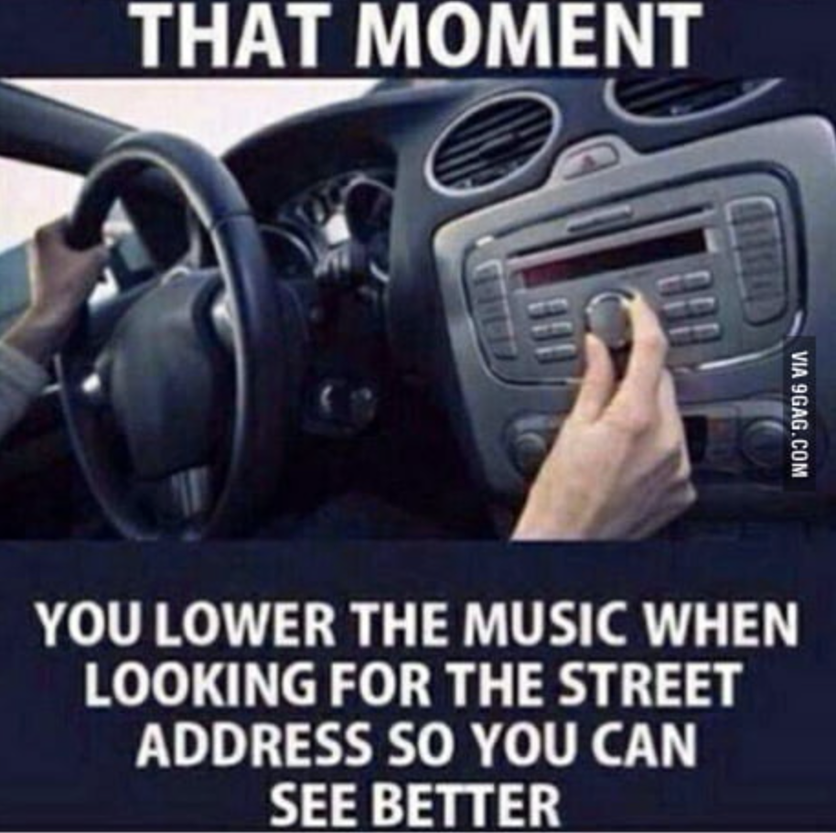


Overload

Slide 17
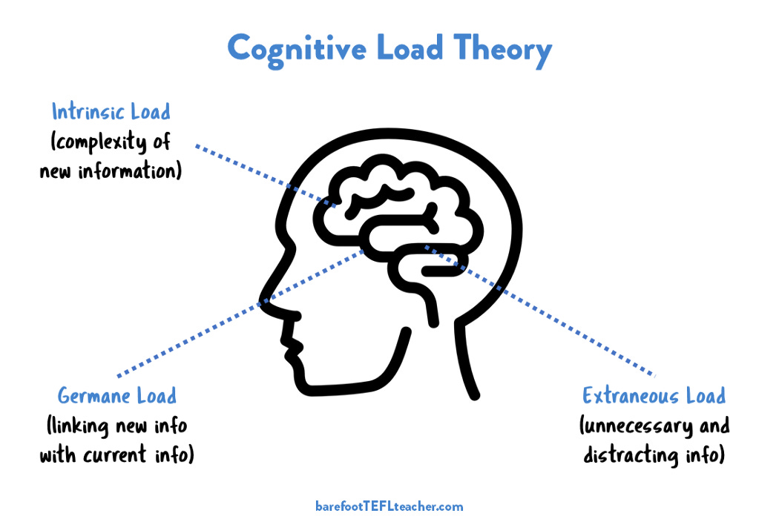
Cognitive Load Theory

Slide 18
Cognitive Load & Meeting Demands
Cognitive load is determined by cognitive resources required for a task
  The more resources required the “heavier” cognitive load
  Specifically working memory and attention
  Critical areas of executive function EF
If working memory capacity exceeded, cognitive overload occurs
  Remaining cognitive resources insufficient to meet demands
  Performance decreases (Pass et al., 2003; Sweller et al., 1998; van Merrienbower & Sweller, 2005; Sweller, 2011)
Notes:
Missing assignments, losing important things, not showing up for appts
Cognitive overload looks like bad student behavior
lack of caring, lack of motivation, or “laziness”

Slide 19
Managing Cognitive Load
Balancing loads
  Higher load in one area, reduces bandwidth in other areas
Attention is required for intrinsic load
Memory is required for germane load
Extraneous load may be important information or junk
  Strategies and skills are required to manage extraneous load
    Need to sort & organize to keep what’s important & eliminate distractions
The greater “amount” of working memory, allows for a greater amount of extraneous load without significantly impacting performance
As rigor/complexities increase, students experience changes in performance if extraneous load is not managed/reduced
”Forgetting” may be seen as a protective factor to increase capacity for intrinsic and germane load
Notes:
Youth from lower SES families do not do as well as their peers from higher SES
Spencer Grant -> tailor interventions to match the demands of the environment- what do we need in 6th grade vs 10, 12 16th
Research says EF skill development it starts to slow down at 15, but atht also seems to coincide with the literature -> as students need to self-regulate more, we teach less- what we’ve heard is college is too late

Slide 20
Cognitive Offloading
Use of external tools to store information
Diminishes the need to “hold” things in your mind
Reduces demand on limited cognitive resources
Allows greater bandwidth for working memory by “clearing the workspace”
  Akin to clearing the physical workspace
Protects from forgetting
  Except for the “fell off my to-do list”

Slide 21
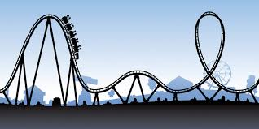
Academic Predictability of Cognitive Load
Cognitive load is low at the beginning of the semester
  precipitous increase in demands as semester continues
Increased reliance on SLR/ EF skills and strategies to manage competing demands
New semester, new me...
until mid-terms, then it’s
last semester, current me

Slide 22
Implications of Under-refined EF Skills & Prolonged Cognitive Load
Competing demands of student life creates a state of prolonged cognitive load
  Cognition, skills, strategies, & supports dictate if load turns to overload
Students with underdeveloped EF skills & strategies struggle to keep up with the constant demands of student life
  Difficulty with organization, time and task management, attention, memory, prioritizing
As performance decreases, stress increases
  Missed assignments, missed classes, unfinished papers, missed appointments
Under-refined EF skills and strategies also hinders help-seeking, keeping appointments, wellness strategies, taking medication, completing/following-up with requests/activities
Notes:
For those of us who have provided services to this group, we see the crash and burn
Refined/advanced EF skills & strategies reduce cognitive load & prevent overload
Particular emphasis on working memory and attention
Paints a picture of an ambivalent, “bad” student, instead of one that is struggling

Slide 23
White Knuckle Effect Theory

Slide 24
White Knuckle Effect Theory
Alternate explanation for good/fair grades & high attrition
Without adequate EF skills, tremendous amount of personal effort to manage student expectations
Cognitive overload leads to diminished performance and “white knuckling” it
Results in pathways of “holding on” and “crashing & burning”
  some make it through and complete semester
  others “crash & burn”: incompletes, withdrawals, failures and/or poor grades
GPAs are periodically impacted by “crash & burn”
Periodic attrition explains repeated attempt history
  Breaks are used to recover from the emotional, cognitive toll of the semester
  (Mullen et al., submitted)
Notes:
This population is not challenged academically in terms of consistently poor grades
Tremendous amount of personal of effort required to manage multiple competing demands without the adequate skills, strategies creates cognitive overload
Students struggle to persist due to the absence of advanced EF skills to manage the cognitive load
When EF skills are under-refined:
the ability to remember all information exceeds working memory capacity
cognitive load becomes too heavy, and
students become cognitively overloaded
Cognitive overload leads to diminished performance and “white knuckling” it
EF skills prevent attrition among this sample and provides an alternate explanation of why students with psychiatric conditions struggle with academic persistence.

Slide 25
White Knuckle Effect Theory Graph
Underdeveloped EF reduces ability of connecting to academic & mental health resources
Under-refined EF Skills
Increased Cognitive Load
Feelings of Stress
Cognitive Overload
Decreased Performance
Feelings of Distress
Increased Symptoms
Crash
&
Burn
Personal factors , e.g. hunger, symptoms, trauma, discrimination, basic needs, life events...
Preventative Specialized Supports
Reactive Symptom-based Supports
Notes:
This may be a reason why symptoms gets identified as the reason for poor grades and attrition, however, it may not be the root cause
College students with psychiatric conditions struggle to persist, not necessarily with performance
GPA may be a transient issue or content-specific
May have history of incompletes or sudden termination of classes
It the personal amount of effort required to manage multiple competing demands, which results in stress
Increased amount of unhealthy stress may decrease a person’s resilience to academically persist
Think about the student who is successful at 4 courses, but cannot manage 5 courses well…its not intelligence/capacity, its bandwidth
EF skills promote self-regulation & management to enhance performance
This is why the narrative of mentally ill, too sick to, and bad grades is so damaging...students need skills, when you teach them, they use them!

Slide 26
Focused Skill & Strategy Training
FSST

Slide 27
Focused Skill & Strategy Training (FSST)
FSST Focused Skills & Strategies Training
  Initially called FAST: Focused Academic Skills Training
A manualized intervention based in the cognitive remediation
  Compensatory model of CR
  Modification of Beth Twamley’s CCT intervention for SE (Twamley et al., 2012)
12, 1 hour coaching sessions that focuses on teaching EF skills and strategies
  Individually provided
Leverages students’ academic goal(s) throughout the curriculum (1,3,5,7,9,11,12)
Individualizes skill development to aligned with students’ articulated barriers
Uses gamification, distributed & deliberate practice, scaffolded learning
Notes:
Goals are set at the first session and are revisited every 3rd session to assess progress, connect strategies, and refine goal
roots all support strategies into the student’s current academic goals (semester and long-term)
explores what’s getting in the way of achieving their goals
individualizes skill development approaches and strategies that are aligned with their articulated barriers
Practitioner uses their language and how they describe their barriers

Slide 28
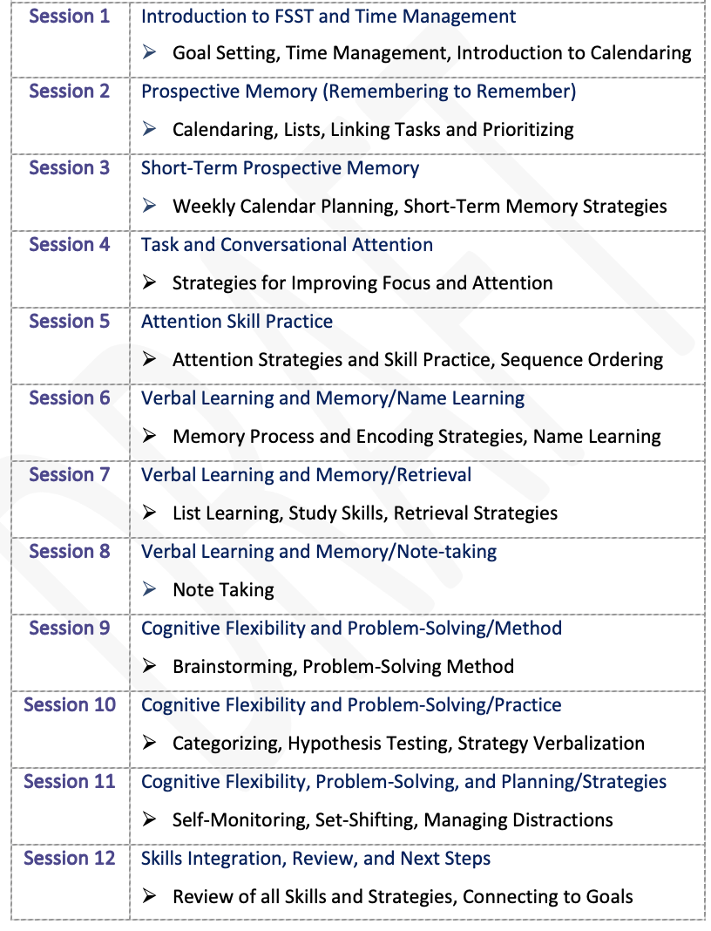
FSST
Modules
Prospective Memory
Attention
Memory
Cognitive Flexibility
How do we usually teach these skills?

Slide 29
Structured Sessions
Agenda
  Review of Home Exercise
  Review of session’s topic
Intro a topic
  Rationale, benefit, exploration of current level of practice
Skill Practice
  Gamification
    Eg. Going on a picnic, Spit, Find the Difference, Categorizing...
  Application
Home Exercise
Notes:
NY Times puzzels
Connection
Woordle

Slide 30
Selected FSST Skills & Strategies
Creating durable habits of cognitive offloading strategies
Goal setting
Time & Task Management (Prospective memory)
  Calendaring
  To-do lists
  Prioritizing tasks (Eisenhower’s Principle: urgent vs important)
Self-talk
Use of timers/reminders
Automatic places, task-linking
Set-shifting vs multi-tasking
Encoding & Retrieval
  Association, categorization, visualization, rewriting notes
Notes:
Goal Driven behavior
CALENDARING!!!!
One calendar: paper OR electronic
Very, very rarely both, so rarely that we say *never* use both
All syllabi assignments & exams should be in the calendar within the first week of school
Calendar should provide time and task management activities daily/weekly
Sometimes people just need a little help getting organized ☺

Slide 31
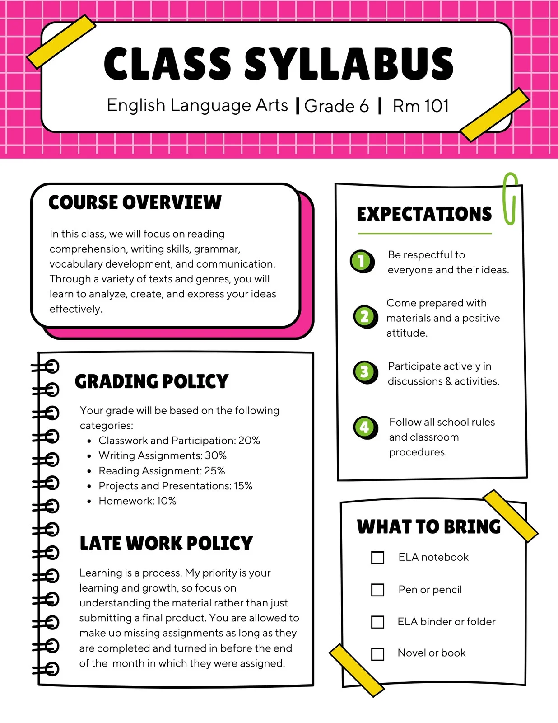

Time & Task Management
The most important, yet complex skill set
Time:
  what am I doing with my time?
  how much time do I have?
Task:
  what do I have to do?
Common companion skills/strategies:
  Prioritizing tasks
  Task chunking
  Set shifting
  Reminders
  Managing Distractions (self-imposed and otherwise)

Slide 32
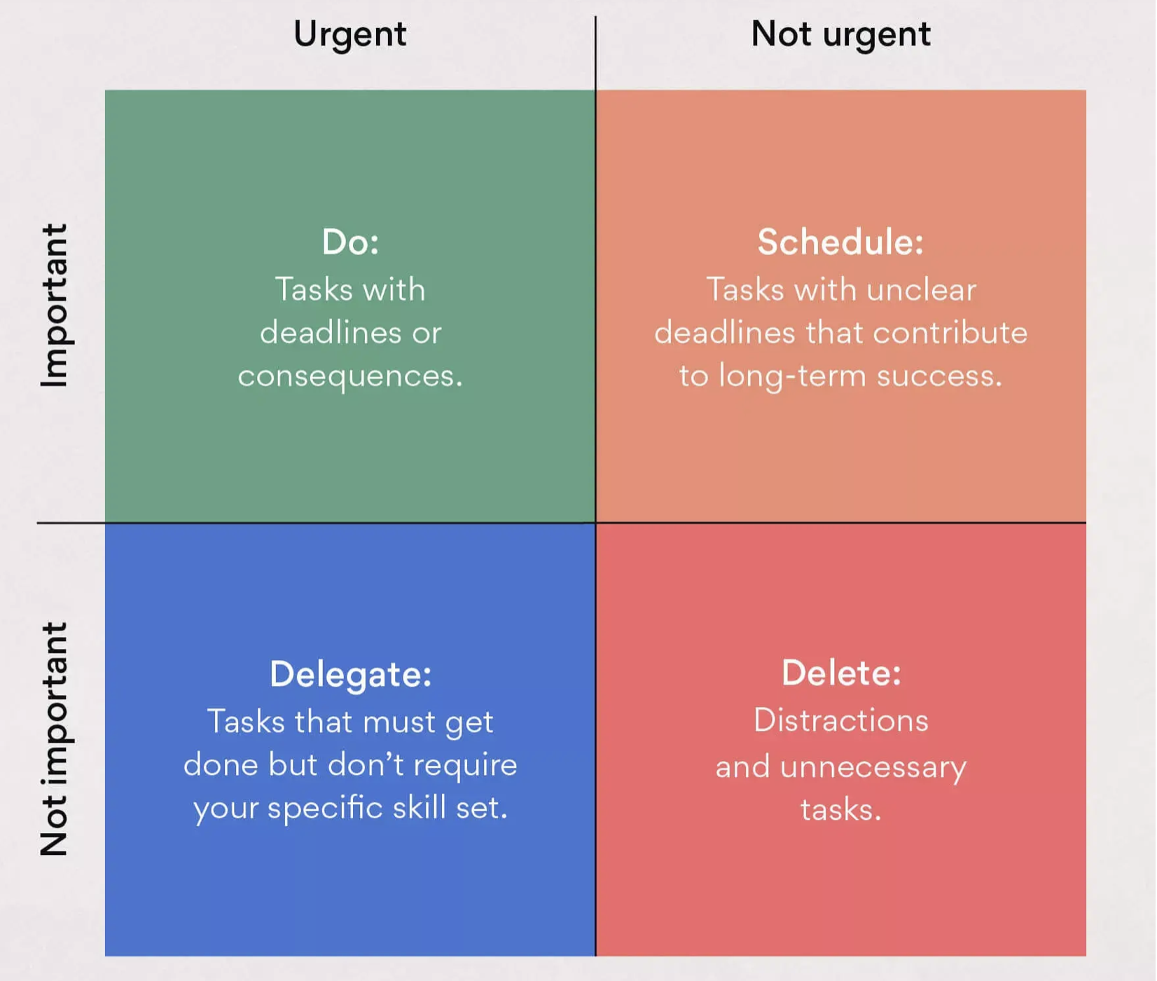
Eisenhower Matrix
Urgent vs
Important

Slide 33
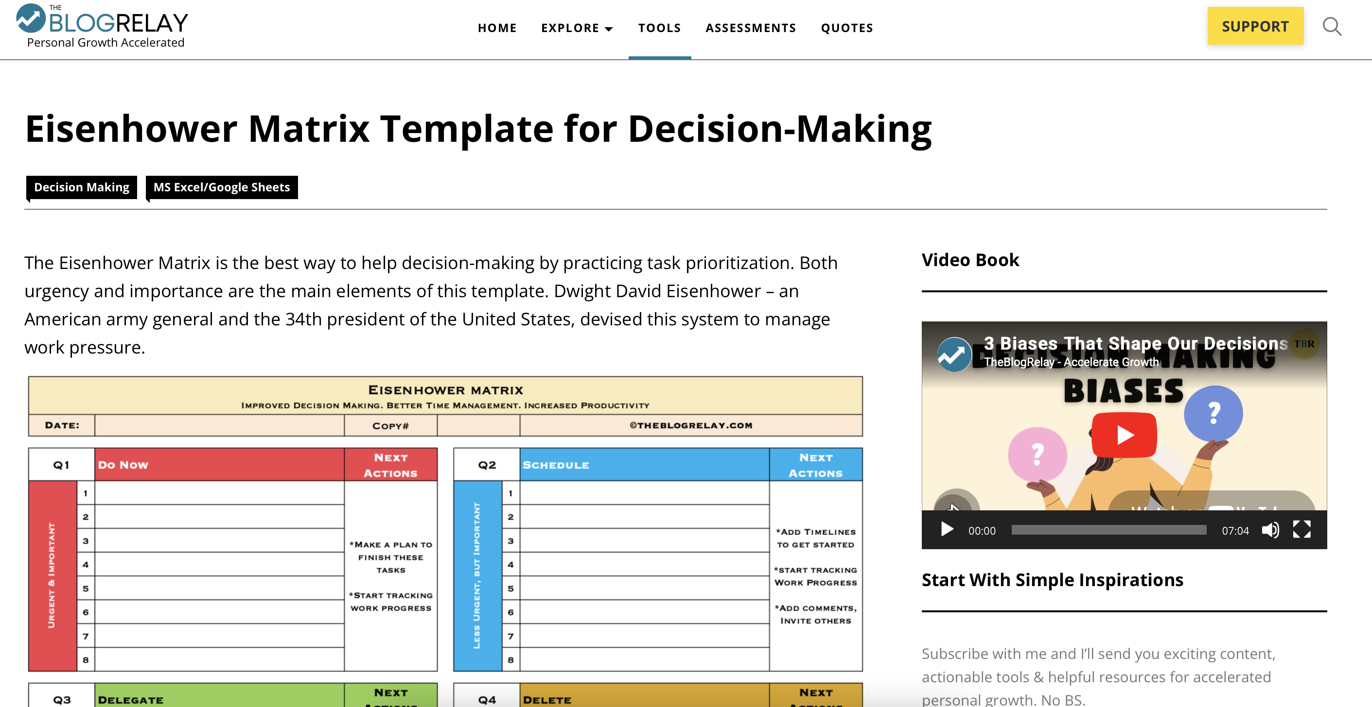
https://theblogrelay.com/tools/eisenhower-matrix-template-for-decision-making/

Slide 34
Data Supporting
The White Knuckle Effect Theory
&
Call for System Change
Notes:
MICHELLE TO UPDATE

Slide 35
Randomized Control Trials
Enhancing EF Skills among College Students (FSST alone)
HYPE on Campus (HOC)*
One large, competitive state school
Wrap-around support vs Information-only control
  HYPE & FSST
  Touch point each semester
MSW student-interns provided the intervention
Community-recruitment
FSST vs Information-only control
Master’s trained Cognitive Specialist
Neurocognitive assessment (MCCB)
  Performance eligibility criteria
FSST at Work
Small pilot
Digital, remote intervention
FSST vs Information-only control

Slide 36
Highlighted Outcomes
In FSST (alone) trial:
FSST participants were statistically more likely to academic persistent (p = .045)
  7 times more likely of persisting for one academic year
  very large estimated effect on academic persistence (d = 1.025; CI: .037, 3.69)
Large effects on working memory (d = .79) and attention (d = .72)
FSST had a huge effect on self-efficacy
Greater use of cognitive strategies & fewer cognitive barriers (p≤.05)
In HOC trial:
  FSST completers finished a greater number of courses (p=.02) and credits (p=.007)
  Reduction of symptoms including depression, stress and anxiety (p≤ .05)
  Greater use of cognitive strategies & fewer cognitive barriers (p≤.05)
FSST at Work:
  Greater role function
  Greater use of cognitive strategies & fewer cognitive barriers (p≤.05)
Notes:
Given the binary outcome and how condition and time were coded,
the β value represents the marginal change in log odds with respect to persistence.
The exponential value of β (Exp (β)) is the odds ratio of an event’s occurrence, so that if Exp(β) is greater than 1, in this analysis, there are increasing odds of academic persistence.
FSST accounted for approximately 21% of the variance (R²= .208) and had an large estimated effect on academic persistence (d = 1.025; Cohen, 1992; Borenstein et al., 2021); the log odds ratio was converted to R² and Cohen’s d
Students with psychiatric conditions who were assigned to/received FSST will have greater improvement in academic persistence than students who were assigned to/received the CSAU+EFA condition.
Y_{Persistence} = β₀ + β_{Time} + β_{Condition} + β_{T*C} + r

Slide 37
Call to Action for Systems
The entire system is motivated by enhanced retention & graduation
What we identify as the problem and how we define it matters
  Solutions are based on the identified problem
Designing for symptom exacerbation has a specific result in mind
  Heavily weighs on mental health services on campus
Identifying the earlier precursors to dropout symptoms benefits the entire system
  Redistribution of efforts, initiatives, FTEs
Currently modifying FSST for general student population as this is not unique to students with MH diagnoses
  High School, summer bridge/college readiness programs, & college First Year Experience seminar
Notes:
When talking about the entire system

Slide 38
White Knuckle Effect Theory
Underdeveloped EF reduces ability of connecting to academic & mental health resources
Under-refined EF Skills
Increased Cognitive Load
Feelings of Stress
Cognitive Overload
Decreased Performance
Feelings of Distress
Increased Symptoms
Crash
&
Burn
Personal factors , e.g. hunger, symptoms, trauma, discrimination, basic needs, life events...
Preventative Specialized Supports
Reactive Symptom-based Supports
Notes:
This may be a reason why symptoms gets identified as the reason for poor grades and attrition, however, it may not be the root cause
College students with psychiatric conditions struggle to persist, not necessarily with performance
GPA may be a transient issue or content-specific
May have history of incompletes or sudden termination of classes
It the personal amount of effort required to manage multiple competing demands, which results in stress
Increased amount of unhealthy stress may decrease a person’s resilience to academically persist
Think about the student who is successful at 4 courses, but cannot manage 5 courses well…its not intelligence/capacity, its bandwidth
EF skills promote self-regulation & management to enhance performance
This is why the narrative of mentally ill, too sick to, and bad grades is so damaging...students need skills, when you teach them, they use them!

Slide 39
Future Research & Practice Partnerships
Current call for research partners to implement FSST...QR Code on next slide
Adaptation for specific age groups & settings
  middle school and high school
  first year experience/seminar
  students without MHC
  athletes
Cultural adaptations & modifications for at-risk youth & young adult groups
  economically disadvantaged communities;
  historically discriminated against communities;
  system-involved
  neurodivergent groups, such as autism/ASD, ADD/ADHD, & TBI
How does it work in ”real life”
  feasibility, acceptability, appropriateness, cost, and adoption
Upcoming FSST Institute
Notes:
evaluate the role of EF skills, course load (e.g. number of classes), and complexity of coursework on cognitive load and academic progress

Slide 40
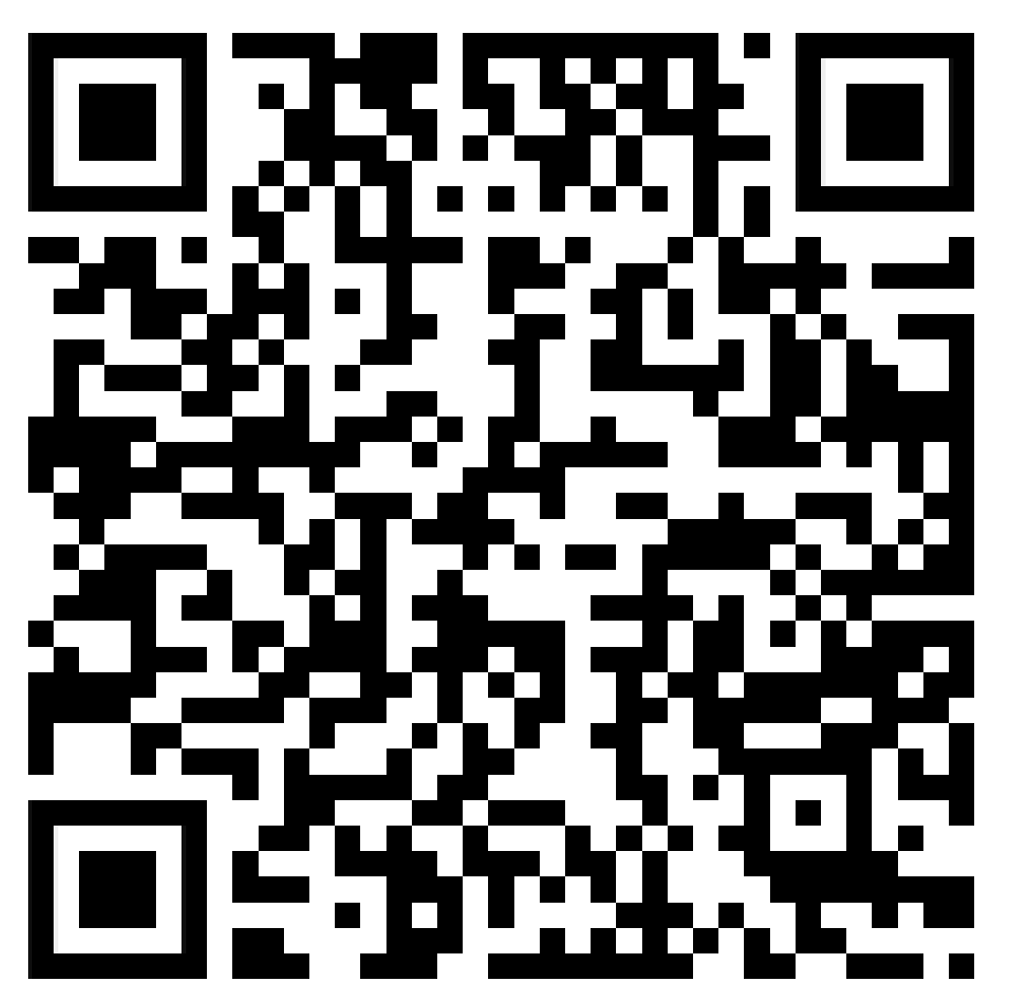
Upcoming Research
Opportunity
Bring FSST to Your Campus

Slide 41

Thank you, Thank you, Thank you!!!
Questions, Comments?
HYPE@umassmed.edu
Michelle.Mullen@umassmed.edu
Let’s connect on Linked In

Slide 42
JIC

Slide 43
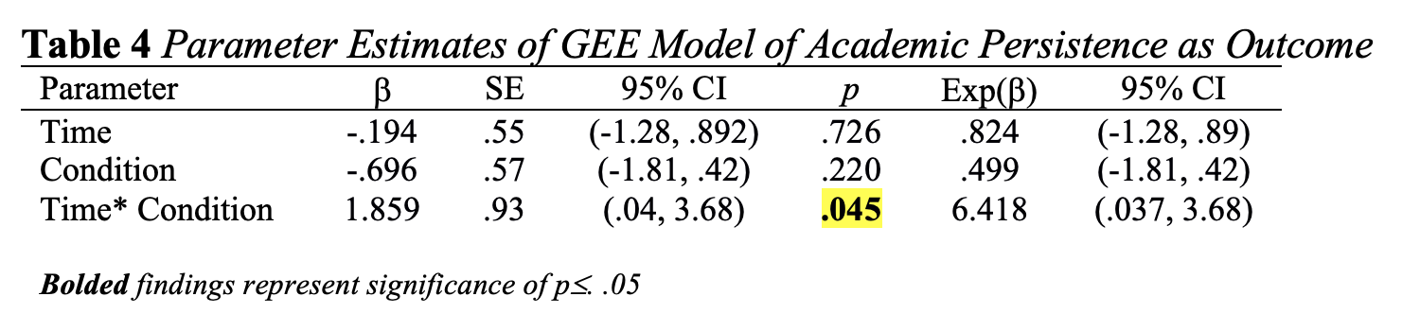
Academic Persistence
Measured by academic transcript (enrolled, graduated, not enrolled)
FSST participants were statistically more likely to academic persistence (completion of 2nd semester; p = .045)
FSST had very large estimated effect on academic persistence (d = 1.025)
Notes:
Given the binary outcome and how condition and time were coded,
the β value represents the marginal change in log odds with respect to persistence.
The exponential value of β (Exp (β)) is the odds ratio of an event’s occurrence, so that if Exp(β) is greater than 1, in this analysis, there are increasing odds of academic persistence.
FSST accounted for approximately 21% of the variance (R²= .208) and had an large estimated effect on academic persistence (d = 1.025; Cohen, 1992; Borenstein et al., 2021); the log odds ratio was converted to R² and Cohen’s d
Students with psychiatric conditions who were assigned to/received FSST will have greater improvement in academic persistence than students who were assigned to/received the CSAU+EFA condition.
Y_{Persistence} = β₀ + β_{Time} + β_{Condition} + β_{T*C} + r

Slide 44
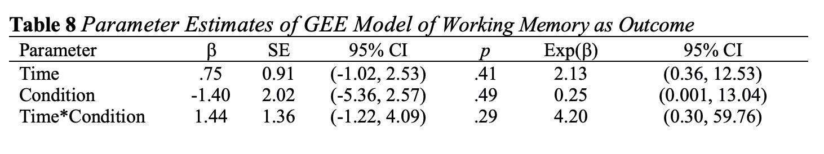
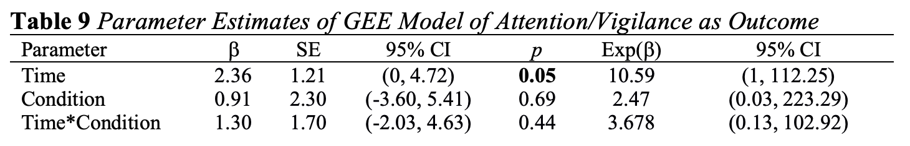
Impact on Memory and Attention
Memory
No significant effects of FSST, but large effect size (d = .79)
Attention
No significant effects of FSST, but medium effect size (d = .72)
Measured by MCCB
Notes:
β coefficient of the interaction term was 1.44
accounts for 13.5% of the variance (R² = 0.135; www.escal.site)

Slide 45
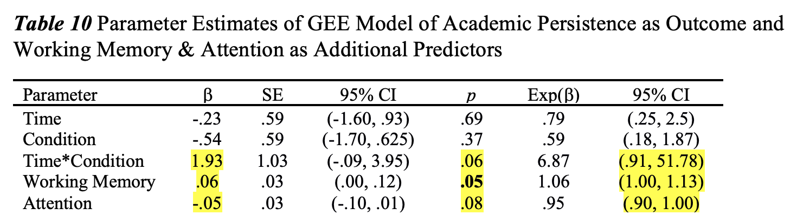
Exploring FSST & Cognitive Load
Is the relationship between FSST and academic persistence further explained by adding working memory and attention?
FSST approached significance (p = .06); H_1a (p = .045)
Very large effect size increased slightly (d = 1.063; R²= .22)
Slightly higher increased relative odds of persistence than first model (β= 1.93)
Working memory score (approached) significance (p = .05; d = .03)
Attention approached significance (p = .08; d = .03)
Notes:
H_1a 86.52%
The exponential value of β (Exp (β)) is the odds ratio of an event’s occurrence, so that if Exp(β) is greater than 1, in this analysis, there are increasing odds of academic persistence.
FSST directly impacts and increases odds of academic persistence
Provides strong, preliminary confirmation that cognitive overload may play part in periodic attrition
FSST’s effect sizes on working memory and attention suggests promise, but analyses not sufficiently powered to detect significance for measurement

