Slide 1
How Do You Do Community? Understanding young adult perspectives on community participation leveraging a community-engaged approach
Davy Yue, Kristin Rivera, Joshua Calarino, Mei Pearlstein, and Tracy Neville
2026 NARRTC Annual Conference | April 14, 2026

Slide 2
Acknowledgement & Disclosure
The contents of this presentation were developed under a grant from the National Institute on Disability, Independent Living, and Rehabilitation Research (NIDILRR grant number 90RTCP0010) and co-funded by the Substance Abuse and Mental Health Services Administration (SAMHSA). NIDILRR is a Center within the Administration for Community Living (ACL), Department of Health and Human Services (HHS). The contents of this presentation do not necessarily represent the policy of NIDILRR, ACL, SAMHSA, or HHS, and you should not assume endorsement by the Federal Government.
The authors have no conflicts of interest.
Notes:
Verbally:
We are grateful for our funders, NIDILRR and SAMHSA.
The contents of this presentation do not necessarily represent the views of our funders or the federal government.

Slide 3
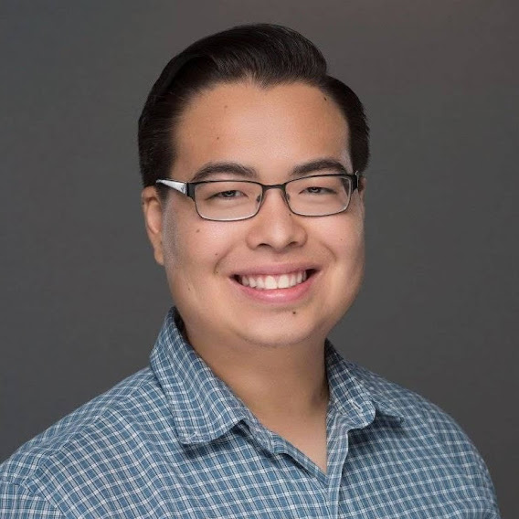
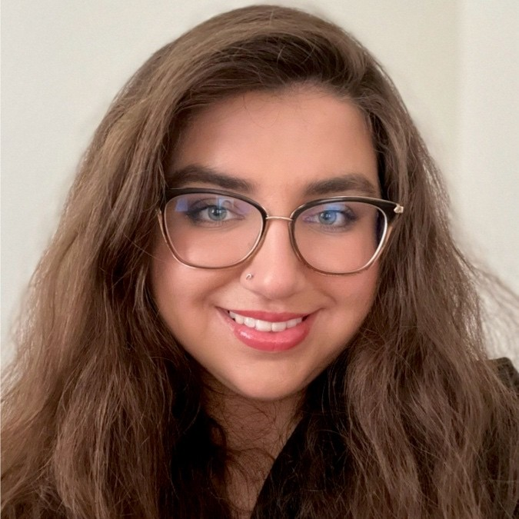
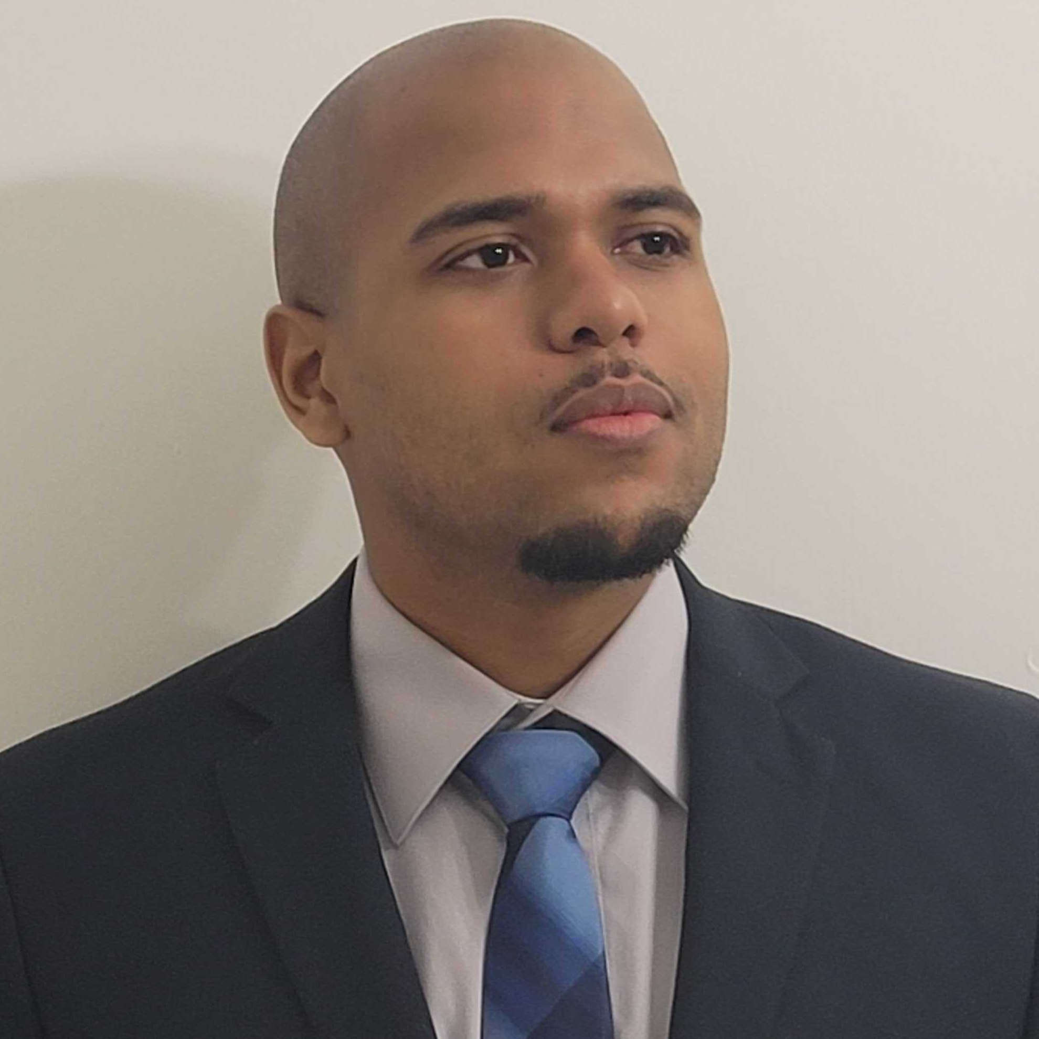
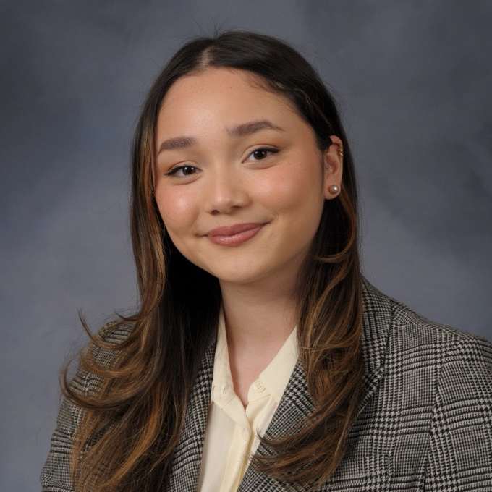
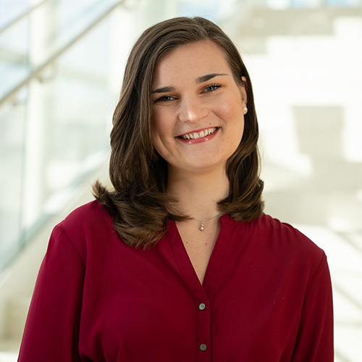
Presenters
Davy Yue
Co-Investigator
Kristin Rivera
Co-Investigator
Joshua Calarino
Interviewer & Data Analyst
Mei Pearlstein
Coordinator
Tracy Neville
Coordinator
Notes:
This is a representation of those of us who are here today, each of us will introduce ourselves as we go along.

Slide 4

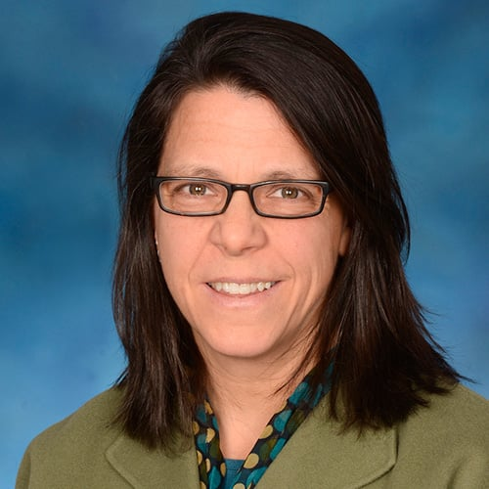
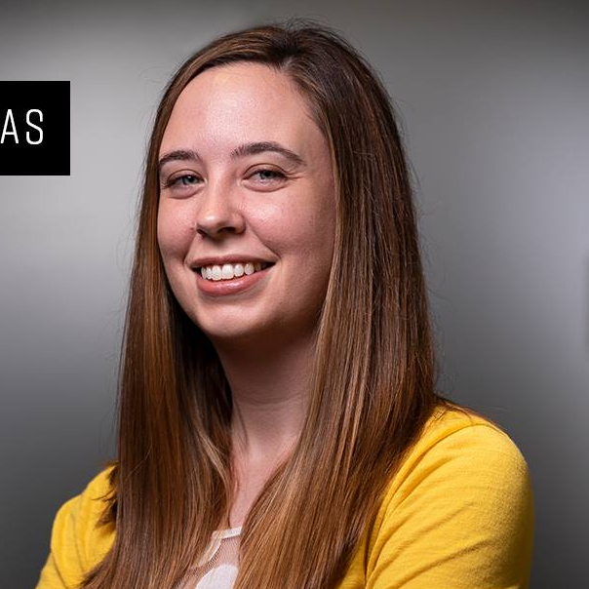
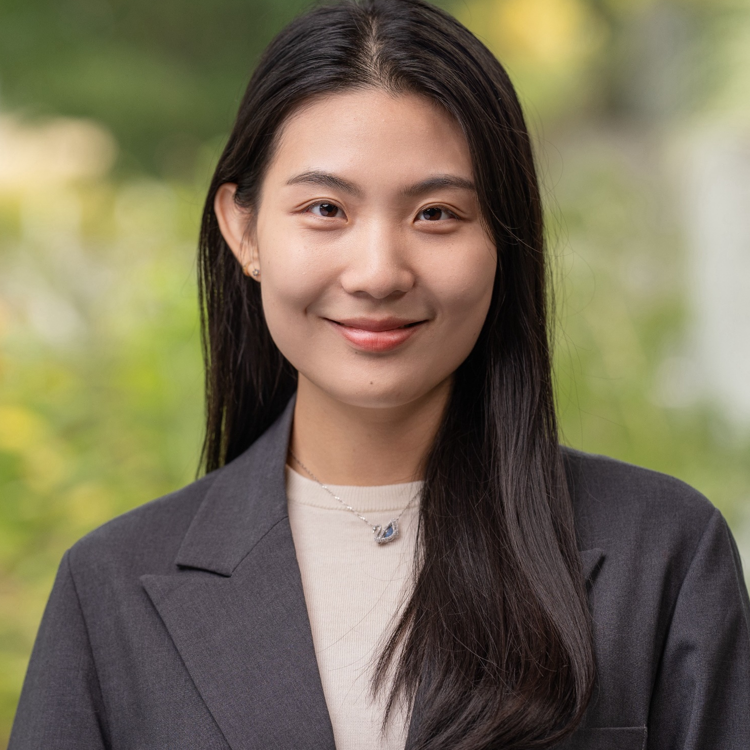
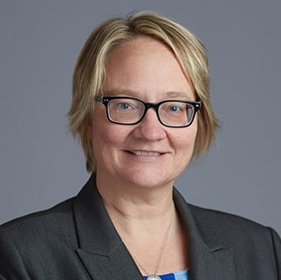
Additional Team Members
Kathryn Sabella, PhD
Co-Principal Investigator
Alicia Lucksted, PhD
Co-Principal Investigator
Elizabeth Thomas, PhD
Co-Investigator
W. Jamie Yang
Interviewer & Data Analyst
Michelle Munson, PhD
Advisor
Notes:
It takes a village, and we are grateful to our whole team for the value they bring to this work. Here is a representation of the team members who could not be here today.

Slide 5
CIRC Center
Overview on mission and scope
  NIDILRR-funded rehabilitation research and training center dedicated to supporting community participation among young adults with the greatest support needs, including disabilities
  Co-development of projects
“How Do You Do Community?” study
Notes:
State the full name of the Center: The Center for Community Inclusion and Reflective Collaboration
Examples of “co-development of projects”:
Young Adult Advisory Board (YAB)
GYABBERs (sub-advisory board during the grant writing process)
“How Do You Do Community?” study – allude to the fact that more detail will be presented later in our panel

Slide 6
Panel Overview
Co-Developing Study Methods
Results from a Thematic Analysis of Interviews Exploring Community Participation among Young Adults with Serious Mental Health Conditions
Reflections on Co-Leadership and Support Structures to Build Capacity among Community Partners
Notes:
Panel overview (with descriptions of each):
Co-Developing Study Methods
Core Roles: Co-investigators, Interviewers, Data Analysts
Community partners with lived expertise
Results from a Thematic Analysis of Interviews Exploring Community Participation among Young Adults with Serious Mental Health Conditions
Interviews with Young Adults SMHC
Define and experiences of community participation since COVID
Reflections on Co-Leadership and Support Structures to Build Capacity among Community Partners
Shared decision making
Perspectives in roles to date

Slide 7
Co-Developing Study Methods

Slide 8
How Do
You Do Community?
Qualitative research study within the CIRC Center
One-time interviews young adults with serious mental health conditions from across the USA to explore how they define and experience community participation
Notes:
We could acknowledge verbally regarding the study population: Will present on the demographic breakdown in Presentation #2

Slide 9
Methodological Strengths
Inherent richness of qualitative research
Community-engaged methods
  Rooted in lived experience
  Informed exploration of complex perspectives
  Centering the voices of those often under-recognized in conducting research, decision-making, and improving services

Slide 10
How Do
You Do Community? Progress So Far
40 qualitative interviews completed
Codes and code categories identified, coding process underway

Slide 11
Long-Term Study Ambitions
Increase understanding of how young adults experience community and participate in their communities
Inspire change in essential services, systems, and policies
Inform the collective knowledge among people with disabilities, practitioners, and policymakers
Improve community participation outcomes
Notes:
#1: Increase understanding of how young adults experience community and participate in their communities
#2: Improve community participation outcomes
in turn, can support the well-being, sense of identity, and self-determination of those with disabilities
#3: Inspire change in essential services, key systems, and strategic policies
#4: Inform the collective knowledge among people with disabilities, practitioners, and policymakers

Slide 12
What is Co-Development?
Collaborations between researchers and community partners to:
  Share leadership and decision-making
  Integrate co-development partners throughout study timeline
  Provide input into grant application process
  Engage within study management meetings
  Offer opportunities to take on sub-activities; smaller initiatives within the broader scope

Slide 13

Benefits of the Community-Engaged Approach
Strengthened partnerships with community of focus
Enhanced project design, progress tracking, recruitment strategies
Optimized data collection and interpretation of findings
Investing in professional development

Slide 14
Setting the Stage for Co-Development
Budget ample time and funds in the grant (e.g., compensation, procurement of tools)
Facilitate intentional co-development at each stage
Ensure sustainable engagement through training and ongoing support
Be thoughtful in assigning roles in alignment with individuals’ talents, interests, and potential
Notes:
#1: Budget ample time and funds in the grant (e.g., compensation, procurement of tools)
Procurement of tools (e.g., laptops, Microsoft accounts)
#2: Be thoughtful in assigning roles in alignment with individuals’ talents, interests, and potential
Conversations with leadership and key personnel about the Co-Investigator role and expectations
#3: Facilitate intentional co-development at each stage
At each stage of the project
Project management and decision-making (balancing a large team where consensus is needed to reach decisions)
#4: Ensure sustainable engagement with all team members
Five-part qualitative interview training complete with practice interviews and feedback built-in from Co-PI Dr. Lucksted
Completion of essential trainings through CITI on research ethics, best practices, privacy, and confidentiality
Ongoing support – will be described later, in part 3 of our panel on “Reflections on Co-Leadership and Support Structures to Build Capacity among Community Partners”

Slide 15
Co-Development of Study Methods
Quality Assurance
Recruitment
Interviews
Coding
Notes:
State verbally: Community partners engaged in study design and development of the methods for the study in the following areas: Recruitment, Interviews, Coding, and Quality Assurance
Examples (Recruitment):
Providing mental health resources to all respondents
Intentionally strategizing outreach to existing young adult networks, both in person and virtually
Examples (Interviews):
Flexible accommodations during online interviews to enhance accessibility (e.g., enabling closed captions, sending questions ahead of time)
Structured the interview process protocol
Revised interview guides based on field experiences
Examples (Coding):
Developed a multi-phased approach
Qualitative analysis training hosted by Co-Principal Investigator Dr. Lucksted
Hands-on learning and skill building
Continued conversations about best practices during each coding phase transition
Examples (Quality Assurance):
Ensuring best practices and meaningful engagement during interview
Real-time feedback relayed to interviewers
Highlighted personal attributes and facilitation skills

Slide 16
Key Lessons Learned
Recognize diverse participant needs and be responsive to feedback
Balance fidelity and flexibility during semi-structured interviews
Notes:
Recognize diverse participant needs and be responsive to feedback
Recognition of diverse backgrounds when designing research tools and being responsive to feedback gathered by participants, including feedback from interview protocols and experiences
Creating interview guide supplements to guide conversations to increase or sustain engagement in responsiveness in response to interactions with participants.
2. Balancing fidelity and flexibility when conducting semi-structured interviews
Overall, we learned about which general methods were successful and which have room for improvement. We will be applying these lessons learned in study methods to future projects

Slide 17
Results from a Thematic Analysis of Interviews:
Exploring Community Participation among Young Adults with Serious Mental Health Conditions

Slide 18

Our Research Questions
How are young adults with serious mental health conditions with the greatest support needs conceptualizing and experiencing community participation since the COVID pandemic?
  How have these conceptualizations and experiences been shaped by their lived experiences?
  How have these conceptualizations and experiences been shaped by the COVID-19 pandemic?

Slide 19

Thematic Data Analysis
Current study status: Completed first phase of coding
Now, further exploring the factors that influence community conceptualization and experience
In process of exploring impacts of COVID

Slide 20
Defining Experience and Conceptualization
Experience: What does community participation look like in practice for young adults based on the interviews?
Conceptualization: How have young adults defined community participation in the interviews?

Slide 21
Inclusion Criteria
18-30 years old
Experience mental health concerns that make work, school, or their personal life challenging
Have other experiences that may complicate community participation (e.g., experience in the justice or child welfare system)
Notes:
Note verbally: Recognition of various backgrounds when designing research tools and being responsive to feedback (e.g., asking preferred name before legal name)

Slide 22
Demographics: Mental Health
(not mutually exclusive, n = 40)
Notes:
Speaker will state:
This chart displayed here shows the types of mental health conditions represented among our 40 participants. Categories are not mutually exclusive, meaning that participants could select multiple mental health conditions that they have been diagnosed with from this list. Notably, a high proportion of participants endorsed a diagnosis of an anxiety disorder (36 out of 40) or a depressive mood disorder (31 out of 40).

Slide 23
Demographics: Race & Ethnicity
(not mutually exclusive, n = 40)
Notes:
Speaker will state:
This chart displays the races and ethnicities represented within our sample of 40 participants. Similarly, participants could select multiple race/ethnicity categories.

Slide 24
Demographics: Sexual Orientation
(not mutually exclusive, n = 40)
Notes:
Speaker will state:
This chart displays the sexual orientations represented within our sample. Participants could select multiple.

Slide 25
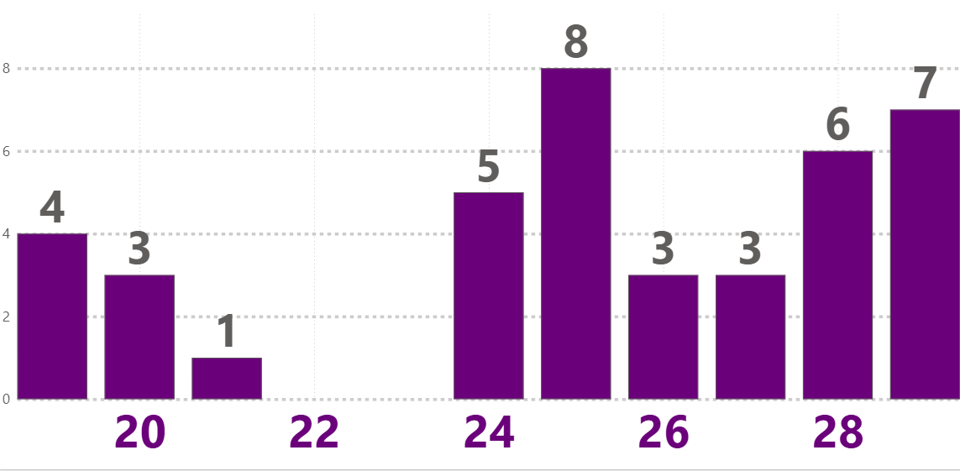
Demographics: Age
(n = 40)
19
21
23
25
27
29
Notes:
Speaker will state:
This chart shows the age range of our participants at the time of screening. Our participants ranged from 19 to 29 years old.
Average age (or mean) was 25.
Notably, there is a gap between ages 22-23. Also worth noting is that we did not have any participants who were 18 or 30, the minimum and maximum age requirement.

Slide 26
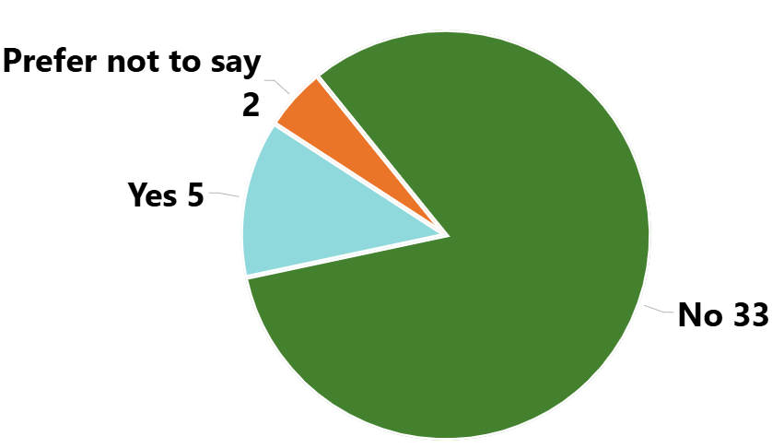
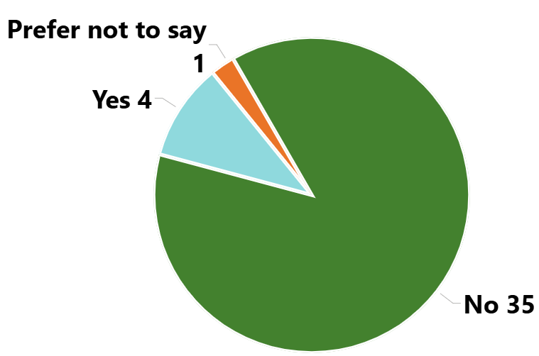
System Experiences
(n = 40)
Foster Care
Justice System
Notes:
Speaker will state:
We asked participants about whether they have had experience in either the foster care or justice system (juvenile and/or adult), experiences that could potentially complicate community participation. A small proportion of our sample had these experiences. (5 out of 40 for foster care; 4 out of 40 for justice system)

Slide 27
Detailed Coding Methods
Initial semi-structured notetaking at the proofreading stage
Iterative process, inductive coding, thematic coding (using “categories”)
Use of ATLAS.ti software to expedite coding

Slide 28
Common Ways Participants Conceptualize Community
People showing up to the same location
People who share the same beliefs
People who do the same activities
People who share the same goal
People who have the same values
A moral obligation or expectation to take part in a community
Intentionality and being present with your interactions
Being born into community
Identity automatically makes you a part of community
Parasocial online relationships can be community

Slide 29
Common Ways Participants Conceptualize Community
(Part II)
Community must include a certain number of people
Community involves all parties putting in effort
Where you choose to spend your money- avoiding supporting certain businesses, choosing to support small businesses
Social media is community
Family IS community
Family is NOT community
Community is when you can be your authentic self
Community involves shared identities

Slide 30
Notable Details: What Does Community Mean To You?
Quotes highlight the variance of how young adults define community
Lots of consensus among young adults
  e.g., Time, reciprocal relationships
Lots of contrasting ideas among young adults
  e.g., Family is and is not community

Slide 31
Common Ways Participants Experience Community
Various emotions that come up when experiencing community
Different experiences between in person and virtual community
Navigating obstacles that prevent community participation
Repeat exposure to same people develops into a community
Gathering intentionally with people to reach a common goal
Experiencing community through acts of kindness and humanity
One's identity shapes their community experiences
Prioritizing one community over another
COVID changing community experiences

Slide 32
Notable Details: How Are You Experiencing Community?
Quotes display the richness of both in person and online community
Virtual community can evolve into in person
Participants consistently mentioned the strengths and accessibility of online community
Importance of consistency and reliability of community

Slide 33
Intersecting Identities and Environmental Factors
What role does identity play in community participation?
Exploring how identities and backgrounds act as barriers and facilitators to community participation
  Social determinants of health
  Prior negative & positive experiences
  Cultural customs and norms
These results will help inform the next study phase

Slide 34
Notable Details:
Identity & Environmental Factors
Mental health conditions can pose as barriers and facilitators to community participation
Cultural and ethnic background can influence how and who you socialize with
  Providing aid and support for your ethnic/cultural community
  High geographic concentration of ethnic group
Rural location, lack of transportation, and financial cost can pose as barriers to participation

Slide 35
Reflections on Co-Leadership and Support Structures to Build Capacity among Community Partners

Slide 36
Sustainable Co-Leadership
Action-packed year of collaboration
Engaging young adults in leadership at fullest capacities
Multi-disciplinary, national team of research professionals and support staff
Shared leadership approaches to innovation

Slide 37
Effective Pathways for Community Partners
Infrastructures & Processes in Place
Support and sustaining in roles: co-investigators, interviewers, and data analysts
  Navigate balancing other competing professional responsibilities
Strategies implemented to maintain balance:
  Regular opportunities for discussion/debriefing with team
  Confidential support from an experienced external advisor
  Administrative support
  Flexibility of work commitments

Slide 38
Team Perspectives: W. Jamie Yang
"This has been a genuinely warm and collaborative experience, where our approach fostered close, meaningful connections and regular engagement with one another throughout the research process. This role deepened my skills in designing mixed methods study and strengthened my ability to translate complex data into meaningful insights for both academic and applied audiences."
- W. Jamie Yang, Interviewer/Data Analyst

Slide 39
Team Perspectives: Dr. Alicia Lucksted
"Team members making observations and asking questions from our various roles and experiences creates a better project, and interesting discussion! Together we are even more brilliant than each one of us is separately."
- Dr. Alicia Lucksted, Co-Principal Investigator

Slide 40
Team Perspectives: Dr. Elizabeth Thomas
"Partnering with young adults as co-leaders on this project has strengthened my work as a researcher by prompting me to examine my assumptions, consider new perspectives, and be more intentional in conversations about study design and execution. This collaboration has also enhanced the project itself - we met our recruitment target (a rarity in research) within a reasonable timeframe and generated high-quality results." - Dr. Elizabeth Thomas, Co-Investigator

Slide 41

Co-Investigator Insights
Problem solving through study phases
Nuances in data interpretations
Lived expertise as technical expertise
Exploration of depth and breadth to data

Slide 42
Co-Investigator Learnings
Flexible collaborations: synchronous and asynchronous
Adaptable leadership for ongoing needs
Comprehensive usage of complementary skills/strengths
Taking initiative to learn and lead
Innovating for peers like us

Slide 43
Co-Leadership as Accessible Pathways
Research participation for people with disabilities
Adaptable engagements in leadership decisions
Lived expertise synergized with technical expertise
Research impact into personally motivated areas
Direct impacts to peers living the data

Slide 44
Future Directions
Quantitative survey informed by the qualitative findings
Knowledge translation approaches
Future presentations across center initiatives
Community-engaged methods in the next phases
Member checking sessions with young adults
Notes:
Development and broad dissemination of a quantitative survey informed by the qualitative findings
Knowledge translation approaches
Future presentations across center initiatives
Exploration of how community-engaged methods will be integrated and implemented in the next phases

Slide 45
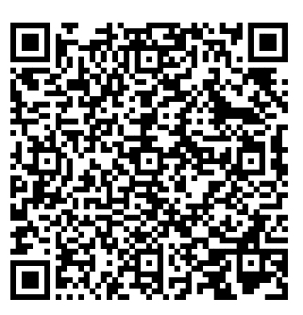
Contact Us!
https://www.umassmed.edu/TransitionsACR/CIRC
@TransitionsACR
(Social Media and YouTube)
CIRC@umassmed.edu

Slide 46
What Participants Said: What Does Community Mean To You?
Participant A: “In the simplest sense, I think it could mean, um, showing up to the same place at a regular time frequently, and then you become a part of that community."
Participant B: “Community care, so like making sure if I'm able to give to a mutual aid for a community member, or I'm able to cook for somebody, or take care of somebody in some way, um, and that reciprocal community relationship, right?"
Participant C: "For me, it's like an emphasis on human connection outside of immediate family."
Participant D: "I think about work, I think about friends, I think about neighbors, family..."

Slide 47
What Participants Said: How Are You Experiencing Community?
Participant A: "I was part of a-a community over Zoom, um, uh, like, a bipolar support group. And, um...that's a good example of where I felt like it was a community and, um, we met over Zoom, they meet every week on Zoom and then we had a lunch together in person. But I did feel like it was a community online, uh, even though it was just on Zoom."
Participant B: "I went to Dublin to celebrate James Joyce, and people from all over the world were there. On one hand, it's a global community of people who love James Joyce, but also, we-- I think what I'm trying to say is sometimes an online or cultural community can become physical, if that makes sense"
Participant C: "Before the pandemic, stuff like in-person things would mean a lot more to me versus-- Now, these days, playing Dungeons & Dragons online with my group, it feels more important…because...it's a settled thing, so it feels more important than doing a new thing, even if that new thing is a physical, in-person thing."

Slide 48
What Participants Said: Identities & Environmental Factors
Participant A: "I think especially, like, autism, and depression, and social anxiety can be personal barriers to engaging in community...Uh, social anxiety, of course, is because I have to actually go out there and talk with people to become part of the community, and…I'm not always comfortable with that."
Participant B: “At work, a lot of people are Hispanic, and then, um, well, my family's Hispanic, my boyfriend's Hispanic. Um, I'm in [City], so [chuckles] like everywhere, like the bus, a lot of people are Hispanic. Um, I spend a lot of time helping others with, like, the language thing. Um, because, well, I'm first generation, so even that's like another community.”
Participant C: "I'm not in like any of the major cities...Um, I also didn't have a car in the first two months I was here, and the city that I'm currently in...just doesn't have great public transportation. So I was very, um, restricted in terms of where I could go and what I could do without breaking the bank."

