Slide 1
Building Solutions and Breaking Barriers: Advancing Behavioral Health Through Community Collaborations
2026 Annual Conference of the DMH Research Centers of Excellence
Month YEAR
May 6, 2026

Slide 2
Disclosures
Cori Cather​, PhD
  Consultant:​
    NAVIGATE Consultants​
  Co-Investigator on a NIH-SBIR Grant:​
    Charles River Analytics​
  Trainer:​
    Amae Health​

Slide 3
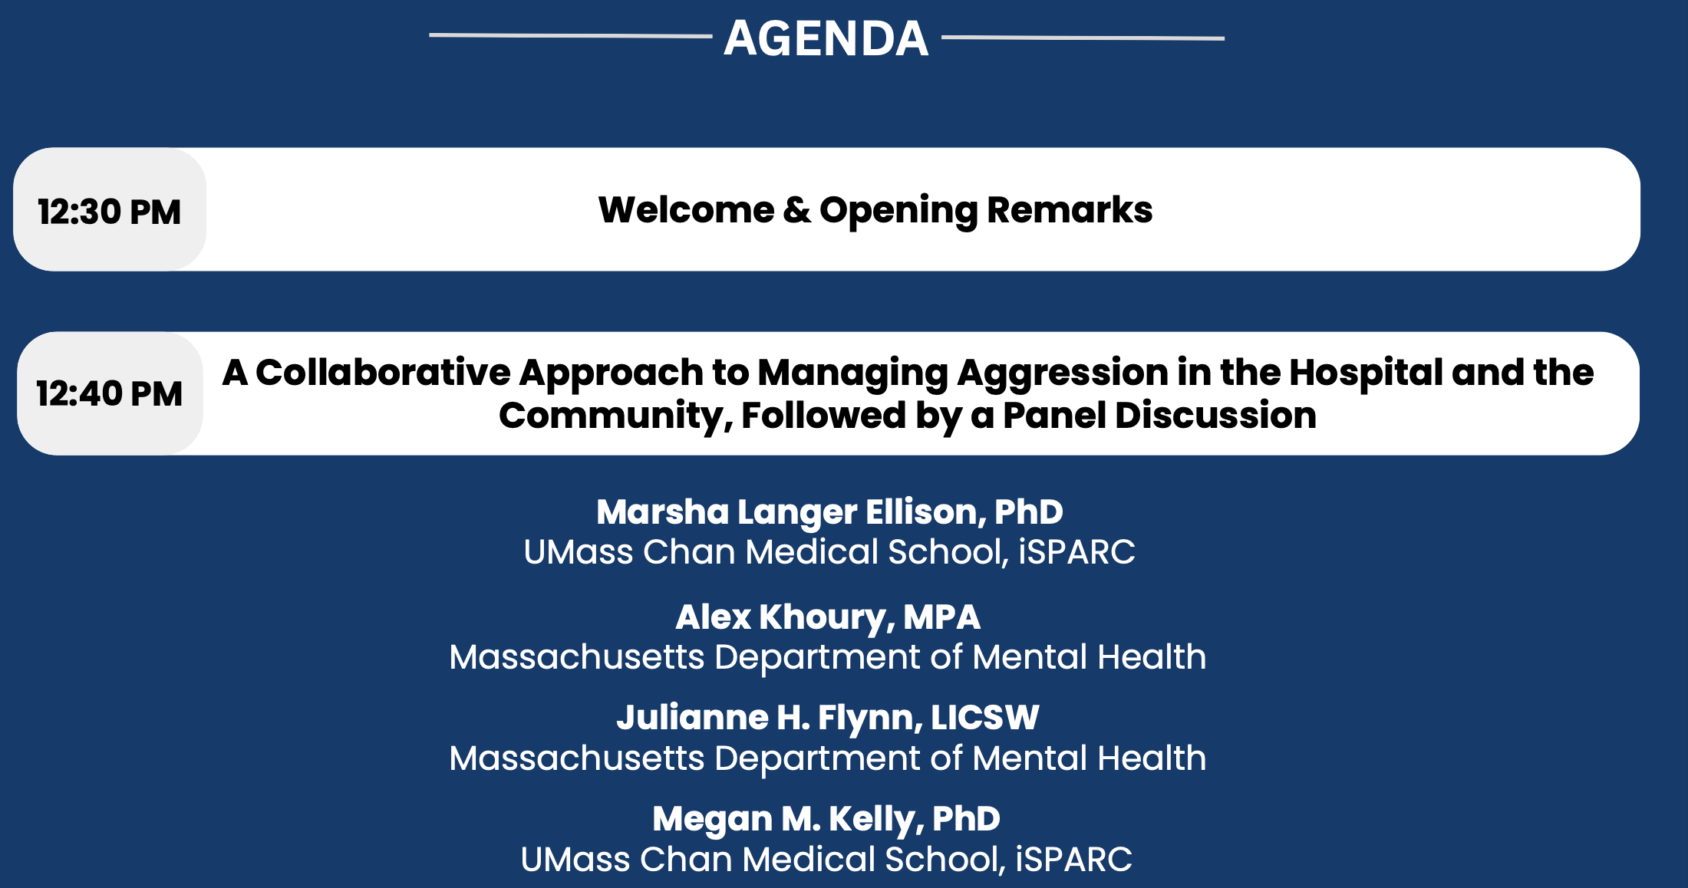
Agenda

Slide 4
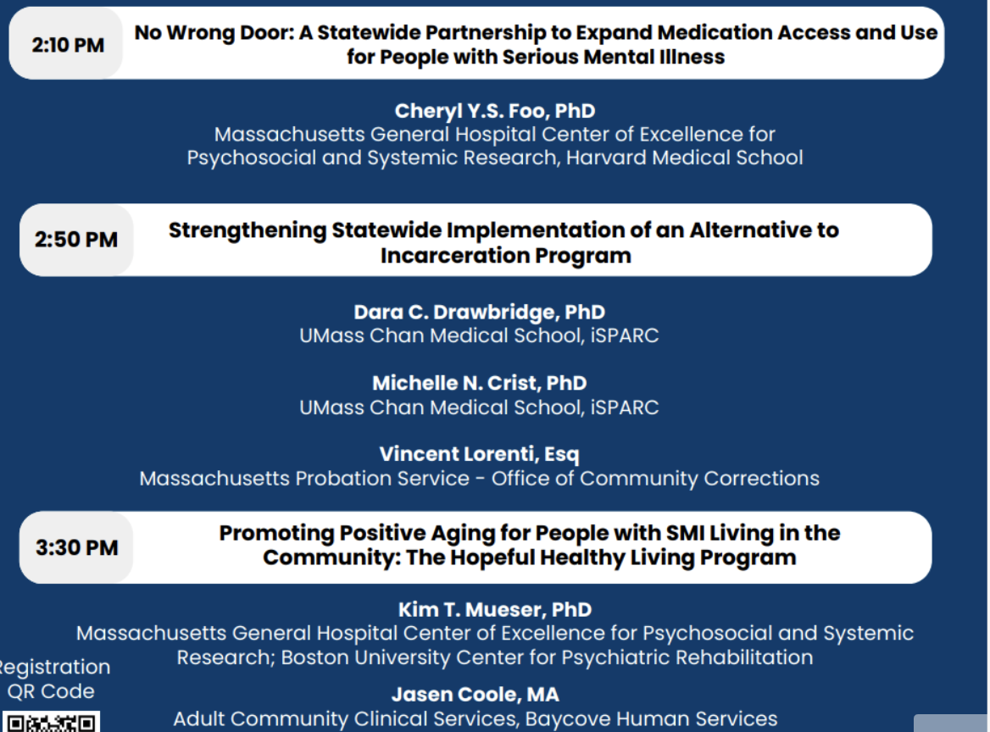
Agenda cont.’d

Slide 5
Continuing Education Units (CEUs)
CEUs are being offered for:
  Psychologists
  Nurses
  Social Workers
  Occupational Therapists
  Licensed Mental Health Counselors
Email dmh-ceap@mass.gov with any CEU questions/concerns.

Slide 6
Continuing Education Units (CEUs)
To receive continuing education credits for this event, participants MUST:
  Join the conference on Zoom with your full name displayed (individuals who only join by phone will not be eligible to receive CEUs).
  Attend the entire program.
  Complete an evaluation upon the conclusion of the program.
Link and a QR code to the evaluation will be shared near the end of the conference.

Slide 7
Continuing Medical Education (CME)
CME Accreditation Statement: The University of Massachusetts Chan Medical School is accredited by the Accreditation Council for Continuing Medical Education to provide continuing medical education for physicians.
Designation Statement: The University of Massachusetts Chan Medical School designates this live activity for a maximum of 4 AMA PRA Category 1 Credit(s)™. Physicians should claim only credit commensurate with the extent of their participation in the activity.
To receive continuing education credits for this event, participants MUST:
  Join the conference on Zoom with your full name (individuals who only join by phone will not be eligible to receive CEUs).
  Attend the entire program.
  Complete an evaluation upon the conclusion of the program.
Link and a QR code to the evaluation will be shared near the end of the conference.
For all CME certificate inquiries, please email continuing.education@umassmed.edu.

Slide 8
Strengthening Statewide Implementation of an Alternative to Incarceration Program
May 6, 2026 | DMH Conference

Slide 9
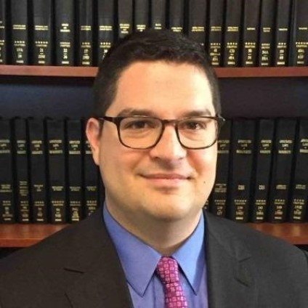

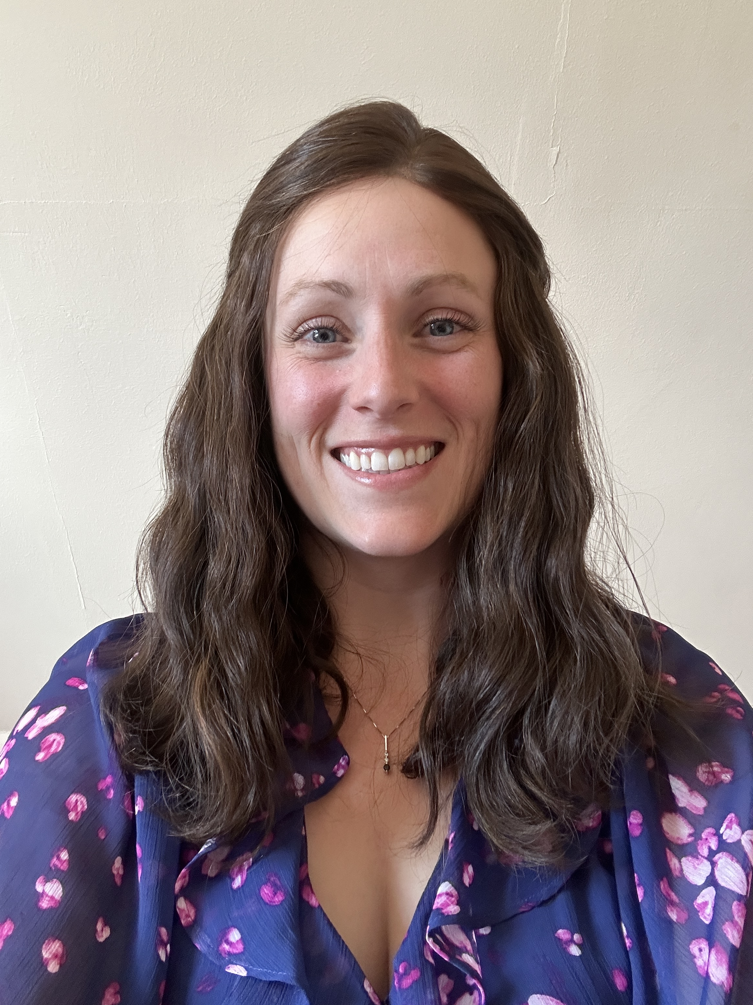
Who we are
VINCENT LORENTI, JD
Executive Director, MA Office of Community Corrections
DARA DRAWBRIDGE, PHD
Assistant Professor, Psychiatry, UMass Chan
Executive Leadership, National Collaborative for Implementation Support
MICHELLE CRIST, PHD
Instructor, Psychiatry, UMass Chan
Executive Leadership, National Collaborative for Implementation Support

Slide 10
Massachusetts Office Of Community Corrections & Community Justice Support Centers
Vincent Lorenti, JD, Executive Director

Slide 11
The Massachusetts Office of Community Corrections (OCC) Mission
Purpose & Community Justice Support Center (CJSC) Mission
The OCC aims to build safer and stronger communities across the Commonwealth through two initiatives, the Community Justice Support Centers and the Community Service Program.
The mission of the CJSCs is to deliver an evidence-based, alternative to incarceration approach that provides individualized and comprehensive treatments and supports delivered in the community by centers that are accessible and locally operated.

Slide 12
The Massachusetts Office of Community Corrections (OCC) Principles
Values & Guiding Principles
Evidence. We use interventions with evidence of improving individual success in the community by engaging in continuous quality assurance and quality improvement endeavors that ensure clients receive interventions most likely to promote positive outcomes, while improving service delivery across the system.
Cultural Competence We collaborate effectively, respectfully, and empathetically with individuals from different cultures by recognizing the diversity both between and within cultures, continuously engaging in cultural self-assessment and embodying a willingness to adapt our personal behaviors and practices to promote collaboration and rapport.
Trauma-Informed We realize that there is no universal definition of trauma, but that the impact of trauma is widespread. We aim to recognize signs and symptoms of trauma, integrate knowledge of trauma into our policies, procedures and practices, and actively avoid creating an environment that re-traumatizes our clients.

Slide 13
The Massachusetts Office of Community Corrections (OCC) Principles cont’d
Values & Guiding Principles
Behavior Change through Personal Motivation. We aim to promote individual behavior change assisting clients with identifying and exploring their own personal reasons for change in a manner that is compassionate and accepting of individuals. We recognize that coercion is an inherent component of the criminal-legal system, but we believe that strengthening clients' personal motivation and commitment to change is essential to promoting success in the community.
Partnerships. We aim to build connection and trust with clients, communities, and other agencies by showing up in non-judgmental ways, identifying and cultivating shared values and goals, and expressing empathy.
Trust. We aim to build trust with clients, communities, and other agencies by acting with transparency, reliability, accountability, and with integrity to our values.

Slide 14
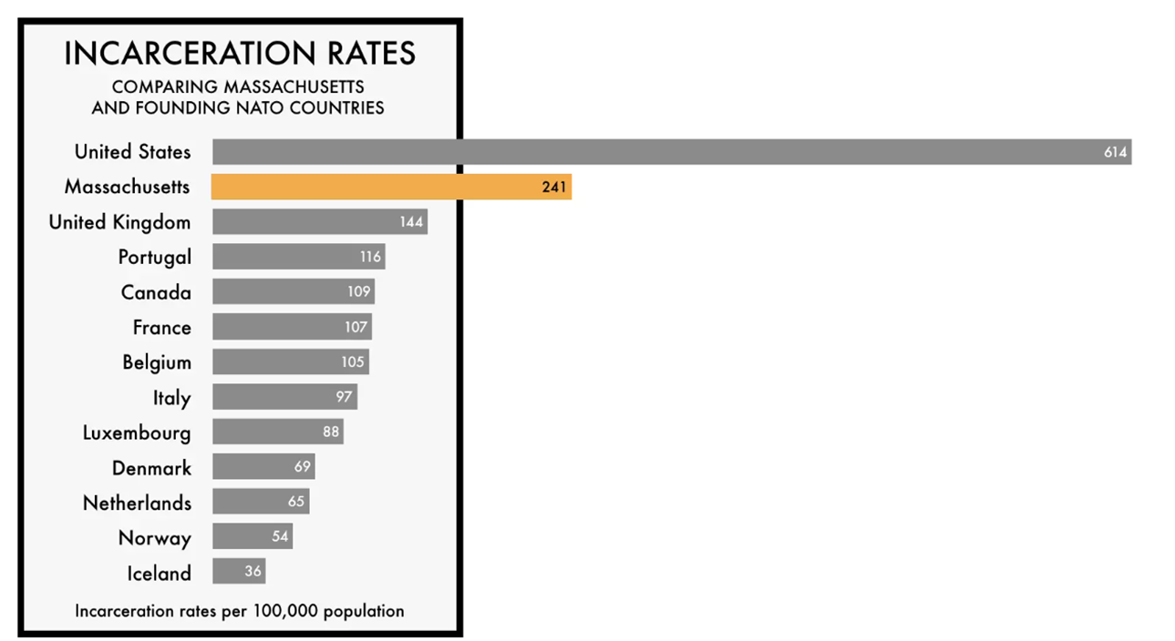

WHY Do Support Centers Exist?
As an Alternative to Incarceration
Incarceration Rate per 100,000
US- 569
MA- 172
Source: Boston Indicators, January 2024

Slide 15
WHAT Do Support Centers Deliver?
Evidence-based Interventions in Local Communities
1
Assess actuarial likelihood of recidivism
  Standardized/validated assessment instrument
2
Target intervention: likelihood of recidivism & needs
  Individual treatment plan, gender/cultural-specific services
Focus on cognitive-behavioral skill development
  Approved cognitive-behavioral curriculum
3
(Drawbridge, D. C., Todorovic, K., Winters, G. M., & Vincent, G. M. 2019; Gendreau, P., Little, T., & Goggin, C. 1996; Kapoor et al, 2018; Labrecque, R.M., Smith, P., Lovins, B.K., & Latessa, E.J. 2014; Long, J. S., Sullivan, C., Wooldredge, J., Pompoco, A., & Lugo, M. 2019; Peterson-Badali et al, 2015; Calleja et al., 2016)

Slide 16
RNR Principles
RISK PRINCIPLE
R
Who should be targeted for interventions, with intensity of interventions matched to person's likelihood for recidivism
NEED PRINCIPLE
N
What interventions should be delivered, with interventions targeting changeable needs directly driving likelihood of recidivism
RESPONSIVITY PRINCIPLE
R
How interventions should be delivered: Cognitive-behavioral therapies (CBT) and tailored toward characteristics, particularly those affecting access, engagement, retention & response to interventions
(Andrews & Bonta, 2017; Baglivio, M. T., Wolff, K. T., Howell, J. C., Jackowski, K., & Greenwald, M. A., 2018 )

Slide 17
WHAT Do Support Centers Deliver? cont’d
Clients at higher likelihood of recidivism receive more structure
Use actuarial Risk-Needs Assessment to determine amount of intervention a person receives
Offer a wide range of interventions to support complex needs
Manualized cognitive behavioural groups
Education & employment supports
Essential need supports
Referrals to community resources
Court condition(s) compliance support
Strength based services
(Andrews & Bonta, 2017; Dowden & Andrews, 1999;
Hanson & Morton-Bourgon, 2009; Prendergast et al, 2013)

Slide 18
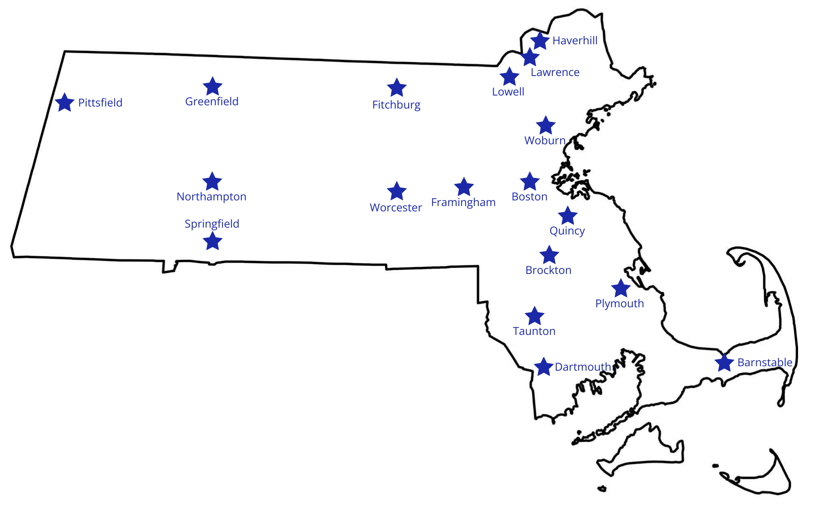
WHERE?
CJSC Locations Across MA

Slide 19

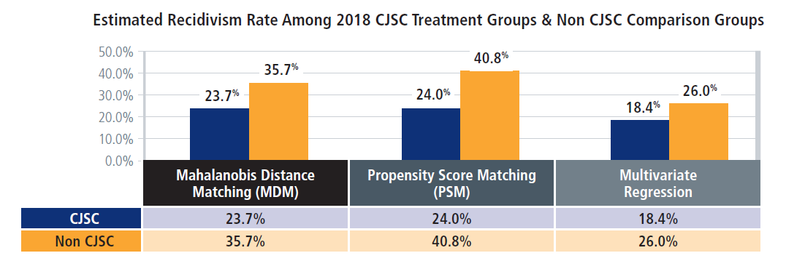
HOW Do Support Centers Achieve Outcomes?
High Quality Implementation
2018 cohort saw 26-36% lower recidivism rates than 2013.

Slide 20
HOW Do Support Centers Achieve Outcomes? cont’d
Partnership with Dr. Drawbridge at UMass Chan dates back to 2016
  Initiated fidelity monitoring of 3 RNR Practices at 3 support centers:
    Risk-needs assessment (RNA)
    Treatment planning
    CBT groups
  Initial fidelity monitoring informed:
    Statewide adoption and implementation of universal screening for substance use and mental health needs
    Statewide adoption and implementation of a risk/needs reassessment policy
    Statewide continuation of implementation support

Slide 21
Supporting Implementation of Evidence-Based Interventions in Community Justice Support Centers Statewide
Drawbridge (PI), Crist (Co-PI)
Funding from the Massachusetts Office of Community Corrections (Aw. No. E63710000057088, Drawbridge PI)

Slide 22
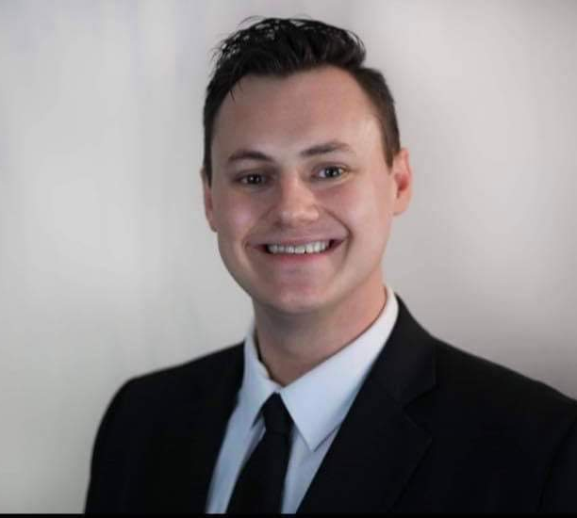



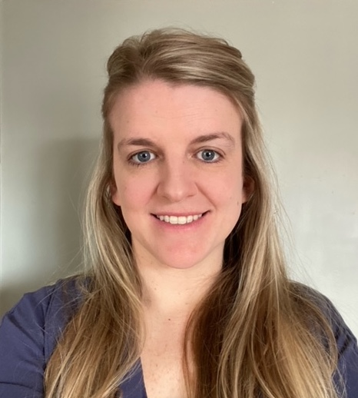

Our Past & Present Team
Charlie Clark, Research Coordinator II | Jessia Bartish, Implementation Support Specialist I | Elena Buonodono, Implementation Support Specialist I
Sydney Little, Research Coordinator II | Gretchen Landry, Research Coordinator II | Janelle LaPlante, Implementation Support Specialist I

Slide 23
WHAT Do We Do?
Primary goal is to support implementation of RNR practices in Support Centers statewide.
Three RNR practices we support:
  Risk-needs assessment (RNA)
  Treatment planning
  Cognitive-behavioral groups (targeting primary drivers of recidivism, which have the capacity to change over time or in response to intervention)
The IRB determined that the proposed activity is not human subject research as defined by DHHS and FDA regulations.

Slide 24
WHAT Do We Do? cont.
Our intention:
NOT a research study
IS an intentional and rigorously designed approach to RNR implementation support that aims to improve implementation fidelity in local settings
IS scalable across a state-system
The IRB determined that the proposed activity is not human subject research as defined by DHHS and FDA regulations.

Slide 25
HOW Do We Approach Our Work?
Stepped Approach - Group Support Centers into steps of about 3-5 sites
When we turn a ”Step” (3-5 sites) on, sites enter a low intensity support phase for 12-months.
If there is high fidelity implementation within first 12 months, sites receive feedback reports and recommendations on sustainability, but active support is turned off.
If implementation challenges are detected within first 12 months, sites enter a high intensity support phase and continue to work with us for another 12 months
Campbell, M. A., French, S., & Gendreau, P., 2009; Cane, O’Connor, Michie, 2012; Carroll, C., Patterson, M., Wood, S., Booth, A., Rick, J., & Balain, S., 2007; Damschroder, Reardon, Widerquist, Lowery, 2023; Glasgow, R. E., & Estabrooks, P. E., 2018; Michie, 2011; Nilsen, P., 2015; Vieira, T., Skilling, T., & Peterson-Badali, M., 2009; Wandersman, A., & Scheier, L. M. ,2024

Slide 26
HOW Do We Approach Our Work? cont.
Phase 1: Low Intensity
Phase 2: High Intensity
Ensure Basic Knowledge, Examine Implementation, Develop Local Knowledge & Identify Areas for Higher Intensity Implementation Support
Design & Deploy Tailored Implementation Supports, Continue to Examine Implementation, & Determine if Supports Work
(Proctor, E. K., Bunger, A. C., Lengnick-Hall, R., Gerke, D. R., Martin, J. K., Phillips, R. J., & Swanson, J. C., 2023 )

Slide 27
Low Intensity Phase 1 Activities
Low Intensity Phase 1 Activities – All Sites
RNR Online, Asynchronous Training
RNR Barrier & Facilitator Assessment – Qualitative Interviews
RNR Organizational Readiness Assessment; Acceptability, Appropriateness & Feasibility; Sustainability - Surveys
RNR Implementation Fidelity – CBT Groups, Tx Planning, RNA

Slide 28
Examining Implementation Quality
RNR Practice | Implementation Quality Indicator | Site Benchmark
Risk Needs Assessment | Consistency between raters in scoring (quality) | Good to excellent agreement
Treatment Planning | Percent of identified needs matched with interventions in tx plans over the course of programming (responsiveness) | On average, site match 75% + of identified needs with Interventions
 | Percent of consecutive referrals w. a treatment plan developed (reach) | 75% referrals reached
Cognitive Behavioral Groups | Facilitator use of & proficiency with essential CBT elements (adherence & quality) | Group facilitators demonstrate moderate to high proficiency with elements

Slide 29
Low Intensity Phase 1 – All Sites To Date
Activity | Source | n
RNR Knowledge | Staff Training Online, asynchronous | 107
Barrier & Facilitator Assessment | Staff Interviews – CFIR informed, Rapid Coding Method & Construct Matrix | 85
Readiness; Acceptability, Feasibility, Appropriateness; Sustainability | Staff Surveys – ORIC, RTT, AIM, IAM, FIM, PSAT | 174
CBT Group Implementation Quality | Direct observations of Facilitators | 134
Treatment Planning Implementation Quality | Case file review of consecutive referrals | 376
Risk Needs Assessment Implementation Quality | Case file review of consecutive referrals | 347

Slide 30
High Intensity Phase 2 Process
High Intensity Phase 2 Process – Only Sites with Implementation Quality Challenges at End of Phase 1
WHAT fidelity challenges need to be addressed?
WHICH supports can be used to address challenges?
WHAT Needs to change to implement & use supports
HOW did implementation of supports go & did they work?

Slide 31
What Makes Phase 2 High Intensity?
Volume of Supports
  Increased number of supports delivered at each site
Design & Customization to Individual Sites
  Designing new supports
  Customizing supports & process for implementing supports – Varies site-to-site
Frequency of Contacts with Sites
  Monitoring not just intervention implementation, but also monitoring adoption and implementation of supports
External & Internal Investment in Supports
  Complexity of the work increases, Emotional investment increases
Proctor, E. K., Powell, B. J., & McMillen, J. C., 2013)

Slide 32
High Intensity Phase 2 – Tailored Supports
Support | RNR Practice | Primary Change Target (CFIR & TDF) | Domain (CFIR)
Cognitive-Behavioral Group Fidelity Tool | CBT | Reflecting & Evaluating - Innovation | Implementation Process
Motivational Interviewing Techniques Tool | CBT | Capability (Memory, Attention, Decision-Making) | Individual Characteristics
Identifying & Responding to Thinking Patterns Tool | CBT | Capability (Memory, Attention, Decision-Making) | Individual Characteristics
RNA Educational Sessions | RNA | Capability (Knowledge) | Individual Characteristics
(Damschroder, Reardon, Widerquist, & Lowery, 2022; Michie, Johnston, Abraham, et al., 2005)

Slide 33
High Intensity Phase 2 – Tailored Supports cont’d
Support | RNR Practice | Primary Change Target (CFIR & TDF) | Domain (CFIR)
Scoring Reminder Tool | RNA | Capability (Memory, Attention, Decision-Making) | Individual Characteristics
Self-Assessment Tool | RNA | Capability (Behavioral Regulation) | Individual Characteristics
Internal Audit & Feedback Tracker | RNA | Reflecting & Evaluating - Innovation | Implementation Process
Treatment Planning Checklist Tool | Tx Planning | Capability (Behavioral Regulation) | Individual Characteristics
(Damschroder, Reardon, Widerquist, & Lowery, 2022; Michie, Johnston, Abraham, et al., 2005)

Slide 34
High Intensity Phase 2 – Tailored Supports cont’d
Support | RNR Practice | Primary Change Target (CFIR & TDF) | Domain (CFIR)
Case File Review Internal Audit & Feedback Tracker | Tx Planning | Reflecting & Evaluating - Innovation | Implementation Process
Treatment Planning Local Consensus Meetings | Tx Planning | Innovation Source (Beliefs About Consequences) | Innovation
Reach Needs Assessment & Consensus Discussions | Tx Planning | Tension for Change (Beliefs About Consequences, Emotions, Social Inf) | Inner Setting
Informing Local Opinion Leaders & Education | Tx Planning | Local Conditions & Attitudes; Capability (Knowledge) - outer | Outer Context,Individual Characteristics
(Damschroder, Reardon, Widerquist, & Lowery, 2022; Michie, Johnston, Abraham, et al., 2005)

Slide 35
High Intensity Phase 2 – Tailored Supports cont’d
Support | RNR Practice | Primary Change Target | CFIR Domain
Dynamic Need Area x CBT Group Alignment Matrix | Tx Planning | Access to Knowledge & Information (Environmental Context & Resources) | Inner Setting
Program Implementation Meetings | Tx Planning & RNA | Relational Connections, Tension for Change (Beliefs About Consequences, Emotions, Social Influences) | Inner Setting
(Damschroder, Reardon, Widerquist, & Lowery, 2022; Michie, Johnston, Abraham, et al., 2005)

Slide 36
Phase 2 Supports & Fidelity Benchmarks
14 Support Strategies Developed
11 Sites Entered into Phase 2 Work
  100% Adopted At least One Support (10 Adopted Multiple)
  Average number of supports adopted: 2-3
5 Sites Entered and Completed Phase 2 Work To-Date
  100% of Sites Reached Implementation Quality Benchmarks by End of Phase 2

Slide 37
Phase 1 & 2 Results by Site
 | Tx Planning | RNA | CBT | Phase 2 Results
Site A | + | - | + | + Achieved
Site B | + | + | + | Not needed
Site C | + | + | + | Not needed
Site D | + | + | - | + Achieved
Site E | + | - | + | In progress
Site F | + | - | - | + Achieved
Site G | + | - | + | + Achieved
Site H | + | - | + | + Achieved
Site I | + | + | + | Not needed
Site J | - | - | - | In progress
Site K | - | In progress | + | In progress
Site L | - | In progress | + | In progress
Site M | - | In progress | - | In progress
Site N | + | + | - | In progress
Site O | In progress
Site P | In progress
Site Q | In progress
Phase 2 Results: Benchmarks
+ Benchmark Achieved
- Benchmark Not Achieved

Slide 38
Site Profile
Organizational Characteristics
# Staff | 16
# Staff Administer RNA | 7
# Staff Develop Treatment Plans | 6
# Staff Facilitate CBT Groups | 8
Past 12-month Census | 309 Participants
Geographic Area Served | Urban
# Years Vendor Operation | 25
Main Referral Sources | District Court, Federal Court; Reentry Center

Slide 39
Site Profile
Staff Characteristics – RNR Practices (N=8)
Age | M=33 years (min=29; max=43)
Length of time in position | M=4 years (min=0.5; max=18)
Length of time at CJSCs | M=7 years (min=0.5; max=18)
Race/Ethnicity -White | 75% white; 25% Latina/o; 12.5% missing
Gender Identity | 50% woman; 37.5% man; 12.5% missing
Education | 100% college degree or higher

Slide 40
Site Profile cont’d
Baseline Organizational Readiness for Implementing Change - RNR

Slide 41
Site Profile cont’d
Phase 1 Implementation Quality & Fidelity Benchmarks
RNA | Benchmark Not Reached (-) Attitudes & Behavioral Patterns & Overall Risk (Poor & Fair Agreement)
Treatment Planning | Benchmark Reached (+) 93% Match Rate; 94% Reach
CBT | Benchmark Reached (+) Moderate-to-Strong Proficiency

Slide 42
Site Profile cont’d
Phase 1 RNA Implementation Barriers – Qualitative Interviews
Access to Knowledge & Information | Access to training in a timely manner is limited
Innovation Complexity | Difficult to score – multiple sources of information; nuanced scoring; difficult to gather information and build rapport
Available Resources | Not enough “time and energy” to administer

Slide 43
Site Profile cont’d
Phase 2 Implementation Supports
 | Supports | Primary Change Target (CFIR & TDF) | Domain (CFIR) | Acceptability, Feasibility, Appropriateness | Phase 2 Results
RNA | Scoring Reminders | Capability (Memory, Attention, Decision-Making) | Individual Characteristics | AIM M=5.0 (0.0) FIM M=5.0 (0.0) IAM M=5.0 (0.0) | Benchmark Reached (+) Excellent Agreement
 | Self-Assessment | Capability (Behavioral Regulation) | Individual Characteristics
 | Educational Sessions | Capability (Knowledge) / Access to Knowledge & Information | Individual Characteristics / Inner Setting

Slide 44
Key Takeaways
Achieving Outcomes is Hard – Especially Recidivism
Need clearly defined interventions, systematic processes for identifying support needs & selecting strategies.
Strategies need to address barriers across multiple domains – must attend to the context.
There is an overwhelming overreliance on training and/or technical assistance as THE support strategies.
Systems need scalable approaches to support. Implementation science, methods, tools are important in real-world change initiatives, but the key to this work is interpersonal.

Slide 45
Transition to Next Section
Embedding quality implementation within organization’s purpose, mission, values and guiding principles.
To ensure evidence & quality implementation intersect with cultural competence, trauma-informed approaches, behavior change through personal motivation, partnerships, and trust.
We partnered with OCC Leadership to develop a Support Center Community Advisory Board comprised of people with lived experiences in the Massachusetts criminal-legal system.
It provides input into policies, programs & practices and helps ensure that our focus on evidence and implementation quality is informed by the voices of people impacted by the criminal-legal system in Massachusetts.

Slide 46
Integrating the Voices of People With Lived Experience in the Massachusetts Criminal-Legal System into Program Design and Implementation
Support Center Community Advisory Board

Slide 47

Community Advisory Boards (CAB) facilitate communication, tailor services, build partnerships, and ensure appropriate delivery of services.
(Zadvinskis & Hoying, 2023)

Slide 48

Benefits to Community Advisory Boards
Organizations
Build relationships with communities
Get feedback for improvement
Identify support needs
Collaborative change
People with Lived Experience
Raise awareness of needs
Shape polices
Professional Experience

Slide 49
The MA Community Justice Support Center CAB Design Process
Working Group
Survey of Clients
Client Focus Group
CAB Design
CAB Recruitment
CAB Implementation
(Stewart et al., 2019)
(Baiye & Drawbrdige, 2023)
(McCaffrey, Narkewicz, & Sudbrock, 2024)

Slide 50
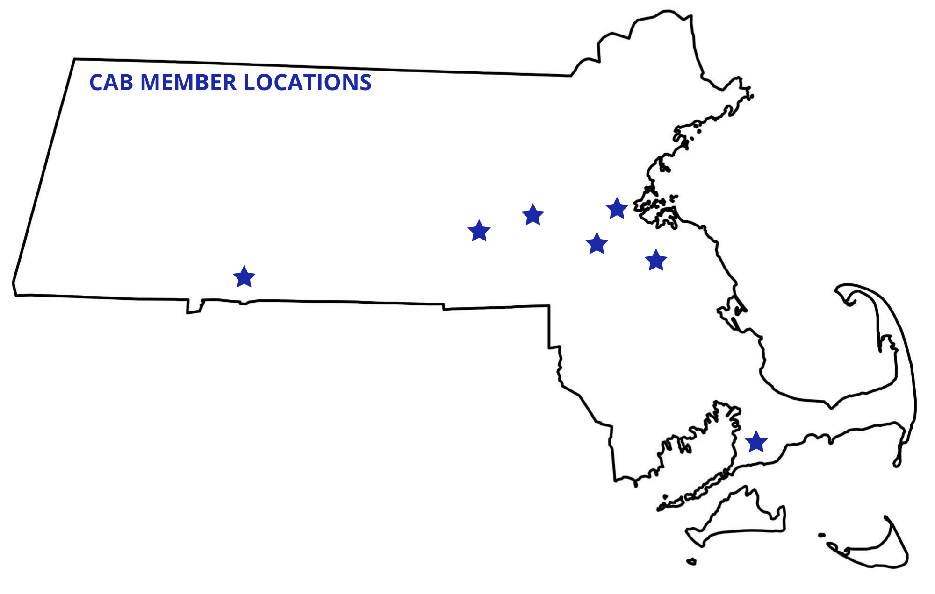
MA Support Center CAB Recruitment
 | CAB Demographics
Race Ethnicity | 4 African American / 4 White 1 Hispanic/Latino/a/x
Gender Identity | 4 male / 4 female
Age | 32-72 years old
Support Center Involvement | 6 yes / 2 no
Criminal-Legal System Involvement Experience | Survivors of domestic/family violence Children of incarcerated parents & homicide victims Behavioral health needs Arrests, probation, CJSC, incarceration, parole, wrongful incarcerations – state & federal systems

Slide 51

Impact of the CAB So Far
August 2024
14 of 18 Support Centers
21 meetings covering 14 different topics
  CAB-reviewed curriculum
  Language modifications
  Handbook layout
  Treatment planning, responsivity, and orientation
  Goals for transition and recognition ceremonies
  Security and drug testing protocols
  Clinical Behavioral Intervention policies
  Engaging with participants

Slide 52

Lessons Learned
Target Population
Broad diversity
Complex lives
Potential for relapse back into the criminal-legal system
Funding
Cost and logistics
Pay equity
Organizational Purpose, Mission, Vision, & Values
Clarifying and articulating where the CAB fits into the organizations purpose, vision, mission, & values
Staff expectations and power dynamics
Impact and awareness of changes by CAB members

Slide 53

THANK
YOU

Slide 54
References
Andrews, D. A., & Bonta, J. (2010). Rehabilitating criminal justice policy and practice. Psychology, Public Policy, and Law, 16(1), 39-55. https://doi.org/10.1037/a0018362
Baglivio, M. T., Wolff, K. T., Howell, J. C., Jackowski, K., & Greenwald, M. A. (2018). The search for the holy grail: Criminogenic needs matching, intervention dosage, and subsequent recidivism among serious juvenile offenders in residential placement. Journal of Criminal Justice, 55, 46-57. https://doi.org/10.1016/j.jcrimjus.2018.02.001
Campbell, M. A., French, S., & Gendreau, P. (2009). The prediction of violence in adult offenders: A meta-analytic comparison of instruments and methods of assessment. Criminal Justice and Behavior, 36(6), 567– 590. http://dx.doi.org/10.1177/0093854809333610
Calleja, N. G., Dadah, A. M., Fisher, J., & Fernandez, M. (2016). Reducing Juvenile Recidivism Through Specialized Reentry Services: A Second Chance Act Project. Journal of Juvenile Justice, 5(2).
Cane, J., O’Connor, D., & Michie, S. (2012). Validation of the theoretical domains framework for use in behaviour change and implementation research. Implementation Science: IS, 7(1), 37-37. https://doi:10.1186/1748-5908-7-37
Carroll, C., Patterson, M., Wood, S., Booth, A., Rick, J., & Balain, S. (2007). A conceptual framework for implementation fidelity. Implementation Science: IS, 2(1), 40-40. https://doi.org/10.1186/1748-5908-2-40
Damschroder, L. J., Reardon, C. M., Widerquist, M. A. O., & Lowery, J. (2022). The updated Consolidated Framework for Implementation Research based on user feedback. Implementation science, 17(1), 75.
Drawbridge, D. C., Todorovic, K., Winters, G. M., & Vincent, G. M. (2019). Implementation of risk-need-responsivity principles into probation case planning. Law and Human Behavior, 43(5), 455–467. https://doi.org/10.1037/lhb0000351
Gendreau, P., Little, T., & Goggin, C. (1996). A meta-analysis of the predictors of adult offender recidivism: What works! Criminology, 34(4), 575-607. https://doi.org/10.1111/j.1745-9125.1996.tb01220.x
Glasgow, R. E., & Estabrooks, P. E. (2018). Pragmatic applications of RE-AIM for health care initiatives in community and clinical settings. Preventing Chronic Disease, 15, E02. https://doi.org/10.5888/pcd15.170271
Hanson, R. K., Bourgon, G., Helmus, L., & Hodgson, S. (2009). The principles of effective correctional treatment also apply to sexual offenders: A meta-analysis. Criminal Justice and Behavior, 36(9), 865-891. https://doi.org/10.1177/0093854809338545
Haqanee, Z., Peterson-Badali, M., & Skilling, T. (2014). Making “what works” work: Examining probation officers’ experiences addressing the criminogenic needs of juvenile offenders. Journal of Offender Rehabilitation, 54(1), 37-59. https://doi.org/10.1080/10509674.2014.980485
Kapoor, A., Peterson-Badali, M., & Skilling, T. (2018). Barriers to service provision for justice-involved youth. Criminal Justice and Behavior, 45(2), 1832-1851. https://doi.org/10.1177/0093854818794754
Labrecque, R.M., Smith, P., Lovins, B.K., & Latessa, E.J. (2014). The importance of reassessment: How change in the LSI-R risk score can improve prediction of recidivism. Journal of Offender Rehabilitation, 53(2), 116-128. https://doi.org/10.1080/10509674.2013.868389
Long, J. S., Sullivan, C., Wooldredge, J., Pompoco, A., & Lugo, M. (2019). Matching needs to services: Prison treatment program allocations. Criminal Justice and Behavior, 46(5), 676.
Michie S, Johnston M, Abraham C, et al. (2005) Making psychological theory useful for implementing evidence based practice: a consensus approach. Qual Saf Health Care,14(1):26–33. doi: 10.1136/qshc.2004.011155
Michie, S., van Stralen, M. M., & West, R. (2011). The behaviour change wheel: A new method for characterising and designing behaviour change interventions. Implementation Science, 6(1), 42-42. https://doi.org/10.1186/1748-5908-6-42
Nilsen, P. (2015). Making sense of implementation theories, models and frameworks. Implementation Sci, 10(1), 53. https://doi.org/10.1186/s13012-015-0242-0
Peterson-Badali, M., Skilling, T., & Haqanee, Z. (2015). Examining implementation of risk assessment in case management for youth in the justice system. Criminal Justice and Behavior, 42(3), 304-320. https://doi.org/10.1177/0093854814549595
Prendergast, M. L., Pearson, F. S., Podus, D., Hamilton, Z. K., & Greenwell, L. (2013). The Andrews’ principles of risk, needs, and responsivity as applied in drug treatment programs: Meta-analysis of crime and drug use outcomes. Journal of Experimental Criminology, 9(3), 275-300. https://doi.org/10.1007/s11292-013-9178-z
Proctor, E. K., Powell, B. J., & McMillen, J. C. (2013). Implementation strategies: recommendations for specifying and reporting. Implementation science : IS, 8, 139. https://doi.org/10.1186/1748-5908-8-139
Proctor, E. K., Bunger, A. C., Lengnick-Hall, R., Gerke, D. R., Martin, J. K., Phillips, R. J., & Swanson, J. C. (2023). Ten years of implementation outcomes research: a scoping review. Implementation science : IS, 18(1), 31. https://doi.org/10.1186/s13012-023-01286-z
Vieira, T., Skilling, T., & Peterson-Badali, M. (2009). Matching court-ordered services with youths’ treatment needs: Predicting treatment success with young offenders. Criminal Justice and Behavior, 36(4), 385-401. https://doi.org/10.1177/0093854808331249
Wandersman, A., & Scheier, L. M. (2024). Strengthening the Science and Practice of Implementation Support: Evaluating the Effectiveness of Training and Technical Assistance Centers. Evaluation & the health professions, 47(2), 143–153. https://doi.org/10.1177/01632787241248768
Zadvinskis, I., & Hoying, J. (2023). Creating a Community Advisory Board. AJN, American Journal of Nursing, 123(7), 56-60.

Slide 55
Closing Remarks
Cori Cather, PhD, Associate Professor of Psychology,
Director of MGH Center of Excellence for Psychosocial and Systemic Research
Megan Kelly, PhD, Professor of Psychiatry and Director of iSPARC ​​

Slide 56
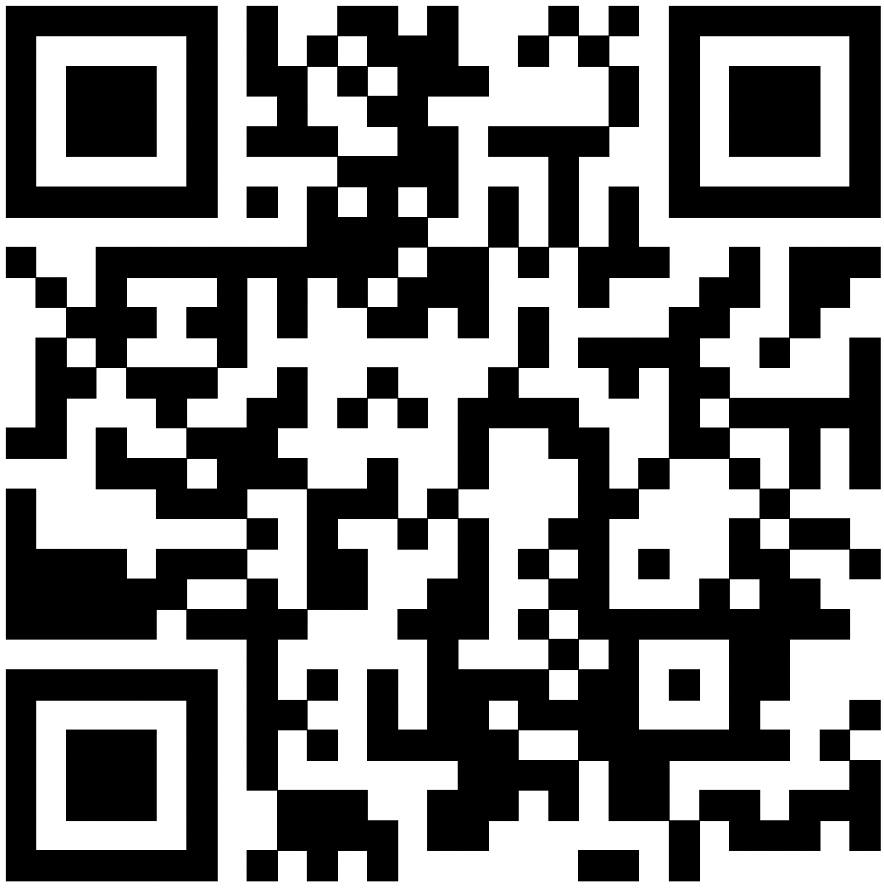
Evaluation Form
Link: https://lms.mghcme.org/BuildingSolutions

Slide 57
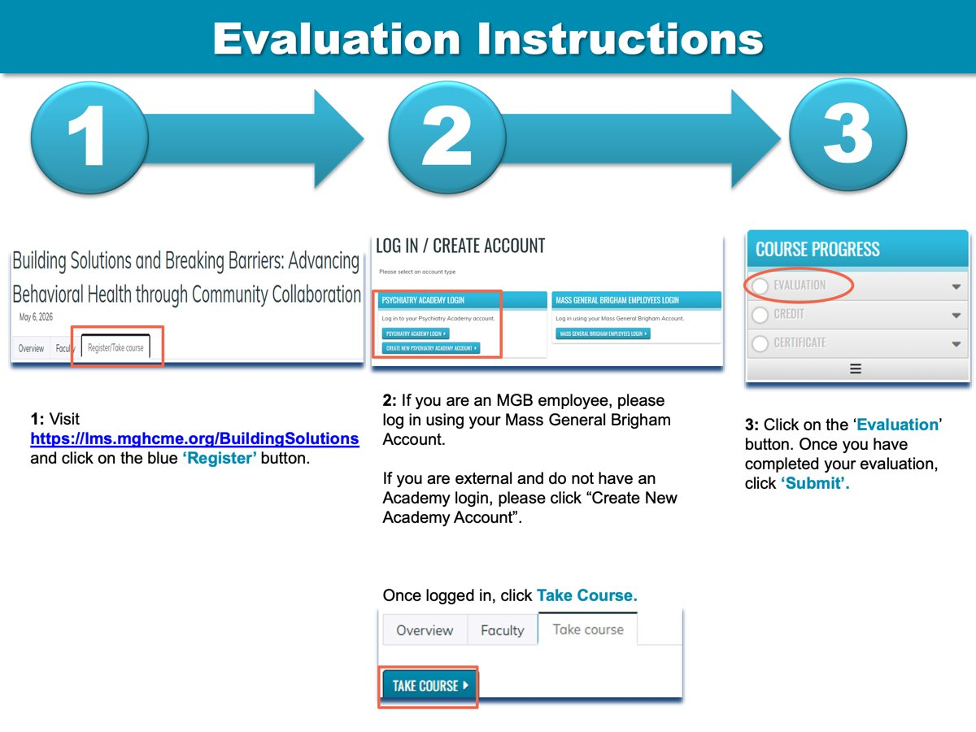
Evaluation instructions

Slide 58

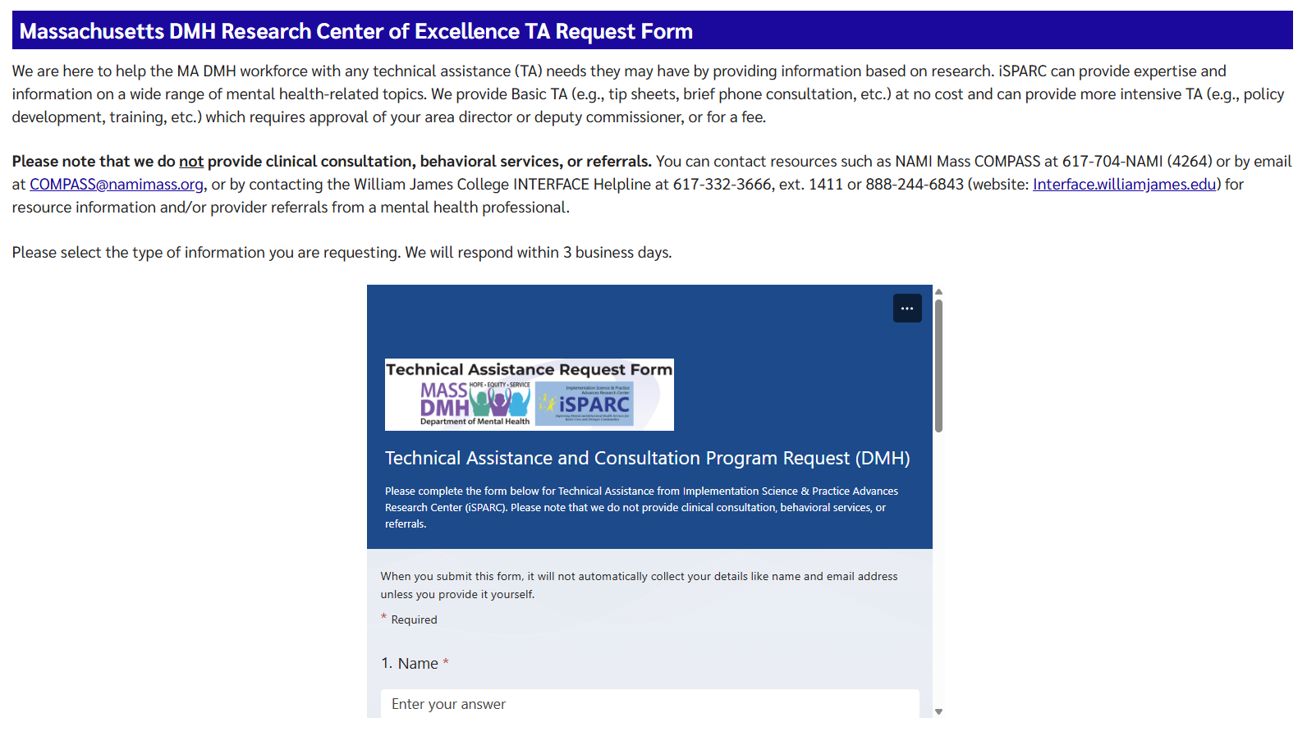
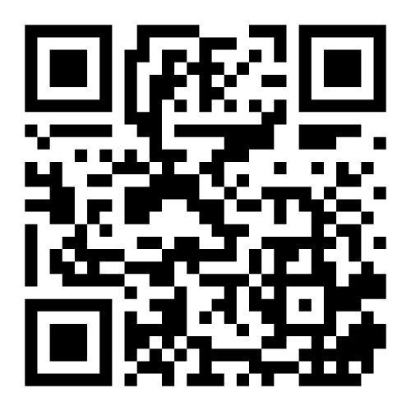
iSPARC Technical Assistance Program www.umassmed.edu/sparc/sparc-ta/

Slide 59
Thank you for attending!

