Slide 1
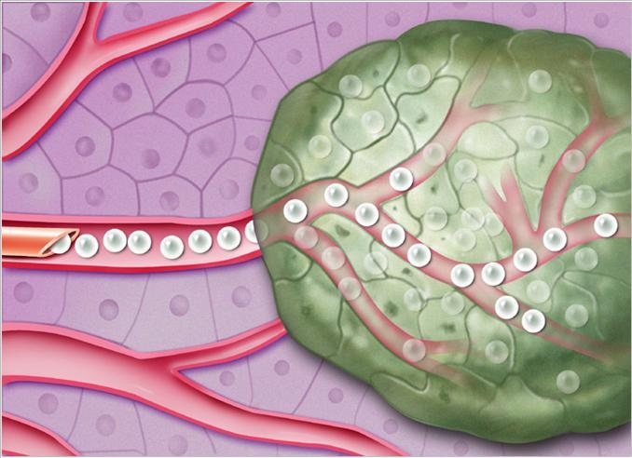
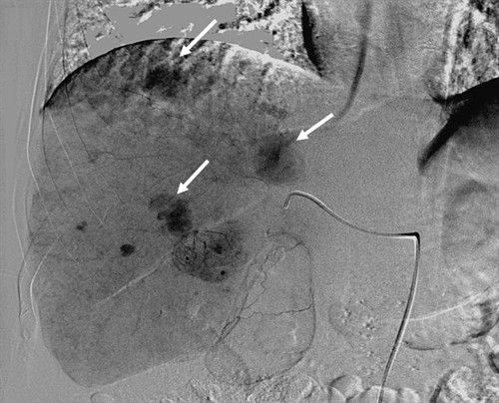
INTERVENTIONAL RADIOLOGY TREATMENTS:
UMass Memorial Healthcare
TACE: Trans-Arterial Chemo-Embolization
High dose chemotherapy is selectively administered via a catheter in the artery to the liver tumor. The chemotherapy targets the tumor while minimizing many side effects of traditional chemotherapy that is given to the whole body.
If necessary, TACE can be performed multiple times to achieve the desired response in the tumor.
SIRT: Selective Internal Radiation Therapy
Catheter-directed delivery of tiny radiation microspheres, which destroys the liver tumors without affecting other parts of your body.
CONCLUSIONS:
Interventional Radiology plays a major role in treating liver metastasis. Talk to your oncologist to discuss these options.
UMass Memorial has a Multidisciplinary Clinic where each patient with liver metastasis is discussed among experts in order to provide the best optimal treatment.
At the end of the treatment, the metastasis are filled with chemotherapy

