Slide 1

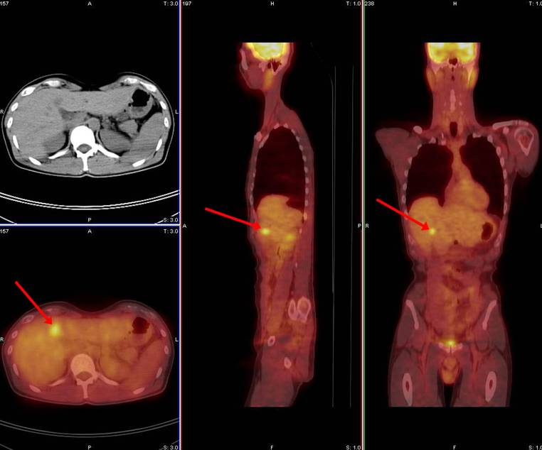
Vascular and Interventional Radiology
UMass Memorial Healthcare
Annually, greater than 130,000 Americans are diagnosed with colorectal cancer, and 50,000 die from this disease. Most have cancer spread (metastasis) to the liver.
The outlook for patients with liver metastasis in the absence of treatment is dismal. The median survival of such patients is only 6–9 months.
PET CT scan showing liver metastasis (red arrows)
Though surgical resection is curative, this is not an option for many at the time of diagnosis. When surgery is not an option, several minimally invasive treatment options are available to control metastases.
At UMass, patients with colorectal metastasis are evaluated in a Multidisciplinary Clinic. Physician experts use a variety of treatment approaches, including Surgery, Interventional Radiology, Oncology and Radiation Therapy.
The Interventional Radiology team at UMass consists of expert board certified physicians with experience in minimally invasive treatments for metastases from colorectal cancer.

