Slide 1
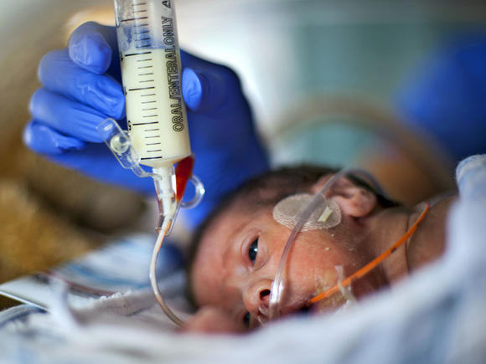
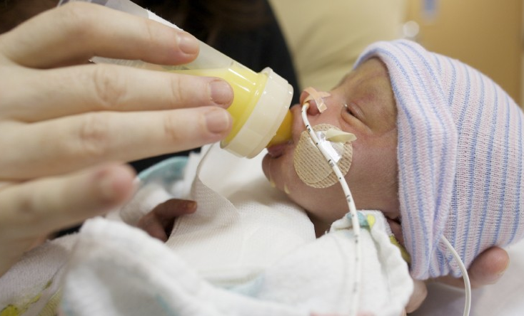
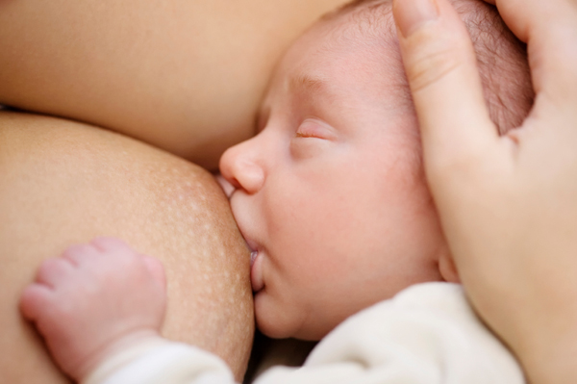
Neonatal Nutrition Overview
Susan Tripp, MS, RD, LDN, CNSC
UMass Memorial Medical Center

Slide 2
Objectives
Summarize nutritional challenges in prematurity
Describe neonatal growth patterns
Review nutritional needs of premature infants
Provide guidelines for parenteral and enteral nutrition in the NICU
Discuss vitamin and mineral supplementation for premature infants
BONUS: Examples of fluid and feeding calculations in the NICU

Slide 3

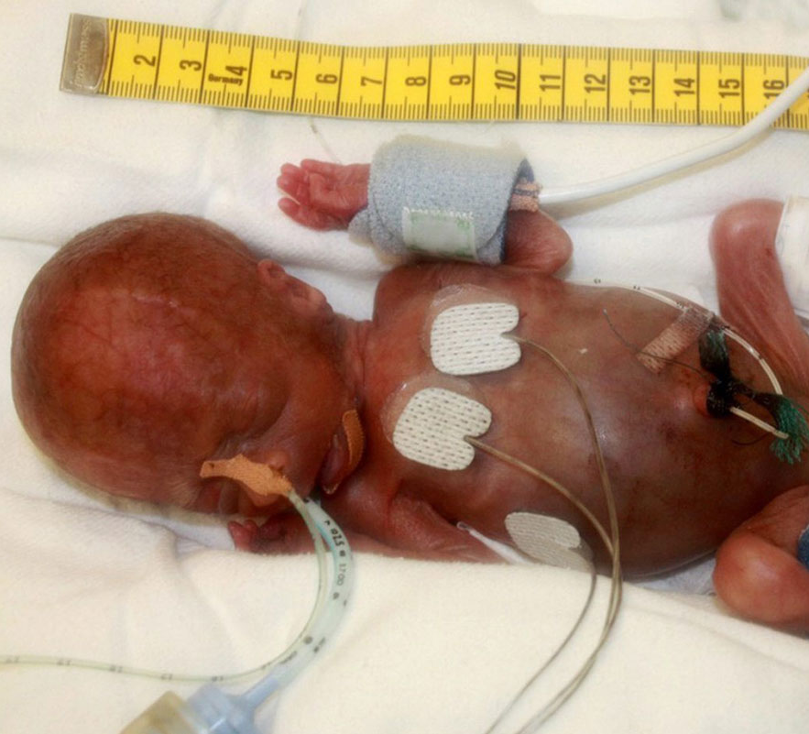
“The goal of nutritional management in VLBW infants is the achievement of postnatal growth at a rate that approximates the intrauterine growth of a normal fetus at the same post conceptual age”
AAP Committee on Nutrition

Slide 4
Goals of Nutritional Management
Mimic in utero growth and development
Optimize body composition
Prevent nutritional deficiency or excess
Establish/support healthy microbiome
Minimize/avoid complications of prematurity
Improve neurodevelopmental outcomes

Slide 5
Nutritional Challenges in Prematurity
Increased complications of prematurity:
BPD
ROP
Limited nutrient reserves and/or nutrient deficiencies
Management of critical illness
Inadequate nutrition
Growth failure
Immature organ function
Poor neurologic outcomes:
Cognitive delay
Behavior problems
Cerebral Palsy
Increased nutritional demands

Slide 6
Infant growth is a key indicator of nutritional adequacy
 | Preterm Infants | Term Infants
Growth chart for tracking | Fenton Fetal Infant Growth Chart | WHO Growth Chart
Weight loss from birth | 5-15% | 7-10%
Time to regain birth weight | 10-14 days | 7-10 days
Growth Goals:
Weight | Variable based on gestational age, weight, and gender 24-26 wks 7-21 g/d 26-28 wks 8-26 g/d 28-30 wks 12-33 g/d 30-32 wks 20-38 g/d 32-34 wks 28-38 g/d 34-36 wks 32-34 g/d 36-38 wks 25-31 g/d | Variable based on age, weight, and gender 0 – 1 mo 27-43 g/d 1 – 2 mo 27-40 g/d 2 – 3 mo 21-29 g/d 3 – 4 mo 17-23 g/d 4 – 5 mo 14-18 g/d
Length | 0.8-1.1 cm/wk | 0.8-0.9 cm/wk
Head Circumference | 0.8-1 cm/wk | 0.4-0.5 cm/wk

Slide 7
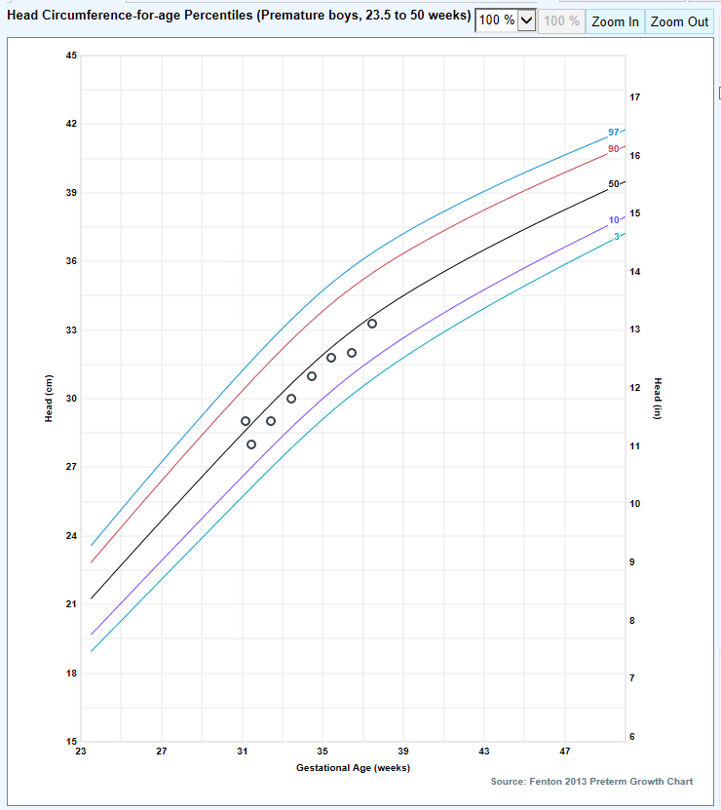
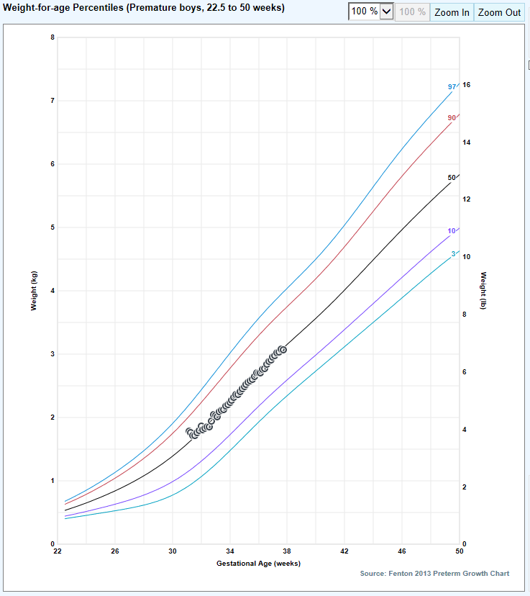
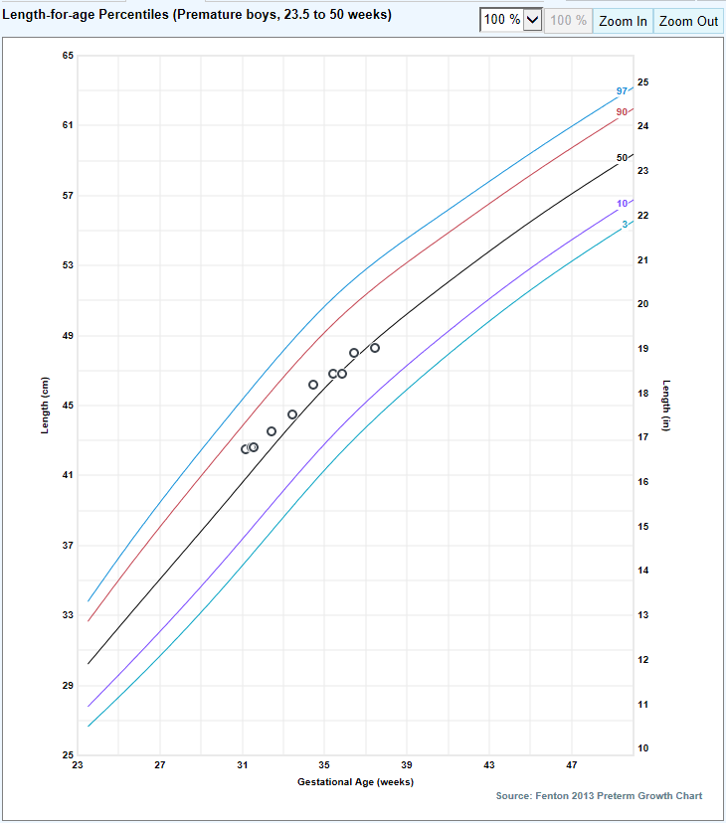
Fenton Fetal Infant Growth Chart

Slide 8
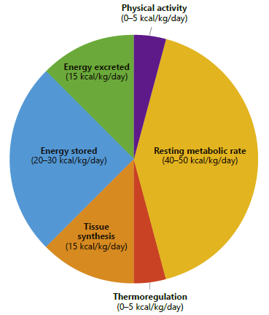
Energy Requirements for Preterm Infants
Figure from: Nutritional Care of Preterm Infants: Scientific Basis and Practical Guidelines, 2nd Ed. (2021)
Factors increasing energy needs
Critical illness
Increased respiratory demands
Environmental stress
Medications (caffeine, steroids)
Physical Activity
Malabsorption
Parenteral requirements ~20-30% lower
Should be individualized based on clinical status and growth
= 90-120 kcal/kg/day

Slide 9
Enteral Nutrient Requirements
Nutrient | Preterm VLBW | RDA/AI (Term) 0-6 mo.
Energy | 110-130 kcal/kg | 90-120 kcal/kg
Protein | 3.5-4.5 g/kg | 1.5 g/kg
Carbohydrate | 11-13 g/kg | 60 g/d
Fat | 4.6-8.1 g/kg | 31 g/d
Vitamin D | 400-1000 IU/d | 400 IU/d
Iron | 2-3 mg/kg | 0.27 mg/d
Calcium | 120-220 mg/kg | 200 mg/d
Phosphorus | 70-120 mg/kg | 100 mg/d

Slide 10
Fluid Needs
Initial Phase
Baseline Fluid Needs:
Transitional Phase
Gradual liberalization of fluids
Growth Phase
Goal volume to support hydration and growth
<1 kg: 80-120 ml/kg/d
1-1.5 kg: 70-90 ml/kg/d
> 1.5 kg: 60-80 ml/kg/d
Advance by 20 ml/kg/d
160 ml/kg/d
Monitoring:
Normal Urine Output: 1-2 ml/kg/hr
Overhydration : early weight gain, edema, hyponatremia
Underhydration: excessive postnatal weight loss, hypernatremia, elevated BUN, sunken fontanelle

Slide 11
Talking About Fluids in the NICU
Total Fluids = amount of fluid baby is getting from all sources (IV and enteral). Reported in ml/kg/d.
Calculate using birth weight until the infant has surpassed birth weight, then use actual weight
Tip: Helpful to present both the absolute amount and the per kilo amount when discussing your plan in rounds
Ex: The baby’s D10 is running at 2.5 ml/hr which is 75 ml/kg/d
The feedings are at 10 ml q 3 hours which is 100 ml/kg/d

Slide 12
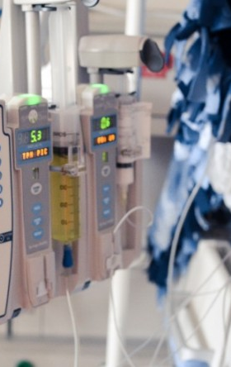
Parenteral Nutrition
Indications for parenteral nutrition in the NICU
Prematurity
<32 weeks or < 1500 grams
Necrotizing enterocolitis (NEC) or spontaneous intestinal perforation (SIP)
Congenital GI anomalies requiring surgical repair
Gastroschisis, omphalocele, bowel obstruction/atresia
Delayed initiation or advancement of enteral feedings
Syndromes or medications associated with impaired GI perfusion
Malabsorption syndromes

Slide 13
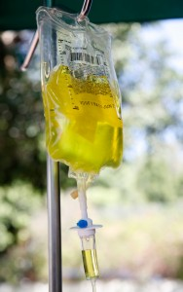
Components of a PN solution
Parenteral Nutrition (PN)
Dextrose and Amino Acid
Electrolytes
Vitamins and Minerals
Trace Elements
Other additives
Heparin
L-cysteine
Lipids (SMOF)
4 oil blend (Soy, MCT, Olive, Fish)
Provided as a separate infusion over 24 hours
Each gram of fat = 5 ml of SMOF

Slide 14
Glucose Infusion Rate (GIR)
Tells you how much carbohydrate (dextrose) you are giving a baby in mg/kg/min
Important calculation for babies who are hypo/hyperglycemic (even if not on TPN)
Need to know % dextrose of fluid, infusion rate, and baby’s weight
Calculation methods:
Method | Example Calculation
GIR = ml/kg/d x % dex 144 | What is the GIR for a baby getting 60 ml/kg/d of 10% dextrose? GIR = 60 x 10 ÷ 144 GIR = 4.2 mg/kg/min
GIR = % dex x rate (ml/hr) weight (kg) x 6 | Calculate the GIR provided by 10% dextrose running at 2.4 ml/hr in an 800-gram baby GIR = (10 x 2.4 ml/hr ) ÷ (0.8 x 6) GIR = 5 mg/kg/min

Slide 15
PN composition dependent on access
 | Central Line (central UVC, PICC) | Peripheral Line (low lying UVC, PIV)
Duration | Long term use | Short term use
Osmolarity | No maximum | Proceed w/ caution: > 900 mOsm/L Absolute maximum: 1250 mOsm/L
Dextrose | 25% | 12.5%
Calcium Gluconate | 10 mg / 1 ml | 3 mg / 1 ml (consider risk vs. benefit)
Heparin | 1 unit / 1 ml | None (unless low lying UVC or central access anticipated)

Slide 16
Stock/Premix Neonatal PN solution
Available 24 hours a day
Can be infused via peripheral or central line
Run at 60 ml/kg/d
May need to piggyback IV dextrose to bring total fluids to goal
Contents | At 60 ml/kg/d provides:
10% dextrose | GIR: 4.2 mg/kg/min
5% amino acid | 3 g/kg protein
Heparin (1 unit/ 1 ml)

Slide 17
Initiation and Advancement of Neonatal TPN
Nutrient | Initiate | Goal/Maintenance | Additional Notes
Dextrose | 4-6 mg/kg/min | 10-12 mg/kg/min | Advance by 1-2 mg/kg/min daily if blood glucose 80-120 mg/dL
Protein | 3 g/kg/d | Preterm Infants: 3-3.5 g/kg/d Term Infants: 2.5-3 g/kg/d | Advance cautiously in infants with IUGR/refeeding syndrome
Fat (SMOF) | Start with custom PN Infants < 1 kg or SGA: 1 g/kg/d Infants > 1 kg and AGA: 2 g/kg/d | 3 g/kg/d | Advance by 1 g/kg daily if TG < 250 mg/dL
Sodium | 0-2 mEq/kg/d | 3-5 mEq/kg/d | Extremely preterm infants may require > 5 mEq/kg/d
Potassium | 0-2 mEq/kg/d | 2-4 mEq/kg/d | Usually given as KPhos in balance with Calcium
Calcium | 0-450 mg/kg/d | Preterm Infants: 600-1000 mg/kg/d Term Infants: 400-800 mg/kg/d | Standard ratio 450 mg Ca Gluc:1 mmol Phos
Phosphorus | 0-1 mmol/kg/d | Preterm Infants: 1.3-2.2 mmol/kg/d Term Infants: 0.9-1.8 mmol/kg/d | If Phos < 4 mg/dL, use 350 mg CaGluc:1 mmol Phos
Chloride/Acetate | Adjust based on acid/base status. Preterm infants tend to be acidotic.

Slide 18

NICU TPN Tips
Mon-Fri: NICU RD will pend TPN orders in Epic, orders reviewed and signed in rounds
Sat/Sun/Holidays: NNPs/PAs & Fellows will assist w/ PN orders
Nutrition notes on Fridays include recommendations for weekend PN orders
PN orders must be in by 12 pm!
New bags are hung at 5 pm
Monitor BMP, Mg, Phos daily until stable on PN, then 1-2x/week
Monitor TG daily until at goal lipid dose (3 g/kg/d)
Monitor Dbili every 1-2 weeks on long term TPN

Slide 19
Enteral Nutrition
Few absolute contraindications to using the GI tract
Preterm infants benefit from early enteral nutrition
Prevents villous atrophy
Promotes neurologic and physiologic gut maturity
Supports a favorable intestinal microbiome
Potential decrease in systemic inflammation and neonatal comorbidities
Limited consensus in literature to guide advancement and fortification of enteral feeding
Standardized feeding protocols associated with improved nutritional outcomes

Slide 20
UMass NICU Enteral Feeding Guidelines
Gestational Age | 23 0/7 – 24 6/7 weeks | 25 0/7 – 27 6/7 weeks | 28 0/7 – 31 6/7 weeks | 32 0/7 – 34 6/7 weeks
IV access and PN at birth ª | UVC at birth for PN | UVC at birth for PN | <1500 g: UVC at birth for PN ≥1500 g: UVC or PIV based on clinical status, should get PN | PN recommended for infants <1500 g or if prolonged NPO anticipated
Total fluid initiation, advancement and goal | 100 ml/kg/d Advance 20 ml/kg daily to goal of 160 ml/kg/d | 90 ml/kg/d Advance 20 ml/kg daily to goal of 160 ml/kg/d | 80 ml/kg/d Advance 20 ml/kg daily to goal of 160 ml/kg/d | 80 ml/kg/d Advance 20 ml/kg daily to goal of 160 ml/kg/d
What to feed | MBM or Donor Breast Milk | MBM or Donor Breast Milk | MBM or Donor Breast Milk | If ≤1800 g or < 34 0/7 weeks MBM or Donor Breast Milk If >1800 g and 34-37 weeks, MBM or Neosure formula
Start feedings on DOL#0 at ^{b} | 10 ml/kg/d | 10 ml/kg/d | 20 ml/kg/d | 20-30 ml/kg/d ^{c}
Feeding advance timing, volume and goal | 10 ml/kg BID ordered on DOL#1 to goal of 160 ml/kg/d | 10 ml/kg BID ordered on DOL#1 to goal of 160 ml/kg/d | 10 ml/kg BID ordered when feeds initiated to goal of 160 ml/kg/d | 15-20 ml/kg ^{c} BID ordered when feeds initiated to goal of 160 ml/kg/d
Volume or DOL to increase calories | Increase to 24 kcal/oz at 80 ml/kg/d and continue feeding advances as ordered ^{d} | Increase to 24 kcal/oz at 80 ml/kg/d and continue feeding advances as ordered ^{d} | Increase to 24 kcal/oz at 80 ml/kg/d and continue feeding advances as ordered ^{d} | Increase to 24 kcal/oz on DOL#3 if indicated ^{e} and continue feeding advances as ordered If <34 weeks, use HMF If ≥34 weeks, use Neosure powder
Enteral volume to discontinue PN/IV fluids ^{f} | 120 ml/kg | 120 ml/kg | 120 ml/kg | 100-120 ml/kg ^{g}
When to start Vitamin D | 48 hours after reaching full feedings | 48 hours after reaching full feedings | 48 hours after reaching full feedings | 48 hours after reaching full feedings
Vitamin D dosing | 400 IU/d (dose divided q 12 hr) | 400 IU/d (dose divided q 12 hr) | 400 IU/d (dose divided q 12 hr) | 400 IU/d (divided q 12 hrs if < 1500 g)
When to start Ferinsol | At 2 weeks of age and 24-48 hours after Vitamin D started | At 2 weeks of age and 24-48 hours after Vitamin D started | At 2 weeks of age and 24-48 hours after Vitamin D started | At 2 weeks of age and 24-48 hours after Vitamin D started
Ferinsol dosing | 3 mg/kg/d (dose divided q 12 hrs) | 3 mg/kg/d (dose divided q 12 hrs) | 3 mg/kg/d (dose divided q 12 hrs) | 3 mg/kg/d if on exclusive human milk 2 mg/kg/d if mixed human milk/formula No supplementation if on full formula
Nutrition laboratory monitoring ^{i} | Na, Cl, Ca, Phos, Alk Phos, Hct q 2 weeks (include Retic after 1 month of age) | Na, Cl, Ca, Phos, Alk Phos, Hct q 2 weeks (include Retic after 1 month of age) | Na, Cl, Ca, Phos, Alk Phos, Hct q 2 weeks (include Retic after 1 month of age) | If <34 weeks, Na, Cl, Ca, Phos, Alk Phos, Hct q 2 weeks (include Retic after 1 month of age)
Growth Failure QI protocol | Initiate once corrected to 31 0/7 weeks, increase goal to 170 ml/kg/d, maintain until 34 0/7 weeks | Initiate once corrected to 31 0/7 weeks, increase goal to 170 ml/kg/d, maintain until 34 0/7 weeks | Initiate once corrected to 31 0/7 weeks AND tolerating feedings of 160 ml/kg/d x 48 hours, increase goal to 170 ml/kg/d, maintain until 34 0/7 weeks | For babies = 32 0/7 weeks at birth, initiate once tolerating feedings of 160 ml/kg/d x 48 hours, increase goal to 170 ml/kg/d, maintain until 34 0/7 weeks

Slide 21
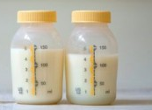
Human Milk
Mom’s breast milk (MBM)
Preferred feeding choice for all babies with few exceptions
Numerous bioactive components with immune-protective effects
Improved GI tolerance and digestibility
Improved outcomes for preterm infants:
Decreased late onset sepsis and NEC
Protection against chronic lung disease
Improved neurodevelopmental outcomes
Most infants < 1800 grams or < 34 weeks will require fortification of MBM
Nutrition Facts
Assumed Calorie Content: 20 kcal/oz
Average Protein Content: 0.9-1.2 grams / 100 ml
Inadequate amounts of protein, vitamin D, calcium, phosphorus and sodium for VLBW infants

Slide 22
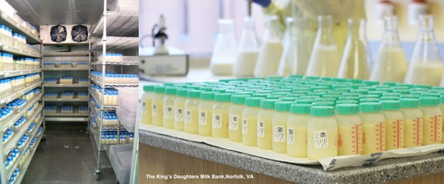
Human Milk
Donor/Bank Breast Milk (DBM/BBM)
Tested, pooled and pasteurized human milk from unpaid donors
Pasteurization reduces levels of antioxidants, growth factors and anti-infectious compounds
Lower caloric density and protein content as compared to Mom’s own milk
Donor Breast Milk Policy for UMass NICU
Offered to all infants <1800 grams at birth OR < 34 weeks gestational age at birth
For multiples, if one infant qualifies, the other infant(s) offered donor breast milk
Transition off once ≥ 34 weeks, > 1800 g, AND tolerating feedings at 160 ml/kg/d x 48 hours
May consider earlier transition off at discretion of NICU team
Transition to formula over a 2-4 day period
Nutrition Facts
Assumed Calorie Content: 20 kcal/oz (but possibly less)
Average Protein Content: 0.9 grams / 100 ml

Slide 23
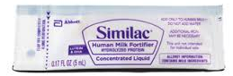
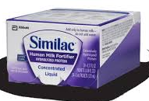
Human Milk Supplements
Human Milk Fortifier (“Supps”)
Used to increase the calories, protein, vitamins and mineral in breast milk for preterm infants
Bovine (cow’s milk) based, hydrolyzed protein
Recommended for infants < 1800 grams and <34 weeks
Each packet add 1 kcal/oz to 100 ml of MBM
Standard dose is 4 packets/100 ml (24 kcal/oz breast milk), but can go to a maximum of 5 packets/100 ml (25 kcal/oz) if poor growth
Nutrition Facts (MBM + 4 packets/100 ml):
Calorie Content: 24 kcal/oz
Protein Content: 2.5 grams / 100 ml

Slide 24
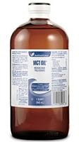
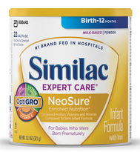
Other Human Milk Supplements
MCT Oil
Medium chain triglyceride oil
Does not increase osmolality of feeding
Does not require bile salts for absorption
Adds fat calories only
1 ml MCT/100 ml adds 2 kcal/oz
Formula Powder
Can be used as a breast milk fortifier in late preterm or term infants
Do not provide as much protein and minerals as HMF, so not appropriate for VLBW infants
½ tsp/100 ml adds 2 kcal/oz
1 tsp/100 ml adds 4 kcal/oz

Slide 25
Formula Options
 | Premature | Premature Discharge | Standard | Low Lactose | Partially Hydrolyzed | Extensively Hydrolyzed | Elemental | Pre-thickened
UMass Preferred Product | Special Care (High Protein) | Neosure | Similac 360 Total Care or Similac Advance | Similac Sensitive | Similac Total Comfort | Alimentum | Elecare or Neocate | Enfamil AR
Standard Concentration(s) | 20, 24, 30 kcal/oz | 22 kcal/oz | 20 kcal/oz | 20 kcal/oz | 20 kcal/oz | 20 kcal/oz | 20 kcal/oz | 20 kcal/oz
Protein (g)/100 cal | 3 (3.3) | 2.8 | 2.1 | 2.1 | 2.3 | 2.8 | 2.8-3.1 | 2.5
Protein (whey:casein) | Intact (60:40) | Intact (50:50) | Intact (50:50) | Intact (20:80) | Partially Hydrolyzed (100:0) | Extensively Hydrolyzed (0:100) | Free Amino Acids | Intact
Ca (mg)/100 cal | 180 | 105 | 78 | 84 | 105 | 105 | 116 | 78
Phos (mg)/100 cal | 100 | 62 | 42 | 56 | 75 | 75 | 84 | 53
Format (ready to feed, powder) | RTF | RTF, P | RTF, P | RTF, P | RTF, P | RTF, P | P | P
Additional Notes | Use if < 34 wks Only available in hospital | Use if 34-37 wks |  |  | Best for general feeding intolerance (not preterm!) | For milk or soy protein allergy | For severe allergy or malabsorption | Thickened for reflux or dysphagia
Alternative Products: | Enfamil Premature | Enfacare | Enfamil Neuropro Good Start Gentle | Enfamil Sensitive Good Start SoothePro | Gentlease | Nutramigen | Gerber Extensive HA, PurAmino, | none

Slide 26
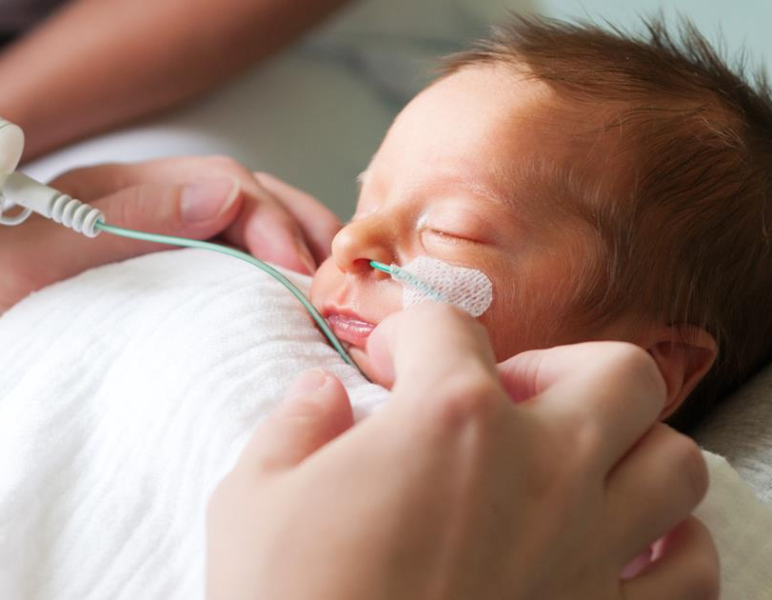
Tube Feeding Preterm Infants
Gastric, bolus feedings preferred
Stimulates greater hormonal response
Shorter infusion time reduces fat loss from feedings
Insufficient evidence to guide preferred interval (q 3 hrs vs. q 2 hrs)
Continuous or post-pyloric feedings may be used
Persistent hypoglycemia
Severe spells associated with feedings (used rarely)

Slide 27
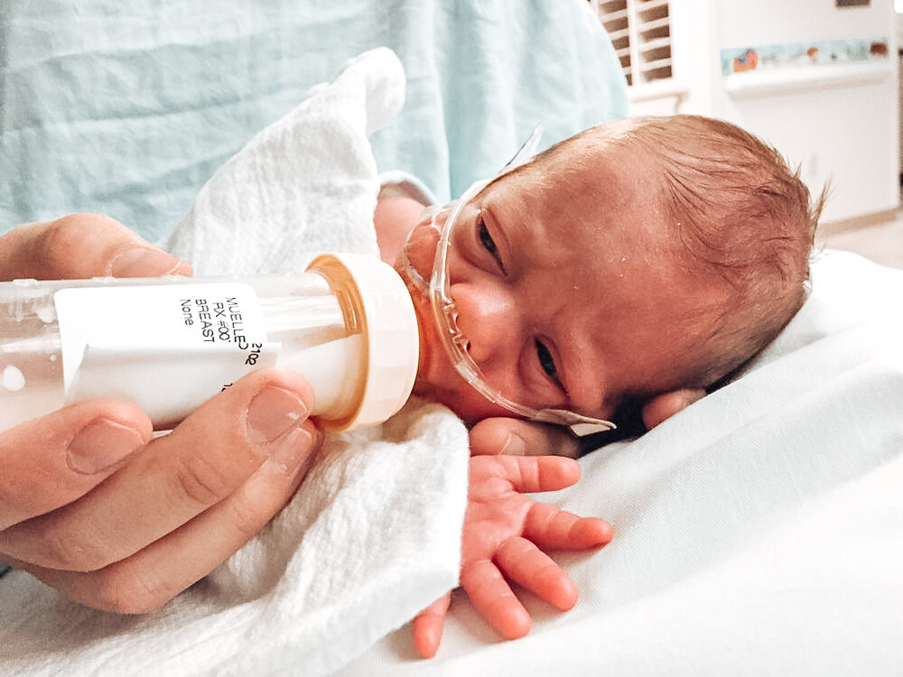
Oral Feeding for Preterm Infants
Coordination of suck-swallow-breathe does not occur until ~34 weeks
Prior to 34 weeks, write for PG (per gavage) feeds
After 34 weeks, can write for PO feedings
Cue based feeding algorithm helps guide nurse in assessing oral feeding readiness
Non-nutritive breastfeeding is a great way for babies to “practice” oral feeding before 34 weeks

Slide 28

Monitoring of Enteral Nutrition
Intake and Output
Tolerance
Growth
Laboratory Monitoring – every 2 weeks until ≥ 34 weeks and stable
Sodium (consider checking sooner if ELBW)
Chloride
Calcium
Phosphorus
Alkaline Phosphatase
Hematocrit
Retic

Slide 29
Vitamin and Mineral Needs in Preterm Infants
Recommended Vitamin and Mineral Intake Compared to Common Feeding Mixtures
 | Enterally fed VLBW* | MBM24 (HMF) @ 160 ml/kg/d | Special Care 24 kcal/oz @ 160 ml/kg/d
 | (amt per kg/d) | (amt per kg/d) | (amt per kg/d)
Iron (mg) | 1-3 | 0.63 | 2.3
Zinc (mg) | 2-3 | 1.81 | 1.95
Vitamin A (IU) | 1332-3330 | 1351 | 1623
Vitamin D (IU) | 400-1000 IU/d | 190 | 195
Vitamin E (IU) | 3.3-16.4 | 5.8 | 5.2
Vitamin K (mcg) | 4.4-28 | 13.1 | 15.6
Thiamin (mcg) | 132-275 | 284 | 325
Riboflavin (mcg) | 200-430 | 441 | 805
Niacin (mg) | 1.1-5.5 | 5.4 | 6.5
Vitamin B6 (mcg) | 66-275 | 294 | 325
Folic Acid (mcg) | 22-100 | 43.6 | 48.0
Vitamin B12 (mcg) | 0.12-0.6 | 0.75 | 0.71
Vitamin C (mg) | 16.5-41 | 46.5 | 54.5
Pantothenic Acid (mg) | 0.6-2.1 | 1.9 | 2.5
Biotin (mcg) | 3.3-15 | 31.4 | 48
*Koletzko B, et al. Recommended nutrient intake levels for preterm infants. In Koletzko B, Cheah F-C, Domellof M, Poindexter BB, Vain N, van Goudoever JB (eds): Nutritional Care of Preterm Infants. Scientific Basis and Practical Guidelines. World Rev Nutr Diet. Basel, Karger, 2021, vol 122, pp 191–197

Slide 30
Vitamin and Mineral Supplementation
Cholecalciferol (Vitamin D3)
400 IU provided to ALL infants
≥ 1500 grams: 400 IU once daily
In full-term, formula fed infants, can d/c once taking > 1 L per day of formula
Ferinsol (Iron Supplement)
2-3 mg/kg/d for all preterm infants
Exclusive human milk: 3 mg/kg/d
Mixed human milk/formula: 2 mg/kg/d
Exclusive formula: no iron required
Divide dose q 12h for infants < 1500 grams
Dose based on feeding type:
< 1500 grams: 200 IU q 12 hrs

Slide 31

Recommended Resources
Fenton TR, et al. “Extrauterine growth restriction” and “postnatal growth failure” are misnomers for preterm infants. J. Perinatol. 2020 May; 40(5): 704-714.
Groh-Wargo S, Barr SM. Parenteral Nutrition. Clin Perinatol. 2022 Jun; 49(2):355-379.
Kwok TC, Dorling J, Gale C. Early enteral feeding in preterm infants. Semin Perinatol. 2-19 Noc; 43)7): 151-159.
Nutritional Care of Preterm Infants: Scientific Basis and Practical Guidelines, 2nd Ed. B. Koletzko, F. Cheah, M. Domellöf, B. Poindexter, N. Vain, J van Goudoever (editors). 2021.
Pereira-da-Silva L, Virella D, Fusch C. Nutritional Assessment in Preterm Infants: A Practical Approach in the NICU. Nutrients. 2019 Aug 23; 11 (9): 1999.
Pocket Guide to Neonatal Nutrition, 2nd Ed, Groh-Wargo S, Thompson M, Hovasi Cox J (Eds), Academy of Nutrition and Dietetics, Chicago, IL, 2016.

Slide 32
Feeding and Fluid Calculations

Slide 33
Calculating Total Fluids
Example: Calculate the total fluids for a 25 0/7 wk, 800 gram baby getting the following:
PN: 2 ml/hr x 24 hrs 48 ml/d ÷ 0.8 kg = 60 ml/kg/d
SMOF (1 g/kg): 0.17 ml/hr x 24 hrs 4 ml/d ÷ 0.8 kg = 5 ml/kg/d
0.45% NaAce: 0.5 ml/hr x 24 hrs 12 ml/d ÷ 0.8 kg = 15 ml/kg/d
MBM: 2 ml q 3 hrs 16 ml/d ÷ 0.8 kg = 20 ml/kg/d
TOTAL FLUIDS = 100 ml/kg/d

Slide 34
Calculating Total Fluids
Example: The baby from the previous example (25 0/7 wk, 800 grams) is doing well and the plan discussed in rounds is to d/c the fluid infusing through the second UVC port, start a feeding advance of 10 ml/kg BID, increase SMOFLipid to 2 g/kg/d (10 ml/kg) and increase total fluids to 120 ml/kg/d with tonight’s TPN order. At what rate should you order the TPN?
 | Total Fluid = 100 ml/kg/d | Total Fluid = 120 ml/kg/d
PN: 2 ml/hr | 60 ml/kg/d | ?
SMOF (1 g/kg/d): 0.17 ml/hr | 5 ml/kg/d | 10 ml/kg/d
0.45% NaAcetate: 0.5 ml/hr | 15 ml/kg/d | 0 ml/kg/d
MBM: 2 ml q 3 hrs | 20 ml/kg/d | 30 ml/kg/d
Fluid remaining for TPN = 80 ml/kg/d
80 ml/kg/d x 0.8 kg = 64 ml/d ÷ 24 hours = 2.666 ml/hr
Tonight’s TPN order should be written for 2.7 ml/hr

Slide 35
Feeding & Fluid Calculations
Trophic feedings: Refer to guidelines for amount (10-20 ml/kg/d)
ml/kg/d x body weight in kg = ml per day of feeds
Divide by the # of times you are feedings each day (usually q 3 hours)
8 times per day if feeding q 3 hours
6 times per day if feeding q 4 hours
Round up or down to the nearest whole number
Can use 0.5 ml increments for smaller babies
Example: Calculate the trophic feeding order for a 25 0/7 wk baby (BW: 800 grams)
10 ml/kg/d x 0.8 kg = 8 ml per day
8 ml/d ÷ 8 feedings per day = 1 ml q 3 hours

Slide 36
Feeding & Fluid Calculations
Calculating feeding advances
Refer to guidelines for how quickly to advance
ml/kg x body weight in kg = ml per day advance
Divide by the # of times you are feeding each day
Round up or down to the nearest whole number
Example: Calculate the feeding advance for a for a 25 0/7 wk baby (BW: 800 grams)
Enteral guidelines are for a 10 ml/kg BID advance
10 ml/kg x 0.8 kg = 8 ml
8 ml/d ÷ 8 feedings per day = 1 ml increase in feed volume
Advance would be 1 ml BID (we generally write 1 ml q 12 hrs)

Slide 37
Feeding & Fluid Calculations
Then determine your max: use 160 ml/kg/d
160 ml/kg/d x body weight in kg = ml per day of feeds
Divide by the # of times you are feeding each day
Round up or down to the nearest whole number
Example: Calculate the feeding max for a 25 0/7 wk baby (BW: 800 grams)
160 ml/kg/d x 0.8 kg = 128 ml per day
128 ml/d ÷ 8 feedings per day = 16 ml q 3 hours
Complete feeding advance order would be : “Advance feeds 1 ml q 12 hrs to a max of 16 ml q 3 hrs”

Slide 38
Feeding & Fluid Calculations
Calculating IV fluid/TPN rate decrease
ml/kg decrease x body weight in kg = total ml decrease
Divide by 24 to convert to an hourly rate to subtract from IV fluid
Round up or down to the nearest 10th
Example: Calculate the TPN decrease for a 25 0/7 wk baby (BW: 800 grams) to keep total fluids stable. Feeds are advancing 1 ml q 12 hours (10 ml/kg BID)
10 ml/kg x 0.8 kg = 8 ml decrease
8 ml ÷ 24 hrs = 0.333 ml/hr
Decrease TPN by 0.3 ml/hr with each feeding advance
*Tip: If you want Total Fluids to advance by 20 ml/kg daily and feedings are advancing by 20 ml/kg BID, you can decrease IV fluids by 10 ml/kg with each advance

Slide 39
Feeding & Fluid Calculations
Example: Baby A is a 33 week, 2 kg infant. Calculate the admission feeding and IV fluid orders based on UMass NICU guidelines
Feedings
Initiation (20-30 ml/kg)
20 ml/kg/d x 2 kg = 40 ml per day
40 ml/d ÷ 8 feedings per day = 5 ml q 3 hrs
Advance (15-20 ml/kg BID)
20 ml/kg x 2 kg = 40 ml
40 ml ÷ 8 feedings per day = 5 ml increase in feed volume
Advance would be 5 ml BID (we generally write 5 ml q 12 hrs)
Goal (160 ml/kg/d)
160 ml/kg/d x 2 kg = 320 ml
320 ml/d ÷ 8 feedings per day = 40 ml q 3 hrs
Feeding Order: MBM or DBM (must obtain parent consent). Start at 5 ml q 3 hrs, increase by 5 ml q 12 hrs to max of 40 ml q 3 hrs

Slide 40
Feeding & Fluid Calculations
Example: Baby A is a 33 week, 2 kg infant. Calculate the admission feeding and IV fluid orders based on UMass NICU guidelines
IV fluids
Initiate
Total Fluids DOL#0 = 80 ml/kg/d - 20 ml/kg/d from feedings = 60 ml/kg/d from IV fluid
60 ml/kg/d x 2 kg = 120 ml per day
120 ml/d ÷ 24 hrs = 5 ml/hr
IV fluid Decrease
Feeds advancing by 20 ml/kg BID, but want total fluids to advance 20 ml/kg/d so can decrease IV fluids by 10 ml/kg with each advance
10 ml/kg x 2 kg = 20 ml decrease
20 ml ÷ 24 hrs = 0.83 ml/hr
Decrease IV fluids by 0.8 ml/hr with each feeding advance
IV Fluids (usually D10): Order at 60 ml/kg/d
Administration Instructions: Decrease by 0.8 ml/hr with each feeding increase

