Slide 1

PALS on One Page:
Five Physiologic States
Preceding
Pediatric Cardiac Arrest
Notes:
Good morning everyone. Welcome to Umass as you begin your residency training and welcome to the Pediatric Advanced Life Support Course.
I am MM, Ped EM physician at the CMC.
This lecture is about 20 minutes long and is a supplement to you course materioals, which I have title “PALS on One Page".
This will help you integrate important material, help you organize your approach to the skills stations but most importantly give you a meaningful and practical framework as you begin your careers in caring for ill and injured young children.

Slide 2
At the end of the course you should be able to:
Differentiate between patients who do and do not require immediate intervention
Differentiate between respiratory distress and failure
Differentiate between compensated and decompensated (hypotensive) shock
Recognize cardiopulmonary arrest early and begin CPR within 10 second
Perform high-quality Child CPR AED and Infant CPR
Perform early interventions for respiratory distress and failure
Apply team dynamics
Perform early interventions for the treatment of shock
Differentiate between unstable and stable patients with arrhythmias
Describe clinical characteristics of instability in patients with arrhythmias
Implement post–cardiac arrest management
Notes:
By the end of this session you should have an understanding of PALS concepts and vocabulary so that you will be able quickly differentiation between important clinical states – respiratory distress, respiratory failure, compensated and decompensated shock and cardiopulmonary failure.
Understanding each of these clinical entities will help you recognize them when they present at the bedside will drive your decision making in selecting correct and critical immediate interventions.

Slide 3
PALS
A structured approach to the initial assessment and early management of the sick, young child without a clear diagnosis.
Notes:
Why is this important to know? Because immediate resuscitation is the first piroity when confronted with a cyanotic, gasping and hypoperfused infant. The diagnosis – or etiology – of the condition and definitive treatment is ovviously important, but is secondary to recognizing and responding to the child’s physiologic state.

Slide 4
Less emphasis on Pediatric Arrest
Out of hospital Pediatric Cardiac Arrest
  Rare event
  Very poor outcome (overall 10% survival to hospital discharge)
  Little improvement in outcomes
  Infants < 1 year of age
  At home (86%)
  Unwitnessed (70%)
  Asystole or PEA (78%)
Notes:
The focus of PALS is early resuscitation in the clinical states that precede a complete cardiac arrest.
It is important to know that and OOH PCA is a very rare event, associated with very poor outcomes. Typically these occur in the home, in children less than one year of age, are unwitnessed and present with nonperfusing rythems (PEA and Asystole)

Slide 5
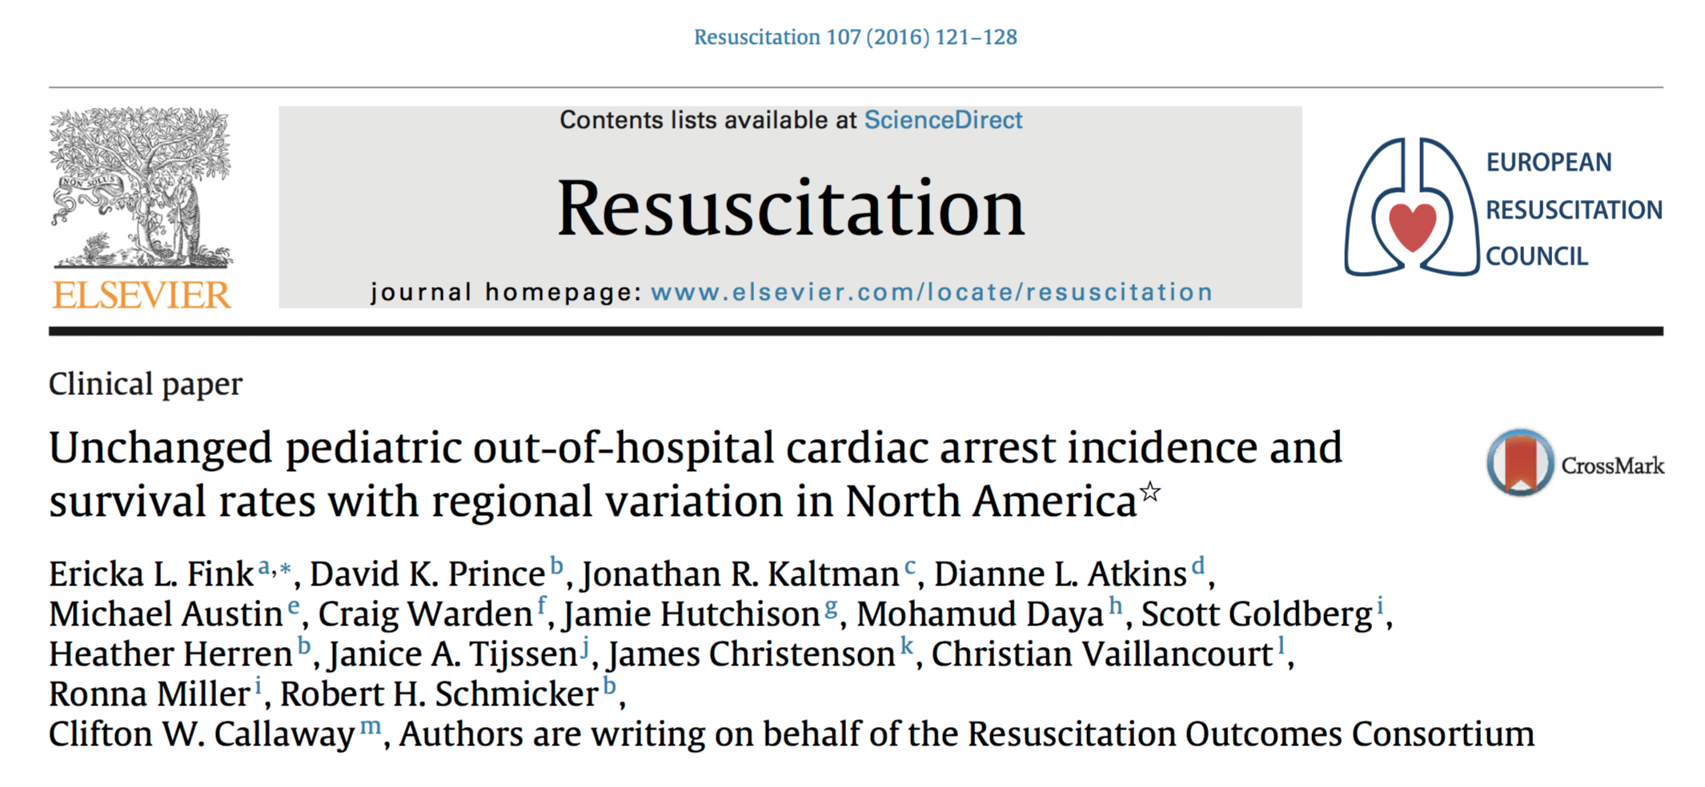
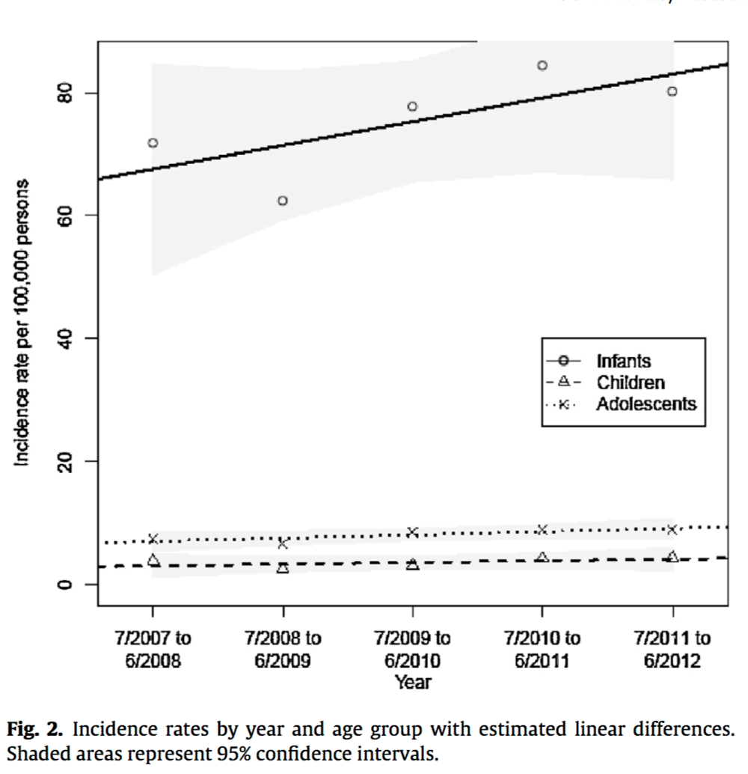
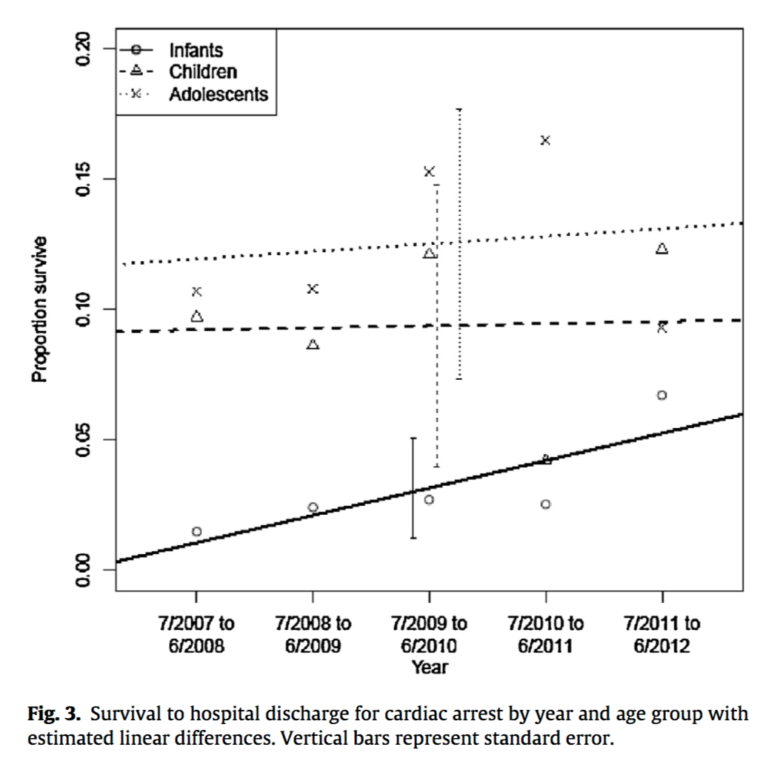
Infant
< 1 year ; 780
Adolescent
12 – 18 yr; 548
Child
1-11 yr; 410
Total 1,738 patients
Notes:
A paper published in 2016 describes the unchanged incidence and survival of children18 years or younger who sustained an OOH PCA between 2007 and 2012..
The graph on the left shows the incidence of of OOH arrest in infants, children and adolescents over time
The graph on the right show the percent of patients who survive an OOH arrest by age group and over time.
First look at infants – the blue circles. The greatest incidence of OOH arrest is in infants one year or less and their survival (range 2-0-5) is the lowest of all age groups.. Survival rates are in the range of 0 -5 %
Children 1-11 years (purple triangle) and adolescents 12-18 years (yellow cross) have lower incidences than infants and unchanged survival rates around 10%.

Slide 6
Five Physiologic States
Precede a Pediatric Cardiac Arrest
Rapid assessment →categorize:
  Respiratory distress
  Respiratory failure
  Compensated shock
  Decompensated shock
  Cardiopulmonary failure
  Don’t worry about the diagnosis
Notes:
Let’s get back to the physiologic states that precede an arrest.
In caring for a critically ill patient, you have two important immediate tasks:
The first is to perform a rapid cardiopulmonary assessment of the child’s general appearance, airway, work fo breathing
Second is identify the correct “category” or physiologic state using your assessment data.
For example, when you recognize that your patient is in respiratory failure, you will immediately begin BVM ventialation with oxygen.
Resusciation, not establishing the diagnosis is you immediate focus.

Slide 7
How?
Two useful questions:
  Is it a primary respiratory or circulatory problem?
  Is the patient compensated or decompensated?
Notes:
Many times the child’s physiologic state is easily determined.
An interactive child with increased work of breathing is in respiratory distress.
The assessment of the sicker patient is more challenging.
Two helpful questions when you are uncertain of the physiologic state are:
Is this primary resp or circ?
Is the patient in a comp or decomp state?

Slide 8
PALS on One Page
Broad Spectrum of Etiologies:
Asthma, Pneumonia, Bronchiolitis, SBS, CHI, Trauma, Drowning, Dehydration,
Sepsis, Cardiogenic shock, Croup, Upper airway infections, Airway FB….
Pediatric Cardiac Arrest

Slide 9
PALS on One Page
Many Etiologies
Respiratory distress

Slide 10
Respiratory Distress
Compensated state
Characterized by increased work of breathing
Adequate oxygenation (+/- O₂) and ventilation
6 month old, poor feeding, fast breathing for several days, getting worse
RR 70s, HR 200, Sat 88%
Marked retractions, Grunting slightly, Coarse BS
Awake. Moving all extremities. Pink and well perfused.

Slide 11
Signs of Respiratory Distress
Things you SEE:
  Mechanics:
    Tachypnea
    Increased effort – retractions, nasal flaring, head bobbing
  Poor color – dusky, pale
Things you HEAR (sometimes):
  Air movement (increased RR, decreased TV)
  Abnormal sounds (wheezing, stridor, grunting)
Notes:
Things that you seen and you hear in your pt will help you determine the severity of illness.
A pt who is hypoxic and in need of suppl O2 will appear dusky or pale.
You make an assessment of mechanics of breathing by looking at the child’s chest. You will notice the RR. Retractions, NF, HB are signs of incr effort and cannot be assessed w/o undressing and looking at chest.
Abnormal sounds can be helpful in assessing SOI as well as localizing pathology Wheezing suggests path in LRT; stridor suggests path in the trachea and UA.
Grunting is an involuntary reflex in infants. Premature closure of the glottis at the end of exhalation allows for the infant to an attempt to maintain FRC and prevent alveolar atelectasis. It is a concerning sign suggesting more severe distress.
You may hear nothing. At very high RR, and small TV, there may be little air movement.

Slide 12
PALS on One Page
Many Etiologies
Respiratory distress
Respiratory failure

Slide 13
Respiratory Failure
Decompensated state
Characterized by inadequate oxygenation and ventilation
  Extreme (prolonged) respiratory distress
  Hypoventilation, apnea
Assisted ventilation required
Airway
-- Clear
-- Maintainable
-- Unmaintainable
6 month old prolonged status epilepticus,
PTA large dose benzodiazepine
RR 10, HR 170, Sat 70%
Course upper airway breath sounds, secretions
Marked retractions, poor air movement, dusky
Apnea
-- Central
-- Obstructive
-- Mixed
Notes:
For example:
Why is she hypoventilating? Central. Obstructive. Mixed
How would you characterize her airway? Unobs, clear. You can maintain with straightforward maneuvers or requires intubation.
First steps:
open her airway and clear secreations
Do a jaw thrust as in a post ictal state, her tongue may be obstruction her airway.
Provide BVN ventilation.
If she is hypovent – the proceed to intubation to definitively treat unmaintainable airway.

Slide 14
Signs of Respiratory Failure
Extreme distress → Fatigue
Hypoventilation → Apnea
Poor color (pale, ashen, gray, cyanotic)
Abnormal mental status
Poor muscle tone
Tachycardia

Slide 15
PALS on One Page
Many Etiologies
Respiratory distress
Compensated shock
Respiratory failure

Slide 16
Shock
Characterized by inadequate perfusion (delivery of oxygen and glucose) to meet the body’s metabolic needs.
Compensated = normal BP
18 month old to ED with 3 days vomiting, poor po
Multiple episodes emesis, increased work of breathing
Lethargic, mottled, pale
Thready peripheral pulses
HR 205, RR 45, BP 75/p

Slide 17
Signs of Compensated Shock
End organs of perfusion
  Skin and pulses (increased SVR):
    Color: Pale, mottled
    Temperature: Cool extremities
    Dry mucus membranes
    Prolonged capillary refill
    Pulses: Rapid, palpable peripheral pulses
  CNS: Slightly abnormal mental status
  Renal: oliguria
VS: Tachycardia, Normal blood pressure
Reassess, don’t depend on VS
Sleepers:
Third spacing-
-- Appendicitis in toddlers
Congestive heart failure:
-- CHD - VSD
-- Myocarditis
Notes:
IINitial assessmnof of sseverity of illness = eoop
VS do not help with differention of severity of illness
Repeat PE of eoop to gage effectivenss of fluid resyscitation
Worry about patients who do not improve with fluid resuscitation. These patient may be in circ failure bc of a clinical eneties with subtile and confusing presentations – such as.

Slide 18
PALS on One Page
Many Etiologies
Respiratory distress
Compensated shock
Respiratory failure
Decompensated Shock

Slide 19
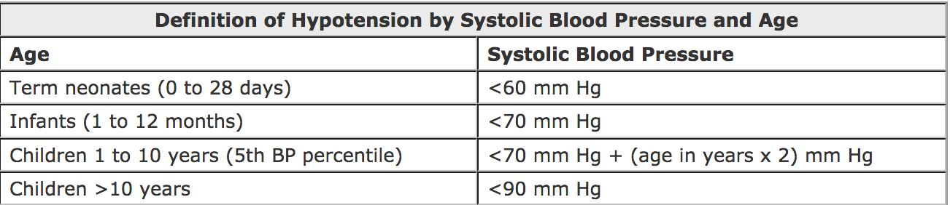
Decompensated Shock
Increased SVR → Skin and pulses
    Cold, mottled, pale extremities
    Prolonged capillary refill
    Absent peripheral pulses
    Weak central pulses
CNS → Markedly abnormal mental status
VS: Tachycardia, hypotension

Slide 20
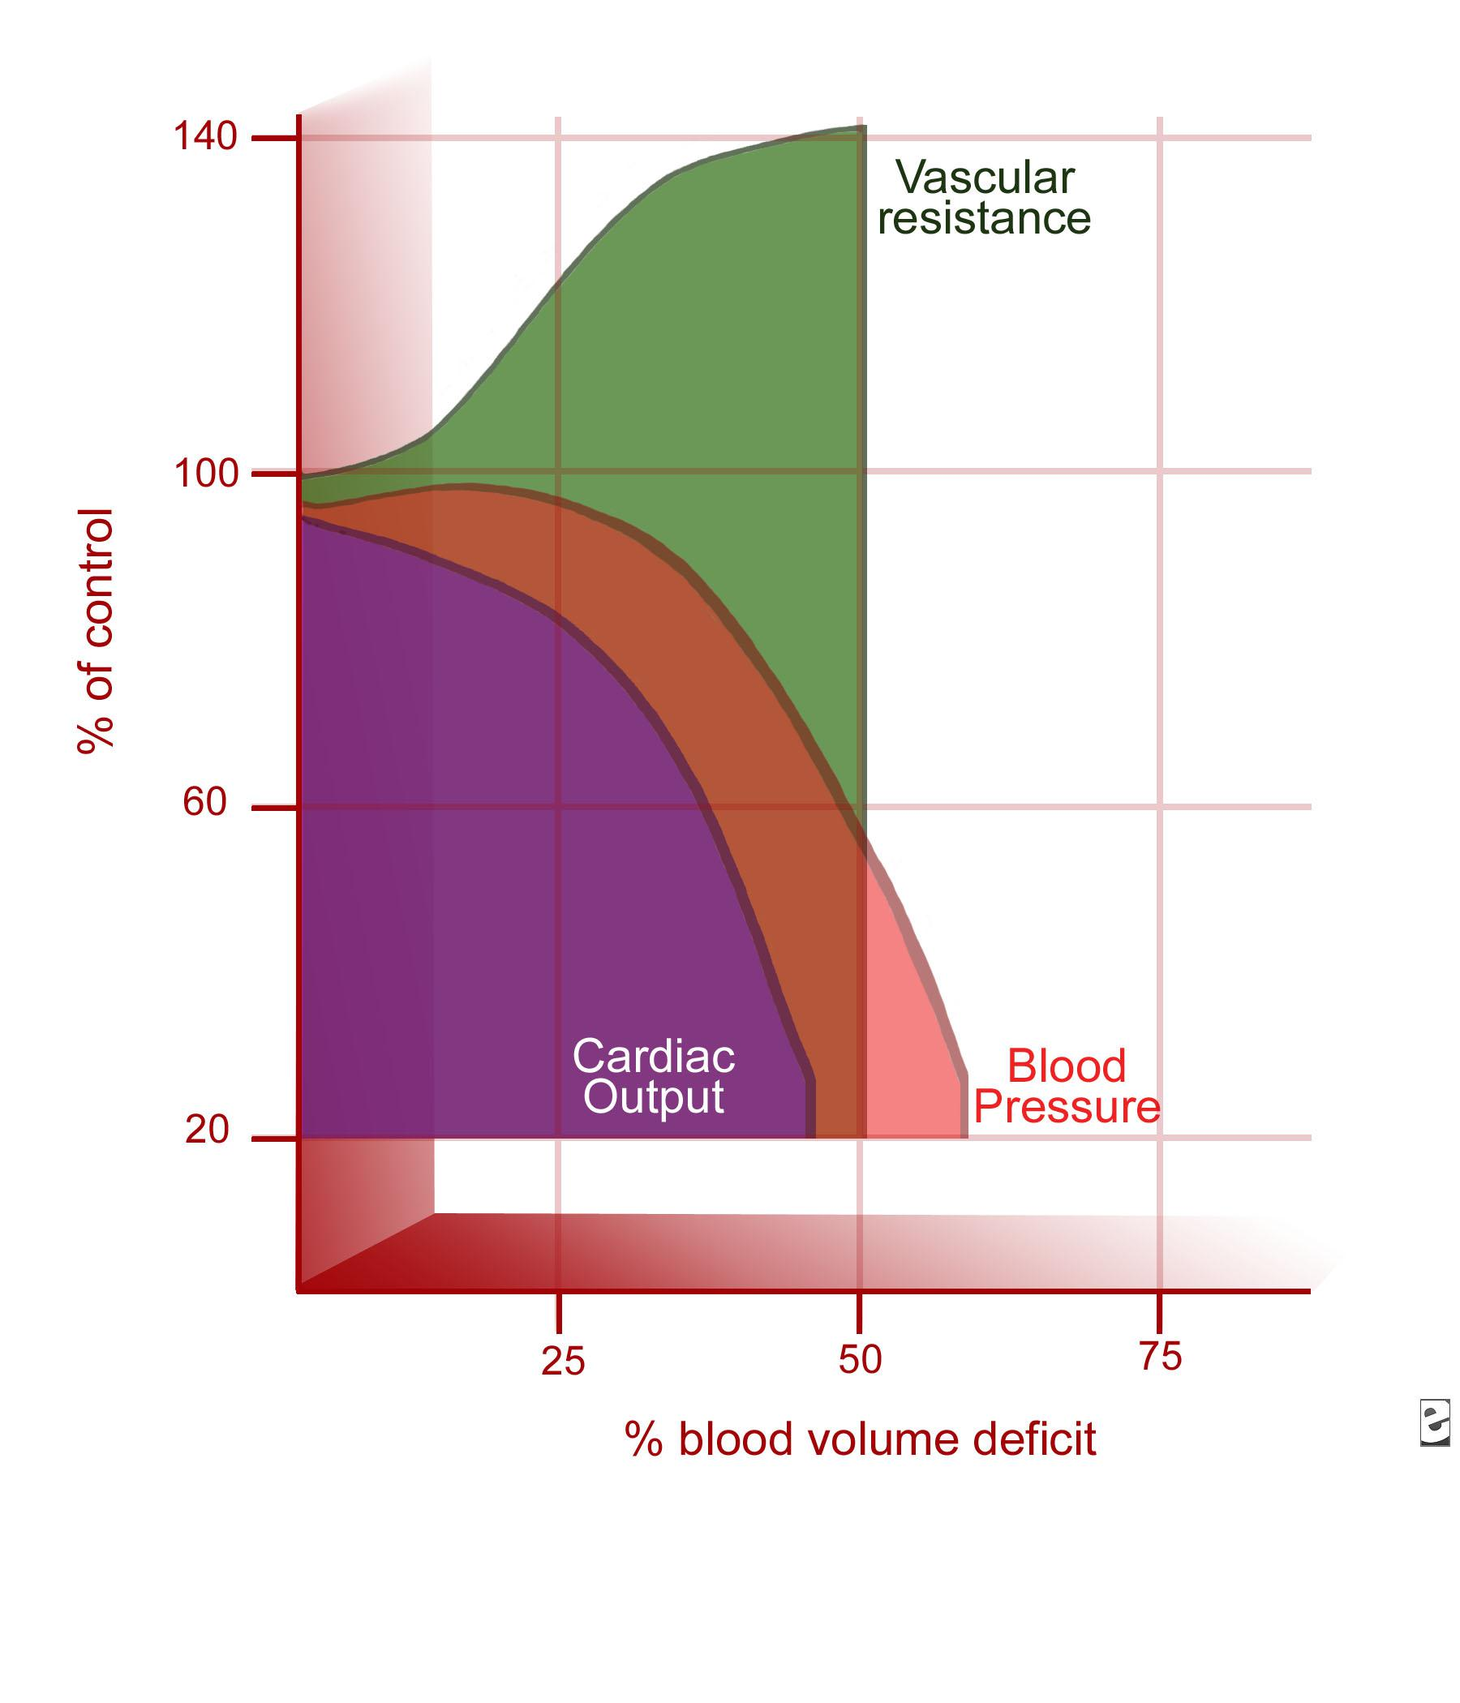
Heart rate
Schwaitzberg, Bergman, Harris. Pediatric trauma model of continuous hemorrhage. J Pediatric Surg. July 1988
Notes:
Tachycardia and increased PVR are early and principle compensatory mecaniss for decreasing cardiac output in infants
This diagram shows that blood pressure is maintained even as cardiac out drops significantly.
Hypotension is a late and ominous finding in children in shock.

Slide 21
Pediatric Arrest
Many Etiologies:
Sepsis, Pneumonia, RSV, SBS, CHI,Major trauma, Dehydration,
RAD, Upper airway obstruction, Drowning, Cardiogenic shock
Respiratory distress
Compensated shock
Respiratory failure
Decompensated Shock
Cardiopulmonary failure

Slide 22
Cardiopulmonary Failure
Global deficits:
  oxygenation
  ventilation
  perfusion

Slide 23
Cardiopulmonary Failure
Global deficits:
  oxygenation (ashen, cyanotic, bradycardic)
  ventilation (hypoventilation, apnea)
  perfusion (bradycardic, hypotension)
Bradycardia
  is the result of hypoxia (not primary cardiac disease).
  immediately precedes a pulseless arrest

Slide 24
PALS on One Page
Many Etiologies
Hypoperfusion with adequate BP;
Compensatory mechanisms are
tachycardia and increased SVR
Compensated; increased WOB
Respiratory distress
Compensated shock
Respiratory failure
Decompensated shock
Decompensated; inadequate oxygenation and
ventilation; requires immediate BVM ventilation
Hypoperfusion with hypotension;
Hypotension late and ominous sign
Cardiopulmonary failure
Global deficits in oxygenation, ventilation
and perfusion; presents with cyanosis, apnea,
bradycardia. Bradycardia is the result
of hypoxia. Immediate ventilation
with 100% O2.
Out of hospital pediatric cardiac arrests
present with nonperfusing rhythms (PEA,
asystole); very poor outcomes
Pulseless cardiac arrest

Slide 25
3 week old
3 week old infant presents to the ED with a 4 day history of mild URI symptoms, poor feeding and occasional vomiting.
Initial assessment: pale and cool extremities, dusky, limp, episodes of hypoventilation (?apnea) with drop in O₂ sats, HR 70
Physiologic status: ?
Interventions: ?
Prognosis: ?

Slide 26
PALS on One Page
Many Etiologies
Hypoperfusion with adequate BP;
Compensatory mechanisms are
tachycardia and increased SVR
Compensated; increased WOB
Respiratory distress
Compensated shock
Respiratory failure
Decompensated shock
Decompensated; inadequate oxygenation and
ventilation; requires immediate BVM ventilation
Hypoperfusion with hypotension;
Hypotension late and ominous sign
Cardiopulmonary failure
Global deficits in oxygenation, ventilation
and perfusion; presents with cyanosis, apnea,
bradycardia. Bradycardia is the result
of hypoxia. Immediate ventilation
with 100% O2.
Out of hospital pediatric cardiac arrests
present with nonperfusing rhythms (PEA,
asystole); very poor outcomes
Pulseless cardiac arrest

Slide 27
3 week old
Interventions:
  administer 100% O2
  assist ventilation and prepare for intubation
  IV access, IV fluids, glucose
  What is the first sign of improvement?
Physiologic states prior to cardiac arrest carry a more favorable prognosis for intact recovery

Slide 28

Welcome to
Pediatric Emergency Medicine
At UMass

Slide 30
University Emergency Department North Pod CMED
We are en route to your facility with a 85 year old man with a history of cardiac disease who clutched his chest and collapsed while pushing his lawn mover up hill. It is 95 degrees and humid. Arrest = Older, cardiac, MI, arrhythmia, algorithm
Pediatric Emergency Department CMED
We are en route to your facility with a 6 month old male found blue and gasping in his crib. He has a palpable central pulse and a heart rate of 60….
Arrest = Young, healthy, cause ?, where to start ?…

Slide 31
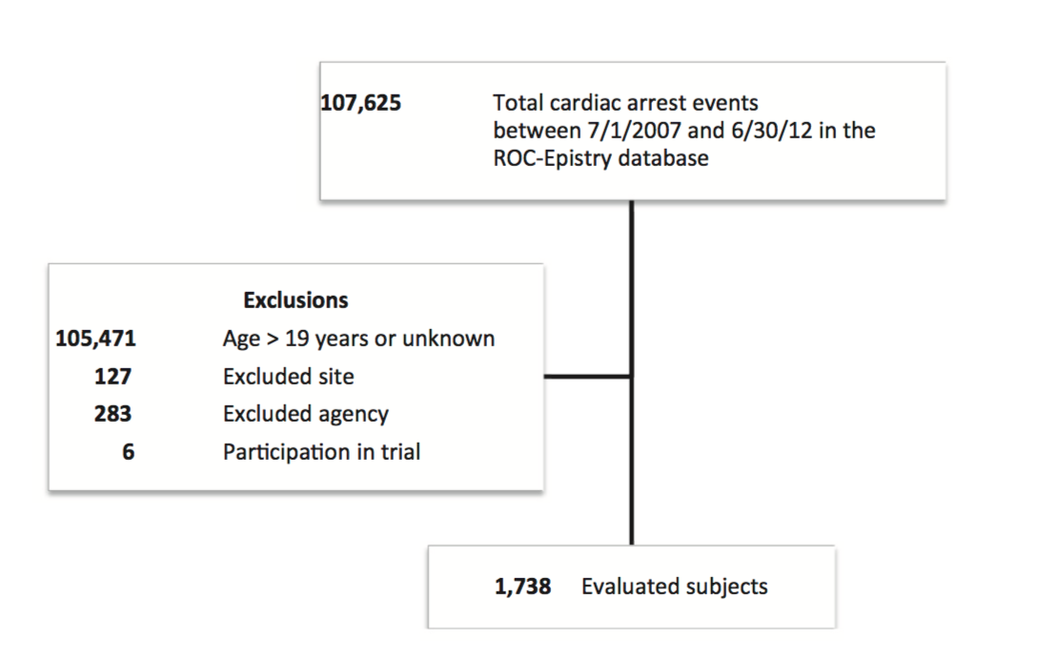
OHCA adults and children; US and Canada; 5 years 2007-2012

Slide 32
Code Etiquette:
Team Leader
Remains composed and organized
Maintains a quiet environment
Assigns tasks based on experience
Solicits advice when appropriate
Seeks agreement before terminating efforts
Checks in with staff following code
Provides feedback

Slide 33
Code Etiquette:
Participants
CPR, Airway, Access, Meds, Family support
Respects the Team Leader
Identify him/herself to the TL and offers to help
Performs only his/her role
  Does not offer unsolicited suggestions or orders
  Does not do a procedure unless asked to do so.
Leaves if not needed if area overcrowded or noisy.

Slide 34
Code Etiquette:
Observers
Should have educational reason to observe
Remains quiet
Does not teach at the bedside
Does not interfere
  Give orders to nurses
  Do not make unsolicited suggestion
Leaves, and take others, if over crowded
Is aware of family members who may be present

Slide 35
Family Presence
Families increasingly demand to be present with their children during recitation and invasive procedures.
Why are families excluded?
Who is most likely to exclude a family member?
Do providers have the right to exclude them?

Slide 36
Family Presence During Resuscitation
In trauma resuscitations, family members are often excluded from the initial trauma team evaluation.
CHOP
  Level One Pediatric Trauma Center/18 moth period
  Existing program that assigns a staff member to screen family members for family presence, provide support, and record events.
Outcomes measured:
  the need for termination of family presence,
  times to completion of key parts of the trauma evaluation, and
  the opinions of staff surveyed immediately after family presence.
Times to completion of key components of the trauma evaluation were compared for cases with and without family presence.
Pediatrics Volume 120, Number 3, September 2007

Slide 37
Results
197 family members participated in family presence.
  No cases of interference with medical care by families
  Seven family members were asked to leave the trauma area by staff
  Times to completion of key components of the evaluation did not differ between enrolled patients with and without family presence.
Providers reported that family presence either had no effect or improved
  Medical decision-making (97%)
  Institution of patient care (94%)
  Communication among providers (92%), and
  Communication with family members (98%).

Slide 38
Conclusions
Low prevalence of negative outcomes associated with family presence during pediatric trauma team evaluation after implementation of a structured family presence program.
Excluding family members as a routine because of provider concerns about negative impact on clinical care does not seem to be indicated.

Slide 39
When to Stop Resuscitation?
Presenting conditions
  Apnea, pulse, rhythm
Duration of downtime
Response to interventions
  Oxygenation and ventilation, epinephrine
Duration of ED efforts
  Staff comfort
  Family presence

Slide 40
Difficult Circumstances
Multiple victims
Unexpected venue
During transport
Scene calls

