Slide 1
Pediatrics Journal Club Guide

Slide 2
Goals of Journal Club
Develop skills in designing studies
Practice analyzing an abstract in a structured way
Exposure to landmark papers, historical articles, and new literature
Participation in discussion!

Slide 3
Expectations for Journal Club
Participants
Show up!
Participate in small groups
Share ideas
Presenters
Select article
Prepare 6-7 slides to present
Research question
Causal hypothesis
Findings
Clinical implications
Next study

Slide 4
Structure
8:00 - 8:10 | Each pair of presenters presents the brief background and research question being addressed by their paper
8:10 - 8:20 | Breakout groups use the template to compose a causal hypothesis. Goal is to develop a study to answer the research question
8:20 - 8:30 | Each group presents their study design and answers (~2 min per group)
8:30 - 9:00 | Leaders discuss structure of the study. Discussion of differences, strengths, weaknesses, and clinical application
Presenters work in pairs
Each pair of presenters presents 1 paper
Ideally 2 groups of participants discuss each research question and develop a proposed study design

Slide 5
Causal Hypothesis
“study purpose” or “causal hypothesis” = the causal relationship that the authors originally intended to study and how they actually studied it
Identify key aspects of the study design just by reading the abstract
Quickly understand the purpose and design of the study
Read the rest of the article with focus
Critically assess the results within the context of the study design
Did the authors adequately study what they intended to?
Content adapted from CTS601A, Dr. William Jesdale

Slide 6
Vocabulary
Exposure → Outcome, in Context
Study design: type of study
Exposure: independent variable; the “cause” of what you are studying
Exposure Contrast: reference group; compared to what alternative
Etiologic Period: when does exposure have an influence on disease, when exposure matters
Causal Direction: the impact/effect
Outcome: what you are measuring/studying
Outcome Contrast: compared to what alternative; “null hypothesis”
Population Context: In what population(s) is this relationship expected to be causal?; when, where, and in whom

Slide 7
Components of a Causal Hypothesis
Exposure → Outcome, in Context
Conceptual definition: What is the idea? (intention)
Operational realization: How does a given person get assigned an exposure status? An outcome status? Included in study population? (actual)
What are the gaps between the conceptual definition and operational definition → leads to better understanding of the context for interpreting the results of the study
Can the results and clinical implications be expanded beyond the context of the study?
Content adapted from CTS601A, Dr. William Jesdale
Notes:
Exposure is albuterol during asthma exacerbation
Improves
Outcome is Respiratory function
Context is Pediatric patients

Slide 8
Study Design (Type of study)
Exposure (Independent variable - the “cause” of what you are studying) | Conceptually: Operationally:
Exposure Contrast (Reference group - compared to what alternative) | Conceptually: Operationally:
Etiologic Period (Time period of reference)
Causal Direction (Effect)
Outcome (Dependent variable - What you are measuring) | Conceptually: Operationally:
Outcome Contrast (“Null hypothesis”) | Conceptually: Operationally:
Population Context (Who, when, where) | Conceptually: Operationally:
Notes:
Given a research question
Goal to work in groups to develop your own study design
Work through this table to identify components of the study design

Slide 9
Types of Study Designs
Meta-Analysis: combining data from many different research studies
Systematic Review: A summary of the clinical literature
Randomized Controlled Trial: A controlled clinical trial that randomly (by chance) assigns participants to two or more groups
Cohort Study (Prospective Observational Study): A clinical research study in which people who presently have a certain condition or receive a particular treatment are followed over time and compared with another group of people who are not affected by the condition
Case-control Study: Case-control studies begin with the outcomes and do not follow people over time. Researchers choose people with a particular result (the cases) and interview the groups or check their records to ascertain what different experiences they had
Cross-sectional study: Observation of a defined population at a single point in time or time interval. Exposure and outcome are determined simultaneously
Case Reports and Series: A report on a series of patients with an outcome of interest. No control group is involved

Slide 10
Cheat Sheet
Study Design | Meta-Analysis, Systematic Review, Randomized Controlled Trial, Cohort Study, Case-control Study, Cross-sectional study,Case Reports and Series
Exposure | “Cause” of what you are studying - medication, intervention, exposure etc.
Exposure Contrast | Compared to what alternative - placebo, unexposed, alternate med/dose, etc.
Etiologic Period | During what time period does the exposure matter - from birth to 2 years, during pregnancy, etc.
Causal Direction | Effect - improves, worsens, increases, decreases, etc.
Outcome | What you are measuring – cancer, happiness, IQ score, etc.
Outcome Contrast | Absence of outcome – no cancer dx, etc
Population Context | Who, when, where - residents in Worcester, MA, etc.

Slide 11
Example of Journal Club Presentation

Slide 12
Background and Research Question
Background: Asthma is a common chronic condition among pediatric patients and is a common cause for presentation to the ED. Short-acting beta(2)-agonists are used to treat asthma symptoms. There are multiple modes of delivery for the medication.
Research Question: Is breath-enhanced nebulizer effective for treating asthma in pediatrics patients?
Notes:
Everyone is given this info to start – then break into small groups and discuss how you could design a study to answer this research question. Complete the causal hypothesis table to address important aspects of study design. Use cheat sheets to help! Write a causal hypothesis and share with larger group.

Slide 13
Cheat Sheet
Study Design | Meta-Analysis, Systematic Review, Randomized Controlled Trial, Cohort Study, Case-control Study, Cross-sectional study,Case Reports and Series
Exposure | “Cause” of what you are studying - medication, intervention, exposure etc.
Exposure Contrast | Compared to what alternative - placebo, unexposed, alternate med/dose, etc.
Etiologic Period | During what time period does the exposure matter - from birth to 2 years, during pregnancy, etc.
Causal Direction | Effect - improves, worsens, increases, decreases, etc.
Outcome | What you are measuring – cancer, happiness, IQ score, etc.
Outcome Contrast | Absence of outcome – no cancer dx, etc
Population Context | Who, when, where - residents in Worcester, MA, etc.

Slide 14
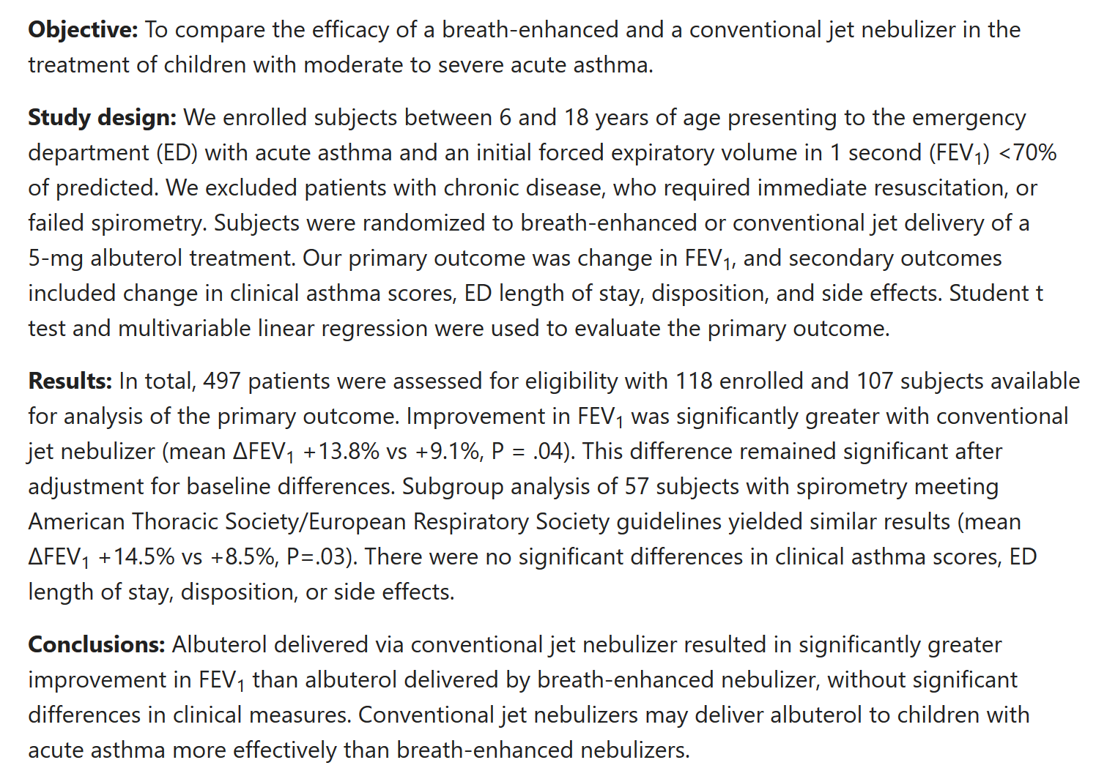








Abstract
Exposure
Etiologic Period
Causal Direction
Outcome
Context
Notes:
After groups present their ideas, the presenters reveal the actual abstract and walk through the components of the causal hypothesis

Slide 15
Identify components of the causal hypothesis
Study Design (Type of study) | Randomized control trial
Exposure (Independent variable - the “cause” of what you are studying) | Conceptually: breath-enhanced nebulizer treatment Operationally: 5 mg albuterol delivered via breath-enhanced system
Exposure Contrast (Reference group - compared to what) | Conceptually: conventional jet delivery nebulizer treatment Operationally: 5 mg albuterol delivered via jet-delivery system
Etiologic Period (Time period when exposure matters) | Conceptually: during acute asthma exacerbation Operationally: initial FEV₁ <70% of predicted
Causal Direction (Effect) | increases
Outcome (Dependent variable - What you are measuring) | Conceptually: change in respiratory function Operationally: change in FEV1 (missing time frame! – how long after neb?!)
Outcome Contrast (“Null hypothesis”) | Conceptually: no change in respiratory function Operationally: no change in FEV1 (missing time frame! – how long after neb?!)
Population Context (Who, when, where) | Conceptually: children with acute asthma exacerbation in the ED Operationally: children 8-16 yo with moderate to severe acute asthma who presented to an urban ED during 20-month period from October 2015 to May 2017

Slide 16
Causal Hypothesis
Exposure → Outcome, in Context
Breath-enhanced delivery of albuterol compared to conventional jet delivery administered during acute asthma exacerbation causes a greater increase in FEV1 among pediatric patients 6-18 years old with a history of moderate to severe asthma while in the Emergency Department

Slide 17
Results
Sample = 107 pediatric patients between 6-18 years old
Improvement in FEV₁ was significantly greater with conventional jet nebulizer (mean ΔFEV₁ +13.8% vs +9.1%, P = .04).
Spirometry is effort dependent and challenging to obtain accurate measurements
Is a change in FEV1 of 9.1% vs 13.8% CLINICALLY significant?
This is an objective outcome, but FEV1 is not used for clinical decision making in the ED
There were no significant differences in clinical asthma scores, ED length of stay, disposition, or side effects.
These were outcomes of clinical importance for providers in the ED
These were secondary outcomes in this study, so they may not have been powered to detect changes, but there was no trend observed either

Slide 18
Clinical Implications
Children who received conventional jet nebulizer treatments had statistically significantly more change in FEV1 than those who received breath-enhanced nebulizer treatments.
Despite greater change in FEV1, there were not differences in clinical symptoms or length of stay or disposition.
Based on this study, conventional jet nebulizers deliver albuterol “more effectively” than breath-enhanced nebulizers in pediatric patients
Not worth the investment of buying new machines for the pediatric ED to replace conventional jet nebulizers

Slide 19
Next Steps
Perform a similar RCT with larger sample size and multiple primary outcomes of clinical importance.
Perform a similar RCT with DuoNebs instead of albuterol
Perform a similar RCT, but measure outcome at 20 minutes after neb was completed rather than 10 minutes

