Slide 1

Pathway team meeting
11.5.2020
Curriculum ReVolution Leadership Team

Slide 2
Agenda
Review calendar for alignment
Define required elements for a pathway
Review timeline
Consider other team members
Identify working groups
Notes:
Moving step 1 to after CCE is a discussion that is ongoing
Plans for a 3 year track
Pathways/track development
HSS as the third pillar
Remediation/deceleration plans and structure
Clinical years (CCE) reno

Slide 3
Pathway Theme Principles
Meets institutional initiatives
  Strategic plan
  Competencies
Health system need
Encompasses breadth of interests
UMass expertise

Slide 4

Pathway Design
Encourages curiosity and development of scholarship skills
Links threads and themes longitudinally
Connect with Capstone and HSC/PHC
Allows both focused and broad exposure through inclusion of defined topics and clinical care
Supports professional development (including combined degrees)
Equitable access regardless of prior experience
Builds on, does not replace what experiences all students should have in these topic areas

Slide 5
Timeline
Identify specific calendar/dates December
  Share with build teams
Draft model, entry/exit, expectations January
Overview to EPC March
Administrative, leadership and budget April
Finalize topics, identify leaders (post EPC – October)

Slide 6
Potential Pathways
Existing
Global health
Rural health
Urban health
Clinical and Translational Research
Baseline
Clinical care
Advocacy and Social Justice in Medicine
Biomedical Innovation and Design
Community Engagement
Education (Medical Education, Patient Education)
Health Systems Science (QI, healthcare policy)
Humanities
LatinX/Spanish Immersion
Leadership
Simulation

Slide 7
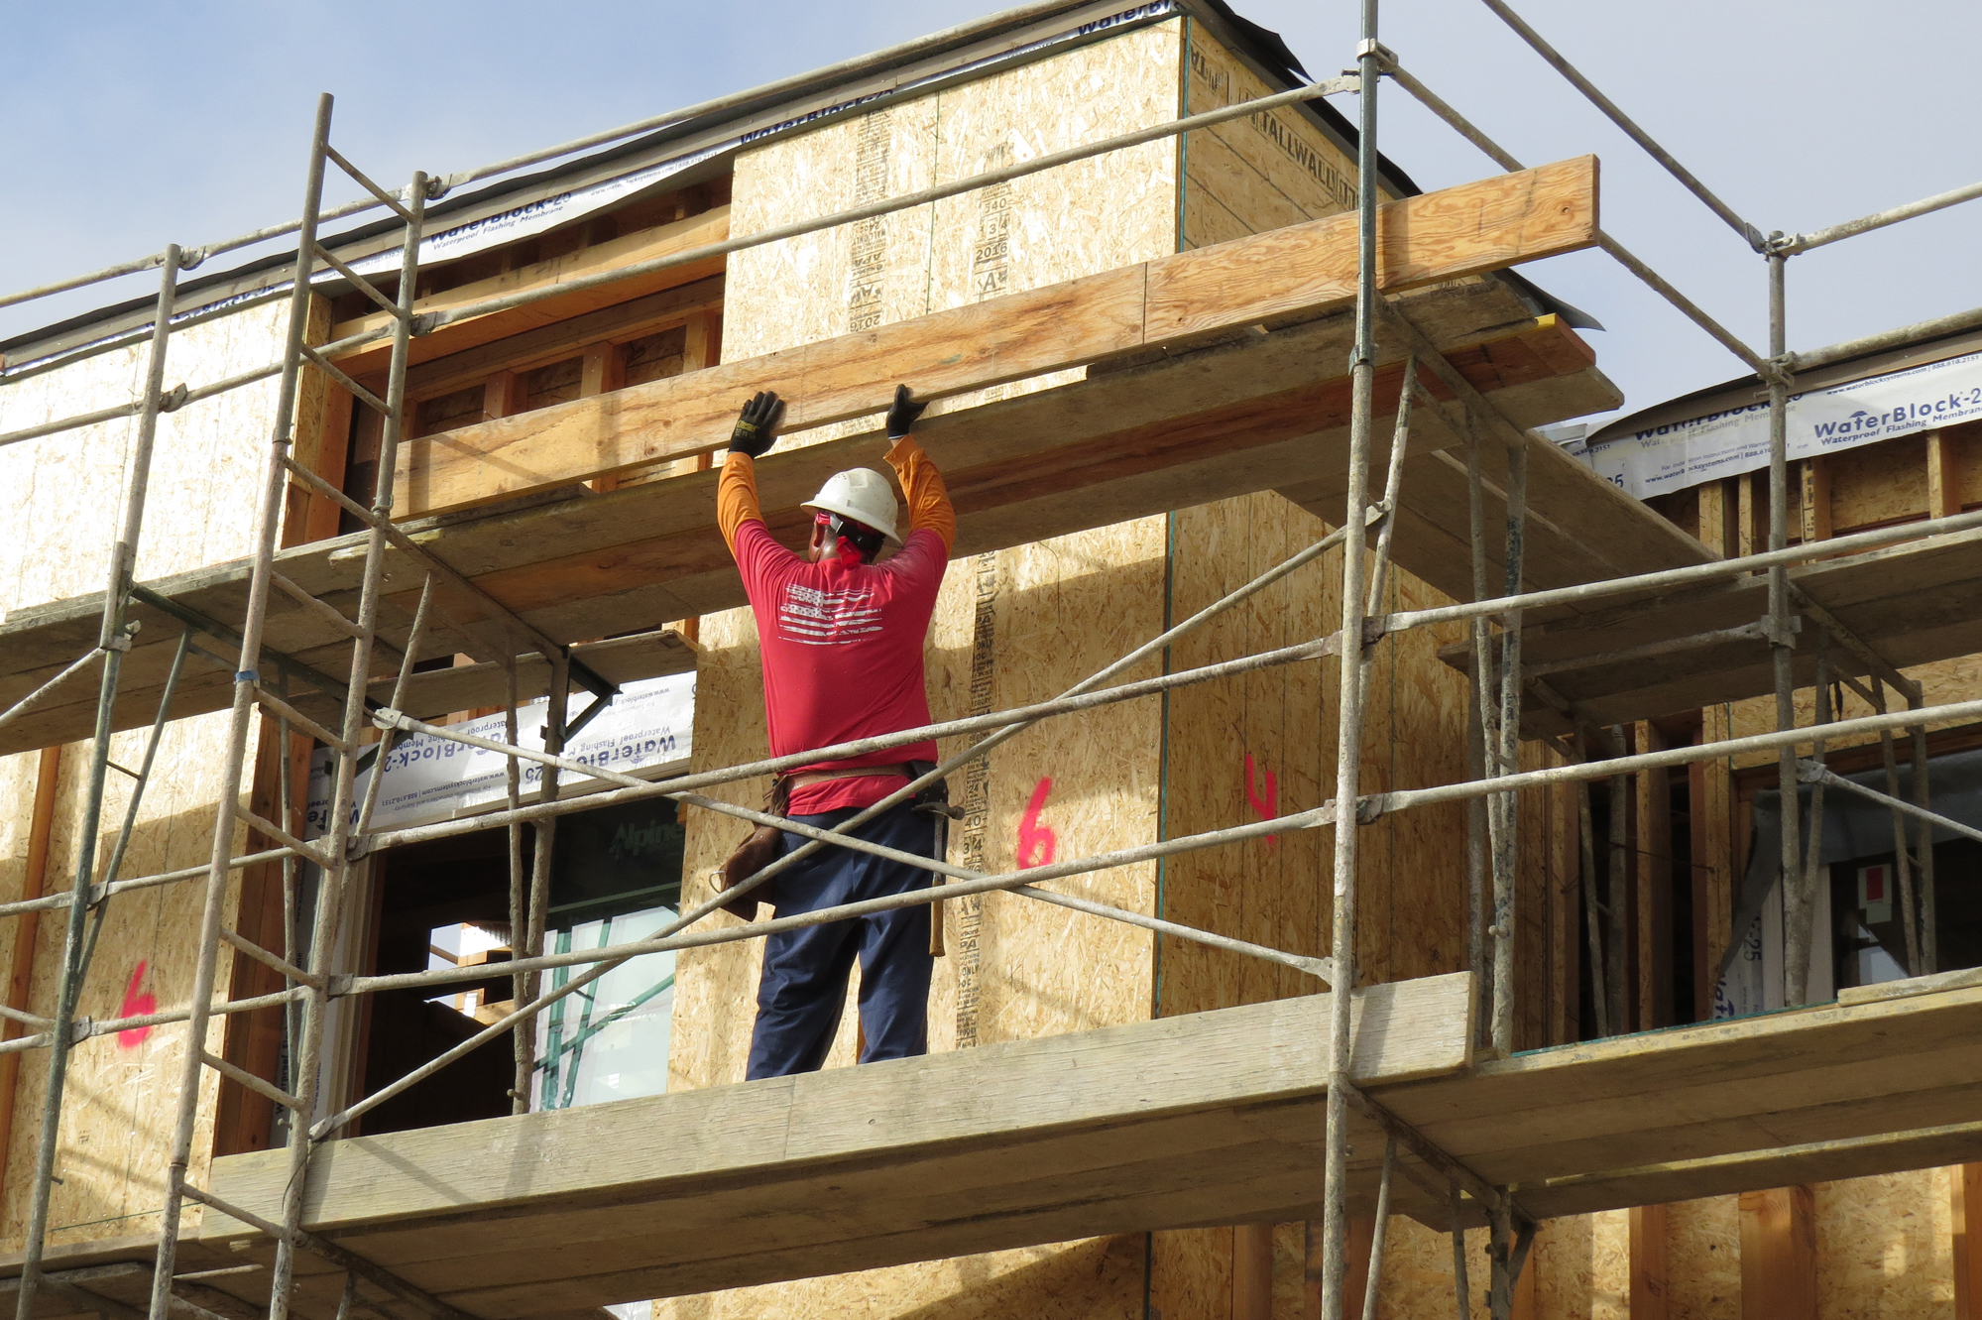
Potential pathway time
Foundational Curriculum
FOM1
P3 week (populations, pathways, peers)
Population health clerkship prep week (CNA)
Core Clinical Experiences
2 week IP service learning (current population health clerkship)
Advanced Studies
Elective
Pathway time (required)
Pathway time (required)
FOM2
Early introduction of all in fall
Integrated with clinical rotations
Students select in spring
Integrated within biomedical and clinical courses
Capstone

