Slide 1

Curriculum ReVolution: Longitudinal Content Team orientation
11/10/20

Slide 2
OLYMPIC RINGS COLOR
Agenda
Each ring is for each continent on Earth
Introduction
Review of Curriculum ReVolution planning
Reframing of longitudinal content from T3
Review of Spokesperson team meeting
EPC Presentation planning
Next steps
https://www.umassmed.edu/oume/initiatives/curriculum-revolution2/
SKIN COLOR
Notes:
Introduction – 5 min (LT)
What to present in EPC – 10 min (LT)
Draft of calendar
Highlight changes
Pedagogy (toward more engaged learning)
Introduction of newer learning methods (Problem-Based Learning, Case-Based Learning, etc.)
Introduction of longitudinal threads (diversity, research, etc.)
Novel assessment methods
Further integration of basic biomedical and clinical sciences
Implementation of HSS as the third pillar
Build team updates (strategies, best practices) – 15 min (SpX)
MSK/GI - LG
NSB – SG
CVS - ?
Clinical BT
Teams that have not met
Build Team Discussions (questions for LT and other blocks) - 15 min
Introduction of a longitudinal thread – 15 min (Longitudinal Consultant)

Slide 3
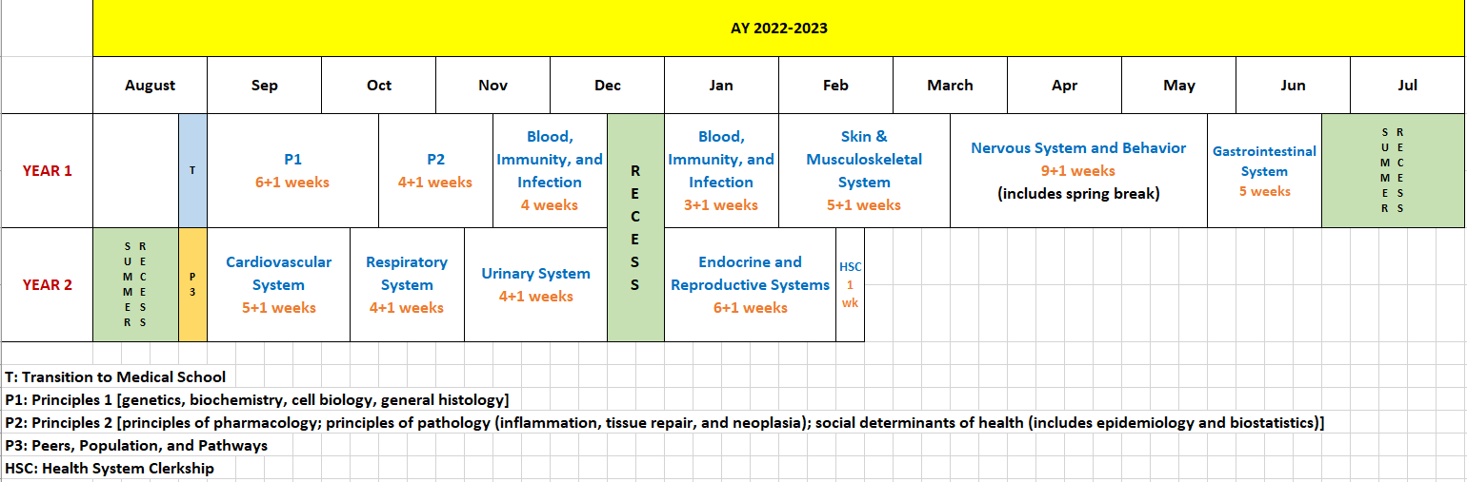
OLYMPIC RINGS COLOR
Most Updated Calendar
Each ring is for each continent on Earth
SKIN COLOR
Notes:
Introduction – 5 min (LT)
What to present in EPC – 10 min (LT)
Draft of calendar
Highlight changes
Pedagogy (toward more engaged learning)
Introduction of newer learning methods (Problem-Based Learning, Case-Based Learning, etc.)
Introduction of longitudinal threads (diversity, research, etc.)
Novel assessment methods
Further integration of basic biomedical and clinical sciences
Implementation of HSS as the third pillar
Build team updates (strategies, best practices) – 15 min (SpX)
MSK/GI - LG
NSB – SG
CVS - ?
Clinical BT
Teams that have not met
Build Team Discussions (questions for LT and other blocks) - 15 min
Introduction of a longitudinal thread – 15 min (Longitudinal Consultant)

Slide 4

General Block Structure
Anatomy and Normal Imaging
Embryology and Congenital Disorders
Histophysiology
Pathology and Abnormal Imaging
Pharmacology
Clinical Content
Longitudinal Threaded Content – Nutrition, Diversity, Wellness, Health Systems Science, Cancer

Slide 5

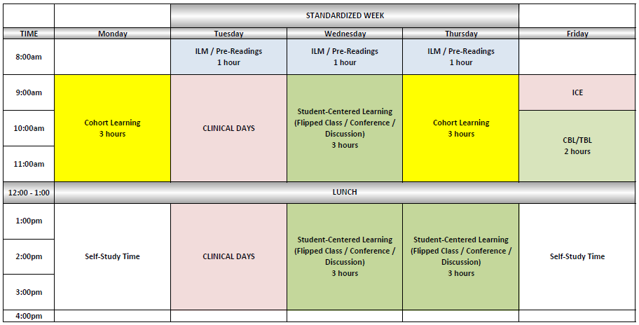
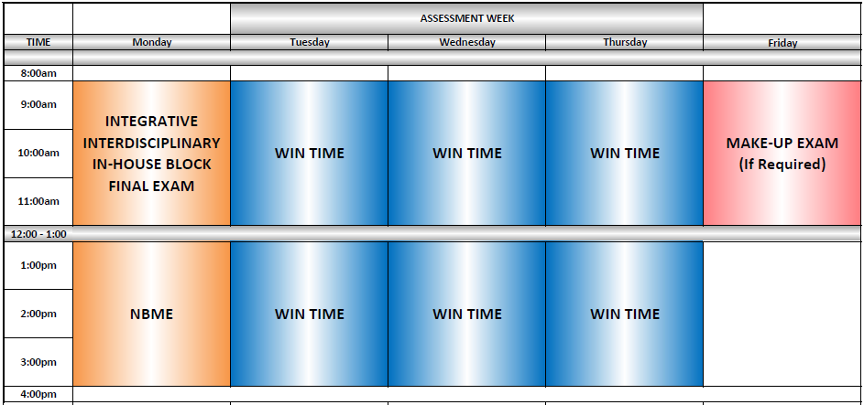
SUGGESTIONS
Flow of information for biomedical sciences in a system block should preferable be in the following sequence – anatomy/normal imaging → histophysiology → embryology/congenital disorders → path/pharm/abnormal imaging
Collaborate with the LCT representatives and to build longitudinal threads for through the curriculum (some more than others)
For large-group cohort learning (yellow blocks in the standardized week calendar), encourage off-campus/remote sessions to add flexibility
Consider weekend, online, and open-book options for midterm assessments/quizzes and use these as learning resources
Consider various modalities for formative and summative assessments

Slide 6
Build Team High Level Timeline
6 months prior to EPC | 3 months prior to EPC | 1 month prior to EPC
Identify and sequence core topics Meet with longitudinal consultants to integrate their content Identify assessment types | Begin weekly schedule Determine methodology Draft assessments | Finalize EPC rules presentation

Slide 7

When to Present to EPC
OLYMPIC RINGS COLOR
Groups | March 2021 | April 2021 | May 2021 | June 2021 | July 2021 | Aug 2021 | Sept 2021 | Oct 2021 | Nov 2021 | Dec 2021
Leadership Team (LT); traditional track – calendar, policies, and processes | X | ●
P1, P2, Blood/Inf |  |  | X | ● |  |  |  |  | †
Skin/MSK, NSB, GI |  |  |  | X | ● |  |  |  | †
CVS, Resp, Renal |  |  |  |  | X | ● |  |  | †
Endo/Repro, PHC, Clinical, & Clinical Integration |  |  |  |  |  | X | ● |  | †
LT (traditional track – wrap up) |  |  |  |  |  |  | X | ● | †
LT; 3-year track – calendar, policies, and processes |  |  |  |  |  |  |  | X | ● | †
LT; Clinical Years Revolution |  |  |  |  |  |  |  | X | ● | †
Each ring is for each continent on Earth
SKIN COLOR
Presentation to EPC rules (steering committee): X
Presentation to EPC: ●
EPC Vote (build team presence not needed): †
(note – presentations to rules committee 1 month prior to EPC presentation)

Slide 8
Suggested approaches to content integration
Meet with your team
Outline the scope of your content
Define priorities and ownership
Sequence topics
Consider methods
Contact build teams

Slide 9
Our questions for you
What would make it easier for you to integrate?
How prescriptive do you prefer we are?

Slide 10
Future meetings
Build team spokesperson meetings

Slide 11
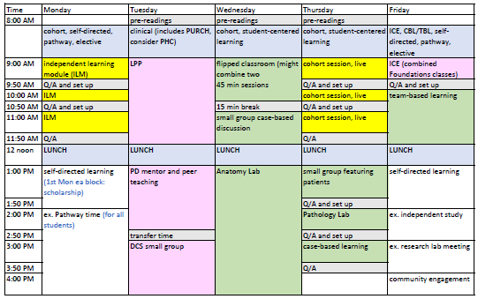
A More Detailed Example of a Typical Week

Slide 12
Central Regulations
Limit individual lectures/large-group cohort-learning to 60 minutes (including break)
Start and end times for the day, lunch time, self-study (white) time, and clinical (pink) times should not be changed
First Monday afternoon in each block is reserved for components of longitudinal curriculum (in addition to integration)
The block should have at least one PBL (LCME standard 6.3; also provides feedback) and a SIMULATION exercise
The first page of every session/activity should have clearly stated learning objectives (LCME standard 6.1)
Multiple formative and summative assessments and mid-block narrative feedback to students (LCME requirements)
Students should know by end of the day of the block final exam if they need to remediate

Slide 13


Invite Content Experts To Build Biomedical, Clinical, and Longitudinal Thread Content For Your Block
(FEEL FREE TO CREATE YOUR OWN BUILD TEAM)
Anatomy – Lela Giannaris
Imaging – Chris Cerniglia
Histology/Physiology/Embryology – Manas Das
Pharmacology – Mark Dershwitz
Pathology – Jacob Bledsoe
Nutrition – Kerri Gosselin
Clinical Integration – Howard Sachs, Jen Carey, Mike Fahey
SDOH -Suzanne Cashman & Susan Hogan
Wellness – Mark Miceli
IPE – Jessica Therrien, Nancy Morris

