Slide 1

3 year track
9/30/2020
Curriculum ReVolution Leadership Team

Slide 2
Why a 3 Year MD Program?
Opportunity for time to follow independent interests
Financial benefit: lifetime savings of $250,000¹
Provides physicians faster for predicted physician shortage
Offers individualized pathways matched to student goals
Allows time for dual degrees
Some programs provide acceptance into residency programs
3-year MD program drives innovation in medical education
¹Weiner S. AAMCNews. Friday, March 29, 2019. Available online at https://news.aamc.org/medical-education/article/med-school-3-years-future-medical-education/ . Accessed 4/10/19.

Slide 3
Medical Schools with 3-Year Medical Program
Current 3-Year MD Programs
Interested in Developing 3-Year MD Program
Columbia U College of Physicians and Surgeons
Cooper Medical School of Rowan University*
Cumming SOM University of Calgary
DeGroote SOM (Ontario) McMaster U
Duke University SOM*
Medical College of Wisconsin*
Mercer U SOM*
NYU SOM Langone Health*
Ohio State SOM*
Pennsylvania State COM*
Renaissance SOM at Stony Brook U
Rutgers Medical School
Texas Tech U Health Science Center SOM*
U of CA Davis SOM*
U of Kentucky SOM*
U of Louisville SOM*
University of North Carolina School of Medicine, Chapel Hill*
Medical University of South Carolina*
Hackensack Meridian School of Medicine at Seton Hall University*
*Member of Consortium of Accelerated Medical Pathway Programs

Slide 4
Variety of Models
A | B | C | D | E
Y1: Foundation Sciences Y2: Clerkships Y3: SubI + electives | Summer sessions before M1 & M2 | # wks and months splitting years | Same 4Y MD program condensed & accelerated | Reduced electives & shorten time off
Some models assign M1 students to a clinical site for all 3 years
Some models have a longitudinal clerkship

Slide 5
Admission Process
Student Profile
  Expresses a strong commitment to a specific Generalist Discipline
  Exhibits mature behavior to complete an accelerated MD program
  Has a strong academic record predictive of success
Application Processes
  Secondary application with MD application
  Must be accepted to MD program first
  During M1 year
  After M1 year
  Anytime during M2
  After PhD

Slide 6
Accreditation issues
LCME considers this a parallel curriculum
  Core, comparable graduation competencies, objectives and assessments
  Institutionally agreed-upon educational rationale
  Can have additional objectives or competencies
Submit
  earliest submission Dec 1, 2020 for consideration at Feb LCME mtg
  Goal implementation in 2021 for students entering in 2022

Slide 7
The Big Picture:
3 year track will align with generalist disciplines and our own residency programs – meeting the needs of the Commonwealth and our Healthcare System
Alignment
Acceptance
Assessment
Equity
Notes:
Re-imagine early clinical learning
Remove silos of DCS, PD, LPP, Hospital sessions (should be related to each other in time)
Tasked with tying content into block-based learning (with assessment contributing to block grade)
Selected EPAs as an overarching framework
I would love to see an actual assessments of the EPAs referred to in your evaluation. I have been requesting my incoming interns to do an incoming self assessment of the 13 EPAs for several years.
Do not have to maintain currently expected activities in the same number
Finite resources in this new model (and the old): physical space and mentor time
Addition of clinical skill simulation activities (phlebotomy, ultrasound)

Slide 8

Draft timeline
Team design begins – September 2020
Program director outreach and GME team invitations -- November 2020
  - involved in planning; involved in first wave of implementation
Step 1 adjustment - October 2020
Modeling -- Nov - Feb 2021
Present to advisory committee - by March 2021
EPC presentations begin April 2021
Final EPC focus on 3 year – September 2021 (final implementation pending LCME report from 2020; may delay to 2023 implementation)

Slide 9
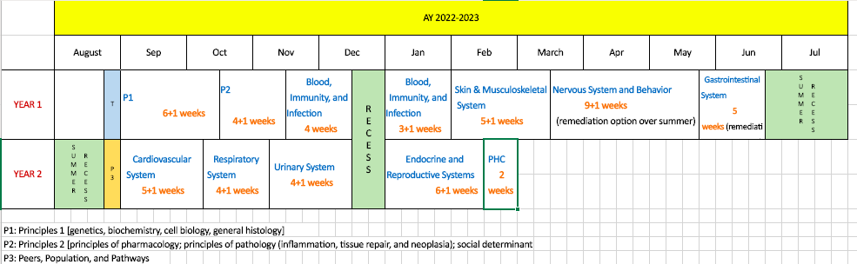
Block-based, Single Pass, 18-month Foundational Curriculum
Each student selects a Pathway (spring year 1) -- relates to Capstone and other experiences
1-week Healthcare Delivery Systems/Pathway experience spring year 2
Redesigning Core Clinical Experiences (clerkships +, integrated interstitial)
Step 1 likely to move into/after 3rd/clerkship year (supports purposeful integration in CCE)
2-week service learning/health systems/population experience in fall year 3
3-year MD track
Notes:
Full transition to single pass curriculum
Templated weekly schedules
Single clinical day standardized each week
Pathways, Optional 3-year track

Slide 10
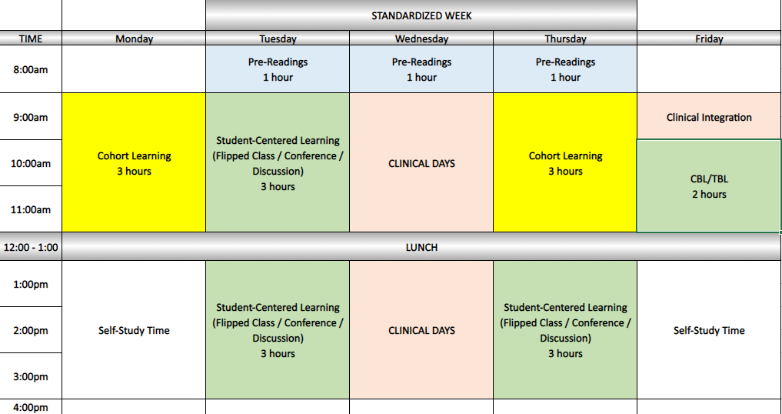
Typical Week
Do we utilize any of this time for 3 year track students?

Slide 11
Longitudinal Assessments
Competencies
NBME (pre-clinical and clinical)
EPAs
Milestones?

Slide 12

Three Year Track Design Questions
When do students apply? What are characteristics?
How do we connect with Capstone and HSC/PHC? LPP/LIC? Clinic alignments?
What additional time do they have to meet requirements?
Are combined degrees feasible?
What is the clinical/clerkship model?
How do we promote equitable enrollment and support?
How do we build advocacy and engagement experiences?
Benchmarks for progression?
Advisory/Committee support structure?
Who else should be on this team?

Slide 13
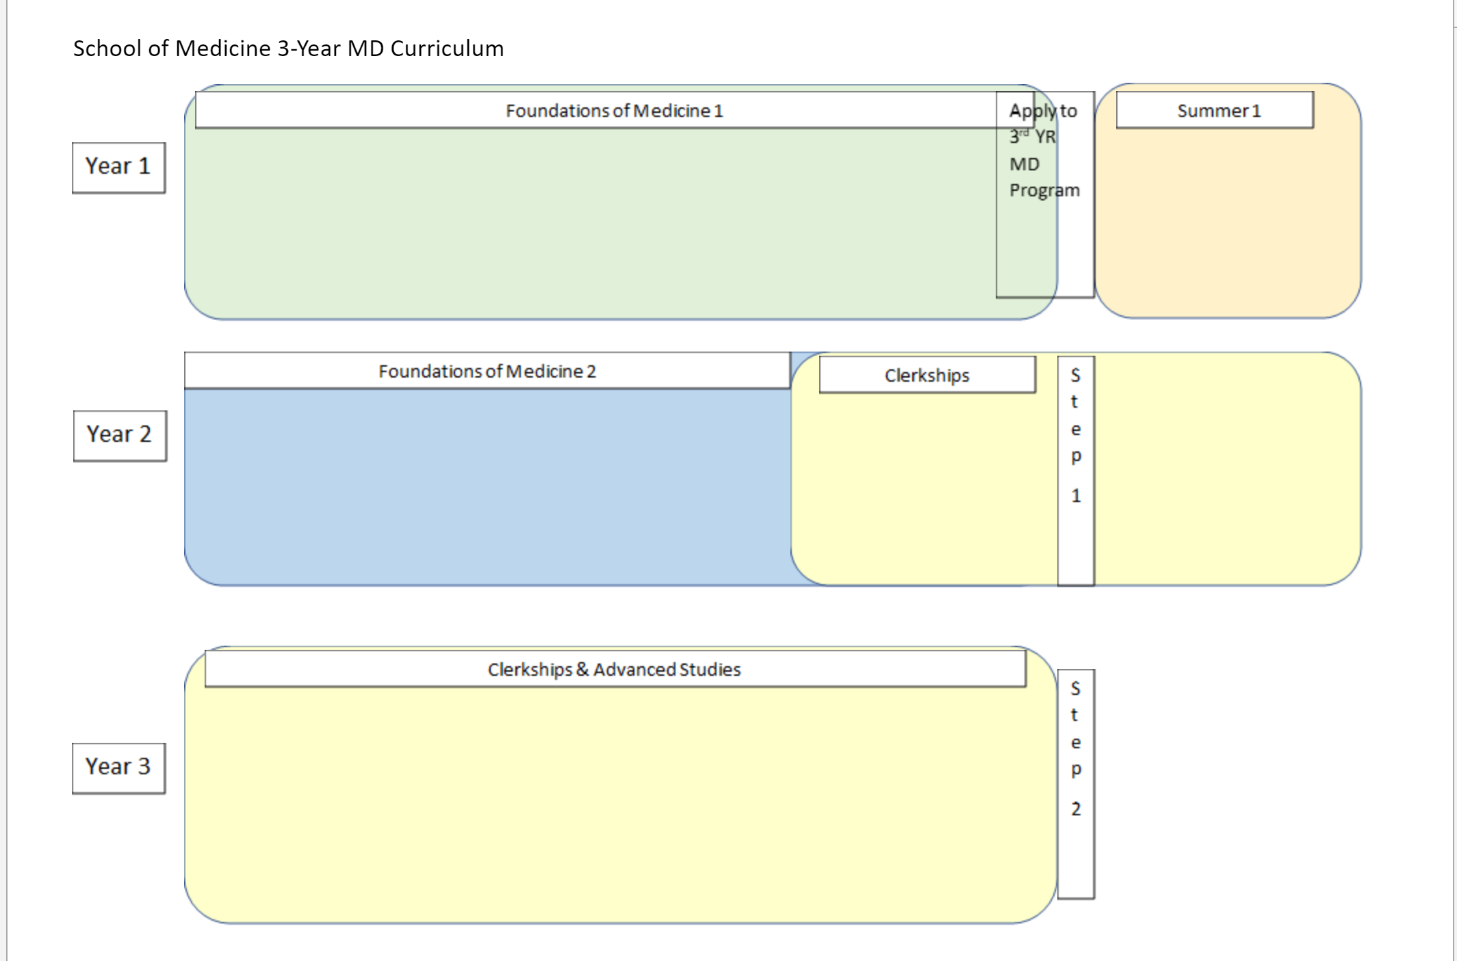

Slide 14
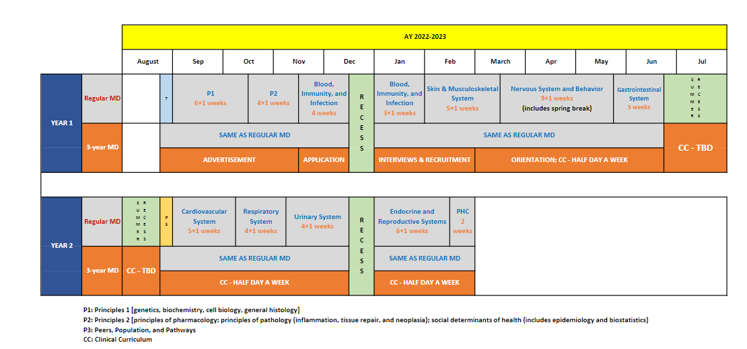
3 Year MD Track draft 18 mos

Slide 15
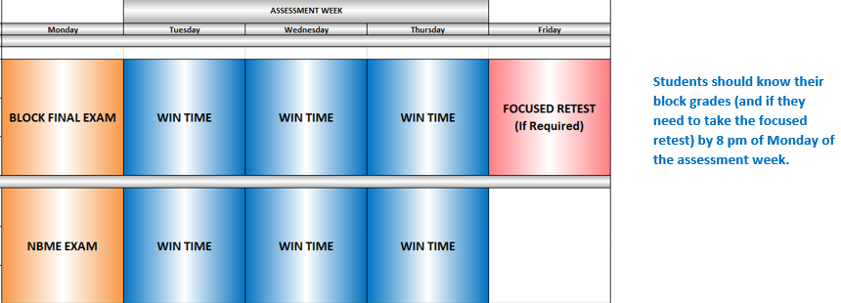
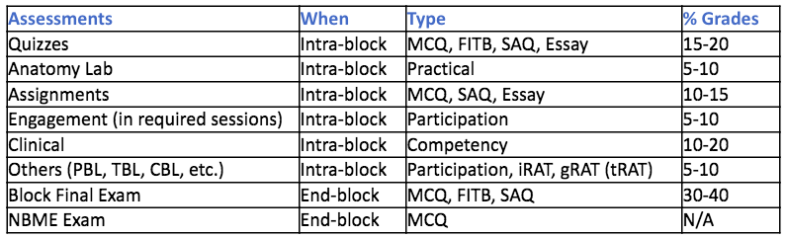
Assessment Week and WIN time

Slide 16
Potential Pathways
Existing
Global health
Rural health
Urban health
Clinical and Translational Research
Baseline
Clinical care
Leadership
Biomedical Innovation, Design, Device development
Diversity – LGBTQ care, race/bias
HSS (QI, HCP)
Humanities
Community engagement
Education (patient, peers, community, medical education)
Simulation
Advocacy (community, political)
Care of vulnerable populations
LatinX health/Spanish immersion

Slide 17
Scope, sequence, methodology table (samples)
Content area | Level of learner (1-4) | Block | Specific link | methodology
Intro to racism and impact on health | 1 | Principles 1 (genetics, EBM) | Race as a social construct vs biologic risk factor; impact of systemic racism and policies on health | interactive lecture; think-pair-share with real-time EBM exercise
Content area | Topic(s) | prioritization | Level of learner | methodology

Slide 18
Moving step 1 AFTER the start of Core Clinical Experiences
Fosters clinical-biomedical learning
Step 1 is increasingly clinical
Allows preclinical space for other curriculum
Would require some curriculum building for clinical-biomedical connection each rotation
"I felt that there was too much emphasis in the MS1 and MS2 years about preparing for Step 1 at the expense of developing a very strong clinical knowledge for the future. The program I am at doesn't have their students take step 1 until after their first year of clerkship and I feel that their clinical knowledge is much stronger than the average UMass student."
Most schools report an increase in scores
  Jurich D, Daniel M, Paniagua M, et al. Moving the United States Medical Licensing Examination (USMLE) Step 1 after core clerkships: An outcomes analysis. Acad Med. 2019;94:371–377.
Notes:
A recent study demonstrated small but statistically signicant increases in Step 1 scores at four schools (an average of 2.78 scaled score points after accounting for rising national Step 1 scores) and decreased firrst-time failure rates (a 2.48% reduction) when the Step 1 exam was positioned after core clerkships. adjusting for MCAT scores and rising national averages
Compared to earlier testing in the prior year but also when compared to schools that had step 1 positioned prior to CCE
Authors are cautious to say that this is not a meaningful improvement but rather evidence of noninferiority
CBSE twice (at end of foundational curriculum) and self assessment
CBSE (in feb), CBSSA (focused exam, close to step 1) --> new would be 2 (end of 18 months, and after clerkships) & 1 (for self-study purposes).

Slide 19
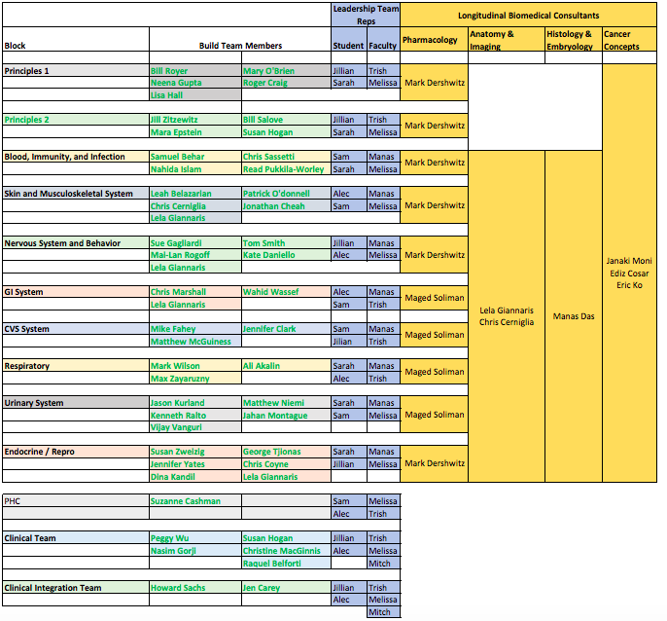
Build Teams and Members

Slide 20
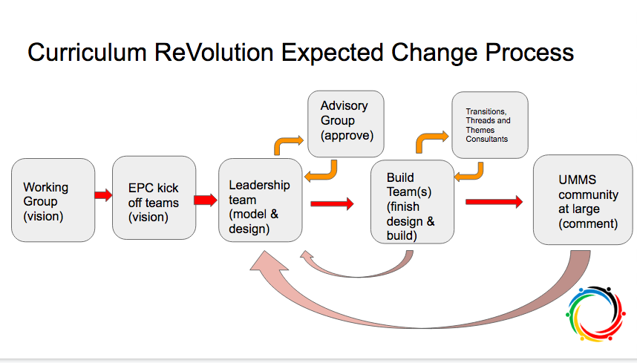

Slide 21
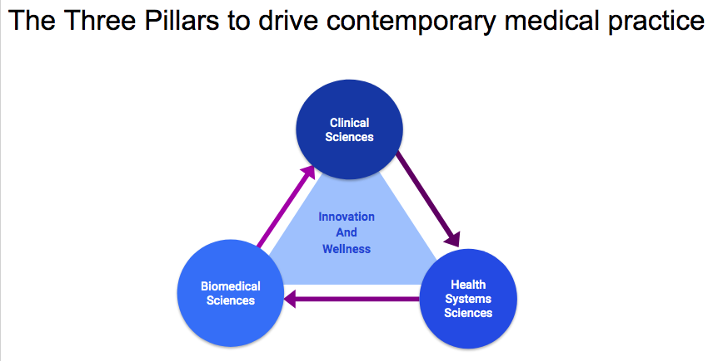
The Big Picture

Slide 22
Agenda
The big picture
Prior 3 year work
Gaps
Next steps
Notes:
Moving step 1 to after CCE is a discussion that is ongoing
Plans for a 3 year track
Pathways/track development
HSS as the third pillar
Remediation/deceleration plans and structure
Clinical years (CCE) reno

