Slide 1

SOM Curriculum ReVolution and the 3-year MD track
10/20/2020
Curriculum ReVolution Leadership Team

Slide 2

We are seeking GME programs that fall into 2 categories:
Partner on design AND wish to be considered for implementation (3-year MD students would be accepted to your program)
Partner on design of the 3 year track, but do NOT want to be considered for implementation

Slide 3

Principles of broad curriculum change
OLYMPIC RINGS COLOR
Single pass curriculum, block structure, consistent expectations
Standardized weekly calendars
Built in remediation space
Integrated longitudinal content
Scheduled, full clinical day +
Engaged, student-centered learning
Decreased unintended redundancy
Pathways to promote curiosity and inquiry
Each ring is for each continent on Earth
SKIN COLOR
Notes:
Add more

Slide 4
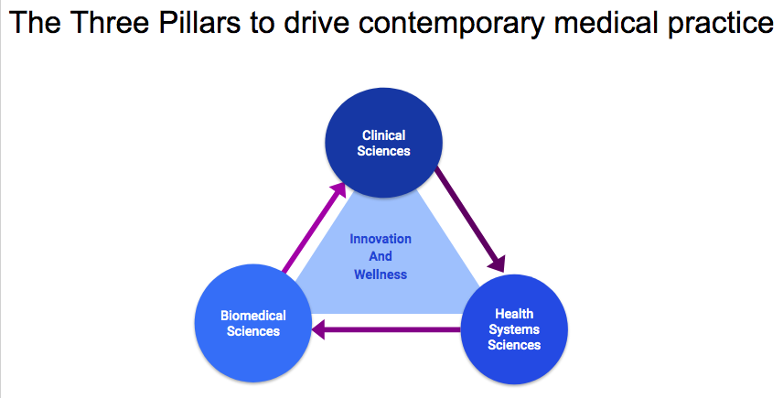
The Big Picture

Slide 5
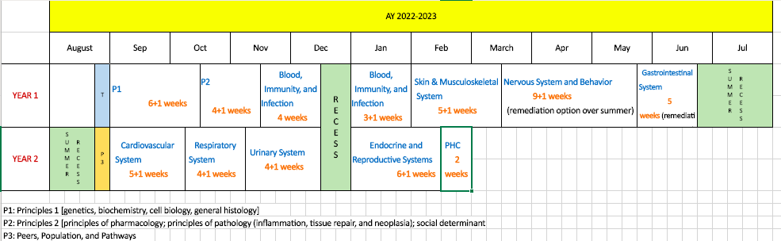
Block-based, Single Pass, 18-month Foundational Curriculum
Each student selects a Pathway (spring year 1) -- relates to Capstone and other experiences
1-week Healthcare Delivery Systems/Pathway experience spring year 2
Redesigning Core Clinical Experiences (clerkships +, integrated interstitial)
Step 1 likely to move into/after 3rd/clerkship year (supports purposeful integration in CCE)
2-week service learning/health systems/population experience in fall year 3
3-year MD track
Notes:
Full transition to single pass curriculum
Templated weekly schedules
Single clinical day standardized each week
Pathways, Optional 3-year track

Slide 6
Why a 3 Year MD Program?
More students enter medical school with related skills
Individualized pathways match student goals
Lifetime savings potential $250,000¹
Address the predicted physician shortage
Alignment with specified residencies and programs
Drive innovation in medical education
¹Weiner S. AAMCNews. Friday, March 29, 2019. Available online at https://news.aamc.org/medical-education/article/med-school-3-years-future-medical-education/ . Accessed 4/10/19.
Notes:
Some electives get cut. Vacations get trimmed. Clinical experiences start much earlier.

Slide 7

Draft Principles
Launch August 2022 in sync with new curriculum
Generalist disciplines (with demonstrated need)
Limited number of disciplines and students; while sufficient to build community cohort
Consistent foundational curricula with adjustments to summer, electives, potential partial parallel curriculum
Multiple points of entry and exit
Equity in admissions
Robust assessment and support
Potential early clinical experiences in residency clinics, role modeling and mentoring from residents and faculty

Slide 8
The Big Picture: 3 year track will align with generalist disciplines and our own residency programs – meeting the needs of the Commonwealth and our Healthcare System
Alignment
Acceptance
Assessment
Equity
Notes:
Re-imagine early clinical learning
Remove silos of DCS, PD, LPP, Hospital sessions (should be related to each other in time)
Tasked with tying content into block-based learning (with assessment contributing to block grade)
Selected EPAs as an overarching framework
I would love to see an actual assessments of the EPAs referred to in your evaluation. I have been requesting my incoming interns to do an incoming self assessment of the 13 EPAs for several years.
Do not have to maintain currently expected activities in the same number
Finite resources in this new model (and the old): physical space and mentor time
Addition of clinical skill simulation activities (phlebotomy, ultrasound)

Slide 9
We are seeking GME programs that fall into 2 categories
Partner on design AND wish to be considered for implementation (3 year MD students would be accepted to your program)
Partner on design of the 3 year track, but do NOT want to be considered for implementation

Slide 10
Admission Process
Student Profile
Expresses a strong commitment to a specific Generalist Discipline
Exhibits mature behavior to complete an accelerated MD program
Has a strong academic record predictive of success
Application Processes
Secondary application with MD application
Must be accepted to MD program first
During M1 year
After M1 year
Anytime during M2
After PhD

Slide 11
Selected medical Schools with 3-Year Medical Program
Current 3-Year MD Programs
Interested in Developing 3-Year MD Program
Columbia U College of Physicians and Surgeons
Cooper Medical School of Rowan University*
Cumming SOM University of Calgary
DeGroote SOM (Ontario) McMaster U
Duke University SOM*
Medical College of Wisconsin*
Mercer U SOM*
NYU SOM Langone Health*
Ohio State SOM*
Pennsylvania State COM*
Renaissance SOM at Stony Brook U
Rutgers Medical School
Texas Tech U Health Science Center SOM*
U of CA Davis SOM*
U of Kentucky SOM*
U of Louisville SOM*
University of North Carolina School of Medicine, Chapel Hill*
Medical University of South Carolina*
Hackensack Meridian School of Medicine at Seton Hall University*
*Member of Consortium of Accelerated Medical Pathway Programs

Slide 12
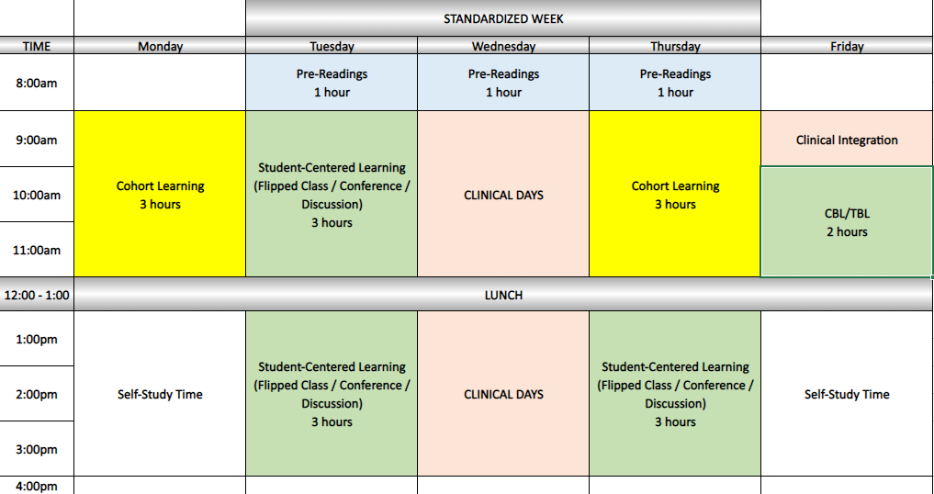
Typical Week
Do we utilize any of this time for 3 year track students?

Slide 13
Longitudinal Assessments
Competencies
NBME (pre-clinical and clinical)
EPAs
Milestones?

Slide 14
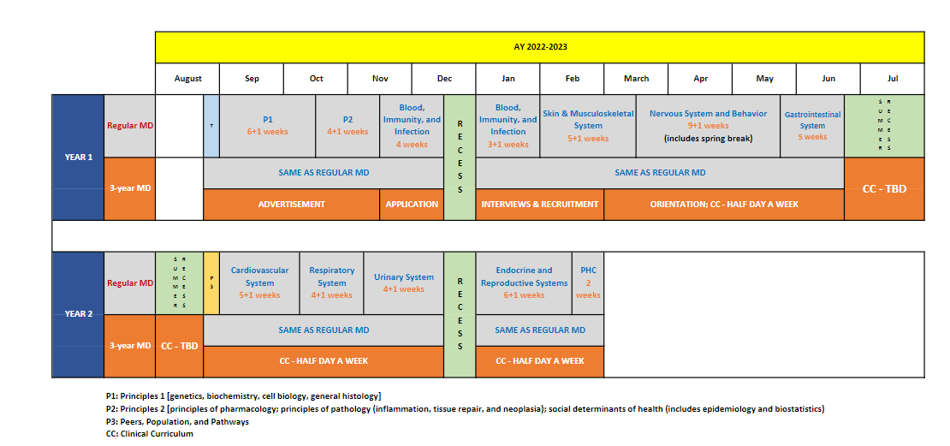
3 Year MD Track draft 18 mos

Slide 15
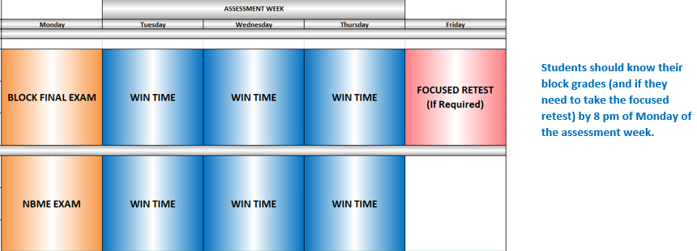
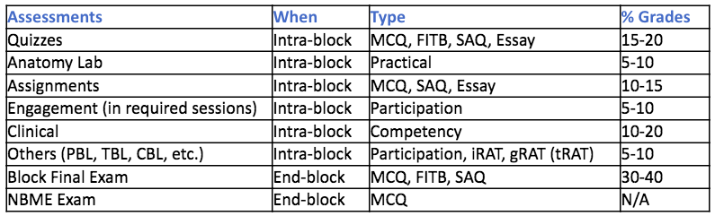
Assessment Week and WIN time

Slide 16
Potential Pathways
Existing
Global health
Rural health
Urban health
Clinical and Translational Research
Baseline
Clinical care
Leadership
Biomedical Innovation, Design, Device development
Diversity – LGBTQ care, race/bias
HSS (QI, HCP)
Humanities
Community engagement
Education (patient, peers, community, medical education)
Simulation
Advocacy (community, political)
Care of vulnerable populations
LatinX health/Spanish immersion

Slide 17
Moving step 1 AFTER the start of Core Clinical Experiences
Fosters clinical-biomedical learning
Step 1 is increasingly clinical
Allows preclinical space for other curriculum
Would require some curriculum building for clinical-biomedical connection each rotation
"I felt that there was too much emphasis in the MS1 and MS2 years about preparing for Step 1 at the expense of developing a very strong clinical knowledge for the future. The program I am at doesn't have their students take step 1 until after their first year of clerkship and I feel that their clinical knowledge is much stronger than the average UMass student."
Most schools report an increase in scores
Jurich D, Daniel M, Paniagua M, et al. Moving the United States Medical Licensing Examination (USMLE) Step 1 after core clerkships: An outcomes analysis. Acad Med. 2019;94:371–377.
Notes:
A recent study demonstrated small but statistically signicant increases in Step 1 scores at four schools (an average of 2.78 scaled score points after accounting for rising national Step 1 scores) and decreased firrst-time failure rates (a 2.48% reduction) when the Step 1 exam was positioned after core clerkships. adjusting for MCAT scores and rising national averages
Compared to earlier testing in the prior year but also when compared to schools that had step 1 positioned prior to CCE
Authors are cautious to say that this is not a meaningful improvement but rather evidence of noninferiority
CBSE twice (at end of foundational curriculum) and self assessment
CBSE (in feb), CBSSA (focused exam, close to step 1) --> new would be 2 (end of 18 months, and after clerkships) & 1 (for self-study purposes).

