Slide 1

3 year track
11/25/2020
Curriculum ReVolution Leadership Team

Slide 2
Agenda
Formalize mission
Review timeline
Develop working groups
other
Notes:
Moving step 1 to after CCE is a discussion that is ongoing
Plans for a 3 year track
Pathways/track development
HSS as the third pillar
Remediation/deceleration plans and structure
Clinical years (CCE) reno

Slide 3
Mission: support learners, amplify the generalist workforce, meeting the needs of the Commonwealth, and our Healthcare System (consider sub-bullets: program should serve the needs of the students/diverse learners,)
Professional development
Equitable enrollment
Robust academic and professional support
Early clinical and community partnership
Notes:
Re-imagine early clinical learning
Remove silos of DCS, PD, LPP, Hospital sessions (should be related to each other in time)
Tasked with tying content into block-based learning (with assessment contributing to block grade)
Selected EPAs as an overarching framework
I would love to see an actual assessments of the EPAs referred to in your evaluation. I have been requesting my incoming interns to do an incoming self assessment of the 13 EPAs for several years.
Do not have to maintain currently expected activities in the same number
Finite resources in this new model (and the old): physical space and mentor time
Addition of clinical skill simulation activities (phlebotomy, ultrasound)

Slide 4
Principles
Generalist disciplines with demonstrated need without need for fellowship training in Worcester and BHS
Equity in admissions
Limited number of students and programs, but enough to build a cohort
Consistent foundational curricula – adjusted summer, electives, increased parallel experiences
Robust longitudinal assessment, feedback, academic and professional development support
Early links to partner resident clinics for mentoring and familiarity
Multiple opportunities for entry and exit

Slide 5
Accreditation issues
LCME considers this a parallel curriculum
Core, comparable graduation competencies, objectives and assessments
Institutionally agreed-upon educational rationale
Can have additional objectives or competencies
130 weeks required Aug to Aug = 48 (4 wks vac); Aug to end Feb = 27 (2 wks vac); March to May = 12 (1 wk vac); June to May = 48 (4 wks vac): total 135 wks
Submit
Goal apply before Aug 2021 (Oct approval) or Dec '21 (Feb approval) for students entering Aug 2022
Date Form Received | Date Notification will be Reviewed by the LCME
August 2 – December 1* | February LCME meeting
December 2 – April 1* | June LCME meeting
April 2 – August 1* | October LCME meeting

Slide 6
NRMP process
Apply for exception to the 'all in' policy
Rural Scholars Programs: tracks into primary care residency at the institution.
Family Medicine Accelerated Programs: transition them into a Family Medicine residency at the institution.
Innovative Programs: address a compelling public interest by creating an educational experience that differs qualitatively from traditional undergraduate medical education curricula.
Basic requirements
LCME approval
Addresses workforce, regional/state/geographic needs
Is exception from the match necessary?
Ability to transfer out without penalty
Approval for up to 3 years (if program meeting objectives)
Due by Nov 30 (? 2021)

Slide 7

Process present to advisory Jan '21 apply for LCME April 21 and NRMP
Formalize mission
Draft goals and objectives from UMMS competencies
Identify curricular model (130 weeks)
Forge residency affiliates
Define acceptance, promotion, deceleration, remediation and transfer criteria
Design mentoring model
Describe necessary resources
Adapted from Medical Education online 2017

Slide 8
Timeline
Advisory Committee approval
NRMP application
EPC approval
LCME application
Students matriculate
Aug '22
Jan '21
April '21
??
??

Slide 9
Three Year Track Design Questions
Admissions:
When do students apply? What are characteristics?
How do we promote equitable enrollment and ongoing support?
Curriculum:
Does the foundational curriculum need to be augmented?
What is the clinical/clerkship model?
How do we connect with Capstone and HSC/PHC? LPP/LIC? Clinic alignments?
Professional development
How do we build advocacy and engagement experiences?
Assessment
What are benchmarks for progression? Deceleration? Transfer? Board timing?
Support
What is the Advisory/Committee support structure?

Slide 10
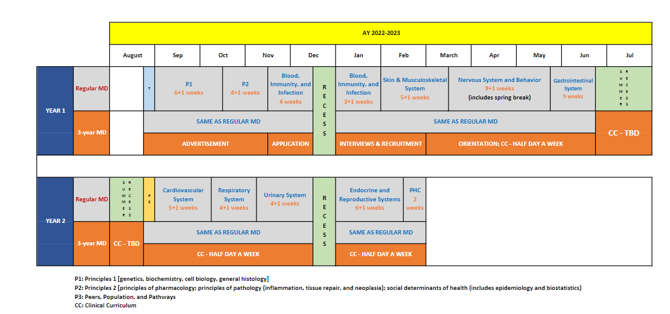
3 Year MD Track draft 18 mos

Slide 11
Longitudinal Assessments
Competencies
NBME (pre-clinical and clinical)
EPAs
Milestones?

Slide 12
Admission Process
Student Profile
Expresses a strong commitment to a specific Generalist Discipline
Exhibits mature behavior to complete an accelerated MD program
Has a strong academic record predictive of success *
Application Processes
Must be accepted to MD program first
During M1 year (when)?
The following options miss opportunity for summer curriculum:
After M1 year
Anytime during M2
After PhD

Slide 13
How to align with Pathways? Is this its own pathway?
Existing
Global health
Rural health
Urban health
Clinical and Translational Research
Baseline
Clinical care
Leadership
Biomedical Innovation, Design, Device development
Diversity – LGBTQ care, race/bias
HSS (QI, HCP)
Humanities
Community engagement
Education (patient, peers, community, medical education)
Simulation
Advocacy (community, political)
Care of vulnerable populations
LatinX health/Spanish immersion

Slide 14
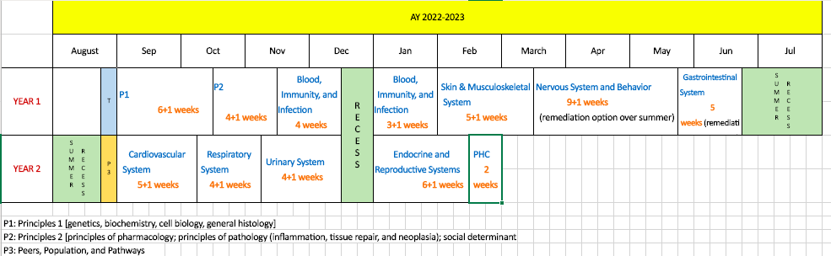
Block-based, Single Pass, 18-month Foundational Curriculum
Each student selects a Pathway (spring year 1) -- relates to Capstone and other experiences
1-week Healthcare Delivery Systems/Pathway experience spring year 2
Redesigning Core Clinical Experiences (clerkships +, integrated interstitial)
Step 1 likely to move into/after 3rd/clerkship year (supports purposeful integration in CCE)
2-week service learning/health systems/population experience in fall year 3
3-year MD track
Notes:
Full transition to single pass curriculum
Templated weekly schedules
Single clinical day standardized each week
Pathways, Optional 3-year track

Slide 15
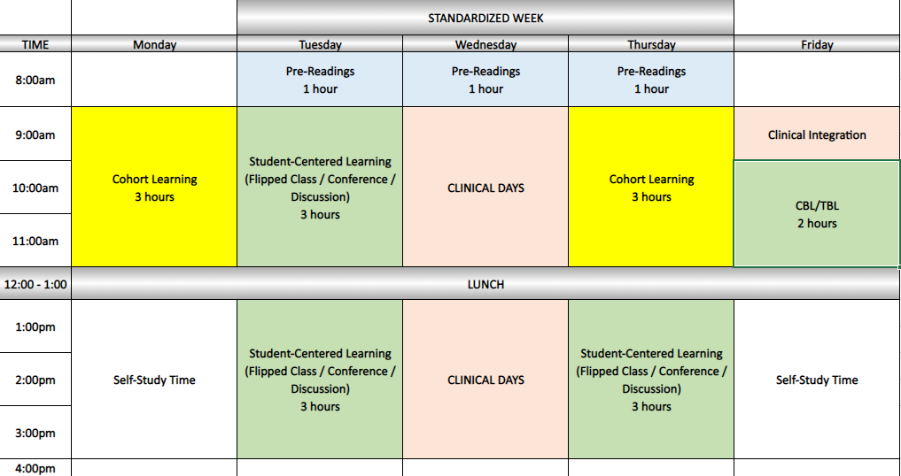
Typical Week
Do we utilize any of this time for 3 year track students?

Slide 16

Draft timeline
Team design begins – September 2020
Program director outreach and GME team invitations -- November 2020
- involved in planning; involved in first wave of implementation
Step 1 adjustment - November 2020
Modeling -- Nov - Jan 2021
Present to SOM advisory committee - by Jan 2021
EPC presentations begin March 2021
Final EPC focus on 3 year – September 2021 (final implementation pending LCME report from 2020; may delay to 2023 implementation)
POST LCME APPROVAL TIMELINE

Slide 17
