Slide 1

3 year track
11/6/2020
Curriculum ReVolution Leadership Team

Slide 2
Agenda
The big picture
Our tasks
Working groups
Next steps
Notes:
Moving step 1 to after CCE is a discussion that is ongoing
Plans for a 3 year track
Pathways/track development
HSS as the third pillar
Remediation/deceleration plans and structure
Clinical years (CCE) reno

Slide 3
Why a 3 Year MD Program?
More students enter medical school with related experience
Financial benefit: lifetime savings of $250,000¹
Provides physicians faster for predicted physician shortage
Offers individualized pathways matched to student goals (dual degrees, links to specific fields)
Provides alignment with specific residencies and programs
Drives innovation in medical education
Fosters competency based learner assessment
¹Weiner S. AAMCNews. Friday, March 29, 2019. Available online at https://news.aamc.org/medical-education/article/med-school-3-years-future-medical-education/ . Accessed 4/10/19.

Slide 4
The Big Picture: 3 year track will align with generalist disciplines and our own residency programs – meeting the needs of the Commonwealth and our Healthcare System
Residency Partnership
Acceptance and Transfer
Programming and Assessment
Equity and Support
Notes:
Re-imagine early clinical learning
Remove silos of DCS, PD, LPP, Hospital sessions (should be related to each other in time)
Tasked with tying content into block-based learning (with assessment contributing to block grade)
Selected EPAs as an overarching framework
I would love to see an actual assessments of the EPAs referred to in your evaluation. I have been requesting my incoming interns to do an incoming self assessment of the 13 EPAs for several years.
Do not have to maintain currently expected activities in the same number
Finite resources in this new model (and the old): physical space and mentor time
Addition of clinical skill simulation activities (phlebotomy, ultrasound)

Slide 5
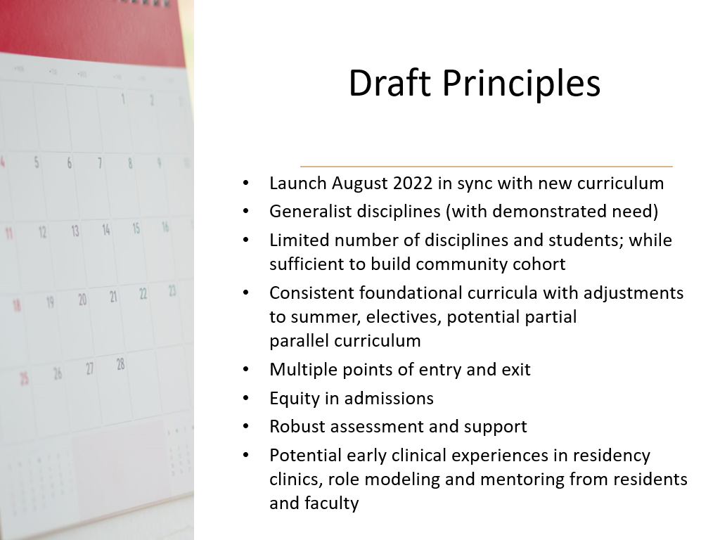

Slide 6

Process
Formalize mission
Draft goals and objectives
Identify curricular model (130 weeks)
Forge residency alliances (?affiliates)
Define acceptance, promotion, deceleration, remediation and transfer criteria
Design mentoring model
Define necessary resources
Apply for LCME (insert anticipated date; Dec 2021)
Adapted from Medical Education online 2017

Slide 7

Draft timeline
Team design begins – September 2020
Program director outreach and GME team invitations -- November 2020
- involved in planning; involved in first wave of implementation
Step 1 adjustment - November 2020
Modeling -- Nov - Jan 2021
Present to SOM advisory committee - by Jan 2021
EPC presentations begin March 2021
Final EPC focus on 3 year – September 2021 (final implementation pending LCME report from 2020; may delay to 2023 implementation)
POST LCME APPROVAL TIMELINE

Slide 8
Clarify our Mission
Should we consider a 3-year track specifically designed for students from backgrounds underrepresented in medicine?
Would this model accept students from outside that demographic?
Notes:
Unusual adversity in the pursuit of medicine
Would this attract those who have multiple acceptances in NE area
Reducing barriers
What is the language from other programs.

Slide 9
Three Year Track Design Questions
When do students apply? What are characteristics?
How do we promote equitable enrollment and ongoing support?
Does the foundational curriculum need to be augmented?
What is the clinical/clerkship model?
How do we connect with Capstone and HSC/PHC? LPP/LIC? Clinic alignments?
How do we build advocacy and engagement experiences?
What are benchmarks for progression? Deceleration? Transfer? Board timing?
What is the Advisory/Committee support structure?

Slide 10
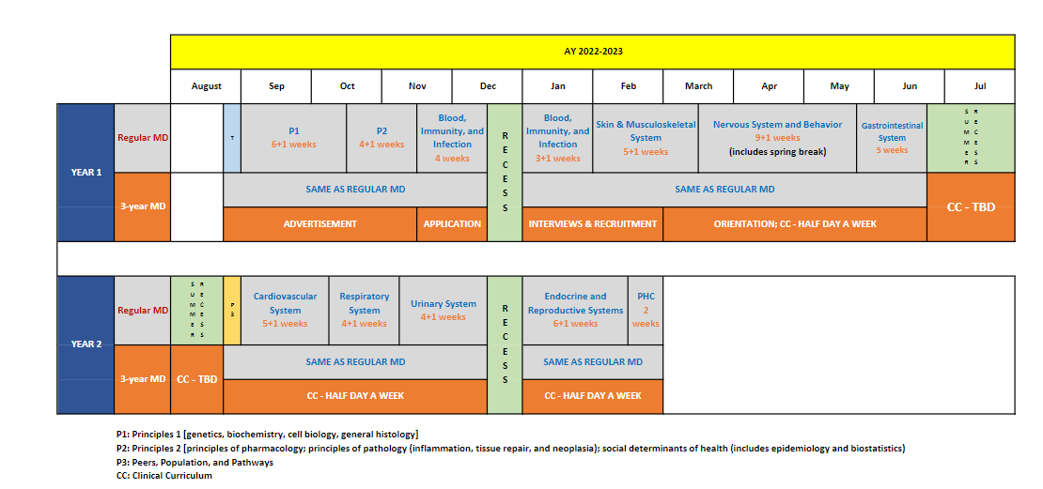
3 Year MD Track draft 18 mos

Slide 11
Longitudinal Assessments
Competencies
NBME (pre-clinical and clinical)
EPAs
Milestones?

Slide 12
Accreditation issues
LCME considers this a parallel curriculum
Core, comparable graduation competencies, objectives and assessments
Institutionally agreed-upon educational rationale
Can have additional objectives or competencies
130 weeks required
Aug to Aug = 48 (4 wks vac); Aug to end Feb = 27 (2 wks vac); March to May = 12 (1 wk vac); June to May = 48 (4 wks vac): total 135 wks
Submit
earliest submission Dec 1, 2020 for consideration at Feb LCME mtg
Goal implementation in 2021 for students entering in 2022

Slide 13
Admission Process
Student Profile
Expresses a strong commitment to a specific Generalist Discipline
Exhibits mature behavior to complete an accelerated MD program
Has a strong academic record predictive of success
Application Processes
Secondary application with MD application
Must be accepted to MD program first
During M1 year
After M1 year
Anytime during M2
After PhD

Slide 14
How to align with Pathways? Is this its own pathway?
Existing
Global health
Rural health
Urban health
Clinical and Translational Research
Baseline
Clinical care
Leadership
Biomedical Innovation, Design, Device development
Diversity – LGBTQ care, race/bias
HSS (QI, HCP)
Humanities
Community engagement
Education (patient, peers, community, medical education)
Simulation
Advocacy (community, political)
Care of vulnerable populations
LatinX health/Spanish immersion

Slide 15
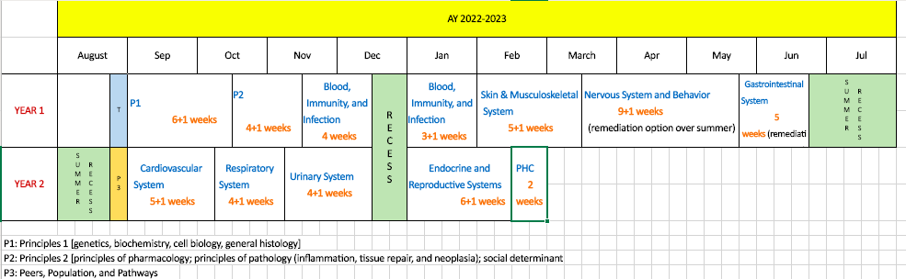
Block-based, Single Pass, 18-month Foundational Curriculum
Each student selects a Pathway (spring year 1) -- relates to Capstone and other experiences
1-week Healthcare Delivery Systems/Pathway experience spring year 2
Redesigning Core Clinical Experiences (clerkships +, integrated interstitial)
Step 1 likely to move into/after 3rd/clerkship year (supports purposeful integration in CCE)
2-week service learning/health systems/population experience in fall year 3
3-year MD track
Notes:
Full transition to single pass curriculum
Templated weekly schedules
Single clinical day standardized each week
Pathways, Optional 3-year track

Slide 16
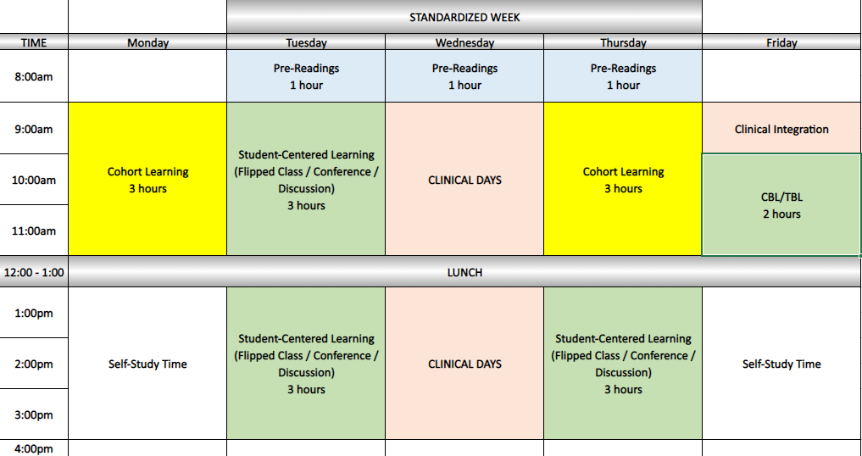
Typical Week
Do we utilize any of this time for 3 year track students?

