Slide 1
Using PPE to Prevent and Control Infection in the Clinical Setting
A Student Guide to Implementing Successful Practices around PPE, Interpreting Hospital Precautions, and Protecting Yourself and Patients
Marie Hydro, MS4
May 2020

Slide 2
Background
This presentation was created by a student (Marie Hydro, MS4), for students!
It is intended to fill a gap in the curriculum that I identified as I reflected on my third year experience:
  No streamlined, formal teaching for students on PPE and how to use it appropriately.
  Teaching often happened in the moment when on clinical rotations.
  Instruction varied based on the attending, resident, etc.
My goal was to create a single, streamlined resource that students can review prior to starting clinical rotations, and reference throughout the year as needed.
Peer teaching is going to be a big part of this presentation!
  Clinical pearls throughout reflect important tips and tricks for using PPE successfully on the wards. These were generated based on personal experience.
  Collaboration with other members of the Class of 2021 led to the creation of student-led demonstration videos. You’ll find these toward the end of the presentation, and it my hope that these will help to reinforce some of the important concepts presented in the earlier slides.

Slide 3
Objectives
By the end of the presentation, students will be able to:
Recognize individual pieces of PPE, describe their functions and limitations, and list examples of use in various clinical scenarios.
Interpret common hospital precautions signs, and correctly identify which pieces of PPE are required for the corresponding clinical scenario.
Explain and execute proper step-by-step technique for donning and doffing PPE, as well as identify mistakes commonly made during these processes by themselves and others.

Slide 4

Overview
Personal protective equipment (PPE) is a term used to describe pieces of medical equipment that are designed to protect the wearer from exposure to infection or injury by limiting contact between mucous membranes and/or skin and infectious materials. It includes:
  Masks (i.e. surgical masks, respirators, and PAPRs)
  Eye protection (i.e. face shield and goggles)
  Gloves
  Gowns
Several clinical scenarios, namely those in the realm of infectious disease, necessitate the correct use of PPE in order to lessen the chances of person-to-person transmission of infectious materials.
Very specific procedures exist to dictate how PPE should be applied (aka “donning”) and removed (aka “doffing”). Following these guideline further protect the wearer and lessens the chance of unintentional contamination.

Slide 5
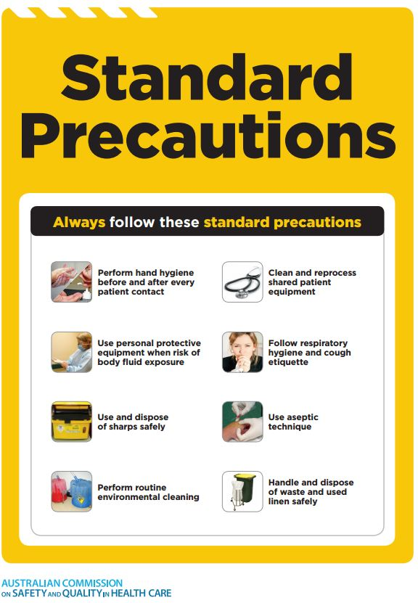
Standard Precautions
The following is a list of practices that should be implemented during the care of every patient, as they limit the risk of infection transmission between patients and providers, and vice versa.
  Good hand hygiene before and after every patient encounter
  Use of proper PPE when risk of exposure to blood or bodily fluids exists
  Respiratory hygiene and cough etiquette
  Appropriate patient rooming to limit contact with others
  Regular and thorough cleaning of all medical instruments, patient care equipment, and communal spaces
  Conscious handling of laundry and linens
  Follow safe injection practices
  Proper handling and disposal of needles and sharps

Slide 6
Let’s start by taking a closer look at which specific pieces of medical equipment are included under the umbrella designation of PPE.
Denotes a “clinical pearl”, or a teaching point that will be particularly relevant when rotating on the wards.
Pay close attention to these over the next several slides!

Slide 7
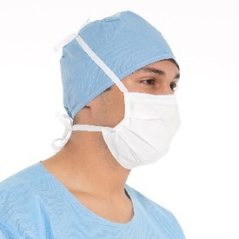
Surgical Mask
Surgical masks should NOT be untied at the top and worn around the neck (i.e. between OR cases).
  Looser fit around the nose and mouth.
  Fluid resistant – protection against large droplets, sprays, and splashes of blood or other bodily fluids.
  DOES NOT offer adequate protection against small particle aerosols (i.e. respiratory droplets) – should NOT be worn for AGPSs performed in patients with suspected or confirmed infection.
  Only appropriate for use in patients in whom suspicion for respiratory infection is LOW.
  Single-use only – replace immediately if damaged. Reusable in times of shortage – follow site-specific guidance for safe and appropriate reuse.
Notes:
Surgical masks feature ties that extend around the back of the head or elastics that are secured behind the ears, and a flexible nose piece that the wearer can mold to conform snugly along the bridge of the nose.
Aerosol-generating procedures (AGPs) include any procedure that may induce coughing in a patient. Examples include bronchoscopy, endotracheal intubation, airway suction, positive pressure ventilation, etc.

Slide 8
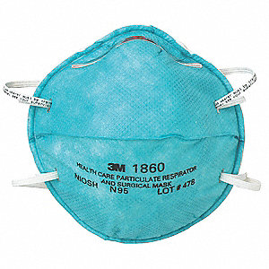
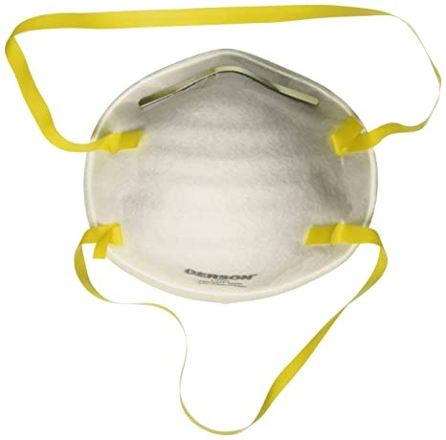
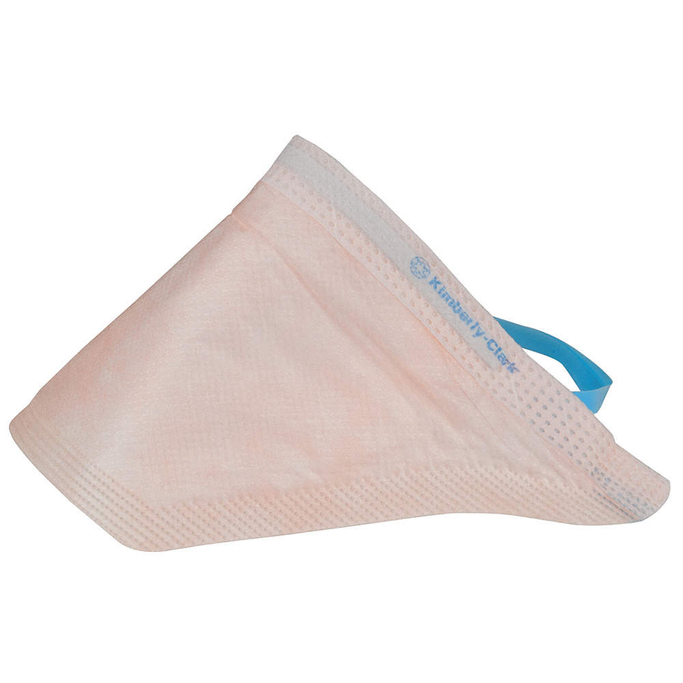
N95 Respirator
You should be fit tested YEARLY by EHS personnel at your institution in order to ensure that your designated respirator is still the best, most protective option.
Makeup has been shown to damage respirators, lessening the number of times they can be safely reused. DO NOT wear makeup if you will be wearing a respirator.
  Airtight fit around the mouth and nose.
  Fluid resistant – protection against 95% of small particle aerosols (i.e. respiratory droplets), as well as large droplets, sprays, and splashes of blood or bodily fluids.
  Appropriate for use when performing AGPs on patients with suspected or confirmed respiratory infection.
  All models offer the same level of protection.
  Single-use only – replace if damaged or deformed, visibly wet or dirty, or if the wearer cannot breathe.
  Reusable in times of shortage – follow site-specific guidance for safe and appropriate reuse.
Notes:
N95 respirators have two elastic straps that are secured around the back of the head – one around the crown, and one around the nape of the neck – with a nose piece that the wearer can mold to conform snugly across the bridge of the nose.
Several companies manufacture their own styles of N95 respirators including 3M, Gerson, and Kimberly Clarke.

Slide 9
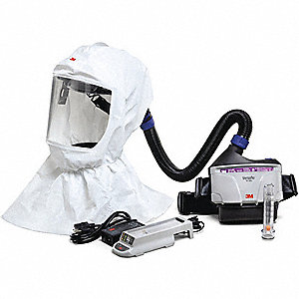
Powered Air-Purifying Respirator (PAPR)
Prior to using a PAPR, be sure to check that batteries are charged, the filter is clean, and air flow through the hose is sufficient.
  Option for individuals who fail fit testing to all available N95 respirators.
  Loose-fitting hood attached via a hose to a battery-powered air purifier worn around the waist.
  Fluid-resistant – protection against small particle aerosols, as well as large droplets, sprays, and splashes of blood or bodily fluids.
  Built in eye protection.
  Reusable – sanitize after each use per CDC guidelines.
Notes:
PAPRs are designed to cover the entirety of a provider’s head, and in some models, the neck and shoulders as well. The battery-powered respirator is worn at the waist and draws air from the surrounding environment in through a filter. Once purified, the air is released into the hood where the wearer can breathe it in.

Slide 10
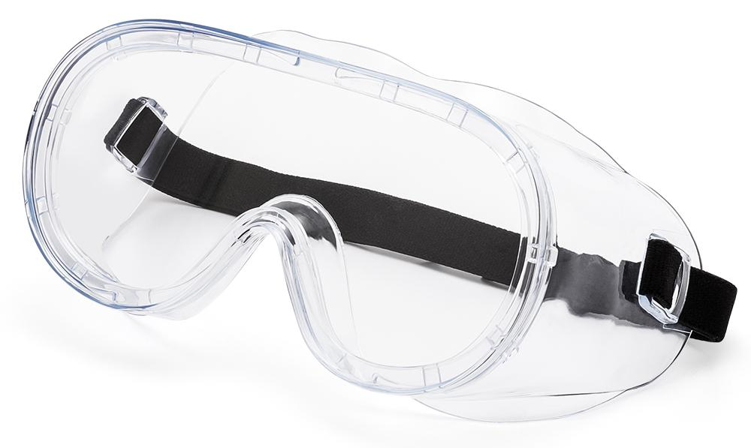
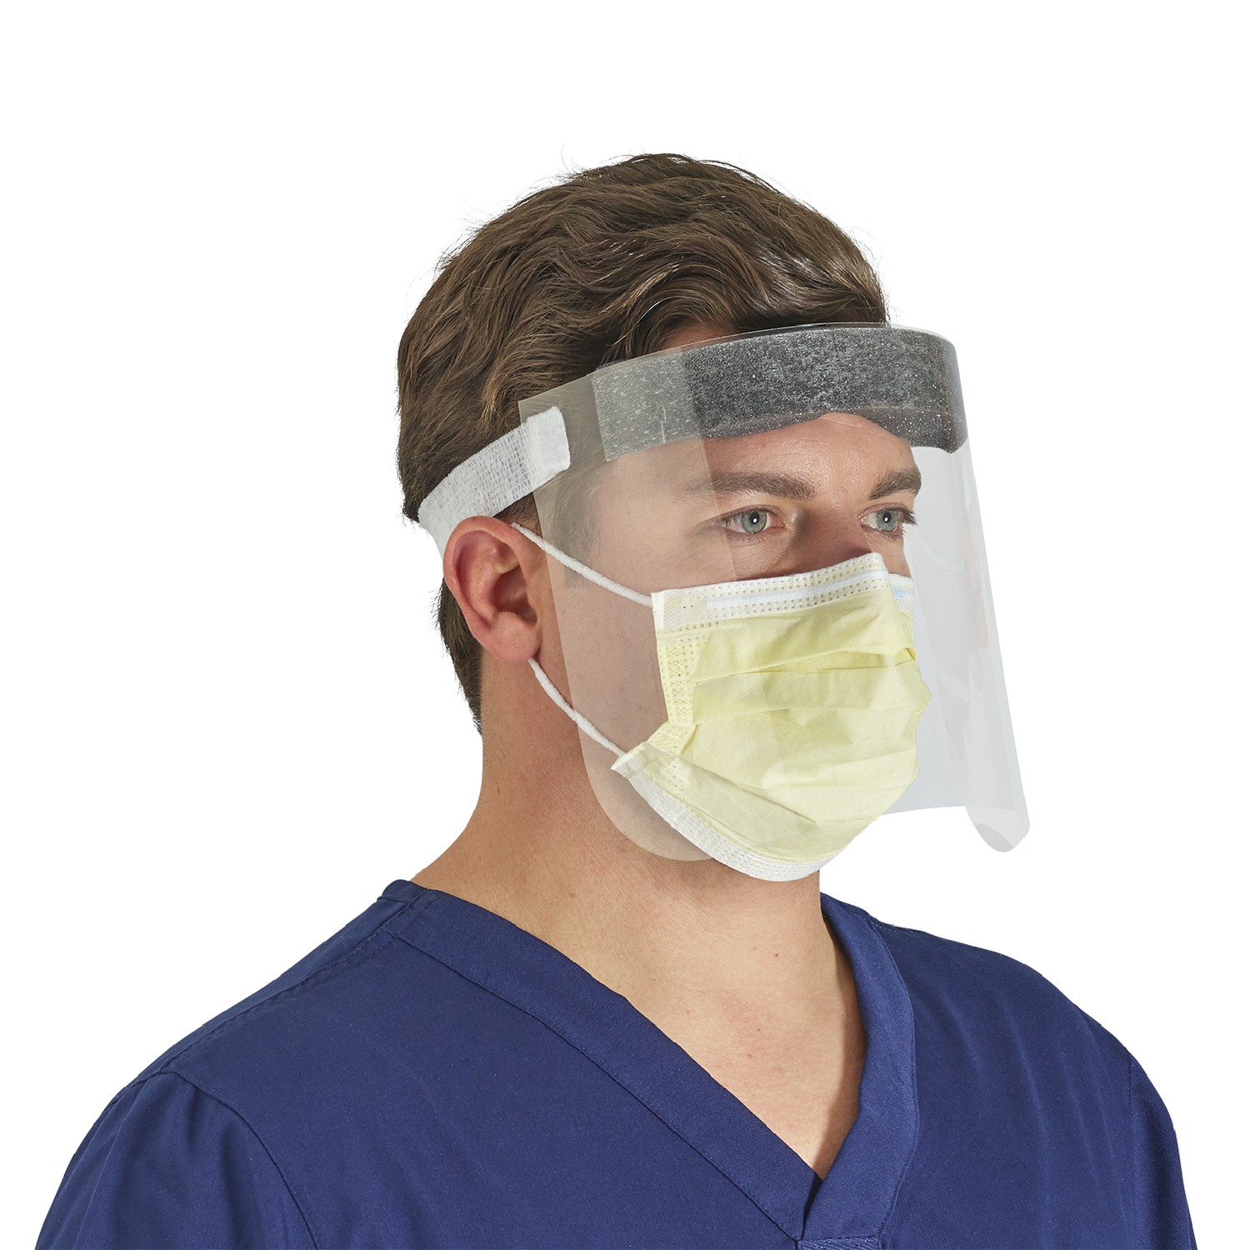
Eye Protection
Goggles are often worn with masks or respirators. It might take a couple tries, but mold the nose piece snugly to the bridge of your nose in order to keep your goggles from fogging up.
  Goggles cover only the eyes.
    Face shields cover the entire face.
  Fluid-resistant – eye protection against droplets, sprays, and splashes of blood and other bodily fluids.
  Single-use or reusable (varies by specific model) – proper sanitization required between uses.
Notes:
The eyes contain mucous membranes which act as another potential point of entry through which blood or bodily fluids can make their way into the body.
Goggles should fit snugly across the brow line and cover the eyes in their entirety, ideally extending slightly beyond the outer corners of the eyes. Notably, they leave the rest of the face exposed.
Face shields fasten around the back of the head and should extend downward to the chin and around to the ears on either side.

Slide 11
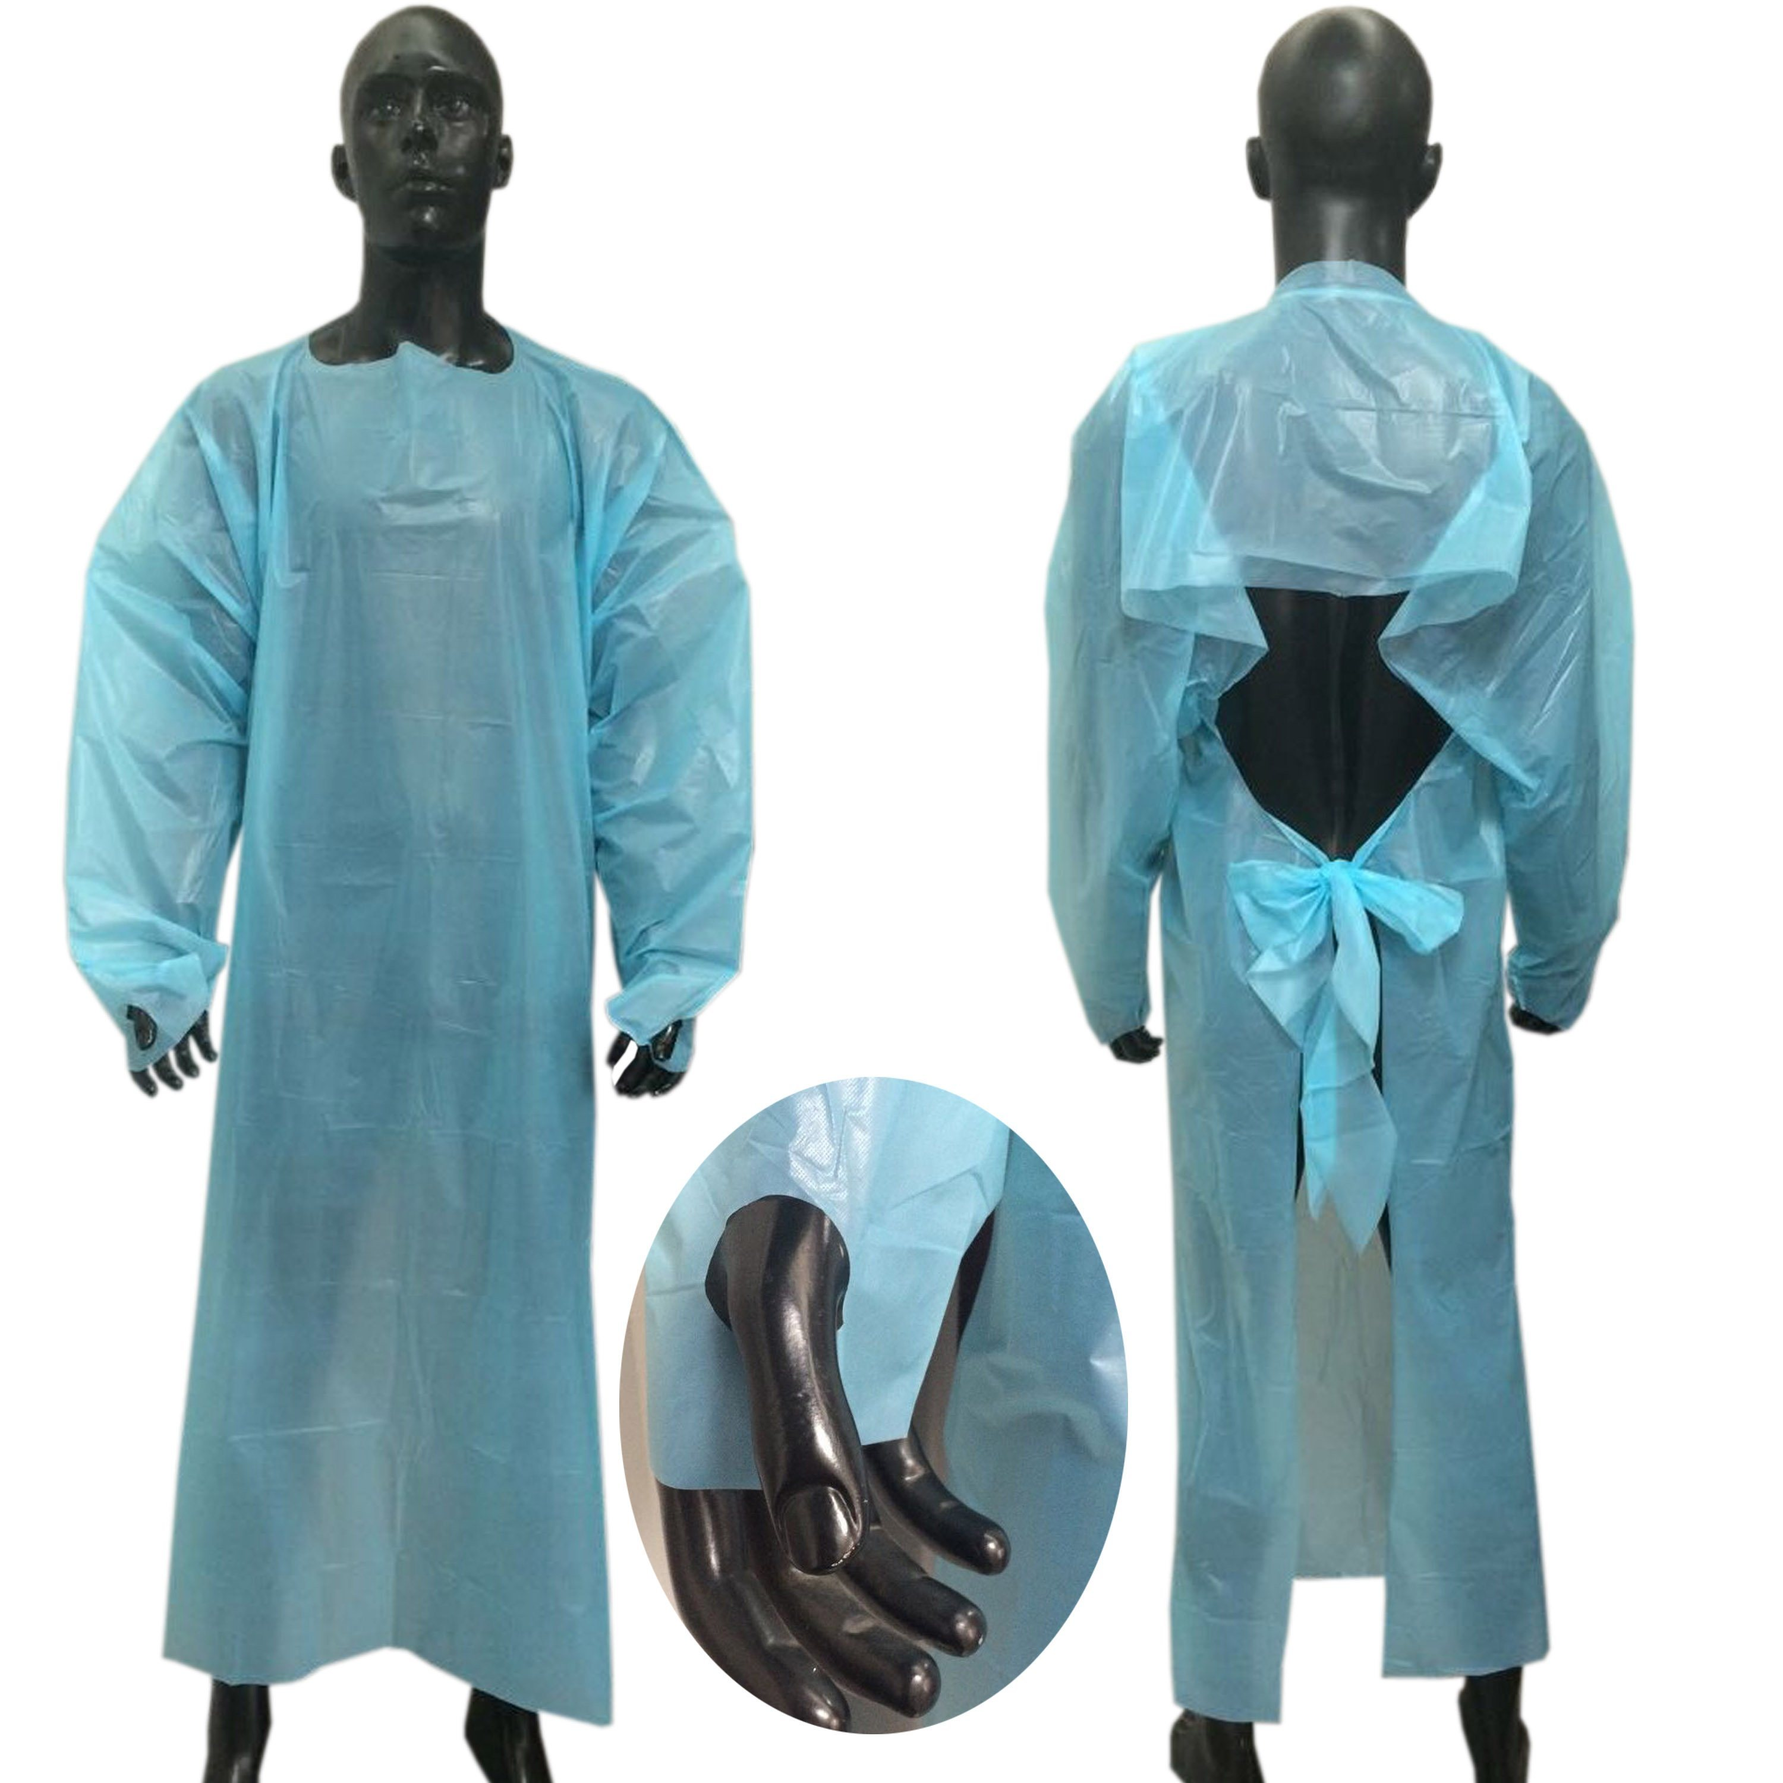
Gown
Loop your thumbs through the holes at the ends of the gown sleeves in order prevent them from riding up and minimize chances skin exposure.
In the past, you may have seen providers tie gowns by wrapping the ties around and knotting in the front. Do NOT do this. Per CDC guidelines, all gowns must be tied in the BACK.
  Covers most of the body surface.
  Fluid-resistant – skin and underlying garment protection against large volumes of droplets, sprays, and splashes of blood or other bodily fluids.
  Two types of gowns – non-sterile patient isolation gowns and sterile surgical gowns.
  Single-use only – true for most standard models.
    Reusable in times of shortage – follow site-specific guidelines for safe and appropriate reuse.
Notes:
Should be sized appropriate to extend from the based of the neck to at least the knees and cover the full length of the arms to the wrists.
Disposable patient isolation gowns are typically made from thin, but durable plastic. Reusable patient isolation gowns are made from studier material such as cotton, polyester, or a blend of these materials, lending them the durability to be washed and reused several times.

Slide 12
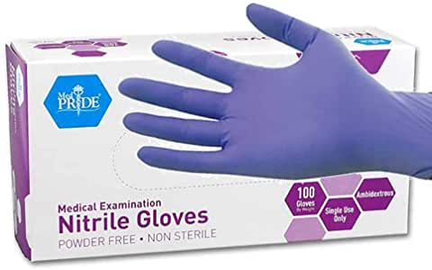
Gloves
Gloves must be changed between each patient encounter.
It is important to ask patients about whether they have an allergy to latex, as some medical gloves are still latex-based. These should be avoided in allergic patients.
  Worn over the hands.
  Choose the appropriate size – should fit snugly without being overly restrictive, and cover the wrists.
  Fluid-resistant – skin protection against large droplets, sprays, and splashes of blood or bodily fluids.
  Different types of gloves for different clinical scenarios – non-sterile patient examination gloves and sterile surgeon’s gloves.
  Single-use only – change between patient encounters or when gloves become visibly soiled or torn.
Notes:
Gloves should extend to cover the entirety of both wrists, as well as the ends of gown sleeves.
Manufacturers used several different kinds of materials to make gloves including rubber latex, nitrile, and other synthetics.

Slide 13
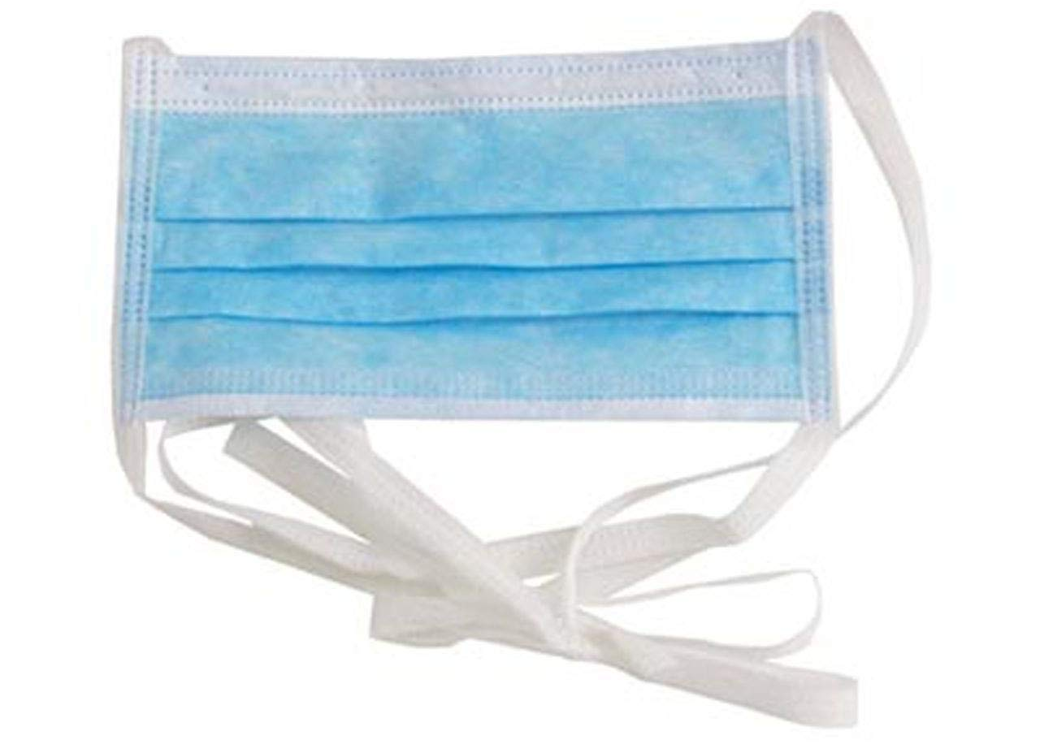
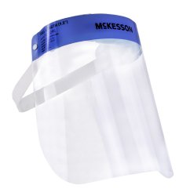
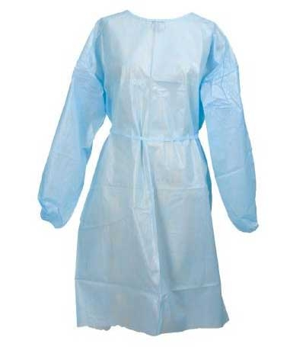
PPE | When to Wear | Example Clinical Scenarios | Clinical Pearls
Surgical mask | Risk of inhalation of large droplets, sprays or splashes of blood or bodily fluids. | Examining a pediatric patient with RSV bronchiolitis. Caring for an adult with influenza and an active cough. | Don’t let the mask dangle around your neck by the bottom ties. Do not wear makeup if you know you’ll be wearing a respirator.
N95 respirator PAPR | Risk of indirect exposure and inhalation of small particle aerosols, typically in patients with severe respiratory infection. | Performing a bronchoscopy on a patient with active tuberculosis. Providing routine medical care for a patient with COVID-19. | Remember to be fit tested yearly. Ensure that PAPR has been charged sufficiently, check for a clean filter, and test air flow before each use.
Eye protection | Risk of direct eye exposure to sprays or splashes of blood or bodily fluids. | Performing any kind of operation. Lancing or draining a tense boil, cyst, or infected wound. | When worn with a mask, pinch the nose piece of your mask tight in order to prevent goggles or face shield from fogging up.
Gown | Risk of direct or indirect exposure to blood or bodily fluids. | Treating a patient in the trauma bay. Examining a patient with C. difficile or active staphylococcal skin infection. | Loop your thumbs into the holes at the end of each sleeve to minimize wrist exposure. Remember to tie in the back.
Gloves | Risk of direct or indirect exposure to blood or bodily fluids. | Suturing or changing a surgical site dressing. Performing an outpatient procedure such as an influenza swab. Cleaning your stethoscope after examining a patient. | Change gloves between each patient encounter. Be sure to ask your patients about latex allergies early in their care.
Figure 1. Summary Table of PPE for Quick Reference

Slide 14
PPE in Clinical Practice
PPE is used daily in a variety of clinical settings.
  Always in addition to standard precautions
  Often in the examination and treatment of patients with known or suspected transmissible infections
Special sets of precautions dictate the care of patients with known or suspected infections.
  Typically necessitate the use of PPE
  Expected that all providers and visitors follow guidelines set forth by precautions
Hospitals use color-coded signs to highlight which set of precautions should be taken during patient care.
  Ensures that all providers and visitors are on the same page
  Signs readily displayed outside patient rooms
  Institutions use different formats, but all signs contain the same basic information
Notes:
When patients are suspected or known to have an infectious condition or disease, they are assigned a set of precautions that all individuals, whether providers or visitors, are expected to follow. These precautions often call for the use of PPE in order to protect both those individuals entering the room, and the patient themselves.
In order to keep all providers and visitors on the same page, hospitals use color-coded signs to highlight which set of precautions should be taken before, during, and after patient interaction. These signs are hung outside the patient room, usually on the door. They may look different depending on which institution you’re at, but all signs contain the same basic information.

Slide 15
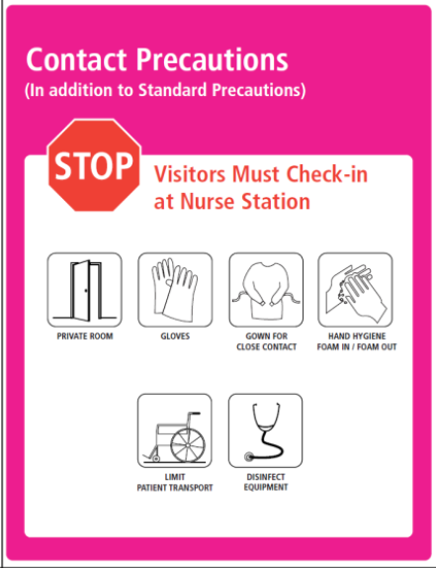
Interpreting a Precautions Sign
Highlights the mode of transmission of known or suspected patient infection. Also offers a clue about what specific kind of infection the patient may have.
Reminder to visitors check in with hospital staff before entering the patient room, as they too will require proper PPE.
Illustrations indicate the various pieces of PPE that should be worn while in the patient room.
Patients with confirmed or suspected transmissible infections should be roomed alone in order to prevent spread of infection to other patients.
Reminder to practice standard precautions (as with all patients!) by washing hands or applying hand sanitizer before entering and after leaving the patient room.
Patient transport to and from their room should be limited to only necessary trips for medical procedures, etc. when transmissible infection is suspected or known. In some cases, patients too, are expected to wear masks while out of the room or interacting with providers.
Reminder to disinfect stethoscopes, reflex hammers, and any other instruments that came in contact with the patient during evaluation.

Slide 16
Next, let’s get familiar with the specific precautions signs that you’ll see during your rotations at the UMass hospitals, and what kinds of PPE they require.

Slide 17
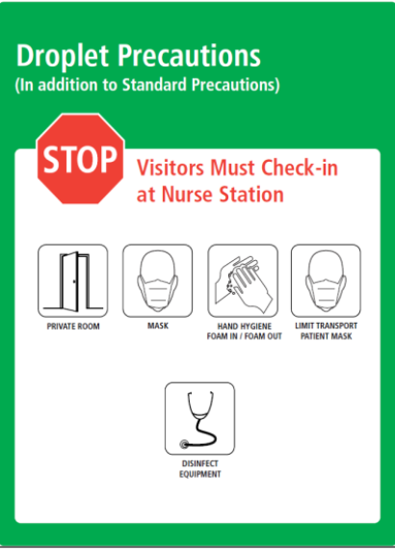
Indicates that patient has a suspected or confirmed infection that is transmissible to other individuals via direct exposure to small fluid droplets produced when the patient sneezes or coughs.
This patient encounter will require a surgical mask.
Common examples of conditions/ infections requiring droplet precautions:
Bronchiolitis
Epiglottis
Human metapneumovirus
Influenza
Mumps
Parainfluenza virus
Parvovirus B19
Pertussis
Meningococcal, mycoplasma, and H. flu pneumonia
RSV
Rubella
Other considerations:
Droplet precautions commonly coexist with contact precautions. This should make sense, since in reality, the respiratory droplets that we’re trying to protect against by using droplet precautions can live on any number of surfaces once expelled from the body. Adding contact precautions lessens the chances of infection via this secondary mode of transmission.
Source control may be attempted by having the patient wear a mask as well.

Slide 18
Indicates that patient has a suspected or confirmed infection that is transmissible to other individuals via direct skin exposure to surfaces that may carry infectious particles such as fluid droplets, fecal matter, blood, or other bodily fluids.
This patient encounter will require non-sterile gloves, and a patient isolation gown.
Common examples of conditions/ infections requiring contact precautions:
Draining abscesses
Bronchiolitis
Chickenpox
Hepatitis A (in diapered or incontinent patients)
Viral conjunctivitis
Skin infections or rashes
ESBL + (past or present)
Influenza
Lice
Rabies
RSV
Wound infections
Other considerations:
Contact and droplet precautions are typically the most common signs you’ll encounter on the wards. They’re especially prevalent during winter months on the pediatric floor, when large number of children are admitted for respiratory infections such as RVS bronchiolitis. When the floor becomes crowded and private rooms are sparse, patients are assigned rooms based on a process called “cohorting”. Cohorting groups patients with similar conditions and precautions such that room sharing it possible but not dangerous. Thus, you may see two bronchiolitis patients in the same room.

Slide 19
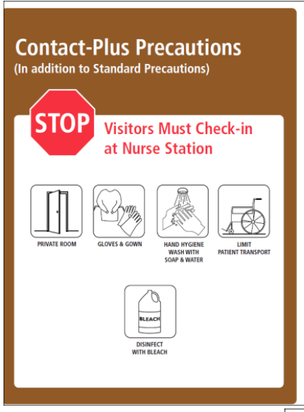
Indicates that patient has a suspected or confirmed infection that is transmissible to other individuals via direct skin exposure to surfaces that may carry infectious particles such as fluid droplets, spores, fecal matter, blood, or other bodily fluids.
This patient encounter will require non-sterile gloves, and a patient isolation gown.
Common examples of conditions/ infections requiring contact-plus precautions:
Clostridium difficile gastroenteritis or enterocolitis
Enteroviral infections in diapered or incontinent children
Norovirus
Rotavirus
Other considerations:
The major difference between contact and contact-plus precautions involves what happens after the patient encounter is over. Infections designated with contact-plus precautions are nasty and resilient (think the hardy spores that are characteristic of C. diff) and require a more thorough decontamination process. Thus, hand washing is encouraged over hand sanitizing and, once vacated, patient rooms should be thoroughly disinfected with a strong, bleach-based cleaning products.

Slide 20
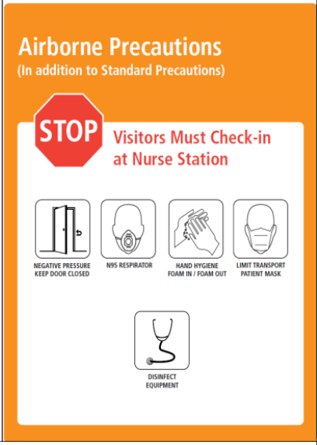
Indicates that patient has a suspected or confirmed infection that is transmissible to other individuals via indirect exposure to small particle aerosols (i.e. small respiratory droplets) produced when the patient speaks, coughs, or sneezes.
This patient encounter will require an N95 respirator or PAPR.
Common examples of conditions/ infections requiring airborne precautions:
Avian influenza
Chickenpox
Measles
Active tuberculosis (pulmonary or extrapulmonary with draining lesions)
Other considerations:
Many health care providers may actually be immune to some of the diseases that require airborne precautions. Knowing this, traffic through patient rooms should be minimized, and immune providers should be chosen to care for patients on airborne precautions whenever possible.
Negative ambient pressure prevents aerosolized infectious particles from escaping the patient room. Where negative pressure rooms are in short supply, greater infection control can be achieved simply by keeping the door to the patient room closed at all times.

Slide 21
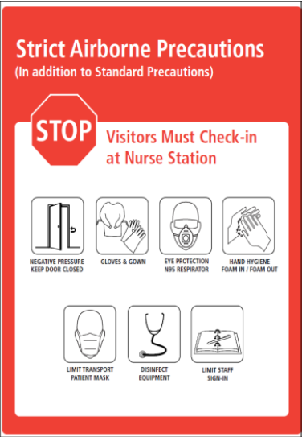
Indicates that patient has a suspected or confirmed infection that is transmissible to other individuals via indirect exposure to small particle aerosols (i.e. respiratory droplets) produced when the patient speaks, coughs, or sneezes.
This patient encounter will require non-sterile gloves, a patient isolation gown, eye protection, and either an N95 respirator or PAPR.
Common examples of conditions/ infections requiring strict airborne precautions include:
Severe acute respiratory infection (SARS)
COVID-19
Viral hemorrhagic fevers (i.e. Ebola)
Other considerations:
The small particle aerosols produced by patients with SARS infections (of which COVID-19 is a subset) have the ability to linger in the airspace around the patient once expelled from the body. Here, they maintain their infectivity for variable periods of time.
Source control can be attempted by having the patient wear a surgical mask as well.

Slide 22
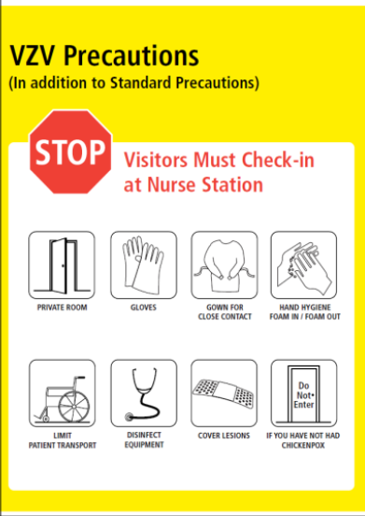
Indicates that patient has a suspected or confirmed infection with varicella-zoster virus.
This patient encounter will require non-sterile gloves and a patient isolation gown.
Conditions that can result from VZV infection include:
Chickenpox (children)
Shingles (older adults)
Other considerations:
Chickenpox and shingles each result in the development of a disseminated vesicular rash. Lesions open, drain, and eventually crust over at various times throughout the duration of infection. Contact with the draining lesions present the opportunity for infection transmission, so it’s best to keep these covered for added protection.
All non-immune providers and visitors should refrain from interacting with patients, even if wearing proper PPE, in order to prevent infection.

Slide 23
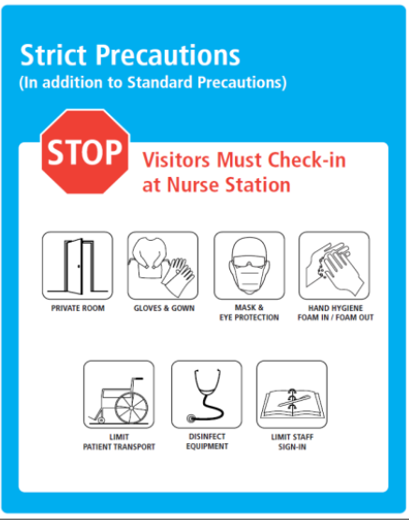
Indicates that patient has a suspected or confirmed infection that is transmissible to other individuals via
This patient encounter will require non-sterile gloves, a patient isolation gown, eye protection, and a surgical mask.
This set of precautions is rarely implemented. However, an example of an infection that might require strict precautions is:
Vancomycin-resistant strains of MRSA
Other considerations:
MRSA most commonly colonizes the nares and throats of affected patients, though visible infection tends to manifest on the skin.
Patients that are particularly susceptible to infection with vancomycin-resistant MRSA include those with severe illnesses, especially those with immune deficiencies, as well as those who have recently undergone surgery or have an indwelling device, and ICU patients. Proper PPE use is essential to minimize the risk of providers passing infection from one susceptible patient to the next.

Slide 24
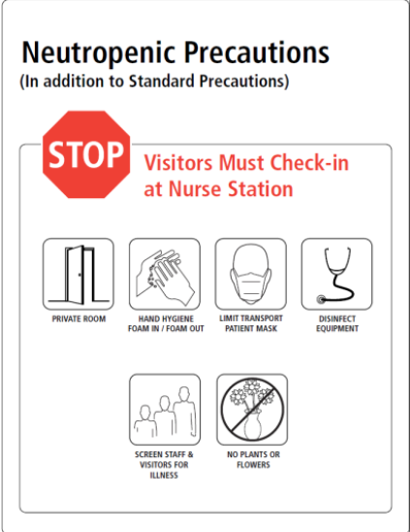
Indicates that patient is immunosuppressed, and therefore, more susceptible to infection.
While no specific PPE is indicated for providers, patients should wear surgical masks in order to lessen their chances of contracting infections from providers and/or visitors.
Circumstances that may lead a patient to become immunosuppressed include:
Active hematologic malignancy (i.e. leukemia)
Chemotherapy for cancer treatment
HIV
AIDS
Infection
Other considerations:
Neutropenic patients are EXTREMELY susceptible to bacterial and fungal infections. In order to minimize their risk of infection, only healthy visitors should be allowed in the patient room. Additionally, patients should limit their exposure to any other mediums that could carry germs, including pets and plants.

Slide 25

Donning and Doffing PPE
Once you know what kind of PPE you’ll need for a specific patient encounter, you’ll be expected to properly don and doff. In the next several slides, we’ll watch Alyssa and Adam, two members of the Class of 2021, as they demonstrate for you all the donning and doffing techniques that they used daily during their emergency medicine rotations at the DCU Field Hospital.
Let’s meet them before we start!

Slide 26
Note:
These videos were filmed as demonstrations.
No patient care or contact took place between donning and doffing, and in the interest of time, some steps, such as hand hygiene, were abbreviated.

Slide 27

Student Donning Demonstration

Slide 28
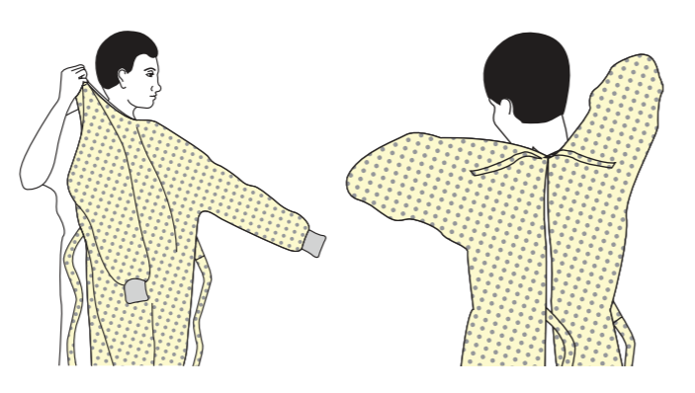
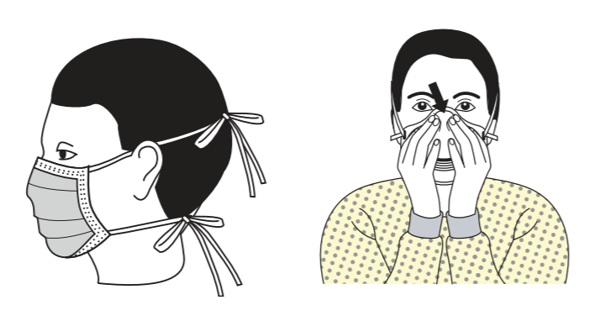
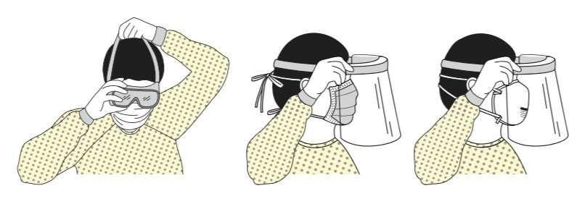
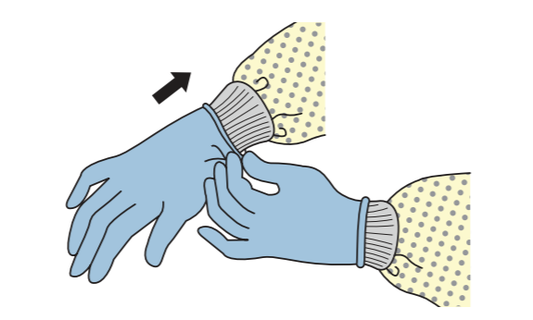
Step-by-Step Guide to Donning
When necessary for a patient encounter, PPE should be applied in the following order:
Gown – It is important that the gown be tied in the BACK, as this will keep the knots clean for later removal.
Mask or respirator – Mask ties or respirator straps should rest one across the back of the head and one at the nape of the neck. Achieve a snug fit by molding the adjustable nose piece across the bridge of the nose. Respirators should be fit checked by cupping hands around the edges and feeling for air leakage during exhalation.
Goggles or face shield – Secure around the back of the head. Ensure a snug fit.
Gloves – Should extend to securely cover the wrist and the ends of the gown sleeves.

Slide 29
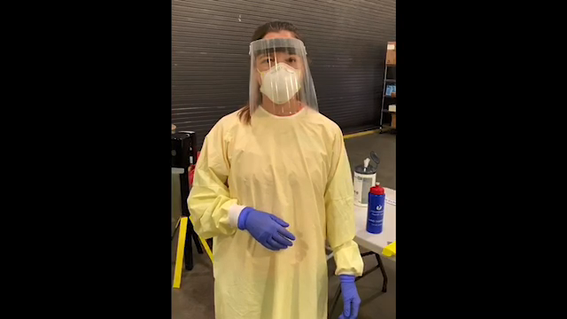
Student Doffing Demonstration

Slide 30
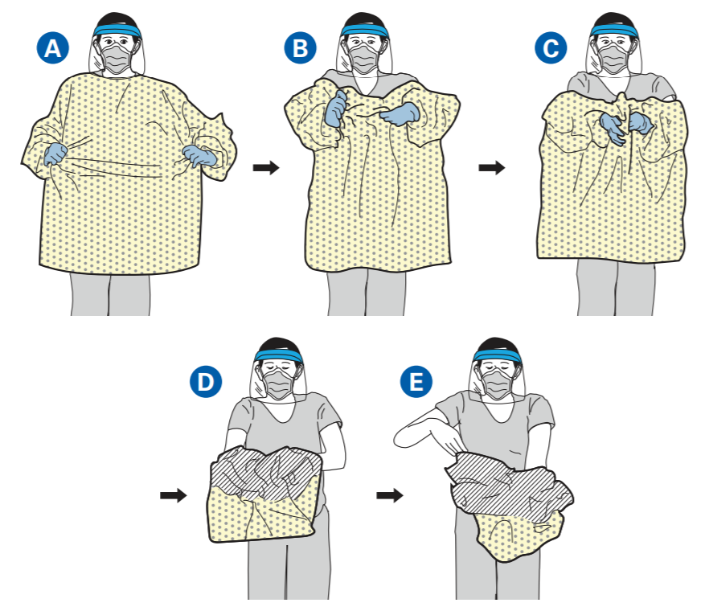
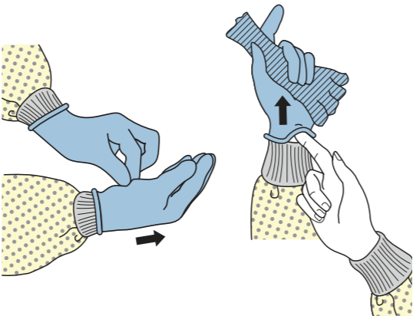
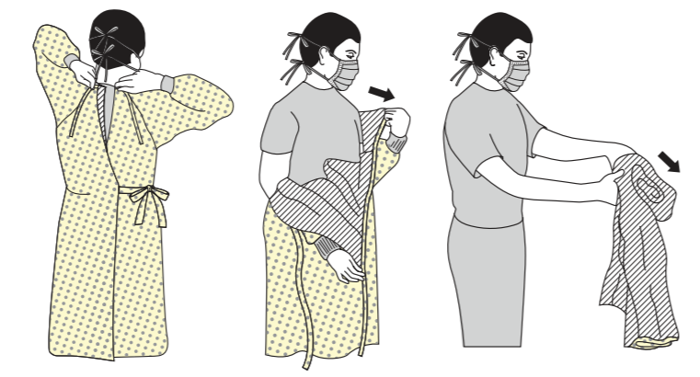
Step-by-Step Guide to Doffing
PPE should be removed very carefully and in a specific sequence in order to prevent contamination.
Gown and gloves – Doffing begins in the patient room. With gloved hands, pull gown from the front to break the ties around the back. Fold gown inside out and peel gloves off as the gown reaches the wrists. Remember that only the insides of the gown and gloves are clean, so avoid touching the outside.
Note from the demo video: You’ll notice that Alyssa removed her gown and gloves separately. This is because the gowns worn by providers at the DCU Center were reusable, and therefore could not be discarded with the gloves. Using her clean base layer of gloves, she was able to reach around to undo the clean knots and remove the gown, before removing her gloves separately. Otherwise, gloves should be removed prior to the gown, as they are dirtier.
Thoroughly sanitize hands and exit the patient room.

Slide 31
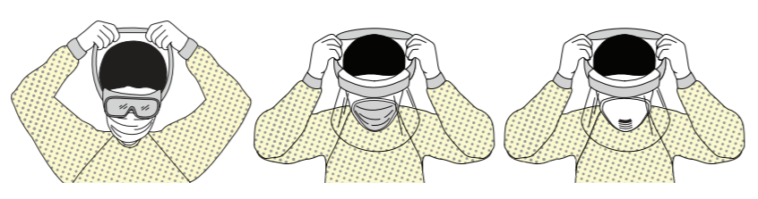
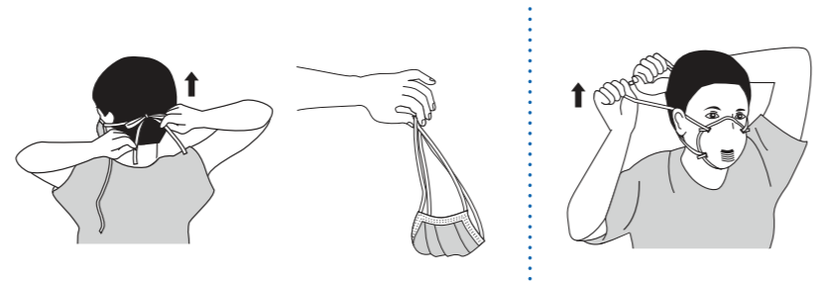
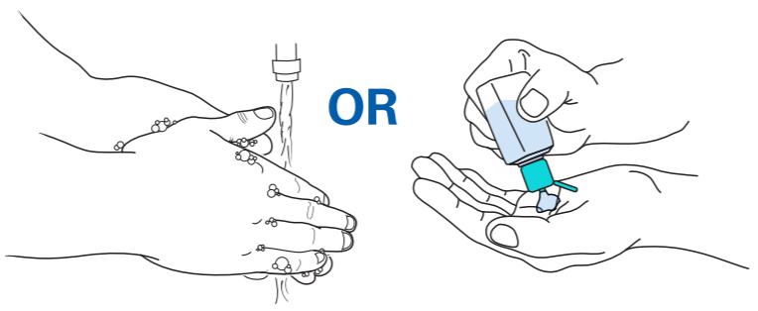
Step-by-Step Guide to Doffing (cont.)
Goggles or face shield – Apply new gloves. Reaching around to the back of the head, remove by grasping the strap and pulling over the head. Be careful to avoid touching the outside front of the goggles or face shield as this surface is dirty. If single-use, dispose. If reusable, place in designated area to be cleaned.
Remove gloves and thoroughly sanitize hands.
Mask or respirator – Reaching around the back of the head, first untie or grasp the bottom strap and pull it over the top of the head. Then do the same with the top strap, making sure to avoid contact with the front of the mask as it is dirty. Holding the mask by the straps, discard in the designated waste bin.
Note from demo video: Note that Alyssa saved her respirator for later reuse by using the strings to place it face down in a paper bag that she then sealed. This can be done in times of shortage.
Thoroughly sanitize hands.

Slide 32
Getting this right is HARD!
Alyssa and Adam did a FANTASTIC job demonstrating how to properly don and doff PPE, however, we wanted to show that even providers who perform these processes daily can make little mistakes that increase their chances of becoming contaminated.
Here are some helpful tips based on the demo videos:
  Never touch any clean surfaces or items with dirty gloves! This includes things such as bottles of hand sanitizer and the lid of the linen bin – use the foot pedal if functional.
  Be sure to reach all the way around to the back of the head when removing face shields, goggles, surgical masks, or respirators. This ensures that you’re touching the “clean” surfaces.
  After removing a face mask or respirator, be aware that the outside front of the mask is dirty and will contaminate anything it touches. Avoid touching it to your skin, the outside of your paper bag, etc.
  Thorough hand sanitization involves rubbing sanitizer between hands for at least 20 seconds, during which time you should cover every surface of the hands, including the thumbs, and interlace the fingers.
  Paper bags for storing respirators should be clearly labeled with your name to prevent confusion.

Slide 33
Putting it all Together
In light of everything you just learned, take a second and consider how comfortable you’d feel completing the following sequence of events:
  Approaching a patient room and locating the posted precautions sign.
  Correctly interpreting the precautions sign such that you understand what PPE will be required for the patient encounter, as well as any other necessary precautions.
  Gathering the correct PPE.
  Foaming in and donning your PPE in accordance with the CDC guidelines.
  Entering the room to conduct your patient encounter, knowing that both you and the patient are well protected.
  Exiting the patient room, doffing your PPE in accordance with your institution’s guidelines, and sanitizing both your hands and any medical equipment that was used during the patient encounter.
See the notes below for a reminder on where to find this material in the presentation if you do not feel comfortable with any of the above steps.
Notes:
1. Slide 14
2. Slides 15-24
3. Slides 7-13
4. Slides 27-28
5. Slides 15-24, 32
6. Slides 29-31, 32

Slide 34
  Remember to take your time and ask questions if you’re ever unsure about something.
  GOOD LUCK!! ☺

Slide 35
Additional Resources
For a more detailed explanation of donning and doffing with additional graphics:
  CDC: Using Personal Protective Equipment (PPE)
  CDC: PPE Sequence
For another helpful donning and doffing demonstration:
  NETEC: Personal Protective Equipment for COVID-19
For a detailed look at how to properly don and doff when using a PAPR:
  CDC: Powered Air-Purifying Respirator (PAPR) and Gown

Slide 36
Special Thanks to…
Nolan Condron, Olivia Grocott, Hannah Hamad, Afu Nti, Candace Wallace, and Rachel Burke for their original work on the “PPE and the COVID-19 Pandemic” presentation from which some of this information was derived.
Alyssa Stetson and Adam Resnick for creating an amazing video that provided so many learning opportunities for other students.
Dr. Ellison and the UMass infection preventionists for sharing their valuable feedback and insight on this topic.
Dr. Hatem, Dr. Fischer, and students in the Curriculum Development elective for their support and collaboration.

Slide 37
References
https://www.cdc.gov/niosh/npptl/pdfs/UnderstandDifferenceInfographic-508.pdf
https://www.cdc.gov/niosh/topics/eye/eye-infectious.html
https://www.cdc.gov/oralhealth/infectioncontrol/faqs/personal-protective-equipment.html
https://www.cdc.gov/handhygiene/providers/index.html
https://www.cdc.gov/infectioncontrol/basics/transmission-based-precautions.html#anchor_1564058235
https://www.cdc.gov/hai/pdfs/ppe/ppe-sequence.pdf
https://www.cdc.gov/hai/pdfs/ppe/ppeslides6-29-04.pdf
https://www.cdc.gov/coronavirus/2019-ncov/hcp/ppe-strategy/index.html
https://www.cdc.gov/infectioncontrol/basics/standard-precautions.html
https://www.ncbi.nlm.nih.gov/pmc/articles/PMC2946685/

