Slide 1
University of Massachusetts Medical School
TOWN HALL MEETING
May 11, 2011
Terence R. Flotte, MD
Celia and Isaac Haidak Professor of Medical Education
Dean, Provost and Executive Deputy Chancellor
Notes:
To Edit the Date go to View> Slide Master
On the Title Slide Master, select the text box with the date and edit.

Slide 2
Guiding Principles
Our target is set at < 25th percentile of other public medical schools in the Northeast region.
We will remain the lowest cost education in the Northeast, in keeping with our commitment to affordability and accessibility
Fee revenues will be dedicated to supporting educational quality and innovation: Examples include simulation, NBME assessments, standardized patients and OSCE resources, and new technologies such as computer based assessment, and on line learning.
Built into the fee increase is a proportionate increase in support for financial aid in the form of gift aid and scholarships, to hold student debt at current levels
Fundraising efforts for financial aid are ongoing and the launching of an endowment campaign for scholarship aid will provide additional funds to support scholarship aid.

Slide 3
EDUCATION MISSION REVENUE AND EXPENSES FY 2010
REVENUE |  |  | $22,221,730
EXPENSES |  |  | $66,727,557
Operating Income/(loss) |  |  | ($44,505,827)
Margin% |  |  | (200.3%)
With State Appropriation and “Par Payment”
REVENUE |  |  | $22,221,730
CAMPUS REVENUE DISTRIBUTION |  |  | $20,056,250
TOTAL REVENUE |  |  | $42,277,980
EXPENSES |  |  | $66,727,557
Operating Income/(Loss) |  |  | ($24,449,577)
Margin % |  |  | (110.0%)

Slide 4
UMMS is 1O^{th} of 10 NE Public Schools, 63rd of 75 public schools nationally
Data Source: AAMC website Comparison Group Public, Northeast
Year(s): 2010
Resident First Year Tuition, Fees, and Health Insurance
Public, Northeast Average | $28,222
Public, Northeast 75th Percentile | $29,583
Public, Northeast Median | $28,023
Public, Northeast 25th Percentile | $26,795
Ranked By Resident First Year Tuition, Fees, and Health Insurance
Vermont | $29,583
Connecticut | $29,576
UMDNJ New Jersey | $29,412
Maryland | $28,023
SUNY Upstate | $27,350
Stony Brook | $26,839
SUNY Downstate | $26,795
Buffalo | $26,095
Massachusetts | $19,744
Uniformed Services-Hebert | NI

Slide 5
Resident First Year Tuition, Fees, and Health Insurance
Data Source: AAMC website
Comparison Group: Public, Northeast
Year(s): 2010

Slide 6
Increasing Cost of Education: new facilities and new curriculum
Major investments to the educational experience
State of the Art Renovations
  Anatomy Lab
  ITLC
  Small Group Study Rooms
  Call Rooms
The Albert Sherman Center
  Space for Learning Communities
  Amphitheater and Lecture Halls
  Simulation Center and Standardized Patient Program
  Fitness Center
The new curriculum and LC mentors

Slide 7
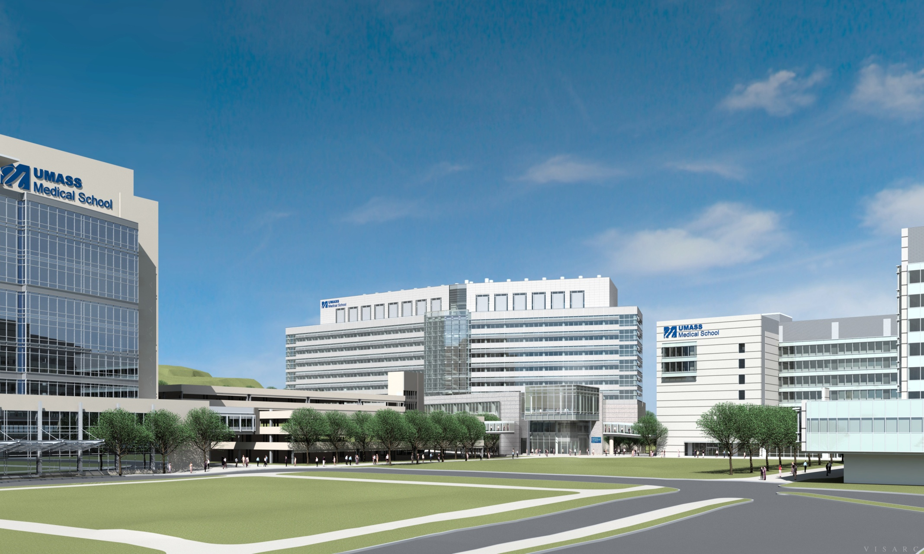
the sherman center

Slide 8
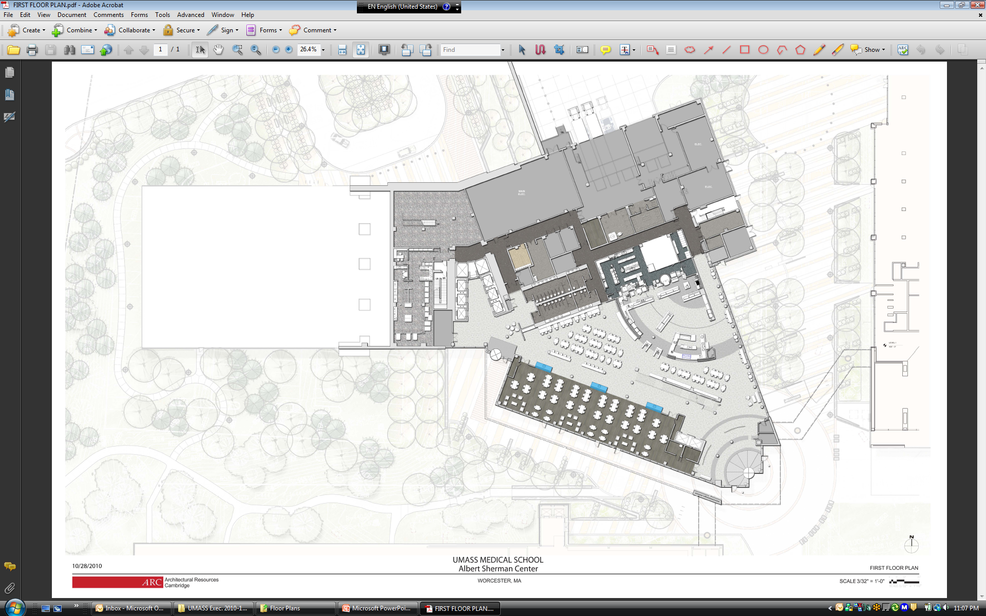
SERVICE
MECH
ELEC
KITCHEN
SERVERY
GLASS WASH
DINING
MULTI-PURPOSE
ROOM
LOBBY

Slide 9
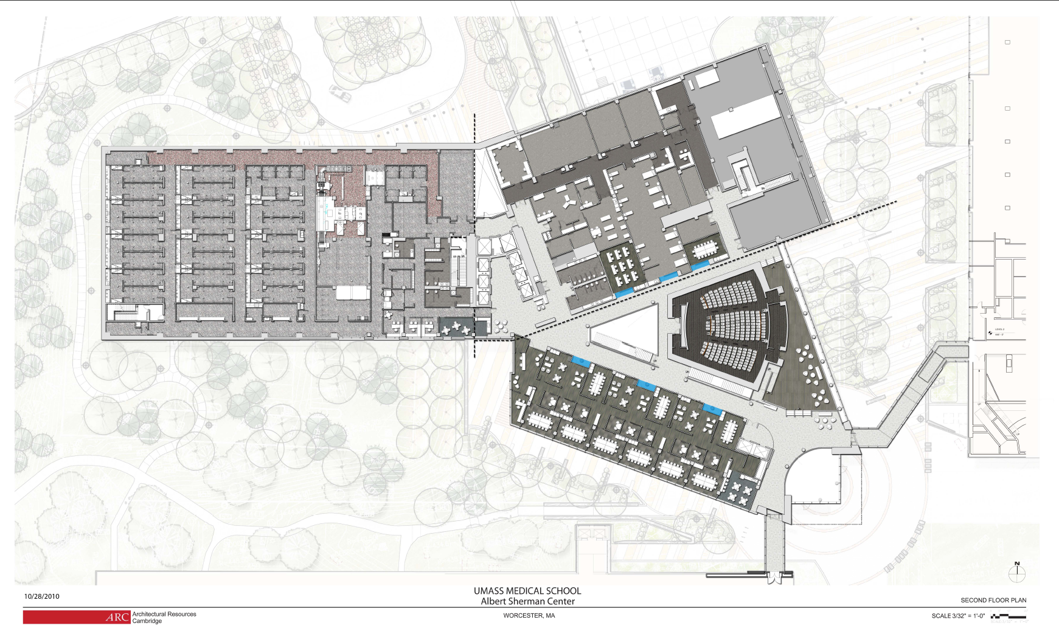
MECH
CELS / SIM
VIVARIUM
ATRIUM
LECTURE
HALL
BRIDGE
LEARNING COMMUNITIES
OPEN
BRIDGE

Slide 10
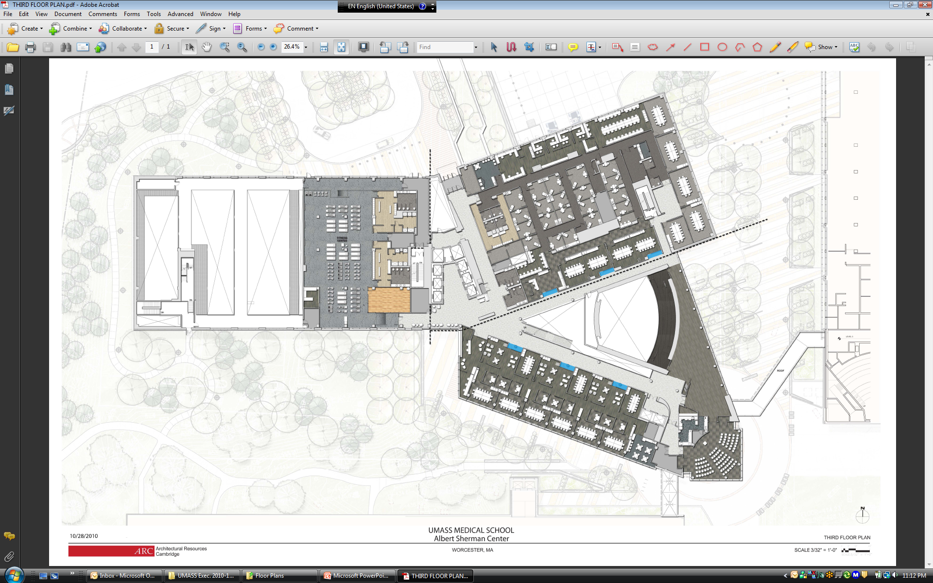
FITNESS CENTER
CELS / SP
ATRIUM
LECTURE
HALL
BREAKOUT
LEARNING COMMUNITIES
FUNCTION ROOM

Slide 11
Questions?

