Slide 1
Provost’s Updates
Faculty Council
February 3, 2011
Terence R. Flotte, MD
Celia and Isaac Haidak Professor of Medical Education
Dean, Provost and Executive Deputy Chancellor
Notes:
To Edit the Date go to View> Slide Master
On the Title Slide Master, select the text box with the date and edit.

Slide 2
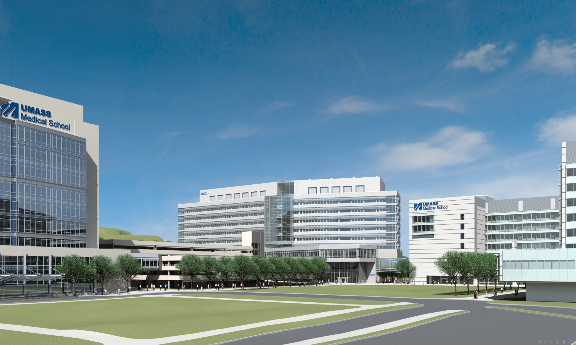
UMMS ALBERT SHERMAN CENTER

Slide 3
ASC Mission
The Albert Sherman Center and supporting infrastructure will attract researchers, physicians, faculty, students and industry partners to UMMS and enhance the medical school’s and the region’s position as a leader in medical research and education

Slide 4
ASC Vision
Promote “T1” bench-to-bedside translational research resulting in early phase human trials of gene therapy, stem cells, RNA-based and other innovative therapeutics
Integrate quantitative “dry lab” methods, such as bioinformatics, biostatistics, interactive health outcome assessments and electronic health care data systems, with the work of biologists and chemists in the “wet lab”
Create the ideal learning environment for innovative elements of the medical, nursing, graduate biomedical and interprofessional curricula, such as learning communities, simulation, and standardized patients
Foster interactions between students, faculty, and the community in public and social forums

Slide 5
Programmatic elements of ASC
144 total faculty lines will be housed in the ASC
  108 “wet bench”
    72 newly hired bench-to-bedside faculty on floors 4, 5, 6
      Advanced Therapeutics Cluster (36)
        RNA Therapeutics Institute (18)
        Center for Stem Cell Biology and Regenerative Medicine (12)
        Gene Therapy Center (6)
      Cardiovascular Research Center (10)
      Diabetes Center (5)
      Neurology Research in the genetics and therapy of neurodegenerative diseases (9)
      Ophthalmology Research in the genetics and therapy of retinal disorders (4)
    36 slots for future growth in shelled space on floors 7, 8, 9
  36 “dry bench”
    Department of Quantitative Health Sciences (30)
    Program in Bioinformatics and Integrative Biology (6)

Slide 6
The Advanced Therapeutics Cluster
The ATC is a key element of the medical school’s new strategic research direction, focusing on translating fundamental basic science discoveries into innovative and effective human therapies
The elements within the cluster include:
  The Center for Stem Cell Biology and Regenerative Medicine, which will focus on realizing the concept of using stem cells for regenerative medicine;
  * The RNA Therapeutics Institute, which will focus on translation of RNAi into specific products for human diseases; and
  * The Gene Therapy Center, which will develop clinical uses of gene delivery vectors
    * active clinical trials ongoing at UMMS

Slide 7
Department or Center/Program/Institute | Leader | Previous Institution | Faculty Recruits hired or committed
RNA Therapeutics | Craig Mello, Victor Ambros, Melissa Moore, Phil Zamore | UMMS, Dartmouth, Brandeis | 18
Bioinformatics | Zhiping Weng | Boston University | 6
Gene Therapy | Guangping Gao | Penn | 6
Stem Cell | TBD |  | 12
Neurology | Robert Brown* | Harvard | 9
Ophthalmology | Shalesh Kaushal* | U of Florida | 4
Quantitative Health Sciences | Catarina Kiefe* | UAB | 30
Diabetes | David Harlan* | National Institutes of Health | 5
Cardiovascular Medicine | John Keaney* | Boston University | 10
Total Faculty |  |  | 108
*Physician Investigators

Slide 8
Shalesh Kaushal
Ophthalmology
David Harlan
Diabetes
Guangping Gao
Gene Therapy Center
Catarina Kiefe
Quantitative Health Sciences
Zhipeng Weng
Bioinformatics
Melissa Moore
RNA Therapeutics
Robert Brown
Neurology
Michael Blute
Cancer
Victor Ambros
RNA Therapeutics
John Ware
Quantitative Health Sciences

Slide 9
Sherman Center Project Summary
Schematic Design – Space Allocation – Total Size 512,000 GSF
Laboratory Research
  Wet Lab and Lab Support
  Lab Office and Dry Research
  Vivarium
Education
  Learning Communities
  Center for Experiential Learning and Simulation
Campus Needs
  Amphitheater
  Administrative Space
  Dining Area
  Fitness Center
Support Space
  Loading Dock
  Tunnel
  Common Areas
  Mechanical and Electrical Support

Slide 10
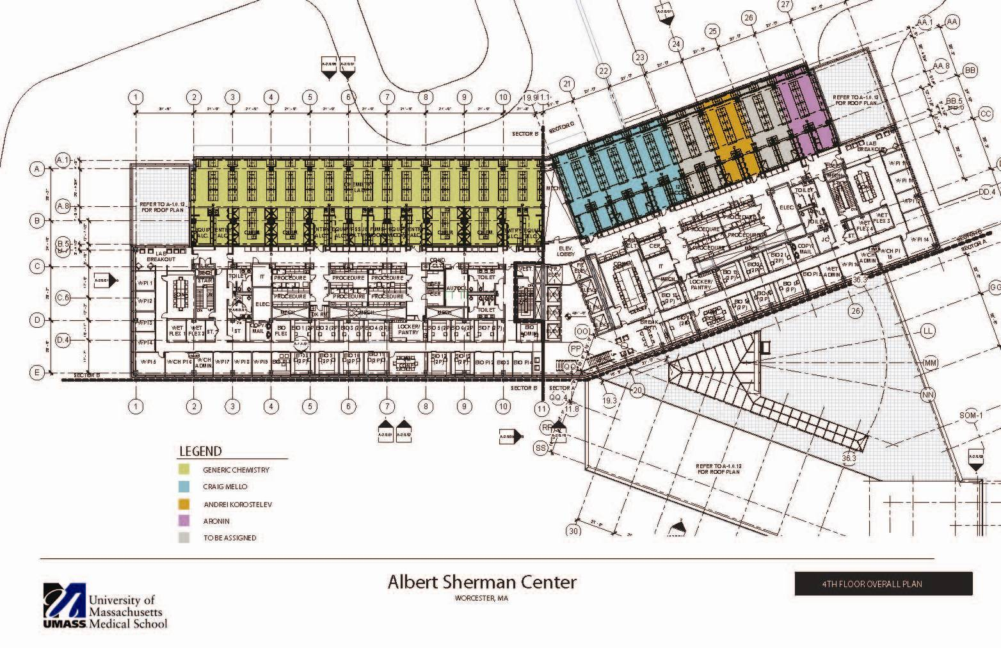

Slide 11
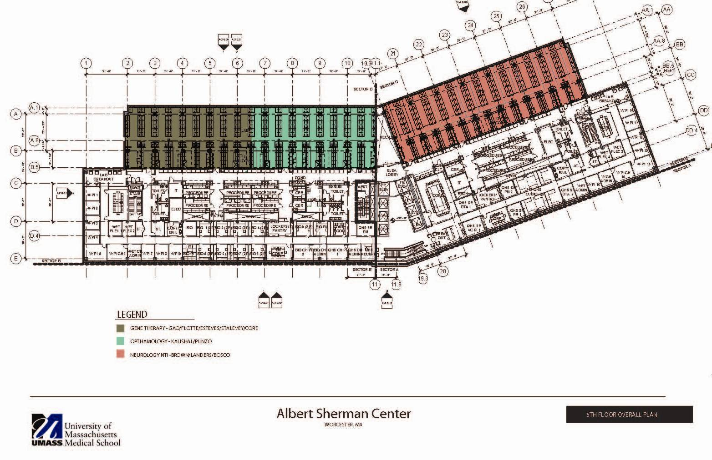

Slide 12
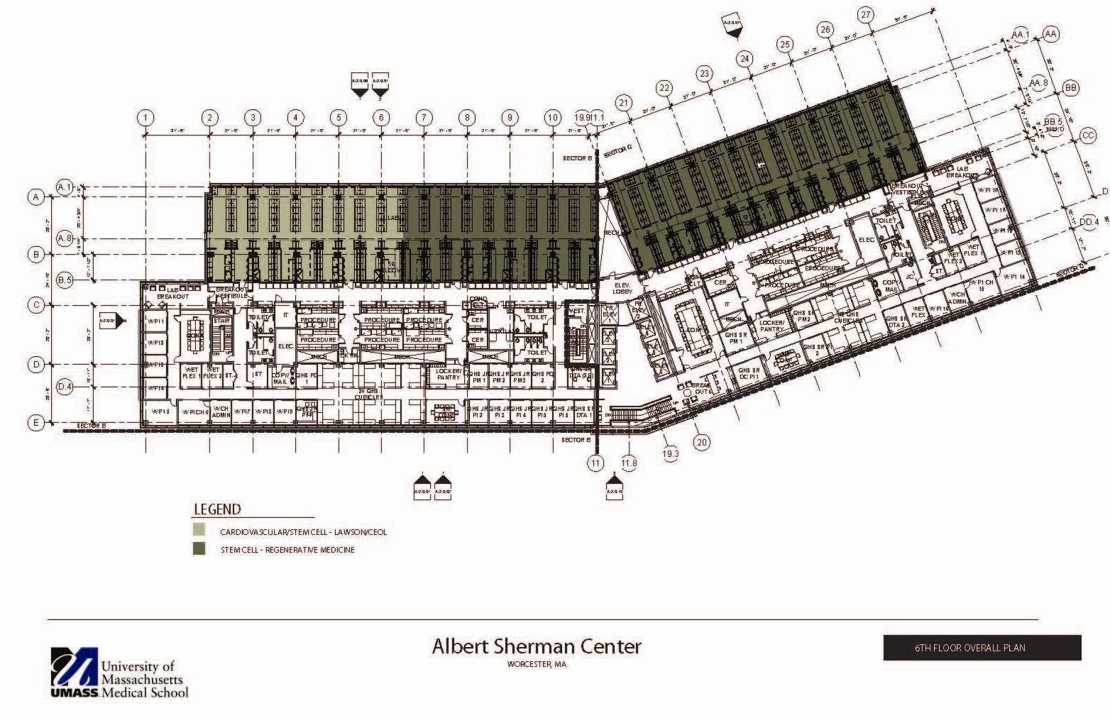

Slide 13
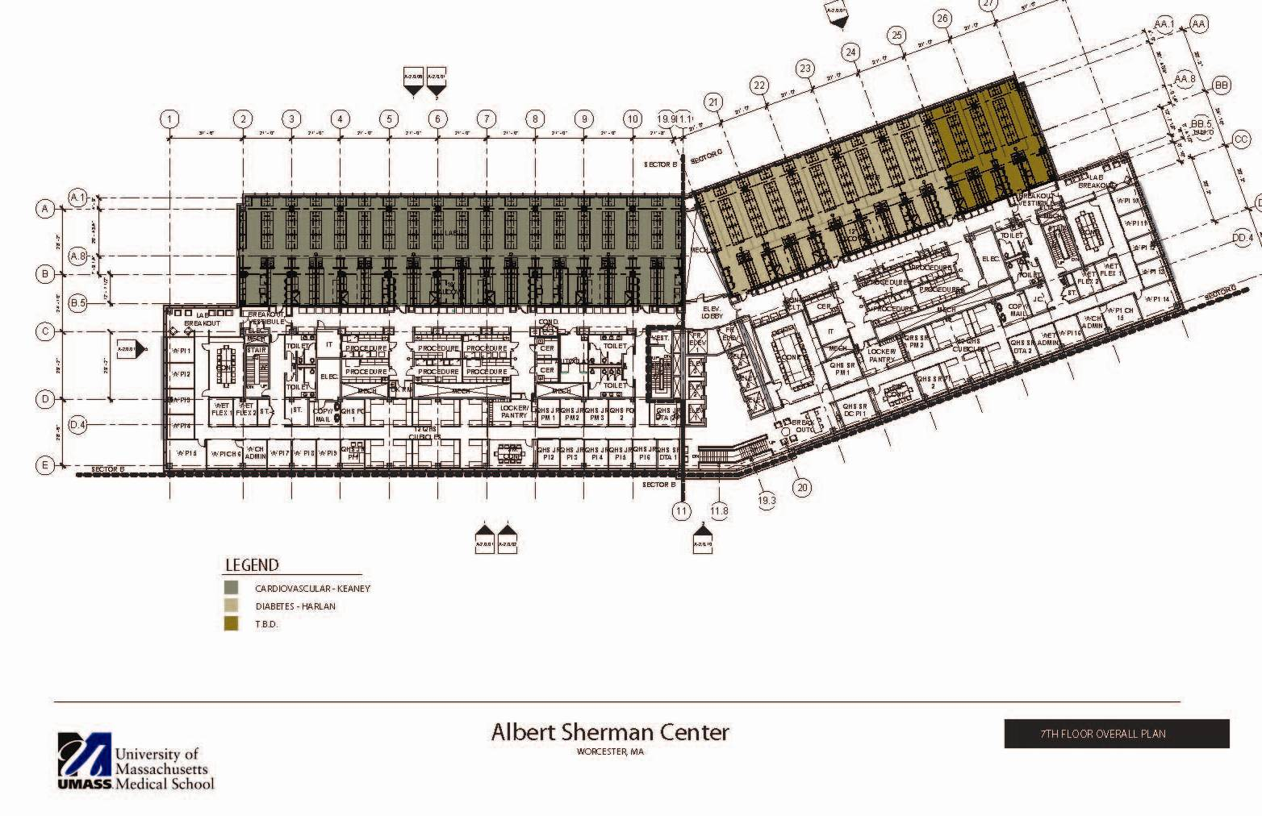

Slide 14
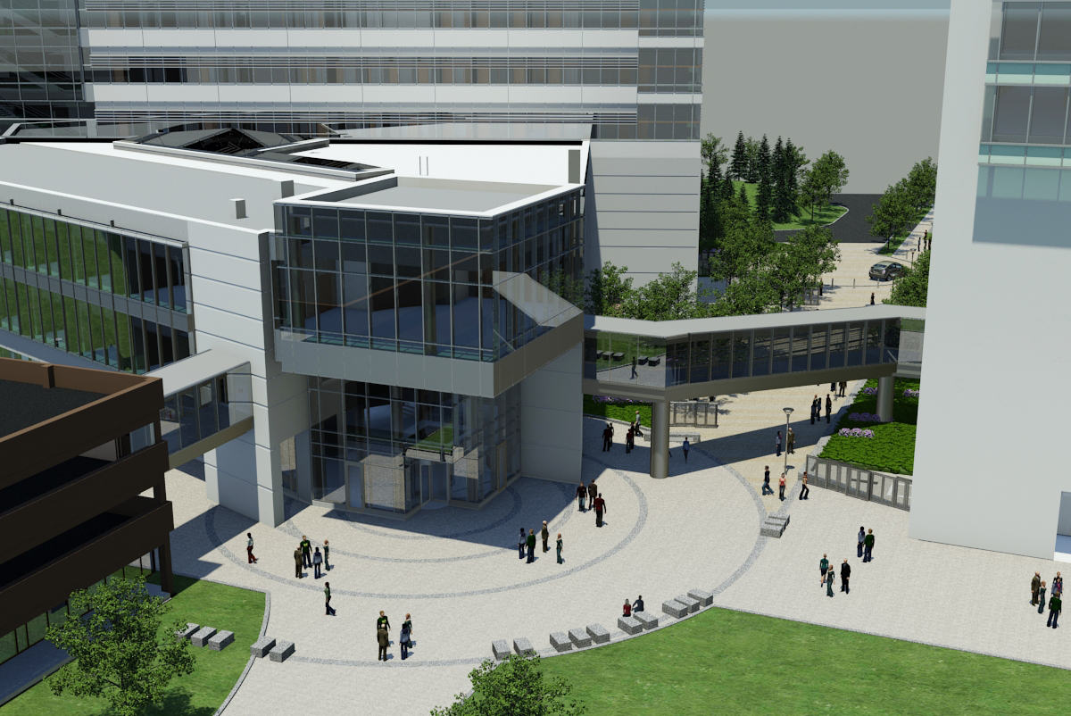

Slide 15
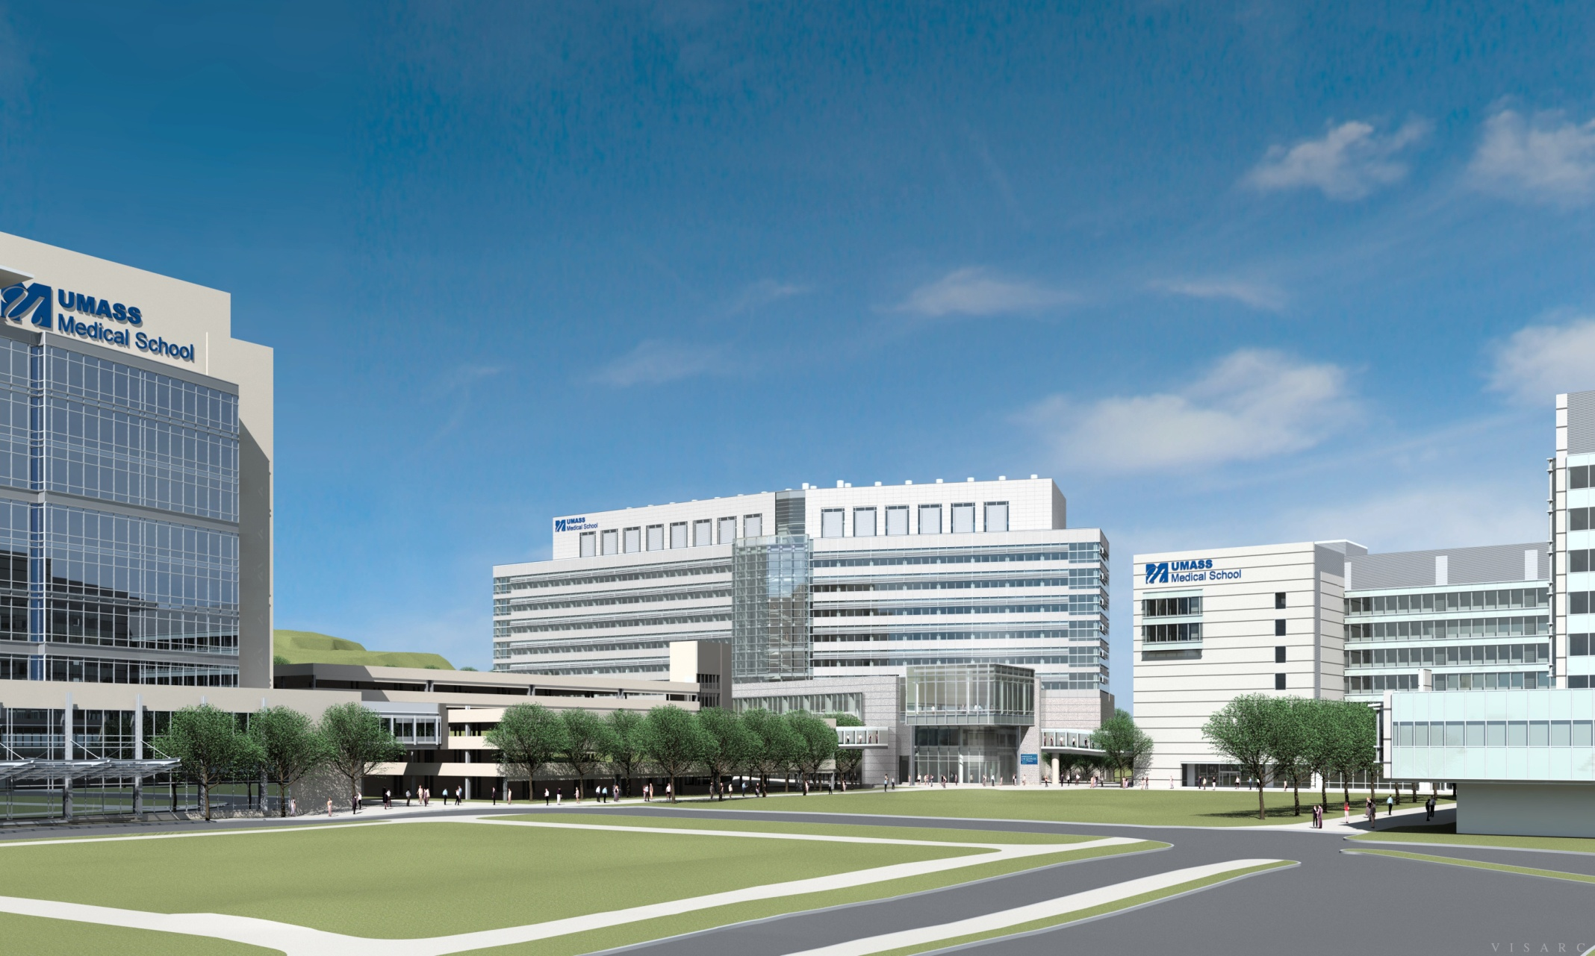

Slide 16
NIH Budget for 2012
Dollars (,000)
FY 2008
FY 2010
UMMS NIH Research Awards
(Direct and Indirect)
124,662
144,412
NIH Enacted Appropriations
29,464,287
31,246,200
UMMS Percentage of Total
NIH Appropriations
0.423%
0.462%
Direct Cost Impact
Approximate Indirect Cost Impact
ARRA
27,872,731
Notes:
for our joint approach of linking the class expansion planning and curriculum redesign.

Slide 17
NIH Budget for 2012
Notes:
for our joint approach of linking the class expansion planning and curriculum redesign.

Slide 18
Strategy to thrive in new environment
Cluster-based approach
Emphasis on already-funded recruits
Play to our strengths
Augment basic science with clinical research
Healthy RTF funds and other reserves

Slide 19
Education
Notes:
To Edit the Date go to View> Slide Master
On the Title Slide Master, select the text box with the date and edit.

Slide 20
Class Expansion -- Integration with Curriculum Redesign
Academic Year | Year 1 Class Size | Year 2 Class Size | Year 3 Class Size | Year 4 Class Size
2009-10 | 125 | 114 | 103 | 103
2010-11 | 125* | 125 | 114 | 103
2011-12 | 125* | 125* | 125 | 114
2012-13 | 125* | 125* | 125* | 125
(* = LInC roll out)
Notes:
National projections estimate 20% enrollment expansion by 2013. N=130 4 new med schools: UCentFla, U Fla international, Tex tech Elpaso, Commonwealth Scranton
New curriculum rollout mapped against Class expansion
New foundational curriculum starts with entering class 2010

Slide 21
Learner-centered Integrated Curriculum
“The UMMS educational experience will inspire our future physicians to excel in patient care, innovation, discovery, leadership and service.”
Learning Communities
Enhanced student responsibility
Longitudinal, tiered formative and summative student assessment to enhance and support learning
Pass-fail in Foundations of Medicine Year 1
Restructured, robust course evaluation to respond to student feedback and support continued curricular innovation
Interprofessional and shared resources
Co-leaders (clinical and basic sci) for Foundations of Medicine

Slide 22
Foundations of Medicine Year 2
Some Common Features of Organ Blocks:
Interconnected, Multidisciplinary with Doctoring and Clinical Components
• Reviews of Year 1 Foundations content as appropriate
• Altered structure/ function in KEY disease states and their diagnosis (imaging/labs/H and P)
• Organ-specific infectious disease considerations
• Pharmacology/therapeutics for selected disease states; preview of management principles
• Genetics, Nutrition-related issues, Selected ‘Frontiers of Medicine’ etc.
• PD more advanced skills; Introduction to Differential Dx and Multi-system approaches
DRAFT Strawman v 3.1
KEY
Integrated Case Exercises (ICE)
Integrated curriculum including: Pharmacology
Infectious Agents, and Cancer Concepts
Nutrition Content
N
Block 1
Block 2A
Block 2B
Block 3A
Block 3B
Block 4
Respiratory Kidney/Urinary
Vacation
Determinants of Health
Community Health Clerkship
Vacation and Boards
Digestive
System
Musculo-skeletal and Skin
Endo-
crinology
and
Expanded Metabolism
Repro-
duction
Male /
Female
Patients
and
Multisystem
Infections
Doctoring Curriculum
Transitional
Curriculum
e.g
-Adv PD
and Tech
skills
-Chart
review
-Labs
interpret.
-Clinical
Pharm .
topics
N
N
N
N
N
N
N
N
N
N
N
The Brain
(Nervous System and Behavior)
FOM2 Formative OSCE
Aug 11th
Dec 19
Dates
Oct 17th- 28th
March 27 May7th-11th
Integrated, sequential student assessment

Slide 23
Core Clinical Experience MODEL: IT-b
Coordinated Orientation, Interstitial Curriculum, Formative/Summative OSCE’s, etc.
3 Coordinated Thematic Blocks
Care of the Adult: shared objectives and basic science leadership
4 weeks
1
1
4 weeks
5 weeks
Coordinated Orientation, Interstitial Curriculum, Formative/Summative OSCE’s, etc.
Medicine
Medicine
IM Ambulatory /Neurology
16 weeks
Perioperative and Maternal Care :
shared objectives and basic science leadership
4 weeks
1
4 weeks
1
5 weeks
Coordinated Orientation, Interstitial Curriculum, Formative/Summative OSCE’s, etc.
Surgery
Surgery
OB/GYN
16 weeks
Care of the Family: shared objectives and basic science leadership
5 weeks
5 weeks
5 weeks
Pediatrics
Family Med
Psychiatry
16 weeks

Slide 24
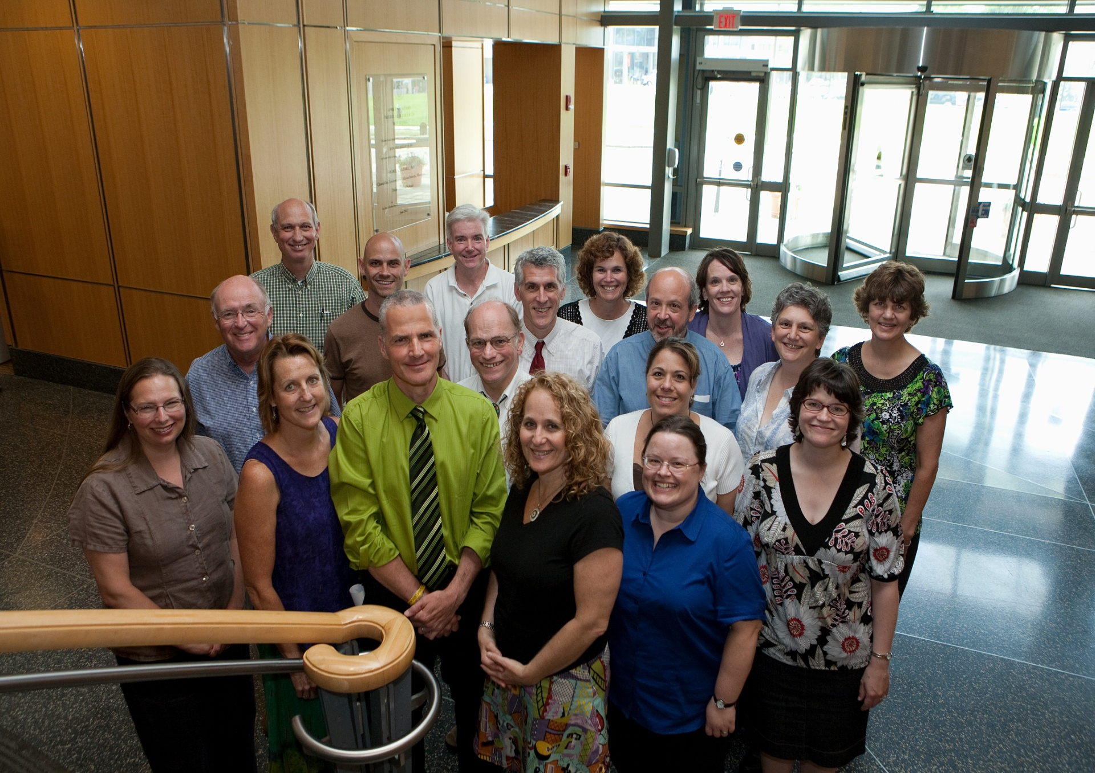
Learning Communities Mentors

Slide 25
Recent on-campus improvements
UMMS Simulation Center 2006
  Simulators, task-trainers, scenarios
  Standardized patient program
New Anatomy Lab - August 2009
  Expansion of tables, specimens, faculty
Amp III renovation - Oct 2009
  State of the art IT support (wireless, multi-screens)
  Expanded seating
Student independent study rooms 2009-2010
ITLC
  All digital learning environment
  Replaces microscope-based histology and pathology
Notes:
for our joint approach of linking the class expansion planning and curriculum redesign.

Slide 26
LCME PROJECT TIMELINE JAN 2010 TO DEC 2013
We are here
TASK | Jan 2010 Dec 2010 | Jan 2011 Dec 2011 | Jan 2012 Dec 2012 | Jan 2013 Dec 2013
LCME PROJECT
Preparation
Project Rollout
Data base AY 09-10 baseline year
Institutional Self-Study Task Force
Task Force Subcommittees
Independent Student Analysis
Database updates AY 10-11
Submission of Institutional Self-Study Summary to LCME |  | Dec 2011
Site Survey Prep
Site Survey Visit |  |  | March 2012
Post-Survey Processing
March 4-7, 2012
Deliverables:
Subcommittee work: Reports with strengths & weaknesses: Feb-May, 2011
Compilation/drafts and outcomes dissemination: May-Nov
Final Draft: Dec 2011
Notes:
Three meetings between now and Feb 1st;
Nov 15, dec 6, Jan 12
Nov 15 Next meeting form groups, propose membership, and initiate member recruitment.
Dec 6 Finalize the groups and member recruitment, begin detailed planning.
Jan 12; prepare for launch.

