Slide 1
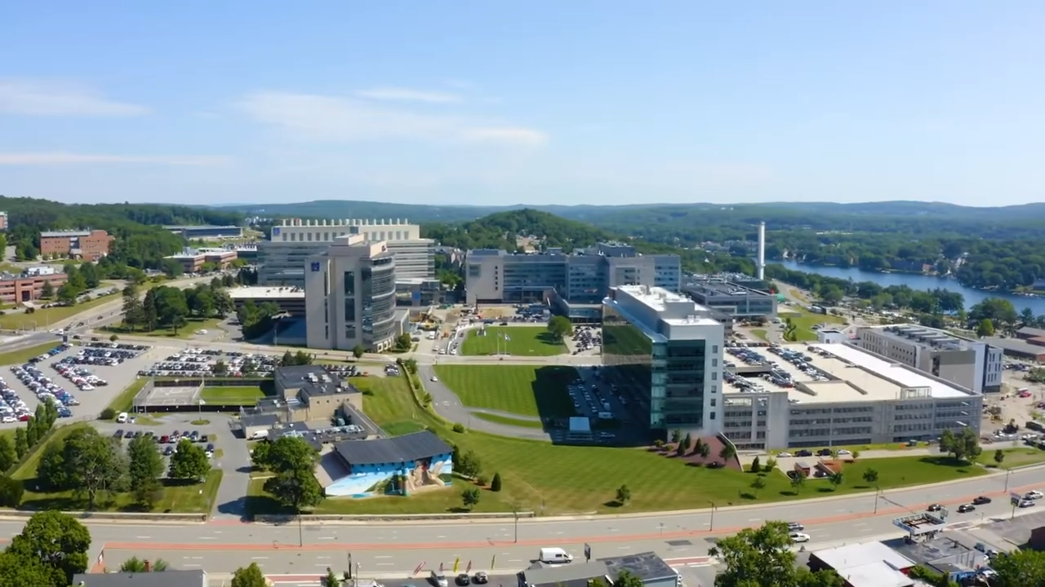
New Faculty Orientation
UMass Chan Medical School

Slide 2
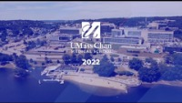
Welcome to UMass Chan Medical School
UMass Chan Year in Review
Notes:
Shared by Jen Barryman and the UMass Chan Communications Office

Slide 3
Goals for the New Faculty Orientation
Provide an overview of UMass Chan Medical School and UMass Memorial Health
Introduce our programs, processes and people
Provide essential information that new faculty need to know for career advancement
Provide a brief venue for networking among faculty

Slide 4
Professional and Leadership Development
Across the Academic Career Lifespan
Hire
Early Career
Mid Career
Advanced Mid Career
Advanced Career
Retirement

Slide 5
9:00 am - 9:05 am | Welcome Mary Ahn, MD Vice Provost for Faculty Affairs
9:05 am - 9:20 am | Chancellor’s Welcome Michael F. Collins, MD, FACP Chancellor, UMass Chan Medical School
9:20 am - 9:25 am | Provost’s Welcome Terence R. Flotte, MD Dean, Provost & Executive Deputy Chancellor
9:25 am - 9:35 am | Ice Breaker Activity Mary Ahn, MD
9:35 am – 9:55 am | Overview of UMass Chan Medical School Mary Ahn, MD
9:55 am - 10:00 am | BREAK
10:00 am – 10:05 am | Diversity and Inclusion at UMass Chan Medical School Marlina Duncan, EdD Vice Chancellor for Diversity and Inclusion & Chief Diversity Officer
10:05 am - 10:30 am | DRIVE: Diversity, Representation and Inclusion for Value in Education William Jesdale, PhD Melissa Augustine, MLIS Assistant Professor, PQHS Education and Clinical Services Librarian
10:30 am - 10:55 am | Overview of Faculty Appointments and Promotions Pranoti Mandrekar, PhD Professor, Medicine
10:55 am - 11:00 am | Closing Remarks
11:00 am – 12:00 pm | Breakout Rooms Sessions 1, 2 & 3 (20 mins each) with representatives from: *Academic Technology *BRIDGE Innovation & Business Development *Center for Clinical & Translational Science *Diversity & Inclusion Office *DRIVE *Foundation Relations & the Advancement Office *Grants & Contracts Administration *Information Technology *Institutional Animal Care & Use/Institutional Biosafety Committees *Institutional Research, Evaluation & Assessment *IRB Office *Lamar Soutter Library *Office of Faculty Affairs *Office of Management *Office of Well-Being *Research Core Administration *Women’s Faculty Committee
Notes:
A special shout out to Emily Green, our AVP for Faculty Development who has procured 17 offices who provide support for our faculty. She will be facilitating the breakout room sessions at 11 am.

Slide 6
Check Your Emails- Coming this Fall!
Annual New Faculty Reception
          Meet the Deans, Department Chairs departments, and other Senior Leadership
Enjoy an IN PERSON venue for networking amongst other faculty
Hors d’oeuvres and Drinks will be served

Slide 7
New Faculty Orientation
Overview of
UMass Chan Medical School and
UMass Memorial Health

Slide 8
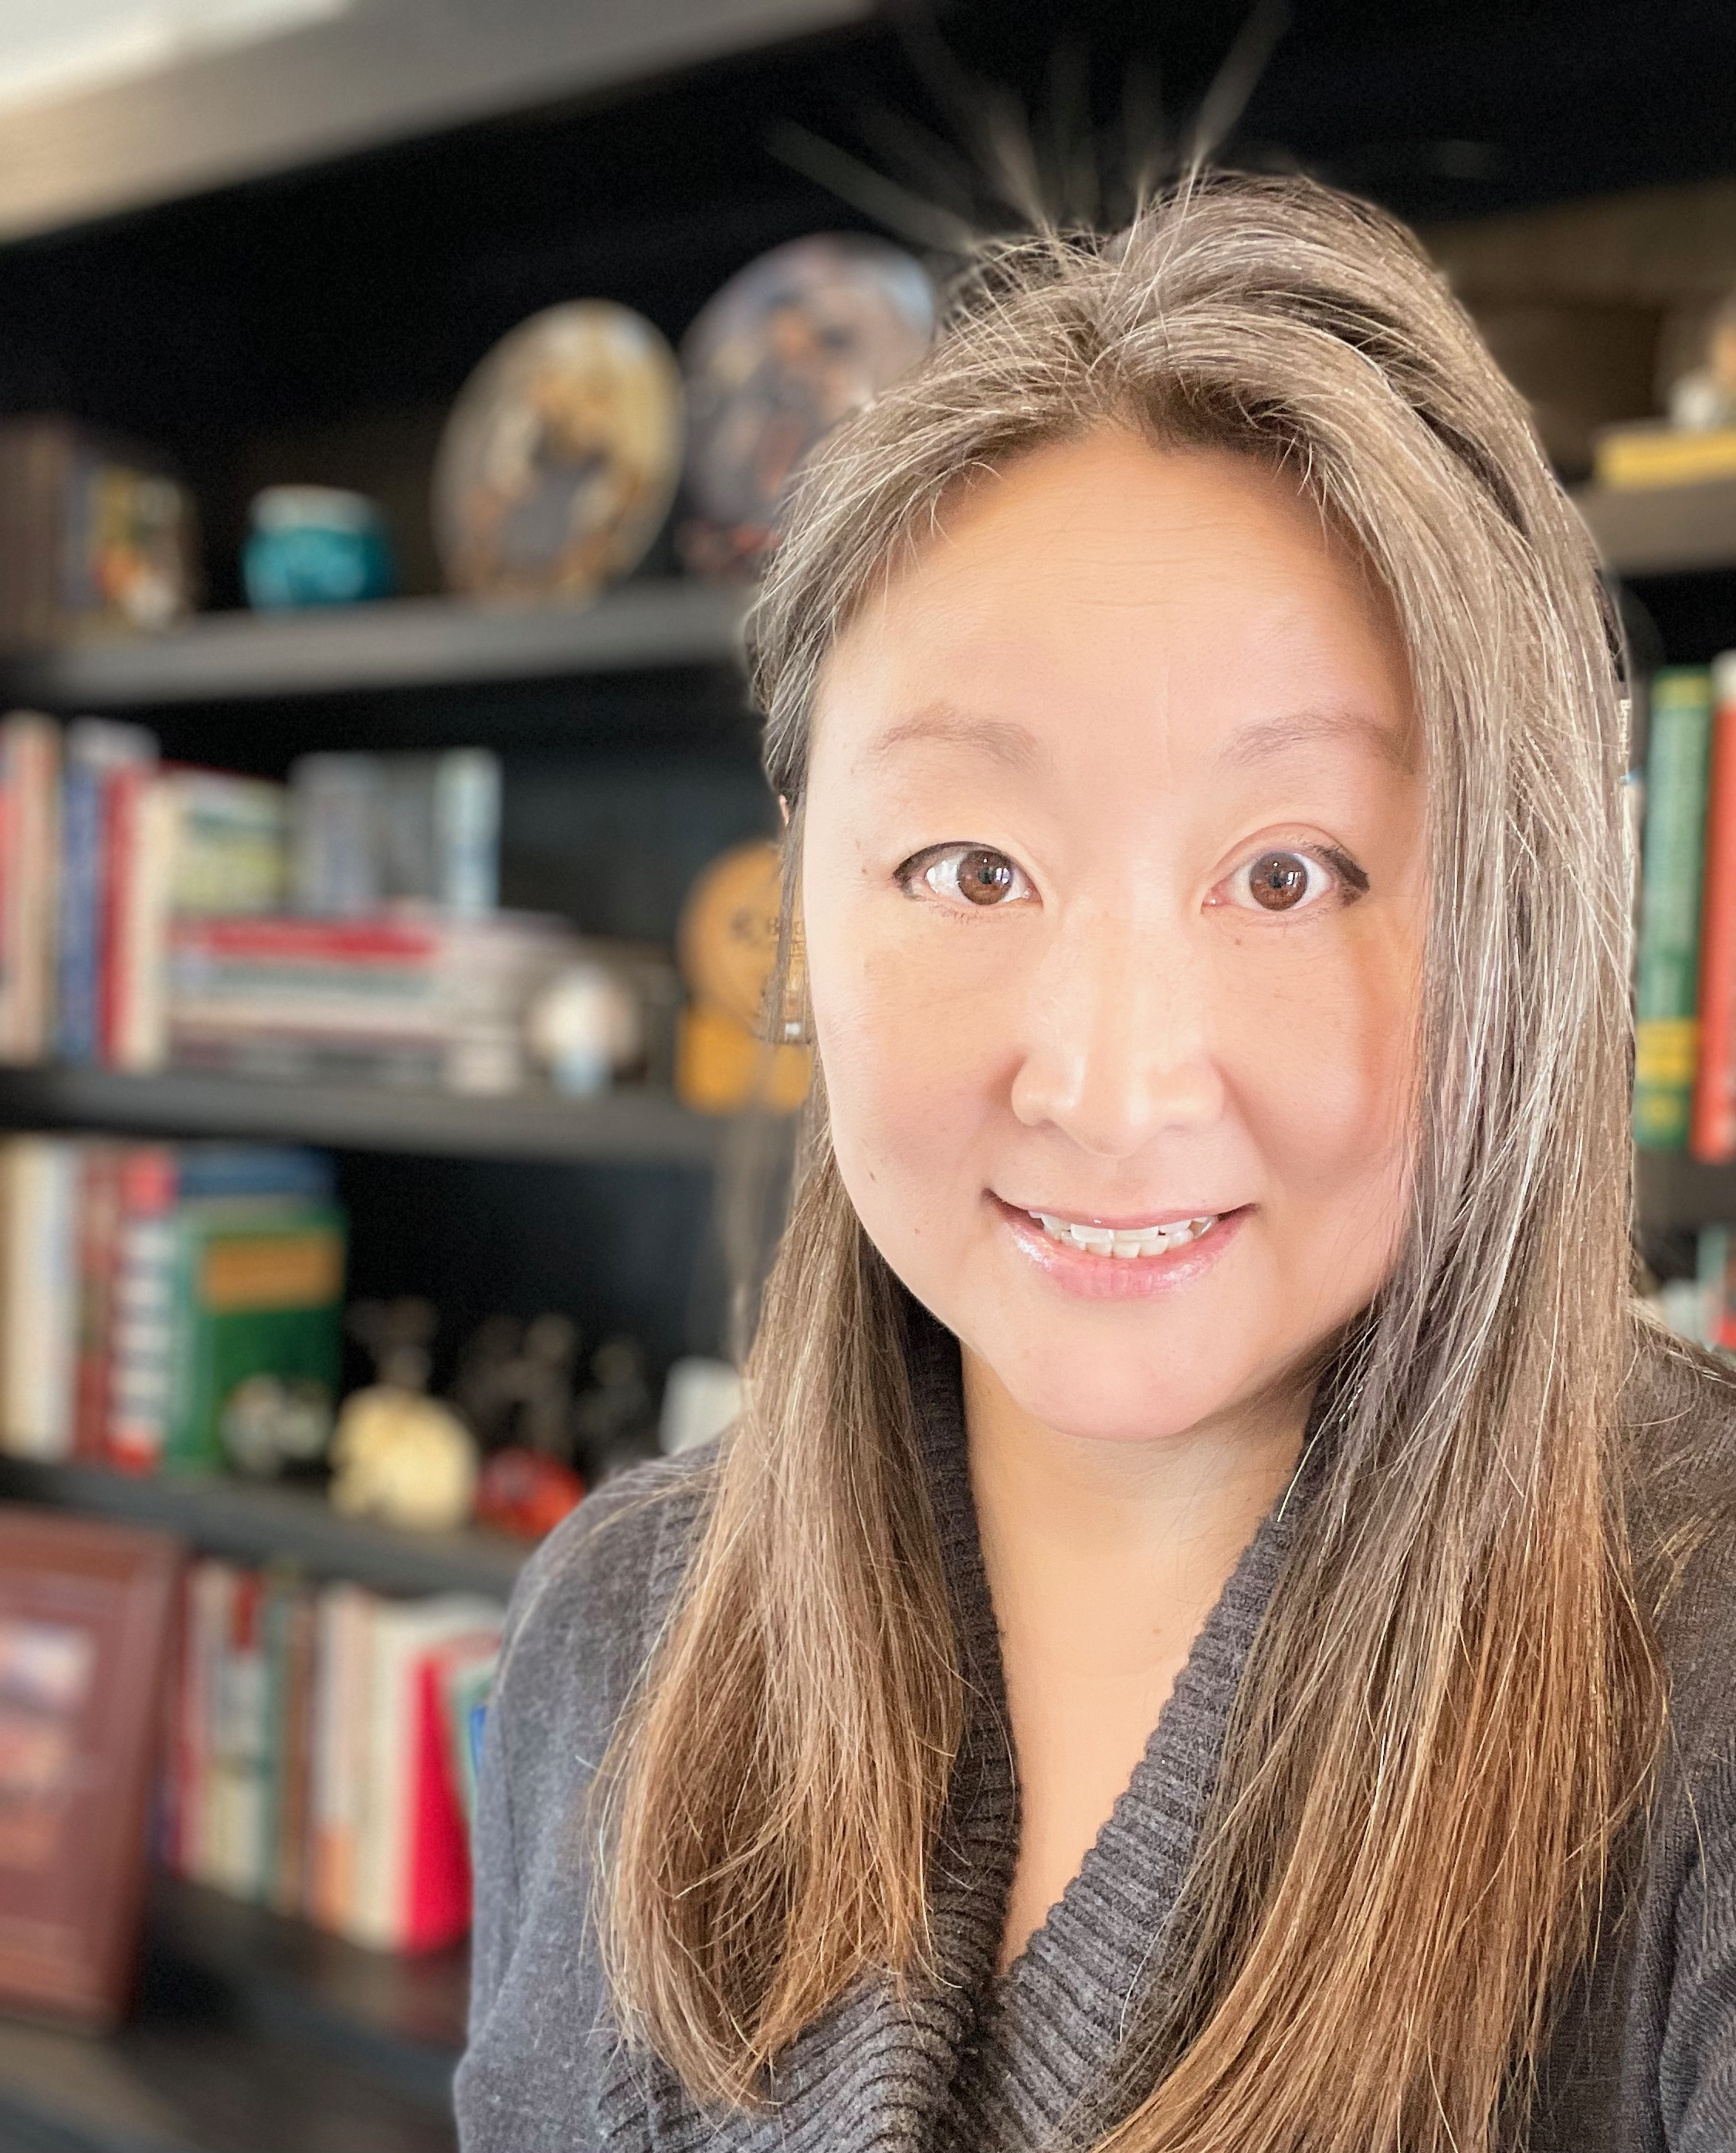
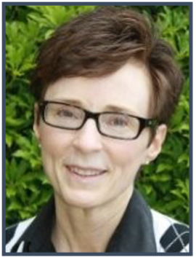
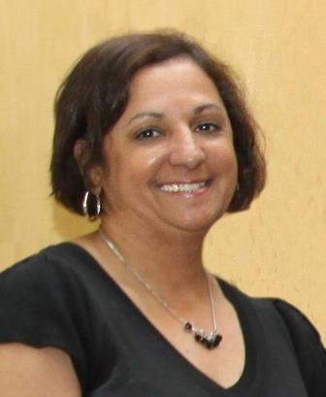
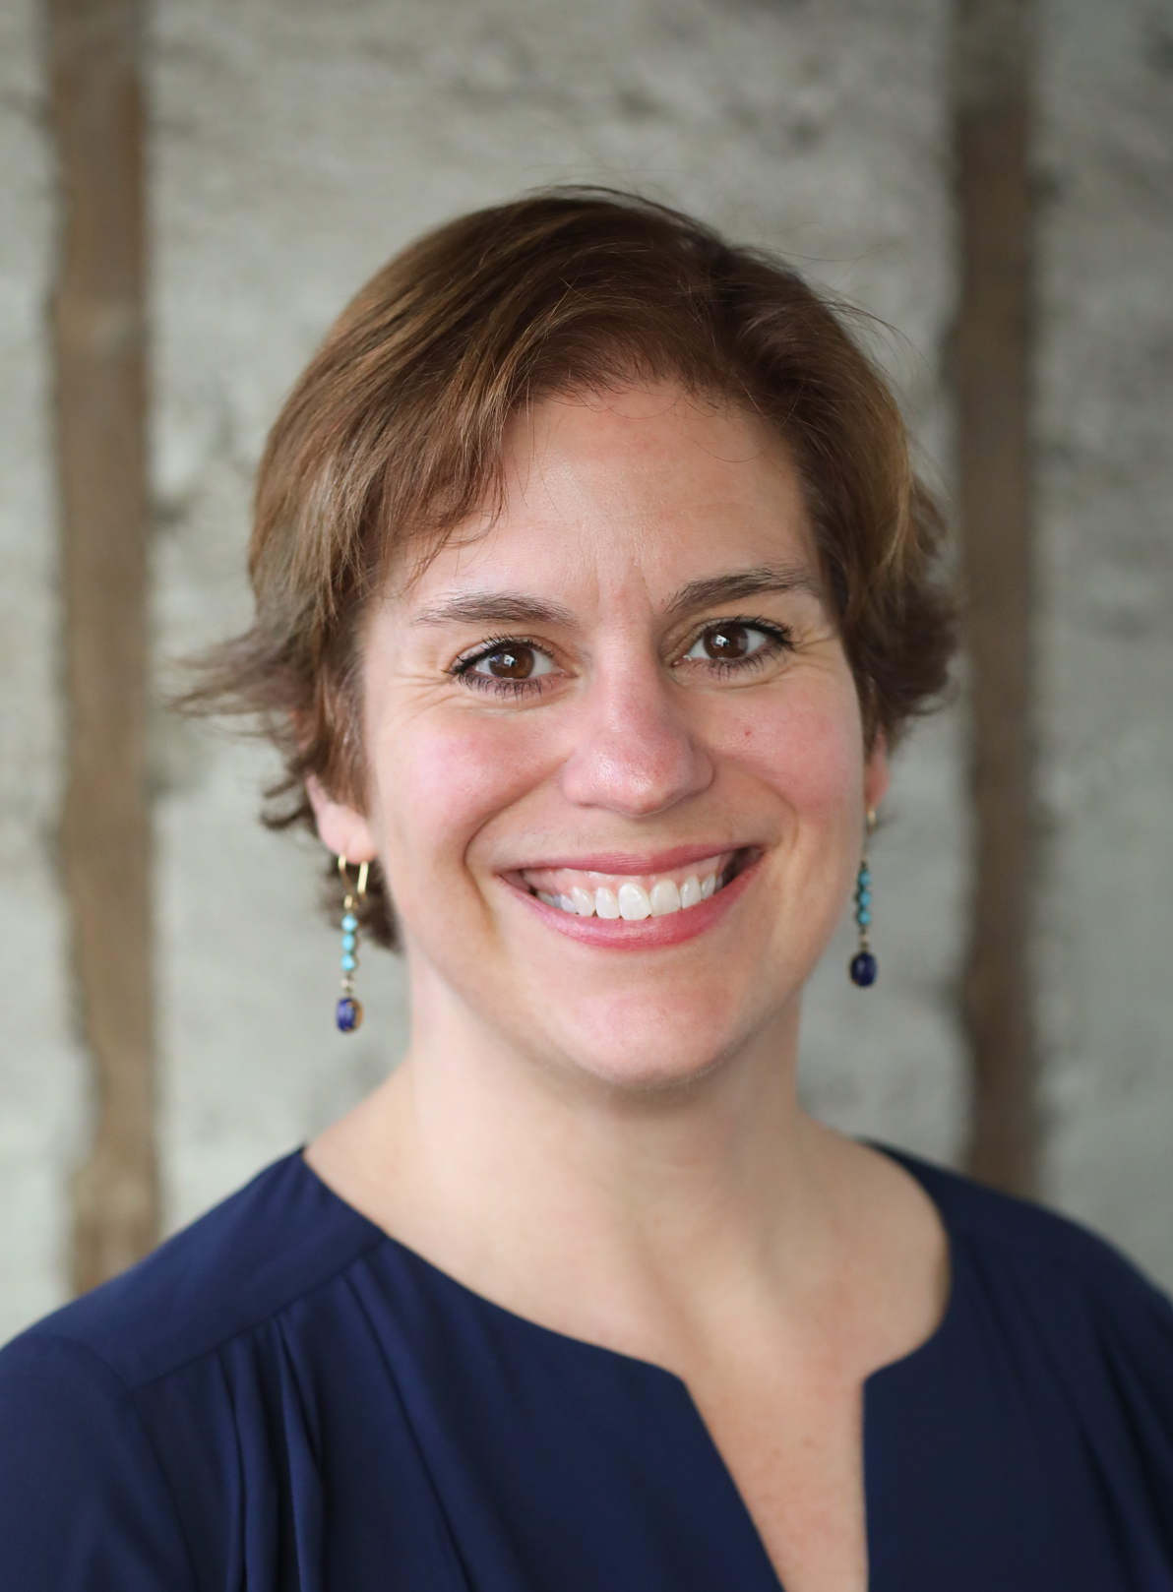
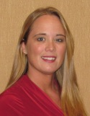
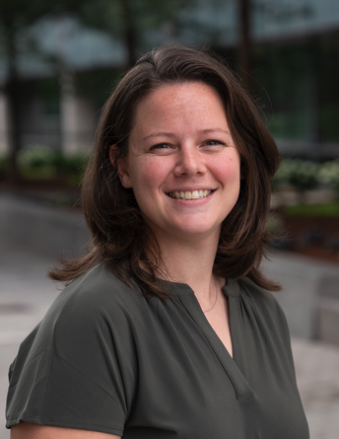
Your OFA Team
Mary Ahn, MD
Vice Provost for Faculty Affairs
Eileen O’Brien, MA, CAGS, LSW
Academic Administrative Manager III
Margie Rodriguez
Executive Assistant to VPFA
Emily Green, PhD, MA
Associate Vice Provost for Faculty Development
Gennie Ludovico
Senior Academic Personnel Specialist
Carrie Wambach
Academic Personnel Specialist

Slide 9
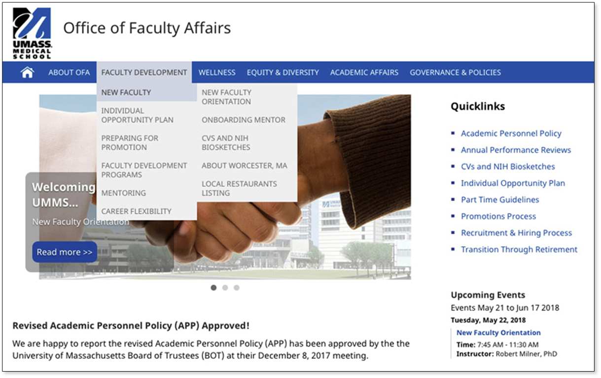

For more information, visit the Office of Faculty Affairs website.

Slide 10

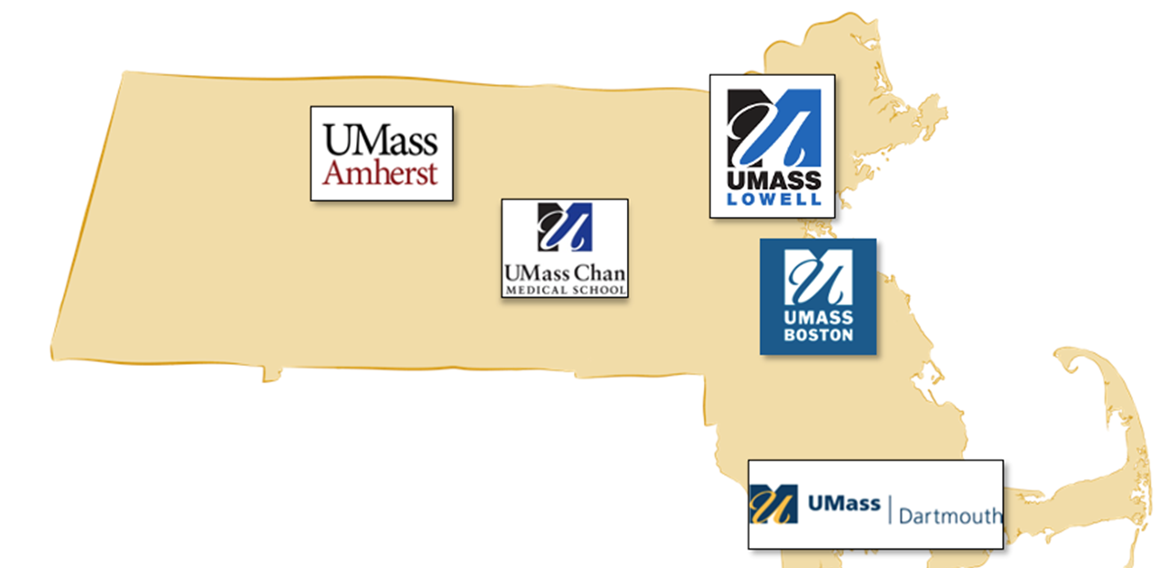
UMass Chan Medical School is one of five campuses within the UMass System.

Slide 11
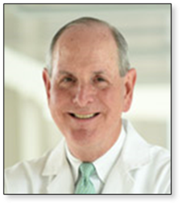
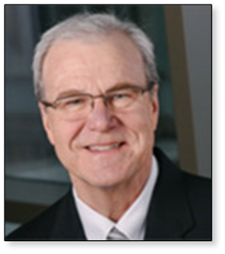
Leadership responsibilities are divided between campus leadership and academics.
Campus Leadership
Finances and Administration,
Human Resources, Legal, Diversity
Communications, Advancement,
Government Relations
Academics
Oversight of 3 Schools
Office of Research, UMCCTS
Office of Education
Office of Faculty Affairs

Slide 12
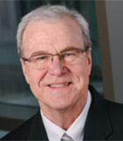
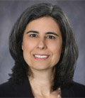
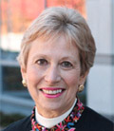
Academic Programs and the Faculty are managed among the three Schools.
TH Chan School
Of Medicine
Morningside Graduate School of
Biomedical Sciences
Tan Chingfen Graduate School
of Nursing
Dean
Terence Flotte, MD
Dean
Mary Ellen Lane, PhD
Dean
Joan Vitello, PhD
Academic Departments
(School of Medicine Faculty)
Graduate
Programs
Nursing
Faculty
Undergraduate Medical Education
Postdoctoral
Training
Nursing
Programs
Graduate Medical Education

Slide 13
A total of 3,549 faculty have TH Chan Medical School appointments.
Employed (1,833)
Affiliate (1716)
Clinicians
teaching in community & hospital practice
703
901
229
UMass Chan-Baystate (593)
UMass Chan-Lahey
UMMMG
only
Medical School
only
UMMMG + Medical School
Notes:
Back in December, an affiliation agreement was signed on 12/7/22 between UMass Chan and Lahey Hospital and Medical Center to establish a SECOND regional medical campus known as UMass Chan-Lahey led by Dean and Provost Flotte and Dr. Anne Larkin. We anticipate an additional 500-700 faculty to join our affiliate faculty.

Slide 14
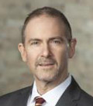
UMass Chan–Baystate Regional Campus
(Springfield, MA)
599 affiliate faculty
12 academic departments
Faculty from UMass Chan-Baystate serve on various committees:
-Executive Council
-Faculty Council
-Admissions Committee
-All Curriculum Committees
-Vista Curriculum Development
-Etc. as stated in SOM bylaws
Andrew Artenstein, MD
Regional Exec. Dean
UMass Chan-Baystate

Slide 15
All faculty have a primary appointment in either the TH Chan School of Medicine or Tan Chingfen Graduate School of Nursing.
Some faculty have a secondary appointment in the Morningside Graduate School of Biomedical Sciences.
TH Chan SOM
Morningside GSBS
Tan Chingfen GSN

Slide 16
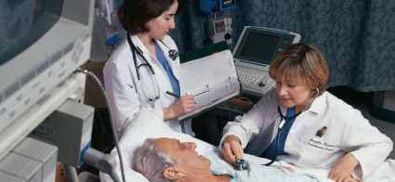
Tan Chingfen Graduate School of Nursing Prepares practice-focused (DNP) and research-focused (PhD) nursing leaders.
Educational Programs:
Graduate Entry Pathway (GEP) - Prelicensure
Master of Science (MS) Program - Nursing & Interprofessional Leadership
Post-Graduate Certificates (PGC)
Doctor of Nursing Practice (DNP) Program
Doctor of Philosophy in Nursing (PhD)
307 students
199 faculty (30 core faculty)
Nursing School Rank: #2 in Massachusetts
(Nursing Schools Almanac) #4 in New England
#23 in USA (public schools)
#41 in USA (all schools)

Slide 17
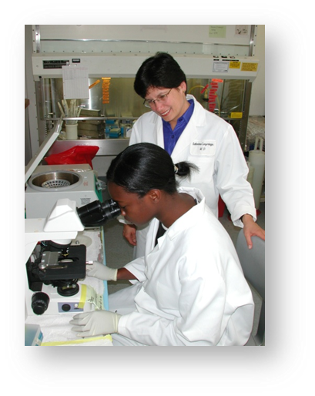
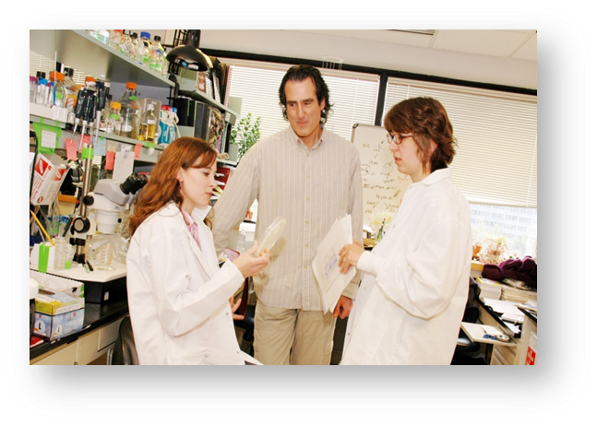
The Morningside Graduate School of Biomedical Sciences educates graduate students in research.
PhD in Biomedical Sciences
  11 program concentrations
Masters of Clinical Science Investigation
Preparatory programs
339 PhD students
74 MD/PhD students
259 postdoctoral scholars
350 faculty

Slide 18
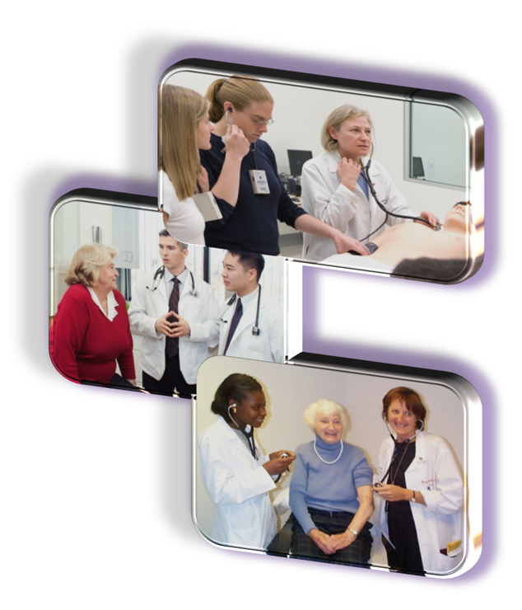
The TH Chan School of Medicine, founded in 1962, admitted its first class in 1970 and has >4000 alums.
Class size now 175/year
647 MD students
75 MD/PhD students
103 PURCH students
678 residents and fellows
26 accredited residencies
38 accredited fellowships
24 non-accredited fellowships

Slide 19
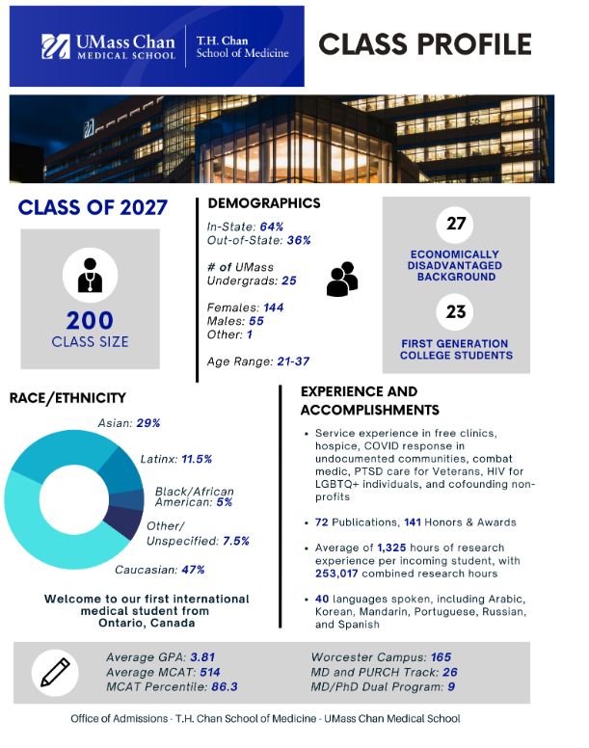
Admission into T.H. Chan Medical School is highly competitive.
Notes:
Information taken from: https://www.umassmed.edu/som/student-community/class-profiles/

Slide 20
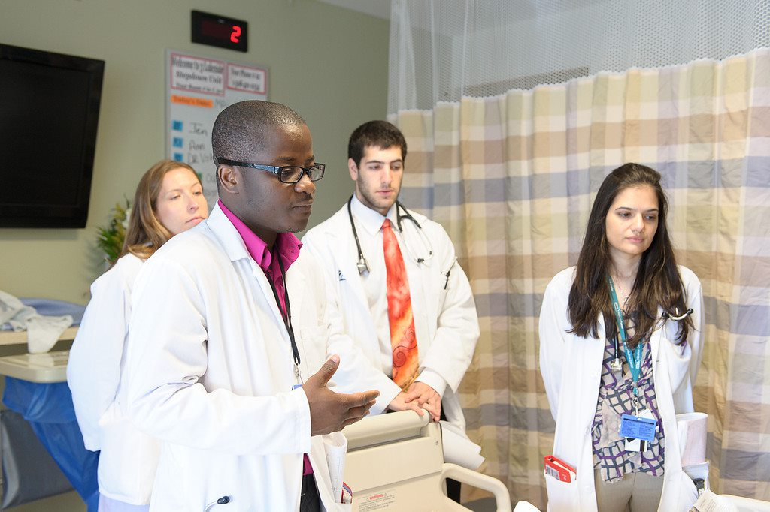
Class of 2026
Average total GPA = 3.76
Average MCAT Percentile = 88
Average Age = 24
Female = 108 (62%)
Male = 66
Economically & Educationally Disadvantaged= 23
Groups under-represented in medicine = 40

Slide 21
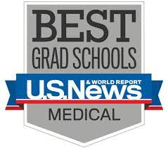
The T.H. Chan School of Medicine perennially ranks in the Top 10 nationwide for primary care education.
UMass Chan Medical School ranks 10th among the 192 medical schools accredited in 2021 by the Liaison Committee on Medical Education (LCME) and American Osteopathic Association.

Slide 22
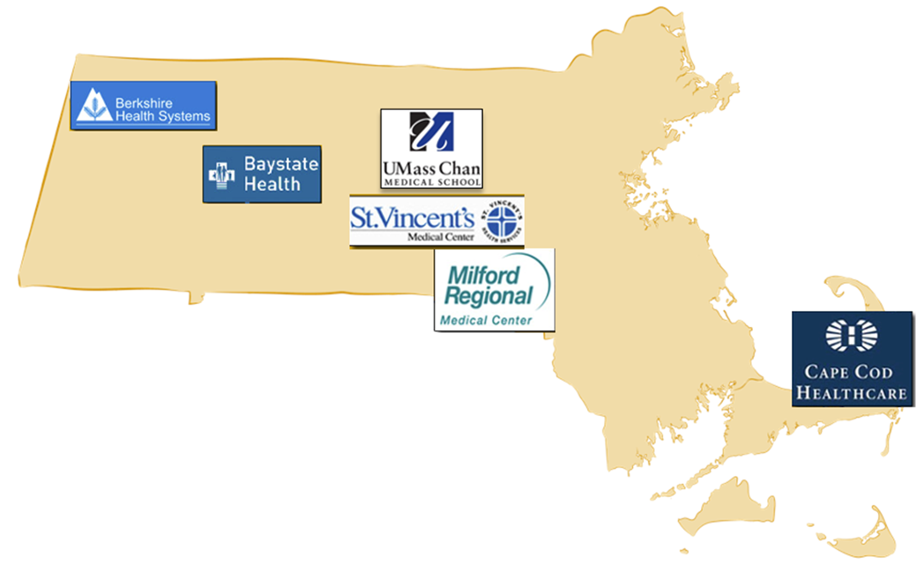
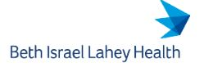
UMass Chan Medical School has affiliations with other healthcare systems for medical student education — major affiliations.
+ 25 other sites in New England
UMass Chan-Baystate Regional Campus
Population-based Urban and Rural Community Health (PURCH) Track
— 28 students in 2023 Class

Slide 23
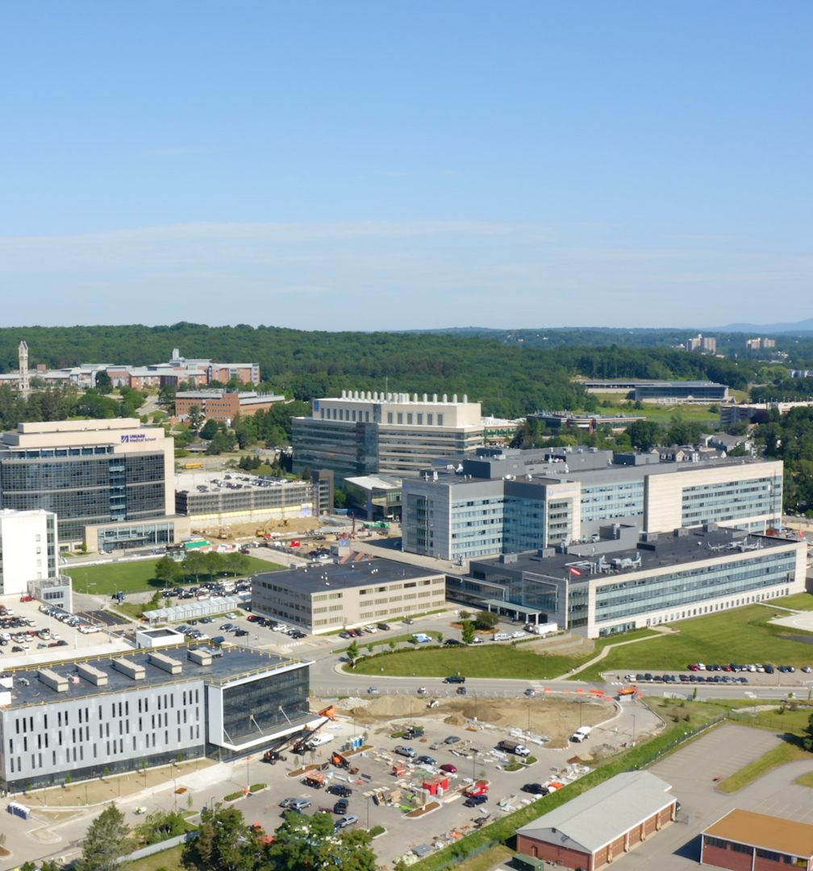
University Campus is home to a state-of-the-art Veterans Affairs Community based Outpatient Clinic (CBOC)
The clinic opened in December 2021
The CBOC is a collaboration between UMass Chan Medical School and the VA Central Western Massachusetts Healthcare System.
Veterans Affairs Clinic

Slide 24
NIH Funding to New England Medical Schools
Ranking | Institution | NIH Funding Total
8 | Yale University | $511,699,920
37 | Harvard Medical School | $171,919,628
38 | UMass Chan Medical School | $168,521,425
46 | Boston University | $120,647,220
63 | Dartmouth College | $66,000,542
67 | Brown University | $60,700,165
68 | UConn School of Medicine/Dentistry | $58,199,337
75 | University of Vermont | $51,400,054
77 | Tufts University School of Medicine | $46,920,270
Source: Blue Ridge Institute for Medical Research

Slide 25
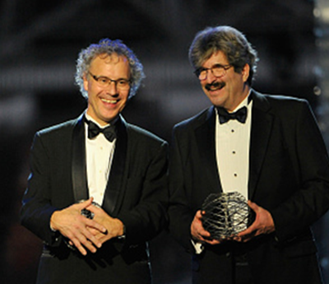
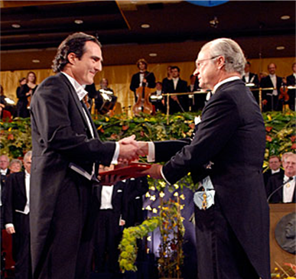
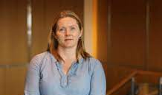
UMass Chan faculty are world renowned.
Nobel Prize for Physiology or Medicine
Craig Mello
Albert Lasker Award for Basic Medical Research
Victor Ambros
Breakthrough Prize in Life Sciences
Victor Ambros
National Academy of Science Members
Victor Ambros Roger Davis Katherine Fitzgerald Michael Green Nikolaus Grigorieff Craig Mello Raul Padron Job Dekker Phillip Zamore
4
1
National Academy of Medicine Members
Robert H. Brown Job Dekker Kate Fitzgerald
American Academy of Arts & Sciences Members
Victor Ambros Katherine Fitzgerald Roger Davis Phillip Zamore Craig Mello Thoru Pederson
1
1
7
9
4
Howard Hughes Medical Institute Investigators
Job Dekker Nikolaus Grigorieff Craig Mello Phillip Zamore
Notes:
Nobel Prize (1)
Craig Mello
Albert Lasker Award for Basic Medical Research (Lasker Award) (1)
Victor Ambros (2008)
Breakthrough Prize in Life Sciences (1)
Victor Ambros (2015)
→ Instead of writing this as “1 Nobel Laureate, Breakthrough Prize Winner and Lasker Award Winner”, perhaps another way to do it is:
1 Nobel Laureate (to indicate Mello)
1 Breakthrough Prize and Lasker Award Winner (to indicate Ambros)
Howard Hughes Medical Institute (Investigators: 3 in CC, 4 in UMMS)
Investigators:
Job Dekker (2015—)
Craig Mello (2000—)
Phillip Zamore (2008—)
Also UMass faculty: Nikolaus Grigorieff (2018—)
HHMI Faculty Scholar:
Cole Haynes (2106—)
National Academy of Science (5 in CC, 7 in UMMS)
Victor Ambros (2007)
Roger Davis (2018)
Katherine Fitzgerald (2021)
Michael Green (2014)
Craig Mello (2005)
Also UMass faculty: Nikolaus Grigorieff (2021), Raul Padron (2018)
National Academy of Medicine (3 in CC, 4 in UMMS)
Michael Green (2015)
Job Dekker (2021)
Kate Fitzgerald (2021)
Also UMass faculty: Robert H. Brown (2001)
American Academy of Arts & Sciences (4 in CC, 5 in UMMS)
Victor Ambros (2011)
Roger Davis (2021)
Michael Green (2018)
Craig Mello (2008)
Also UMass faculty: Thoru Pederson (2020)

Slide 26
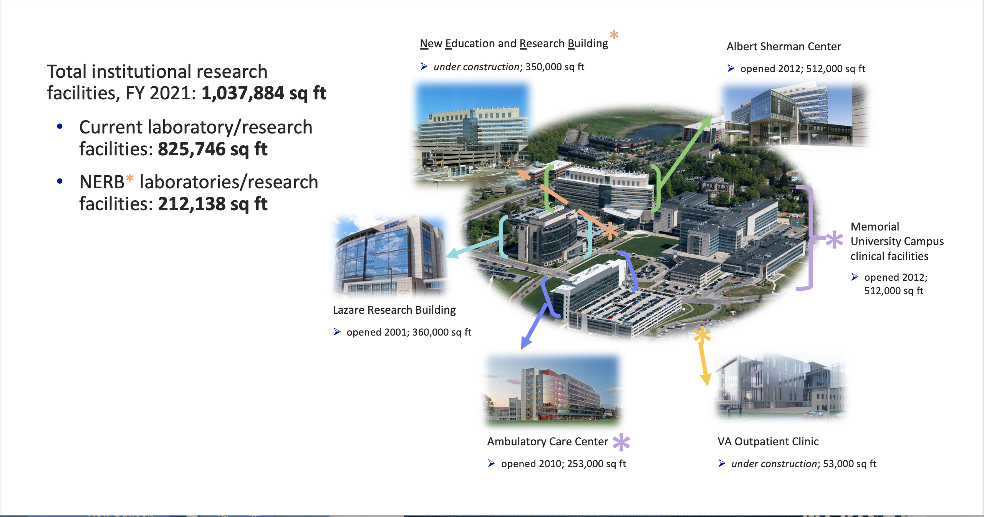
State-of-the-Art Research Facilities
Program in Molecular Medicine
Gene Therapy Center
Human Genetics
Neurobiology
Gene Therapy Center
RNA Therapeutics
Population and Quant Health Sciences
Biochemistry/Molecular Biotech
Cancer Center
Neurobiology
Medicine
Mixed clinical and research space
Cardiovascular Center
Diabetes Center
Cancer Center Clinical Trials
UMCCTS Clinical Research Center
Notes:
Ambulatory Care Center; opened 2010; 253,000 square feet
The Ambulatory Care Center (ACC) was opened in 2010 by UMass Medical School in collaboration with its clinical partner the UMass Memorial Medical Center. The 350,000 square-foot ACC is home to a mix of patient-care, clinical research and educational activities.

Slide 27
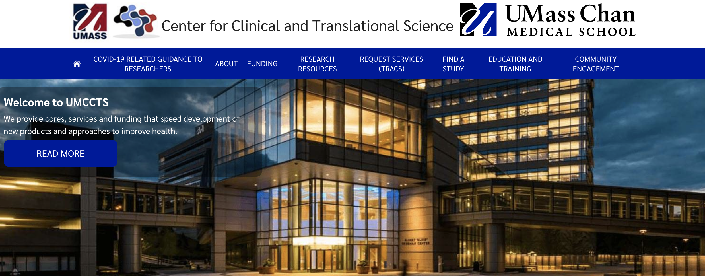
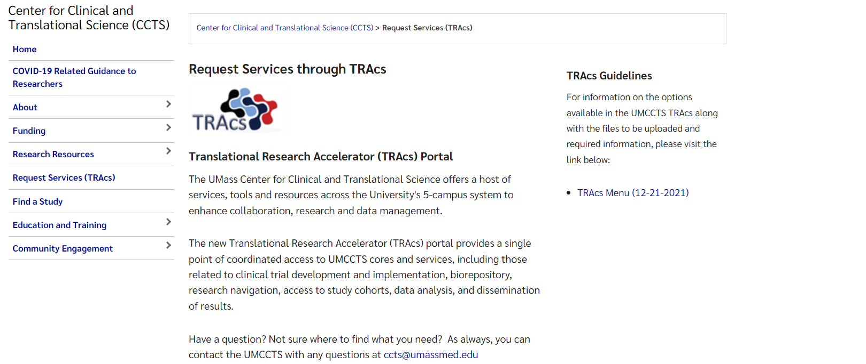
The UMCCTS provides oversight for all human subject research, as well as cores, services, training, and funding to advance clinical and translational research, including:
Institutional Review Board (IRB)
Office of Clinical Research: Clinical Trials Agreements, clinical study and clinical trials budgets
Clinical Research Center: Experienced clinical trials personnel, regulatory support, facilities
Cores: Small Molecule Screening, Bioinformatics, Tissue Bank and Biorepository
With PQHS: Community Engagement, Informatics, and Quantitative Methods Cores
UMCCTS
www.umassmed.edu/ccts
REQUEST SERVICES
https://www.umassmed.edu/ccts/request-services/

Slide 28
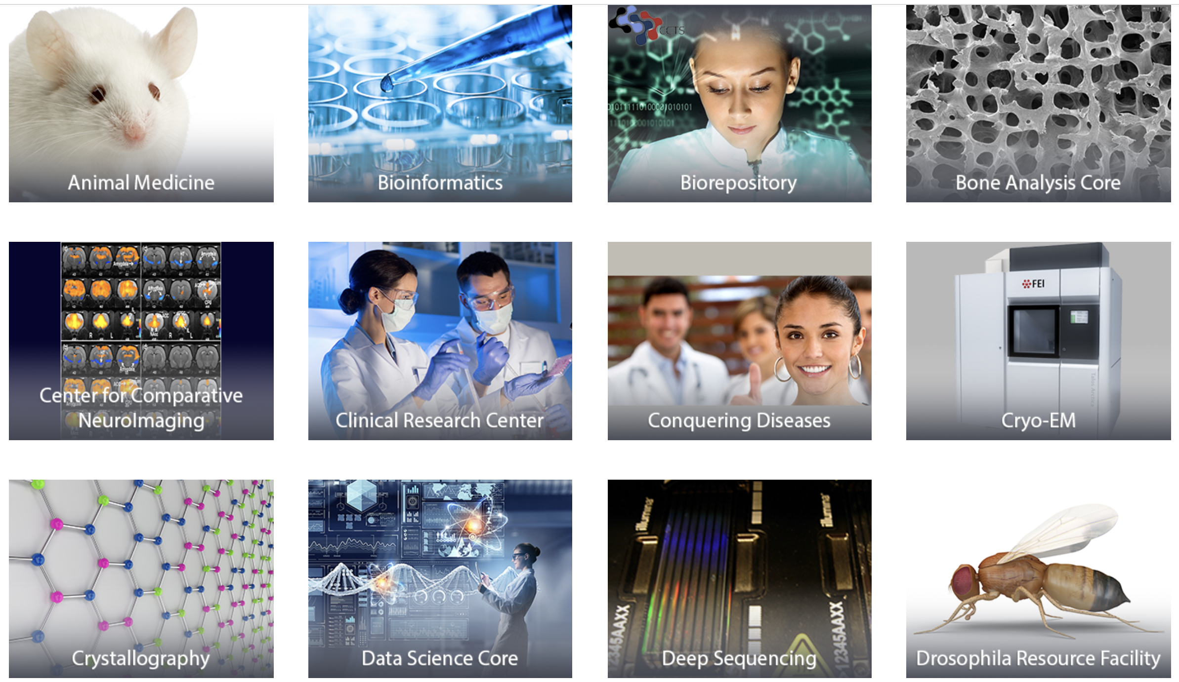
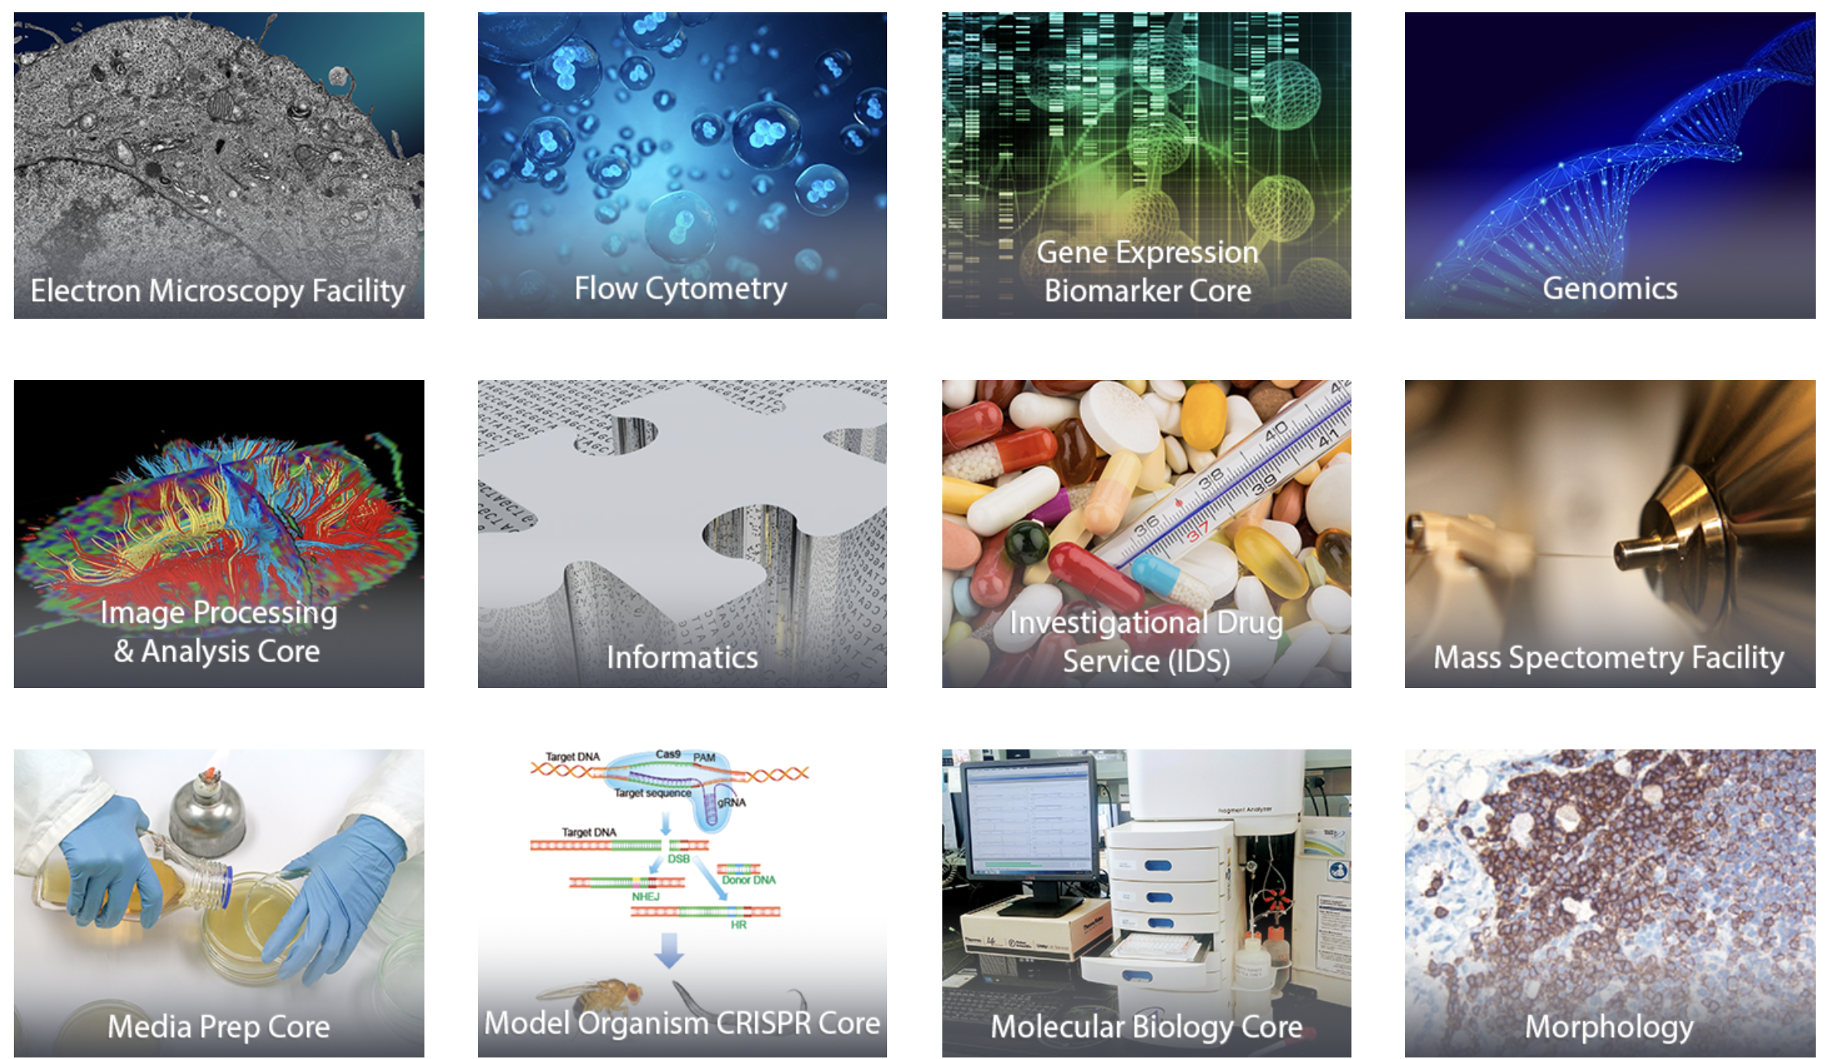
How We Excel – Core Facilities
UMass Research Core Facilities
  ~50 scientific cores available to all internal investigators for a fee-for-service charge
  Offer a wide range of services to the research community including cutting edge technologies, high-end instrumentation and technical support for basic, translational and clinical research
  Core Directors are leaders in their fields, offer consultation on projects, and are collaborative partners
Example Core Facilities
Notes:
Possibly combine with KL slide?

Slide 29
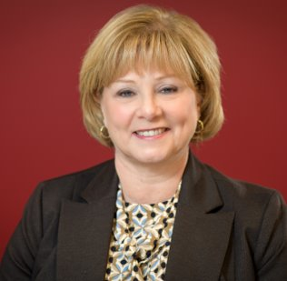
ForHealth Consulting
Founded in 1999, ForHealth Consulting is the healthcare consulting and operations division of UMass Chan Medical School.
The value of our mission as part of one of the nation’s top medical schools is our commitment to reinvest revenue to advance research and prepare the next generation of healthcare providers.
FY22 Revenue ~ $200M
More than 1,000 Employees
Includes management of over 400 active contracts
Partner with 100+ organizations across the country in more than 25 states
Massachusetts clients include multiple state agencies and other health & human service entities
Initiated multi-year state contracts to mitigate disruption due to administration changes
Salaries and fringes represent approximately 70% of total expenses
Executive Vice Chancellor​
Lisa M. Colombo, DNP, MHA, RN​
We partner with purposeful organizations to improve the healthcare experience, making it more equitable, effective, and accessible. As part of UMass Chan Medical School, we leverage world-class expertise and deep experience to create transformational solutions across the health and human services system.
Notes:
Formerly Commonwealth Medicine, it was renamed ForHealth Consulting earlier this year.
We partner with purposeful organizations to improve the healthcare experience, making it more equitable, effective, and accessible. As part of UMass Chan Medical School, we leverage world-class expertise and deep experience to create transformational solutions across the health and human services system.

Slide 30
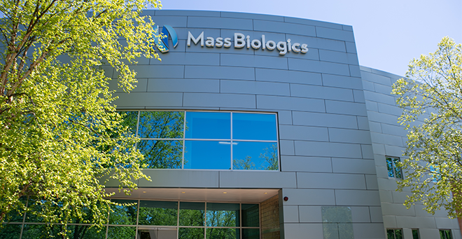
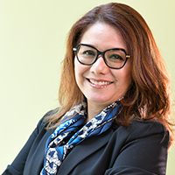
Developer and manufacturer of vaccines and biologics
Founded in 1894 to provide vaccines and antisera to the citizens of Massachusetts
Only FDA-licensed publicly-owned facility in US and approved for commercial production of Gene Therapy drugs in Europe
Expertise from product discovery to product and process development, clinical, registration and commercial production
  More than 25 licensed vaccines and biologics. TDVax current licensed product supplies >50% of US market. Two recent MassBiologics discoveries (Zinplava & Rabishield) are licensed biologics.
  Operating through partnerships, as a CDMO and commercialization of internal products
Large scale, GMP capabilities across biological modalities from vaccines, proteins and mAbs to viral vectors and oligonucleotides
Mireli Fino, MBA
Executive Vice Chancellor
Mass Biologics
Notes:
MassBiologics, located in Boston, is the only non-profit, FDA-licensed manufacturer of vaccines in the United States. For over 100 years, MassBiologics has worked to improve public health through applied research, development and production of biologic products, including vaccines, plasma derivatives and most recently, monoclonal antibodies. Mission: "Medicine for Better Lives”: To discover, develop, and manufacture biological medicines that improve the lives of people in the Commonwealth of Massachusetts and around the world while educating and training a workforce that will perpetuate this public health mission.

Slide 31
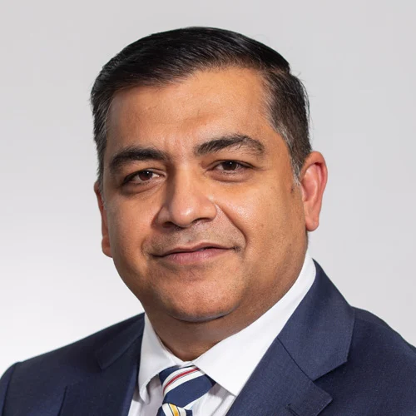
BRIDGE Innovation & Business Development
What do we do?
We serve as a BRIDGE between our faculty investigators and external investors and partners of all kinds
We identify and protect proprietary UMass Chan innovations through patent filing and other methods
We provide guidance and support to faculty and staff regarding the commercialization of their inventions
We collaborate with academic and commercial partners to further emerging technologies through the use of material transfer, confidential disclosure, inter-institutional, sponsored research, option and license agreements
We generate income for UMass Chan via licensing and partnerships
We launch new innovative startups with potential partners with VCs and PE
We generate new funding sources for UMass Chan research labs/faculty PIs
Parth Chakrabarti, MPH, MBA
Executive Vice Chancellor
Notes:
Our mission is to create a “bridge” between UMass Chan Medical School and the external life science ecosystem to support innovative research, protect intellectual property, and facilitate commercialization to help our community, the Commonwealth and the world.
BRIDGE Innovation & Business Development serves as the hub of all commercialization activities at the UMass Chan Medical School. It facilitates intellectual property protection, business opportunity development, technology licensing, and new-enterprise creation.
The BRIDGE team are committed to promptly and effectively facilitating the commercial development of intellectual property arising at the Medical School.

Slide 32
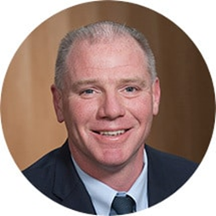
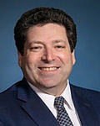
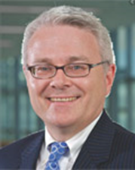
UMass Memorial Health Leadership
Eric Dickson, MD, MHCM, FACEP
President and CEO
Andrew Karson, MD, MPH
Interim President
UMass Memorial Medical Group
Michael Gustafson, MD, MBA
President
UMass Memorial Medical Center

Slide 33
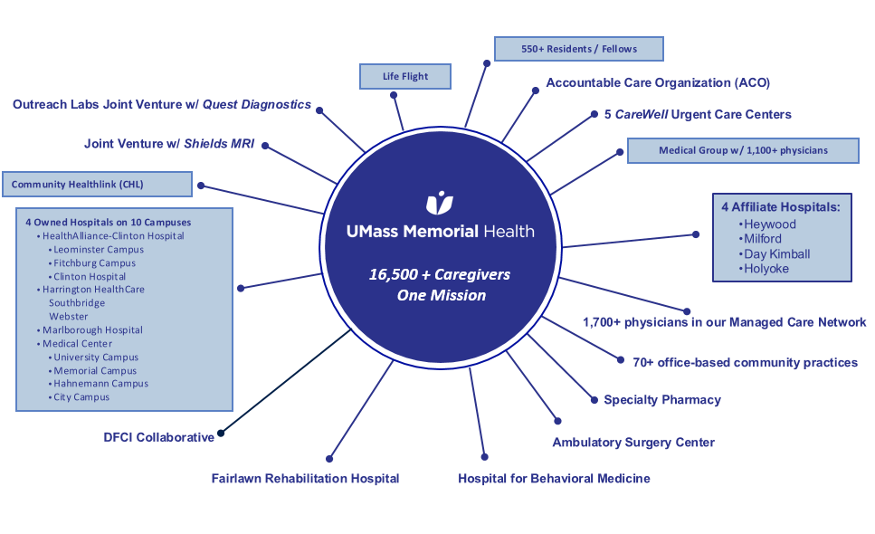
OUR MAJOR CLINICAL PARTNER

Slide 34
UMass Memorial Medical Group
UMass Memorial Medical Group is a dedicated, multispecialty network of more than 1,100 doctors who serve at more than 200 health care facilities throughout Central Massachusetts. One of the largest group medical practices on the East Coast, we also are the clinical partner of the UMass Chan Medical School.
UMass Memorial Medical Group is focused on four priorities to drive improvement of both the patient and physician experience. These are our LEAD priorities (Lean, Engagement, Access, Diversity):
Lean/Leadership Development
Disseminate LEAN management tools to all physicians and offer leadership development to our providers
Physician Engagement
Work together to combat the effects of burnout — and help elevate physician satisfaction
Access - (Inpatient/ED and Ambulatory)
Continue to work with UMass Memorial leadership, as well the leaders of other entities where we provide services, to make it as easy as possible for our patients to receive our exceptional care
Diversity
Make sure we learn from each other and make the Medical Group a safe community where everyone feels that they belong – no matter their color, culture, religious belief or sexual orientation

Slide 35
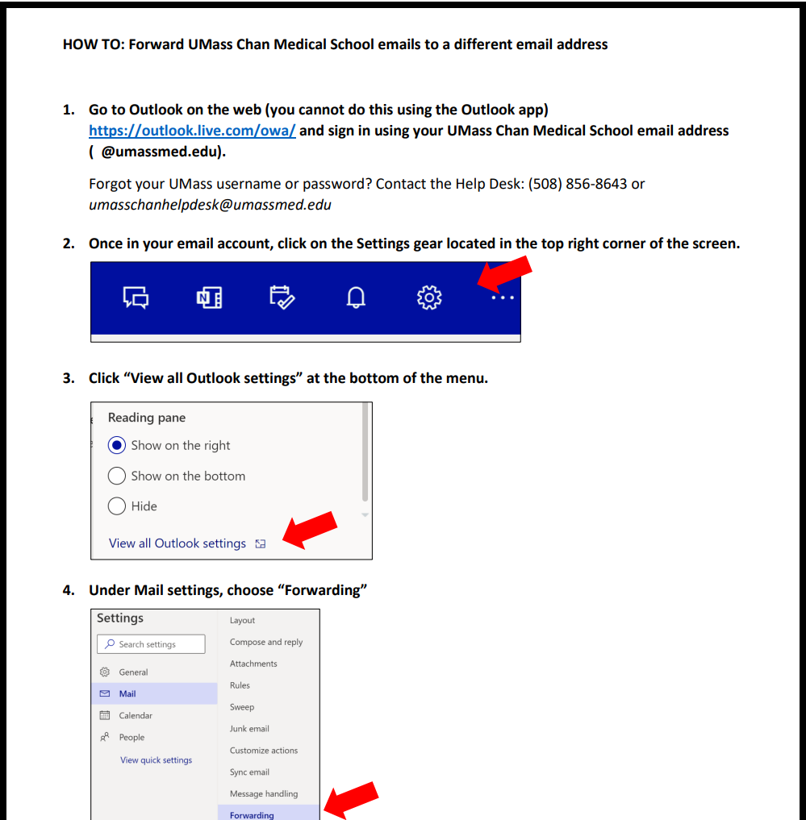
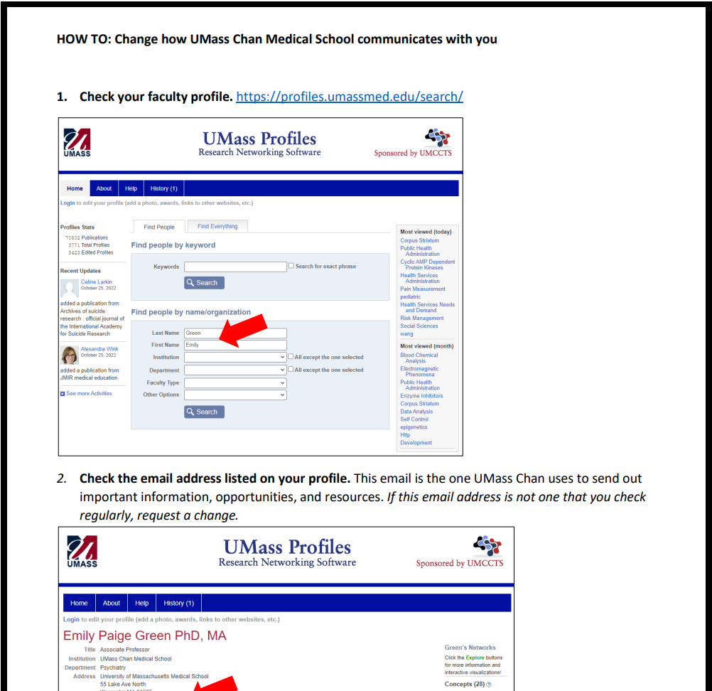
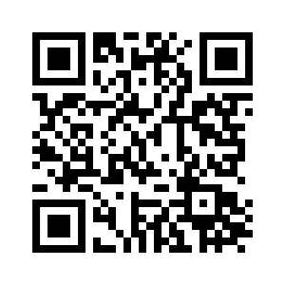
We want to communicate with you!
Forwarding your @umassmed.edu emails
Changing your preferred email
https://www.umassmed.edu/ofa/about/newswire/

Slide 36
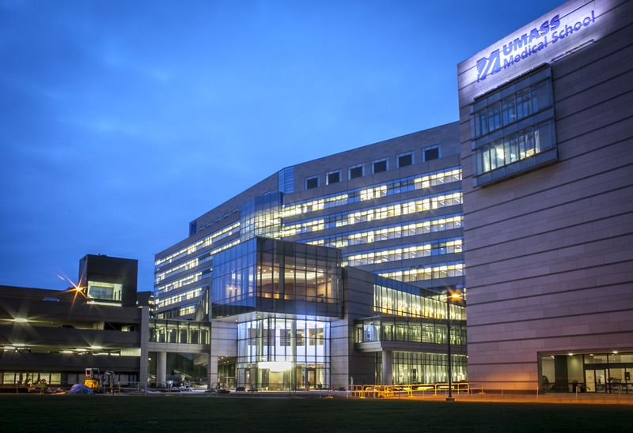
Any questions?
Office of Faculty Affairs (OFA): Faculty.Affairs@umassmed.edu
508-856-3244
Visit our website www.umassmed.edu/ofa

