Slide 1


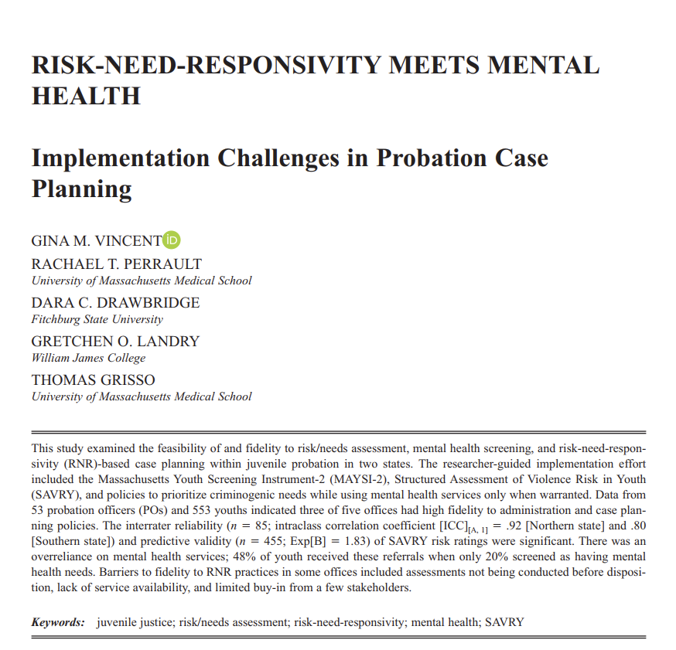


Mental Health versus dynamic risk: challenges of implementing rnr in justice settings
Gina M. Vincent, PhD
Co-Director, Law & Psychiatry Program
Professor of Psychiatry, UMass Chan Medical School
Notes:
How I got interested in this area is that I have believed since graduate school that valid risk assessment could help keep youth out of the justice system, or at least out of incarceration, when they do not belong there in order to protect public safety and change youths’ behavior. As I got into my career, I also realized that training only psychologists/clinicians how to conduct risk assessments would not have as big of an impact or as much of a reach as educating probation officers and the whole system that is making critical decisions about youths’ lives every day.
This presentation is going to report one of the studies we have conducted to help integrate evidence based practices in risk assessment and risk-need-responsivity based case management into juvenile justice settings –using lessons from implementation science. Although the project primarily worked with judges, probation, and mental health providers, this work has some implications for the forensic psychology/psychiatry professional as well, which I will get into near the end.

Slide 2

Recommendations For Reform & Preventing Youth Reoffending
National Research Council of the National Academy of Sciences (2013).
Use structured risk and need assessment instruments to identify low-risk youths who can be handled less formally in community-based settings, to match youths with specialized treatment, and to target more intensive and expensive interventions toward high-risk youths.
Risk-Need-Responsivity
Notes:
In 2013, One of the many recommendations that came out from the National Academy of Sciences for juvenile justice reform in the US to be consistent with adolescent development was…….
Notice the key word here was to USE risk and needs assessment in their decisions that affect many elements of youth case processing. The recommendation is about more than mere adoption of an instrument, we are looking for actual implementation of RNR ---- which means adhering to use of the instrument in decision-making, not only completing the tool with fidelity but also using it in decisions with fidelity.

Slide 3
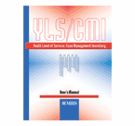




Risk and Needs Assessment Instruments for Youth
1. Who do I need to be most concerned about?
2. What should I do about it?
Ohio Youth Assessment System
Notes:
Many state juvenile justice agencies in the U.S. have been adopting risk/needs assessment tools (I believe over 40 are using an instrument statewide at this point). And it has become widely accepted that this is a good thing to do as long as the instrument selected has evidence of its reliability and validity.
These are some of the instruments most commonly used by justice state agencies in the U.S.
As I assume the participants of this webinar know, these instruments assess a number of factors known to be significantly associated with reoffending or violence, such as personality characteristics (e.g., impulsiity/anger control, lack of empathy), substance abuse, and official criminal history to tell us (or probation officers in this case) – who they need to be most concerned about. Then, through identification of specific risk factor areas (aka criminogenic needs), they give an evaluator or PO a sense of ‘what to do about it’ to prevent reoffending down the road

Slide 4
Risk Assessment Must be Paired With Practices that Promote Risk-Needs-Responsivity (RNR)
vb
The "Who"
Risk Principle
Match the intensity of the intervention with one’s level of risk for re-offending
The "What"
Need Principle
Target dynamic or changeable risk factors and only those factors (criminogenic needs)
The "How"
Responsivity Principle
Match the mode & strategies of services with the individual
‘How much to do & with whom’
‘’What to do’
‘How to do it’
Notes:
Once a risk/needs assessment is completed – it should be paired with a case management approach, like risk-need-responsivity – in order to be USED effectively to actually prevent violence/reoffending from occurring. There are three simple principles that should shape our work with justice-involved youth
Risk Principle – Match the intensity of the intervention with one’s level of risk for re-offending. This means higher risk youth need formal processing, low risk youth usually do not. Higher risk youth need more services and low risk youth don’t need very few services or no services.
Need Principle – Target dynamic or changeable risk factors and only those factors in any service planning. You want to address the things DRIVING the youths offending behavior – the point is not to address everything youth might need. This principle really SHAPES THE SERVICE PLAN
Responsivity Principle – Match the mode & strategies of services with the individual’s characteristics to increase their responsiveness to treatment and chances of success. To simplify this principle – it can include considerations that may be barriers to a youth benefiting from treatment, like not having the resources to attend certain types of programs or not having the cognitive capacity to benefit from certain types of programs. It also can include characteristics of the youth that underlie, maintain, or exacerbate risk factors (targeted responsivity).
Put simply, we think of these principles as ‘How much to do and with whom”, “What to do”, and “How to do it”
These principles seem very straightforward yet they are very hard to implement – and clinicians have a role in improving the implementation

Slide 5
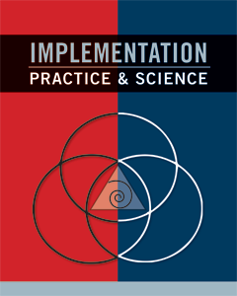
Lessons from Implementation Science
It requires about 2 to 4 full years for adoption of a new practice to become fully operational and have an impact on the recipient of services (e.g., Barrett, Bradshaw, & Lewis-Palmer, 2008; Fixsen et al., 2005)
Training is necessary, but alone is insufficient. It increases knowledge but, in isolation, it does nothing to change practice.
Decades of evidence from studies in human service areas shows that only about 5-15% of attempts to use new innovations (or EBPs) will succeed in the absence of purposeful implementation supports.
Active Implementation Frameworks
Fixsen, Blasé, & Van Dyke (2019)
Notes:
In order to actually implement a new procedure within a system – be it forensic or justice settings (such as courts and probation), a planful process is required upfront – with continual retraining and supervisory or quality assurance methods
Lessons from implementation science tell us……… (see slide)
There have been many studies recently indicating POs are not utilizing risk assessment instruments to their full capacity (ie., not doing RNR). Generally, research has indicated POs are completing the instruments because they are compliant but they are not using it in any of their decisions or in their case planning. The research typically has involved researchers going into jurisdictions many years after the jurisdiction adopted their instrument and they don’t necessarily know or report how or when the instrument was implemented, or researchers may passively observe and document the implementation effort. There is value to all of these because they have identified an issue. However, The narrative by some researchers is becoming that POs cannot, or will not, implement RNR
Maybe instead we should ask ourselves ”why would we have expected that POs are using risk assessment in their decisions”? For years the way these assessments were implemented was for the leadership to simply to pick and adopt a risk instrument, get a trainer to train POs how to do it, maybe develop a policy about when it should be completed – not how to use it. Basically in many agencies it has been “implementation by proclamation” (Dean Fixsen) which has never worked. Another issue is that POs don’t operate in a vacuum - they operate within a jurisdiction that either enables their ability to implement reform efforts and do their job or it doesn’t..

Slide 6
Implementation of Need Principle % of Youth With Need That Actually Received a Service (n = 148)
Peterson-Badali, Skilling, Haqanee (2014)
Notes:
Here is an example of one of several studies now that demonstrated the need principle is not being implemented in probation. In this example from Peterson-Badali’s lab in Toronto, researchers documented the results of the YLS/CMI completed by clinicians – who also prioritized the need areas to address. That info was handed off to POs and the researchers then looked at files/case plans to determine what services youth actually received while on probation. As you can see – the match of services to needs was pretty terrible, particularly in the areas that have the strongest relation to recidivism.
A latter study from this group, indicated that one of the most common referrals from POs was for mental health services – even though mental health alone is not a risk factor for reoffending. Further, there is no evidence that generic MH treatment has an impact on recidivism.

Slide 7
Risk Assessment and Behavioral health Screening (Rabs) Study
PURPOSE: To test a comprehensive approach to implementation of RNR principles in youth justice to prioritize dynamic risk while still attending to mental health when indicated
Notes:
In the RABS study, we attempted to change that tendency to just refer to MH services and attempted to improve implementation of all three principles of RNR by using a researcher-guided, comprehensive implementation of a risk-needs assessment + RNR in the state-run probation offices in a Northeastern state and 4 county-run probation offices in a Southern state so that they would prioritize treatment of dynamic risk factors while still attending to mental health needs when indicated
We received funding for this project from OJJDP and MacArthur

Slide 8
Risk Assessment and Behavioral health Screening (RABS) Study
Mixed-methods feasibility and fidelity study following a comprehensive, 1-year implementation process in 2 states:
SAVRY – risk assessment
MAYSI-2 – behavioral health screening
Research Questions:
Were JPOs able to complete the SAVRY with fidelity (IRR and PV)?
Did JPOs adhere to instrument administration policies? (policy fidelity)
Did JPOs adhere to RNR-principles in their case planning? (procedural fidelity)
*Also interviewed JPOs to assess feasibility
Notes:
We helped probation offices in 2 states to select and implement the SAVRY, a behavioral health screen (the MAYSI-2), and RNR-based case planning.
Fidelity is ‘the degree to which an intervention was implemented as it was prescribed in the original protocol” (Proctor et al., 2011, pg. 69). We examined fidelity using both PO self-report data and administrative data to assess adherence to three policies.
We tested their fidelity to the “predispositional risk assessment system’ by examining….(3 Questions on slide)
We also interviewed JPOs to qualitatively assess feasibility - which is the extent to which a new innovation can be successfully used within an agency or setting (Karsh, 2004; Proctor et al., 2011). We evaluated the feasibility of the policies and procedures using qualitative data from interviews with POs to gauge whether jurisdictions could successfully use the instruments and procedures.

Slide 9

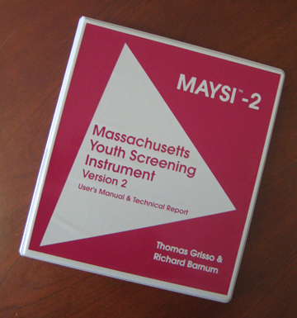
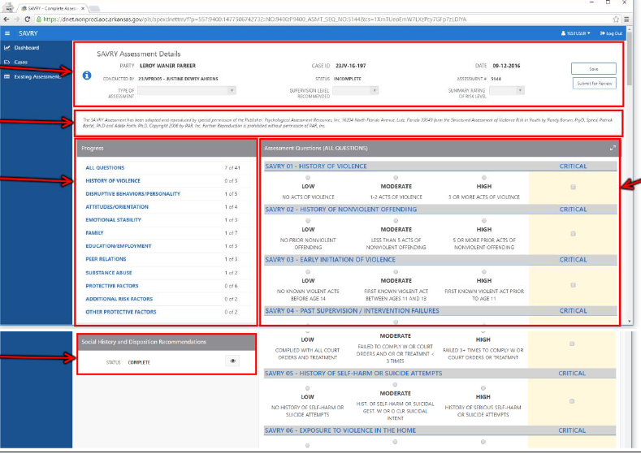
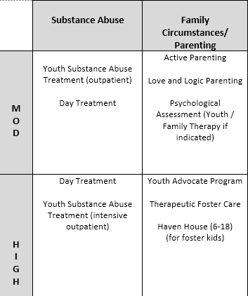
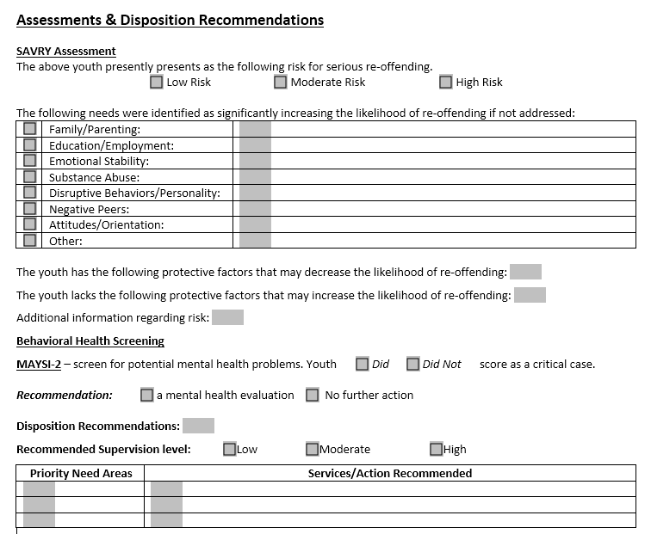
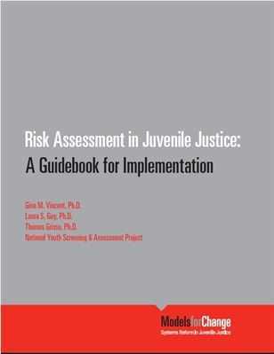

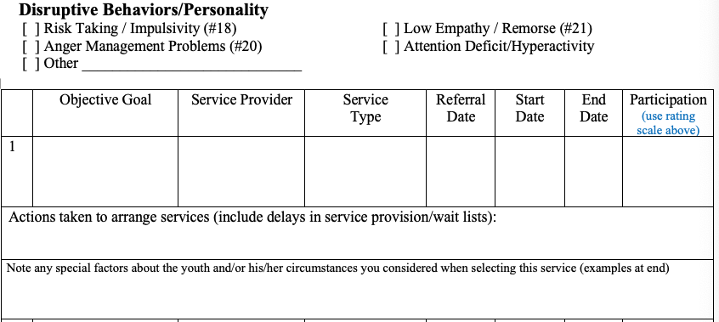
RABS Implementation Procedures
What was implemented?
Policies & Procedures for Administration
Integration into Electronic System
RNR-related Policies for Use in Disposition Recommendations & Case Planning
Staff Training on SAVRY & MAYSI-2
Training in RNR & Case Planning
Service Matrix
RNR-Based case plans
Disposition recs template
Implementation Process
Case plan aligned
Notes:
SAVRY to be implemented pre-dispo for recs & case planning – MAYSI for making eval referrals (not service referrals per se - but we would expect youth who screened in to be more likely to receive MH services than those who did not). For those familiar w/the SAVRY you know it doesn’t have need areas per se – we teach POs how to combine items to identify particular need area domains common in the RNR model
Process included 8 steps - including
Presentations to stakeholders to obtain buy-in – mainly court, attorneys, POs & providers
Implementation teams developed in both states to design policies, procedures, decision-support tools, & data tracking plans
Assisted with upgrades to case management systems to ensure essential data were tracked
Once policies & tools created – trained staff on the tools –
Affter 2 months trained on RNR practice & case planning
Service matrix -service providers
Dispo recommendations template – vetted by judges
Case plan aligned with whole process that was intended to get into the electronic system but never did
Remember to indicate MAYSI was supposed to lead to eval referral

Slide 10
Training: Responsivity Principle & Mental Health
Mental Health is not a risk factor – it does not increase the likelihood that someone will reoffend - but…….
Among youth - mental health problems are related to higher levels of dynamic risk/need domains (Guebert & Olver, 2014; McCormick et al., 2017; Schubert et al., 2011)
Treatment of dynamic risk factors/needs has a larger impact on reoffending than MH-related programming (McCormick et al., 2017; Skeem et al., 2011) – but…….
Matching services to both dynamic risk/need domains and mental health needs can result in lower reoffending rates within key domains (e.g., personality/behavior, education/employment) (McCormick et al., 2017)
Message to JPOs: Case plans should incorporate MH treatment when MH may underlie the risk factors or interfere with risk reduction services – but it should not be in lieu of risk reduction services.
Notes:
This training occurred in the beginning of case plan training
MH Service providers/clinicians attended the training alongside JPOs and were asked to help them complete their service matrices for their jurisdiction

Slide 11
Risk Assessment and Behavioral health Screening (RABS) Study
Sample:
All Youth eligible for the SAVRY (risk assessment) and MAYSI-2 (mental health screen) over 9 months (N = 856)
Juvenile Probation Officers (JPOs; N = 54) interviewed at 4.5 months
Youth case management data were tracked M = 10 mths (min 6 mths)
Notes:
The research sample included ---- see slide
NOTE IF ASKED (BUT WON”T BE DISCUSSED OTHERWISE)
This final sample lower proportion of Black youth (53.3% vs 73%, respectively), a higher proportion of non-Hispanic White youth (43.7% vs 25.1%, respectively; χ² (4) = 25.67, p < .001, Φ = .19), and a significantly higher proportion of Hispanic youth (16.4% vs. 2.4%); χ² (1) = 5.84, p = .016, Φ = .12. Youth in the final sample also were more likely to have committed a violent index offense (33.1%) than the excluded youth (24.1%); χ² (1) = 7.56, p = .006, Φ = .09.

Slide 12
Could JPOs Complete the SAVRY To Fidelity?
Inter-Rater Reliability (ICC_{A, 1}) | NE (N = 18) | South (N = 67)
Summary Risk Rating (Risk Level) | .92*** | .80***
Disruptive Behavior Problems | .77*** | .80***
Attitudes/Orientation | .88*** | .77***
Emotional Stability | .89*** | .78***
Family | .59 | .57**
Education | .81*** | .70***
Negative Peers | .50 | .82***
Substance Abuse | .85*** | .80***
Predictive Validity over 602 days
p < .01
Cox Regressions:
Any petition - Exp(B) = 1.83***
Violent petitions - Exp(B) = 1.96**
ICC ≥ .75 = excellent; .60 ≤ ICC < .75 = good
Notes:
There has been much conjecture that probation officers cannot complete structured professional judgment risk assessments accurately or reliably because they are too subjective. Our studies have consistently found that is not the case.
We examined inter-rater reliability in the field by a JPO conducting the SAVRY while being observed by a 2nd JPO and both then rating the SAVRY independently for a random sample of youth.
This slide indicates they had excellent inter-rater reliability in their determinations of youths’ risk levels and good to excellent reliability in most of the risk factor items we had them condense into various dynamic risk or criminogenic need areas.
Also – their SAVRY risk level ratings were significantly predictive of recidivism and violent recidivism specifically over an average 10 mth follow-up period. This is good because the baserates of reoffending for these youth were relatively low

Slide 13
Did They Adhere to Instrument Administration Policies?
Only 55.6% (n = 461) of youth had a MAYSI-2
Only 53.9% had a SAVRY
Site-Level Differences in Adherence
High in NE state & 2 Southern offices – > 90%
Moderate in one Southern office = 67%
Poor in one Southern office = 23%
20.4% were Critical MAYSI-2 cases
Notes:
NEXT research question was did they have fidelity to their administration policies. If they aren’t administering the tools – we cannot expect RNR to be implemented properly. Or, in the least, if RNR WAS implemented properly, we wouldn’t really have a way of knowing that without the tools being administered
Just over 50% of eligible youth (based on policies – which were to administer the instruments pre-disposition) received the instruments – this is bad but there were site-level differences.
We should always expect some youth are going to be missed – court issues, scheduling issues, refusals (rare), diverted before the RNR could be completed– so we shouldn’t expect 100% adherence to an assessment policy in a probation office; so we strive for a 90% adherence rate
Southern POs’ explanations for the missing MAYSI-2s and SAVRYs in the 2 offices that did poorly were 1) it wasn’t feasible, 2) they claimed the instruments had been done but the new electronic case management system wasn’t storing their data properly (ID problem), and 3) judges not asking for it (this was not an excuse, however)

Slide 14
Did They Adhere to RNR-Based Case Planning Policies? Types of Service Referrals (n = 437 youth w/assessments)
142 of the 437 received no service referrals
Notes:
This slide shows the service referrals made for the 437 youth from the sample who received the instruments AND received dispositions that would have been eligible for receiving services. About a quarter of the youth did not receive any services/programming over the average 10 mth follow-up period
We Used the agency service matrices and provider websites to categorize services into the need area addressed
The most common service referral was still in the emotional stability area – meaning a MH service. This may be problematic given only 20% of youth screened in on MAYSI, indicating they had an actual mental health need. At best, roughly 15% actually had an active MH condition since the MAYSI is just a screen, yet almost 50% got a MH service.

Slide 15
Did They Adhere to RNR Policy Regarding Types of Service Referrals - Responsivity?
Types of Service Referrals for Youth by MAYSI-2 Critical Case Status (n = 437)
Notes:
Next we attempted to examine whether all those youth with MH service referrals in the Emotional stability area may have been an accurate referral according to their MH Screening. As the slide shows – whether youth received a MH referral had nothing to do with their screening results. It was still the most common service above any dynamic risk-related services. And less than 40% of youth received BOTH a MH service and a dynamic risk service.
WHY:
Northeastern state–the whole case plan determined by judges and plea bargain w/o the benefit of risk assessment info – and they order a psych evaluation on most every youth, which is conducted by not highly trained individuals and they tell us most of the reports look the same and include recommendations for mental health services (say nothing about dynamic risk)
Southern state:
limited service availability so MH is their go-to,
handful of seasoned JPOs – not interested in following the new protocol
3 of the 4 southern offices did NOT have probation supervisors

Slide 16
One Southern County - Service-to-Need Match: % of Youth Rated High in Need That Received a Service
What Was Different?
Strong supervisors who provided coaching & QA
Strong judge buy—in
Well resourced in terms of services
Notes:
One probation office had very high fidelity to RNR. This graph shows how well they matched services to the dynamic risk areas identified for their youth on the SAVRY. 85% of youth with the emotional stability area as a priority received a service to address it, 73% of youth with a disruptive behavior priority received a service to address it, etc
In addition to excellent implementation - they cut their recidivism rate by 50% and it was low to begin with
What was different about this probation office that implemented RNR well? (see slide)

Slide 17
Conclusions
Were JPOs able to complete the SAVRY with fidelity? YES
Did JPOs adhere to instrument administration policies? DEPENDS
Administered SAVRY & MAYSI to most youth in all but 2 offices
However, NE state never accomplished this pre-disposition as per policy
Did JPOs adhere to the need and responsivity principles? Mostly NO
MH the most common referral (> 50% of youth) regardless of MH screen indicating only 20% may need it
Most of these youth also received a dynamic risk-related service
One site implemented the principles very well!
Notes:
1st point – evidence from this study AND 3 prior studies of JPOs in the field suggests……

Slide 18
Conclusions
What interfered with implementation & does not work? (JPO interviews)
Post-disposition assessments (NE state) simply did not work – systemic obstacles
Stakeholder buy-in problems w/seasoned JPOs and one judge (the site with poorest adherence)
Service availability limited in rural areas – MH referrals the ‘go-to’
Buy-in from MH providers was low in many sites & is essential (Haqanee et al., 2014)
Data management system problems
What DOES work?
Strong supervision with coaching & quality assurance
Strong judge, provider, & JPO buy-in
Well-resourced with services
Notes:
Point 1: the Northeastern state was never actually able to administer the SAVRY pre-disposition as planned and therefore, JPOs were stuck with the uninformed services judges required in the court orders & the MH evaluations that weren’t helpful. Systemic obstacles 1) turnover in the court, in leadership in their state agency (which was primarily a child welfare agency), and the probation officer union
Stakeholder buy-in issues from seasoned JPOs who were still surveillance oriented, and one judge who was originally bought-in and then changed her mind,
Limited service availability in the sites that were more rural; JPOs stated that mental health services were their ‘go-to’ due to limited service options and their impressions that clinicians were addressing criminogenic needs in counseling.
Data management systems –Most of the JPOs in the Southern state were having to learn a whole new data management system at the same time as the SAVRY – made them not like it

Slide 19
Conclusions
Limitations:
Just the first year of implementation – agencies generally approve and achieve outcomes later
MAYSI-2 is a screen; shouldn’t drive treatment decisions,
BUT…..way more youth received MH services than screened in & it should be the opposite
Recommendations:
All clinicians & providers should be educated about RNR & how the justice system’s risk/needs assessment defines dynamic risks (criminogenic needs)
MH providers should educate JPOs about how they can or cannot address these risks
Notes:
AR has since implemented into legislation and is doing this statewide
Predicting recidivism & recidivism reduction – only count activities that occur before the reoffending (that includes the RNA)

Slide 20

Recommendations cont. How Forensic Clinicians/Clinicians Might Facilitate Use of RNR With Fidelity?
In evaluations, clearly align treatment recommendations with dynamic risk areas/criminogenic needs
Assess the severity of a mental health condition & whether it is a targeted responsivity factor, barrier, or neither (not severe)
Inform the PO developing a case plan
Collectively, ensure both mental health (when applicable) and dynamic risks are addressed in plans

