Slide 1
HYPE on Campus: Initial Results from an Educational Support Intervention for Young Adult College Students with Mental Health Conditions November 15, 2024

Slide 2






Acknowledgements
The mission of the Transitions to Adulthood Center for Research is to promote the full participation in socially valued roles of transition-age youth and young adults (ages 14-30) with serious mental health conditions. We use the tools of research and knowledge translation in partnership with this at-risk population to achieve this mission.
Visit us at umassmed.edu/TransitionsACR
The contents of this presentation were developed with funding from the National Institute on Disability, Independent Living, and Rehabilitation Research, (NIDILRR), United States Departments of Health and Human Services (90DPGE0008). NIDILRR is a Center within the Administration for Community Living (ACL), Department of Health and Human Services (HHS). The content of this presentation does not necessarily represent the policy of NIDILRR, ACL, and/or HHS and you should not assume endorsement by the Federal Government.
Notes:
Maya to update

Slide 3
Agenda
Welcome & Many Thanks
Review of HYPE on Campus (HOC) Study Rationale
Review of HOC Study
Overview of Preliminary Results
Q&A

Slide 4

Special Thanks
Debbie Nicolellis
Kathryn Sabella
Jonggyu Beck
Special & many thanks to: Samantha Hersh, Louise Harkins, Mei Pearlstein, Maya Ingram, Amanda Costa, Ian Lane, Rachel Stone, Brian Miller, Emily McCaffrey, & Emma Narkewicz
Notes:
Special Thanks to Drs. Bronstein & Painter.
Allowing this modification and bringing us to BU

Slide 5
State of the State: Mental Health on Campus
Mental health conditions (MHC) considered most rapidly growing diagnoses on campus (AUCCCD, 2019)
20% of students reported a diagnosed MHC (ACHA-NCHA, 2016)
Conditions that would make them eligible for community mental health services
60% of the student population report symptoms that would meet the clinical criteria of a MHC (Lipson et al., 2024)
In 2013, 30% experienced symptoms (Eisenberg et al., 2013)
Utilization rates of student counseling services on campus has steadily increased
Over the last 10 years, campus service utilization increased each year (Lipson et al., 2018)
Notes:
30% experience symtpoms

Slide 6
Presenting Problem: Attrition
Students with MHCs have the highest rates of college dropout compared to any other group, including those with other disabilities (Kessler et al., 1995; Salzer, 2012; Arria et al., 2013).
Estimated dropout rate of 86% (Kessler, et al., 1995; Salzer, et al., 2008; Collins & Mowbray, 2005)
triple the rate of freshmen at 24%, the highest drop-out rate of any general student population (U.S. News and World Report: “Freshman Return Rate”)
In a recent study, 70% of 264 students reported at least one failed attempt at school; 25% of those were on their second, and 44% were on their third or more attempt (Mullen, unpublished data)
Commonly-held belief: Students with MHC have high attrition rates because of poor grades due to MH symptoms.

Slide 7

A Narrative of Convenience...
Evidence does not support GPAs as reason for attrition
Average GPA in a competitive university 3.2* (Eisenberg et al., 2009)
Average GPA from a community samples 3.0, 2.9 (Gill, Mullen, et al., 2022)
Narrative of attrition due to poor grades and symptoms is
too simplistic
Rooted in bias and discrimination associated with “mental
illness”
Significantly impacts:
Types of services/interventions created, funded, and offered
Perspectives of who is responsible
Young adult identities
Notes:
Eisenberg, Golberstein, and Hunt’s (2009) study of students with psychiatric conditions at an academically rigorous and competitive university has provided a valuable citation to support this narrative,
this study is largely misinterpreted with their results being misunderstood.
The authors stated that depression and anxiety symptoms predicted lower GPA, which is true,
average GPA of these students was 3.22 as compared to the larger student population’s GPA of 3.36.
These students’ GPAs were, in fact, lower than the comparative sample, but not low enough to support the symptom-based attrition narrative.
Students with MHC cycle in and out of school
Our samples have had GPAs of 2.9-3.1
Our hypothesis is that symptoms and grades are not the cause of the staggering attrition rates of this group...

Slide 8
Prior Work that Informed this Study

Slide 9
Evolution of thought...
Students struggle with effectively using existing campus resources, which have not historically been designed for students with MHC.
Specifically, Disability/Accessibility Services, CAPS/counseling services, & Career Services (Gill, Mullen, et al., 2022; Mullen et al., 2017).
In earlier studies, students with MHC more commonly endorsed issues associated with executive function (EF) tasks than “classic” mental health symptoms when identifying academic barriers (Gill, Mullen, et al., 2022; Mullen et al., 2017).
When taught EF skills, students experience greater academic persistence & self-efficacy; use more cognitive strategies...and report fewer academic barriers (Mullen et al, submitted; Mullen et al., 2017).
Focused Skill & Strategy Training (FSST)
Notes:
Searched literature for interventions that addresses issues with memory, time management, prioritizing tasks
At time of grant submission, no published literature existed for CR interventions for college students with mental health conditions

Slide 10
Focused Skill & Strategy Training (FSST)
Cognitive Remediation Intervention → “Coaching Intervention”
Initially called FAST: Focused Academic Skills Training
A manualized compensatory approach based in the cognitive remediation literature
Modification of Beth Twamley’s CCT intervention for SE (Twamley et al., 2012)
12, 1 hour skill and strategy coaching sessions that focuses on teaching EF skills
Based on student’s academic goal
Individualizes skill development approaches and strategies that are aligned with their articulated barriers
Uses distributed learning and deliberate practice
After completing FSST, odds increase by 6x to complete one additional academic year.
Greater academic persistence & self-efficacy, and experience less barriers (Mullen et al, submitted; Mullen et al., 2017).
Notes:
Goals are set at the first session and are revisited every 3rd session to assess progress, connect strategies, and refine goal
roots all support strategies into the student’s current academic goals (semester and long-term)
explores what’s getting in the way of achieving their goals
individualizes skill development approaches and strategies that are aligned with their articulated barriers
Practitioner uses their language and how they describe their barriers

Slide 11

HYPE on Campus

Slide 12
Overview HYPE on Campus
Helping
Youth on the
Path to
Employment
Acts as a bridge between Disability Services, Counseling/Psychological Services, and Career Services
Intends to fill the gap in services that’s typically seen on campus for this group of students
Does not duplicate services
assists students to utilize services on campus more effectively
Assists in the coordination of services to enhance outcomes
Facilitates information sharing between offices, off campus resources, and students.
Assists students and career services personnel with determining job/internship matches to promote career development.
Informs accommodations & assistive technology recommendations based on functional implications of MHC.

Slide 13
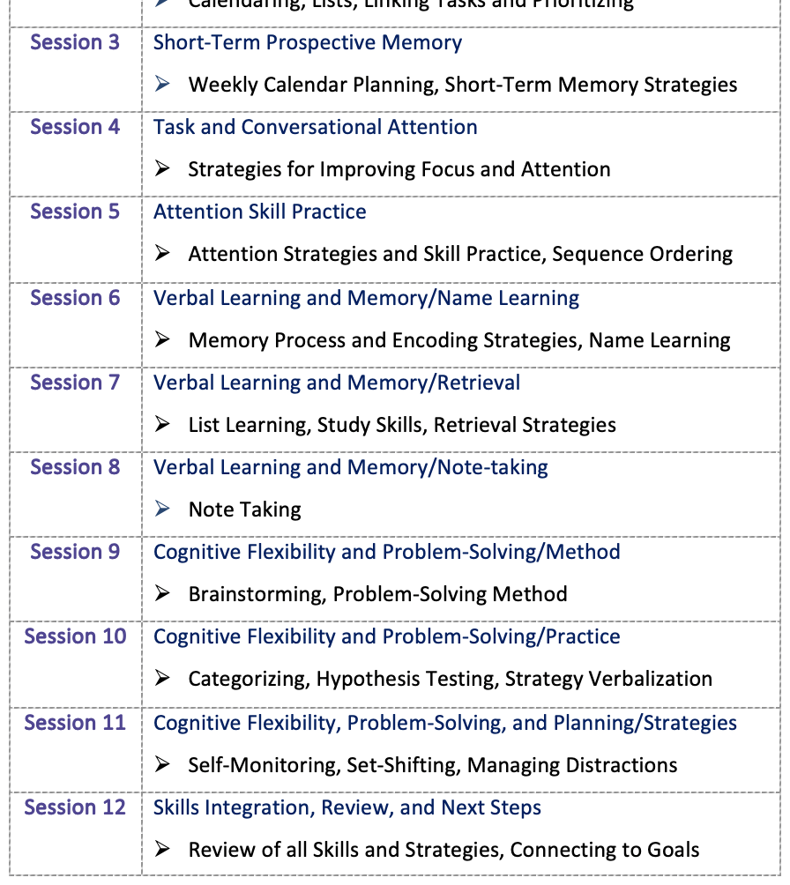
FSST
Four Modules:
Prospective Memory
Attention
Memory
Cognitive Flexibility

Slide 14
Methods

Slide 15
COVID-related Design Modifications
Flipped in-person to web-based training
Live, synchronous training & TA
Asynchronous training via Moodle
Selected student intern model
MSW
OT

Slide 16
HYPE on Campus Project
Fall 2020
Prepare for Feasibility Trial
Spring 2021
Open, Feasibility Trial
Fall 2021- Fall 2022
Pilot RCT efficacy trial
Can we do this here?
1 semester
Services for up to one academic year
Recruit MSW students
MOU
Learnings inform efficacy trial
Training & Technical Assistance
A little practice…
Can this work on campus?
How does this work on campus?
Can we train MSW Interns & Supervisors?
Data collected through Dec 2023

Slide 17
Research Hypotheses & Exploratory Analysis
H1 - Persistence: HYPE participants will experience fewer disruptions towards degree completion as compared to those in the active control.
H2 - Progress: HYPE participants will achieve satisfactory academic progress across a greater number of semesters as compared to those in the active control condition.
H3 - Self-Regulated Learning (SRL): HYPE participants will report greater self-regulating learning on average over semesters enrolled than will control group participants.
Notes:
MAYA TO UPDATE

Slide 18
Research Hypotheses & Exploratory Analysis
H4 - Barriers: HYPE participants will experience fewer barriers in performing academic tasks on average over semesters enrolled than control group participants.
H5 - Self-efficacy: HYPE participants will report greater self-efficacy on average after the completion of the intervention period than control group participants.
Exploratory Analyses:
Impact of student level factors on progress and persistence outcomes
Self-efficacy and expectations
Quality assurance Indicators
Notes:
MAYA TO UPDATE

Slide 19
Study design
Pilot Randomized Control Trial
Large, Primarily Residential, 4-year, Selective University
HYPE on Campus or Campus Services as Usual
Trained Master’s Social Work Interns as HYPE providers (n=8)
Trained in two waves
AY 2020
Summer 2021
Two teams of 4 HYPE providers
Assigned to Psych clinic or Disability Services
Data collection:
Diagnostic interview: eMINI
Self-report at Baseline, Dec. 2021, Feb 2022, June 2022, December 2022
Brief surveys (i.e., “touchpoints”) every month in between (11 check-ins)
Notes:
Binghamton is considered a “selective” university
acceptance rate of 42%
Average SAT score between 1340-1510 or an average ACT score of 29-34.

Slide 20
Study criteria
Inclusion
Exclusion
Undergraduates (18-30)
DSM diagnosis
Taking more than 6 credits
One prior academic disruption due to their MHC
Falling under 2.0 GPA
Inability to complete 2/3 of course load
Medical withdrawal
Taken a semester off
OR
Reported 3 or more academic barriers (due to MH condition)
E.g., writing papers, managing symptoms in school, prioritizing tasks, concentrating, time management
Co-occurring condition of ASD, TBI, other neurologic condition that affects cognition
ADD/ADHD diagnosis without other mental health condition
First semester freshmen
Anticipated graduation prior to December 2022

Slide 21
Conditions

Slide 22
HOC MSW Intern Training
2 MSW training cohorts, 8 providers
Interns were randomized into two teams
Complex intervention = in-depth training prior to service delivery
Ongoing TTA after services started
Use of Audit & Feedback to evaluate quality/fidelity
Development and presentation of “student conceptualizations”
Individual TA was recommended, mandated if did not meet adequate fidelity scores
Weekly Team Meetings with each team

Slide 23
HYPE on Campus
Up to one academic year of HYPE services
1 – 2 Semesters of services depending on when participant joined study
Weekly meetings with HYPE Provider (MSW Intern)
HYPE Services include:
FSST (first semester)
Development of education and employment goals
Individualized support relevant to goals
Use of structured HYPE tools and worksheets as needed
Connection to Campus Resources (SSD, Career Services, CAPS, clubs, etc)

Slide 24
FSST Sessions
Short-term, highly focused on teaching EF skills & strategies
Agenda
Review of Home Exercise
Review of session’s topic
Intro a topic
Rationale, benefit, exploration of current level of practice
Skill Practice
Gamification
Eg. Going on a picnic, Spit, Find the Difference, Categorizing...
Application
Home Exercise
Notes:
NY Times puzzels
Connection
Woordle

Slide 25
Selected FSST Topics
Creating habits to promote self-regulated learning
Goal setting
Time & Task Management (Prospective memory)
Calendaring: the most important self-regulation skill
To-do lists
Sequencing
Prioritizing tasks (Eisenhower’s Principle: urgent vs important)
Self-talk
Use of timers/reminders
Automatic places, task-linking
Set-shifting vs multi-tasking
Visualization
Encode- Store -Retrieve
Notes:
Goal Driven behavior
CALENDARING!!!!
One calendar: paper OR electronic
Very, very rarely both, so rarely that we say *never* use both
All syllabi assignments & exams should be in the calendar within the first week of school
Calendar should provide time and task management activities daily/weekly
Sometimes people just need a little help getting organized ☺

Slide 26
Campus Services & Usual
One, 1-hour meeting with Control Group Specialist
Offered at beginning of each semester
Resources on campus reviewed and use encouraged, some personalization to participant needs
E.x., if participant indicated a difficulty with essay writing, Control Group Specialist would highlight the campus writing center
“Campus Services as Usual” included, but not limited to:
counseling, psychiatry, disability services, academic support center (e.g. tutoring, math lab), student groups, clubs, facilities (e.g. wellness, fitness) or any other resource available on campus.
Notes:
SAM TO UPDATE

Slide 27
Recruitment
472
Inquiries
154
Eligible
318
Excluded
140
Consented
37
Excluded
Notes:
Flyer on campus, BU's Student Advisory Board,
Residence Halls
Partnered with campus-based services (Advisors, CAPS, BIT,)
Reddit
University Social Media
Student paper (paper & electnoic)
136 additional people were interested after we closed
Closed capacity- 608 inquiries

Slide 28
Final Sample
First Eligibility Review
4/3/21
Final Eligibility Review
1/20/22
Final Randomization
2/8/22
103
Randomized
52
HYPE
51
Control
26
SSD
26
Psych Clinic
Notes:
*per KIM discussion, there were 5 other participants who withdrew or were determined to be ineligible post randomization

Slide 29
Participant Characteristics

Slide 30
Credits & GPA at Baseline
Class year | Percentage
0-30 credits (1st year) | 21.4%
30-60 credits (junior) | 38.8%
60-90 credits (sophomore) | 30.1%
90-120 credits (senior) | 9.7%
Baseline GPA 3.33 (SD= 0.77)

Slide 31
Age & Gender Identity
Average age
20 years old
(SD = 1.56; 18-29)
*51.3% Identify as female on BU’s campus

Slide 32
Sexual Orientation

Slide 33
Race & Ethnicity
Race/Ethnicity | HOC | On Campus
American Indian or another Native American | 0% | 1%
Black or African American | 3% | 5%
Hispanic/Latinx | 10% | 11%
Asian or Pacific Islander | 16% | 14%
Caucasian | 52% | 56%
Other | 1%
Multiracial | 18% | 3%

Slide 34
Academic Disruptions
Academic Disruption | Percentage
Starting classes in a semester and then withdrawing | 33.0%
Dropping a majority of your classes in a semester | 12.6%
Taking a formal/medical leave of absence from a college or university | 9.7%
Taking a semester off from college | 8.7%
On academic probation | 6.8%
Falling under a GPA of 2.0 | 6.8%
Not returning to school after a semester | 4.9%
I'm not sure | 2.9%
Other | 8.7%
None of the above | 50.5%
Notes:
*per KIM discussion, there were 5 other participants who withdrew or were determined to be ineligible post randomization

Slide 35
Academic Barriers
Academic Barriers | Percentage
Concentrating | 92%
Managing symptoms in school | 85%
Time management | 80%
Studying for exams | 75%
Maintaining stamina | 72%
Prioritizing tasks | 71%
Maintaining organization | 67%
Memorizing information | 61%
Writing papers | 60%
Taking tests | 50%
None of these | 0%
Notes:
Executive functioning:
Each student reported an average of 7 different executive functioning issues.
Top 3 reported areas of difficulty:
Concentration- 92%
Managing symptoms in school- 85%
Time Management- 80%

Slide 36
Diagnoses
Diagnosis | Percentage
Major Depression | 44.7%
Generalized Anxiety Disorder | 39.8%
Social Anxiety | 20.4%
Panic Disorder | 20.4%
Obsessive-Compulsive Disorder | 17.5%
Agoraphobia | 12.6%
Post-traumatic Stress Disorder | 9.7%
Bipolar (I and II) | 8.7%
Other Conditions | 4.9%
Notes:
Average: 6.355769 Mode: 4 Median: 6

Slide 37
Employment and Parental Education

Slide 38
HYPE on Campus Fidelity
Notes:
MICHELLE TO UPDATE

Slide 39
Provider Mean Scores

Slide 40
Average Scores by Fidelity Domain
Notes:
Interns are performing well in the following domains:
Engaged Student During Session
Taught Effectively (skill development and/or FSST)
Used Time Effectively
Interns are struggling to meet fidelity in the following domains;
Summarized Session
Reviewed Home Exercise(s)
Assigned Home Exercise(s)
Most variability observed in the following domains;
Worked to Prevent Disruption
Set and Implemented Agenda

Slide 41
Preliminary Results
Notes:
MICHELLE TO UPDATE

Slide 42
Results
Academic Persistence
No differences between conditions
For those that completed FSST
Significant effects for # of credits completed (given # registered; p=0.043)
Significant effects for # of courses completed (given # registered; p=0.026 S1; p=0.039 S2)
Satisfactory Academic Progress
No differences between conditions
Self-Regulated Learning Strategies
No differences between conditions
Greater SRL strategy use for those who completed 9 sessions (T1: p=0.02, T2= .087) and 12 sessions (T1: p=0.029, T2= .09) of FSST
Notes:
SAP is completion of 2/3 of all coursework with GPA over 2.0

Slide 43
Results cont...
Educational Barriers:
Ex: taking notes, meeting deadlines, asking questions, memorizing info
At end of Spring Semester, HYPE participants had fewer educational barriers (p=0.039)
FSST completers: p=0.016
Cognitive Problems
Ex: forgetting appointments, difficulty remembering information, difficulty focusing, etc.
At end of Spring Semester, HYPE participants had fewer cognitive barriers (p=0.032)
FSST completers: p=0.012
Self-Efficacy
No differences between conditions

Slide 44
Results Exploratory Factors that Influence Progress & Persistence Outcomes
Cognitive Strategies
At all time points, HYPE participants had greater number of strategy use (T1: p=0.0003, T2= .001, T3= .006)
7m after the end of services, p=.052
Educational Support
No differences between groups
Perceived Stress
No differences between groups
For those that completed FSST, reduction in stress (p=0.053)
Symptoms
HYPE participants reported a reduction in depression (T1: p=0.054, T2= .024); approached significance for reduction in feelings of distress (T1: p=0.087)
For those that completed FSST, reduction in depression (T1: p=0.036, T2= .029, T3= .032); approached significance for reduction in feelings of distress (T1: p=0.071)

Slide 45

Conclusions
Very promising results!!!
While not powered to show outcomes for persistence, significant findings show powerful signals.
Campus-based model shows promise!
MSW Interns can be well trained
Fidelity varies however
Setting/supervision may be a factor
Training should focus on fidelity reviews earlier
Real-world implementation reduces effect size (expected)
FSST seems to be the secret sauce...or salt!

Slide 46

Thank you, thank you, Thank you!!! Questions, Comments?
HYPE@umassmed.edu Michelle.Mullen@umassmed.edu

Slide 47
White Knuckle Theory
reduces ability of connecting to academic & mental health resources
Under-refined EF Skills
Increased Cognitive Load
Feelings of Stress
Cognitive Overload
Decreased Performance
Feelings of Distress
Increased Symptoms
Crash
&
Burn
Personal factors , e.g. hunger, symptoms, trauma, discrimination, basic needs, life events...
Preventative Specialized Supports
Reactive Symptom-based Supports
Notes:
This may be a reason why symptoms gets identified as the reason for poor grades and attrition, however, it may not be the root cause
College students with psychiatric conditions struggle to persist, not necessarily with performance
GPA may be a transient issue or content-specific
May have history of incompletes or sudden termination of classes
It the personal amount of effort required to manage multiple competing demands, which results in stress
Increased amount of unhealthy stress may decrease a person’s resilience to academically persist
Think about the student who is successful at 4 courses, but cannot manage 5 courses well…its not intelligence/capacity, its bandwidth
EF skills promote self-regulation & management to enhance performance
This is why the narrative of mentally ill, too sick to, and bad grades is so damaging...students need skills, when you teach them, they use them!

Slide 48
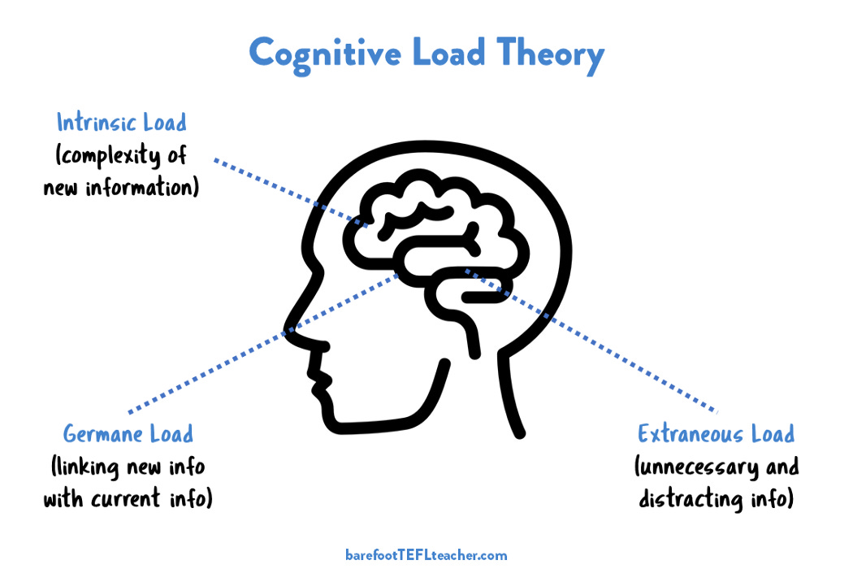

Slide 49
Cognitive Load
Determined by cognitive resources required for a task
The more resources required OR the less resources available, the “heavier” cognitive load
Basic unmet needs & symptoms use cognitive resources
Significant reliance on working memory and attention
Effort is influenced by processing speed
If working memory capacity exceeded, cognitive overload occurs
Remaining cognitive resources insufficient to meet demands
Performance decreases (Pass et al., 2003; Sweller et al., 1998; van Merrienbower & Sweller, 2005; Sweller, 2011)
Notes:
Missing assignments, losing important things, not showing up for appts
Cognitive overload looks like bad student behavior
lack of caring, lack of motivation, or “laziness”

Slide 50

Academic Predictability to Cognitive Load
Cognitive load is low at the beginning of the semester
precipitous increase in demands as semester continues
Increased reliance on EF skills and strategies to manage competing demands
New semester, new me...
until mid-terms, then it’s
last semester, current me

Slide 51


