Slide 1
The Hiring Review Process
An Overview, Navigation Tips, and Where to find Forms and Information
Notes:
We are coming to the close of the fiscal year, and many departments are planning for their FY 15 hires. So this appeared to a good time to the review the steps required to request approval to hire thru the Hiring Review Process
Hiring Review and a signed approval to hire is required before recruitment for all UMMS staff positions (both permanent and temporary) that are not 100% grant funded.
In this presentation I will :
1. Overview the typical steps to follow to when requesting Hiring Review
2. Provide tips that will help move your request efficiently through the process
3. And show you how to keep informed of updates and changes in the process
Stop me at any point with questions. My voice does not project, so if at any point you cannot hear me in the back please wave and let me know.

Slide 2
Hiring Review: The 5 Steps
If required for the position, hiring manager or designee:
Opens a Requisition in iCIMS
Downloads and completes the Administrative Decision Exemption for Hiring Freeze form
Emails request to DEOO
Responds to any requests for additional information
Receives response via email
If approved, initiates the recruitment process with the Talent Specialist assigned to her/his department
Notes:
To request approval to hire through the Hiring Review Process the hiring manager or designee: .
Opens a Requisition in iCIMS
Downloads and completes a request form
Emails the request to DEOO
Responds to any requests for additional information
Receives response to the request via email
Note that MassBiologics follows a different process.
If approved, the hiring manager initiates the recruitment process with the Talent Specialist assigned to her/his department

Slide 3
Search Waiver or Expedited Search
Complete ADMINISTRATIVE DECISION POLICY REQUEST FORM (Staff) (OR Administrative Decision for Faculty Hires Request)
Submit the form to DEOO
Notes:
For any position, whether staff or faculty, a department must get DEOO approval to seek a wavier of the search or a reduction in the length of time a position is posted.
To make such requests, department should submit the ADMINISTRATIVE DECISION POLICY REQUEST FORM (Staff) OR submit an Administrative Decision for Faculty Hires Request to the DEOO.

Slide 4
Tips for a Smooth Hire Review Process
Use the most up to date PDF version of request form(s)
Email the PDF (do not copy or scan)
Include the Requisition # and Speed type
Use formal job titles for existing jobs
Notes:
Avoid Hardcopies or scanned PDFs. Faxed or paper copies cannot be circulated and electronically approved – thus delaying disposition of your request.

Slide 5
Other Tips for a Smooth Hire Review Process
Indicate on the form if you are proposing a new unapproved position
Request waivers/expedited searches as early in the process as possible or with the request for Hiring Review
If you are requesting approval for multiple positions, indicate the number of positions on the form at the time of request.
Notes:
Continued
By new I mean that the position has never existed before. Replacement can mean that an individual held the position and you are replacing them OR you are replacing one job with a newly created or identified job.
The search strategy has to be worked out before a position can be posted. It can be frustrating to have to wait for a decision for a search wavier/ expedited search at the point where you are ready to recruit.

Slide 6

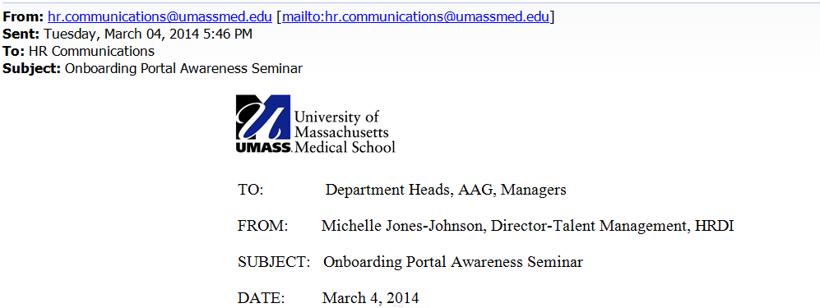
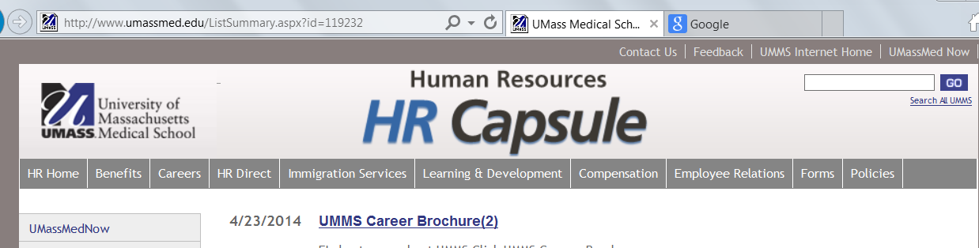
Stay Informed
Notes:
There are 3 ways to keep informed of new tools, information or process improvements as they occur with this or other HR processes, procedures, policies and programs.
The HR Capsule – Published monthly
Email Announcements from HR Leaders
If you miss it or cannot find it in your email check the The HR Capsule Archive of both prior HR Capsules and Announcements

Slide 7
Handy Links
Managers Guide to Hiring
(http://umassmed.edu/uploadedFiles/hr/Landing_Pages/Hiring_manager_User%20Guide.pdf)
Administrative Decision Exemption to Hiring Freeze Form (Hiring Review)
http://inside.umassmed.edu/uploadedFiles/Hiring%20Freeze%20EXEMPTION%20Form.pdf
Administrative Decision Policy Request Form (For Search Wavier/Expedited Search)
http://inside.umassmed.edu/uploadedFiles/Administrative_Decision_Policy_Request_Form.pdf
HR Capsule and Announcements Archive
http://www.umassmed.edu/ListSummary.aspx?id=119232
Notes:
These resources and forms can also be found on the HR website under forms

Slide 8
Key Takeaways
The Hiring Review consists of 5 Steps
Waivers/ expedited searches require a separate request
Watch the HR Capsule, HR Communication or reference the HR Capsule archive for updates and changes
Contact Greer Jordan with questions or suggestions to improve the process.

