Slide 1
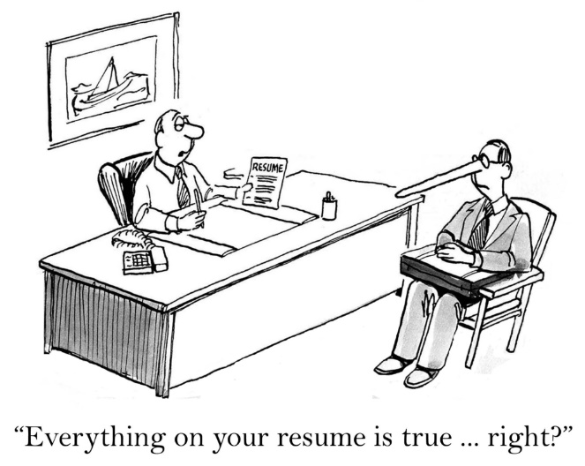
HIRE
Manage and Lead at UMMS
Interviewing and Hiring “Best Practices”

Slide 2

Manage and Lead at UMMS
SHAPING YOUR CAREER AND YOUR FUTURE
PROGRAM OVERVIEW
What it Offers
Description: The Manage and Lead program at UMMS is an intensive, multi-tiered training program designed specifically for UMMS Leaders and Managers. This leadership series will:
Provide you with the necessary tools to build a successful leadership foundation and create a culture where people collaborate and effectively work together
Assist you in gaining enhanced skills in attracting and hiring new staff, developing and coaching staff, managing performance and behavior and reducing legal and employee relations problems
Provide the training and tools to ensure UMMS managers develop into great leaders, such as:
  Communicating Up, Down and Across, Developing Performance Goals and Standards, Resolving Conflict, Providing Continuous Performance Feedback, Hiring and Retaining Top Tier Talent, Motivating Team Members, Developing and Coaching Others, Retaining Top Tier Talent, Understanding the Importance of Situational Awareness and much more
Notes:
Welcome to Critical Thinking – our latest course offering in our Professional Development series.
In this course, we will talk about the importance of using critical thinking to solve problems. We will first discuss the concept of critical thinking, the process of thinking the problem through, and review various critical thinking tools such as:
- defining the real problem,
- the five “why's”, and the seven “so what's”,
- blowing up the business
- the 80/20 rule,
- and how to conduct insightful analysis.
Lastly, I’ll discuss how you can apply these techniques to your daily work, and how you can build a culture of critical thinking within your team and/or coworkers.
Now, let’s do a quick exercise to see what you may already know about this concept.

Slide 3

Manage and Lead at UMMS
SHAPING YOUR CAREER AND YOUR FUTURE
TRAINING MODULES
HIRE, COMPLY, MANAGE, DEVELOP
The training program consists of the following four (4) training modules that are taught by UMMS HR subject matter experts. The modules are to be taken sequentially as follows:
HIRE - Creating Functional Competency Based Job Descriptions, The UMMS Recruiting & Hiring Process, Diversity in Hiring, Behavioral & Competency Based Interviewing, The Key to Effective Departmental Onboarding and Retaining New Staff
COMPLY - Legal and Compliance Issues, Understanding FMLA, ADA, etc.
MANAGE - Managing the Team to Goals, Managing Performance and Behavior, and Understanding the HR Employee Relations Consultant Role
DEVELOP - Coaching, Developing, Motivating, Communicating and Leading Employees
Notes:
Welcome to Critical Thinking – our latest course offering in our Professional Development series.
In this course, we will talk about the importance of using critical thinking to solve problems. We will first discuss the concept of critical thinking, the process of thinking the problem through, and review various critical thinking tools such as:
- defining the real problem,
- the five “why's”, and the seven “so what's”,
- blowing up the business
- the 80/20 rule,
- and how to conduct insightful analysis.
Lastly, I’ll discuss how you can apply these techniques to your daily work, and how you can build a culture of critical thinking within your team and/or coworkers.
Now, let’s do a quick exercise to see what you may already know about this concept.

Slide 4

Agenda
PROGRAM LAUNCH
HIRE Module, Part I
HIRE Module, Part I - Interviewing & Hiring
Description: This module takes the management and leadership training and weaves in the context of the following management position responsibilities:
Learning UMMS recruiting hiring process and behavioral competency based interviewing that consists of:
  Understanding UMMS Hiring Process and Diversity in Hiring
  Identify, Select and Hire the Right Candidates
  Understand "Behavioral & Competency Based Interviewing" and "Best Practices" Models & Theory
  Implement a Standard and Consistent Interview Process
  Application of Behavioral Competency Based Interviewing
Notes:
Welcome to Critical Thinking – our latest course offering in our Professional Development series.
In this course, we will talk about the importance of using critical thinking to solve problems. We will first discuss the concept of critical thinking, the process of thinking the problem through, and review various critical thinking tools such as:
- defining the real problem,
- the five “why's”, and the seven “so what's”,
- blowing up the business
- the 80/20 rule,
- and how to conduct insightful analysis.
Lastly, I’ll discuss how you can apply these techniques to your daily work, and how you can build a culture of critical thinking within your team and/or coworkers.
Now, let’s do a quick exercise to see what you may already know about this concept.

Slide 5
I. Interviewing and Hiring
Course Goals
Understand and follow the UMMS hiring process steps
Understand the integration of diversity with the hiring process
Identify, select and hire the top tier candidates
Understand “Behavioral & Competency Based Interviewing” and “Best Practices” Models & Theory
Implement a standard and consistent interview process
Practice and complete training exercises
Complete group debriefings
Review and discuss “Learning Outcomes”

Slide 6
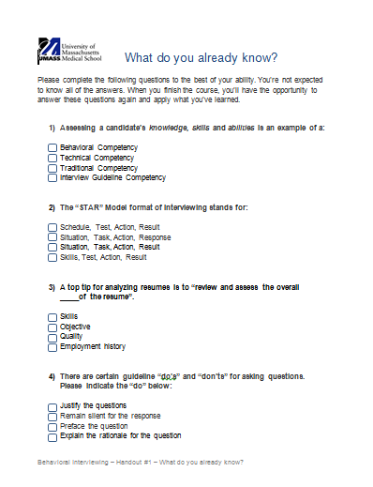
What do you already know?
Please refer to the handout and answer the questions
Notes:
Please refer to the handout and answer the questions to the best of your ability . You’re not expected to know all of the answers. When you finish the course, you’ll have the opportunity to answer these questions again and apply what you’ve learned.

Slide 7

I. Interviewing and Hiring
Identify, Select & Hire Candidates: Employer Branding
  Employer branding describes an organization’s reputation as an employer, and its employer value proposition to its employees.
    The employer value proposition (EVP) is a unique set of offerings, associations and values to positively influence target candidates and employees. The EVP gives current and future employees a reason to work for an employer and reflects the company’s competitive advantage. Employers that manage their EVP effectively benefit from an increase in their talent pool and employee engagement.
  A strong employer brand is key for recruiting and retaining the best talent.
  Companies with strong employer brands attract 3.5x more candidates, and have 28% lower employee turnover.*
    How?
      Strong employer brands attract the right people to your organization by clearly stating who you are as an organization and what you offer, and you help job seekers understand what it’s like to work for your organization. Through this communication, you will further engage the right talent and inadvertently help unfit candidates select out.
      Strong employer brands set expectations and improve retention by communicating upfront and clearly what it’s like to work for your organization.
      You set expectations about what it means to be a successful employee at your company. You can showcase the skills and traits that are highly valued in your organization so that new hires know how to behave upon starting. This communication resonates with the job seekers who are able and willing to meet these expectations. As a result, the ones who apply and get hired are less likely to leave your organization.
  Build the UMMS brand: An academic health sciences leader with a reputation for groundbreaking education, research and health care; committed to excellence, diversity, competitive benefits and work-life integration.
  *iCIMs, 2016

Slide 8

I. Interviewing and Hiring
Building the UMMS Brand: Diversity & Inclusion
  UMMS is committed to a diverse and inclusive workforce that is reflected in our faculty, students and staff.
    Diversity: Understanding that each individual is unique and recognizing our individual differences.
    Inclusion: Welcoming diversity and creating an environment where all different kinds of people can thrive and succeed.
  Diversity compels UMMS to lead in the development and implementation of innovative approaches to health sciences education, research and public service.*
  *UMMS Diversity & Inclusion Office, Guide to Recruiting a Diverse Faculty, 2014.

Slide 9
I. Interviewing and Hiring
Recruiting and Hiring Process
Step 1: Requisitions Created and Approved
Step 2: Recruitment Consultation
Step 3: Job Posting
Step 4: Review Incoming Applications
Step 5: Source Additional Applications
Step 6: Phone Screen and/or Interview
Step 7: Submit to Hiring Manager for Review and Interview
Step 8: Reference Check
Step 9: Job Offer Development
Step 10: Extend Job Offer
Step 11: Send to Onboarding
Notes:
One important element to critical thinking and problem solving is to first define a problem statement.
When you put together a good problem statement, it becomes your charter for your critical thinking efforts. It will:
- Spell out your goals
- Lay out boundaries and define success criteria
- Spell out the constraints you're going to face & articulate your assumptions
- Identify who the stakeholders are
- Provide timelines that you're going to face
Take a look at a problem you're trying to solve. Is it clear what the problem statement is? Do you know what the goals are? What the boundaries, constraints, and assumptions are? Do you know who the stakeholders are?
The time you spend with this type of critical thought is going to help you be more effective in solving the problems that you face.
Now let’s talk about another critical tool – asking the question behind the question.

Slide 10
I. Interviewing and Hiring
Hiring Process and Diversity
  Chancellor’s Initiative
  Targeted Approach
  Expanding Diversity Candidate Pools
  Increase the Opportunity to Hire Diversity Candidates
  Diversity is a Competitive Advantage and Better Reflects Faculty, Students, Staff and our Customer
Notes:
One important element to critical thinking and problem solving is to first define a problem statement.
When you put together a good problem statement, it becomes your charter for your critical thinking efforts. It will:
- Spell out your goals
- Lay out boundaries and define success criteria
- Spell out the constraints you're going to face & articulate your assumptions
- Identify who the stakeholders are
- Provide timelines that you're going to face
Take a look at a problem you're trying to solve. Is it clear what the problem statement is? Do you know what the goals are? What the boundaries, constraints, and assumptions are? Do you know who the stakeholders are?
The time you spend with this type of critical thought is going to help you be more effective in solving the problems that you face.
Now let’s talk about another critical tool – asking the question behind the question.

Slide 11
I. Interviewing and Hiring
Skills versus Competencies
Types | Definition | Example
What is a Skill? | Proficiency, facility, or dexterity that is acquired or developed through training or experience The ability, coming from one's knowledge, practice, aptitude, etc., to do something well An ability and capacity acquired through deliberate, systematic, and sustained effort to smoothly and adaptively carry out complex activities or job functions involving ideas (cognitive skills), things (technical skills), and/or people (interpersonal skills) A skill is the learned capacity to carry out pre-determined results A learned ability to bring about the result you want, with maximum certainty and efficiency So, a Skill is something Learned in order to be able to carry out one or more job functions | Programming Skills – need the skill to write the program in a specific language. Learning Java, C++, C# etc. is a Skill.
What is a Competency? | A cluster of related abilities, commitments, knowledge, and skills that enable a person (or an organization) to act effectively in a job or situation Competencies refer to skills or knowledge that lead to superior performance Measurable skills, abilities and personality traits that identify successful employees against defined roles within an organization A competency is more than just knowledge and skills. It involves the ability to meet complex demands, by drawing on and mobilizing psychosocial resources (including skills and attitudes) in a particular context A measurable pattern of knowledge, skills, abilities, behaviors, and other characteristics that an individual needs to perform work roles or occupational functions successfully Competencies specify the "how" (as opposed to the what) of performing job tasks, or what the person needs to do the job successfully Competencies, therefore, may incorporate a skill, but are MORE than the skill, they include abilities and behaviors, as well as knowledge that is fundamental to the use of a skill | Programming Competencies – to effectively write a computer program one needs good analytical, logical and interpretive ability as well as the skill to write the program in a specific language. The underlying ability to use that skill effectively Is analytical, logical and interpretive ability are the Competencies.
Notes:
Please refer to the handout and answer the questions to the best of your ability . You’re not expected to know all of the answers. When you finish the course, you’ll have the opportunity to answer these questions again and apply what you’ve learned.

Slide 12
I. Interviewing and Hiring
Manager’s Goal for Interviewing: “The Candidate Assessment”
Types | The Candidate Assessment | Definition | Sample Questions
Technical Competencies | Does the candidate possess the knowledge, skills, and abilities necessary to be successful in this position and at UMMS? | Knowledge, skill & ability required for successful accomplishment of a job or task. | What development tools have you used? How would you rate your key competencies for this job?
Behavioral Competencies | Will the candidate “fit” and thrive in the department and in the overall UMMS culture? | Helps define a candidate’s behavioral strengths that could predict future successes in the workplace. | Describe a time on any job in which you were faced with stresses which tested your coping skills. What did you do?
Notes:
Please refer to the handout and answer the questions to the best of your ability . You’re not expected to know all of the answers. When you finish the course, you’ll have the opportunity to answer these questions again and apply what you’ve learned.

Slide 13
I. Interviewing and Hiring
What is Behavioral & Competency Based Interviewing?
Types | Definition | Sample Questions
Competency Based Interviewing | Knowledge, skill & ability required for successful accomplishment of a job or task. In a competency interview, the interviewer will tell you the specific skills required for the job and then ask you to describe your abilities in those areas. | What development tools have you used? How would you rate your key competencies for this job?
Behavioral & Competency Based Interviewing Model | Behavioral and Competency Based Interviewing is the process of engaging applicants in an interview process by identifying key leadership competencies required for success in the job, and developing behavioral specific questions to target and assess employee performance in previous jobs. The interviewer is assuming that your past actions or behaviors are a good indication of how you can be expected to perform in the future. Helps define a candidate’s behavioral strengths that could predict future successes in the workplace. A behavioral interview poses questions about specific previous work experiences. The interviewer focuses on specific open-ended questions targeting the position’s key knowledge, skills, abilities, competencies and fit. The interviewer probes further with drill down questions to seek specific actions, results and learning outcomes (based on candidate’s experience). | Describe a time on any job in which you were faced with stresses which tested your coping skills. What did you do?
Notes:
Please refer to the handout and answer the questions to the best of your ability . You’re not expected to know all of the answers. When you finish the course, you’ll have the opportunity to answer these questions again and apply what you’ve learned.

Slide 14
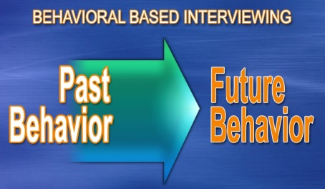
I. Interviewing and Hiring
Behavioral Based Interviewing Model
  The interviewer frames the interview questions using the
  STAR Model format to assess the candidate.
Types | Description | Sample Questions
Situation | Describes a situation and context of the story | Describe a time where you had to interact with a difficult client.
Task | Highlights a specific task to complete | Describe a time where you were given a difficult problem to solve.
Action | Action taken to complete the task | How did you handle it?
Result | Result of the action taken | What was the end result?

Slide 15

I. Interviewing and Hiring
Traditional versus Behavioral Questions
  Traditional Questions: (General Baseline) – Refer to handout
    Tell me about yourself?
    What are your strengths & weaknesses?
    Why are you interested in this job?
    Why are you leaving your current position?
  Behavioral Questions: (Specific knowledge, skill, competencies and behaviors) – Refer to handout
    Can you tell me about a work situation where you had to resolve a complex network outage issue?
    Can you provide an overview of the situation? How did you specifically solve the problem?
    What was the outcome? Would you do anything differently next time?
  Observations:
    Traditional questions do NOT allow you to assess candidate’s specific experience
    Behavioral Interviewing allows you to validate specific experience
    The “Best” interview process is a blended approach of both styles

Slide 16
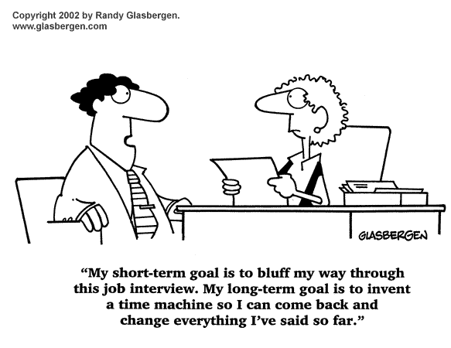
I. Interviewing and Hiring
Interviewing Dilemmas

Slide 17
I. Interviewing and Hiring
Common Interview Mistakes
  What are some common interviewing mistakes?
  Why does this happen?
  Group break out session

Slide 18

I. Interviewing and Hiring
Common Interview Mistakes
  Lack of preparation
  Over-weighing first impressions
  Pre-judging the candidates (Halo or Horn Effect)
    A bias that causes you to allow one trait, either good (halo) or bad (horn) to overshadow other traits. (i.e. knowing a candidate went to a particular University may be looked upon favorably).
  Neglecting the 80/20 Pareto Rule (Over-talking)
    Candidate speaks 80% of the time; Interviewer speaks 20% of the time
  Interrupting candidate’s answers
  Lack of “Specific Targeted” questions
  Insufficient data gathering (“should have asked”)
  Incomplete interview team
  Poor “note taking” during the interview
  Inconsistent messaging with group interviews
    Interviewers having different opinions on what the job entails and skills needed for the job

Slide 19
I. Interviewing and Hiring
Interview Guidelines & Suggestions
  What should your interview process look like?
    Interviewee Goal – (Get the job offer)
    Interviewer Goal – (Yes or No decision to hire)
  Group Break Out Session

Slide 20

I. Interviewing and Hiring
Interviewing Guidelines
  Review job description and resume, and prepare interview questions in advance (identify green and red flags)
  Welcome/build professional and friendly rapport (Why? How?)
    Building rapport with candidates creates a level of trust and understanding. It is important to build rapport early on so candidates will feel more comfortable and will be more open and honest to questions
    Ways to establish rapport: listen, find a common ground, be empathetic, treat candidates with respect
  Inquire about the candidate’s understanding of the position, UMMS, and interest level (fit, personality, and motivation indicators)
  Explain the interview process (STAR Behavioral Interviewing Model)

Slide 21

I. Interviewing and Hiring
Interviewing Guidelines (Cont’d)
  Evaluate all candidates consistently by asking behavioral competency type questions to surface if the candidate has the needed experience, skills and overall requirements for the job
  Ask candidate to demonstrate or describe a specific skill and ask for an example of how he/she used it in the workplace
  Provide feedback within 24 – 48 hours to the hiring manager and recruiter based on your interview documentation tool
  Keep an open mind
  Avoid illegal questions (examples in slides to come)
  Close the interview and explain next steps
  How?
    Promising candidate
      Ask candidate their level of interest, explore any doubts or reservations the applicant might have, let the candidate know what’s likely to happen next, whether another interview will be needed, how long it will be before a decision is made
      Thank the candidate for coming
    Non-promising candidate
      Close the interview graciously, you can let them know at this point your not offering he/she the job, you don’t need to be specific about why you’ve rejected the candidate, if you tell the applicant he/she was “unqualified” or “lacking experience” then be honest , but don’t be confrontational
      Thank the candidate for coming

Slide 22

I. Interviewing and Hiring
Resume Analysis
  How do we evaluate resumes?
  Group Break Out Session

Slide 23

I. Interviewing and Hiring
Resume Analysis Tips
  Review and assess the overall quality of the resume, such as:
    accomplishment oriented, qualified accomplishments, short bullets, job progression, accurate, clear/simple, clean formatting, one page, provide metrics to show accomplishments
  Is the objective and or the professional summary aligned with the position, department and institution’s needs?
  Do the current or recent job titles and duties match your specific needs?
  Does the individual’s resume demonstrate a solid employment history of performance, skill development, specific accomplishments and promotion?
  Or short tenure and gaps?
  Does the resume meet your educational, training or specific experience requirements? Does the resume reflect associations with professional groups?
  Have you determined if the resume meets your green flag (needed experience, skills, etc.) overall requirements? Have you identified any red flags (work gaps, skill gaps etc.) with the resume?
  Is temporary work listed correctly by including the staffing agency as the employer (if applicable) and each temporary job is in a list under the staffing agency? Also, are the achievements in each temporary job highlighted?

Slide 24

I. Interviewing and Hiring
Do’s and Don’ts about asking questions
  Don’t
    Justify the question by explaining why you are asking it
    Explain the rationale for the question
    Preface the question
    Tell a story about the question
  Do’s
    Just ask the question, and then…
    Remain silent for the response
  Example:
  Don’t: I want to ask you more about what you are looking for in the culture of an institution? Fit can make all the difference and I want to make sure you would be a good fit for this culture.
  Do: Can you describe what an ideal culture
  of an institution and its workplace would look like?

Slide 25
I. Interviewing and Hiring
Learn More About Open-Ended Questions
  Behavioral & Competency Based Interviewing Model
    Behavioral and Competency Based Interviewing is the process of engaging applicants in an interview process by identifying key leadership competencies required for success in the job, and developing behavioral specific questions to target and assess employee performance in previous jobs.
  Group Exercise: Video
  Other resources:
    Writing Effective behavioral Interview Questions– Lynda.com
Notes:
Facilitator
Annie
Why This Slide
Contains short instruction clip on task learners have just attempted
More Information
Show the video clip (4 minutes) – and ask them to take a few minutes to review their first question and make it better.
What was still light – and how did you use content from the video to make it better?
Image Prompt
Nothing critical

Slide 26
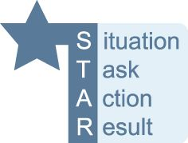
I. Interviewing and Hiring
Developing Behavioral Based Interview Questions
  Identify and focus your questions on the Technical and Behavioral Competencies you need
  Frame the specific questions using the STAR Model focused on common and more complex position situations and scenarios
  Create opportunities for follow-up & drill down questions by asking who, what, when, how, why, type of result and learning outcomes
    Example 1: Tell me about a time when you had to resolve a difficult project issue at work?
    Example 2: Can you provide me a specific example of how you performed at a high level on an enterprise project team?
  To identify negative behavior, don’t ask a question that obviously divulges a positive experience answer. If you don’t give away the correct answer in the question, you will hear a wide range of responses.
    Example 1 (giving away the correct answer in the question): Tell me about a time when you were bored on the job and what you did to make the job more interesting?
    Example 2 (not giving away the answer in the question):
    Could you tell me about a time when you were bored on the job?
Notes:
Facilitator
Annie
Why This Slide
Contains short instruction clip on task learners have just attempted
More Information
Show the video clip (4 minutes) – and ask them to take a few minutes to review their first question and make it better.
What was still light – and how did you use content from the video to make it better?
Image Prompt
Nothing critical

Slide 27

I. Interviewing and Hiring
Large Group Discussion
  What have you learned about developing Behavioral and Competency Based interview questions?
  What worked? Didn’t work?
  Examples of questions
  Impactful? Match the criteria? How do you know?
  Favorite questions that you usually like to ask, behavioral or traditional?
Notes:
Facilitator
Annie
Why This Slide
Contains short instruction clip on task learners have just attempted
More Information
Show the video clip (4 minutes) – and ask them to take a few minutes to review their first question and make it better.
What was still light – and how did you use content from the video to make it better?
Image Prompt
Nothing critical

Slide 28

I. Interviewing and Hiring
Interviewer’s Role
  Prepare, plan and manage the interview process and candidate
  Observe the candidate for first impressions and if he/she displaying appropriate dress and demeanor
  Listen and learn as much as possible to assess technical, behavioral and cultural “fit” for the position
  Pareto Analysis – 80/20 rule
    You speak 20% of the time
    Candidate speaks 80% of the time
  Targeted selection
    Strategize the questions to surface needed competencies
    Target relevant green flags
    Leverage follow-up questions
  ***Yes or No decision to hire a candidate
    See “Candidate Assessment” Handout
    Other Methods:
      You can use a 5 point scale where each point’s definition might vary unsatisfactory to satisfactory or low to high
      You can evaluate answers through a pass/fail or positive/negative
      scorecard for simplicity
Notes:
Facilitator
Annie
Why This Slide
Contains short instruction clip on task learners have just attempted
More Information
Show the video clip (4 minutes) – and ask them to take a few minutes to review their first question and make it better.
What was still light – and how did you use content from the video to make it better?
Image Prompt
Nothing critical

Slide 29

I. Interviewing and Hiring
Illegal Questions
  What do you want to ask? Is it relevant to the position or industry?
  Individual Exercise – Refer to handout
  Group Review
Notes:
Facilitator
Annie
Why This Slide
Contains short instruction clip on task learners have just attempted
More Information
Show the video clip (4 minutes) – and ask them to take a few minutes to review their first question and make it better.
What was still light – and how did you use content from the video to make it better?
Image Prompt
Nothing critical

Slide 30
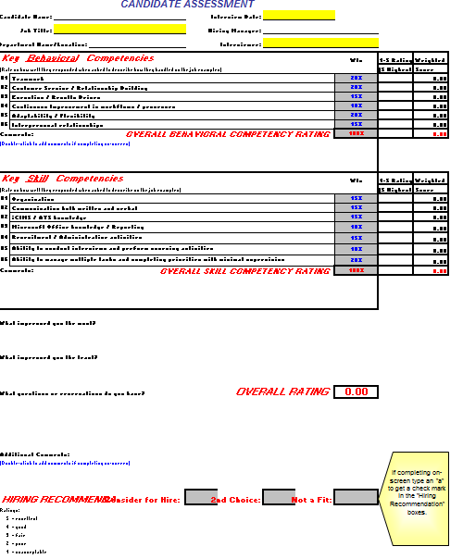
I. Interviewing and Hiring
Candidate Assessment
  Refer to handout
Notes:
Facilitator
Annie
Why This Slide
Contains short instruction clip on task learners have just attempted
More Information
Show the video clip (4 minutes) – and ask them to take a few minutes to review their first question and make it better.
What was still light – and how did you use content from the video to make it better?
Image Prompt
Nothing critical

Slide 31

I. Interviewing and Hiring
Team Interviewing Guidelines
  Consider both department and customer participants
  Consider both panel or individual team interview options
  Identify and segment specific key areas for individuals to target
  Identify needed subject matter experts for specific key areas to target
  It’s recommended to cover some of the same targeted areas of questions via the same or different questions via interviewer
  Have all team interviewers score and provide feedback on all candidates
  Discuss the candidates as an interview team for consensus
  The hiring manager should strongly consider all feedback before his/her final decision
Notes:
Facilitator
Annie
Why This Slide
Contains short instruction clip on task learners have just attempted
More Information
Show the video clip (4 minutes) – and ask them to take a few minutes to review their first question and make it better.
What was still light – and how did you use content from the video to make it better?
Image Prompt
Nothing critical

Slide 32

I. Interviewing and Hiring
Interview Practice
  Choose a team of 3 – interviewer, interviewee and observer
  Complete a practice interview
  Reflect and share feedback with one another
  Change Roles
Notes:
Facilitator
Annie
Why This Slide
Contains short instruction clip on task learners have just attempted
More Information
Show the video clip (4 minutes) – and ask them to take a few minutes to review their first question and make it better.
What was still light – and how did you use content from the video to make it better?
Image Prompt
Nothing critical

Slide 33
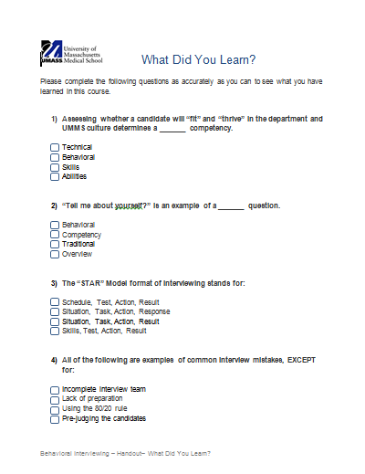
I. Interviewing and Hiring
Learning Outcomes
  Refer to the handout and take a few minutes to answer the questions
  Group summary and discussion
    Have you developed your knowledge and skill set for effective interviewing?
    Can you share 2 things that you have learned today about interviewing and selection?
Notes:
Facilitator
Annie
Why This Slide
Contains short instruction clip on task learners have just attempted
More Information
Show the video clip (4 minutes) – and ask them to take a few minutes to review their first question and make it better.
What was still light – and how did you use content from the video to make it better?
Image Prompt
Nothing critical

Slide 34
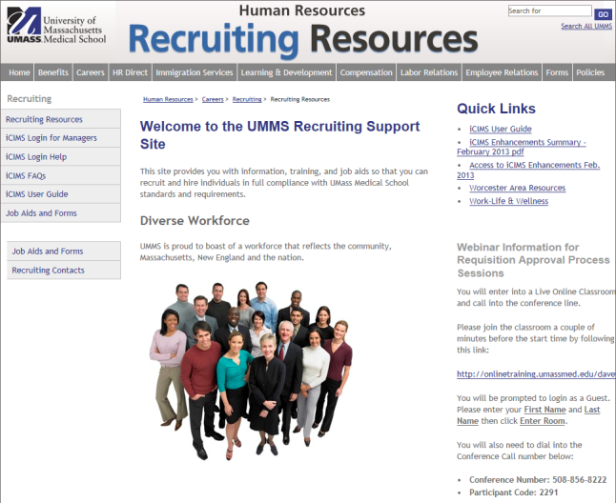
I. Interviewing and Hiring
Additional Resources
  Recruiting Resources Website
    Provides information, training and job aids to assist you with the recruitment and hiring process.
  Writing Effective behavioral Interview Questions – Lynda.com
  Talent Acquisition Contacts
    Who should we add here?
Notes:
Facilitator
Annie
Why This Slide
Contains short instruction clip on task learners have just attempted
More Information
Show the video clip (4 minutes) – and ask them to take a few minutes to review their first question and make it better.
What was still light – and how did you use content from the video to make it better?
Image Prompt
Nothing critical

Slide 35

Thank you
Notes:
Refer to the handout - What Did You Learn?. Please complete the following questions as accurately as you can to see what you’ve learned in this course.

