Slide 1


UMMS Learning Management System (LMS): Join the New Learning Environment
January 2019
Notes:
Hello, my name is Martha Streeter and I am the director of HR Communications, Learning and Professional Development. I am going to review with you today our new UMass Medical School Learning Management System.

Slide 2
Agenda
Basics
What is a Learning Management System (LMS)
Benefits of LMS
LMS Admin View
Homepage Dashboard - Overview
Course Section - Create Content and Courses
People Section – Add Users and Assign Learners
Reporting Section – Reviewing Reports and Create Custom Reports
LMS Learners View
Homepage Dashboard - Overview
Courses and Learning Paths
Getting Started
Notes:
I am going to provide you an overview of our learning management system or what I will refer to throughout the rest of the presentation as LMS. We will go over what it is, what are the benefits of an LMS.
We will review the LMS admin view, and the functionality under the admin view, including the home page dashboard, the course section, the people section and the reporting section.
We will follow a review of the learners view of the system and go over the learner’s view dashboard and the courses and learning paths, and then we will, lastly, talk about getting started and getting into the learning management system.

Slide 3
What is a LMS?
What is a Learning Management System (LMS)?
A software application for the administration, documentation, tracking, reporting of learning and development programs
Notes:
So, what is an LMS?
It is a software application for the administration, documentation, tracking, reporting of learning and development programs. In short, it is a one-stop source to administer and learn development programs.

Slide 4
Benefits of LMS
Time Savings
Compliance Training Tracked
Flexibility
Built in Effectiveness Tools
Enterprise Training
Employee Retention
Ease of Usability
Support - If you have course set up, technical or system questions or problems, please contact Litmos support group at:
Course set up, technical or system questions:
Phone #: 925-251-2220 ext. 2
Email: support@litmos.com
Website: https://support.litmos.com/hc/en-us
Notes:
So, what are the benefits of an LMS? Well for one, it's a time saver. The LMS will minimalize production time, because it will streamline the steps taken for an employee to follow up, for scheduling, attendance confirmation, metric dashboard generation, survey generation and more. It's a one-stop source.
Also, the LMS makes it very easy to deploy compliance trainings, especially if they're not a one-time event, but an ongoing occurrence that needs to be tracked to meet certain policies or regulations. It will automatically push out to the employee the compliance training based on the compliance anniversaries. The LMS also provides a lot of flexibility to employees. You can remote in access from a variety of devices, you can do it from tablets, iPhones. Employees can manage their own training schedules, it is very flexible.
Another benefit of the LMS, it has built-in effectiveness tools. It can automatically generate online surveys about the effectiveness of the training course, it has a comprehensive metrics dashboard that provides attendance tracking, course effectiveness, time spent analytics and more. The LMS also allows you to deliver online training resources to multiple UMass Medical School locations, including Boston, Quincy, Charlestown and more.
The LMS can help retain employees. It is a great employee retention tool. We can create a broad-based online training curriculum, and by implementing online training courses to meet soft and/or hard skill needs, we are engaging employees and helping them grow and develop professionally.
It's easy to build curriculums and ensure your employees are participating in the courses that they need, and lastly, it has a whole support system. If you have any course setup, technical or system questions or problems, you can contact the Litmos Support Group. You can phone them, email or website, to help them solve any of your issues.

Slide 5
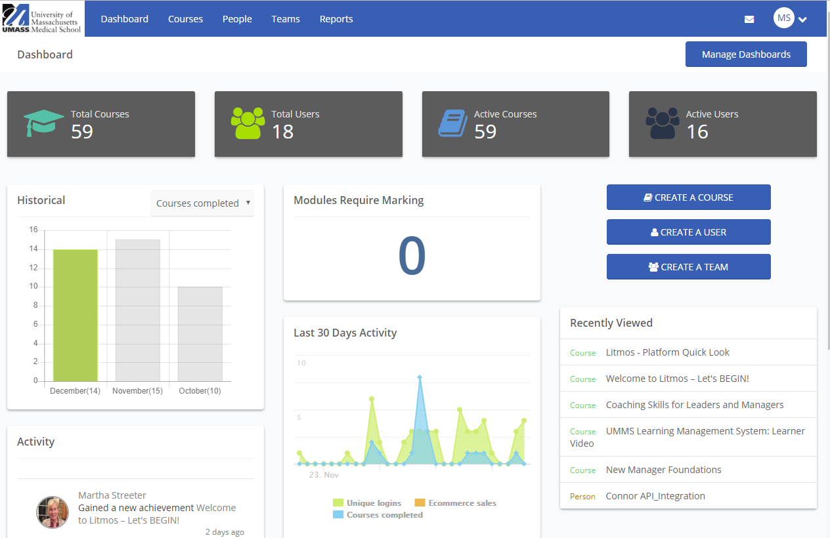
LMS Admin Homepage Dashboard
Summary – Tools at your fingertips including create courses, add users + teams, review analytics, view reports and edit settings
Top horizontal menu:
Dashboard – Ability to customize your dashboard by adding user activity, recently viewed links, assessment and more.
Courses – With content creation tool, build out courses and building paths for your learners.
People – Simple tool to manage and track learners.
Teams – Ability to assign learners to teams.
Reports – Reporting gathers all useful user and course activity so you can get a pulse of how your education courses are being perceived.
Notes:
So, let's talk about the LMS admin homepage dashboard. So, what is this dashboard? Well, in short, it is providing admins the tools at their fingertips. That includes creating courses, adding users and teams, reviewing analytics, view reports, and they can edit settings. So, if you look at the image below, you can see the top horizontal menu of this admin dashboard. It includes the dashboard tab, where you have the ability to customize your dashboard by adding user activity, recently viewed links, assessments and more.
The next tab under the admin dashboard, is courses. With this you can create content, you can build out courses and learning paths for your learners. The third tab is the people tab. This is a simple tool to manage and track your learners. The team's tab, you have the ability to assign learners to teams, and lastly, the reports tab. The reporting gathers all the useful user and course activity, so you can get a pulse of how your education courses are being perceived. There are set reports and there are also, you can create custom reports, and we will go over all these different sections further in this webinar.

Slide 6

LMS Course vs. LMS Learning Path
For an admin creating a course versus a learning path.
Courses – Courses are great for presenting a single topic.
Learning Paths – Learning Paths are perfect for presenting multiple topics in a specific order.
Notes:
So, before we go in more depth in regard to the admin dashboard sections, I want to take a minute and just discuss the LMS course versus an LMS learning path. So, for an admin, they can create both a course or a learning path. The courses are great for presenting a single topic. The learning paths are perfect for presenting multiple topics in a specific order. You may have multiple modules, and they cover a more extensive topic for you.

Slide 7
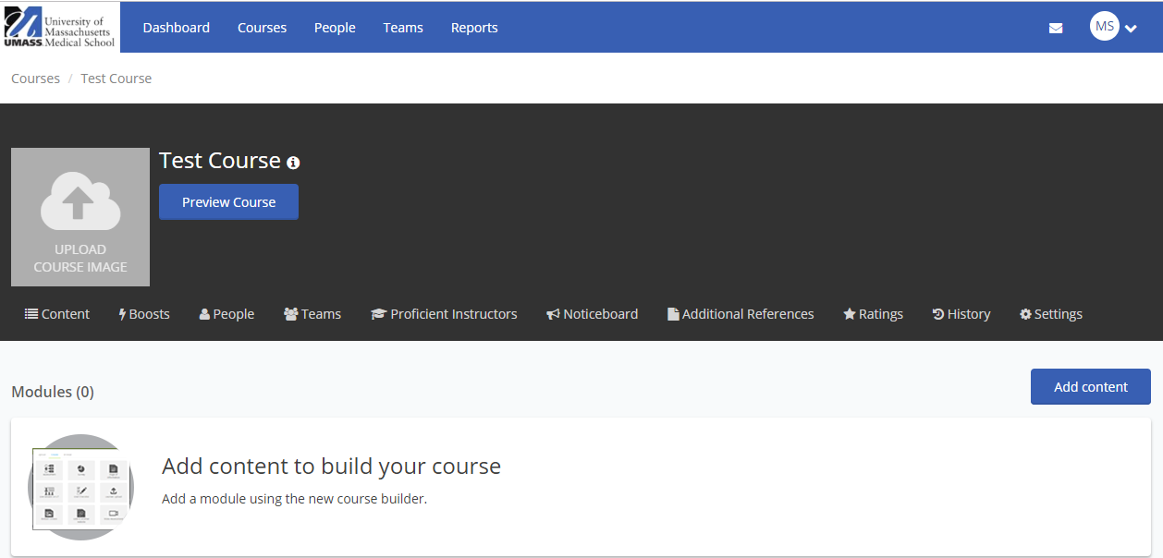
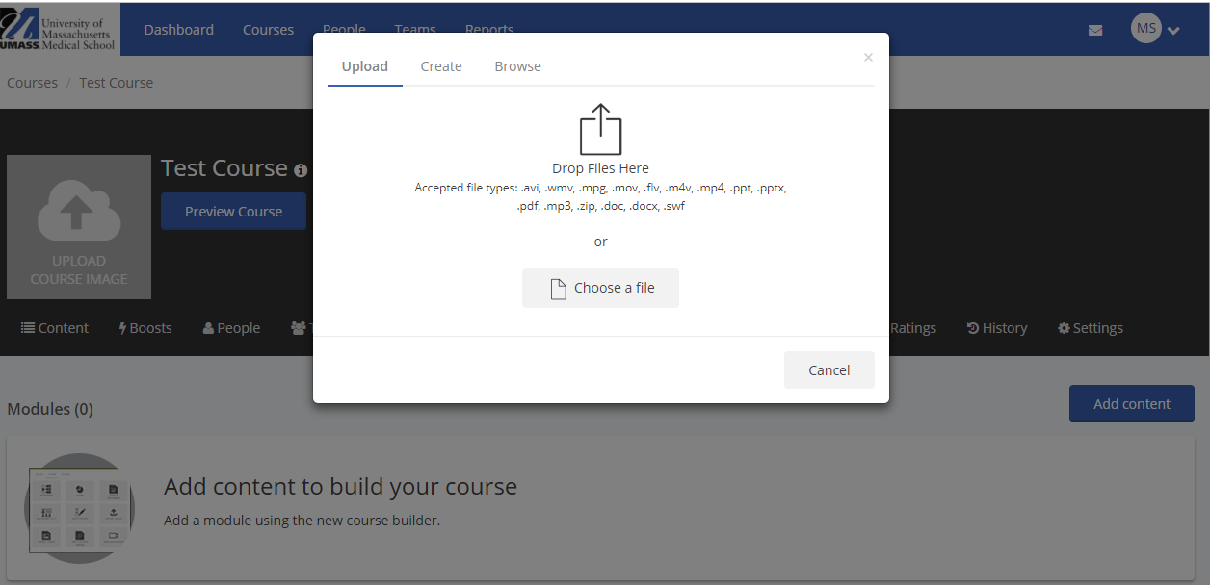
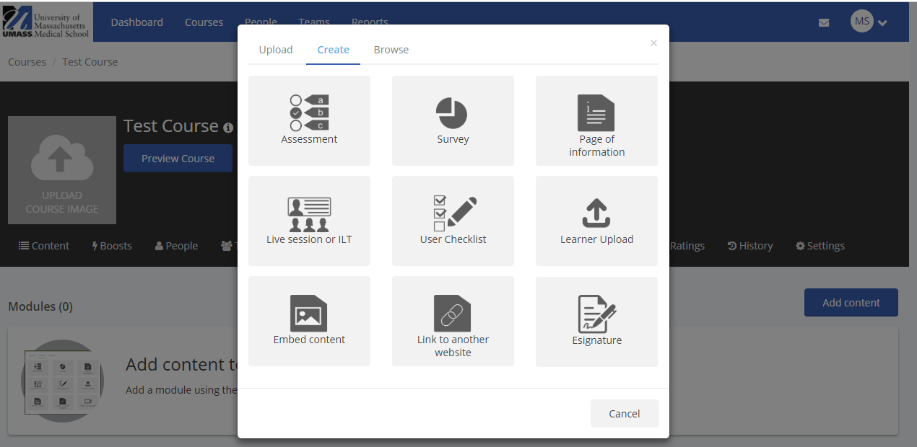
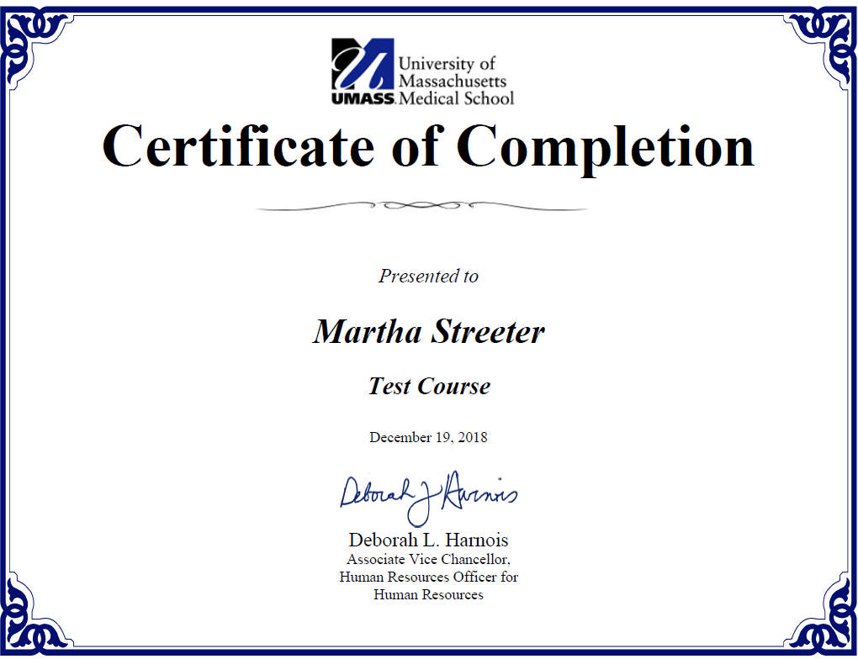
LMS Courses
Courses section
Adding Content – It is easy, you can upload files (scorm, powerpoint, pdf, mov, tin can, mpeg4, and dozens of other formats) or create content from a powerful suite of tools.
Analytics and Activity – Once courses are built out, you can set up user rewards such as certificates or badges, view assessment results, and see user usage analytics.
Add content to course
Upload files
Add assessments, surveys and more to your course
Set up a certificate of completion
Notes:
Let's review the LMS courses section of the dashboard. So, in the courses section, you can add content. It is easy. It's as easy as attaching a file to an email. You can either upload files, they can be PDF files, they can be PowerPoint files, there are dozens of other formats, or you can create content from a powerful suite of tools that are available in the LMS. As you can see, in the picture below, in the left quadrant there are surveys, assessments and user checklists, that are part of the LMS that are templates that you can create within the system.
Another functionality of the courses section is the analytics and activity. So, once an admin or instructor courses are built out, you can set up user rewards such as certificates or badges, you can view assessment results and see user usage analytics. Another functionality in the courses section is analytics and activity. So once courses are built out, you can set up user rewards such as certificates or badges or view assessment results and see user usage analytics.

Slide 8
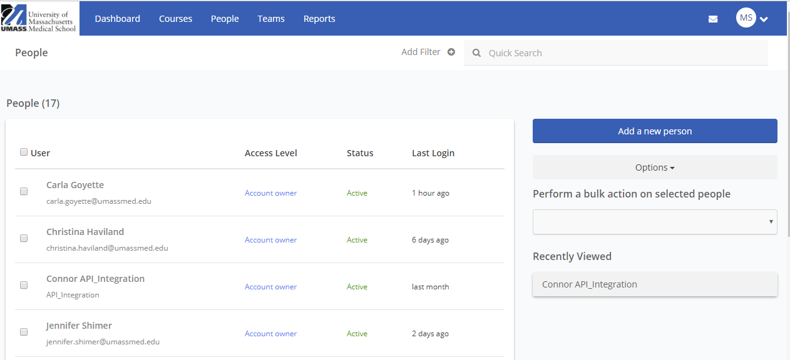
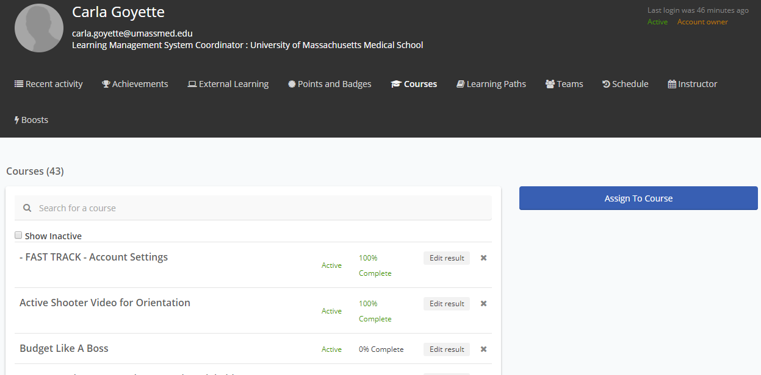
LMS People
People section
Users Added – All UMMS employees are loaded in the LMS system. Data feed is monthly of UMMS employees into the LMS. You can also add manually.
Assign Learners – You can assign your learners to teams and upload profile photo.
Finding Users – To find a user, go to the upper right search window and put in first or last name or email. When you find a user, you will be able to see recent activity, courses, certificates and badges completed.
People Tab
Notes:
The LMS people admin dashboard section is where you can add users. However, please know that all the UMass Medical School employees are loaded already into the LMS system by a data feed. They are inputted monthly into the system.
Another functionality of the people section is that you can assign learners. You can assign your learners to teams, and you can upload profile photos. So, for instance, if there was an HR team and there was a new member that came on to the HR department, you could assign that learner to the team.
Lastly, a functionality is finding the users. To find a user, you go to the upper-right search window and put in the first or the last name or email, and when you find a user, you will be able to see recent activity, the courses, certificates and the badges completed, as shown in the pictures below.

Slide 9
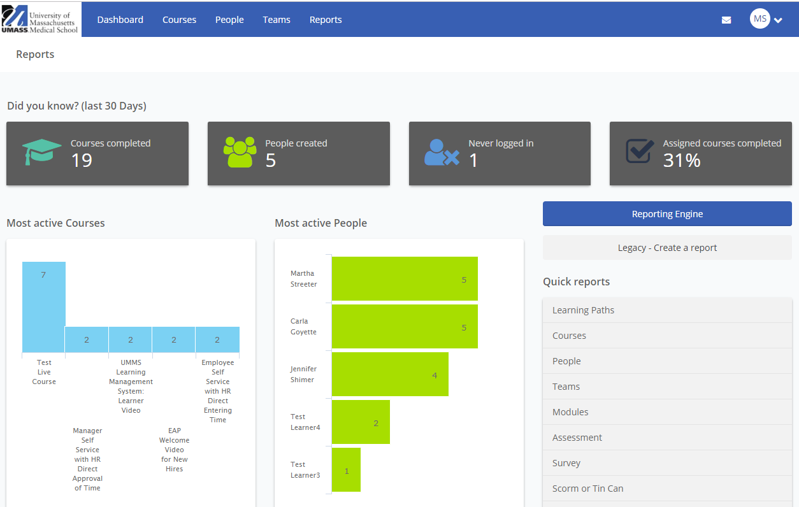
LMS Reporting
Reporting tab
Quick Reports – Use the Quick Reports section to see the most common reports generated in LMS or create a custom report by clicking on the Create a Report button.
Notes:
Next is the LMS admin dashboard reporting section. So, these are quick reports, and you use the quick reports section to see the most common reports generated in the LMS, or you can create a custom report just by clicking on the create a report button, as indicated below.

Slide 10
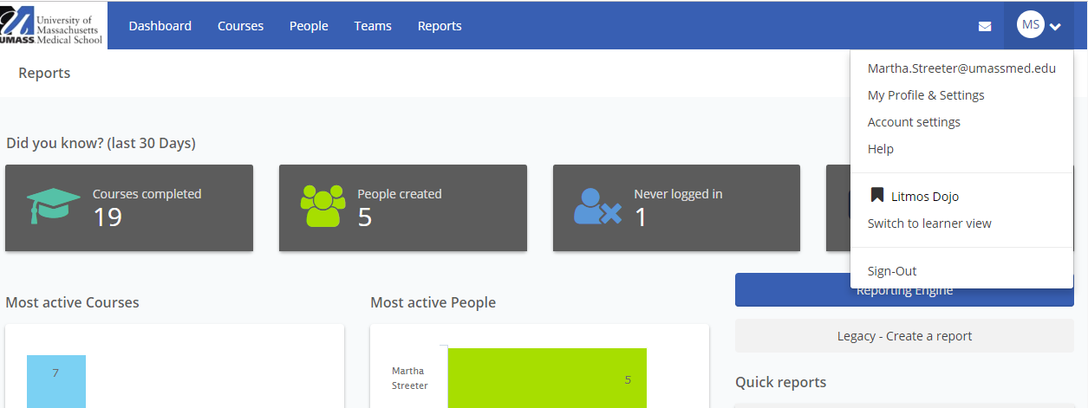
LMS Learner View
Switch to Learner View
Learner View – As an Admin, you can switch to the Learner View anytime to see what the learner sees. Go to your initials within the circle in the upper right corner, select the drop down menu and click on “Switch to learner View”.
Notes:
So, we have just reviewed all the admin dashboard functionality, and now we're going to switch over to the learner’s view. So, to switch over from an admin view to a learner view, you go to your initials within the circle that's located in the upper right corner, and you select the drop-down menu to click on “Switch to learner view”, as shown in the diagram below.

Slide 11
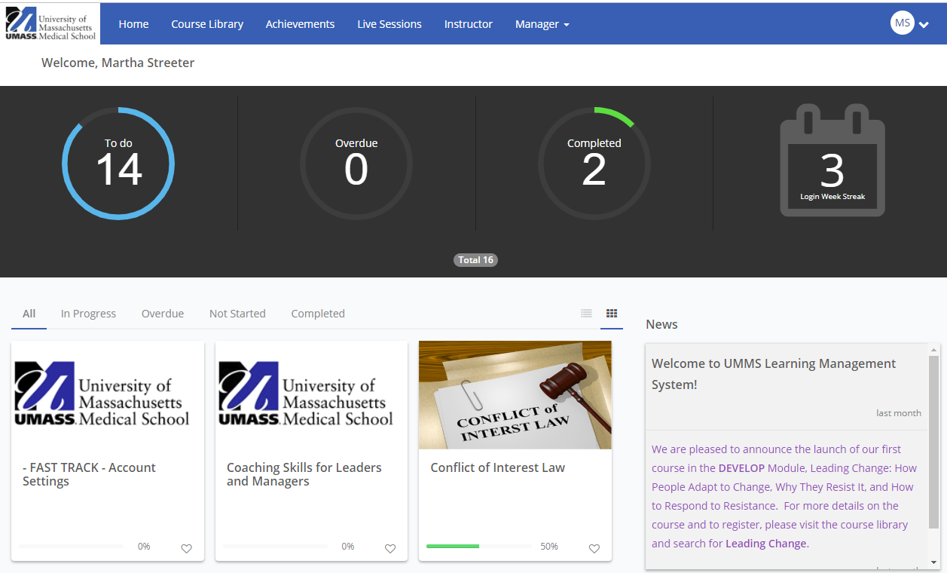
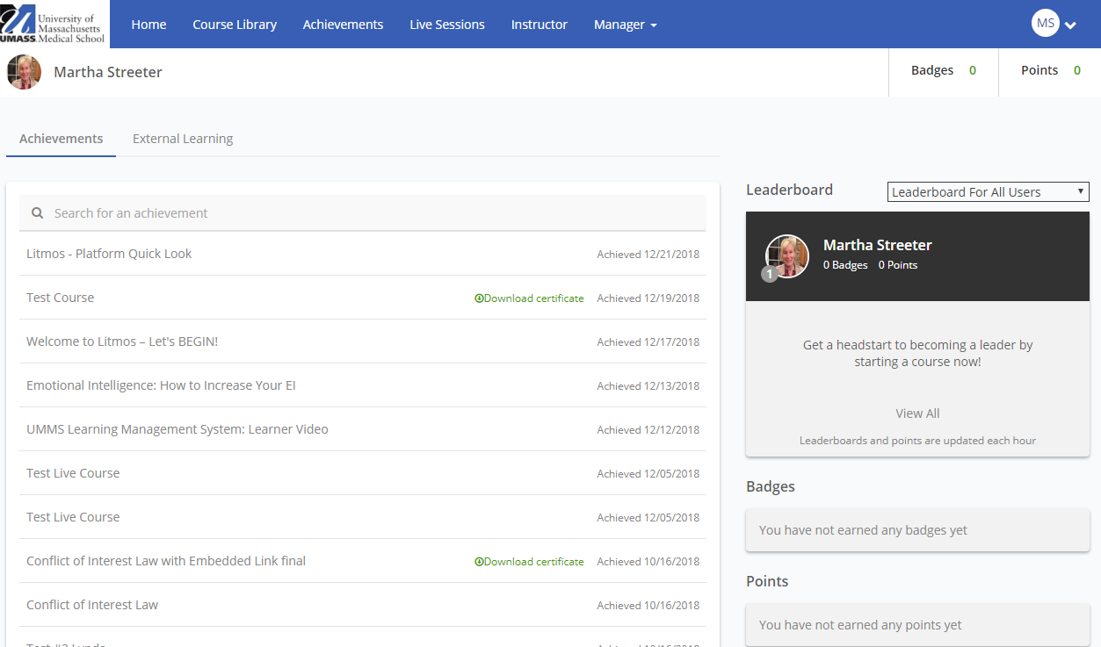
LMS Learner View (Cont’d)
Learner View
Home - LMS landing page is displayed below with your LMS dashboard.
Achievements – It brings you to your completed courses, and in this section, you can see your certificates that can also be downloaded too.
Leaderboard – Leaderboard shows points and badges for taking courses and learning paths that you can also access.
Notes:
So, now we're in the learner’s view, and we have the home, which is the LMS landing page, as displayed below, that shows your LMS dashboard. There's also the achievements tab, and this will bring you to your completed courses as a learner, and in this section, as a learner, you can see your certificates that can also be downloaded.
Also, if you select into the achievements, there's a leaderboard, and what the leaderboard does for the learner, it shows the learners points and badges for taking certain courses and learning paths that you can also access.

Slide 12
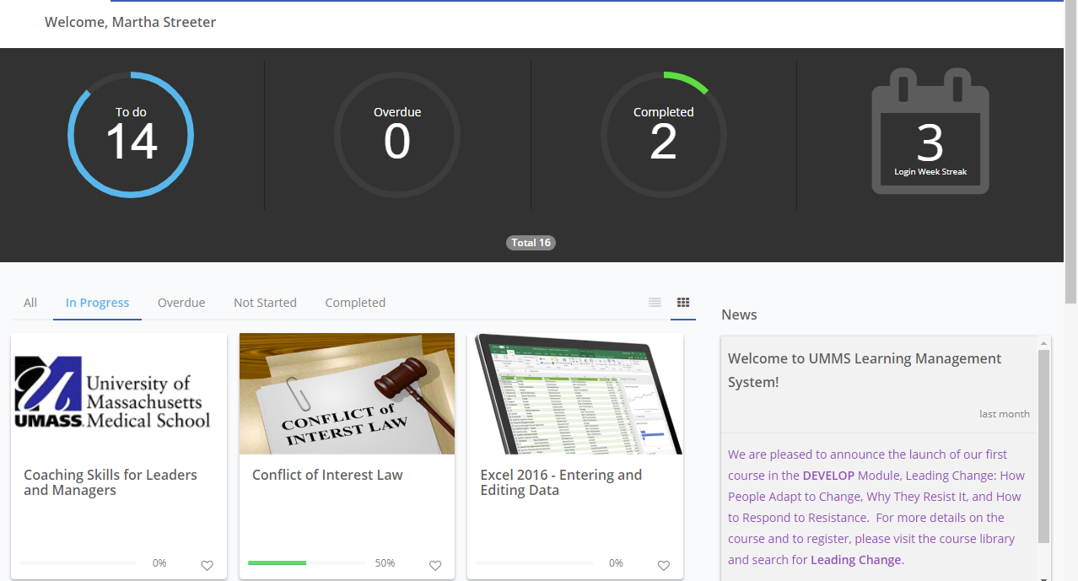
LMS Metrics Banner
Other homepage components:
Courses – Below the Metrics Banner are the courses and learning paths assigned that are in progress, not started and overdue. You will see the percent completion of each course.
Metrics Horizonal Menu – It represents the metrics banner as a horizontal menu too.
Metrics Banner
Metrics Horizontal Menu
Notes:
So, other learner homepage components, the learners are going to see their courses, so below the learner’s metrics banners, the learner is going to see their courses in learning paths that were assigned to them. And what they will also see, is the progress, or if they're not started, or if the courses are overdue. As you can see in the image below, the conflict of interest law, this learner had 50% of it taken.
Next to each of them, you're going to see the percent completion of any course that was assigned to you as a learner. The other home page component is the metrics horizontal menu, and all this does it is a representation of the metrics banner, but as a horizontal menu. So, if you select in progress in the horizontal menu, or you select overdue, it will give you all the courses and/or learning paths that are in progress for you or that are overdue for you.

Slide 13
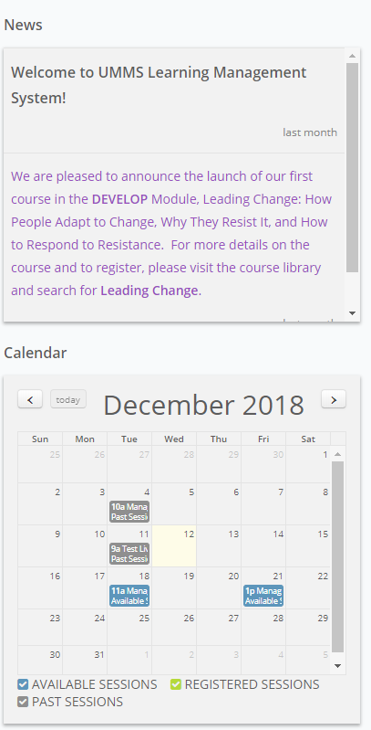
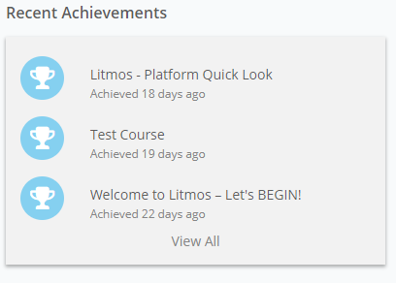
LMS Homepage
Other homepage components:
News Panel – This panel consists of the latest news and announcements.
Calendar – It shows upcoming courses and webinars available to sharpen your skills.
Recent Achievements – A list of courses you have completed. If you click “View All,” go to the achievements page where you can download your certifications you have earned.
Recent Achievements
News Panel
Calendar
Notes:
So, the other learner homepage components are the news panel. This panel consists of the latest news and announcements for the learner. You will see below there's a welcome to the UMass Medical School launch management system announcing the launch of a development module. Learners will go here for all latest news.
The calendar is another component, and this will show the learner all the upcoming courses and webinars that are available to sharpen their skills. And lastly, our recent achievements. This is a list of courses that the learner has completed. If you click “View All” and go to the achievements page, you can download all your certifications you have earned.

Slide 14
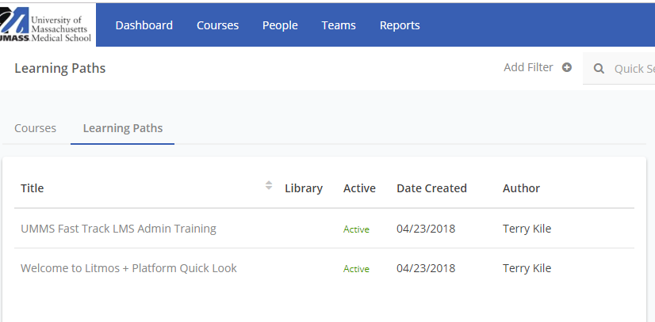
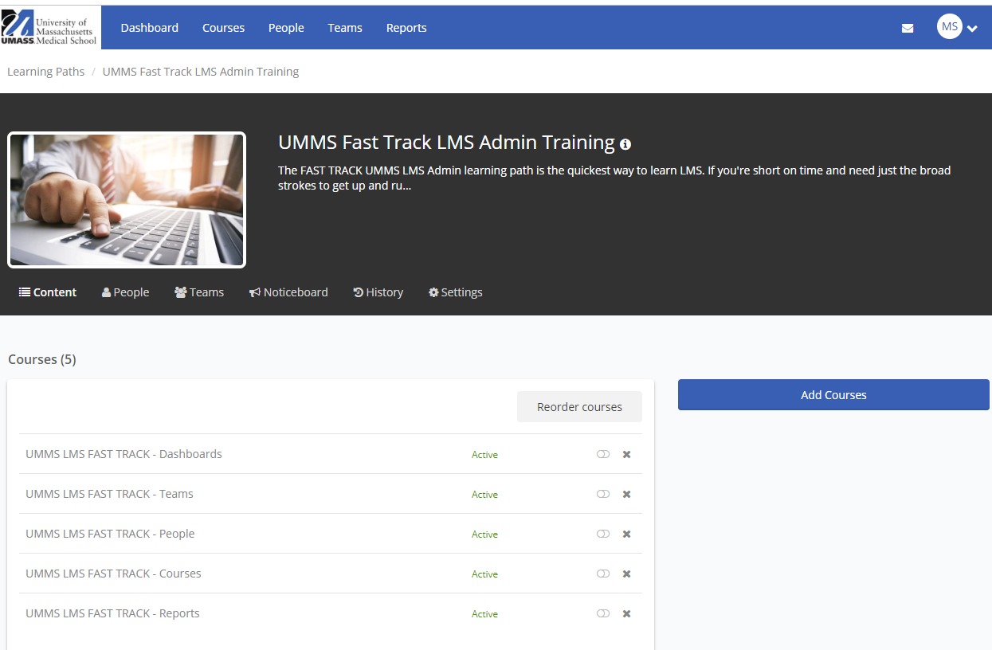
UMMS Fast Track LMS Admin Learning Path
LMS Admin Learning Path
For more in depth and robust training, go to the UMMS Fast Track LMS Admin Learning Path in your Admin Course Library (this learning path will also be assigned to you)
LMS Admin Learning Path consists of this LMS Overview presentation as a webinar and 5 trainings on the primary LMS functions – Dashboards, Teams, People, Courses and Reports
Notes:
Now that we have just reviewed the LMS system and the admin functionality, and the learner’s functionality, we are also going to provide you a more in-depth and robust training for you as an Admin. It is actually a learning path that we have assigned to you to take. The path consists of this LMS overview webinar, but it also has five additional module trainings, and they are on the primary LMS functions. That includes the dashboards, the teams, the people, the courses and the reports. So, I highly recommend for a little bit more in-depth learning as an admin role in the LMS system to take these trainings.

Slide 15
LMS Get Started
Get Started
Remember your training and apply what you have learned.
Go to https://umassmedical.litmos.com and log into the LMS portal.
Complete your UMMS LMS Admin Training learning path.
Access the LMS course library and review other courses available for you to take.
Support/Resources - If you have course set up, technical or system questions or problems, please contact Litmos support group at:
Course set up, technical or system questions:
Phone #: 925-251-2220 ext. 2
Email: support@litmos.com
Website: https://support.litmos.com/hc/en-us
Click here to access the LMS Support Contact Resource Sheet for a full list of support contact numbers
Notes:
So, let's get started into the LMS system as an admin. So, remember, your training and apply what you've learned, go to the Litmos URL, which you can link here, login to the LMS portal and complete your UMass Medical School LMS admin training learning path.
Also, access the LMS course library, and review other courses available for you to take. Remember, we have support and resources. If you have poor setup, technical or system questions or problems, please contact Litmos Support Group. Again, you can see that you can contact them by phone, email or website, see the listing below.
Also, lastly, you can click on the last link on this slide, to access our LMS support contact resource sheet, which will provide you a full list of support contact numbers for the system. Thank you.

