Slide 1
UMMS Human Resources Learning Management System (LMS): Join the Learning Revolution
Notes:
Hello,
My name is Martha Streeter and I am the Director of HR Communications, Learning and Professional Development.
I am excited to talk with you today about the University of Massachusetts Learning Management System (the LMS as I will reference it going forward).

Slide 2
Agenda
I. Overview
What is a Learning Management System (LMS)
Background
LMS Course vs. Learning Path
Benefits of LMS
LMS as a Career Planning Tool - Phase II FY Year 2020
II. LMS System Functionality and Navigation
Reviewing your personalized homepage and metrics dashboard
Learn how to access courses
Checking your progress
Setting up your profile and settings
Using the mobile application
508 Compliance
Getting started
Notes:
For today’s meeting, I plan to cover the following:
The first part of the agenda is to provide you an Overview.
I. Overview
What is a Learning Management System (LMS) – Discuss what actually is a LMS? Who uses an LMS and what type of services does an LMS provide?
Review the background behind this initiative. Why did we pursue getting a LMS?
What is a LMS Course vs. a Learning Path – this is common terminology you will hear with a LMS. I want to expand upon this terminology and how it relates to a LMS
I will review the benefits for you as a Learner in the system
Then briefly review how the LMS can support employees as a Career Planning Tool
Secondly, I want to highlight the LMS functionality and navigation
II. LMS System Functionality and Navigation
I will review your personalized homepage and metrics dashboard
Show you how to access courses
Review how you would check progress of all your courses (the status if courses are “in progress”, “complete”, or on the “to do list”)
Review how to set up your profiles and settings (can add a photo of yourself)
How using the mobile application, you can access the courses from your cell or tablet that are completely accessible
Review how the system is 508 compliant and what that exactly means
We will then discuss how you can get started in the system

Slide 3
What is an LMS?
LMS is a Learning Management System
“Learning” - delivers educational, professional development, compliance, and eLearning training courses and programs.
“Management” - organizes these courses (create them, edit them, assign them to employees, and, monitor and assess their performance (attendance, proficiencies, etc.).
“System” - a cloud-based system.
LMS System Explanation
An LMS is the "engine" that powers eLearning, and it consists of two separate parts:
A server component that performs the core functionality (creating, managing and delivering courses, authenticating users, serving data and notifications, etc.)
A user interface that runs inside your browser as a web (like Gmail), that is used by administrators, instructors and learners (employees)
Notes:
So what is an LMS?
An LMS is an acronym for a Learning Management System.
And what does that acronym stand for:
“Learning” – it delivers educational, professional development, compliance, and eLearning training courses and programs.
“Management” – it organizes these courses (create them, edit them, assign them to employees, and, monitor and assess their performance (attendance, proficiencies, etc.).
“System” - a cloud-based system, meaning the system’s services are available on demand via the Internet
A more simplified explanation of the “System”:
An LMS is the "engine" that powers eLearning, and it consists of two separate parts:
A server component that performs the core functionality (creating, managing and delivering courses, authenticating users, serving data and notifications, etc.)
A user interface that runs inside your browser as a web (like Gmail), that is used by administrators, instructors and learners (employees)

Slide 4
Who uses an LMS? What are they using an LMS for?
Who? Those who provide eLearning are using an LMS
Traditional educational institutions (schools, universities, colleges).
Businesses of all sizes, from large multinational enterprises to small and medium businesses.
Organizations, from the United Nations to Non-Government Organizations and non-profits.
Government agencies and local governments.
Online and eLearning based educational institutions.
What is it used for? An LMS can be used for all kinds of learning activities
Employee training
Compliance requirements
Employee orientation and onboarding support
Knowledge retention
Education
Employee professional development training
Career planning
Notes:
Who uses and LMS? Those who provide eLearning are using an LMS
Traditional educational institutions (schools, universities, colleges).
Businesses of all sizes, from large multinational enterprises to small and medium businesses.
Organizations, from the United Nations to Non-Government Organizations and non-profits.
Government agencies and local governments.
Online and eLearning based educational institutions.
What is an LMS used for? An LMS can be used for all kinds of learning activities.
Employee training
The need to train new employees or teach existing employees new skills is a constant.
With an LMS you let your employees study the material online and at their own pace.
With eLearning, managers can gain better insights on their employees' progress with integrated monitoring and reporting tools.
Compliance requirements
Title IX, IT security, and more The LMS is a flexible and easy way to deploy and for employees to access compliance trainings.
It is a complete compliance tracking database.
Employee orientation and onboarding support
Some of the manual tasks of onboarding a new hire can be automated and handled easily by an LMS. For example, Title IX and Clery Act compliance tasks
Knowledge retention
A knowledge retention program ensures that valuable skills, techniques and information stays with our institution when employees leave or retire.
You don't want this valuable information to just sit in a document management system that nobody ever checks.
You always want to have that valuable information available to train new employees or people coming from other departments is what an LMS can do.
Education
An LMS is a good fit for general educational offerings.
It supplements its live classroom-based courses, educating its employees, and more.
Employee Professional Development Training
An LMS is a platform where employees can take all different types of professional development courses that are easily available that may not be if it were not for the LMS.
Career Planning (Phase II)
There are more details in coming slides on the LMS and Career planning.
eLearning is here to stay, and it might be the very future of learning.

Slide 5
Background
UMMS Did Not Have a Turn-key Learning & Development Platform – We utilized multiple platforms for the administration and training of compliance, professional development, business processes, and courses because we did not have a one stop source learning management platform.
Gaps with Training Platform Needs – With no electronic and database functionality, we were unable to provide a full-service eLearning and training platform that could also track attendance and provide metrics.
HR LMS Review Fall 2018 – In the Fall of 2018, the Human Resources Learning and Development Team began looking at the market for a best-in-class LMS platform for UMMS. The review included a thorough assessment of the top tier LMS providers on the market today.
Litmos Learning Management System - After looking at multiple systems, the Litmos system was determined to be the best product available. It has been given numerous awards including Top 10+ Best LMS Software in 2019; LMS Category Leaders for Q1 2019 Award, Winner of Talented Learning and Best Learning System 2019, and more. It demonstrated a very user-friendly experience, excellent functionality, is adaptable to a wide variety of learning practices, operates in a very reliable environment and fits the needs of UMMS. As a result, Litmos was purchased.
Other UMMS Groups Taking Advantage of System - Other University potential users were consulted as we began the LMS process and they are now preparing to take advantage of the LMS for their department compliance and other trainings.
Notes:
Why did we do this? Why did we turn to getting an LMS?
UMMS Did Not Have a Turn-key Learning & Development Platform – We utilized multiple platforms for the administration and training of compliance, professional development, business process, etc. courses because we did not have a one stop source learning management platform. We actually used 6+ platforms to create, announce, register, track, survey, metrics etc. a training here at UMMS. It was very fragmented and not the best efficiencies.
Gaps with Training Platform Needs – Without an electronic and database functionality, we were unable to provide a full-service eLearning learning and training platform that could also track attendance and provide metrics.
HR LMS Review Fall 2018 – In in the Fall of 2018, the Human Resources Learning and Development Team began looking at the market for a best-in-class LMS platform for UMMS. The review included a thorough assessment of the top tier LMS providers on the market today.
Litmos Learning Management System - After looking at multiple systems, the Litmos system was determined to be the best product available. It has been given numerous awards including Top 10+ Best LMS Software in 2019; LMS Category Leaders for Q1 2019 Award, Winner of Talented Learning and Best Learning System 2019, and more. It demonstrated a very user-friendly experience (intuitive to the user and to navigate around), excellent functionality (it has all the bells and whistles where you can upload multiple file formats, a personalized dashboard), it is adaptable to a wide variety of learning practices (mp4 files, PowerPoint, webinars etc.), operates in a very reliable environment and fits the needs of UMMS. As a result, Litmos was purchased.
Other UMMS Groups Taking Advantage of System - Other University potential users were consulted, and they are now preparing to take advantage of the LMS for their department compliance and other trainings.

Slide 6
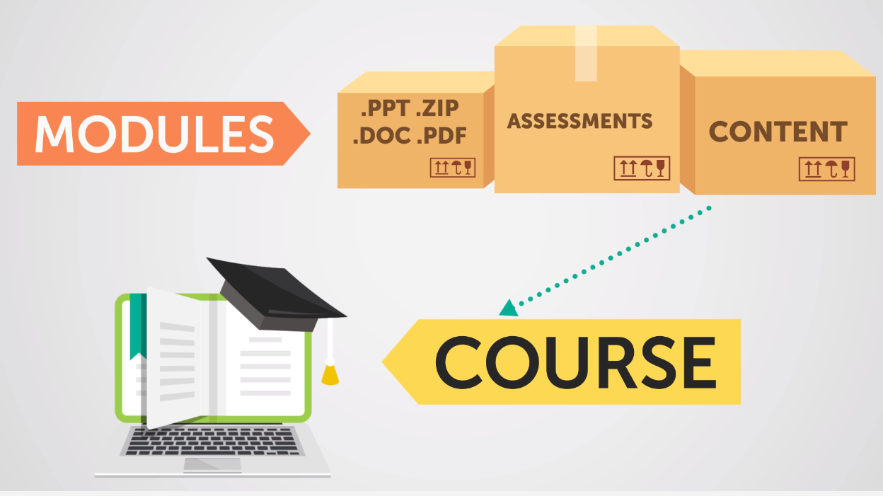
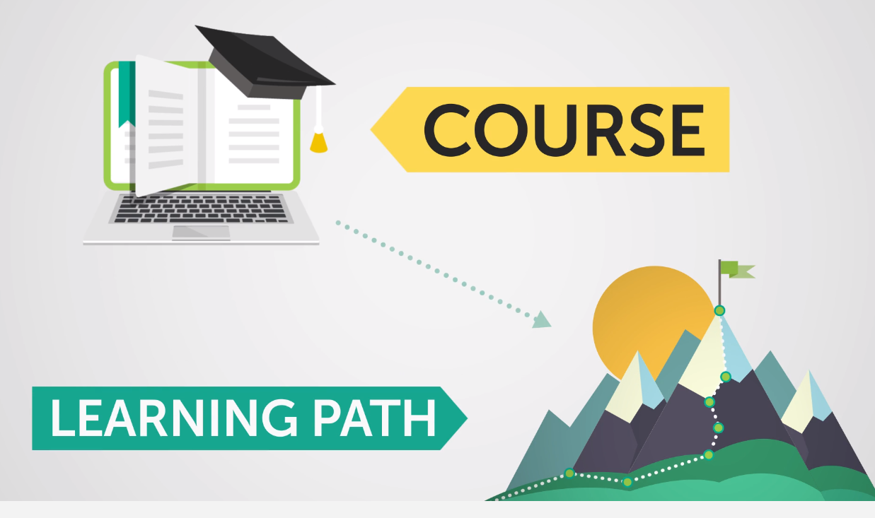
LMS Course vs. LMS Learning Path
What is a course versus a learning path?
Course – A course consists of modules that make up the instructional content of the course that can be anything from videos to PowerPoint decks.
Learning Paths – A collection of courses that allows the learner to master a topic in small steps. The learning path approach is more effective when a learner needs to absorb a lot information on a certain topic.
Notes:
You will see some common terms in the LMS
A very common term is a learning path. What is a course versus a learning path?
Course – A course consists of modules that make up the instructional content of the course that can be anything from videos to PowerPoint decks.
Learning Paths – A collection of courses that allows the learner to master a topic in small steps. The learning path approach is more effective when a learner needs to absorb a lot information on a certain topic.

Slide 7
LMS Learner Benefits
Learner Benefits
Learning Libraries – Access to a wide range of skill-development, compliance, leadership and professional development content, etc. that is instantly available to you.
Flexibility - Access the training and materials at your own pace. Stop the course and then come back to it the next day to begin right where you left off.
Accessibility – Learning material is accessible on any device. You can access courses and videos from your computer, laptop, phone or tablet.
Learning Paths and Courses to Attain Skill Set – You will have more ways to access our learning paths and courses to learn new skills/competencies to increase your career mobility at UMMS.
Access to Compliance Trainings - Easy access to complete compliance trainings and meet those requirements.
Personalized Metrics Dashboard – Access to your very own UMMS LMS dashboard that reflects your personalized assigned trainings, achievements, course library, and more that makes it easy for you to track and keep all your training histories and certifications.
Support – Support team for technical or system problems.
Employee Development Planning Tool – An LMS solution offers a variety of compelling benefits for your professional development and career planning.
Notes:
Below are some of the LMS Learner Benefits
Learning Libraries – Access to a wide range of skill-development, compliance, leadership and professional development content, and more that is instantly available to you.
Flexibility - Access the training and materials at your own pace. Stop the course and then come back to it the next day to begin right where you left off.
Accessibility – Learning material is accessible on any device. You can access courses and videos from your computer, laptop, phone or tablet.
Learning Paths and Courses to Attain Skill Set – You will have more ways to access our learning paths and courses to learn new skills/competencies to increase your career mobility at UMMS.
Access to Compliance Trainings - Easy access to complete compliance trainings and meet those requirements.
Personalized Metrics Dashboard – Access to your very own UMMS LMS dashboard that reflects your personalized assigned trainings, achievements, course library, and more that makes it easy for you to track and keep all your training histories and certifications.
Support – A support team for technical or system problems.
Employee Development Planning Tool – An LMS solution offers a variety of compelling benefits for your professional development and career planning.

Slide 8
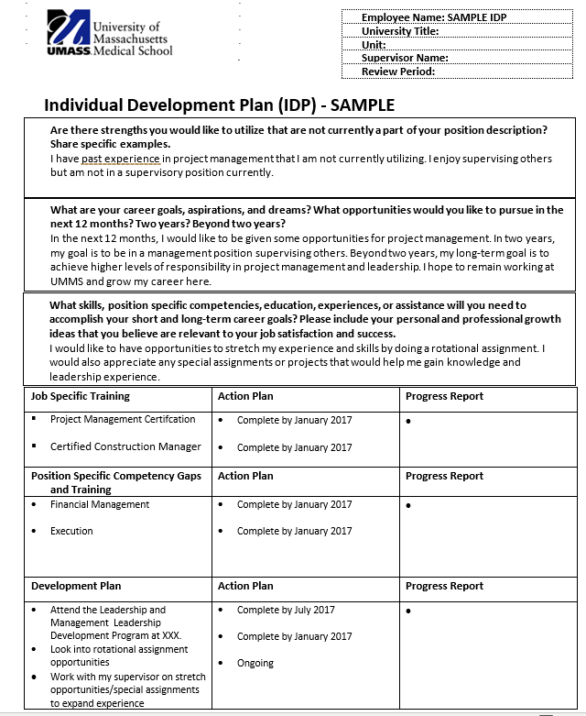
LMS as a Career Planning Tool – Phase II 2020
Complete the UMMS Individual Development Plan (IDP)
Identify job specific training
Identify position specific competency gaps and training
Identify a development plan
Notes:
Learning strategies will be closely linked to the career paths, internal mobility and succession planning. This will be part of the 2020-2025 HR Strategic Plan.
We will offer an Individual Development Plan (IDP) to our employees to assist them in achieving their career and professional development goals at UMMS.
the IDP is designed to help managers, employees and HR understand the development needs of each employee and translate those needs into a defined career path.
the IDP will also assist in setting expectations between employees and their managers for specific learning objectives and a timeframe in which to achieve them.
We will use our Learning Management System (LMS) for content and tracking, give employees visibility how they can progress from one position to the next at UMMS and how long a typical progression path will take for them.

Slide 9
LMS – Career Planning
Resource for IDP
In FY2020, managers and employees will begin working on creating a professional development and a career development plan.
The LMS can be leveraged as a foundational resource to support the employee’s professional and career development plan.
Notes:
Resource for IDP
In FY2020, managers and employees will begin working on creating a professional development and a career development plan.
The LMS can be leveraged as a foundational resource to support the employee’s professional and career development plan.

Slide 10
LMS – Career Planning
LMS Supporting the IDP
Review LMS courses and learning paths to support employee’s IDP job specific training needs, position specific competency gaps and other development plan training
The LMS can provide courses and/or learning paths that align with becoming proficient with a specific competency (skill set)
The training programs can be either face-to-face or in an eLearning format
The training programs will enable employees to learn about the diverse options open to them within the institution
Notes:
LMS Supporting the IDP
Review LMS courses and learning paths to support employee’s IDP job specific training needs, position specific competency gaps and other development plan training
The LMS can provide courses and/or learning paths that align with becoming proficient with a specific competency (skill set)
The training programs can be either face-to-face or in an eLearning format
The training programs will enable employees to learn about the diverse options open to them within the institution

Slide 11
LMS – Taking Your First Step
II. LMS System Functionality and Navigation
Review your personalized homepage and metrics dashboard
Learn how to access courses
Checking your progress
Setting up your profile and settings
Using the mobile application
508 Compliant
Getting started
Notes:
Now, we will begin the second part of our training which is:
LMS System Functionality and Navigation where we will:
Review your personalized homepage and metrics dashboard
Learn how to access courses
How to Check your progress
Setting up your profile and settings
Using the mobile application
Review of the how the LMS is 508 Compliant
Then, lastly, how to get started in the system

Slide 12
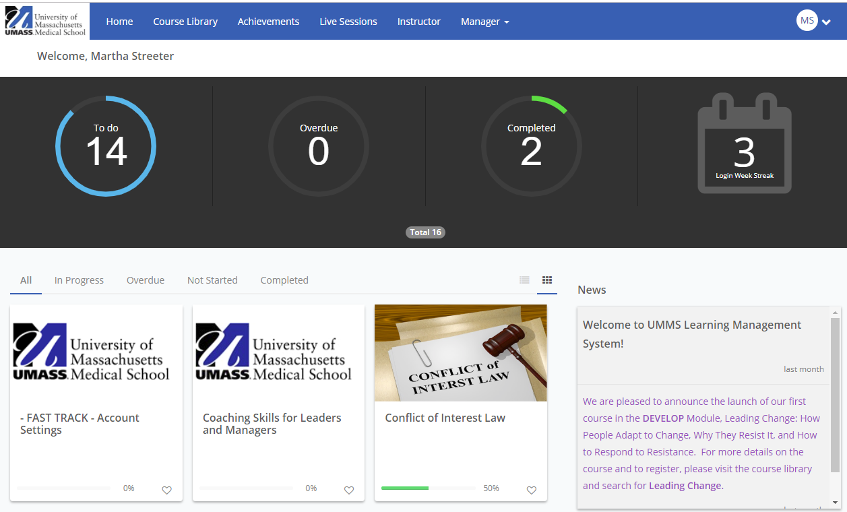
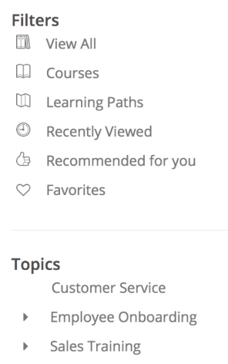
LMS Homepage
Main navigation top horizontal bar:
Home – LMS landing page is displayed below with your LMS dashboard.
Course Library – Library shows all courses that are active and available in the LMS. Narrow your search by Filters and Topics tool that will be in left navigation menu.
Achievements – It looks similar to a trophy case that shows all the course certificates and points you have achieved.
Live Sessions – It tracks live trainings that are available as well as those you have already registered for and have attended.
Homepage
Course Library Filter
Notes:
As a “Learner” in the system, we will begin with the Learner’s LMS homepage.
The Learner’s home page has a main navigation top horizontal bar that consists of the following tabs. I am going to briefly describe each tab but go into more detail on the following slides.
Home – LMS home landing page is displayed in the slide with your LMS dashboard.
Course Library – The Course Library shows all courses that are active and available in the LMS. Narrow your search by a “Filters” and “Topics” tool that will be in left navigation menu. We will discuss the meaning of those filters too.
Achievements – The Achievements tab looks like a trophy case that shows all the course certificates and points you have achieved.
Live Sessions – It tracks live trainings that are available as well as those you have already registered for and have attended.

Slide 13
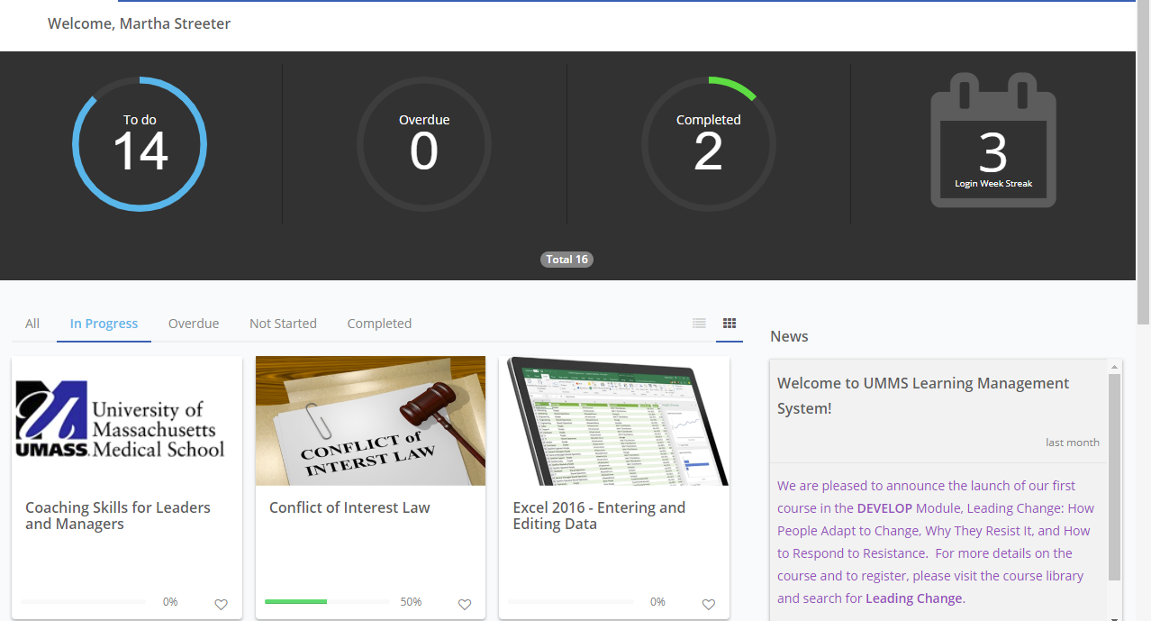
LMS Metrics Banner
Other homepage components:
Metrics Banner – A summary of your course work in the LMS. Click any circle with a one or higher to retrieve more in-depth information. Tabs below will change to show you the data. Click the “To Do” circle and see the courses and/or learning paths your administrator has assigned directly to you.
Metrics Horizonal Menu – It represents the metrics banner as a horizontal menu too.
Metrics Banner
Metrics Horizontal Menu
Notes:
Some of the other homepage components include a:
Metrics Banner – A summary of your course work in the LMS. Click any circle with a one or higher to retrieve more in-depth information. Tabs below will change to show you the data. Click the “To Do” circle and see the courses and/or learning paths your administrator has assigned directly to you.
Metrics Horizonal Menu – It represents the metrics banner as a horizontal menu too.

Slide 14
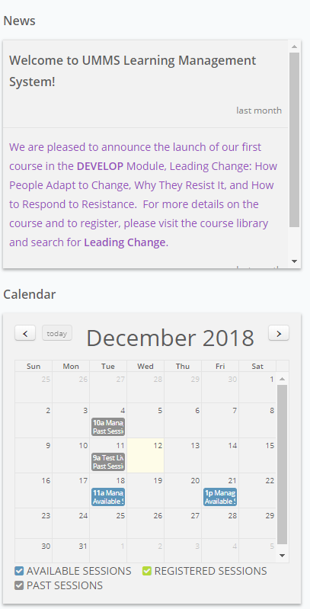
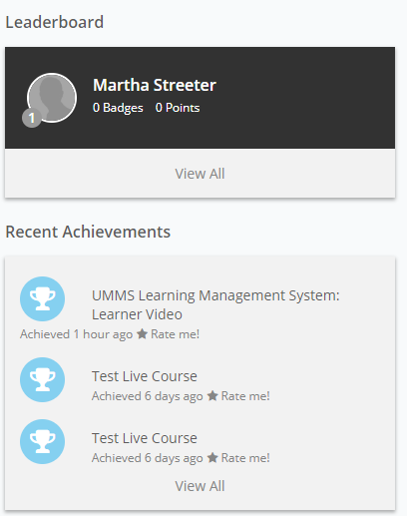
LMS Homepage – Other Components
Other homepage components:
News Panel – This panel consists of the latest news and announcements and is located on the right side of the homepage.
Calendar – Shows upcoming live courses that can be used to sharpen your skills, as well as, classes you have already registered for.
Recent Achievements – A list of the courses you have completed. If you click “View All,” go to the achievements page where you can download the certifications you have earned.
Leaderboard – Leaderboard included within Achievements section shows points and badges for taking courses and learning paths.
Leaderboard
News Panel
Calendar
Recent Achievement
Notes:
The other homepage components continue:
News Panel – This panel consists of the latest news and announcements and is located on the right side of the homepage.
Calendar – Shows upcoming live courses that can be used to sharpen your skills, as well as, classes you have already registered for.
Recent Achievements – A list of the courses you have completed. If you click “View All,” go to the achievements page where you can download the certifications you have earned.
Leaderboard – Leaderboard included within Achievements section shows points and badges for taking courses and learning paths.

Slide 15
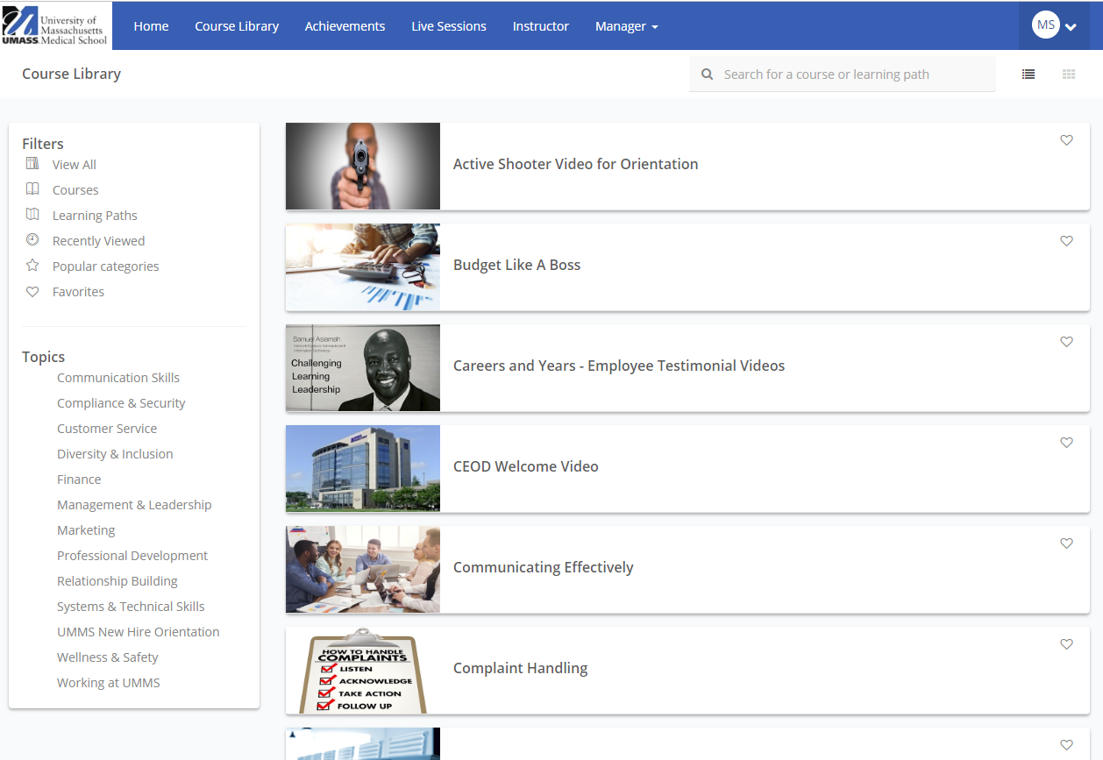
LMS Course Library
Course Library:
Course Dashboard Tiles – You can browse through all the available courses and enroll in what is available. Or, you can search for a specific course using top search bar.
Filter Navigation Menu – The filter menu is another option to refine your search for finding a course. Click on the course to explore.
Search Course Function
Notes:
Let’s review the next homepage tab which is the LMS Course Library as highlighted with the arrow above. The Course Library consists of the following sections:
Course Dashboard Tiles – You can browse through all the available courses and enroll in what is available. Or, you can search for a specific course using top search bar as indicated with the arrow in the slide.
Filter Navigation Menu – The filter menu is another option to refine your search for finding a course. You can choose to filter courses by topic categories or by other filters such as popular categories.
Let’s click on a course tile in the library to explore more.

Slide 16
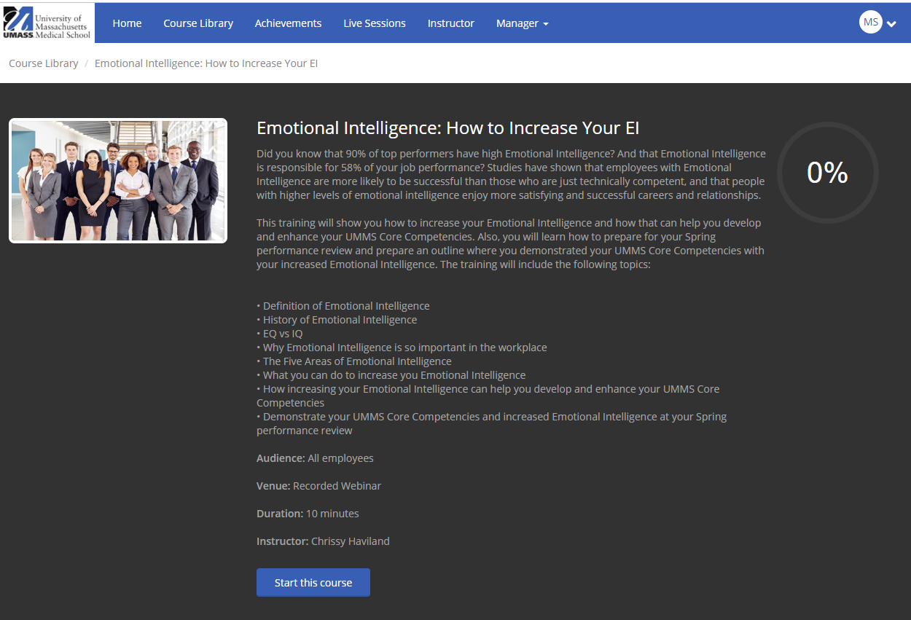
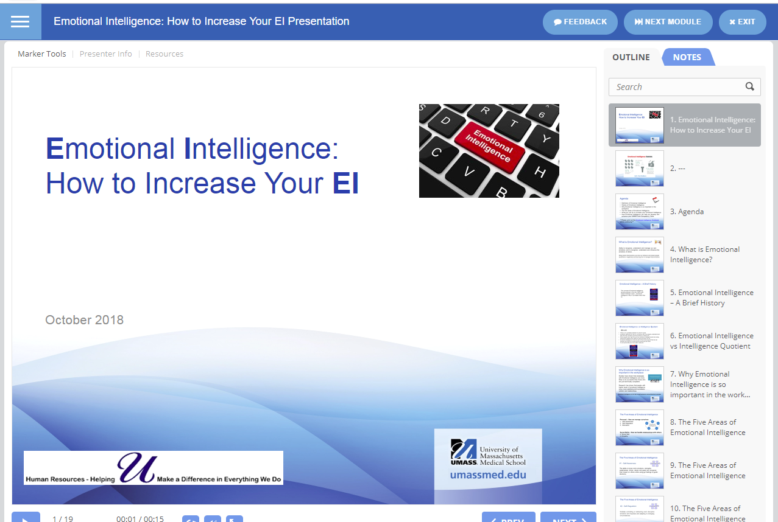
LMS Course
Course:
Course Description – Click on a course to see the course description and the button to click to start the course. You will also see in the upper right corner the progress you have made with your course participation.
Course Feedback – On the course’s horizontal navigation menu, click on “Feedback” you will be able to provide course feedback directly to the course administrator.
Next Module – On the course’s horizontal navigation menu, click on “Next Module” and you will continue to the next module in the course. You may receive a “Locked” message that states you need to complete the previous modules before you can attempt other course modules. This will be determined by your administrator if you will take the modules sequentially.
Exit - on the course’s horizontal navigation menu, if you click on “Exit” you will continue to the initial course description page where you can continue this course or unenroll in the course.
Notes:
I clicked on the Emotional Intelligence course and as you can see on the slide, there are different components that make up the course as follows:
Course Description – You will see the course description as shown in the slide and the button to click to start the course. You will also see in the upper right corner the progress you have made with your course participation.
Course Feedback – On the course’s horizontal navigation menu, click on “Feedback” you will be able to provide course feedback directly to the course administrator.
Next Module – On the course’s horizontal navigation menu, click on “Next Module” and you will continue to the next module in the course. You may receive a “Locked” message that states you need to complete the previous modules before you can attempt other course modules. This will be determined by your administrator if you will take the modules sequentially.
Exit - on the course’s horizontal navigation menu, if you click on “Exit” you will continue to the initial course description page where you can continue this course or unenroll in the course.

Slide 17
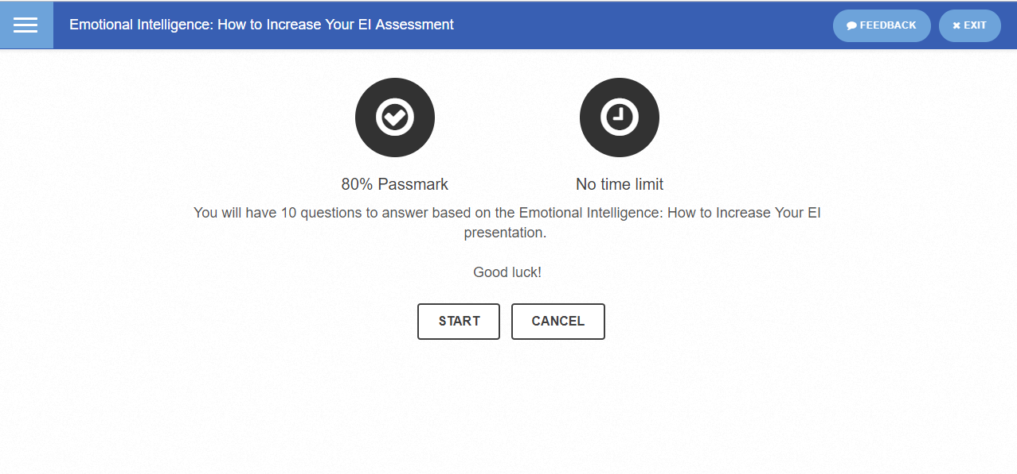
LMS Course Assessment & Certificates
Course:
Course Assessment – Once you complete your course, you may have an assessment as your next module. Your administrator may assign a passmark you need to reach in order to successfully complete this course. At the end of the assessment, you will see your score immediately.
Course Certificates, Badges, Points – If your course has a certificate, badge or points associated with it, you will be able to download that certificate via the achievements tab and view your earned badges and points.
Notes:
Additional course components are the:
Course Assessment – Once you complete your course, you may have an assessment as your next module. Your administrator may assign a passmark you need to reach in order to successfully complete this course. As shown in the slide above, this Emotional Intelligence slide requires an 80% passmark to successfully complete the course. At the end of the assessment, you will see your score immediately. I scored a 90% and therefore passed the course.
Course Certificates, Badges, Points – If your course has a certificate, badge or points associated with it, you will be able to download that certificate via the achievements tab and view your earned badges and points.

Slide 18
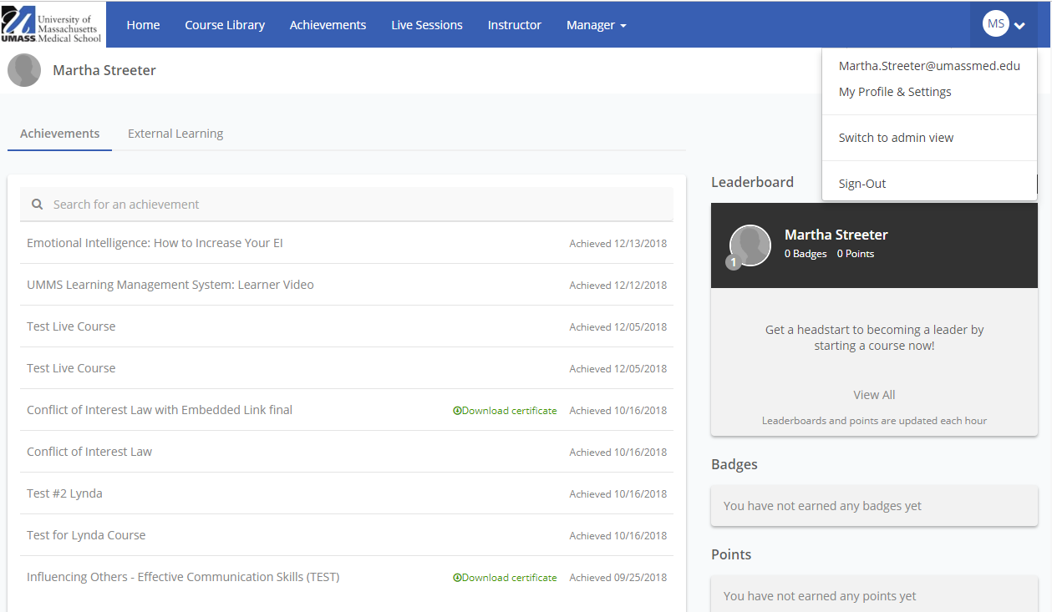
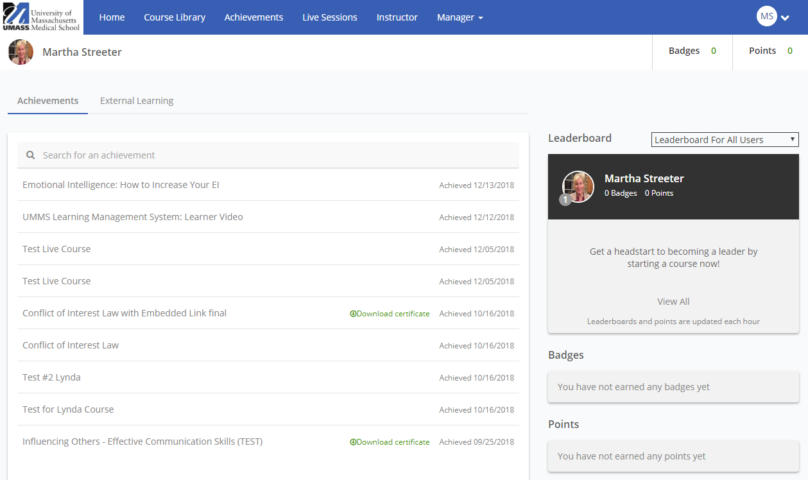
LMS My Achievements, Profile and Settings
Achievement, Profile and Settings:
Achievements – Once you complete your course, you can go to the Achievements section to review your certificates or points. You can download your course certificate here.
Profile Picture – You also have the option of adding a profile picture versus the grey profile that is current. Go to the circle with your initials in the top right corner and access the drop down menu. Select My Profile & Settings and upload a profile picture.
Notes:
Achievement, Profile and Settings:
Achievements – Once you complete your course, you can go to the Achievements section to review your certificates or points. You can download your course certificate here.
Profile Picture – You also have the option of adding a profile picture versus the grey profile that is current. Go to the circle with your initials in the top right corner and access the drop down menu. Select My Profile & Settings and upload a profile picture.

Slide 19
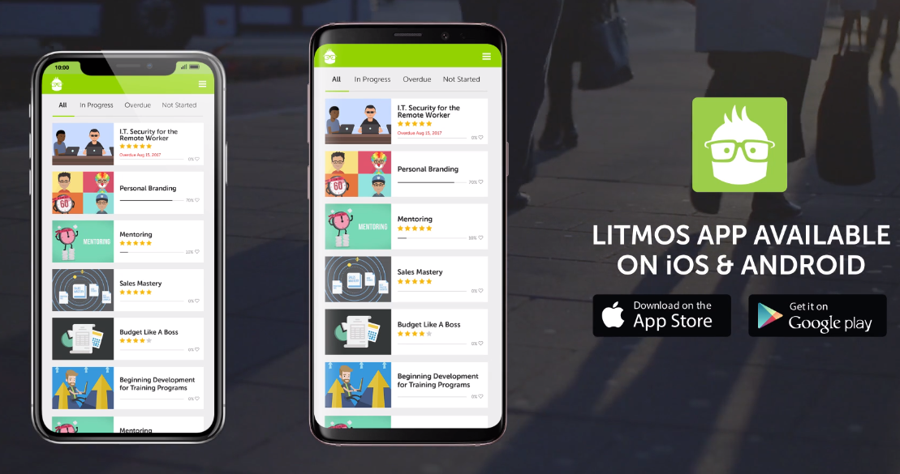
LMS Other Tips
Other Tips:
Course Invite Link One Time Use – Do not try to use your course invite link each time you access your LMS portal. You need to login to the LMS portal URL at https://umassmedical.litmos.com to access the course again.
Mobile App – If you want to access your courses outside the office, your LMS app is available on iOS & Android. Go to https://umassmedical.litmos.com and log in.
UMMS LMS APP
Notes:
Other Tips:
Course Invite Link One Time Use – Do not try to use your course invite link each time you access your LMS portal. You need to login to the LMS portal URL at https://umassmedical.litmos.com to access the course again.
Mobile App – If you want to access your courses outside the office, your LMS app is available on iOS & Android. Go to https://umassmedical.litmos.com and log in.

Slide 20
LMS 508 Complaint
Litmos Systems is certified 508 compliant
Litmos has embedded code in their systems to support these Assistive Technologies Software:
JAWS Screen – allows visually impaired users to read the text displayed on the computer screen
NVDA Screen Reader - allows visually impaired users to read the text displayed on the computer screen
ZoomText – allows low-vision users to magnify/reader enlarges and enhances everything on screen
Keyboard only navigation – allows the users who can’t use a mouse to make interactive and navigation elements easily accessible by tabbing and display a keyboard-focus indicator
HTML validator – validate HTML files for compliance against W3C standards (finds missing or unbalanced HTML tags in your documents, stray characters, duplicate IDs, missing or invalid attributes and other recommendations).
Notes:
The Litmos System is certified 508 compliant
Litmos has embedded code in their systems to support these Assistive Technologies Software:
JAWS Screen – allows visually impaired users to read the text displayed on the computer screen
NVDA Screen Reader - allows visually impaired users to read the text displayed on the computer screen
ZoomText – allows low-vision users to magnify/reader enlarges and enhances everything on screen
Keyboard only navigation – allows the users who can’t use a mouse to make interactive and navigation elements easily accessible by tabbing and display a keyboard-focus indicator
HTML validator – validate HTML files for compliance against W3C standards (finds missing or unbalanced HTML tags in your documents, stray characters, duplicate IDs, missing or invalid attributes and other recommendations).

Slide 21
LMS Let’s Get Started
Getting Started:
Remember your training and apply what you have learned.
Go to https://umassmedical.litmos.com and log into the LMS portal.
Complete your assigned trainings.
Access the LMS course library and review other courses available for you to take.
Support - If you have technical or system problems for an enterprise wide training, please contact Litmos support group at:
Course questions for department sponsored training – contact UMMS course contact person (contact person will be stated on the assigned course email)
Technical or system questions - Phone #: 925-251-2220 ext. 2 or email: support@litmos.com
Click here to access the LMS Support Contact Resource Sheet for a full list of support contact numbers
Notes:
Let's Get Started:
Remember your training and apply what you have learned.
Go to https://umassmedical.litmos.com and log into the LMS portal.
Complete your assigned trainings.
Access the LMS course library and review other courses available for you to take.
Support - If you have technical or system problems for an enterprise wide training, please contact Litmos support group at:
Course questions for department sponsored training – contact UMMS course contact person (contact person will be stated on the assigned course email)
Technical or system questions - Phone #: 925-251-2220 ext. 2 or email: support@litmos.com
Click here to access the LMS Support Contact Resource Sheet for a full list of support contact numbers

