Slide 1
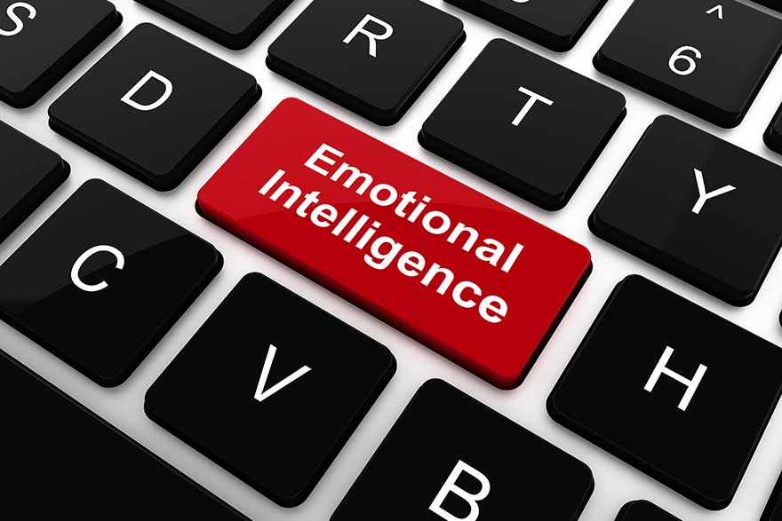


Emotional Intelligence: How to Increase Your EI
October 2018
Notes:
Welcome to Emotional Intelligence How to Increase Your EI training. My name is Chrissy Havilland and I'm a member of the HR Communications Learning and Professional Development Team. I'm excited to talk to you today about emotional intelligence, an important and relevant topic.

Slide 2
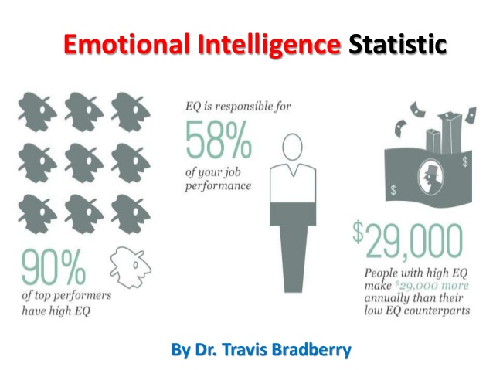
Emotional Intelligence by the numbers
Notes:
So, why is emotional intelligence or EQ so important? Let's take a look at some statistics. 90% of top performers have high emotional intelligence or EQ. EQ is responsible for 58% of your job performance and people with high EQ make approximately $29,000 more each year than their low EQ counterparts. As we go through this presentation you'll see why emotional intelligence is not just critical in the workplace but is an essential aspect of everyday life.

Slide 3

Agenda
Definition of Emotional Intelligence
History of Emotional Intelligence
Why Emotional Intelligence is so important in the workplace
The five areas of Emotional Intelligence
What you can do to increase your Emotional Intelligence
How Emotional Intelligence can help you develop and enhance your UMMS Core Competency Skills
***Please print out the Emotional Intelligence Workbook before continuing***
Notes:
Today, I will first discuss the concept of emotional intelligence, its history why it's so important in the workplace. I'll then talk about the five key components and what you can do to increase your emotional intelligence. Lastly, we'll take a look at how increasing your emotional intelligence can help you develop, acquire and/or demonstrate the UMass Medical School core competencies, which is critical to your success as a UMass Medical School employee. Please print out the emotional intelligence workbook for your reference. This contains all of the five areas of emotional intelligence that we will be discussing in this training. It also includes information on the UMass Medical School core competencies which will be discussed at the end of the training.

Slide 4

What is Emotional Intelligence?
Ability to recognize, understand and manage our own emotions; and to recognize, understand and influence the emotions of others.
Being aware that emotions can drive our behavior and impact people (positively or negatively) and learning how to manage those emotions.
Notes:
So, what is emotional intelligence. Emotional intelligence is the ability to recognize, understand and manage our own emotions while at the same time recognizing understanding and influencing the emotions of others. Basically, it is being aware that emotions can drive our behavior and impact people positively or negatively and learning how to manage those emotions.

Slide 5
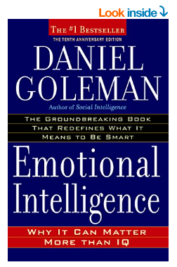
Emotional Intelligence – A Brief History
The concept of Emotional Intelligence became popular in the mid-1990’s with Daniel Goleman’s book – Emotional Intelligence: Why it Can Matter More than IQ.
Notes:
The concept of emotional intelligence is actually not new and has been around for quite a few years. Throughout the 1900s, psychologists suggested that there is an emotional component to intelligence and that is essential to being successful in life. They called it social intelligence, however the concept of emotional did not really become popular until the mid-1990s with Daniel Goleman's book emotional intelligence why it can matter more than IQ.

Slide 6
Emotional Intelligence vs Intelligence Quotient
EQ vs IQ
There is no correlation between IQ and EI scores
Academic aptitude (IQ) has no connection with how people understand and deal with their emotions and the emotions of others (EI)
Some people have high IQs and low emotional intelligence and vice versa, while some people score highly on both and some do not
Emotional intelligence is the one part of the human psyche that we can develop and improve by learning and practicing new skills
IQ and personality are more static measures
Notes:
So let's talk about EQ versus IQ. there is actually no correlation between EQ and IQ scores. in other words academic aptitude or your IQ has no connection with how people understand and deal with their emotions and the emotions of others. this makes perfect sense. we've all met very clever people who nonetheless had no idea about how to deal with people and in Reverse. some people have high IQs and low emotional intelligence and vice versa, while some people score highly on both and some do not. IQ and emotional intelligence attempt to measure different forms of human intelligence along with personality these measures make up an individual psyche. IQ and personality are more static measures and likely to stay reasonably constant throughout life emotional intelligence is the one part of the human psyche that we can develop and improve by learning and practicing new skills.

Slide 7

Why Emotional Intelligence is so important in the workplace
Studies have shown that employees with Emotional Intelligence are more likely to be successful than those who are just technically competent.
Research has shown that people with higher levels of emotional intelligence enjoy more satisfying and successful careers and relationships.
Emotional Intelligence is the key to both personal and professional success.
Notes:
So, why is emotional intelligence so important in the workplace? Studies have shown that employees with emotional intelligence are more likely to be successful than those who are just technically competent. In addition, research has shown that people with higher levels of emotional intelligence enjoy more satisfying and successful careers in relationships. Higher IQs indicate better cognitive abilities or the ability to learn and understand. People with higher IQs are more likely to do well academically without exerting the same amount of mental effort as those with lower IQ scores. So, a logical assumption therefore is that people with higher IQs will be more successful at working through life. This assumption has been proven incorrect - there is more to success than simply being clever. Emotional intelligence is the key to the close personal and professional success.

Slide 8
The Five Areas of Emotional Intelligence
Personal – How we manage ourselves
Self-Awareness
Self-Regulation
Motivation
Social Skills – How we handle relationships with others
4. Social Skill
5. Empathy
Notes:
Emotional intelligence consists of five main areas. The first is personal - how we manage ourselves. This includes self-awareness, self-regulation and motivation. The second section is social skills - how we handle relationships with others. This includes social skill and empathy. Let's examine each of these in more detail.

Slide 9
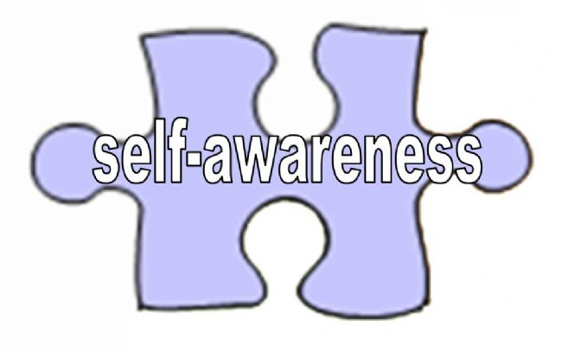
The Five Areas of Emotional Intelligence: Self-Awareness
#1 - Self-Awareness
The ability to know one's emotions, strengths, weaknesses, drives, values and goals and recognize their impact on others while using gut feelings to guide decisions.
Notes:
The first is self-awareness. This is all about knowing your emotions, your strengths and weaknesses and their impact on others. Self-awareness is the skill of being aware of and understanding your emotions as they occur and as they evolve. It's wrong to think of emotions as either positive or negative. Instead you should think of them as appropriate or inappropriate. For example, anger is usually associated with being a negative emotion, however it can be a completely reasonable and appropriate emotion in certain circumstances. Emotional intelligence allows us to recognize our anger and understand why this emotion has occurred. Effective self-assessment of feelings and emotions will help you improve your confidence and self-esteem.

Slide 10
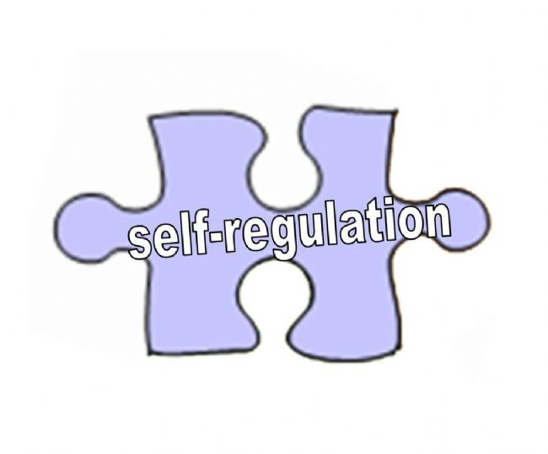
The Five Areas of Emotional Intelligence: Self-Regulation
#2 - Self-Regulation
Involves controlling or redirecting one's disruptive emotions and impulses and adapting to changing circumstances.
Notes:
The second area is self-regulation. This involves being able to control your emotions and handling responses, so they are appropriate. Self-regulation relates to the emotions you are feeling at any given time or in any given circumstance and how well you manage them. It also relates to what you then do whether you behave in a way which is recognized as good or virtuous or not.

Slide 11

The Five Areas of Emotional Intelligence: Motivation
#3 - Motivation
Motivated by things beyond external rewards; have a passion to fulfill their own inner needs and goals.
Notes:
The third area of emotional intelligence is motivation. Motivation includes our personal drive to improve and achieve commitment to our goals initiative or readiness to act and opportunities and optimism and resilience. Self-motivation and personal time management are key skills in this area. Do not make unreasonable demands on yourself. Instead learn to be assertive rather than just saying yes to the demands of others.

Slide 12
The Five Areas of Emotional Intelligence: Social Skills
Social skills encompasses a wide range of relationship and interpersonal skills. These range from leadership through to influencing and persuading, and managing conflict, as well as working in a team.
Notes:
The fourth area of emotional intelligence is social skill. The term social skill covers a wide variety of skills and competencies, many of which are rooted in self-esteem and personal confidence. By developing your social skills such as being easy to talk to being a good listener, or being caring, trustworthy you also become more charismatic and to others. This in turn improves self-esteem and confidence which makes it easier for positive personal dialogues and a greater understanding and acceptance of your own emotions.

Slide 13

The Five Areas of Emotional Intelligence: Empathy
Empathy is an awareness of the needs and feelings of others both individually and in groups, and being able to see things from the point of view of others.
Notes:
Empathy is the fifth area. Empathy helps us to develop a stronger understanding of other people's situations. It includes understanding others, developing others, having a service orientation, leveraging diversity, and political awareness. Empathy can often be difficult to achieve. Learn to listen effectively to both the verbal and nonverbal messages of others including body movements, gestures and physical signs of emotion. Use questions to find out more about other people and what they are feeling and feedback to clarify that you have correctly understood their feelings. Acknowledge and respect the feelings of others even if you disagree and avoid making comments or statements that are judgmental, belittling, rejecting or undermining.

Slide 14
Exercise
Break out into groups of 5 or so
Each team will read scenario and come up with best answer to the question below
Group discussion
Scenario: Your manager assigns a new project to you and a colleague. You put in 100% and complete your tasks on time, however, your colleague turns around tasks behind schedule and leaves you waiting and behind in your own work. You are extremely frustrated, but your colleague does not seem to care.
Question: How would you address this situation?
Notes:
If we were doing this workshop live, at this point, I would have the class break out into teams and have them discuss how they would best address the scenario you see on the screen. We would then have a group discussion. Take a moment to think about this scenario: your manager assigns a new project to you and a colleague. You put in a hundred percent and complete your tasks on time. However, your colleague turns around tasks behind schedule and leaves you waiting and behind in your own work. You are extremely frustrated, but your colleague just doesn't seem to care. How would you address this situation?

Slide 15

What you can do to increase your Emotional Intelligence
Manage negative emotions
The Ability to Be Assertive and Express Difficult Emotions When Necessary
The Ability to Stay Proactive, Not Reactive in the Face of a Difficult Person
Ability to Stay Cool and Manage Stress
Bounce back from adversity
Notes:
So, what can you do to increase your emotional intelligence?
First, you can learn to manage negative emotions. If someone upsets you don’t jump to conclusions – look at the situation in a variety of ways.
Second. There are times in all of our lives when it's important to set our boundaries appropriately, so people know where we stand. These can include exercising our right to disagree (without being disagreeable), saying "no" without feeling guilty, setting our own priorities, getting what we paid for, and protecting ourselves from duress and harm.
One method to consider when needing to express difficult emotions is the XYZ technique - I feel X when you do Y in situation Z. Here are some examples:
"I feel strongly that I should receive recognition from the company based on my contributions.“ "I feel uncomfortable that you expect me to help you over my own priorities.“ "I feel disappointed when you didn't follow through when you told me you would."
Third, The Ability to Stay Proactive, Not Reactive in the Face of a Difficult Person - Most of us encounter unreasonable people in our lives. We may be “stuck” with a difficult individual at work or at home. It’s easy to let a challenging person affect us and ruin our day. What are some of the keys to staying proactive in such situations? Here are three quick tips:
When you feel angry and upset with someone, before you say something you might later regret, take a deep breath and count slowly to ten.
B. Another way to reduce reactivity is to try to put yourself in the difficult individual’s shoes, even for just a moment. For example, consider the person you’re dealing with, and complete the sentence: “It must not be easy….”
So, what can you do to increase your emotional intelligence? First, you can learn to manage negative emotions. If someone upsets you don't jump to conclusions. Look at the situation in a variety of ways. Second, there will be times in all of our lives when it's important to set our boundaries appropriately, so people know where we stand. These can include exercising our right to disagree without being disagreeable, saying no without feeling guilty, setting our own priorities, getting what we paid for and protecting ourselves from duress and harm. One method to consider when needing to express difficult emotions is the X Y Z technique. For example, I feel X when you do Y in situation Z. Third, the ability to stay proactive, not reactive in the face of a difficult person. Most of us encounter unreasonable people in our lives. We may be stuck with a difficult individual at work or at home. It's easy to let a challenging person affect us and ruin our day. What are some of the keys to staying proactive in such situations? Here are three quick tips. You feel angry and upset with someone before you say something you might later regret, take a deep breath and count slowly into 10. Another way to reduce reactivity is to try to put yourself in a difficult individual’s shoes even for just a moment. For example, consider the person you're dealing with and complete the sentence it must not be easy. Fourth the ability to stay cool and manage stress. Most of us experienced some level of stress in life. How we handle stressful situations can make a difference between being assertive versus reactive and poised versus frazzled. When under pressure the most important thing to keep in mind is to keep our cool. Here are some quick tips. One, if you feel nervous and anxious put cold water in your face and get some fresh air. Cool temperature can help reduce our anxiety levels. Avoid caffeinated beverages, which can stimulate your nervousness. And second, if you feel fearful, depressed or discouraged try intense aerobic exercises. Energize yourself. The way we use our body affects greatly the way we feel. Lastly, bounce back from adversity. Life is not always easy. How we choose the way we think, feel and act in relation to life's challenges can often make the difference between hope versus despair, optimism versus frustration, and victory versus defeat. Ask questions such as: where is the lesson here, how can I learn from this experience, what is most important now?

Slide 16
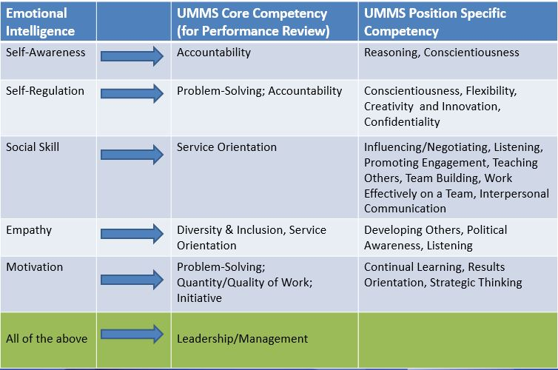
Developing the UMMS Competencies
Notes:
So now that we've learned about emotional intelligence, let's talk about how increasing these skills can also help you develop and hone your core competency skills and help you become more successful at UMass Medical School. First, let's talk about what a competency is. A competency is the knowledge skills and attributes needed to be successful in your roles. UMass Medical School has identified 6 plus 1 core competencies as skills that all employees need to have to be successful. These are accountability, initiative, problem solving, decision making, quantity/quality of work, service orientation, diversity inclusion and leadership management for those supervisory skills. These competencies are also tied to your performance. By increasing the various areas of emotional intelligence, you are also developing your core competency skills. You can refer to your workbook for this listing of core competencies. We also have UMass Medical School position specific competencies. Position specific competencies will allow leaders to define additional significant expectations that are unique to their specific department or roles. There is a menu of 60 that a manager may choose from - the list was drawn from the Department of Labor and customized for UMass Medical School. Up to five may be included for any given position. These competencies will allow us to promote performance excellence across over 700 different jobs we have within UMass Medical School. If you take a look at the chart, you can see that each area of emotional intelligence can directly relate to one or more of the core competencies. Let's talk through a couple of examples. Let's start with self-awareness. As you recall self-awareness is the area of emotional intelligence where you have the ability to know your emotions, your strengths and weaknesses, and recognize their impact on others. This relates directly to the core competency accountability where you will hold yourself accountable and can accept personal responsibility for our own actions. It also relates to position specific competencies such as reasoning and conscientiousness. One example could be if you missed a deadline on a project and you were proactive in explaining the situation with your manager, accepting responsibility for this error. Let's talk to another example. Let's take social skill. Social skill is the area of emotional intelligence which encompasses relationship and interpersonal skills. This could include leadership managing conflict and working in teams. If you develop and hone your social skills, you'll find that you will also better demonstrate service orientation. The core competency where you apply effective interpersonal and problem-solving skills. Developing social skills also helps a host of position specific confidence such as listening, teaching others and working effectively on teams. For example, if you were on a project team and you did for an opinion from another team member as you develop your social skills you will be able to work together effectively and come up with solutions even if there is a conflict.

Slide 17
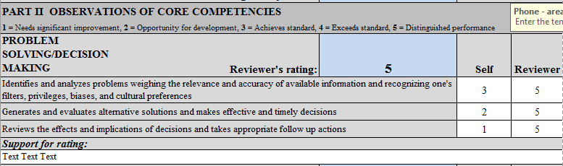
UMMS Competency Based Performance Appraisal
UMMS Performance Appraisal Form - Observations of Core Competencies:
UMMS Core Competencies demonstrating the capabilities that are central across all UMMS positions that collectively contribute to UMMS success
UMMS Performance Appraisal this Spring will incorporate the UMMS Core Competencies
Increase your EI to demonstrate the UMMS Core Competencies
These are the same competencies used in the competency based position description
Notes:
Keep in mind that your performance appraisal this spring will incorporate these core competencies that we have talked about. I recommend that you prepare an outline showing how you have demonstrated the core competencies for your spring performance review. The last page of the emotion intelligence workbook contains a worksheet that you can use. Of course you do not have to use this format, but it is just one example of a way that you can keep track of examples on how you have demonstrated the core competencies, so that you are prepared when you meet with your manager for your performance review. Remember increase your EI to demonstrate the UMass Medical School core competencies. Emotional intelligence is the key to both personal and professional success.

Slide 18
Resources
Daniel Goleman’s Book: Emotional Intelligence: Why It Can Matter More Than IQ
UMMS Compensation Website – https://umassmed.edu/hr/compensation
-UMMS Core Competencies
-Dept. & Position Specific Competencies
-Core Competency Worksheet
-FY 2019 UMMS Performance Appraisal Form
UMMS Learning & Development Website –
https://umassmed.edu/hr/learninganddevelopment/course-offerings/
-UMMS Competency Model Training Webinar (within Professional Development)
Notes:
Here are some resources. If you are interested in finding out more about emotional intelligence, there is Daniel Goleman's book or his website. You can also reference our compensation website, which has links to the core competencies, position specific competencies, and a worksheet which are all included in your workbook. It also has a link to the UMass Medical School performance appraisal form, which incorporates all of the core competencies. Lastly, you can visit our Learning and Development website which contains a webinar of the core competency model training.

Slide 19

Questions?
Notes:
I would like to thank you for taking the time to take this course. I hope you found this course valuable and that you will continue to increase your emotional intelligence skills which will help you develop your core competencies.

