Slide 1
HIV/AIDS in African Americans Compared to the General Population in Massachusetts
Obinna Asia (Burncoat High School)
Kevin Nguyen (South High Community School)
Jackey Zhang (North Quincy High School)
Seun Kolawole (Saint Peter-Marian High School)

Slide 2
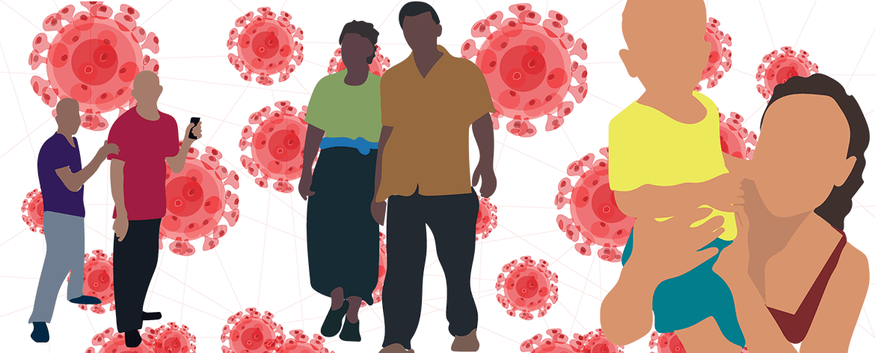
HIV/AIDS Overview
AIDS: Acquired Immunodeficiency
Syndrome
HIV: Human
Immunodeficiency Virus
Retrovirus
Destroys T-Cells ​
Blood-borne pathogen
(sexual contact, injection)
No available cures
T-Cell count drops over time (6-10 years)
Weakened immune system
Death results from body being immuno-compromised

Slide 3
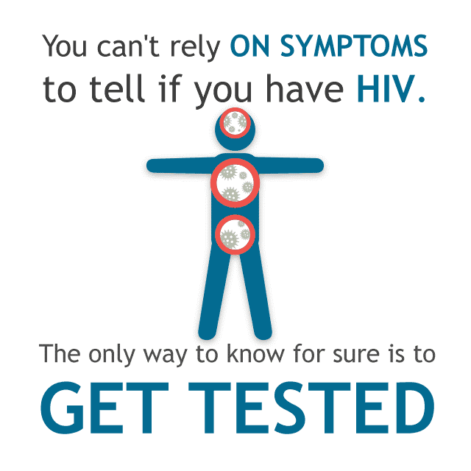
HIV/AIDS Symptoms
HIV
AIDS
Swollen lymph nodes
Mouth ulcers
Fevers
Sore throat
Fatigue
Secondary Infections
Rapid weight loss
Sores
Memory loss
Profuse night sweats
Notes:
Sores: mouth, anus, or genitals

Slide 4
Health Disparity
"The difference in the:
incidence
prevalence
mortality
burden of disease
and other adverse health conditions that exist among specific population groups in the United States, when compared in contrast to a larger group (general population)."
Notes:
https://www.nhlbi.nih.gov/health/educational/healthdisp/index.htm

Slide 5
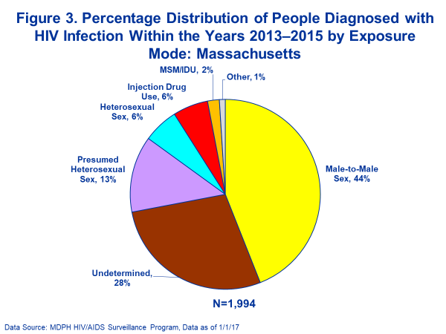
HIV Exposure
Male to male sex is the most prevalent means of exposure to HIV
A percentage of people diagnosed with HIV have confounding reports
Drug abuse in African Americans contributes to HIV transmission
Notes:
https://www.mass.gov/files/documents/2018/05/10/epidemic-glance.docx

Slide 6
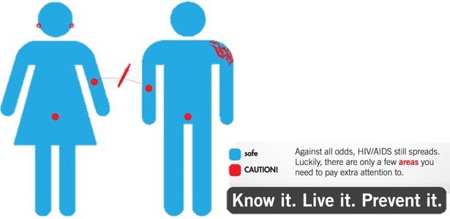
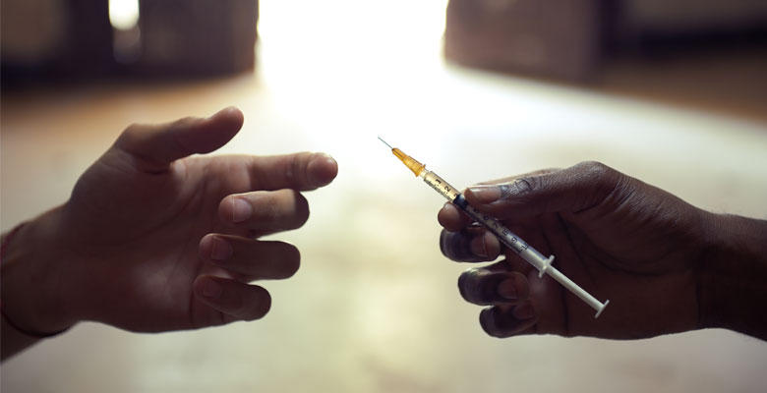
Risk Factors
Risk factors of HIV include:
Injection drug use
Unprotected sexual contact
Mother to child
Low perception of risks

Slide 7
Massachusetts Demographics
Asian
6.9%
Massachusetts Population: 6,859,819
Native Hawaiian and Other Pacific Islander .1%
African American
8.8%
Hispanic/Latino
11.9%
White
72.2%
Notes:
HTTPS://WWW.CENSUS.GOV/QUICKFACTS/FACT/TABLE/MA/PST045217

Slide 8
8
Notes:
https://www.mass.gov/files/documents/2018/06/29/dying-aids.docx

Slide 9
Reasons Contributing to the Disparity
The biggest contributors to the disparity include:
Economic differences
&
Social barriers

Slide 10
Poverty Rates in Massachusetts
Ethnicity | Poverty Rate
All | 10.10%
White | 7.80%
African American | 21.00%
Asian | 13.80%
Other | 26.40%
“Poverty can limit access to health care, HIV testing, and medications that can lower levels of HIV in the blood... those who cannot afford the basics in life... increase their HIV risk.”
(Talkpoverty, 2014)
Notes:
https://talkpoverty.org/2014/09/23/end-hiv-aids-and-poverty/
“The high costs of housing in Massachusetts, particularly in and around Boston, which is home to 30% of PLWH, and limited affordable housing options, places housing insecurity as one of the most substantial barriers to health facing individuals living with and at risk for HIV infection in the Commonwealth.”

Slide 11
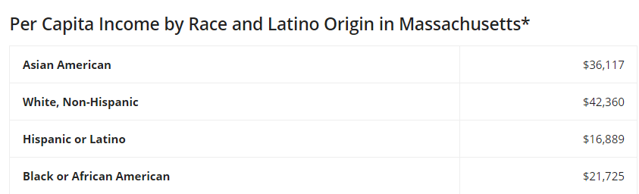
Costs of Treatment
Adequate treatment proves to be too costly
Yearly: ~$23,000 (2010)
Lifetime: $379,668 (2010)
Source: UMASS Boston, Web, Data by Race and Latino Origin in Massachusetts, 2014
Source: Healthline, Web, The Cost of HIV Treatment, 2018
Notes:
https://www.hiv.gov/hiv-basics/staying-in-hiv-care/hiv-treatment/paying-for-hiv-care-and-treatment <<<<<<<LOOK AT THIS SEUN FOR HEALTH CARE IDEAS
www.cdc.gov/hiv/programresources/guidance/costeffectiveness/index.html
https://www.healthline.com/health/hiv-aids/cost-of-treatment

Slide 12
Social Adversity “Stigma, fear, discrimination, and homophobia may place many African Americans at higher risk for HIV.” (CDC)
1/5 Massachusetts residents report
they hide HIV condition
Damages social relationships
Affects mental health negatively
Neglects education on disease
Notes:
Poor mental health may delay or complicate access to care
https://www.boston.com/uncategorized/noprimarytagmatch/2012/07/27/living-with-the-stigma-of-hiv-many-in-state-hide-their-status

Slide 13
Racial Discrimination “Persons with HIV are still faced with discrimination by hospitals, doctors, dentists, and other health care providers.” (Glad 2014)
“Whenever AIDS has won, stigma, shame, distrust, discrimination and apathy was on its side. Every time AIDS has been defeated, it has been because of trust, openness, dialogue between individuals and communities, family support, human solidarity, and the human perseverance to find new paths and solutions.” (Avert 2014)
Notes:
MASSACHUSETTS INTEGRATED HIV/AIDS PREVENTION AND CARE PLAN

Slide 14
Conclusion
HIV/AIDS affects African Americans disproportionately as opposed to other ethnic groups in Massachusetts
Several barriers contribute to this disparity:
Poverty
Monetary demands
Stigma
HIV is avoidable through information and prevention
Future of optimism
Massachusetts Integrated HIV/AIDS Prevention and Care Plan

Slide 15
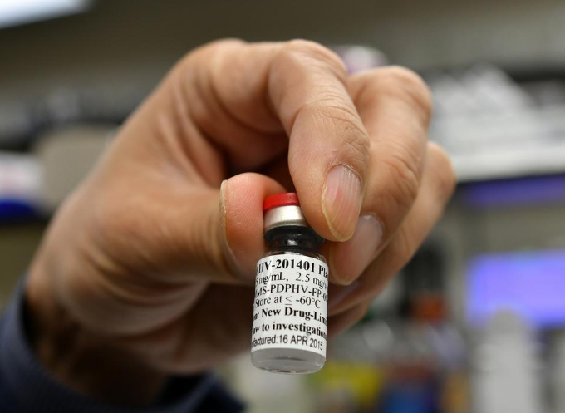
Shan Lu, M.D., Ph.D. and His Work
Professor of medicine and biochemistry & molecular pharmacology
Working on research and development of DNA vaccines for HIV
Vaccine will be tested over 6-12 months with volunteers
Vaccine strategy best hope to combat HIV
T&G Staff/Christine Peterson
Notes:
https://www.umassmed.edu/news/news-archives/2018/03/umass-medical-school-hiv-vaccine-to-be-tested-in-new-phase-i-trial/

Slide 16
HIV/AIDS Resources and Help in Massachusetts
AIDS Project Worcester
Planned Parenthood
AIDS Action Committee of Massachusetts
Massachusetts HIV Drug Assistance Program

Slide 17
Bibliography
CDC. “What Are HIV and AIDS?” HIV.gov, 21 Feb. 2018, www.hiv.gov/hiv-basics/overview/about-hiv-and-aids/what-are-hiv-and-aids.
“Health Disparities.” National Heart Lung and Blood Institute, U.S. Department of Health and Human Services, www.nhlbi.nih.gov/health/educational/healthdisp/index.htm.
“2017 Massachusetts HIV/AIDS Epidemiologic Profile, .” MassGov, 2017, www.mass.gov/files/documents/2018/05/10/epidemic-glance.docx . “U.S. Census Bureau QuickFacts: Massachusetts.” QuickFacts Massachusetts,
“U.S. Census Bureau QuickFacts: Massachusetts.” QuickFacts Massachusetts, www.census.gov/quickfacts/fact/table/ma/PST045217.
“Local Data: Massachusetts.” AIDSVu, aidsvu.org/state/massachusetts/.
“Stigma.” What Works in Youth HIV, 4 Jan. 2018, www.whatworksinyouthhiv.org/youth-hiv/hiv-prevention-treatment/stigma.
Campbell, Scott, et al. “The Struggle to End HIV/AIDS and Poverty.” Talk Poverty, 6 Mar. 2018, talkpoverty.org/2014/09/23/end-hiv-aids-and-poverty/.
Albelda, Randy; Cadet, Ferry; and Mei, Dinghong, "Poverty in Massachusetts by Race" (2011). Center for Social Policy Publications. 56. https://scholarworks.umb.edu/csp_pubs/56.
“The Cost of HIV Treatment.” Healthline, Healthline Media, www.healthline.com/health/hiv-aids/cost-of-treatment.
Shrage, Laurie. “The Lancet | Vol 388, Issue 10049, Pages 1025-1128, e2-e3 (10–16 September 2016).” Egyptian Journal of Medical Human Genetics, Elsevier, 14 July 2016, www.sciencedirect.com/journal/the-lancet/vol/388/issue/10049.
Initiative, Prison Policy. “Massachusetts Profile.” Mass Incarceration: The Whole Pie 2016 | Prison Policy Initiative, www.prisonpolicy.org/profiles/MA.html.
Fekih, Sihem, and Rachel Glickhouse. “Inside New York's Prison HIV Problem.” Popular Blocks, 30 Apr. 2015, bl.ocks.org/riogringa/raw/c51388dfd91d9c4bd86d/.
“HIV/AIDS.” HIV Cost-Effectiveness, Centers for Disease Control and Prevention, 8 Mar. 2017, www.cdc.gov/hiv/programresources/guidance/costeffectiveness/index.html.

Slide 18
Bibliography
Bibliography
“Institute for Asian American Studies.” Data by Race and Latino Origin in Massachusetts, 2014, University of Massachusetts Boston, 2014, www.umb.edu/iaas/census/acs/data_by_race_and_latino_origin_in_ma_2014.
“Massachusetts Overview of Legal Issues for People with HIV.” GLADAnswers, June 2014, www.glad.org/wp-content/uploads/2017/01/ma-hiv-overview.pdf.
Ojikutu, Bisola et al. “All Black People Are Not Alike: Differences in HIV Testing Patterns, Knowledge, and Experience of Stigma Between U.S.-Born and Non–U.S.- Born Blacks in Massachusetts.” AIDS Patient Care and STDs 27.1 (2013): 45–54. PMC. Web. 20 July 2018.
“Homophobia and HIV.” AVERT, Avert, 23 Apr. 2018, www.avert.org/professionals/hiv-social-issues/homophobia.
“STIGMA, DISCRIMINATION AND HIV.” Testsgn.org, Avert.org, 3 Feb. 2017, www.testsgn.org/en/news/stigma-discrimination-and-hiv.
Kotz, Deborah. “Living with the Stigma of HIV: Many in State Hide Their Status.” Boston.com, The Boston Globe, 27 July 2012, www.boston.com/uncategorized/noprimarytagmatch/2012/07/27/living-with-the-stigma-of-hiv-many-in-state-hide-their-status.
Wolitski, Richard. “HIV in the African American Community: Progress, But Our Work Is Far From Over.” HIV.gov, 1 Mar. 2018, www.hiv.gov/blog/hiv-african- american-community-progress-our-work-far-over.
MASSACHUSETTS INTEGRATED HIV/AIDS PREVENTION AND CARE PLAN. BUREAU OF INFECTIOUS DISEASE AND LABORATORY SCIENCES, 2017, www.mass.gov/files/documents/2016/12/vz/mass-hiv-aids-plan.pdf.
Spencer, Susan. “HIV Vaccine Developed at UMass Medical School to Start Clinical Trials at Four US Sites.” Telegram.com, Telegram.com, 12 Apr. 2018, www.telegram.com/news/20180411/hiv-vaccine-developed-at-umass-medical-school-to-start-clinical-trials-at-four-us-sites.
Basics. “HIV/AIDS.” Treatment Decisions for HIV - HIV/AIDS, 21 June 2005, www.hiv.va.gov/patient/basics/what-is-HIV.asp.
Content Source: HIV.govDate last updated: May 15, 2017. “Symptoms of HIV.” HIV.gov, 31 Aug. 2017, www.hiv.gov/hiv-basics/overview/about-hiv-and- aids/symptoms-of-hiv.

