Slide 1
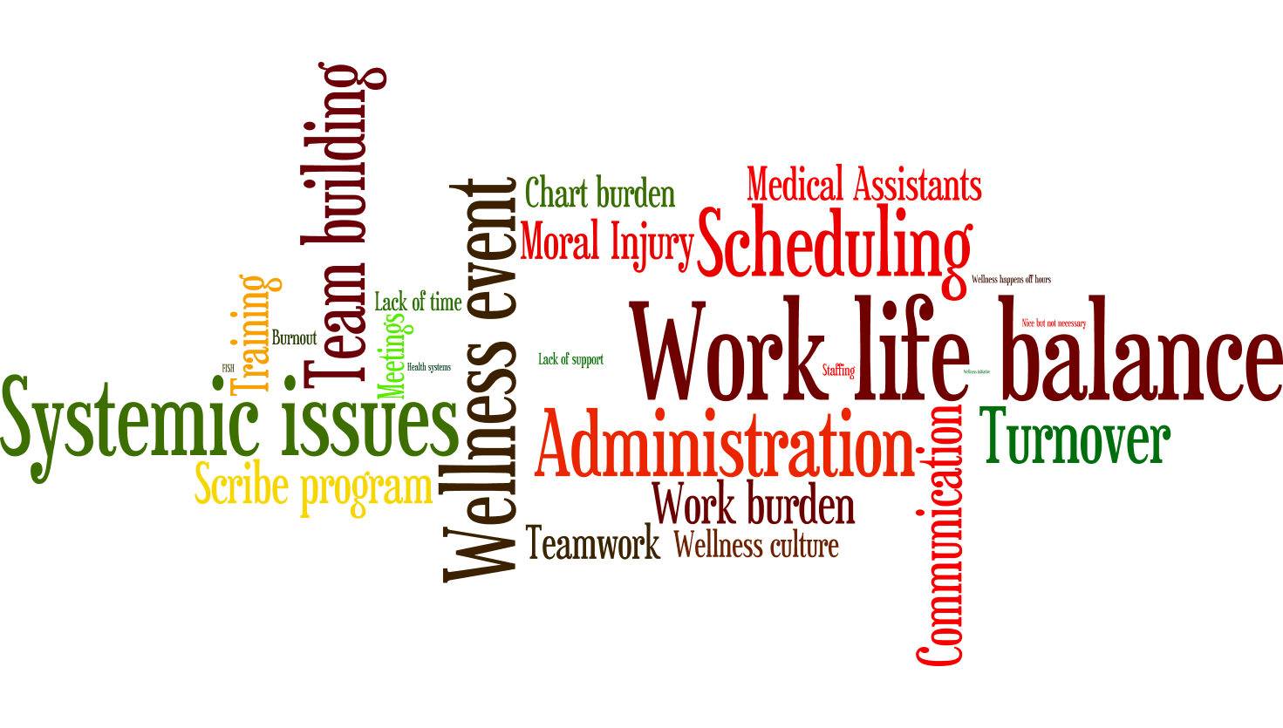
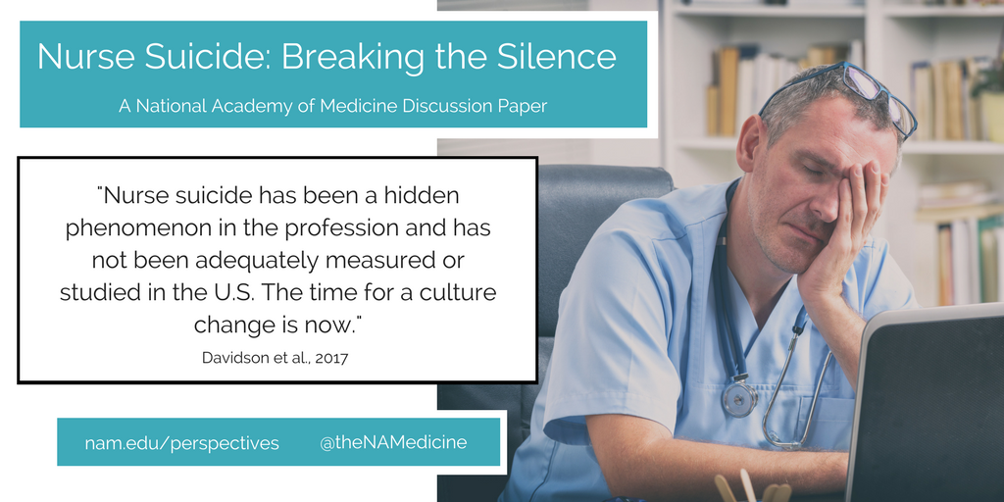
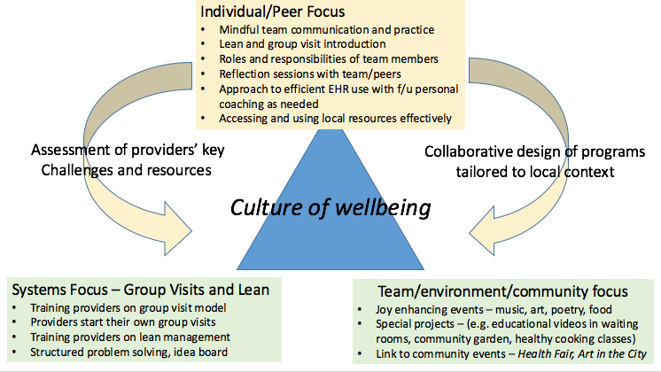

Healthcare Wellness and Burnout, Perspectives from Clinicians in a Federally Qualified Health Center
Andrew Cauley¹, Alexander Green^{2,3}, Paula Gardiner^{1,3}
¹University of Massachusetts Medical School, ²Harvard Medical School, ³Family Health Center of Worcester
Introduction
Results
Discussion & Conclusion
Burnout continues to be one of the most challenging problems to solve in healthcare. More than half of all physicians in the United States experience some form of burnout (Shanafelt, Hasan et al. 2015) and the national costs incurred may be as high as $6.3 billion (Han, Shanafelt et al. 2019). Burnout is especially endemic in the fields of primary care, where clinicians often work in complicated health systems that require them to see an abundance of challenging patients (Beasley, Holden et al. 2020).
Clinicians who work at Federally Qualified Health Centers (FQHCs) are particularly at risk for burnout due to increased administrative work load, electronic health record (EHR) burden, and the rising complexity of primary care practice for patients with socioeconomic disparities (Edwards, Marino et al. 2018) (Friedberg, Reid et al. 2017) (Kroth, Morioka-Douglas et al. 2018, Gardner, Cooper et al. 2019, Tai-Seale, Dillon et al. 2019) (Olayiwola, Willard-Grace et al. 2018, Kung, Cheung et al. 2019). Increased clinician burnout has been shown to decrease positive interactions with patients leading to low patient satisfaction, poor quality of care, and higher staff and clinician turnover (Rothenberger 2017) (Willard-Grace, Knox et al. 2019). We sought to investigate perspectives of burnout among clinicians at Family Health Center of Worcester in Worcester, Massachusetts.
Coding Results
Thematic Results
The results from our focus group analysis indicate that burnout is a complex problem with no clear, singular solution. This is especially true in FQHCs in areas with low income or racially diverse patients and where the recent COVID-19 pandemic has exacerbated deep seeded disparities (citation). Clinicians who choose to practice in these settings do so in large part because of their commitment to serving patients that require complex care, often in multicultural and multilingual environments (citation). Although they are often mission driven and committed, the systemic problems in FQHCs can be overwhelming to the care team (citation?).
Literature about burnout in primary care increasingly shows that it is rooted in systemic problems (citation) and our data supports this. Without highly functional systems in place to allow clinicians to care for their patients efficiently and effectively, clinicians are faced with the choice of taking on the extra burden themselves, or not doing so and feeling they have let their patients down (and their mission to serve). This no-win situation can then lead to burnout, characterized by emotional exhaustion, depersonalization, and a lack of personal accomplishment (Maslach). Our findings highlight these difficulties as well as potential solutions from the perspectives of clinicians.
Figure 1. Most frequent phrases (codes) that emerged from our focus groups centered on work life, experience with burnout, and the wellness program.
Theme | Example Quote
Clinicians feel burdened by their current workload and can experience moral injury due to lack of resources to care for patients. | “But I think we've come home very stressed and then… physically we're doing things that we would tell our patients never to do.” -Speaker 12, Group 3
The reasons for burnout are due to systemic problems in the health center. | “The systems are completely inefficient. Right. I was talking to somebody the other day I'm like it's a building of incredibly talented people and we just cannot find a way to work efficiently to actually provide good care to patients.” -Speaker 10, Group 3
Support staff (medical assistants, scribes, schedulers, etc.) play a crucial role in the wellness of the entire team. | I've had great feedback from patients about when I have a scribe compared to when I don’t. My patients love it… because I actually am more present.” -Speaker 8, Group 3
Perceived differences in priorities and poor communication between administration and healthcare workers contributes to burnout. | “Yeah a lot of what is going on when I sort of took on the role of provider retention in the health center. A lot of what I end up doing is just helping people navigate the bureaucracy and trying to figure out who you even talk to you to get things done. Who do you e-mail.” -Speaker 20, Group 2
A communicative and stable team helps clinicians effectively care for patients and thus reduce burnout | “And then like in the beginning I was all enthusiastic and tried to like build this relationship to the scheduler... And it was great but then they left and then it was like the same thing again and now I'm trying to muster the energy to do it yet again.” -Speaker 8, Group 1
References
Materials & Methods
We proposed a novel, three-component wellness program to our clinicians (Figure S1) to help mitigate the effects of burnout at FHCW. After one year, we invited our clinicians to attend one of three focus groups where we could listen to their feedback about the program as well as their thoughts on burnout and wellness. Participants were randomly assigned to one of the three groups, each led by a trained facilitator that utilized a focus group guide.
All three groups were audio recorded, transcribed by professional software (NVIVO transcription), and reviewed by the RA (AWC). The RA and co-investigator (PG) independently coded all three transcripts. The RA and co-investigator reconciled the codes with the PI (AG) and resolved any differences by consensus and transcript review. Coders identified high density codes and combined similar codes into categories, which were shared with the research team.
Will fill this out for final draft
Acknowledgements
Figure 2. Themes that emerged from our focus groups centered on work life, experience with burnout, and the wellness program.
Figure S1. Implementation of our three-component wellness program.

