Slide 1



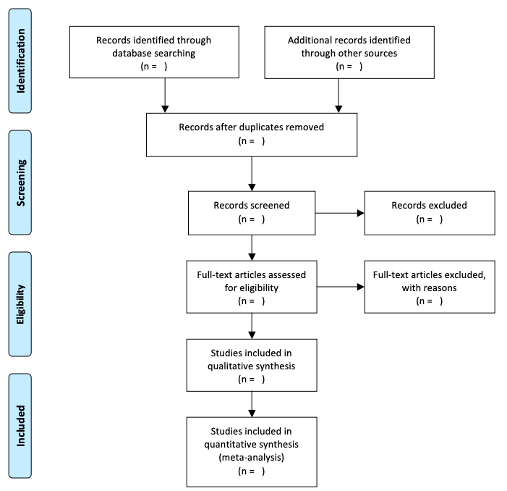

Social determinants of health screening in emergency department settings
Sabahat Rahman MS¹, Payal Modi MD^{1,2}
¹ University of Massachusetts Medical School
² UMass Memorial Medical Center
Introduction
The role of the social determinants of health (SDOH) as a causative factor for poor health outcomes is well established in the medical literature. Studies have found that these needs, including access to food, housing, transportation, jobs, education, healthcare etc., are the primary determinants of morbidity and mortality.^{1–4} McGinnis et al. estimated that clinical care was responsible for a mere 10%–15% of preventable mortality in the U.S.⁵ The coronavirus pandemic has further enhanced these pre-existing social needs while disproportionately infecting marginalized communities.^{6–8} Due to the COVID-19 pandemic shut down, higher unemployment rates have been causing increased social needs including food and housing insecurity for months.⁸
As coronavirus continues to devastate the health and financial security of many, it is crucial to develop a system to assess these needs immediately and mitigate further morbidity and mortality. Thus far, most SDOH screening implementation efforts have focused on primary care clinic settings.^{9,10} However, emergency departments (EDs) serving large catchment areas often encounter the most socially vulnerable patients and a unique opportunity to assess and intervene. A study by Rodriquez et al. done before the introduction of COVID-19 showed that 24% of the homeless patient participants stated they would not have presented to the ED if services addressing their primary concerns of hunger, shelter, and safety had been accessible.¹¹ The widespread delay in identifying and addressing social health risks in the ED is not only affecting community health, but also saturating the health system and reducing efficiency, as poor SDOH have been proven to be risk factors for costly hospital readmission rates.¹²
﻿To date, there have been limited published reviews of SDOH screening in emergency department settings. Therefore, the purpose of this review is to identify available SDOH screening tools used across ED settings and to evaluate their comprehensiveness and validity in assessing multiple SDOH. To our knowledge, this is the first review of existing multidimensional SDOH risk screening tools used in emergency departments in the United States.
Table 1. Inclusion/Exclusion Criteria
Conclusions
Social determinants of health are undeniably critical to promoting good health outcomes in our community. With COVID-19’s pandemic response leading to an exponential rise in social needs, swift and immediate identification of these needs is essential to intervene and connect them to community resources. The ED is a unique clinical environment as it is the catchment area for our most vulnerable populations who are homeless, uninsured, or struggling with other social needs.15,16 We hope that our goals to assess the current landscape of SDOH screening in ED settings in the U.S. alongside our pilot project of implementing our own social needs survey in UMass ED will put us on track to best serve our community during this time and lay down the groundwork to give these elements of healthcare the priority they deserve.
Inclusion | Exclusion
Assessing screening tool for 2+ SDOH elements | Assessing survey tool for only one SDOH element, assessing non-SDOH factors only, OR addressing SDOH without a screening tool
Conducted in an ED setting | Conducted solely outside of ED settings (primary care center, community clinic, etc)
Based in the U.S. | Based outside of the U.S.
Original studies | Reviews, commentaries, and other secondary presentation of data
Future Work
Conduct the search strategy for the systematic review, consolidate the search results, complete title/abstract screening and full-text review, extrapolate meta-data, and report findings.
Explore funding opportunities for pilot program
  Establish relationship with ED administrators and staff to properly integrate the survey into patient care flow
Develop educational material for ED providers and staff on the significance of SDOH and effects on health outcomes
Methods
We will be following the Preferred Reporting Items for Systematic Reviews and Meta-Anlysis (PRISMA) guidelines for systematic literature reviews.¹³ We plan to search six electronic academic databases—PubMed/MEDLINE, CINAHL, ﻿PsycINFO, EMBASE, SocINDEX, and Social Work Abstracts—using search strings constructed from the following concepts and associated synonyms and keywords using ﻿using Boolean operators: social determinants of health, screening tools, and emergency departments (search strategy available upon request). Results will be saved from each database and duplicates removed.
Our inclusion and exclusion criteria can be seen in Table 1. SDOH-centered screening was defined as the tool assessing two or more elements including but not limited to housing, food insecurity, safety/violence, healthcare access, utilities problems, transportation, and need for legal assistance. Although SDOH screening tools may exist internationally, given the unique social, cultural, economic and political climate and the specific healthcare delivery system resources of the U.S., only tools used and developed in U.S. emergency department healthcare settings were included in this review to understand more direct implications.¹⁴ Results from searches will be filtered according to the PRISMA flowchart in Figure 1. After a conservative first stage of title and abstract screening, two reviewers will complete the second stage of reviewing full-texts of the studies that were filtered through. Disagreements at both stages were resolved by a third reviewer.
Data from the final studies will be abstracted using an evaluation matrix for relevant elements, such as SDOH domains or variables assessed, modality used for survey delivery, methods used to validate the tool, how the tool was developed, response rate, integration into workflow, location of hospital, setting of community, study timeline, and sample size.
Acknowledgements
Thank you to the MassAHEC Network and the Summer Service-Learning Assistantship Program for the support for this project.
Additionally, thank you to Dr. Seth Jones for his contributions towards the pilot project and other various programmatic elements. .
Lastly, thank you to the many ED providers and staff for providing guidance.
Figure 1. Empty PRISMA flowchart to be filled out when conducting search and filtering
Program Implementation
The purpose of this review is to inform best practices when incorporating a screening procedure for SDOH in EDs in the U.S. Concurrent to this review, we have developed a modified screening tool using various studied questionnaires to pilot within our own UMass Memorial Health Care system.
Previously at UMass, patients were screened in primary care clinics by the nurse every 6 months. As addressing SDOH needs in the ED allows us to serve the most vulnerable in the timeliest manner, and with COVID-19 exacerbating social needs, we find it imperative to start laying the groundwork for SDOH screening integration in our ED with the hopes of iterating on it with the guidance we can extrapolate from this review. Assessing the distribution of these needs amongst the patient population presenting to UMass ED will not only allow us to better understand the social needs of our patients, but also how these needs are evolving and changing as the COVID-19 pandemic progresses.
Currently, we have applied for IRB approval to administer our custom questionnaire and are exploring funding options to carry out this pilot project.
References
To view a list of references, scan the QR code below:

