Slide 1


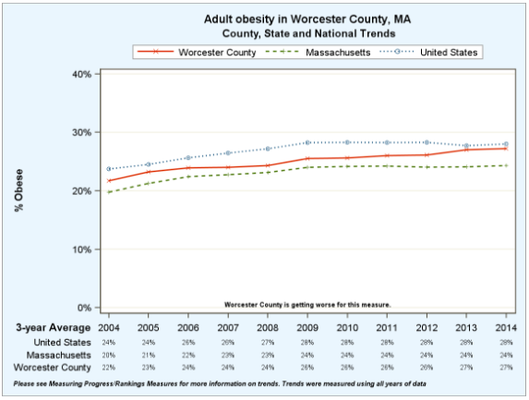
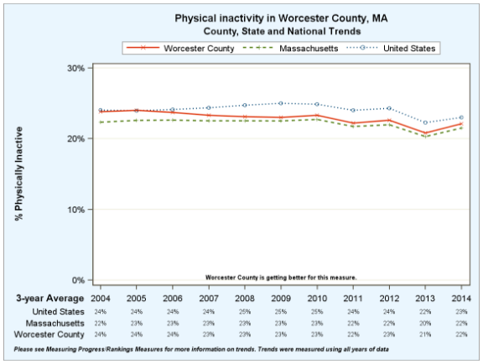
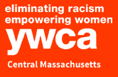
Evaluating Supports and Barriers to Exercise at the YWCA in Worcester
Kelsey Jones, University of Massachusetts Medical School, Class of 2021
Summer Service Assistantship 2018
The YWCA
Worcester County
Sample
Survey Questions
Approximately 979 fitness plan members and 200 fitness center visits per week by clients and staff from 21 local non-profits¹
22 group fitness classes, 4 aquatic classes, and 5 classes for youth and parents
Reduced cost memberships are available for low-income clients
Local health organizations, like Family Health Center of Worcester, purchase institutional memberships offered to patients who may not be able to afford to go to the gym
Regardless of ability to pay, all YWCA members vary greatly in their usage of fitness resources, amount of visits per week, and length of membership
27% of adults report a BMI of 30+, which is considered obese²
22% of adults over age 20 report no leisure-time physical activity
94% of the population is considered to have adequate access to locations for physical activity
What is your main fitness goal/reason for coming to the YWCA today?
What support systems do you have in place for your healthy exercise habits?
Are there any barriers that get in the way of your ability to exercise at the YWCA?
What does “success” at the gym mean for you?
What motivates you to keep exercising?
Do you ever feel social pressure to look a certain way, or exercise more or less?
Do you ever feel embarrassed or afraid you’ll be made fun of when you work out?
How would you convince someone else to exercise more often?
Acknowledgements
Objectives
Future Directions
Thank you to Patty Flanagan, Dr. Heather-Lyn Haley, and the YWCA of Central Massachusetts for making this project possible.
Gain a greater understanding of how social determinants like race, income level, and education impact health and resource access
Explore what supports help fitness program utilizers to maintain their health and increase physical activity
Evaluate and eliminate barriers to exercise and YWCA health and wellness program utilization
Assess the types of exercise and health goals people are setting for themselves
Improve access to and utilization of fitness resources by Worcester county residents to increase overall health
Population health clerkship students will administer short surveys, interviews, and focus groups to gather data
Data will be used to improve utilization of the fitness center and health and wellness programming
Other YWCA departments, such as the domestic violence services and young parent program, can be further integrated with the health and wellness program
References
YWCA Central MA, issuu.com/ywcacentralmass/docs/yYWCA Central Massachusetts 2017/2018 Community Report. wca_2018_fy17_annual_report_finaln.
“Worcester.” County Health Rankings & Roadmaps, University of Wisconsin Population Health Institute, www.countyhealthrankings.org/app/massachusetts/2018/rankings/worcester/county/outcomes/overall/snapshot.

