Slide 1

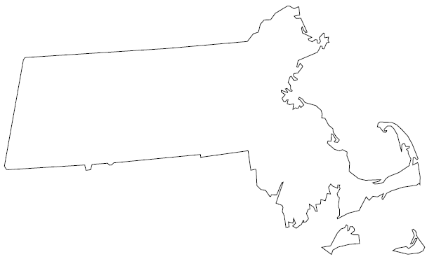

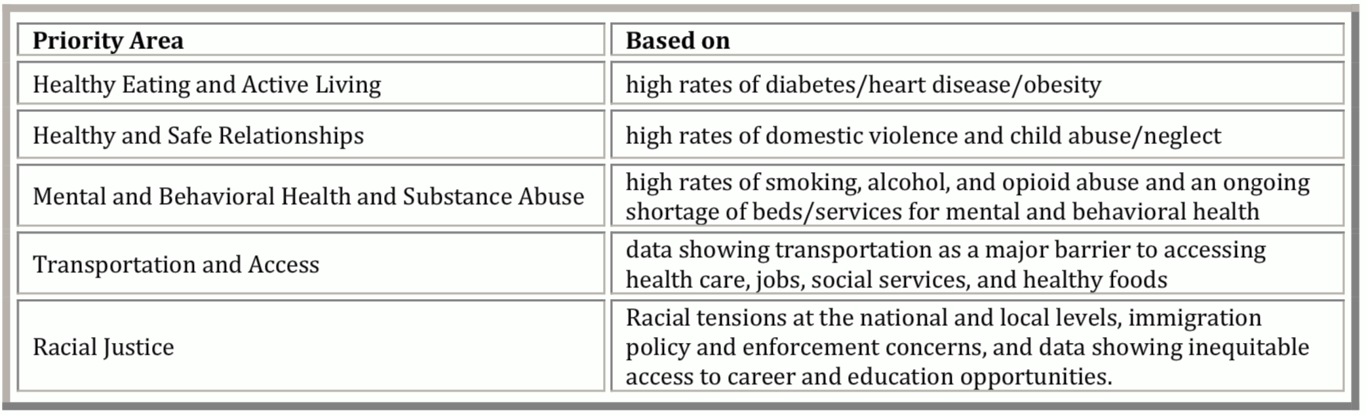
Community Health Priorities in North Central MA
Abigail Bose
What is North Central MA?
Spans from
Orange on the west
Groton on the east
Princeton to the south
Promoting Healthy and Safe Relationships
Supporting Substance Abuse Recovery
Goal 2.2.2: Promote opportunities for North Central residents to advocate for legislation in support of healthy and safe relationships.
Goal 3.1.3: Identify bridge services and flag them in HelpPRO
Did you know?
What are Bridge Services?
When an individual wants to pursue recovery, there is often a long wait to get into a permanent program. Any services that can bridge this gap in care would be called bridge services.
Counseling
Support groups
Group therapy
Food resources
Recovery coaching
Mindfulness practices
Yoga
Wellness activities
The “boyfriend” loophole refers to the fact that gun laws restrict domestic violence perpetrators from maintaining their firearm license if they were married to, living with, had a child with, or were legal guardian of the victim. Stalkers, former and current boyfriends NOT living with victim, are not limited in any way .
In many states, sexual assault kits are never tested. DNA may belong to someone already in the criminal database (CODIS), and which could take a serial rapist off the street. In states without mandated DNA testing, there is often a backlog of many thousands of untouched kits.
Located in Gardner, MA, Alyssa’s Place provides assistance for anyone seeking recovery for themselves or family
Objective:
Compile a comprehensive list of bridge services in North Central MA
Great news for Massachusetts!
In April 2018, MA legislature signed a bill mandating that all sexual assault kits be tested. In July 2018, this bill was put into effect!
Methods
Contact community organizations and medical centers in the region for their recommended resources
Follow up by phone to confirm that information on websites is accurate
Next Steps
Sustainability: How will this list be maintained and updated as services change?
Accessibility: How can this list be available to the people who would use this information?
Objectives:
Produce a sheet with general information about the legislative issues and ways for the public to get involved.
Identify legislators, lobby groups, and community organizations working to shift the legislature.
Next Steps:
Get the word out to as many MA communities as possible.
Encourage participation in this campaign, continue contacting representatives and senators about progress on this change.
Acknowledgements
Thanks to Dr. Heather-Lyn Haley for encouragement and direction. Thanks to Chelsey Patriss, Deb Stone, Michelle Dunne and CHNA 9 Community workers for their willingness to teach me and welcome me into their community efforts. Additional thanks to MassAHEC and Umass Family Medicine for resources.
References
http://www.chna9.com/index.html
http://www.endthebacklog.org

