Slide 1
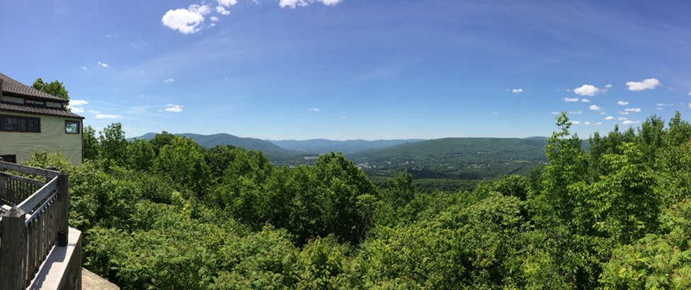
Stroke Outreach in the Berkshires
Julia Oppenheimer, MS2
Summer 2018

Slide 2
Berkshire County
Berkshire Medical Center, Pittsfield
Berkshire Health North, North Adams
Fairview Hospital, Great Barrington
Albany Medical Center, Albany
Baystate Medical Center, Springfield

Slide 3
BMC Stroke Task Force
<10% of BMC stroke patients receive tPA
Time-bound
Awareness of when to seek treatment
Access and perception of care
Outreach survey
Community demographics
Stroke risk factors, symptoms, treatment
Barriers to care/fear of discrimination

Slide 4
Outreach Clinics
Free blood pressure screening
Stroke education
Outreach survey
Venues
Community fairs, Polish Picnic
Food pantries
Community meal sites
Town halls
Senior centers
Public libraries
Elderly and subsidized housing
Homeless shelters
Correctional facilities
Baseball games

Slide 5
Stroke Education
Goals:
Improved knowledge of blood pressure, individual stroke risk factors, and stroke symptoms.
Improved understanding of urgency to seek medical care in the event of possible stroke.
Improved rate of tPA administration for patients with ischemic stroke.

Slide 6
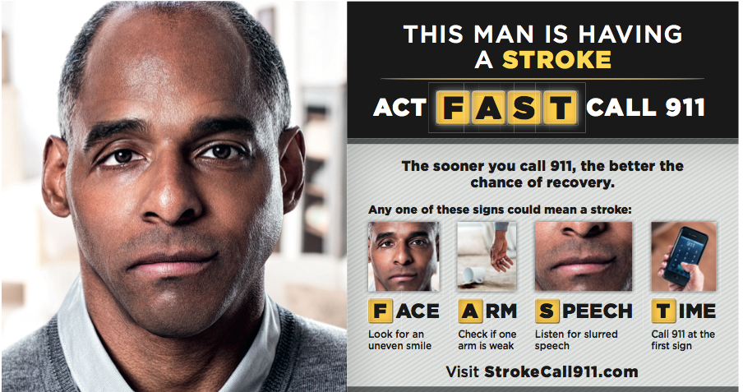
Stroke Education
Goals:
Improved knowledge of blood pressure, individual stroke risk factors, and stroke symptoms.
Improved understanding of urgency to seek medical care in the event of possible stroke.
Improved rate of tPA administration for patients with ischemic stroke.

Slide 7
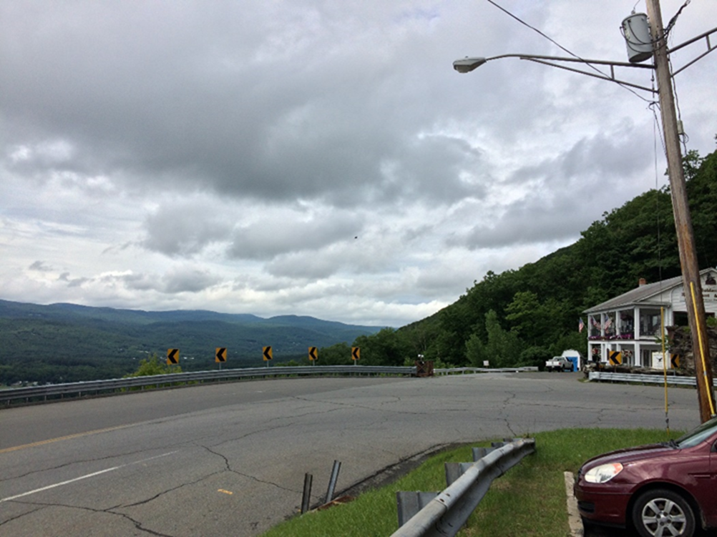
Takeaways
Access and social determinants of health
Transportation & Cost
Literacy
Tick-borne illnesses
Pervasiveness of stroke and risk factors
Challenges in community-wide education
Gaps in knowledge
Each interaction is an opportunity

Slide 8
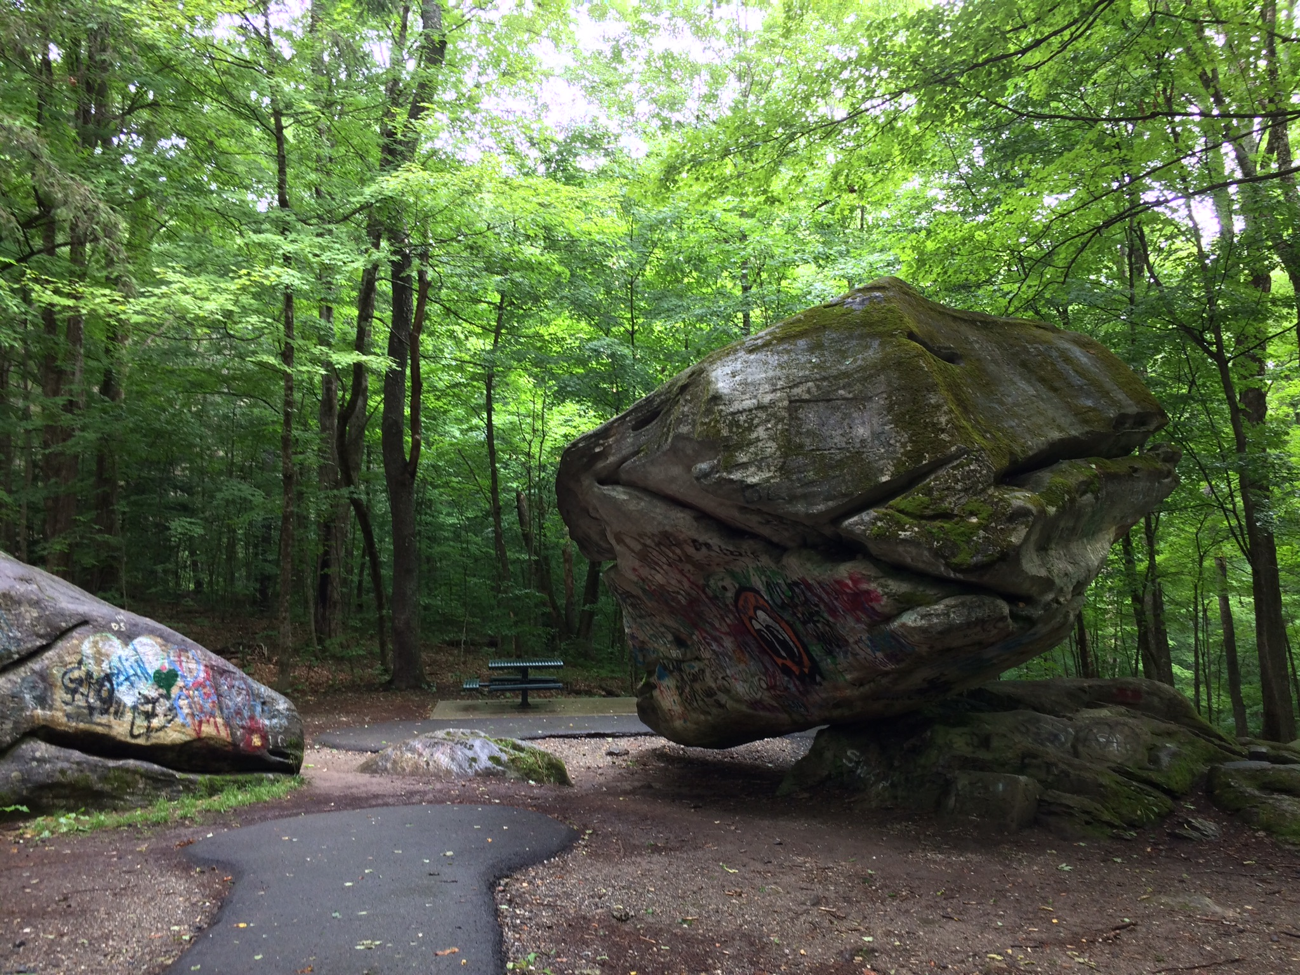
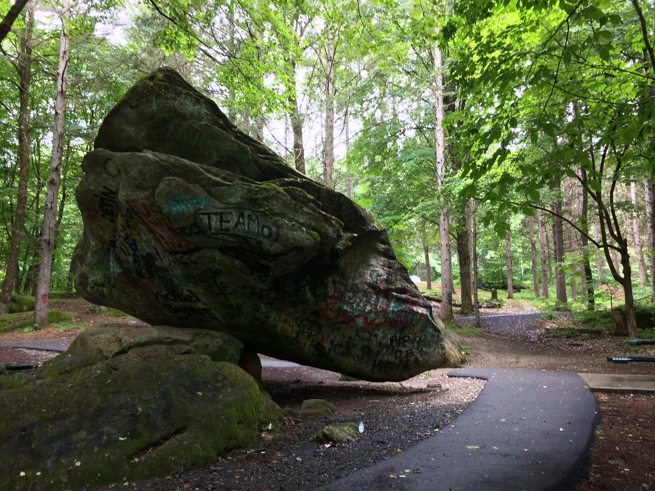
Balance Rock State Park

Slide 9
Great Barrington & North Adams
Daily Hampshire Gazette
Travelocity

Slide 10
Tanglewood & Jacob’s Pillow
The Berkshire Eagle
Jacob’s Pillow

