Slide 1

Health Literacy:
Improve Patient Outcomes and Decrease Health Disparities
Mary M. Philbin, EdM mary.philbin@umassmed.edu

Slide 2
Some Questions to get us started:
What are some barriers to effective health communication with patients?
What’s the goal of any health communication?
And are there specific questions you have or things you are hoping to address?

Slide 3
Today’s Objectives
Define the concept of Health Literacy and unpack the complex definition.
Explore the impact of low health literacy on health care and outcomes.
Describe some Practical strategies for ensuring effective oral and written communication with patients.
Apply the strategies in practice exercises.

Slide 4
Health Literacy is complex, requiring multiple actions by the patient
Personal health literacy is the degree to which individuals have the ability to find, understand, and use information and services to inform health-related decisions and actions for themselves and others.
Organizational health literacy is the degree to which organizations equitably enable individuals to find, understand, and use information and services to inform health-related decisions and actions for themselves and others.
Developed for Healthy People 2030.
Notes:
An individual’s ability to read health-related materials.
*Note: Information on such far reaching illnesses as cancer, diabetes, asthma and HIV are generally written at a reading level of 10th grade or above!
Literacy skills alone may be necessary but not sufficient.

Slide 5
Health Literacy is complex, requiring multiple actions by the patient
The degree to which individuals have the ability to:
Find,
Understand and
Apply / Use health information and services
To make decisions
To take action
Notes:
An individual’s ability to read health-related materials.
*Note: Information on such far reaching illnesses as cancer, diabetes, asthma and HIV are generally written at a reading level of 10th grade or above!
Literacy skills alone may be necessary but not sufficient.

Slide 6
Changes for 2030:
Emphasize people’s ability to use health information rather than just understand it
Focus on the ability to make “well-informed” decisions rather than “appropriate” ones
Incorporate a public health perspective
Acknowledge that organizations have a responsibility to address health literacy

Slide 7
Adequate health literacy expects patients to take an active role in their health care
Patients will seek to understand:
  Health conditions/diagnoses
  Preventive care
  Next steps – referrals, visits, etc.
Patients will follow up/follow through with the plan
  Make and keep appointments
  Change behavior
Patients will partner with providers – Take responsibility for their health and outcomes
  Ask questions
  Apply and use health information

Slide 8
The concept of health literacy is much broader than simple literacy alone
Fundamental Literacy
Scientific literacy
Civic literacy
Cultural literacy

Slide 9

The concept of health literacy is much broader than simple literacy alone
Fundamental Literacy
Scientific literacy
Civic literacy
Cultural literacy
Notes:
National Center for Education Statistics 2003, US Dept Education, national assessment
http://nces.ed.gov/naal/health AVERAGE READING LEVEL OF US POP IS 8th GRADE
36% at basic (22) or below basic(14) health literacy
Comparing 2003 to 1992; fewer adults with below basic BUT fewer with proficiency
Below basic /simple, concrete),Basic/simple, everyday activities,Intermediate/ mod challenging,,Proficient/complex• The National Adult Literacy Study (NALS
1993) 49% (almost half) of all Americans do
not have functional literacy above the 8th
grade level.• Twenty five percent (25%) are functionally
illiterate – that’s 40 to 44 million adults.
Another 50 million adults are only
marginally literate.

Slide 10
The concept of health literacy is much broader than simple literacy alone
Fundamental Literacy
Scientific literacy
Civic literacy
Cultural literacy
Notes:
Science/ knowledge of basic scientific concepts, understanding of technology and scientific uncertainty

Slide 11
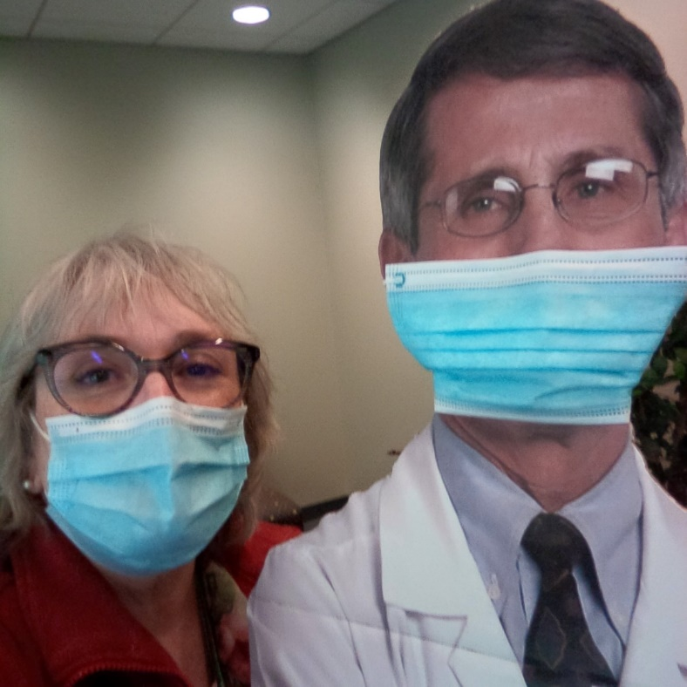
The concept of health literacy is much broader than simple literacy alone
Fundamental Literacy
Scientific literacy
Civic literacy
Cultural literacy
Notes:
Science/ knowledge of basic scientific concepts, understanding of technology and scientific uncertainty

Slide 12



The concept of health literacy is much broader than simple literacy alone
Fundamental Literacy
Scientific literacy
Civic literacy
Cultural literacy
Notes:
Health insurance options
Impact of individual decisions on public health – and vice versa

Slide 13
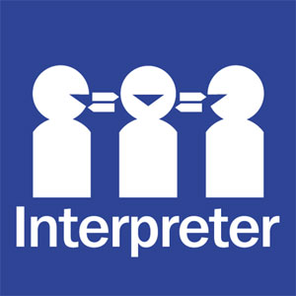
The concept of health literacy is much broader than simple literacy alone
Fundamental Literacy
Scientific literacy
Civic literacy
Cultural literacy
Notes:
When we use cultural references – Example from IMS: “Trojan Horse” – short cuts for us can = confusion for the patient
Mom 2 yo – giving kids choices – Don’t ask “would you like diaper changed” – ask, “Where would you like diaper changed”. BUT – kid already toilet trained: very concrete!

Slide 14
Vulnerable Populations
Elderly
Immigrants and LEP
Poor
Mentally challenged
Poorly educated
Homeless
Prisoners

Slide 15
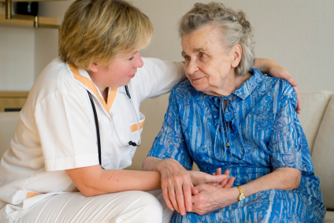

At some point, 9 out of 10 Americans have difficulty understanding and using health information
And remember: none of us is at our cognitive best when we are sick or under stress.

Slide 16
Low health literacy is linked to poorer health outcomes and poorer use of services
    Hospitalization rates
  Use of emergency services
  Medication errors
  Chronic conditions
  Mortality among elderly
  Overall health in elderly
  Mammography screening
  Influenza immunizations

Slide 17

The estimated cost to the system due to low health literacy is $100-120 238 billion/yr
Missed appointments
Inadequate prep = Cancelled procedures
Inpatient stay increased by 2 days

Slide 18
Effective Patient Communication
What approaches or techniques have you seen?
What approaches or techniques have you used?

Slide 19
There are 5 steps to improving provider / patient communication
Slow Down!
Organize the information
Reinforce through multiple channels
  Use pictures, models – “multi-media”
Encourage and help patients ask questions
Confirm understanding – Teach Back

Slide 20
Organize the information
Most important point 1^{st -}
- and limit the amount
Present in small chunks
Use active voice
Be specific – no hypotheticals
Reduce complexity:
  -Use plain language

Slide 21
Limiting the number of points of information also reduces complexity
I can remember up to 3-4 key points (on a good day!)
I need to know:
My diagnosis
The treatment plan
The importance of the plan and side effects of Rx
Hint: Pathophysiology is probably not a key point!

Slide 22
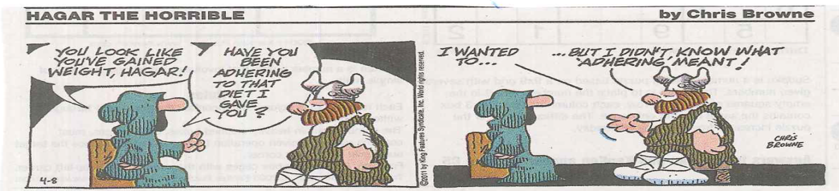
Plain language includes our vocabulary we use as well as medical terms and jargon

Slide 23

Reducing complexity also includes providing a framework or context for understanding
“Your LDL is 103”
“Your test was negative”
Notes:
What is LDL
What does 103 mean
What does this mean FOR ME?

Slide 24
Our 1st Technique to improve communication is:
ASK
TELL
ASK

Slide 25
ASK: Obtain patient’s perspective
TELL: Use an Organized Approach
ASK:
  Encourage questions
  Confirm understanding

Slide 26
2nd Technique: Have the patient ‘Teach Back’ to you what you explained to them.
* You should own any confusion – don’t ‘blame’ the patient.
Sample questions:
  I’ve given you a lot of information and I want to make sure I was clear. Can you summarize what I explained to you?
  What will you do when you get home?
  How will you remember to take your medicine?
  What will you tell your _______ about this visit when you get home?

Slide 27
We can encourage or invite questions by changing a few words:
Do you have any questions?
v.
It’s your turn: What questions do you have for me?

Slide 28
Written Communication

Slide 29
Written materials include patient education pamphlets, instructions, forms – in paper and online.
Most are too hard to read
Forms are too confusing
Reading level often exceeds 12th grade

Slide 30
Please raise your hand once you have read and understood these sentences.
Your naicisyhp has dednemmocer that you have a ypocsonoloc. Ypocsonoloc is a test for noloc recnac. It sevlovni gnitresni a elbixefl gniweiv epocs inot your mutcer. You must drink a laiceps diuqil the thgin erofeb the nonitanimaxe to naelc out your noloc.
AMA Foundation: Health Literacy and patient safety: Help patients understand. Barry D. Weiss, MD 2nd edition, 2007.

Slide 31
Key Elements for more ‘readable’ / understandable materials
Appearance
Layout
Visual elements
Content
Organization
Writing Style

Slide 32
Some Practice / Application
Assessing Readability
Applying our practical techniques
  ASK – TELL – ASK
  Teach Back
Drafting your own information

Slide 33
Calculating READABILITY < 300 words
Find total # sentences
Find total # words
Find total # syllableentences
Average Sentences/100 words (#sent. X 100/ #words)
Average Syllables/100 words (#syll. X 100 / #words)
Chart above 2 values

