Slide 1

Health Disparities of Worcester
An update to the Greater Worcester Community Health Assessment
October 2020
Presented by:
Nikki Nixon
Epidemiologist, WDPH

Slide 2
Purpose
The Community Health Assessment (CHA) and the Community Health Improvement Plan (CHIP) act as the backbone for community health improvement in the Worcester region. While the CHA and CHIP identified Health Equity as the overarching goal and Racism and Discrimination as a priority area, a comprehensive analysis of the disparities and inequities that exist within our community is not enough.
This report seeks to not only highlight the disparities in health outcomes such as mortality and hospitalization, but in the environments and social context from which those disparities are born. This report is intended to further illustrate the current state of health and health determinants within the City of Worcester community.
Notes:
The Community Health Assessment is conducted every 3 years and provides an account of the key health issues in the City. The Community Health Improvement Plan is conducted every 4 years and serves as the roadmap for improving these health issues. The intent of the full report is to provide a deeper dive into some of the key health issues by race and ethnicity.

Slide 3
Introduction
The Greater Worcester Community Health Assessment (CHA) serves as a frequently updated source for quantitative and qualitative health data for individuals and organizations in the city to use in their work in improving the health of the region’s residents.
Because the CHA is limited in scope, much of the rich data presented in the report includes limited stratification or ‘broken-down data’ by ethnoracial groups.
This document is intended to serve as a supplement to the CHA, making available data that highlights racial health disparities and hopefully serves as a starting point to, or endorsement of the work done by the many partners and coalitions.

Slide 4
Demographics of Worcester

Slide 5
Basic Demographics
Table 1. Demographics of Worcester Residents, 2017
Characteristics
 | Number | (Percent)
Total population | 184,743 | (100%)
Sex
Male | 90,476 | (49%)
Female | 94,267 | (51%)
Median age (years) | 34.2
Race and Ethnicity
White | 105,507 | (57%)
Black/African American | 21,799 | (12%)
Hispanic or Latino | 38,687 | (21%)
American Indian and Alaska Native | 613 | (0.3%)
Asian | 13,466 | (7.3%)
Native Hawaiian/Other Pacific Islander | 74 | (0.0%)
Other Race | 688 | (0.3%)
Two or More Races | 3,909 | (2.1%)
Source: U.S. Census Bureau, 2010 Census.
At the time of the last census, Worcester had a population of 181,045. Population growth has been estimated at over 600 new residents per year according to the American Community Survey.
Worcester has a large student population attributed to the many higher education institutions in the city. Combined, the nine institutions within city limits enroll nearly 35,000 students. Some of these students are counted within the total population, while many are not. Many students commute and many other who reside in Worcester for the academic year are counted under their guardians’ homes.

Slide 6





Race, Ethnicity, and Nativity
Because of Worcester’s rich history of welcoming immigrants and refugees, examining racioethnic groups by nativity, whether individuals were born in the US or outside of it, is also useful. Over 20% of Worcester residents are foreign born. Another 12,287 residents <18 have foreign born parents but are native born themselves.
An additional 6% of residents, counted here as native born, were born outside the US in a US territory or to citizen parents abroad.
Just over half (51%) of Worcester’s residents are White and were born in the US.
= White/Caucasian
= Latino/Hispanic
= Black/African-American
= Asian/Pacific Islander
= Other
U.S. Born Foreign Born

Slide 7
Family Origin of Hispanic and Latino Residents
Nearly two-thirds of Hispanic or Latino identified residents’ family origin is Puerto Rico. The next most common origin is the Dominican Republic. Salvadoran, Colombian, Mexican, and Ecuadorian residents each comprise about 4% of the Hispanic and Latino population. All other origins make up the remaining 8% including, in order of most residents to least, multiple origins, Guatemalan, Cuban, Spaniard, Peruvian, Honduran, Panamanian, Spanish, Nicaraguan, Chilean, Venezuelan, Argentinean, Paraguayan, and Bolivian.
Notes:
source

Slide 8
Ethnoracial Group and Age
The older population in Worcester is predominantly White while the younger population is predominantly people of color. While 82% of the population over 65 identify as White, less than 40% of residents under age 18 identify as white.
Median age:
White - 41.5 years
Black - 29.7 years
Asian - 29.3 years
Latino - 27.0 years
Notes:
source

Slide 9
Top Countries of Origin among Worcester Immigrants and Refugees
ACS 2012-2016 5-Year Estimates
Top countries of origin for foreign-born residents span the globe, with the top five all representing a different continent.

Slide 10
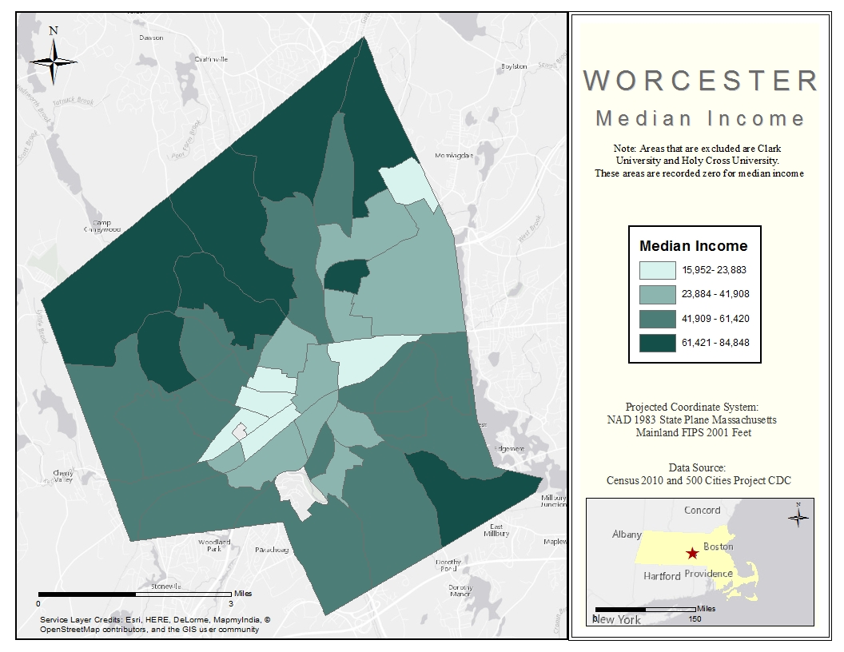
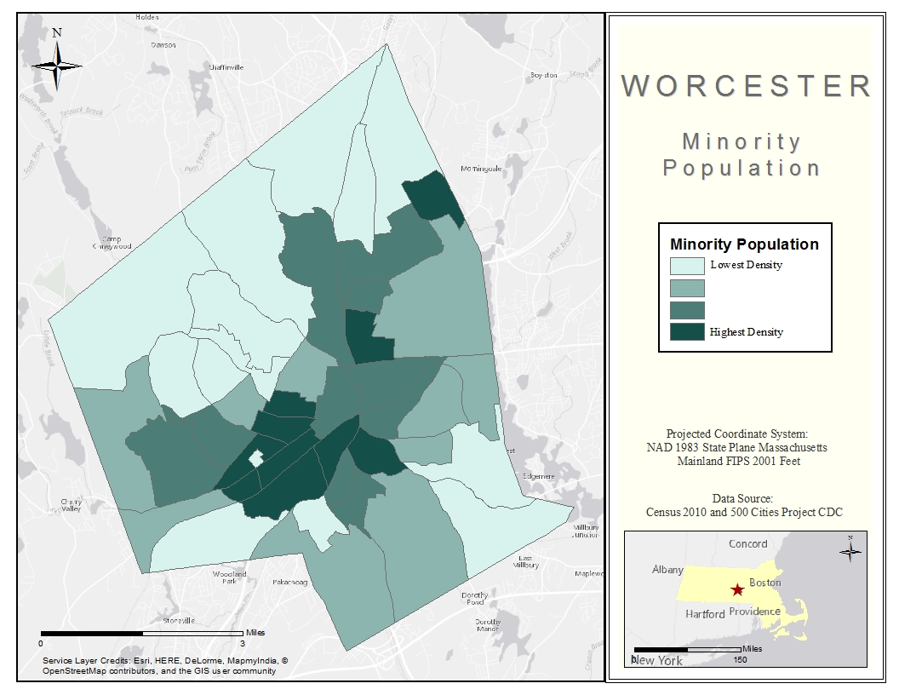
Demographic Characteristics by Census Tracts
As is often the case, populations of color in Worcester often live in areas with lower median household income.

Slide 11
Social Determinants of Health

Slide 12
“The SDH are the conditions in which people are born, grow, work, live, and age, and the wider set of forces and systems shaping the conditions of daily life. These forces and systems include economic policies and systems, development agendas, social norms, social policies and political systems.”
— World Health Organization

Slide 13
Social Determinants of Health (SDOH)
SDOH
Neighborhood and Built Environment
Health and Health Care
Social and Community Context
Education
Economic Stability
Source: Healthy People 2020
Notes:
The SDH are the conditions in which people are born, grow, work, live, and age, and the wider set of forces and systems shaping the conditions of daily life. These forces and systems include economic policies and systems, development agendas, social norms, social policies and political systems. -WHO

Slide 14
Neighborhood and Built Environment

Slide 15
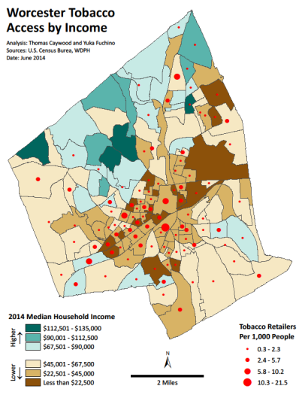
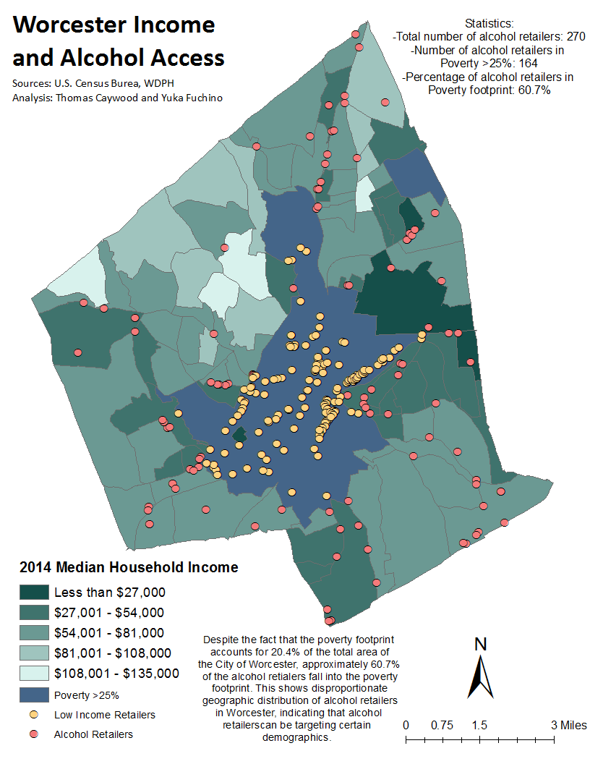
Tobacco and Alcohol Retailer Density
Tobacco and alcohol retailer density also coincides with areas with high proportions of low-income residents and residents of color. The presence of tobacco and alcohol retailers increases the exposure of youth to advertising and reduces barriers to obtaining these products.

Slide 16
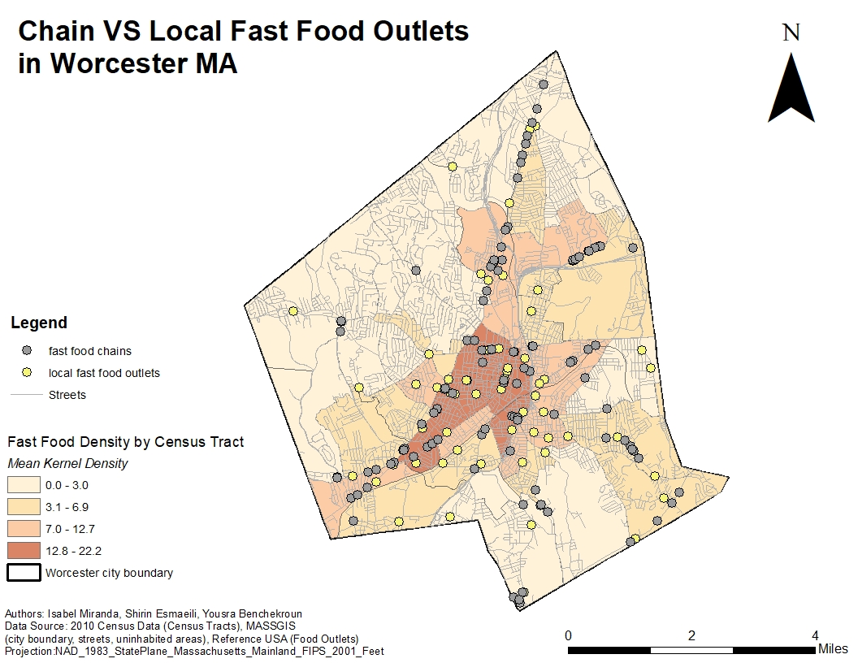
Fast Food Outlet Density
Areas of higher densities of fast food outlets, sometimes referred to as “food swamps,” coincide with areas more densely populated by people of color. Food swamps have been shown to be a better predictor of poor health outcomes than food deserts, the absence of healthy food outlets.
Notes:
AMA Style
Cooksey-Stowers K, Schwartz MB, Brownell KD. Food Swamps Predict Obesity Rates Better Than Food Deserts in the United States. International Journal of Environmental Research and Public Health. 2017; 14(11):1366.

Slide 17
Health and Health Care

Slide 18
Health Insurance Coverage, 2017
While uninsured rates in Massachusetts are uniformly low, Asian, Black, Latino, and Multiracial residents are more likely to be uninsured than White residents.
Notes:
Source:

Slide 19
Health Insurance Coverage, 2017
Latino residents are much more likely to be covered by public insurance and less likely to be covered by employer-sponsored insurance than White residents.
Employer-sponsored insurance tends to be more robust coverage than public insurance.
Notes:
Source:

Slide 20
Social & Community Context

Slide 21
Classroom Composition by Race and Ethnicity
Source: Mass Department of Elementary and Secondary Education (MA DESE) , 2016-2017
While 70% of Worcester Public School students are of color, only 15% of teachers are. Representation in the classroom is thought to be a predictor of student engagement and success in the classroom.

Slide 22
Perceived Discrimination among Worcester Area Residents, 2018
White residents are significantly less likely to report they have ever felt discriminated against based on their race compared to their peers while a majority of Latino and Black residents reported having been discriminated against.
Notes:
The Ns represent total number of respondents for this slide

Slide 23
Education

Slide 24
High School Graduation Rates among Worcester Students*, 2016 -2018
Source: Mass Department of Elementary and Secondary Education (MA DESE) , 2015-2018
Asian and White students consistently achieve higher graduation rates than their peers of other ethnoracial groups. Additionally, English language learners have a particularly significant burden in graduating high school in four years.

Slide 25
Economic Stability

Slide 26
Household Income
Median household income has increased modestly since 2009, and significant disparities in income persist, with Latino households earning around half that of White households.
Notes:
Source:

Slide 27
Food Insecurity among Worcester Youth, 2017
A significant proportion of youth of all races report experiencing not having enough food in the house in the past year, with Latino students reporting more frequently.
Source: 2016-2017 Regional Youth Health Survey

Slide 28
Health Behaviors

Slide 29
Prevalence of Cigarette Smoking in Worcester, 2011 -2013
Source: Behavioral Risk Factor Surveillance System, 2011-2013
White residents report smoking consistently more frequently than Black and Hispanic residents.

Slide 30
Smoking among Worcester Residents by Census Tract, 2014
People of color are more likely to live in areas with high smoking rates although they are less likely to have ever smoked.
Source: 500 Cities Project

Slide 31
Health Outcomes

Slide 32
Adult Overweight and Obesity, Worcester 2011-2013
Source: Behavioral Risk Factor Surveillance System, 2011-2013
While the majority of adults report being overweight or obese Asian/Pacific Islanders are less likely to be overweight.

Slide 33
Youth Depression
Over one quarter of high-school-aged youth reported feeling sad or depressed for at least two continuous weeks during the past year. White and multiracial students reported the highest rates, while Black and Asian students reported the lowest.

Slide 34
Overall Health
When asked to describe their overall health, Hispanic residents described their health as “fair” or “poor” nearly a third of the time, twice the rate of both White and Black residents.
Source: Behavioral Risk Factor Surveillance System, 2011-2013

Slide 35
Hospital Discharge

Slide 36
Diabetes Related Hospital Discharges
Source: MDPH Hospital Discharge 3-Year Aggregates
Black residents are hospitalized at a higher rate for diabetes-related hospital visits compared to White and Hispanic residents.

Slide 37
Heart Disease Related Hospital Discharges
Source: MDPH Hospital Discharge 3-Year Aggregates
Black residents are significantly more likely than their White and Hispanic counterparts to be hospitalized for heart disease related issues.

Slide 38
Emergency Department Visits

Slide 39
Total Emergency Department Visits
Source: MDPH Emergency Department Visits 3-Year Aggregates
Black residents are more likely to visit the emergency department than their White and Hispanic counterparts.

Slide 40
Mortality

Slide 41
Heart Disease and Stroke Mortality
Worcester’s Black population experience higher rates of mortality due to heart disease and stroke than other ethnoracial groups.

Slide 42
Infant Mortality
In Worcester during the period of 2012-2014, infants born to Hispanic mothers are more likely to die before their first birthday as compared to infants born to White and Black mothers. Three-year running averages are typically used by advocates tracking infant mortality in Worcester. While this 3-year average shows a particular disparity, other years show reversal of ethnoracial categories. One constant however is that Worcester’s combined rate and individual ethnoracial group rates are consistently above the state average.

Slide 43
COVID -19 Disparities in Worcester

Slide 44
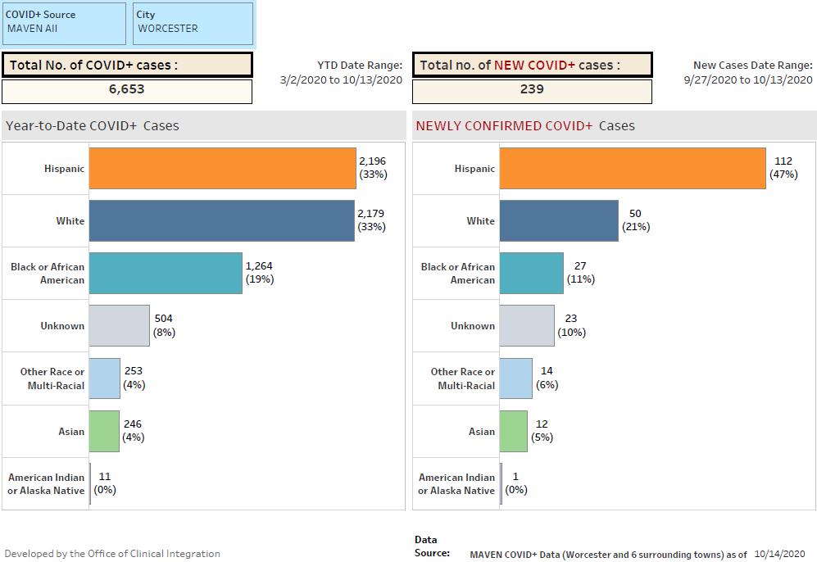
COVID-19 Positive Worcester City Patients:
Race and Ethnicity
Among TOTAL COVID+
cases, Hispanics have overtaken Whites as the highest majority
Among new COVID+ cases, the majority is still Hispanic (47%).
Notes:
In more timely data, in Worcester, those identified as Hispanic now account for the highest majority of COVID positive cases, surpassing those identified as white.

Slide 45
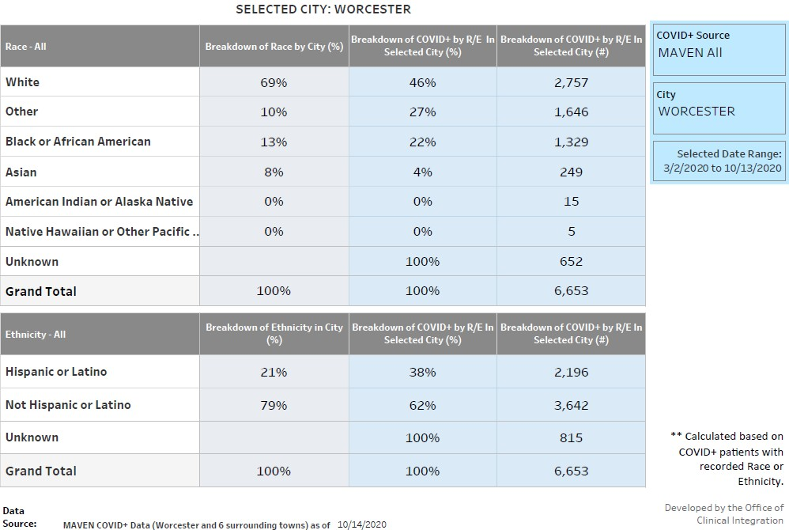
COVID-19 Positive Worcester City Patients: Race and Ethnicity – Comparison
In Worcester City, Hispanic or Latino, Black African American and Other minority races are disproportionately affected by
COVID-19.

Slide 46
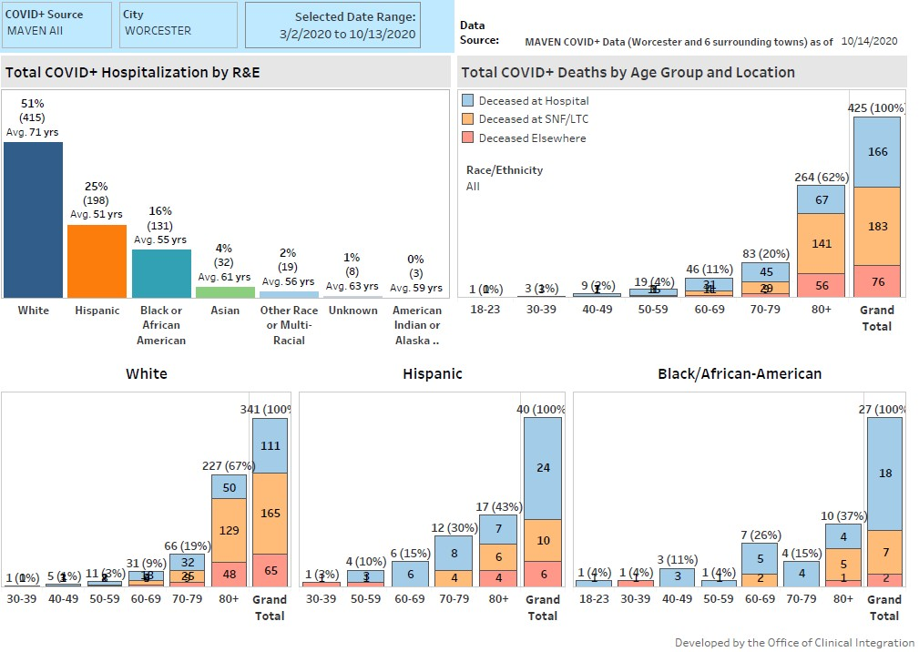
COVID-19 Positives* - Worcester City
Hospitalization & Mortality Rates By Race & Ethnicity
Notes:
Overall, White COVID-19 cases are more likely to be hospitalized than cases of other racial/ethnic groups, however, these cases are generally older and the vast majority are residents of long-term care facilities. This has resulted in more deaths (counts) among the white population as compared with Black and Hispanic cases.

Slide 47
Addressing Health Disparities and Health Inequities in Worcester
Community Health Improvement Plan
http://www.worcesterma.gov/building-a-healthy-community
Racial Ethnic Approach to Community Health (Worcester REACH)
http://www.worcesterma.gov/public-health/reach
Coalition for a Healthy Greater Worcester
https://www.healthygreaterworcester.org/
Health Equity Task Force

