Slide 1
Evidence-Based Practices to Promoting Social Emotional Development in Preschool
Carole Upshur, EdD
Melodie Wenz-Gross, PhD
University of Massachusetts Medical School
Department of Family Medicine and Community Health
Early Education Conference
Burlington MA October 17, 2015

Slide 2
Introductions
Name
School/age group you work with
Any experience with social emotional or executive functioning curricula

Slide 3
Overview of session
Describe importance of social emotional and executive functioning in early child development
Present information about early childhood brain development and what promotes or detracts from self-regulatory development
Describe several curricula that address social emotional and executive functioning
Describe in more detail the Committee for Children SSEL curriculum & our study (US Dept. of Education Early Learning Efficacy Study- #R025A130336)
Illustrate and practice some classroom activities that can promote these skills

Slide 4
Why Target Socio-Emotional Skills and Executive Functioning?

Slide 5

Research on Socio-Emotional Competence Shows…
ç√
The years between 2 and 5 are a key time for the development of socio-emotional skills -although these continue to develop with more complexity as children mature (Shankoff & Phillips, 2000)
Children with better socio-emotional skills are more self confident, competent in using language to communicate, and better able to engage in enjoyable activities and interactions with others…leading to better relationships and academic success (Cohen, Onunaku, Clothier, & Poppe, 2005; Guay, Boivin, & Hodges, 1999)
Children who lack socio-emotional skills misinterpret social situations, are more aggressive, disruptive in class and are at risk for long term academic and peer problems (Crick & Dodge, 1994; Denham, 2006)
Emotion knowledge, emotional regulation, and social problem solving skills are key building blocks of social competence (Denham, Blair, DeMulder, Levitas, Sawyer, Auerbach-Major & Queenan, 2003)

Slide 6
Why self-regulation is important
Young children’s academic and social success depends on the ability to regulate their behavior in addition to basic literacy and math skills (Raver, 2003; Ursache, Blair, & Raver, 2012)
In preschool, strong self-regulation has been linked with positive classroom behavior and high achievement; poor self-regulation predicts future school problems (Ursache, et al., 2012; Sasser, Bierman, Heinrichs, 2015)
Between 15 to 50% of young children have trouble paying attention to and remembering instructions, controlling and inhibiting behavior (e.g., raising their hand before calling out; being able to take turns), working independently, and shifting between tasks –a higher rate of low income children have these issues due to higher rates of stressful events, lower parent education and other factors (Ponitz, McClelland, Jewkes, Connor, Farris, Morrison, 2008)
This impacts individual child learning but also overall classroom functioning--one or two children with poor regulation can impact the teacher’s ability to teach the entire class (Houts, Caspi, Pianta , Arseneault, & Moffitt, 2010)

Slide 7
Research on Executive Functioning Skills
Executive Functioning (EF) an umbrella term that includes:
  Inhibitory control (deliberately stopping an automatic response)
  Attention (focusing, sustaining, and shifting attention)
  Working memory (holding information in mind while processing new information)
EF skills are linked to cortical network development involving the prefrontal cortex and the limbic system (which is involved in emotion processing, learning, and memory) (Blair, Zelazo, & Greenberg, 2005)
EF skills directly influence and are influenced by emotional and autonomic responses to stimulation—they are interconnected—at high levels of arousal, executive functioning is inhibited (Blair, Zelazo, & Greenberg, 2005)
The development of EF, like the development of these neural networks in the brain, is particularly rapid during early childhood (Carlson, 2005)

Slide 8

Executive Functioning and Self Regulation in Life!
http://developingchild.harvard.edu/resources/multimedia/videos/inbrief_series/inbrief_executive_function/
Notes:
This video summarizes the importance of these skills for children as they grow. 5 ½ minute video. Right click link; open hyperlink.

Slide 9
Effects of Toxic Stress
Stress is normal and can help children and adults develop coping skills. But when stress is chronic or too intense, it can negatively affect physical health, emotional health, learning & behavior. (Felitti, Anda, Nordenberg, Spitz, Edwards, Koss, et al., 1998; Lupien, McEwen, Gunnar, & Heim, 2009)
ACES study results: Adverse childhood experiences show a strong link to not only mental health and substance abuse problems in adulthood, but a wide array of physical health problems, including heart disease and cancer and premature death. The more ACEs you have the higher your risk (Felitti, et al, 1998)
Caregivers and teachers play a key role in helping to protect children from negative effects of stress and facilitating coping

Slide 10
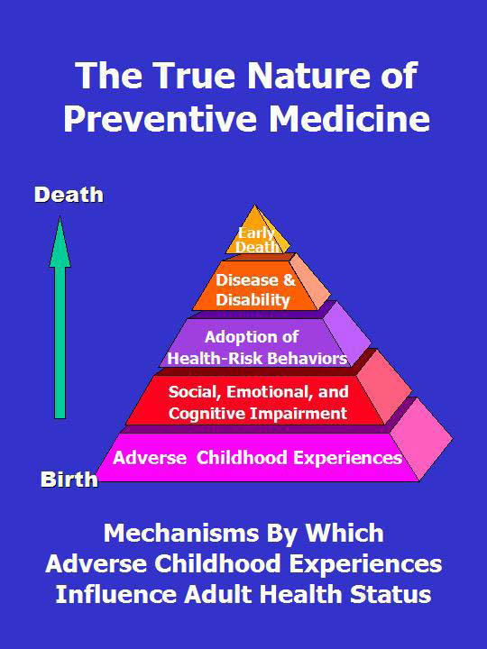
From: Anda & Felitti (April, 2003) ACE Reporter Vol 1
Notes:
So the more we can build social, emotional and cognitive competence, the more we can create resiliency and buffer the negative impact of stress.

Slide 11
Toxic Stress and Development
http://www.youtube.com/watch?v=chhQc0HShCo

Slide 12
Review of Evidence
Institute of Education Sciences
What Works Clearinghouse
http://ies.ed.gov/ncee/wwc/findwhatworks.aspx

Slide 13
For preschool social emotional development*
Three programs listed, two targeted to children with identified social emotional disabilities such as autism
  Social Skills Training-not a curriculum but collection of behavioral approaches for both regular and special education preschool settings; 3 studies with 135 children-improvement index of 18 points in social skills but no effect on cognition-teacher modeling, role play and direct instruction
  Lovaas Applied Behavior Analysis, improvement index of 27 points on cognition, but no effect on social skills, behavior, functional abilities from two studies of 51 children
  Head Start-national sample of over 3600 children found positive effect (13 improvement points) on reading achievement but no effects for math or social emotional development
  * As listed on US Dept. of Education What Works Clearinghouse

Slide 14
Other preschool curricula
Tools of the Mind-40 activities with dramatic play at the core to support planning skills (self-regulatory speech), early literacy and meta-cognition using; 4 WWC quality studies, one randomized with about 200 children; no effects on oral language, or print knowledge; small cognition or math-improvements in the 4-8 point range
Creative Curriculum-guidelines for project based learning using blocks, dramatic play, toys, games, art, library, sand and water, music and movement, computers and outdoors activities; two studies of 364 children; no effects (-2 to + 2 range of point change) on oral language, print knowledge, phonological processing, or math-no measures of social skills even though targeted in curriculum

Slide 15
Programs inclusive of K-3
We Have Skills-video based lessons and discussion show to children with teacher guide and supplemental activities; 1466 children classrooms randomized to program or comparison; 11 point improvement in teacher-rated social skills
Positive Action-character development, six units of classroom discussion, role play, games, songs, activity sheets, 4x a week; 2 high quality studies, 2600 students, focused on Grade 5, positive effect on behavior (+20 points on fewer suspensions, violent incidents, and alcohol/tobacco use) and academics (+7-8 points on standard tests, +36 points on grade retention)
Caring Community-class meetings on fairness, helpfulness, caring, respect; cross-age buddies; activities to discuss with parents and bring back to class; schoolwide traditions. 2 studies of 5600 students; small positive effect on behavior (+8 points); but no effects on knowledge, attitudes, values, academic achievement

Slide 16
Programs (cont)
Incredible Years-provides teacher, parent and child interventions (sometimes also delivered to whole classroom); evidence from one study of 51 4-8 year old children identified with ODD; group lessons 2-3x a week, encourage parent involvement; improvement of +18-20 points on externalizing behavior and social outcomes as rated by parents and teachers
Early Risers-for children with disruptive behavior, social skills training targeted to child plus classroom management plans and parent skills meetings and family support. 2 studies of 389 children k-2 grade found no effects for externalizing or internalizing behavior but potentially positive effects for social outcomes (+7 points) and academic performance (+3 points)
Fast Track & PATHS-Promoting Alternative Thinking Strategies; multiple components for first grade up including parent groups, child skills groups, tutoring, home visiting, peer buddies. 1 study of 891 children with ED; positive effect on externalizing and internalizing behavior, reading/literacy, and social outcomes (+4-+9 points)

Slide 17
A Head Start CARES Demonstration using: Incredible Years
PATHS
Tools of the Mind
Challenges-didn’t have right materials or manuals/materials in Spanish
Incredible Years- easy to implement, but teachers had to change their classroom management styles-reinforce positive behavior
PATHS-easy to implement b/c highly structured and defined amount of time-talking about feelings and modeling positive interactions
Tools of the Mind-had to reorganize classroom and a lot of effort for some activities including engaging specifically with each child at free play when teachers usually get other tasks done-goal to extend play and have child think about other steps

Slide 18
Outcomes
Incredible Years-small to moderate classroom management & social emotional teaching improvements but
  No impact on overall classroom quality or climate;
  No impact on problem behavior or executive functioning, except highest risk children had reduced problem behavior
  Small effect on child emotion knowledge and social problem solving, social and learning behaviors
PATHS-large improvements in social emotional teaching strategies but
  No effect on classroom emotional support or organization
  No effect on child behavior problems or executive functioning
  Small positive effect on learning behaviors, emotion knowledge, social problem solving and social behaviors

Slide 19
Outcomes
Tools of the Mind- moderate to large increase in teacher’s scaffolding positive child play
  No effect on emotional climate, classroom organization or instructional support
  No effect on child problem behavior or executive functioning
  Small effect on emotion knowledge but not on social skills or behaviors
No effects of any intervention on children’s pre-academic skills
No kindergarten teacher reported effects of any intervention on social skills, problem behavior, academic skills or receipt of special services

Slide 20
Summary of Research
No programs for preschool that provide evidence for improving executive functioning
Limited evidence –one study of Head Start-of improving emotion knowledge and social skills (Incredible Years and PATHS)
Limited evidence of improving reading or math skills
Some evidence of effective social skills, character development curricula in elementary school age programs 1-5th grade

Slide 21
Why we picked Second Step Early Learning*
One of few curricula developed specifically for preschool age
A universal classroom curriculum for programs with large numbers of at risk children
Modest cost ($400/kit) and learning demands with highly scripted and structured teacher instructions
Materials are multicultural and kits and parent materials available in Spanish
Incorporates both social emotional and executive functioning skills
*http://www.cfchildren.org/second-step/early-learning

Slide 22
Implementing the Second Step Early Learning Intervention

Slide 23
Program Goals
The Second Step early learning program is a
universal, classroom-based program designed to:
Increase school readiness and social success
Decrease problem behaviors
Promote
social and emotional competence and
self-regulation skills
Notes:
1 minute
The Second Step early learning program is a universal, classroom-based program designed to increase children’s school readiness and social success and decrease problem behaviors by building their social-emotional competence and self-regulation skills.
It supports skill development in four key areas of social-emotional competence: empathy, emotion management, friendship skills and problem solving, and Skills for Learning.
Designed for four year olds but works well with mixed age classrooms and 3 year olds.

Slide 24
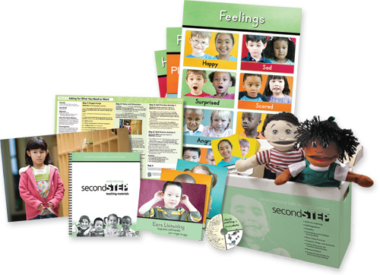
Program Materials
Feelings
Cards
Posters
•
Weekly Theme
Cards, Unit Cards
•
•
Puppets
•
•
Teaching Materials Notebook
•
•
Listening
Rules Cards
Join In and Sing CD
Notes:
Talking Points
Introduce the program materials:
The Second Step program comes with everything you need to teach it successfully.
Materials include:
Unit cards
Weekly Theme Cards
Puppets
Posters
Feelings and Listening Rules Cards
Teaching Materials Notebook
Join In and Sing CD
And we are providing you with one book per lesson (for Day 5 of each week)
Core social-emotional and self-regulation skills are taught in 28 Weekly Themes, divided into five units.
The Weekly Themes are presented on large photo cards that feature short five- to seven-minute daily activities designed to be integrated into the flow of the day.
The program is taught through a variety of learning strategies:
Puppet Scripts that feature the two puppets included in the kit
Story and Discussion activities based on large color photos of typical early childhood scenarios
Skill Practices that can be done in small groups or large groups, or can be integrated into daily activities
Songs written to common melodies that reinforce program skills and concepts
Brain Builder games that develop children’s ability to pay attention, remember, and control their behavior
Visual aids, including a set of 4 Listening Rules Cards, 20 Feelings Cards, and 3 colorful posters.
Home Link activities that help families learn more about the skills their children are learning and reinforce those skills at home
Activity
Have participants spend a few minutes finding each of the items in their kit: Open your kit and each take a turn finding one of the materials identified on the slide. Sit down when your group has found one of each item. Give participants a few minutes to find one of each of the items. There is a lot of good stuff in your kits!

Slide 25
Program Elements
Weekly Theme Activities
Reinforcing Activities
  Brain Builder games
  Puppet Script
  Story and Discussion
  Skill Practices
  Song
  Recommended books
  Using Skills Every Day
  Home Links
  Practice Opportunities
  Curriculum Connections
Notes:
Talking Points
Introduce the program elements:
Children learn best when they practice skills and concepts many times and in different ways.
That’s why the Second Step program includes elements for both teaching and reinforcing skills and concepts.
Children learn the skills through a variety of Weekly Theme activities. Then reinforcing activities provide more opportunities for children to cement their skills.
Reinforcing activities are Using Skills Every Day, Home Links, practice opportunities, and Curriculum Connections.

Slide 26
Program Skills and Topics
Unit 1: Skills for Learning
Listening • Focusing attention •Using self-talk •Being assertive
Unit 2: Empathy
Identifying one’s own and others’ feelings •Taking others’ perspectives
Unit 4: Friendship Skills and Problem Solving
Showing care and concern for others
Unit 3: Emotion Management
Unit 5: Transitioning to Kindergarten
Understanding strong feelings •Identifying one’s own strong feelings
Calming down strong feelings
Making and keeping friends •Calming down and using the Problem-Solving Steps
Reviewing program skills and concepts •Thinking about how they’ll help in kindergarten
Notes:
Talking Points
Discuss the program’s skills and topics in more detail:
Let’s take a closer look at the program’s skills and topics.
The Second Step Weekly Themes are divided into five units:
Unit 1: Skills for Learning—Weeks 1–6
Unit 2: Empathy—Weeks 7–12
Unit 3: Emotion Management —Weeks 13–18
Unit 4: Friendship Skills and Problem Solving—Weeks 19–25
Unit 5: Transitioning to Kindergarten—Weeks 26–28
Activity
Have participants open their notebook to the first handout: Program-at-a-Glance.
Describe the handout: This Program-at-a-Glance diagram shows the skills addressed in each unit of the program and the Weekly Themes that directly teach those skills. The Weekly Themes build on each other to develop children’s social-emotional and self-regulation skills. The Brain Builder games, designed to be played daily throughout the program, build foundational executive-function skills. We’ll talk more about those later today.
Ask participants to quickly read the skills taught in each unit and the Weekly Theme topics.
Ask: Which Weekly Theme topic do you feel will be most important for your children?
Call on a few participants at random to describe their choices.
Have other participants show their agreement by doing an action; for example, tapping their shoulders, patting their knees, and so on.

Slide 27
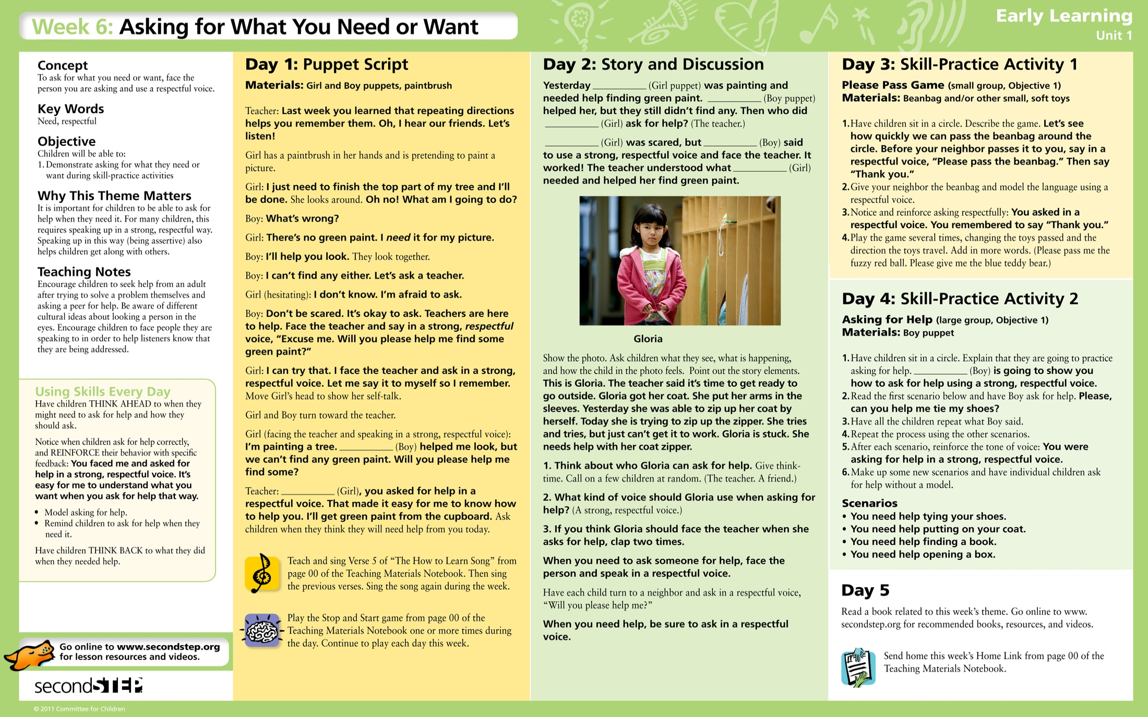
Notes:
Talking Points
Introduce the Weekly Theme Card: Let’s take a closer look at the Weekly Theme Card.
Activity
Find the Lesson 16 Weekly Theme Card.
Take a few minutes to look at the :
Puppet Script: The Puppet Script is the Day 1 activity each week.
Story and Discussion: The Story and Discussion is the Day 2 activity each week.
Skill Practices: The Day 3 and Day 4 activities each week are skill-practice activities designed to be done with a small group or large group, or to be integrated into a classroom activity (for example, at snack or mealtime).
All of the activities are typically five to seven minutes long, but can last longer if the children are still engaged. Find which Weekly Theme objective the Skill Practices address, then read the objective in the left-hand column of the card.
Brain Builder games: Brain Builders are active, fun games designed to help children practice and improve their self-regulation skills. Brain Builder games should be played every day.
Song: The Second Step program comes with the Join In and Sing CD of fun songs that help reinforce and remind children of the skills learned each week. Songs are introduced on the first day of each week and can be sung every day and at any time. Find the CD in the Teaching Materials notebook.
Recommended book: The Day 5 activity each week is reading a book related to the Weekly Theme. There are three books recommended for each week and we have purchased and will give you one of the books for Day 5 of each lesson (obviously, you are free to use others as well throughout the week).

Slide 28
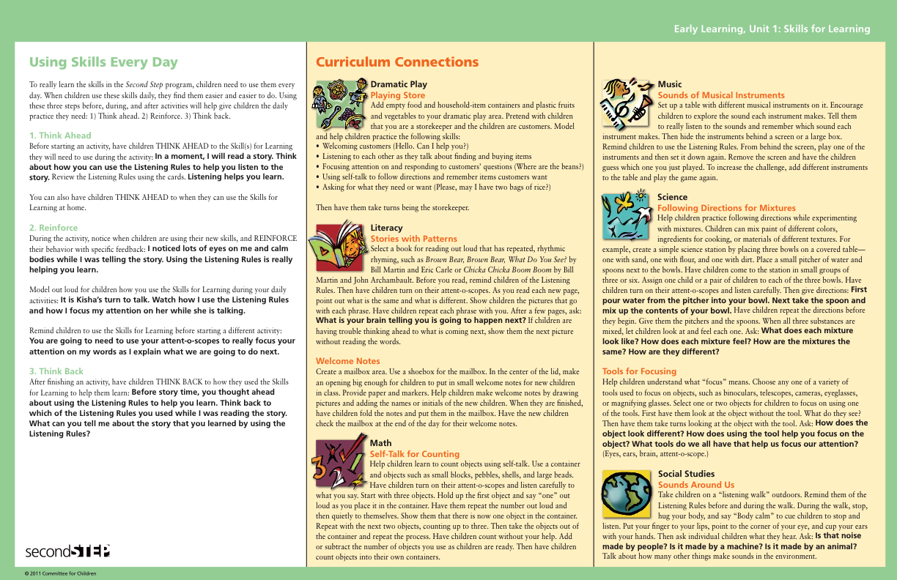

Notes:
Talking Points
Tell participants where they can find Using Skills Every Day examples: There are examples of language to use with children on every unit card and Weekly Theme Card. Let’s look at some examples on the unit 1 card.
Activity
Have participants explore Using Skills Every Day examples on unit cards: In groups of two or three, look at examples of Using Skills Every Day language on the Unit 1 card. You’ll find the Using Skills Every Day section on the back of the card. As you look at the examples, think about how they are helping reinforce the goals and objectives found on the front of the card. Think about how this might work with children in your classroom. Discuss your ideas with your partner or group. Be prepared to share one idea with the whole group. Give participants time to look through unit card Using Skills Every Day examples and discuss how the examples are helping reinforce unit goals and objectives. Call on a few participants at random to share. Have other participants show their agreement by doing an action; for example, raising their hands, tapping their shoulders, and so on. Summarize participant comments.
Remind participants that examples are also found on every Weekly Theme Card: Specific Using Skills Every Day language examples are also found on every Weekly Theme Card.

Slide 29
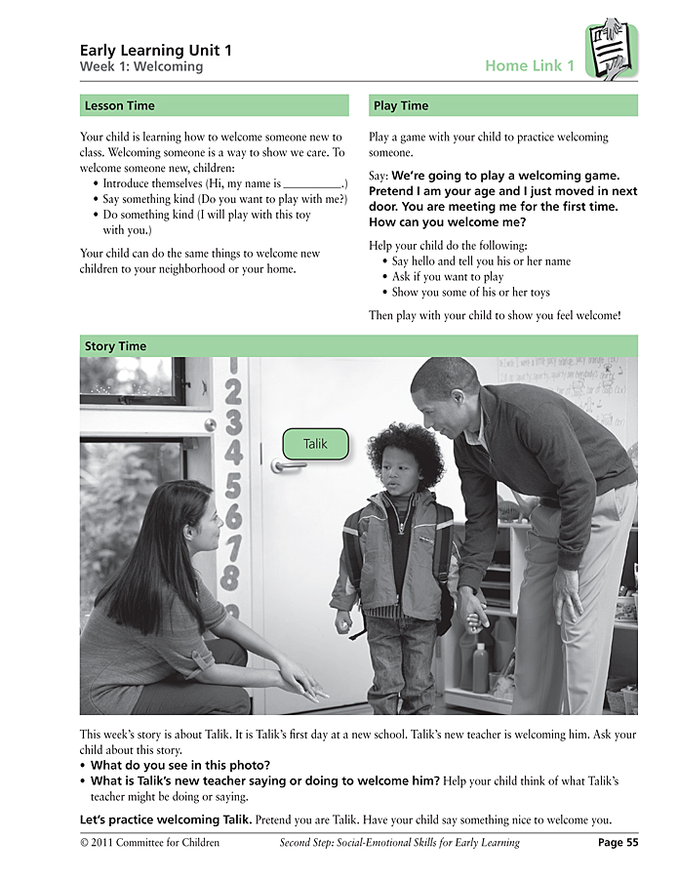
Home Links
One activity to send home each week
Gives children a chance to practice skills at home
Keeps caregivers informed about the program
Three parts:
  Lesson Time
  Play Time
  Story Time
Found in Teaching Materials Notebook and online
Send Home Links
to families
Notes:
Talking Points
Introduce the fourth core program component.
The fourth core program component is not only a way to reinforce skills, it’s also a way to involve caregivers.
There is a Home Link activity to send home on Day Five of each week. These short activities give children a chance to practice skills at home with their caregivers. Home Links also keep families informed about what their children are learning in the program.
Home Links have three parts:
Lesson Time: Tells caregivers what their children have been learning.
Play Time: A game for caregivers to play with their child to practice the skills of the week.
Story Time: Has the week’s photo and story, with a few questions for the caregiver and child to discuss.
Families are introduced to Home Links with a Home Link Introductory Letter. The letter encourages caregivers to collect the Home Links during the year so they’ll have a complete set of skills their child has learned by the end of the program.
You will find copies of every Home Link in your Teaching Materials Notebook. They are also available for download online as PDFs, so you can email them to caregivers. We have included an English and a Spanish copy of each Home Link sheet in your binder under the appropriate unit.
Activity
Have participants become familiar with a Home Link from the binder. Take a couple of minutes to look at the first Home Link in your notebook.

Slide 30
Overview of SSEL
http://www.secondstep.org/EarlyLearning/ProgramCoordinators/SecondStepKit/VideosDownloads/VideoLibrary/TeachingAdaptation/TeachingWeeklyThemes.aspx
This video is available online in the Video Library for SSEL, Committee for Children website—you need to register a kit to access
Notes:
(4 minute video) Right click on link; open hyperlink; click on SSEL; Go to “Story and Discussion” demos…Week 6.

Slide 31
Book Reading
Feelings labeling
Think time
Nonverbal responding
Non-judgemental responses

Slide 32

Daily Brain Builder Games
http://www.secondstep.org/EarlyLearning/TeachersCounselors/SecondStepKit/VideosDownloads/VideoLibrary/ClassroomDemos/BrainBuilderDemos.aspx
Found on the Second Step Website: Classroom Demos/Brain Builder Demos: Sink or Swim
Notes:
So it’s really important to do the games often, but also to do them correctly. You will notice in this video that he really demonstrates for the children how to do it, and corrects them and supports them to do it right. He also shows how to increase the complexity and make it fun.

Slide 33
Brain Builder
Practice Activity

Slide 34
Relaxation/Breathing Exercise Extensions/Alternatives for children
http://www.youtube.com/watch?v=OaVB7j4BJnY
Notes:
Ok, so how might this look for children? Obviously it needs to be simple and lesson 16 teaches them how to do it in a few exercises over the course of the week—and we saw some of those videos in our other trainings (remember when the one teacher demonstrated how to do it on one of the videos and on another video he had the children practice it with bean bags on their tummies? This next video shows how you might use this technique and extend it beyond the simple belly breathing in lesson 16. I thought it was good and worth showing because it gives some nice child friendly concepts and scenarios of when the different techniques might be helpful to use with kids.

Slide 35
Preliminary Findings of Kidsteps II: Promoting School Readiness through Social Emotional Skill Building in Preschool
Funded by US Department of Education
Institute of Education Sciences-Early Learning Efficacy Study #R035A130336
$3.5 million, 4 years

Slide 36
Purpose of Study
To evaluate the efficacy of the Second Step Early Learning (SSEL) curriculum (commercially available from the Committee for Children, Seattle WA), on young children’s end of preschool social skills, emotion regulation, executive functioning, and academic readiness skills, and how these impact kindergarten readiness screening and kindergarten performance.
This will be the first large-scale study of SSEL, which uniquely incorporates a dual emphasis on social-emotional and executive functioning skill development.

Slide 37
Design
64 preschool and Head Start classrooms in Worcester County in two cohorts
Stratified (Head Start vs community) , classroom randomized (within site), prospective study
Half implementing curriculum, half doing usual curriculum
  Monthly teacher meetings and monthly classroom visits to help coach new curriculum
Study observed all classrooms, had teachers rate social skills (SSIS) of all children, and conducted individual assessments of social skills, executive functioning , and academic readiness of 4-year olds
Had kindergarten teachers also rate social skills and academic competence when children move on from preschool
Collected school kindergarten screenings, data on need for special services and promotion to first grade

Slide 38
Implementation strategies
Randomly select sites for each cohort
Within site randomly assign to intervention and control group
Provide site-wide teacher orientation about teacher role in each condition (e.g., not sharing information to prevent unintended diffusion)
Work with intervention classrooms for two years by providing:
  Monthly or bimonthly evening teacher trainings
  Monthly classroom observations and coaching on curriculum delivery
Incentives-
  Pay for evening meetings, dinner, and granting of required annual CEUs
  Curriculum kits and books for intervention classrooms
  All teachers (intervention and control) receive gift certificates for $50 each for classroom supplies twice a year for completing child social skills checklists
  Control teachers receive kits and an orientation at the end of their participation

Slide 39
Results
85-90% family consent, over 900 families
With attrition, results from 747 children over 2 years from 34 classrooms plus n=232 kindergarten follow-up
51% of the children were male; 38% Hispanic, 25% white and 15% Black
62% of families had income under $20,000 and 25% were married couples
60% of parents had a high school education or less

Slide 40
Associations among social skills and academic and executive functioning skills
No pattern of gender differences in scores (e.g. girls not better at social skills than boys, also boys not more problem behaviors)
No ethnic/racial differences in social skills and problem behaviors
Some differences in academic skills—Hispanics do less well
Few differences by parent marital status or education
Children from families with incomes >$20,000 did better on academic skills but not social skills or executive functioning skills

Slide 41
Changes in Preschool Teacher ratings
Combining Years 1 and 2, we found significantly greater improvements for the intervention children compared to controls in:
  teacher-rated social skills (p = .048)
  teacher-rated behavior problems (p = .008)

Slide 42
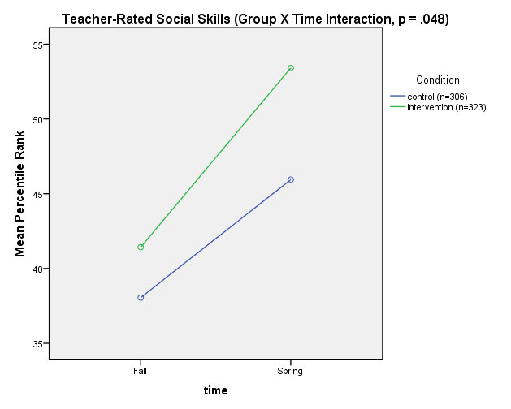
Teacher-Rated Social Skills

Slide 43
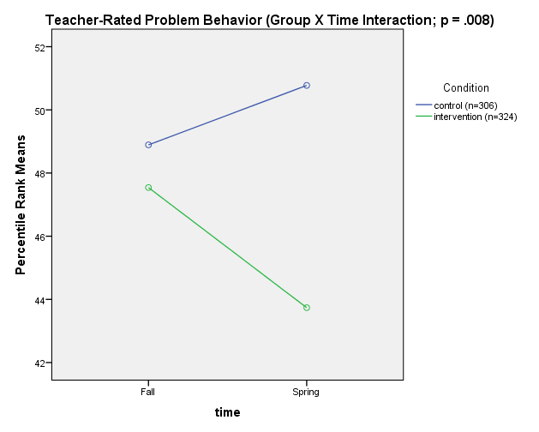
Teacher-Rated Problem Behavior

Slide 44
Changes in Child Assessed Socio-Emotional and Executive Functioning Skills
Composite scores were created for the individually assessed socio-emotional skills (emotion knowledge and social problem solving), and executive functioning skills (working memory, attention and set-shifting, and inhibitory control)
We found no significant group differences in socio-emotional skills development—both groups improved significantly (p<.001)
Intervention children improved significantly more than control children in executive functioning skills (p =.003)

Slide 45
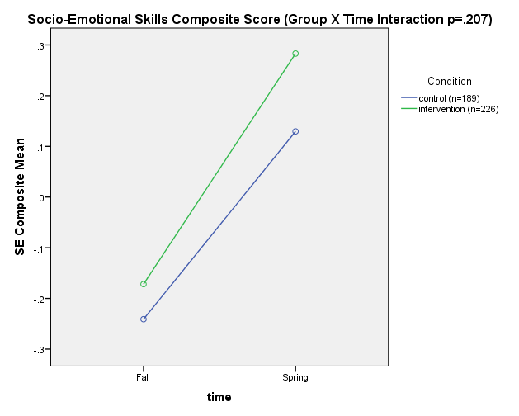
Change in Socio-Emotional Skills

Slide 46
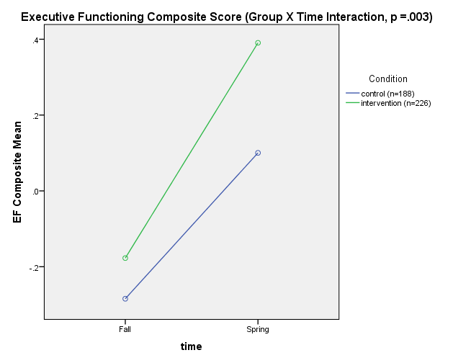
Change in Executive Functioning Skills

Slide 47
Structural equation modeling of change in SE and EF as it relates to school readiness
Controlling for baseline skills, intervention children:
  Had greater social emotional functioning skills at the end of the year-such as recognizing emotions and implementing prosocial skills
  Had greater executive functioning skills at the end of the year-such as following directions, inhibiting behavior, and doing complex problem solving
  The improvements in social emotional and executive functioning skills were associated with better end of year school readiness such as pre-literacy and pre-math skills

Slide 48
SEM Model

Slide 49
All CLASS summary scores (and many subscores) showed greater improvements in intervention vs. control classrooms: Effect sizes show small to moderate differences between the groups

Slide 50
Implementation success
14 of the 16 intervention classrooms reached overall fidelity
77% said they would be continuing with the curriculum even though not in the study; 83% said it improved classroom environment
“Second Step impacted my approach to teaching because it made me more aware of the importance of emotional and social skills and development. The Second Step program was a huge part of our classroom and daily interactions. My children look forward to new concepts and are eager to learn and use them in their play and interactions.” –Worcester Teacher
“The children participating in this program take control of their behavior more than children in previous centers I have worked in. They really use the language, the songs, and solve conflicts. They think back to the books and say ‘Hey, I did it on the first time like Howard B. Wigglebottom!” –North County Teacher
“The Second Step program impacted my classroom in a positive way. We love it and hope to use it ongoing! I’m super proud of the children and all they’ve learned and use with the program daily.” –Worcester Teacher
Notes:
Have veteran teachers talk about their experience if possible

Slide 51
Kindergarten Teacher Ratings
We didn’t find differences in kindergarten teacher ratings between intervention and control children-but the 232 children followed-up in kindergarten were from the first year when preschool teachers were just learning the curriculum. We expect the Year 2 group to show more change. Overall, study children in kindergarten are about on par for behavior problems with national norms, but a bit lower on social skills and academic skills than national norms.

Slide 52
Kidsteps Staff
Gail Sawosik, BA- Project Coordinator
Jenny Hazelton, BA-Field Coordinator
Yeonsoon Yoo, PhD-Post-doctoral fellow
Elizabeth Lawson, BA-Data entry and RA
Lorna Chiasson, Administrative Assistant

Slide 53
Part-time staff-Classroom observations
& child assessments
Classroom observers:
Martha McGown
Linda Granville
Child assessors:
Maggie Azur
Amber Bissonette-LeDuc
Laurie Bonnett
Nicole Herbert
Richard Hewitt
Persis Thorndike
Josefina Zuniga

Slide 54
Participating Programs
Programs included the following, located in Worcester, Gardner, Fitchburg, Leominster, and Devens:
Guild of St. Agnes Child Care Programs-4 sites, 16 classrooms*
Montachusett Opportunity Council Child Care and Head Start, 3 sites, 27 classrooms
Rainbow Child Development Center, 1 site, 4 classrooms
Worcester Comprehensive Education and Care, 2 sites, 6 classrooms
Worcester Public Schools Head Start, 3 sites, 23 classrooms
YWCA Child Care, 1 site, 6 classrooms
*counting only preschool (ages 3-5) classrooms; most sites have additional toddler, infant and afterschool classrooms
Notes:
I simplified this a bit, seemed like a lot of detail, and included classrooms (e.g., WCEC-constitution) that we aren’t including in the study.

Slide 55
Web link on DFMCH Research Page
http://www.umassmed.edu/fmch/research/kidsteps-ii

Slide 56
References
Blair, C., Zelazo, P. D., & Greenberg, M. T. (2005). The measurement of executive function in early childhood. Developmental Neuropsychology, 28(2), 561-571.
Carlson, S. M. (2005). Developmentally sensitive measures of executive function in preschool children. Developmental neuropsychology, 28(2), 595-616.
Cohen, J., Onunaku, N., Clothier, S., & Poppe, J. (2005). Early Childhood Research and Policy Report. Helping Young Children Succeed: Strategies to Promote Early Childhood Social and Emotional Development. Retrieved on May 5, 2009 from http://www. zerotothree. org.
Crick, N. R., & Dodge, K. A. (1994). A review and reformulation of social information-processing mechanisms in children's social adjustment.Psychological bulletin, 115(1), 74.
Denham, S. A. (2006). Social-emotional competence as support for school readiness: What is it and how do we assess it?. Early education and development, 17(1), 57-89.
Denham, S. A., Blair, K. A., DeMulder, E., Levitas, J., Sawyer, K., Auerbach–Major, S., & Queenan, P. (2003). Preschool emotional competence: Pathway to social competence?. Child development, 74(1), 238-256.
Felitti, V. J., Anda, R. F., Nordenberg, D., Williamson, D. F., Spitz, A. M., Edwards, V., ... & Marks, J. S. (1998). Relationship of childhood abuse and household dysfunction to many of the leading causes of death in adults: The Adverse Childhood Experiences (ACE) Study. American journal of preventive medicine, 14(4), 245-258.

Slide 57
References
Guay, F., Boivin, M., & Hodges, E. V. (1999). Predicting change in academic achievement: A model of peer experiences and self-system processes. Journal of educational psychology, 91(1), 105.
Houts, R. M., Caspi, A., Pianta, R. C., Arseneault, L., & Moffitt, T. E. (2010). The Challenging Pupil in the Classroom The Effect of the Child on the Teacher.Psychological science.
Lupien, S. J., McEwen, B. S., Gunnar, M. R., & Heim, C. (2009). Effects of stress throughout the lifespan on the brain, behaviour and cognition. Nature Reviews Neuroscience, 10(6), 434-445.
Phillips, D. A., & Shonkoff, J. P. (Eds.). (2000). From Neurons to Neighborhoods:: The Science of Early Childhood Development. National Academies Press.
Ponitz, C. E. C., McClelland, M. M., Jewkes, A. M., Connor, C. M., Farris, C. L., & Morrison, F. J. (2008). Touch your toes! Developing a direct measure of behavioral regulation in early childhood. Early Childhood Research Quarterly,23(2), 141-158.
Raver, C. (2003). Young children’s emotional development and school readiness. Social policy report, 16(3), 3-19.
Sasser, T. R., Bierman, K. L., & Heinrichs, B. (2015). Executive functioning and school adjustment: The mediational role of pre-kindergarten learning-related behaviors. Early Childhood Research Quarterly, 30, 70-79.
Ursache, A., Blair, C., & Raver, C. C. (2012). The promotion of self‐regulation as a means of enhancing school readiness and early achievement in children at risk for school failure. Child Development Perspectives, 6(2), 122-128.

Slide 58
Questions
Next Steps
Notes:
Talking Points
Transition to questions and next steps:
Now I’d like to take your questions.
Then let’s talk about next steps. [Use this time to talk about how participants get their kits, hand out Unit 1 implementation resources if applicable, remind participants about the follow-up email, and so on.]

