Slide 1
Open Access: What, Why, How?
Family Medicine and Community Health Research Forum
May 20, 2016

Slide 2
What?
(2002). Budapest Open Access Initiative. Available from: http://www.budapestopenaccessinitiative.org/read Peter Suber (2004, updated 2015). Open Access Overview. Available from: http://legacy.earlham.edu/~peters/fos/overview.htm
Open Access (OA) is the free, immediate, and unrestricted online access to research and scholarly products.
“OA is compatible with copyright, peer review, revenue (even profit), print, preservation, prestige, quality, career-advancement, indexing, and other features and supportive services associated with conventional scholarly literature.” – Peter Suber

Slide 3
Why?
“I truly believe that published scientific articles must be open access, allowing this treasure to best benefit research and society.”
Hong Yu, PhD Professor, Dept. of Quantitative Health Sciences, Health Informatics and Implementation Science, UMass Medical School

Slide 4
Citation advantage
Increased visibility, dissemination, citations, impact
SPARC Europe (2015). The Open Access Citation Advantage Service. Available from: http://sparceurope.org/oaca/
Research Information Network (Aug. 2014). OA articles in Nature Communications attract more views and downloads. Available from: http://www.researchinformation.info/news/news_story.php?news_id=1652
Gargouri et al. (2010). Self-Selected or Mandated, Open Access Increases Citation Impact for Higher Quality Research. Available from: http://dx.doi.org/10.1371/journal.pone.0013636
Teplitskiy et al. (2015). Amplifying the Impact of Open Access: Wikipedia and the Diffusion of Science. Available from: http://arxiv.org/abs/1506.07608

Slide 5
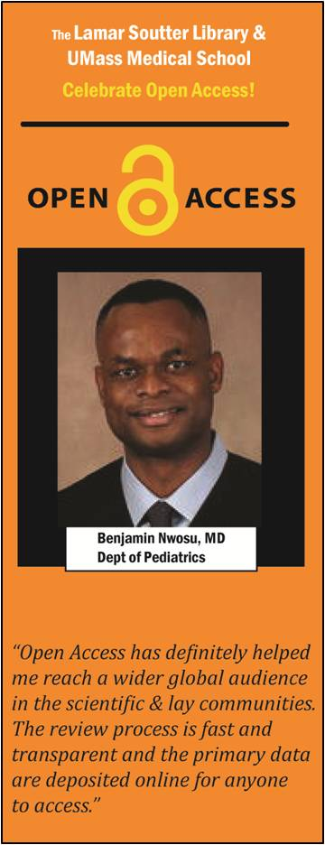
dissemination
“Open access has definitely helped me reach a wider global audience in the scientific and lay communities.”
Benjamin Nwosu, MD Associate Professor, Dept. of Pediatrics, Division of Endocrinology, UMass Medical School

Slide 6
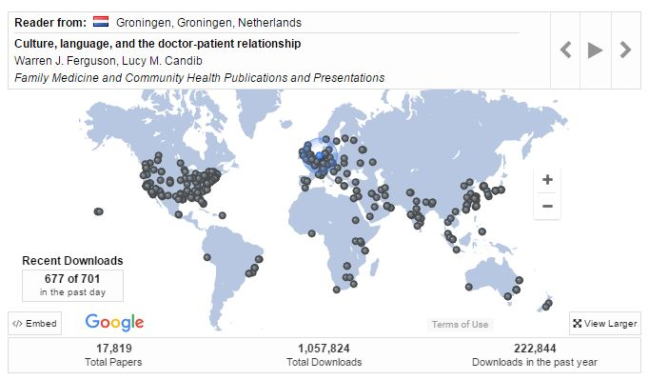
eScholarship@UMMS Readership Activity Map, May 2016
Pins represent recent downloads of full text content from viewers worldwide
http://escholarship.umassmed.edu/

Slide 7
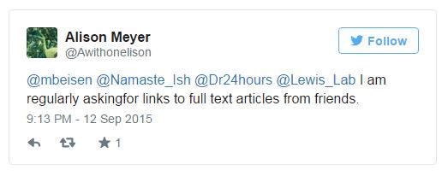
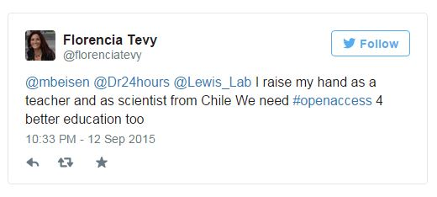
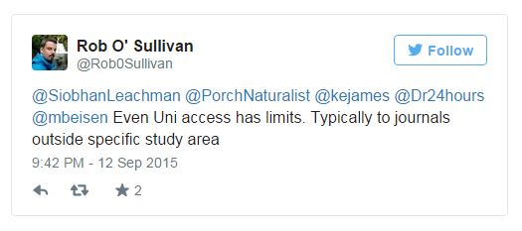
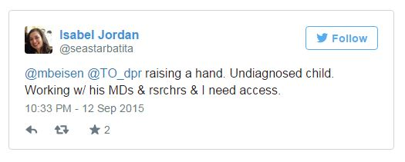
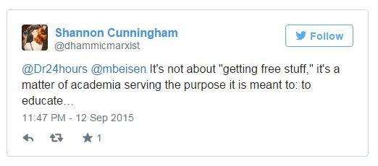
access
https://storify.com/mbeisen/here-s-why-we-need-openaccess

Slide 8
Scholarly Communication Landscape
Library Journal Periodicals Price Survey 2015. Available from: http://lj.libraryjournal.com/2015/04/publishing/whole-lotta-shakin-goin-on-periodicals-price-survey-2015/
K. (2013). 2012 Study of Subscription Prices for Scholarly Society Journals: Society Journal Pricing Trends and Industry Overview. Allen Press, Inc. Retrieved on March 29, 2013 from http://allenpress.com/resources/education/jps
Overall 6% average price increase in 2015 with projected 6-7% increase for 2016.
STM journals are consistently the most expensive.
Biology average cost per title $2977
Health Sciences average cost per title $1694
Library budgets not keeping pace.
Elsevier, Wiley, Springer, Taylor& Francis, and Sage dominate the market.

Slide 9
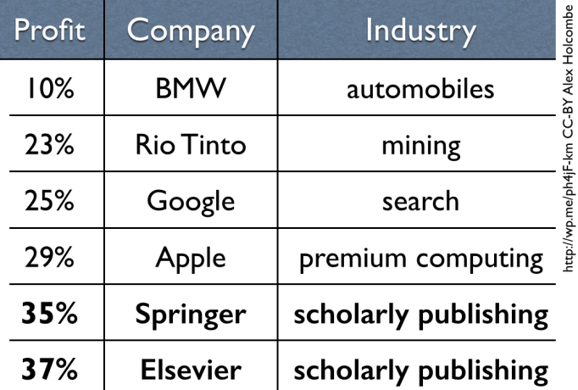
Profit margins
Alex Holcombe (May 21, 2015). Scholarly publisher profit update. Available from: https://alexholcombe.wordpress.com/2015/05/21/scholarly-publisher-profit-update/
Library Journal Periodicals Price Survey (2015). Available from: http://lj.libraryjournal.com/2015/04/publishing/whole-lotta-shakin-goin-on-periodicals-price-survey-2015/
Lariviere et al. (2015). The Oligopoly of Academic Publishers in the Digital Era. Available from: http://dx.doi.org/10.1371/journal.pone.0127502
!

Slide 10
Why oa – summing up
Altruistic
Practical
Better visibility, improved dissemination, and higher impact for scholarship
More knowledge leads to better patient outcomes
Return on the public's investment in taxpayer-funded research
To help achieve science's full potential by removing price barriers
Improved education
Expectations around access have changed
Mechanisms for communication and dissemination have evolved
Article-level metrics have emerged
Journal pricing and academic reward systems have remained largely unchanged

Slide 11
How?
Two roads:
“Green Open Access”
Self-archiving
“Gold Open Access”
Publication

Slide 12
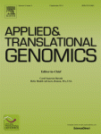
Open Access Publishing (Gold OA)
The publication of a scholarly article in open access in a journal, peer-reviewed and often financed through article publication charges.
Information Standards Quarterly 26(2) summer 2014

Slide 13
Open Access Publishing (Gold OA)
How it works
Select OA journal (free, paid, or hybrid) to submit your article
Pay Article Processing Fee (if required) for immediate open publication
Select license (if applicable) to allow broadest dissemination and reuse possible
See: How To Make Your Own Work Open Access (Harvard Open Access Project)

Slide 14
Open Access Publishing (Gold OA)
Directory of Open Access Journals: https://doaj.org/
!
8,834 journals

Slide 15
Gold business models
OA Model | Subscription | Article Processing Charge | Embargo | Example
Full OA | No | Yes* | No | BMC Family Practice, BMC Medicine, Annals of Family Medicine, Family Medicine, Journal of Global Radiology*
Hybrid OA | Yes | Yes | No | The Lancet, Epidemiologic Reviews, American Journal of Public Health, American Journal of Preventive Medicine
Embargoed OA | Yes | No | Yes | JAMA Internal Medicine, New England Journal of Medicine
None (Toll Access) | Yes | No | No | Annual Reviews of Public Health
*Not all Full OA journals will require an APC

Slide 16
Article Processing Charges (APC)
Fee | Publisher
$0 | Society and library-based publishers
$500 | Ubiquity Press
$1,495-$2,900 | PLOS
$575-$2,255 | BioMed Central
$3,000 | SpringerOpen
$500-$5,000 | Elsevier
$1,350-$5,200 | Nature Publishing Group
!
$5,200

Slide 17
Funding options
Funding Source | Description | Example
Institutional Membership | Authors receive a discount on APC when their institutions are members | BioMed Central, Nucleic Acids Research, Hindawi
Site license discounts | Authors receive a discount on APC when their institutions have a site license | PNAS, Science Advances
Institutional Accounts | Pre-funded accounts with publisher pay APC | SpringerOpen
Open Access Funds | Institutions/libraries/departments put aside funds to support faculty APCs | University of Massachusetts Amherst, UMMS FMCH
Individual Membership |  | PeerJ
Out-of-Pocket | Author pays APCs out of pocket | Individual
Grant Funds | Author use funds from their grants to support payment of APCs | Individual

Slide 18
Open Access Publishing (Gold OA)
Clarke, M. 2014. “Peak Subscription” [blogpost] Scholarly Kitchen. Available from: https://scholarlykitchen.sspnet.org/2014/10/01/peak-subscription/
“The most notable new revenue stream is, of course, the article-processing charges (APCs) associated with Gold OA titles. APCs often come from sources other than the library, including other areas of the institution as well as research funders.”
Michael Clarke
Scholarly Publishing Consultant

Slide 19
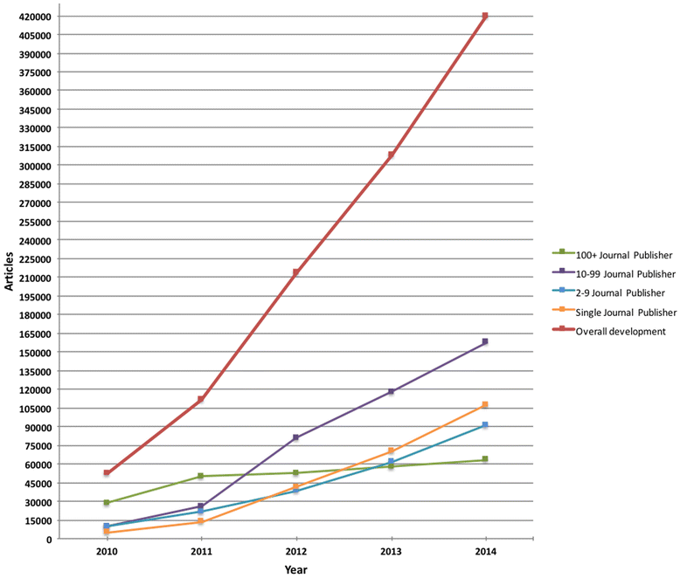
“Predatory” publishers
Shen and Bjork (2015). ‘Predatory’ open access: a longitudinal study of article volumes and market characteristics. Available from: http://dx.doi.org/10.1186/s12916-015-0469-2
Opportunistic open access publishers that charge publication fees to authors without providing the editorial and publishing services associated with legitimate journals.

Slide 20
Quality of open access journals
Pastorino, R. et. al. 2016. Quality Assessment of Studies Published in Open Access andSubscription Journals: Results of a Systematic Evaluation. PLoS One 11(5): e0154217. doi: 10.1371/journal.pone.0154217
Most open access scholarly journals are peer-reviewed.
There are high impact open access journals in a wide range of disciplines, e.g. BMJ, PLOS Medicine, BMC Medicine, Annals of Family Medicine, Journal of the American Board of Family Medicine, BMC Family Practice
“Our findings indicate that the methodological quality of studies published in OA and non-OA journals, as well as the quality of reporting, are comparable.” -Roberta Pastorino

Slide 21
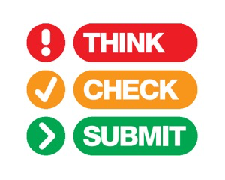
Evaluating open access journals
Do your homework!
Choose the right journal for your research. http://thinkchecksubmit.org/
The Open Access Journal Quality Indicators site maintained by Grand Valley State University is a listing of positive and negative indicators of journal quality.

Slide 22
Evaluating open access journals
Have you heard of the journal before?
Have you read any articles in the journal?
Have any of your colleagues published articles in the journal?
Is the journal peer-reviewed?
Is the journal's standard fee schedule publicly accessible?
Do you recognize the members of the Editorial Board?
Is the journal listed in the Directory of Open Access Journals (DOAJ)?
Does the journal have policies and practices consistent with the Open Access Scholarly Publishers Association Code of Conduct and Principles of Transparency and Best Practice in Scholarly Publishing?
Is the journal indexed in an established and reputable database such as PubMed,Web of Science, or Scopus?
Does the journal have a true impact factor found in Journal Citation Reports?

Slide 23
Spelling?
Low APC, with time-limited discount
404 errors on all links. No peer review information found on site.
Very fast
Email subject line:
Only 100 USD APC: British Journal of Education, Society & Behavioural Science
Not indexed in DOAJ or JCR

Slide 24
Open Access Publishing (Gold OA)
Pros:
Immediate dissemination of research results
Contextualized access point
Version of Record
May have re-use rights
Cons:
Expensive for authors and funders
Rights may be limited to read only
Does not satisfy NIH Public Access Policy
Subject to “predatory” practices

Slide 25
THE SELF-ARCHIVING OPTION (Green OA)
The archiving of a scholarly publication for public access in a repository other than that of the publisher, e.g. an institutional repository or a discipline-related repository.
Also known as “green open access.”

Slide 26
Definitions
Pre-print: author-created version first submitted to publisher, before peer review
Post-print: author-created version after peer review, the “accepted manuscript”
Publisher’s version/PDF: copyedited version with publisher’s formatting and paging
Embargo: a fixed delay between the time a publication (or data) is deposited into a repository and the time it is made public

Slide 27
Self-Archiving (Green OA)
How it works
Find out the status of your work’s copyright and publisher policies for archiving
Identify an appropriate Open Access repository
Deposit your work (or have someone deposit it for you)
See: How To Make Your Own Work Open Access (Harvard Open Access Project)
Strasser C. (2012). Researchers! Make Your Previous Work OA. DtaPub blog November 6, 2012. Available from: http://datapub.cdlib.org/2012/11/06/researchers-make-your-previous-work-oa/

Slide 28
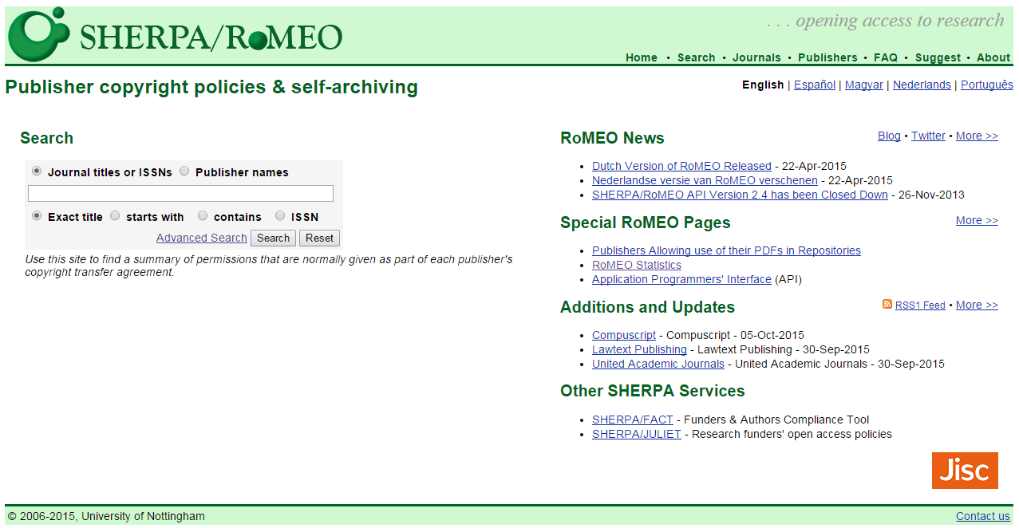
Many publishers allow self-archiving
Self-archive pre-print, post-print, and/or published article –
publisher policies and conditions imposed vary.
SHERPA/RoMEO: http://www.sherpa.ac.uk/romeo/

Slide 29
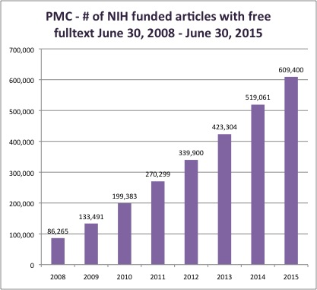
Slow but steady growth
Heather Morrison (June 2015). Dramatic Growth of Open Access June 30, 2015. Available from: http://poeticeconomics.blogspot.com/2015/06/dramatic-growth-of-open-access-june-30.html
Registry of Open Access Repository Mandates and Policies (ROARMAP). Available from: http://roarmap.eprints.org/

Slide 30
A word about researchgate & academia.edu
See: A Social Networking Site Is Not an Open Access Repository
(Office of Scholarly Communication, University of California)

Slide 31
Green oa – summing up
Pros:
Increased dissemination of research results
Cost-effective for authors and funders
Applicable to wide range of scholarly output
Managed repositories ensure long-term access
Disciplinary influence on deposit
Supported by 79% of publishers (Sherpa/RoMEO)
Cons:
Decentralized access
“Degraded” version of article
Few re-use rights, typically read-only
Effort required to understand journal policies
Effort required to identify appropriate repository
Mediated deposit is common
Difficult to quantify

Slide 32
Debunking OA myths
Old Dominion University Libraries (2015). OA myths. Available at: http://guides.lib.odu.edu/content.php?pid=682275&sid=5688065
Sarah Hoey (October 2015). Debunking the myths of open access. Available at:
http://blog.mendeley.com/academic-features/debunking-the-myths-of-open-access/
Scholarly Publishing @ MIT Libraries (2016). Dispelling Myths about Open Access. Available at: https://libraries.mit.edu/scholarly/mit-open-access/general-information-about-open-access/dispelling-myths-about-open-access/
“Open access journals are the ONLY option for open access” (No, they're not)
“Open access journals are of poorer quality than toll access journals.” (Not necessarily)
“Access is already easy.” (No!!)
“Publishing in traditional journals disallows open access.” (No, it doesn’t)

Slide 33
What you can do
Know your author rights
Read your copyright transfer or license agreements before you sign!
Review http://sparcopen.org/our-work/author-rights/, from the Scholarly Publishing & Academic Resources Coalition (SPARC)
Retain your right to post open access versions of your articles in open access repositories
Scholar’s Copyright Addendum Engine is easy to use
Copyright is an author’s right, not a publisher’s right
Publish open access
Publish in OA journals and/or self-archive your work
Utilize Directory of Open Access Journals, http://www/doaj.org

Slide 34
Contact us
Rebecca Reznik-Zellen
508.856.6810
rebecca.reznik-zellen@umassmed.edu
Lisa Palmer
508.856.4368
lisa.palmer@umassmed.edu

