Slide 1

Veterans & Military Health Issues
Carl Adams, Emily Dillon, and Taylor Quinn
University of Massachusetts Chan Medical School
Interprofessional Population Health Clerkship
Faculty Leaders: Linda Cragin and Janet Hale, PhD, RN, FNP
November 1, 2021

Slide 2
Disclosures
Carl Adams, MS-2 - The views expressed in this presentation are those of the presenter and do not necessarily reflect the official policy or position of the Department of the Army, the Department of Defense, the Department of Veterans Affairs or the US Government.
All other students have no disclosures.

Slide 3







What defines a “veteran”?
The Legal Definition: Title 38 of the Code of Federal Regulations defines a veteran as “a person who served in the active military, naval, or air service and who was discharged or released under conditions other than dishonorable”
The true definition: it's complicated
Recognize the signs!
Notes:
Recognize the signs that a patient might be a veteran: military tattoos, military paraphernalia, hairstyle, body language
The definition of a veteran in the eye of the public and the govt are very different. It isn’t as simple as if you served in the military you are a veteran. There are different service length and discharge requirements to be considered a veteran. On top of that there is distinct service eligibility criteria in order to qualify for different VA benefits. With this in mind, service members may not respond well the asking if they are a veteran, should ask if they are/or previously were members of the military

Slide 4
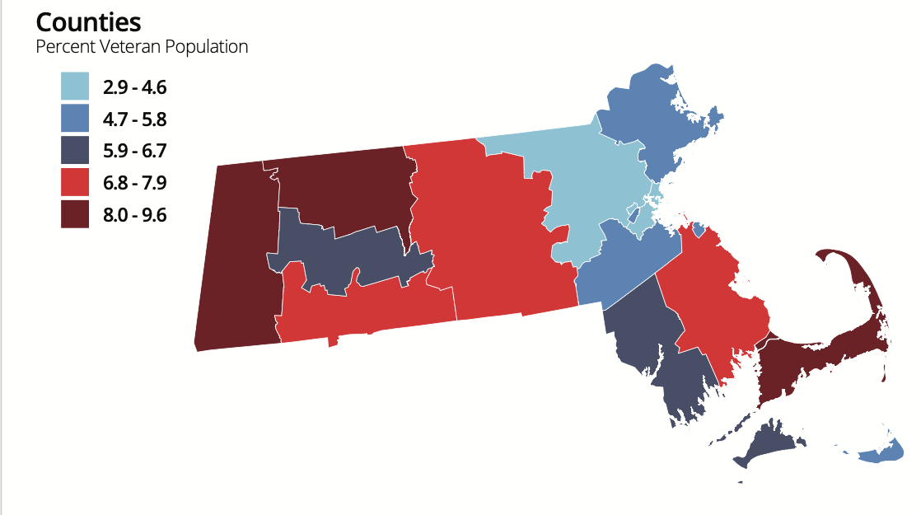
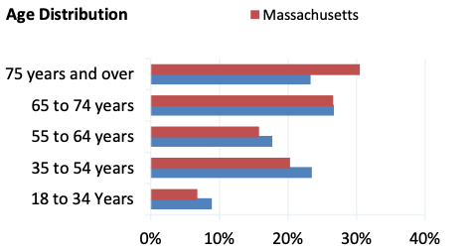
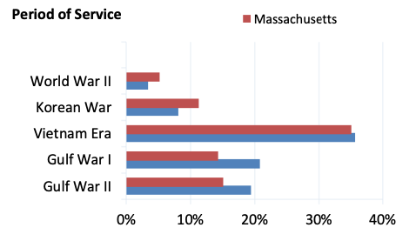
Veteran Demographics in MA
(HAC veterans data central)
Notes:
Veterans exist all throughout MA, so regardless of where you go for a clerkship you WILL encounter veterans. But as you look at the population density of veterans throughout the state consider the healthcare access and resources in those areas. As with the nation, MA veterans trend towards our older population with those over 65 making up over 50% of the veteran population. We have decent representation from each war era, the health implications of each we will revisit later, but importantly we do have a large Vietnam Era Vet population. Vietnam vets were treated very poorly upon return to the US which plays into their health.

Slide 5
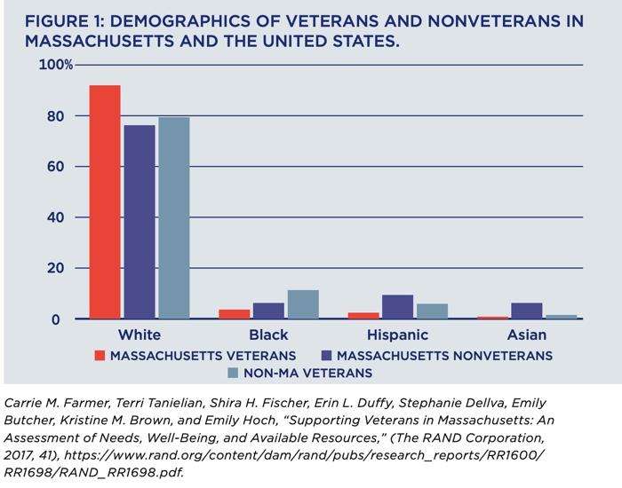

Veteran Demographics in MA
Veteran Population Estimates, according to the VA (September 2020)
Total MA Veteran Population | 286,875
Women Veterans | 21,917 (7.6%)
White, Not Hispanic | 255,999
Minority | 30,876
LGBTQ MA Veterans | ~19,200
Veterans living in poverty | 6%
Veterans experiencing housing problems | 31.1% (with ~836 homeless)
(Grogan et. al.)
(State Summaries Massachusetts)
Notes:
Massachusetts has the 23rd largest veteran population
Massachusetts differ from their counterparts in other states. Overall, the general veteran population skews older (57.43 percent were over age 65 in 2017, compared to 47.05 percent of veterans nationally), and are accordingly also more male (93.07 percent versus 90.59 percent), and more white (91 percent versus 77 percent) than veterans nationally

Slide 6
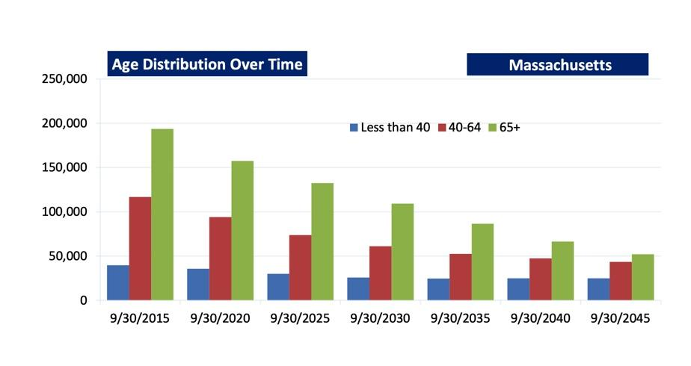
Present day
(State Summaries Massachusetts)
Trends in Veteran Demographics in MA
Notes:
the veteran population is shrinking nationwide as the large cohorts who served in World War II, Korea, and Vietnam pass away, the decline is more dramatic in Massachusetts than nationwide. overall there has been a decline of the veteran population, both nationwide and in Massachusetts. This can be explained by generational change and the aging of conscription-era veterans.
Veteran Demographics in M

Slide 7
Medical Needs of Veterans
Veterans suffer both visible and invisible wounds from war, invisible wounds being the hardest to treat
Common issues experienced by veterans:
Battlefield injuries (TBIs, amputations, trauma, burns) Depression Suicide PTS/PTSD Moral Injury Hearing Loss | Substance Use Disorder Military Sexual Trauma Exposure to hazardous materials/chemicals Occupational Hazards Infectious Disease Oral/Dental Health
BUT no two veterans are alike!

Slide 8
Veterans Health Issues Related to Service History
ERA | Years | Health Concerns & Exposures
WWII | 9/1/1939 - 9/2/1945 | Radiation, Cold injuries, Mustard gas
Korean War | 6/25/1950 - 7/27/1953 | Cold injuries
Vietnam War | 11/1/1965 - 4/30/1975 | Agent Orange, Hepatitis C
Cold War | 1945 - 1991 | Mustard Gas, Herbicides, Radiation
Camp Lejeune, NC | 1953-1987 | Contaminated water supply: Many forms of cancer, miscarriages, infertility, neurobehavioral effects, hepatic steatosis
Gulf Wars - Operation Desert Shield & Desert Storm | 8/2/1990 - Present | Particulate, Radiation, Chemical agents, Oil well fires, extreme heat, Vaccination & anti-nerve agent side effects, toxic embedded fragments
Iraq War - Operation Iraqi Freedom & Operation New Dawn | 3/19/2003 - 12/15/2011 | Particulate, Radiation, Burn pit smoke, Chemical agents, Sulfur Fire, Qarmat Ali Water Treatment Chromium contamination, TBI, Toxic embedded fragments
Afghanistan - Operation Enduring Freedom | 10/7/ 2001 - Present | Particulate, Radiation, Burn pit smoke, extreme heat & cold, Toxic embedded fragments
(Fraser Hale, 2020; US Department of Veteran Affairs, 2013)

Slide 9

The COVID-19 Pandemic and the impact on Veterans Health Care Needs
Population is disproportionately more at risk for severe COVID-19 health impacts: nearly half of all veterans are over the age of 65
Increased isolation & substance use
PTSD Triggers
  “War against COVID”; “battle the virus”
  Face coverings
Notes:
“war against COVID” or how to “battle the virus” can remind veterans of their traumatic experiences. Additionally, while face masks are safe for nearly everyone, some veterans whose trauma involves having their mouth covered or otherwise being unable to breathe may experience distress at wearing a mask.
https://www.heroesmile.com/how-coronavirus-affects-veterans-like-nobody-else/
https://www.brightonmarine.org/wp-content/uploads/2019/10/CNAS-Report-MVS-MA-Needs-Dec-2020-Final.pdf
https://newsroom.woundedwarriorproject.org/2021-09-22-Wounded-Warrior-Project-Outlines-Veteran-Suicide-Prevention-Efforts-to-US-House-Committee:
Over the first two months of the pandemic, we saw a 38% increase in referrals to our mental health programs and learned that most of the warriors we serve were feeling disconnected and isolated

Slide 10
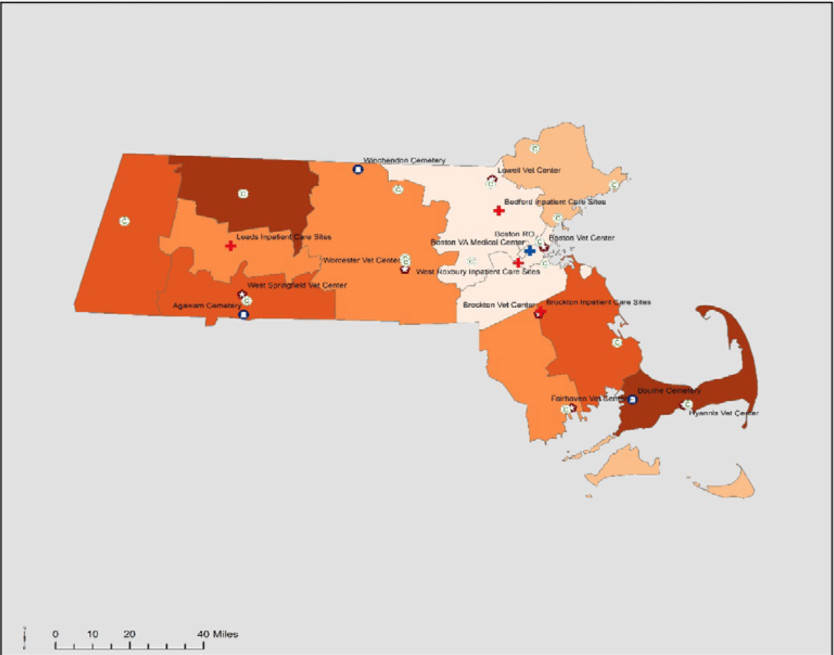
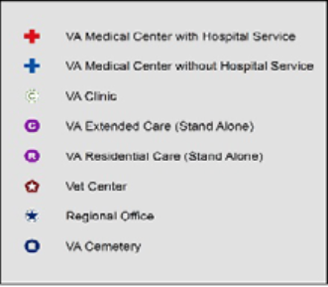
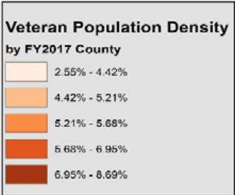
Medical Needs of Veterans
MA VA Facilities (9/30/2017)
Inpatient Care Sites | 4
Outpatient Care Sites | 18
Vet Centers | 7
VBA Regional Offices | 1
19.2% of Massachusetts Veterans have a service related disability
As of 2017 there were 134,799 veterans enrolled in the VA Healthcare System
(State Summaries Massachusetts)

Slide 11
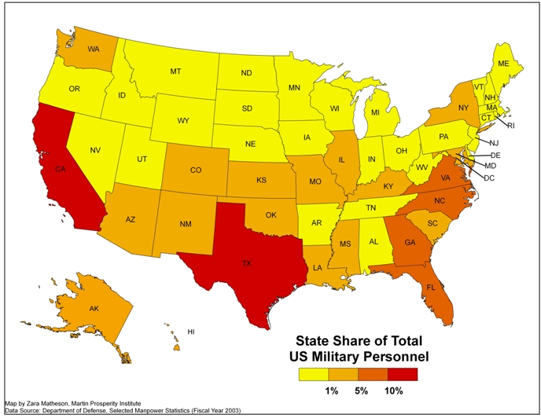
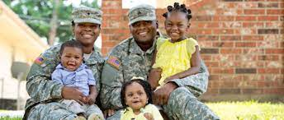
When we recognize triggers for our spouses we adjust roles to try to eliminate them...we enable them to exist in a state of PTSD dysfunction
- Spouse of veteran
“Asking a child if one of their parents serves in the military could just make their day ”
It’s not just service members that we care for...
Notes:
We care for service members families both while they are deployed and when they return. Knowing the service history within a family can provide very important context about a patient’s health & living situation. For those who live in states with less military representation they can feel isolated regarding the struggles they face as a military family; they don’t have the same military community surrounding them. Upon return, family members will face their own obstacles (role confusion, emotional distancing, etc) but regarding their spouse love can start to look like enabling. It’s important to include them in therapy to set expectactions, boundaries, and accountability.

Slide 12

True or False?
Most veterans receive health care through the VA

Slide 13

Who Receives Care Through the VA?
It's complicated…
For those who have served in the active military, naval or air service
  Large number of Reservists and National Guard members in Massachusetts
If a veteran has a service-connected injury, or if they have returned from deployment within the past 5 years
A service member may not be eligible for services if they have an other than honorable, bad conduct or dishonorable discharge (U.S. Department of Veterans Affairs, 2020c)
When in doubt, refer the veteran to their local Veterans' Service Officer (VSO)!
Notes:
VA eligibility is very complicated. A few of the requirements are listed here, but the big ones are the individual must have served in active military and needs to have a service-connected injury or returned from deployment in the past 5 years. The active military component is especially important in massachusetts, because we have a large number of individuals who are part of the reserves, meaning they may not yet deployed, or deployed for the necessary amount of time to be eligible for benefits. If a veteran is unsure if they are eligible for services or benefits, put them in touch with their local Veteran Service officer (VSO), with the Lincoln street veteran clinic adjacent to UMass, or with a Vet Center. If there is one thing you remember about VA eligibility- it is the VSO officer. The process is challenging to navigate, and in Massachusetts, each town or group of small towns has an officer that can assist the veteran with eligibility and navigating the process

Slide 14

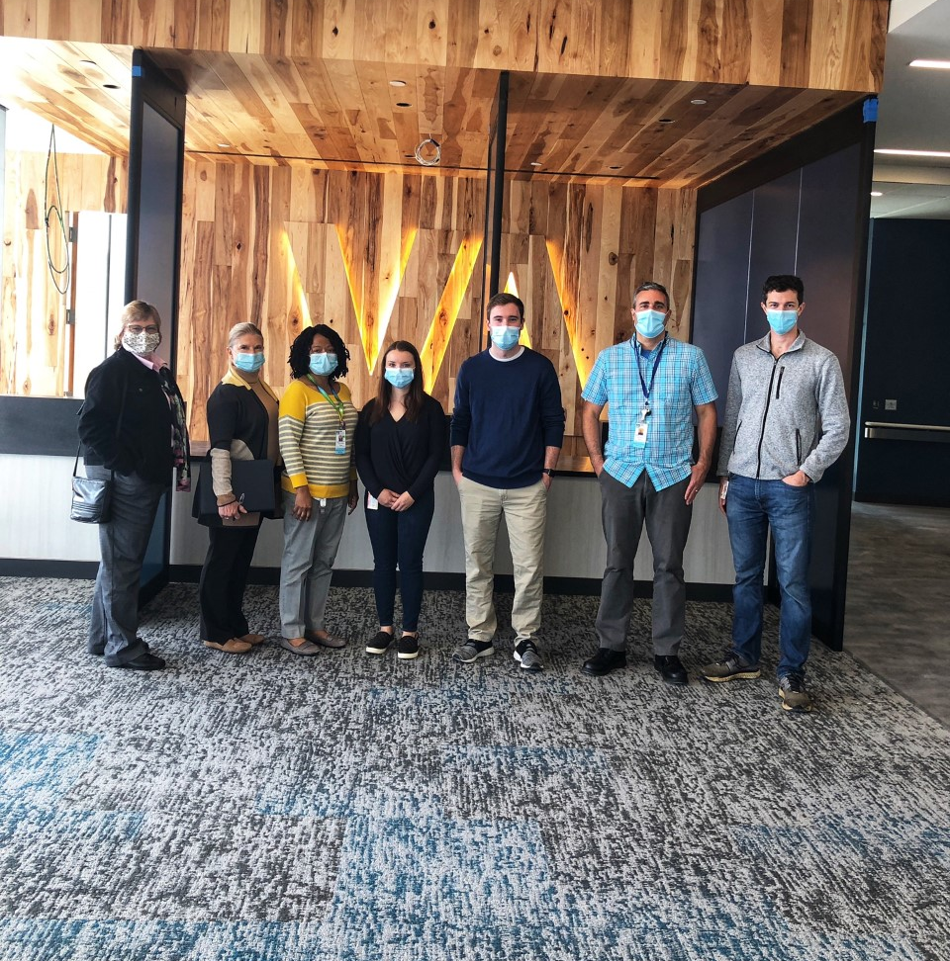
Organizations Providing Care to Veterans
Dept. of Veterans Affairs (VA)
Locations:
  VA Medical Centers and Clinics
  Vet Centers (social and psychological services)
Not all Veterans get care from the VA
  Nationally 45% of Veterans are enrolled in the VA Healthcare System
  In Massachusetts, 41% of Veterans are enrolled
VA only serves veterans with service related injuries (with some exceptions)
Civilian Medical Organizations
Many VA patients receive additional healthcare elsewhere
1/10 patients seen at UMMS have some military service experience
Support Organizations
Non-Profits: Home Base, Brookfield Institute, Animal Therapy
VFW, American Legion
VSO (Veteran Services Officer)
Notes:
National Center for Veterans Analysis and Statistics (2017)
UMMS Guide to Veterans’ Health Resources (NOV 2020)

Slide 15
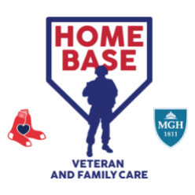
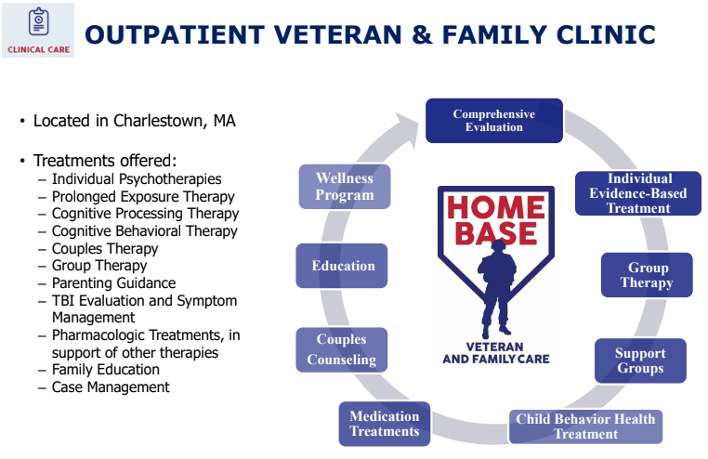
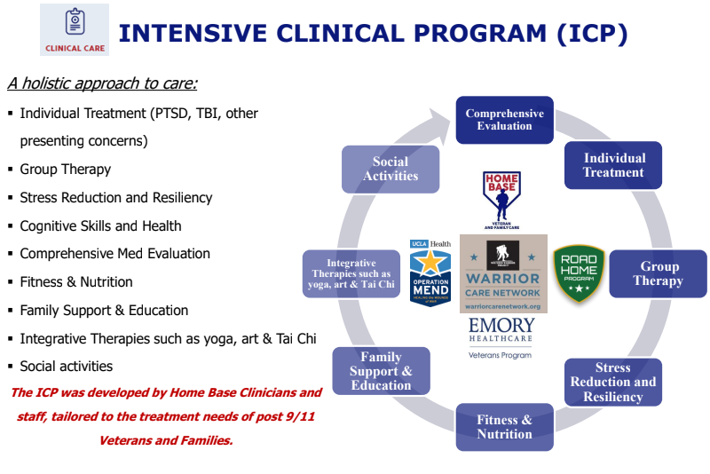
Home Base: Healing Invisible Wounds
(Home Base, 2021)
Notes:
Davidson, William. (2021, October 27). The Invisible Wounds of War and Home Base. Lecture presented at Population Health Clerkship: Introduction to Military/Veterans Health in University of Massachusetts Medical School Graduate School, Worcester.

Slide 16
Interprofessional Teams: Example Case 1
JJ
Served in an extended tour in Iraq (2003-4); survived multiple explosions, but some squadmates did not
Diagnosed with TBI, PTSD, COPD, Alcohol Use Disorder, Sensorineural Deafness
Veterans’ Affairs:
Patient aligned Care Team (PACT)
  PCP (MD/DO, NP, or PA)
  Clinical Pharmacist (PharmD)
  RN Care Manager
  LPN or MA
Specialty Care
  Neurology (MD/DO)
  Psychiatry (MD/DO)
  Audiology (AuD)
  Dental Care (DDS or DMD)
Vet Center (Long term therapy in Worcester)
  Psychologist (MS)
  Readjustment counselor (MSW)
Civilian Health System:
Family Healthcare
  Separate PCP for the rest of the family
Emergency Room Visits
  EM team
Support Organizations:
Spouse
Home Base (2 week program in Boston)
  Psychologist (PsyD)
  Physical Therapy (PT or PM&R)
  Peer Support (veteran)
Animal Therapy (Support Dog)
Notes:
https://www.va.gov/health-care/about-va-health-benefits/your-care-team/

Slide 17
Interprofessional Teams: Example Case 2
JD
Marine Sergeant, Served 3 tours in Vietnam as a squad leader in combat, exposed to Agent Orange
PMH: HTN, Diabetes, COPD, partial nephrectomy, PTSD
Veterans’ Affairs:
Went once and was diagnosed with
PTSD, never went back
Civilian Health System:
Primary Care Team
  PCP (MD/DO, NP, or PA)
  Clinical Pharmacist (PharmD)
  Psychologist (MS)
  RN Care Manager
  LPN or MA
Dental Care (DDS or DMD)
Support Organizations:
Veteran Services Officer

Slide 18
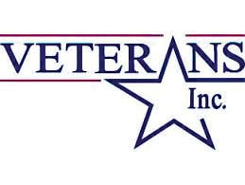

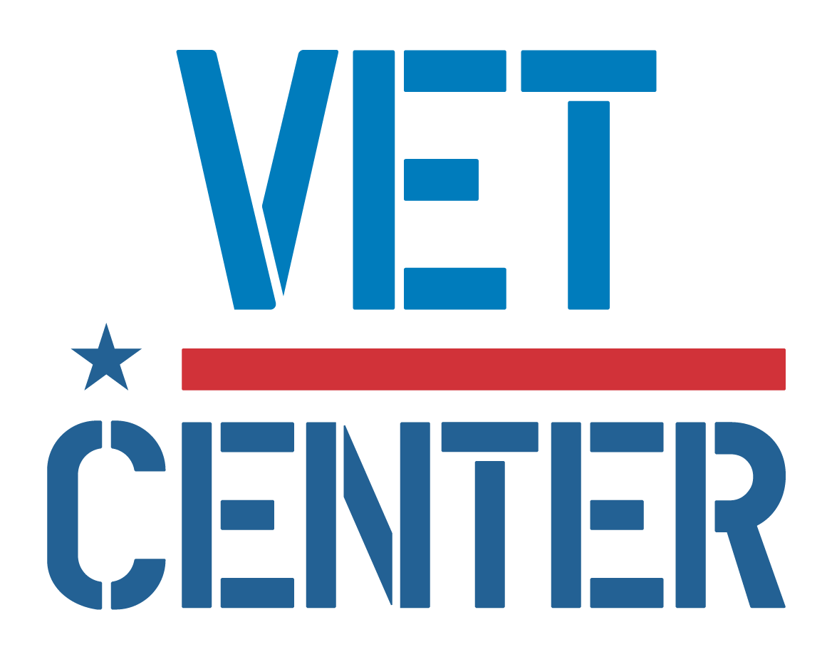


Local & State Advocacy for Veterans
Headquarters:
69 Grove Street
Worcester, MA 01605
362 Plantation St
Worcester, MA
Areas of advocacy: support services, employment for veterans, suidcide prevention
Chapter 115 Benefits/Safety Net Program
Areas of advocacy: housing, case management, food security, employment health and wellness, family support programs for veterans
Areas of advocacy: benefits, health care access
Legislative Agenda:
Address Toxic Exposure & Burn Pits
Improve Health Care for Women Veterans
Telehealth/Rural Health
600 Washington Street, 7th Floor, Boston, MA 02111
Notes:
Veterans Inc.: is a nonprofit organization headquartered in Worcester Mass, that is one of the largest providers of support services to veterans and their families in New England. Their main focus is ending homelessness among veterans- they have a 85% success rate, one of the highest rates in the nation, for transitioning veterans out of homelessness. They now operate offices and programs in all six New England states and Advocate on a local, state and national level to help address the needs of the veteran population. Their main areas of advocacy is housing, case management, food security, employment health and wellness, family support programs for veterans
Veterans Inc. had an aggressive response to the opiate epidemic in 2016, which disproportionately affected veterans, by creating the first licensed substance addiction treatment center, Independence Hall in, in the country that is operated by a veteran specific, non-profit organization. the center offers a full array of care including inpatient, day treatment, and outpatient counseling for both veterans and nonveterans.
The American Legion:
National Legislative Division serves as the principal advocate of servicemembers, veterans, and their families on Capitol Hill. the American Legion has fought for service-connected disability benefits for conditions linked to toxic exposures
For example, The American Legion urges Congress to reintroduce and pass the Toxic Exposure in the American Military (TEAM) Act of 2020 and supports further studies into conditions directly related to contaminants in order to establish a complete list of presumptive diseases caused by toxic exposure during service.
.The Department of Veterans Affairs (VA) announced Sept. 20 that veterans forced out of the military with other than honorable discharges under the “Don’t Ask, Don’t Tell” policy will now be eligible for VA benefits.
Mass Department of Veteran Services mission is to advocate on behalf of all the Commonwealth’s veterans and provide them with quality support services and to direct an emergency financial assistance program for those veterans and their dependents who are in need. The Chapter 115 Benefits Program is run by the Massachusetts Department Veterans’ Services (DVS) in partnership with local Veterans’ Service Officers (VSOs). The Program provides financial aid for food, shelter/housing, clothing, and medical care to veterans and their dependents who have limited incomes.The fundamental principle of the SAVE program is to advocate for veterans who are not able to obtain the benefits they have earned due to institutional or personal barriers. The program's primary mission is prevention of suicide and mental health of veterans when they return from service and proactively providing them with access to benefits and services that may address these issues and result in positive transitions back to civilian life.

Slide 19
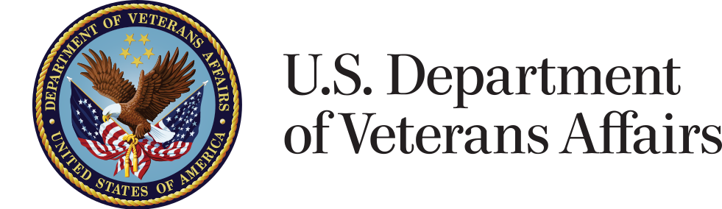
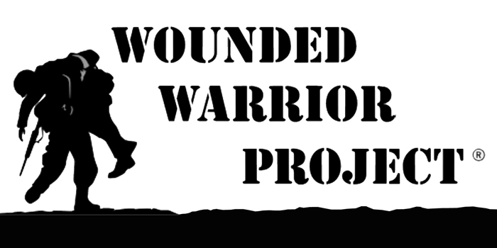

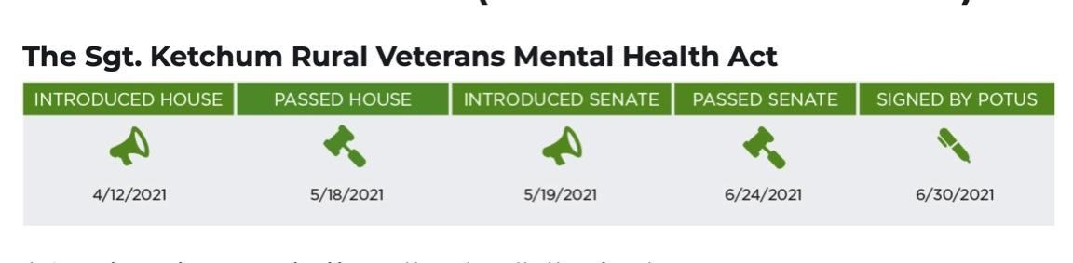

National Advocacy for Veterans
Areas of advocacy: improve access to care and encourage participation by non-VA physicians
The Veterans Choice Program
Area of advocacy: health care access
Veterans Deserve Care national campaign
Areas of advocacy: physical and
mental health, financial wellness,
peer and community support of
veterans
Area of advocacy: benefits, health care
VA MISSION Act (2019)
Legislative Priorities:
Women Veterans
Toxic Exposures
Whole Health & Wellness (Suicide prevention & TBI)
Expand caregiver access to VA
Enhanced Quality of life
Example of Success:
Notes:
The US Department of Veteran Affairs, originally created in 1930, gives the veteran population a voice and representation in the national government. It has a mission centered around veteran service benefits and veteran health care. Recently they launched the VA Mission Act of 2019 in replace of the The Veterans Choice Program, expanding community services to veterans, such as telemedicine and urgent care.
This Veteran choice program was a former bill that Allowed veterans to receive care through civilian hospitals if there is no VA in the area and was strongly supported by the American Medical Association which is an organization also involved in advocating for veterans health
. The AMA advocates for improved access to health care for veterans and encourages participation of by non-VA physicians in providing for veterans. The AMA continues to work with the Committees on Veterans’ Affairs of the Senate and the House of Representatives to streamline programs, improve access to care and to encourage participation by non-VA physicians and other providers.
A similar organization is the American Association of Nurse Practitioners (AANP). They led the Veterans Deserve Care, a national campaign to raise awareness of the need to strengthen health care for veterans by ensuring that veterans have direct access to nurse practitioner care within the VA health system.
In 2016 with the strong support and lobbying of the AANP, the VA published a final rule granting veterans direct access to care by nurse practitioners (NPs), certified nurse midwives and clinical nurse specialists who work in the VA health system
WWP: works with Veterans who incurred a physical or mental injury, illness, or wound while serving in the military on or after September 11, 2001. They offer FREE programs in areas like:
Mental Health
Financial Wellness
Physical Health
Peer and Community Connections
the WWP also proudly serves as a voice for veterans and talks with members of Congress, and pushes for policies and initiatives that focus on the improvement of Women Veterans access to care and VA services, toxic exposure related VA health coverage, expansion of suicidide prevention, MST ,TBI services, and enhancing the quality of life for veterans and improving caregiver access to the VA.
For example Wwp helped pass The Sgt. Ketchum Rural Veterans Mental Health Act through congress earlier this year within 2 months!, which expanded mental health care for rural veterans

Slide 20
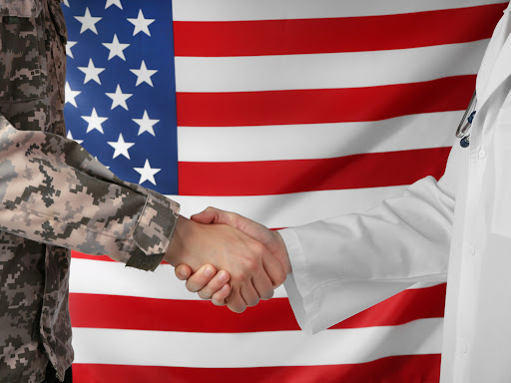
Advocate for Veterans as Providers
Starts by asking…
“Have you, or a loved one, served in the military?”
Get Involved!
Be involved with professional organizations that support veterans' health issues
Training Institute for Healthcare Professions- Home Base
Notes:
As future providers we cannot advocate for our veteran patients unless we identify the patient sitting in front of us as a veteran. This can be simply done by asking…
Assess on an individual level each veteran patients needs, and connect them with the local VSO with their permission
You can also get involved and become a member or volunteer at an organization such as veterans inc, home base, AANP, AMA to promote veteran advocacy and access to services and benefits
Homebase also offers free certified 1 credit online and in-person classes and training to clinicians through the training institute for health care professions

Slide 21
Service Learning Project: My Life, My Story
Our service learning project is centered around the VA’s initiative My Life, My Story which promotes patient centered care through veteran story telling
For this project we each interview two veterans about their experiences in the military and how it has impacted them, their health, and their families
"Nam doesn't go away.. having the orders to burn the villages to the ground was the end of me..”
- US Army Vietnam Veteran
“The experience coming home, and going to a desk job, was one that no one is truly ready for”
- US Marine Corps Veteran
“It took a brain cancer at 50 and a lot of pushing from my daughter to finally start looking for help.”
US Army Veteran

Slide 22
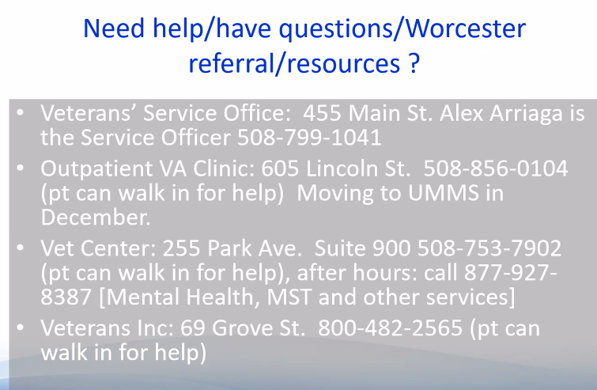
Need help/have questions/ Worcester referral/resources?

Slide 23
Acknowledgements
Faculty:
Linda Cragin
Director, MassAHEC Network
Janet Hale PhD, RN, FNP
Professor and Associate Dean for Academic Affairs, Dir. Interprofessional and Community Partnerships, GSN, COL, US Army Res, Ret.
Benjamin Eovaldi, DO
Preventive Medicine Resident, CAP, US Air Force (2012-2016)
Guest Speakers:
Sean Collins, PhD, APRN-BC
Brigadier General, Asst. for Mobilization and Reserve Affair, Office of the Sec. of Defense for Health Affairs, (former 104th Fighter Wing Med Group, US Air Nat Guard)
Jenny D’Olympia, PsyD, LMHC
Assistant Chair, Counseling and Behavioral Health Department, Interim Director, Military Veteran Psychology and Train Vets to Treat Vets Programs William James College, Air Force and military spouse
Brent French, MBA, PhD & Maddie French
Col. US Air Force & Reserves/Retired
Aimee Kroll-Desrosiers, PhD
Research Health Scientist, VA Central Western Massachusetts
Kevin Lambert, Infantryman, US Army, OIF
Bill Moore & Robert Hewins
Justin Sousa, Veterans Service Officer
Central Mass Vets Services District; MA Army National Guard ‘07-14
Mike Spiros, MS, MALD, AGACNP-BC, US Navy, Iraq 2003-4 & Sarah Spiros,MS,AGPCNP-BC; GSN Class of 2015
Pankaj Ksheersagar, MD FAAFP, MAJ, MC USAR
Medical Director, Family Medicine Inpatient Service
John P. Collins, FACHE & Nancy Collins, CNM
Former Director, VA Central Western Massachusetts Healthcare System; COL, Ret US Army
Amber Cahill, PsyD
Dir. Behavioral Science/Fitchburg Family Med Res/UMMS Dept. Family Medicine & Community Health
Anthony Riello, MSW, LISCW
William Davidson
Director, Veteran Outreach Brigade Command Sergeant Major, MA Army National Guard
Jennifer Baublitz, MA/CAGS
Exec. Dir, Brookfield Institute
Tina Runyan, PhD, ABPP
Professor, Dept. of Family, Medicine and Community Health, Licensed Clinical Health Psychologist, UMMHC; 6 Years Active Duty - USAF/Biomed Science Corps
Shawn McGuinness, AIA, LEED AP
Manager of Design and Construction, UMMS

Slide 24
References
American Association of Nurse Practitioners. (n.d.). Nurse Practitioners in Primary Care. https://www.aanp.org/advocacy/advocacy-resource/position-statements/nurse-practitioners-in-primary-care
American Association of Nurse Practitioners. (n.d.). U.S. Department of Veterans Affairs Final Rule. https://www.aanp.org/advocacy/recent-legislative-changes/u-s-department-of-veterans-affairs-final-rule
American Medical Association. (n.d.). Advocating for Veterans' Health. https://www.ama-assn.org/delivering-care/population-care/advocating-veterans-health
Davidson, William. (2021, October 27). The Invisible Wounds of War and Home Base. Lecture presented at Population Health Clerkship: Introduction to Military/Veterans Health in University of Massachusetts Medical School Graduate School, Worcester.
Grogan, N., Howe, E., Lazarowitz, D., Moore, E., & Williams, K. M. (2020, December 3). Massachusetts veteran needs assessment: During the pandemic and beyond. Center for a New American Security (en-US).
https://www.cnas.org/publications/reports/massachusetts-veterans-needs-assessment-during-the-pandemic-and-beyond.
HAC veterans data central - informing strategies to help veterans. HAC Veterans Data Central - Informing Strategies to Help Veterans. (n.d.).
http://veteransdata.info/.
How coronavirus affects veterans like nobody else - heroes' mile rehab. Heroes' Mile Veterans Recovery Center. (2020, September 1). https://www.heroesmile.com/how-coronavirus-affects-veterans-like-nobody-else/.
Mass.gov. (n.d.). Statewide Advocacy for Veterans' Health Empowerment. https://www.mass.gov/service-details/statewide-advocacy-for-veterans-empowerment-save

Slide 25
References
Massachusetts Department of Veteran Services. (2021). Statewide Advocacy for Veterans' Empowerment (SAVE). https://www.mass.gov/service-details/statewide-advocacy-for-veterans-empowerment-save
State summaries Massachusetts - Va.gov Home. (n.d.) https://www.va.gov/vetdata/docs/SpecialReports/State_Summaries_Massachusetts.pdf.
State of Massachusetts. (2020). Massachusetts Department of Veterans' Services. https://www.mass.gov/orgs/massachusetts-department-of-veterans-services
The General Court of the Commonwealth of Massachusetts. (n.d.). Chapter 115: Veterans Benefits. https://malegislature.gov/Laws/GeneralLaws/PartI/TitleXVII/Chapter115
Wounded warrior project outlines veteran suicide prevention efforts to US House Committee. WWP News & Media: Veteran Group Outings, Charity Events, Helping Vets. (n.d.) https://newsroom.woundedwarriorproject.org/2021-09-22-Wounded-Warrior-Project-Outlines-Veteran-Suicide-Prevention-Efforts-to-US-House-Committee.
Your VA primary care provider and pact team. Veterans Affairs. (n.d.). https://www.va.gov/health-care/about-va-health-benefits/your-care-team/.

