Slide 1
Bassett-UMass
MAT ECHO

Slide 2
Bassett-UMass MAT ECHO 1.25.2017
Practicalities of
Buprenorphine Induction

Slide 3
What Is Induction?
Process of transferring a patient from other opioids to buprenorphine.
Two potential methods and settings:
Office induction
Home induction

Slide 4
Office-Based Induction
Patient should be in mild to moderate withdrawal
This is due to high affinity of opioid mu receptor in the brain
Giving buprenorphine when patient is still intoxicated with opioid → precipitated withdrawal
Instruct patient to abstain from opioid use, 12-16 hrs for short-acting, 24 hrs for sustained-release, 36 hrs for methadone
Clinical Opioid Withdrawal Scale (COWS): quantifies level of withdrawal
Typically okay to start buprenorphine with COWS score 10-11

Slide 5
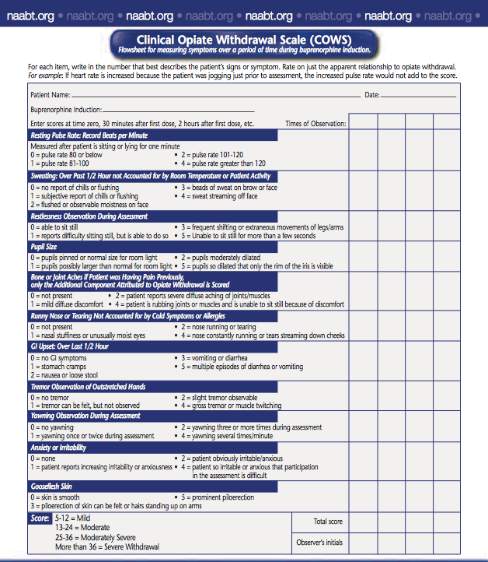

Slide 6
What To Do With Low COWS Score
Pause and consider possible scenarios:
Patient used opioid drugs more recently than reported
Patient may have used long acting opioid such as methadone
Patient might not be opioid dependent
Patient may have taken drugs/medications that mask symptoms of withdrawal (i.e. clonidine or beta-blocker)
Ask about these possibilities in a non-confrontational, non-judgmental way.

Slide 7
Office-Based Induction
Patient either brings buprenorphine or dispensed at health center
Administer 4 mg buprenorphine with instruction to let it completely dissolve under tongue.
Instruct patient to wait 45 minutes
After 45 minutes, if withdrawal symptoms persist and patient does not feel worse, administer another 4 mg.
If patient feels worse after first dose, precipitated withdrawal may be occurring: **see separate slide**

Slide 8
Office-Based Induction
Reassess 45 min after second dose. Continue to dose as above until withdrawal symptoms are improved. Patient may be sent home with additional 8mg tablet and instructed to take 4-8mg if needed before following day.
Generally, withdrawal symptoms are well controlled with 16mg daily. If more than 16mg is requested, would wait 5-7 days to reassess before further increase. Beyond 32mg daily, risk of diversion is increased. Prior authorization usually required for daily dose of 24mg or greater.
The modal dose for stable patients in early treatment is generally 16-24mg.

Slide 9
Office-Based Induction
Remain in contact with patient by telephone for the first few days as doses may need to be adjusted before next visit.
Given sufficient medication until next visit (3-4 days).
It is not necessary to take buprenorphine more than once a day. However, if patient has chronic pain, it may be better to divide the dose and administer three to four times a day to provide better analgesic effect.

Slide 10
Precipitated Withdrawal
Many providers never see or hear of a case in their care …
Two options:
Stop the induction, provide symptomatic treatments for withdrawal symptoms (e.g., clonidine, dicyclomine, ibuprofen), and have patient return the next day.
If mild precipitated withdrawal (e.g., increased anxiety), can continue dosing with small doses (2mg) buprenorphine to provide enough agonist effect to suppress withdrawal.

Slide 11
A Word About Methadone
Would explore why patient is seeking the switch, especially those who have been stable on it long-term.
Risk of relapse during the transition period.
While patient may dislike going to methadone clinic frequently to take methadone under observation, some may need the structure and monitoring in order to be successful at maintaining sobriety. On the other hand, clinic requirements may be burdensome in terms of family and job responsibilities.
Would taper methadone down to about 30mg a day for a week before proceeding with the transfer—this is thought to decrease likelihood of withdrawal.

Slide 12
Home Induction
Education is key, written handouts helpful.
Discuss how buprenorphine works.
Discuss withdrawal symptoms and teach COWS scale.
Start scoring 12 hrs after last short-acting opioid use and 24 hrs after last long-acting opioid use.
Self administer 4mg if COWS >10.
Self score again in 1-3 hrs, if COWS still >10, self administer another 4mg.
Continue dosing until maximum dose of 12mg is reached.
Next day if patient is feeling fine, self administer total dose taken on day #1. If not feeling fine, self administer total dose taken on day #1 PLUS additional 4mg. Follow up in office on Day #3.

Slide 13
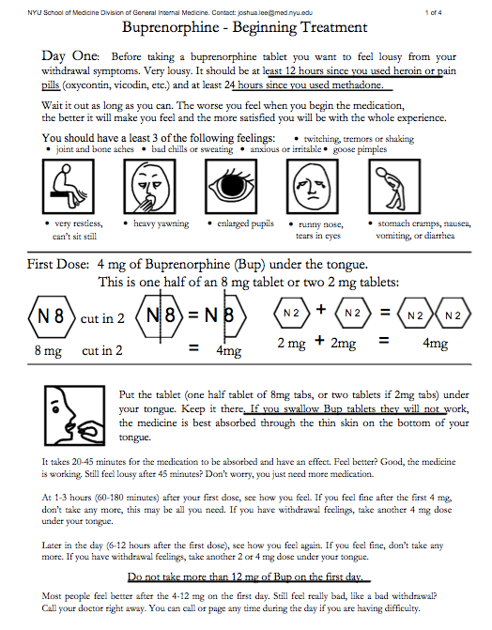
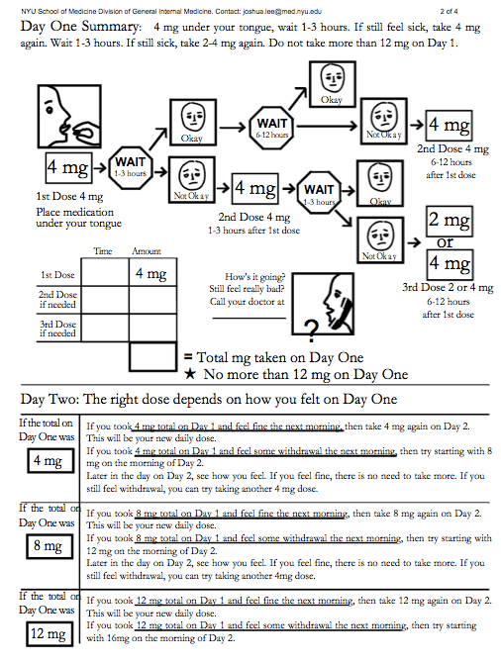

Slide 14
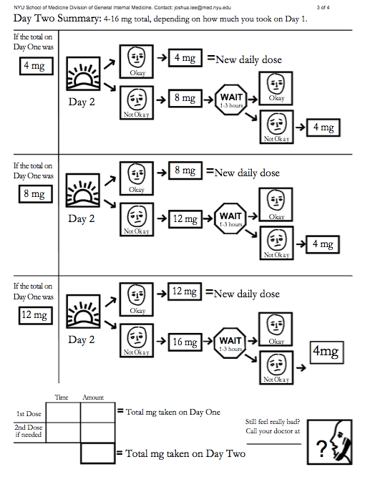
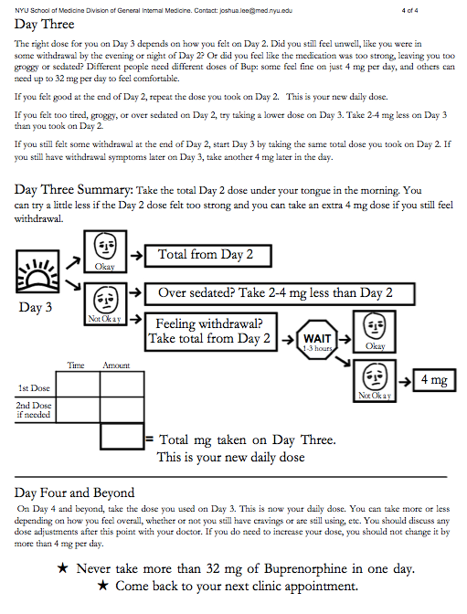

Slide 15
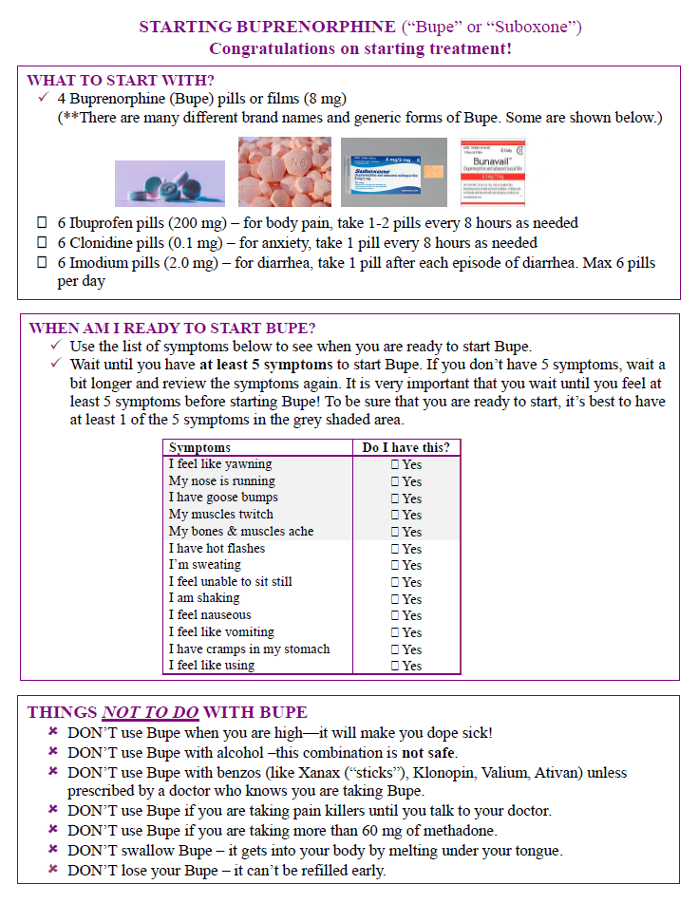
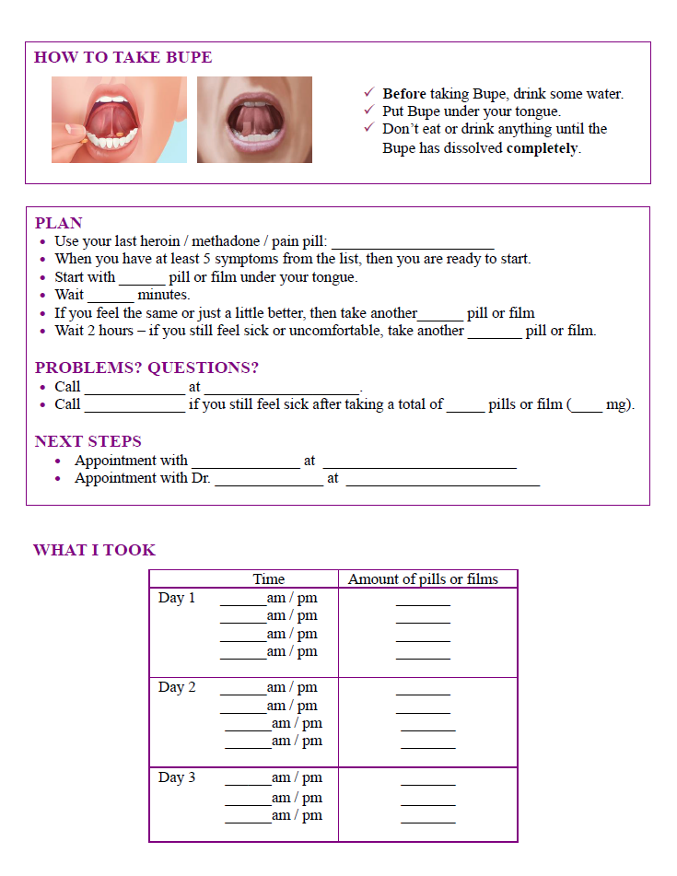

Slide 16
Buprenorphine Side Effects
Buprenorphine side effects are much milder than opioid full agonists; except for constipation, these tend to improve over time
Constipation (most common)
Sweating
Mild sedation
Decreased libido
Urinary retention
Pedal edema
Sore mouth

Slide 17
Does the location of buprenorphine induction influence treatment success? No Can compelling office-based induction lead to negative effects? Yes
Summary from last week’s presentation:
Ways to augment successful transition to buprenorphine:
Longitudinal, primary-care relationship
Shared decision-making as to location
Instructions and ready practice/clinician availability
Care with transitions from methadone (treatment or otherwise)

Slide 18
References
Lee JD, Grossman E, DiRocco D, Gourevitch MN. Home Buprenorphine/Naloxone Induction in Primary Care. Journal of General Internal Medicine. 2009;24(2):226-232. doi:10.1007/s11606-008-0866-8.
Sohler NL, Li X, Kunins HV, et al. Home- versus office-based buprenorphine inductions for opioid-dependent patients. Journal of substance abuse treatment. 2010;38(2):153-159. doi:10.1016/j.jsat.2009.08.001.
Komaromy M, Buser R, Silver H, Hayes L, Boban J, Duhigg D, Kraybill Mount B, Block J, Weiss J, Cianciabella S. New Mexico Treatment Guidelines For Medical Providers Who Treat Opioid Addiction Using Buprenorphine. New Mexico Behavioral Health Collaborative, 2012.

Slide 19
Bassett-UMass
MAT ECHO

