Slide 1
Bassett-UMass
MAT ECHO

Slide 2
Bassett-UMass MAT ECHO 2.8.2017
Acute Pain Care
for Patients Taking Buprenorphine

Slide 3
Acute pain care during buprenorphine treatment is crucial to address—both for the pain itself and for relapse prevention Acute pain can result from predictable (elective surgery) and non-predictable outcomes (fractures, tooth pain)
Overview:
Relapse risk from unrelenting acute pain
Opioid use for acute pain and relapse risk
Unexpected acute pain
Expected acute pain (surgery, dental procedures)

Slide 4
An Ohio mother who lost her husband to a heroin overdose has shared a stirring photo of herself and her children beside his open casket in an effort to warn others about the dangers of drug addiction.
“The cold hard truth is heroin kills. You may think it will never happen to you but guess what that's what Mike thought too,” Eva Holland of Cincinnati posted with her family's final photo, showing 26-year-old Mike Settles lying lifeless beside them.
Tragically, it was something as small as a toothache that his wife said led to him to turn to pain pills again. That slip re-sparked his deadly battle with addiction.
Notes:
http://www.nydailynews.com/news/national/ohio-family-poses-dead-dad-warn-drug-addiction-article-1.2360021

Slide 5
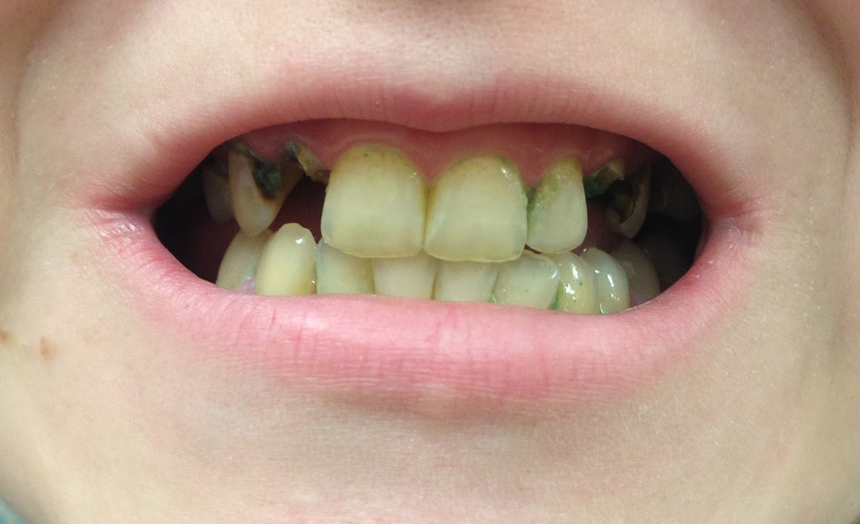
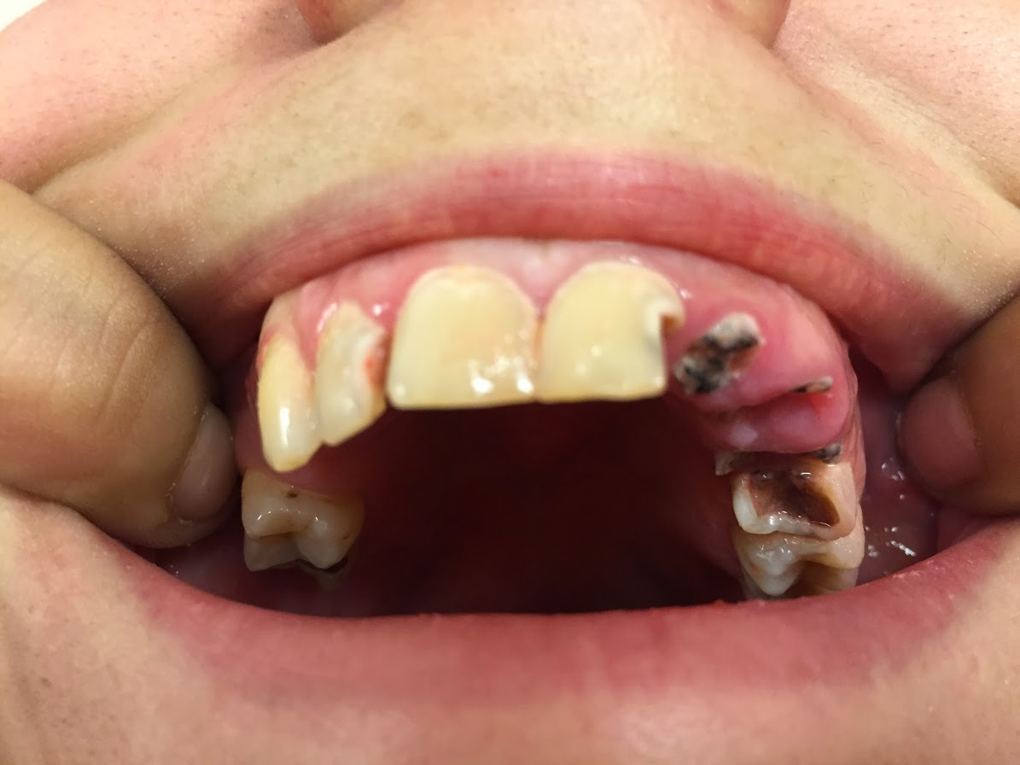
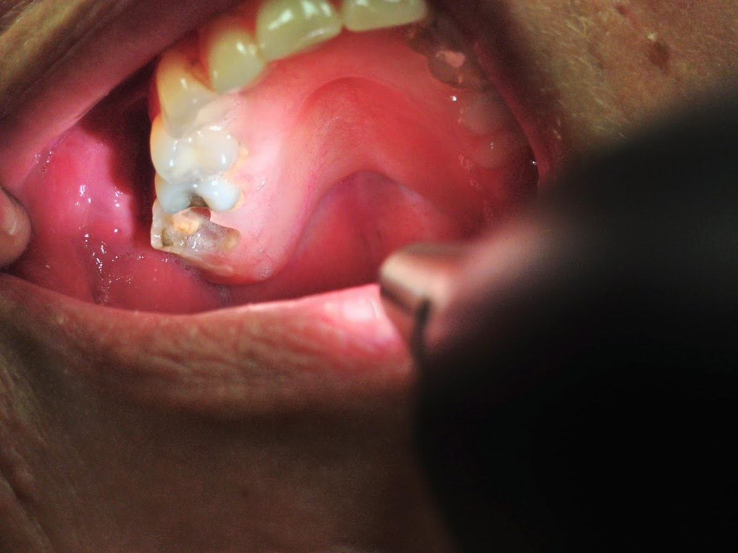
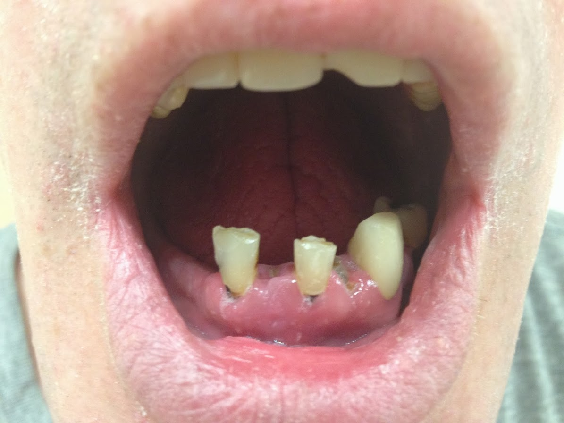
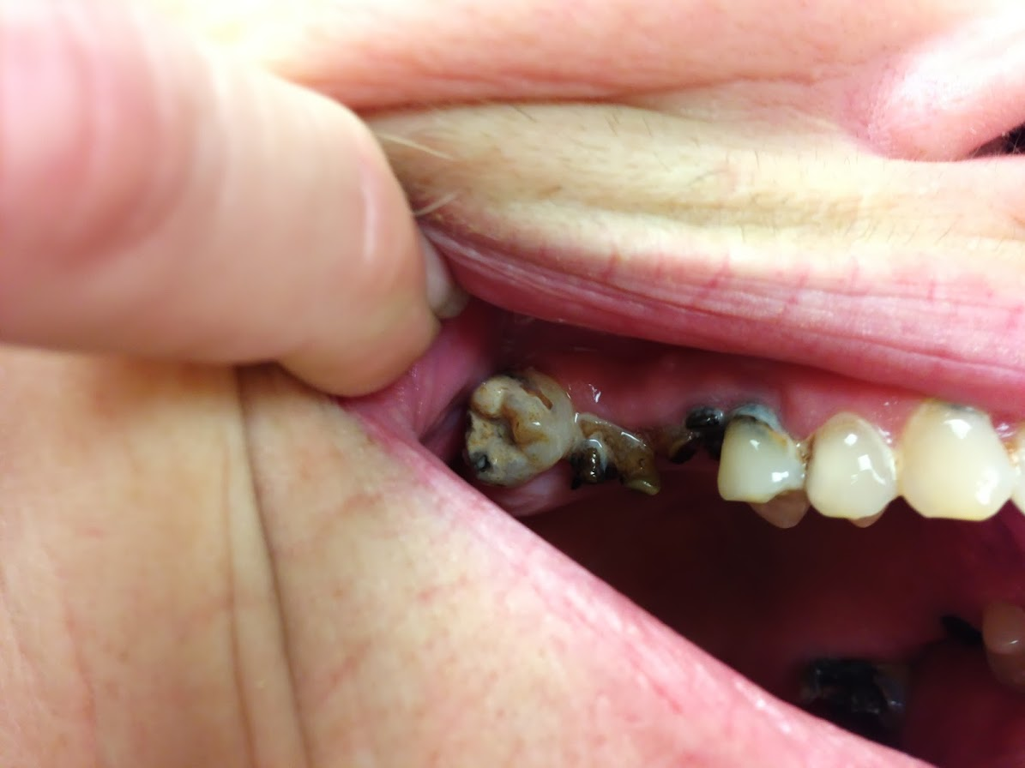

Slide 6
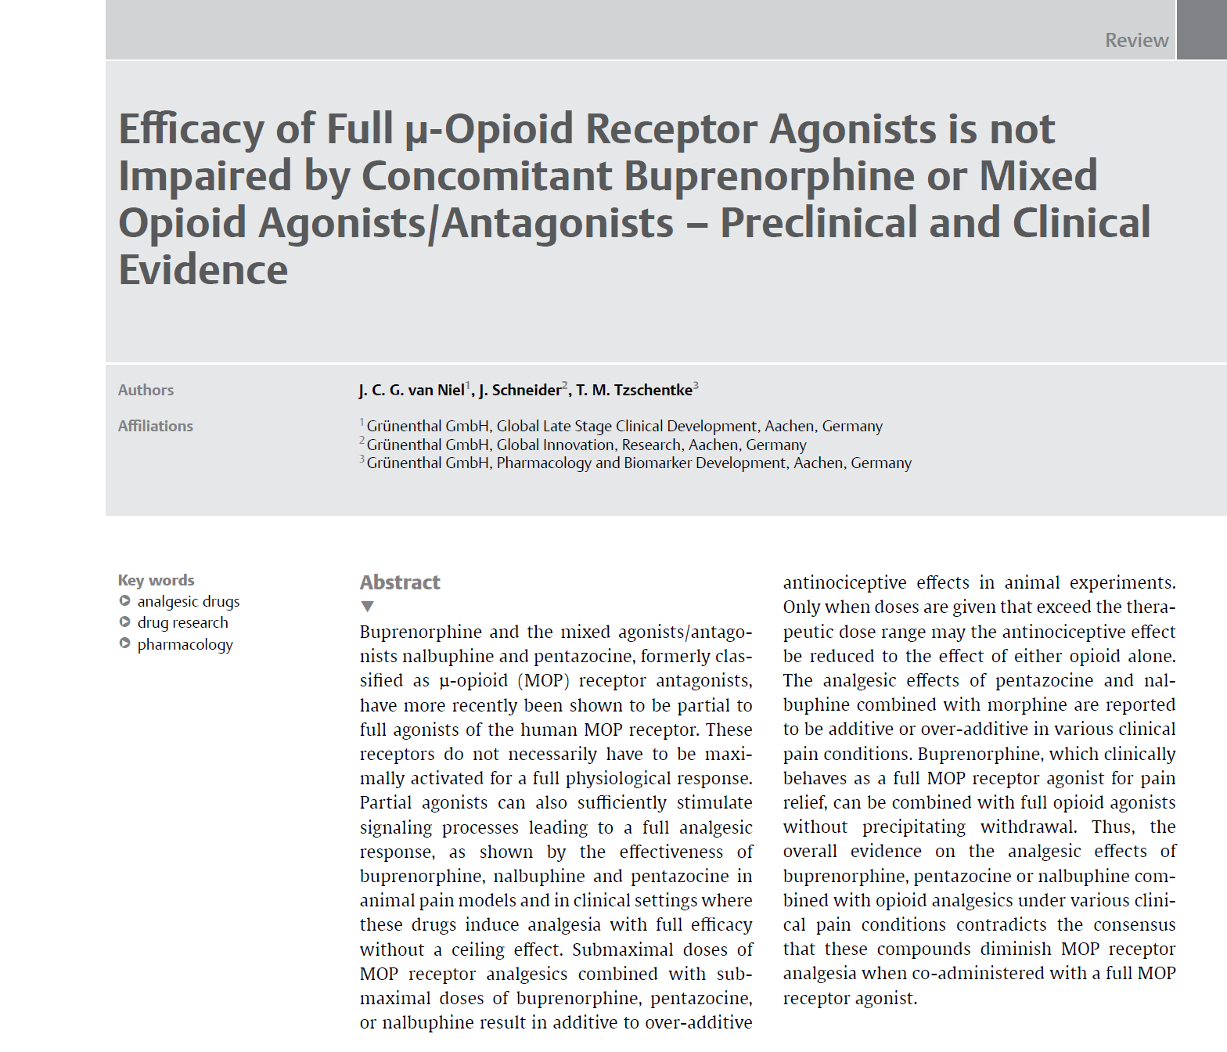
Buprenorphine, which clinically
behaves as a full µ-Opioid Receptor receptor agonist for pain
relief, can be combined with full opioid agonists
without precipitating withdrawal.
Notes:
van Niel JCG, Schneider J, Tzschentke TM. Efficacy of Full µ-Opioid Receptor Agonists is not Impaired by Concomitant Buprenorphine or Mixed Opioid Agonists/Antagonists - Preclinical and Clinical Evidence. Drug Res (Stuttg) [Internet] 2016;66(11):562–70. Available from: http://www.ncbi.nlm.nih.gov/pubmed/27504867

Slide 7
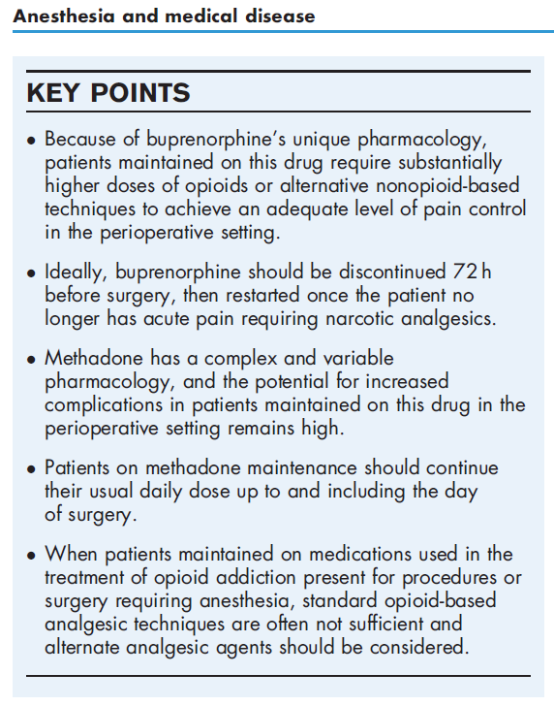
Notes:
Bryson EO. The perioperative management of patients maintained on medications used to manage opioid addiction. Curr Opin Anaesthesiol [Internet] 2014;27(3):359–64. Available from: http://www.ncbi.nlm.nih.gov/pubmed/24500338

Slide 8
Opioid Agonists and Buprenorphine
“Maintenance therapy for opioid addiction cannot be relied upon to provide analgesia during an episode of acute pain.”
“Several studies … suggest that full opioid agonists are effective in buprenorphine-treated patients.”
“Limited clinical experience, expert opinion, pharmacologic principles and published recommendations suggest that buprenorphine does not antagonize the analgesic effectiveness of other opioids.”
“… Buprenorphine and methadone can be safely continued without interruption through labor, delivery, and post-partum.”
“These results confirm that continuation of buprenorphine perioperatively is appropriate.”
Notes:
Vadivelu N, Anwar M. Buprenorphine in postoperative pain management. Anesthesiol Clin [Internet] 2010;28(4):601–9. Available from: http://dx.doi.org/10.1016/j.anclin.2010.08.015
Jones HE, Johnson RE, Milio L. Post-Cesarean Pain Management of Patients Maintained on Methadone or Buprenorphine. Am J Addict [Internet] 2006;15(3):258–9. Available from: http://ovidsp.ovid.com/ovidweb.cgi?T=JS&PAGE=reference&D=psyc5&NEWS=N&AN=2006-08476-011
Mehta V, Langford R. Acute Pain Management in Opioid Dependent Patients. Rev pain [Internet] 2009;3(2):10–4. Available from: http://www.ncbi.nlm.nih.gov/pubmed/26525109
Paschkis Z, Potter ML. CE: Acute Pain Management for Inpatients with Opioid Use Disorder. Am J Nurs [Internet] 2015;115(9):24-32, 46. Available from: http://www.ncbi.nlm.nih.gov/pubmed/26273927
Macintyre PE, Russell RA, Usher KAN, Gaughwin M, Huxtable CA. Pain relief and opioid requirements in the first 24 hours after surgery in patients taking buprenorphine and methadone opioid substitution therapy. Anaesth Intensive Care [Internet] 2013;41(2):222–30. Available from: http://www.ncbi.nlm.nih.gov/pubmed/23530789

Slide 9
Opioids for Pain and Relapse
“ … there is no evidence that exposure to opioid analgesics in the presence of acute pain increases rates of relapse in such patients.”
“To our knowledge, no research to date has linked inpatient use of opioid analgesics for acute pain to worsening addiction.”
Context
Fear and pain are potential triggers for drug craving and relapse.
People in treatment for OUD are generally very protective of their recovery
“Patients with a history of opioid abuse are stigmatized as such. They may receive less opioid than others, resulting in poor pain control and withdrawal.”
Acute pain has been correlated with a 50% reduction in care retention with buprenorphine; “Results … suggest an association between control of acute pain and long-term OMT (opioid maintenance treatment) retention” (Bounes 2013)
Notes:
Vadivelu N, Anwar M. Buprenorphine in postoperative pain management. Anesthesiol Clin [Internet] 2010;28(4):601–9. Available from: http://dx.doi.org/10.1016/j.anclin.2010.08.015
Jones HE, Johnson RE, Milio L. Post-Cesarean Pain Management of Patients Maintained on Methadone or Buprenorphine. Am J Addict [Internet] 2006;15(3):258–9. Available from: http://ovidsp.ovid.com/ovidweb.cgi?T=JS&PAGE=reference&D=psyc5&NEWS=N&AN=2006-08476-011
Mehta V, Langford R. Acute Pain Management in Opioid Dependent Patients. Rev pain [Internet] 2009;3(2):10–4. Available from: http://www.ncbi.nlm.nih.gov/pubmed/26525109
Paschkis Z, Potter ML. CE: Acute Pain Management for Inpatients with Opioid Use Disorder. Am J Nurs [Internet] 2015;115(9):24-32, 46. Available from: http://www.ncbi.nlm.nih.gov/pubmed/26273927
Macintyre PE, Russell RA, Usher KAN, Gaughwin M, Huxtable CA. Pain relief and opioid requirements in the first 24 hours after surgery in patients taking buprenorphine and methadone opioid substitution therapy. Anaesth Intensive Care [Internet] 2013;41(2):222–30. Available from: http://www.ncbi.nlm.nih.gov/pubmed/23530789

Slide 10
Implications for Practice
Dental pain, fractures, trauma and elective surgery are among the most common causes of acute pain for patients on buprenorphine
Clear responsibility for prescription provision helps the patient and the team; primary care—the buprenorphine prescriber—most often takes this responsibility
Coordination with dentistry is crucial and provision of dental anesthesia blocks helpful
Short acting opioids—including Tylenol/Codeine, Tramadol, Acetaminophen/Hydrocodone, and Oxycodone—can each be helpful and readily discontinued
Involving trusted family and friends to help monitor outpatient use can be important; it may be advisable for them to hold full opioid medications for pain
Notes:
Lee, J. D., Grossman, E., Dirocco, D., & Gourevitch, M. N. (2009). Home buprenorphine/naloxone induction in primary care. Journal of General Internal Medicine, 24(2), 226–232. https://doi.org/10.1007/s11606-008-0866-8
Buprenorphine induction is an important barrier limiting opioid dependence treatment diffusion nationally.
Gunderson, E. W., Wang, X.-Q., Fiellin, D. A., Bryan, B., & Levin, F. R. (2010). Unobserved versus observed office buprenorphine/naloxone induction: a pilot randomized clinical trial. Addictive Behaviors, 35(5), 537–40. https://doi.org/10.1016/j.addbeh.2010.01.001
Shah S, Kapoor S, Durkin B. Analgesic management of acute pain in the opioid-tolerant patient. Curr Opin Anaesthesiol [Internet] 2015;28(4):398–402. Available from: http://www.ncbi.nlm.nih.gov/pubmed/26107026

Slide 11
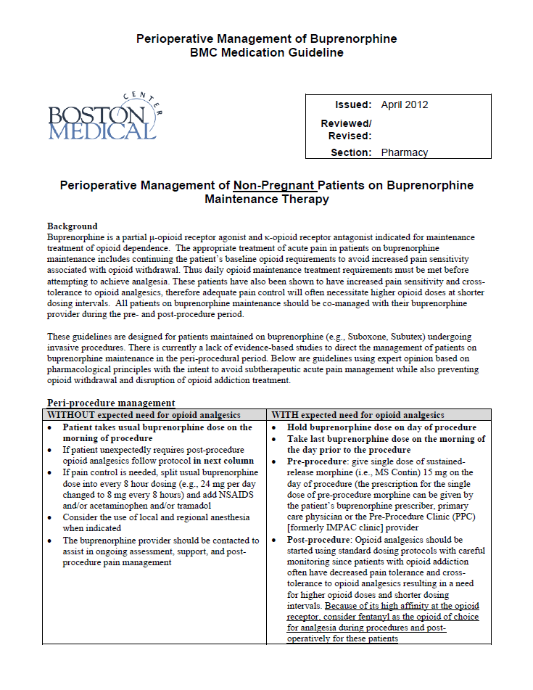
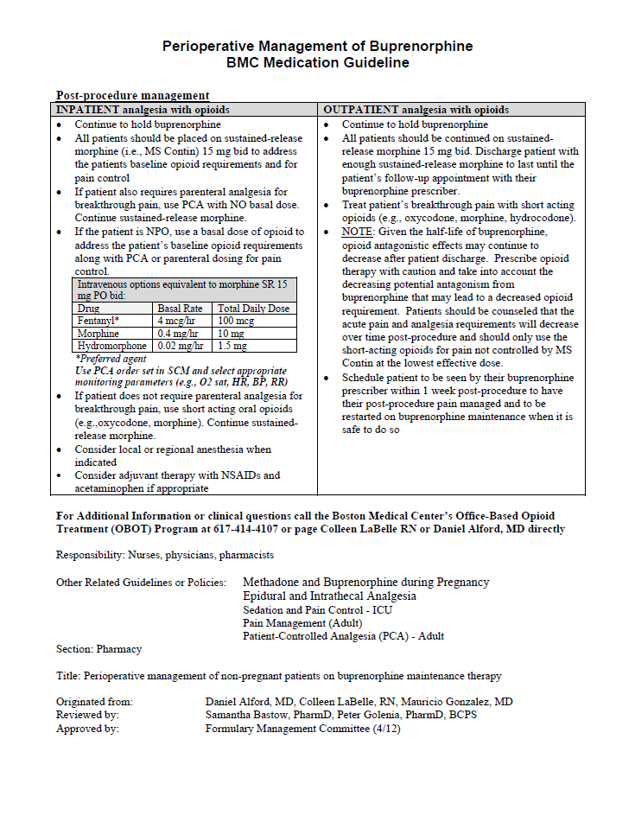

Slide 13
Perioperative Care
Preoperative consultation: A reassuring conversation is essential in reducing stress and fear of pain during the perioperative period. Patients’ concerns have to be addressed and the treatment discussed.
The default preferred by most patient is to remain on buprenorphine until surgery
The choice of drugs and options for a multimodal perioperative analgesia plan depends on clinical criteria and the nature of the procedure. Opioids and non-opioids should be included as indicated.
Preoperative care: Preoperative ketorolac and corticosteroids have both been found to reduce pain.
Intraoperative care: For patients taking buprenorphine, the administration of IV midazolam or alternate benzodiazepines with a propofol infusion or bolus dosing is recommended. Regional anesthesia (including discussion of rescue general anesthesia) can be a useful approach. Incision sites and be preloaded with local anesthetic before incision. In orthopedic surgery, post-operative intra-articular bupivicaine can be used.
Notes:
Stromer W, Michaeli K, Sandner-Kiesling A. Perioperative pain therapy in opioid abuse. Eur J Anaesthesiol [Internet] 2013;30(2):55–64. Available from: http://www.ncbi.nlm.nih.gov/pubmed/23241915
Gevirtz C, Frost E a M, Bryson EO. Perioperative implications of buprenorphine maintenance treatment for opioid addiction. Int Anesthesiol Clin 2011;49(1):147–55.
Wasson M, Beirne OR. Buprenorphine therapy: An increasing challenge in oral and maxillofacial surgery. Oral Surg Oral Med Oral Pathol Oral Radiol [Internet] 2013;116(2):142–6. Available from: http://dx.doi.org/10.1016/j.oooo.2013.04.018

Slide 14
Postoperative care: Emphasis on maintaining substitution to stabilize dependence and prevent withdrawal, supplemented by an approach to analgesia that meets the needs of the procedure and the patient. Non-opioids with an evidence base for effectiveness can include ketorolac, ketamine, intrathecal clonidine, tricyclic antidepressants, gapapentin, corticosteroids. (ESA 2013)
The buprenorphine prescriber should generally be the prescriber of full agonist opioids if needed
Notes:
Stromer W, Michaeli K, Sandner-Kiesling A. Perioperative pain therapy in opioid abuse. Eur J Anaesthesiol [Internet] 2013;30(2):55–64. Available from: http://www.ncbi.nlm.nih.gov/pubmed/23241915
Gevirtz C, Frost E a M, Bryson EO. Perioperative implications of buprenorphine maintenance treatment for opioid addiction. Int Anesthesiol Clin 2011;49(1):147–55.
Wasson M, Beirne OR. Buprenorphine therapy: An increasing challenge in oral and maxillofacial surgery. Oral Surg Oral Med Oral Pathol Oral Radiol [Internet] 2013;116(2):142–6. Available from: http://dx.doi.org/10.1016/j.oooo.2013.04.018

Slide 15
Acute pain care during buprenorphine treatment is crucial to address Acute pain can result from predictable (elective surgery) and non-predictable outcomes (fractures, tooth pain)
Summary
Helpful clinical approaches:
Clarity and transparency with patient and medical team
Timely coordination with colleagues (especially dental) for definitive care
For elective procedures, collaborative planning
Deliberate planning as to discontinuation of full agonist opioids for pain

Slide 16
References
Alford DP, Compton P, Samet JH. Acute pain management for patients receiving maintenance methadone or buprenorphine therapy. Ann Intern Med [Internet] 2006;144(2):127–34. Available from: http://www.ncbi.nlm.nih.gov/pubmed/19448245
Boston Medical Center. Perioperative Management of Buprenorphine: BMC Medication Guideline. 2012.
Bryson EO. The perioperative management of patients maintained on medications used to manage opioid addiction. Curr Opin Anaesthesiol [Internet] 2014;27(3):359–64. Available from: http://www.ncbi.nlm.nih.gov/pubmed/24500338
Chern S-YS, Isserman R, Chen L, Ashburn M, Liu R. Perioperative Pain Management for Patients on Chronic Buprenorphine: A Case Report. J Anesth Clin Res [Internet] 2013;3(250). Available from: http://www.pubmedcentral.nih.gov/articlerender.fcgi?artid=3846172&tool=pmcentrez&rendertype=abstract
Gevirtz C, Frost E a M, Bryson EO. Perioperative implications of buprenorphine maintenance treatment for opioid addiction. Int Anesthesiol Clin 2011;49(1):147–55.
Jones HE, Johnson RE, Milio L. Post-Cesarean Pain Management of Patients Maintained on Methadone or Buprenorphine. Am J Addict [Internet] 2006;15(3):258–9. Available from: http://ovidsp.ovid.com/ovidweb.cgi?T=JS&PAGE=reference&D=psyc5&NEWS=N&AN=2006-08476-011
Macintyre PE, Russell RA, Usher KAN, Gaughwin M, Huxtable CA. Pain relief and opioid requirements in the first 24 hours after surgery in patients taking buprenorphine and methadone opioid substitution therapy. Anaesth Intensive Care [Internet] 2013;41(2):222–30. Available from: http://www.ncbi.nlm.nih.gov/pubmed/23530789
Mehta V, Langford R. Acute Pain Management in Opioid Dependent Patients. Rev pain [Internet] 2009;3(2):10–4. Available from: http://www.ncbi.nlm.nih.gov/pubmed/26525109
Paschkis Z, Potter ML. CE: Acute Pain Management for Inpatients with Opioid Use Disorder. Am J Nurs [Internet] 2015;115(9):24-32, 46. Available from: http://www.ncbi.nlm.nih.gov/pubmed/26273927
Ruan X, Luo J, Kaye A. Efficacy and Tolerability of Co-Administering Full µ-Opioid Receptor Agonists with Buprenorphine and Mixed Opioid Agonists. Drug Res (Stuttg) [Internet] 2016 [cited 2017 Feb 6];Available from: http://www.thieme-connect.de/DOI/DOI?10.1055/s-0042-119946
Sen S, Arulkumar S, Cornett EM, et al. New Pain Management Options for the Surgical Patient on Methadone and Buprenorphine. Curr Pain Headache Rep [Internet] 2016;20(3):16. Available from: http://www.ncbi.nlm.nih.gov/pubmed/26879874
Shah S, Kapoor S, Durkin B. Analgesic management of acute pain in the opioid-tolerant patient. Curr Opin Anaesthesiol [Internet] 2015;28(4):398–402. Available from: http://www.ncbi.nlm.nih.gov/pubmed/26107026
Stromer W, Michaeli K, Sandner-Kiesling A. Perioperative pain therapy in opioid abuse. Eur J Anaesthesiol [Internet] 2013;30(2):55–64. Available from: http://www.ncbi.nlm.nih.gov/pubmed/23241915
Vadivelu N, Anwar M. Buprenorphine in postoperative pain management. Anesthesiol Clin [Internet] 2010;28(4):601–9. Available from: http://dx.doi.org/10.1016/j.anclin.2010.08.015
van Niel JCG, Schneider J, Tzschentke TM. Efficacy of Full µ-Opioid Receptor Agonists is not Impaired by Concomitant Buprenorphine or Mixed Opioid Agonists/Antagonists - Preclinical and Clinical Evidence. Drug Res (Stuttg) [Internet] 2016;66(11):562–70. Available from: http://www.ncbi.nlm.nih.gov/pubmed/27504867
Zinck L, Sonne NM, Madsen SL, Nikolajsen L. [Analgesic management of acute pain in patients receiving methadone or buprenorphine]. Ugeskr Laeger [Internet] 2015 [cited 2017 Feb 6];177(10). Available from: http://www.ncbi.nlm.nih.gov/pubmed/25749118

Slide 17
Bassett-UMass
MAT ECHO

Slide 18
Ugeskr Laeger. 2015 Mar 2;177(10). pii: V10140557.
[Analgesic management of acute pain in patients receiving methadone or buprenorphine].
[Article in Danish]
Zinck L, Sonne NM, Madsen SL, Nikolajsen L¹.
Author information
Abstract
In Denmark, approximately 7,600 patients receive maintenance therapy with methadone or buprenorphine because of opioid addiction. These patients have an increased risk of inadequate pain treatment during hospitalization, among others because of tolerance to opioids and poor communication with the staff. The present article describes four common misconceptions among health-care providers that underlie inadequate pain treatment and provides practical recommendations for the analgesic management of acute pain in patients receiving methadone or buprenorphine.

Slide 19
As concluded by van Niel, J. Schneider and Tzschentke, buprenorphine, which clinically behaves as a full MOP receptor agonist, can be co-administered safely with full opioid agonists without precipitating withdrawal. However, in the FDA-approved package insert (FDA-PI) of buprenorphine, there is a statement claiming “Because of the partial agonist properties of buprenorphine, sublingual tablets may precipitate opioid withdrawal signs and symptoms in individuals physically dependent on full opioid agonists, if administered sublingually or parenterally before the agonist effects of other opioids have subsided” [2]. This may be an example of ill-founded information, which may be included into textbooks and official labels, impacting physicians in practice. As a matter of fact, the term “opioid withdrawal” has been mentioned over 20 times in the buprenorphine FDA-PI. Yet, both the preclinical and clinical data reviewed by van Niel et al. clearly demonstrate that buprenorphine can be combined with a full MOP agonist without precipitating opioid withdrawal. Further, many physicians prescribe buprenorphine patches for moderate to severe persistent pain, together with an immediate-release opioid analgesic, such as morphine or hydrocodone, for breakthrough pain, without encountering withdrawal symptoms.
We wonder, therefore, if the withdrawal symptoms listed in the FDA-PI were an exaggerated untoward effect, rather than true opioid withdrawal symptoms. Thus, we re-visited the clinical trial adverse events data referenced for Buprenorphine in the FDA-PI. To our surprise, the percentage of withdrawal symptoms was significantly lower in subjects taking buprenorphine (18.4%,19/103) than in those taking placebo (37.4%, 40/107) [2]. How then, is it possible that the placebo group reported more opioid withdrawal symptoms than the buprenorphine group? These data beg for additional questions as to the validity of the reported “opioid withdrawal symptoms” in reported trials. We wonder whether buprenorphine actually provokes any opioid withdrawal at all?
Notes:
Ruan X, Luo J, Kaye A. Efficacy and Tolerability of Co-Administering Full µ-Opioid Receptor Agonists with Buprenorphine and Mixed Opioid Agonists. Drug Res (Stuttg) [Internet] 2016 [cited 2017 Feb 6];Available from: http://www.thieme-connect.de/DOI/DOI?10.1055/s-0042-119946

Slide 20
If the patient who uses opioids indicates
that she is in pain and requests
pain medication, a careful assessment of
the cause of the pain is necessary. The
provider should not assume that the patient
is seeking medication to “get high.”
An underlying physical disorder may be
responsible for her pain, and adequate
pain management should be provided.
Full opioid-agonists can be used for pain
relief; however, mixed opioid agonist-antagonists
(eg, nalbuphine or butorphanol)
must not be used because these
medications precipitate opioid withdrawal. (2014)
These cases suggest that routine opioid analgesic doses
are effective in reducing pain in buprenorphine- or
methadone-maintained patients. However, most opioiddependent
patients require greater than typical doses
for pain management; thus, pain control must be individualized. (2006)
Notes:
Jones HE, Deppen K, Hudak ML, et al. Clinical care for opioid-using pregnant and postpartum women: The role of obstetric providers. Am J Obstet Gynecol [Internet] 2014;210(4):302–10. Available from: http://dx.doi.org/10.1016/j.ajog.2013.10.010
Jones HE, Johnson RE, Milio L. Post-Cesarean Pain Management of Patients Maintained on Methadone or Buprenorphine. Am J Addict [Internet] 2006;15(3):258–9. Available from: http://ovidsp.ovid.com/ovidweb.cgi?T=JS&PAGE=reference&D=psyc5&NEWS=N&AN=2006-08476-011

Slide 21
No evidence of superior effect of IV vs. PO acetaminophen
Notes:
Jibril F, Sharaby S, Mohamed A, Wilby KJ. Intravenous versus Oral Acetaminophen for Pain: Systematic Review of Current Evidence to Support Clinical Decision-Making. Can J Hosp Pharm [Internet] 68(3):238–47. Available from: http://www.ncbi.nlm.nih.gov/pubmed/26157186

Slide 22
The dose of buprenorphine was not altered prior
to, during, or following delivery.
Our data suggest that patients can be maintained on buprenorphine
throughout labor and delivery with a modest increase in opioid
analgesics available if cesarean delivery is required.
Notes:
Meyer M, Paranya G, Keefer Norris A, Howard D. Intrapartum and postpartum analgesia for women maintained on buprenorphine during pregnancy. Eur J Pain [Internet] 2010;14(9):939–43. Available from: http://dx.doi.org/10.1016/j.ejpain.2010.03.002

Slide 23
Therefore, we undertook a retrospective cohort study comparing pain relief and opioid requirements in the first 24 hours after surgery in 22 BOST and 29 MOST patients prescribed patient-controlled analgesia. There were no significant differences in pain scores (rest and movement), incidence of nausea or vomiting requiring treatment, or sedation between the BOST and MOST patient groups overall, or between those patients within each of these groups who had and had not received their methadone or buprenorphine the day after surgery. There were also no significant differences in patient-controlled analgesia requirements between BOST and MOST patient groups overall, or between patients who did or did not receive MOST on the day after surgery. BOST patients who were not given their usual buprenorphine the day after surgery used significantly more patient-controlled analgesia opioid (P=0.02) compared with those who had received their dose. These results confirm that continuation of buprenorphine perioperatively is appropriate.
Notes:
Macintyre PE, Russell RA, Usher KAN, Gaughwin M, Huxtable CA. Pain relief and opioid requirements in the first 24 hours after surgery in patients taking buprenorphine and methadone opioid substitution therapy. Anaesth Intensive Care [Internet] 2013;41(2):222–30. Available from: http://www.ncbi.nlm.nih.gov/pubmed/23530789

