Slide 1
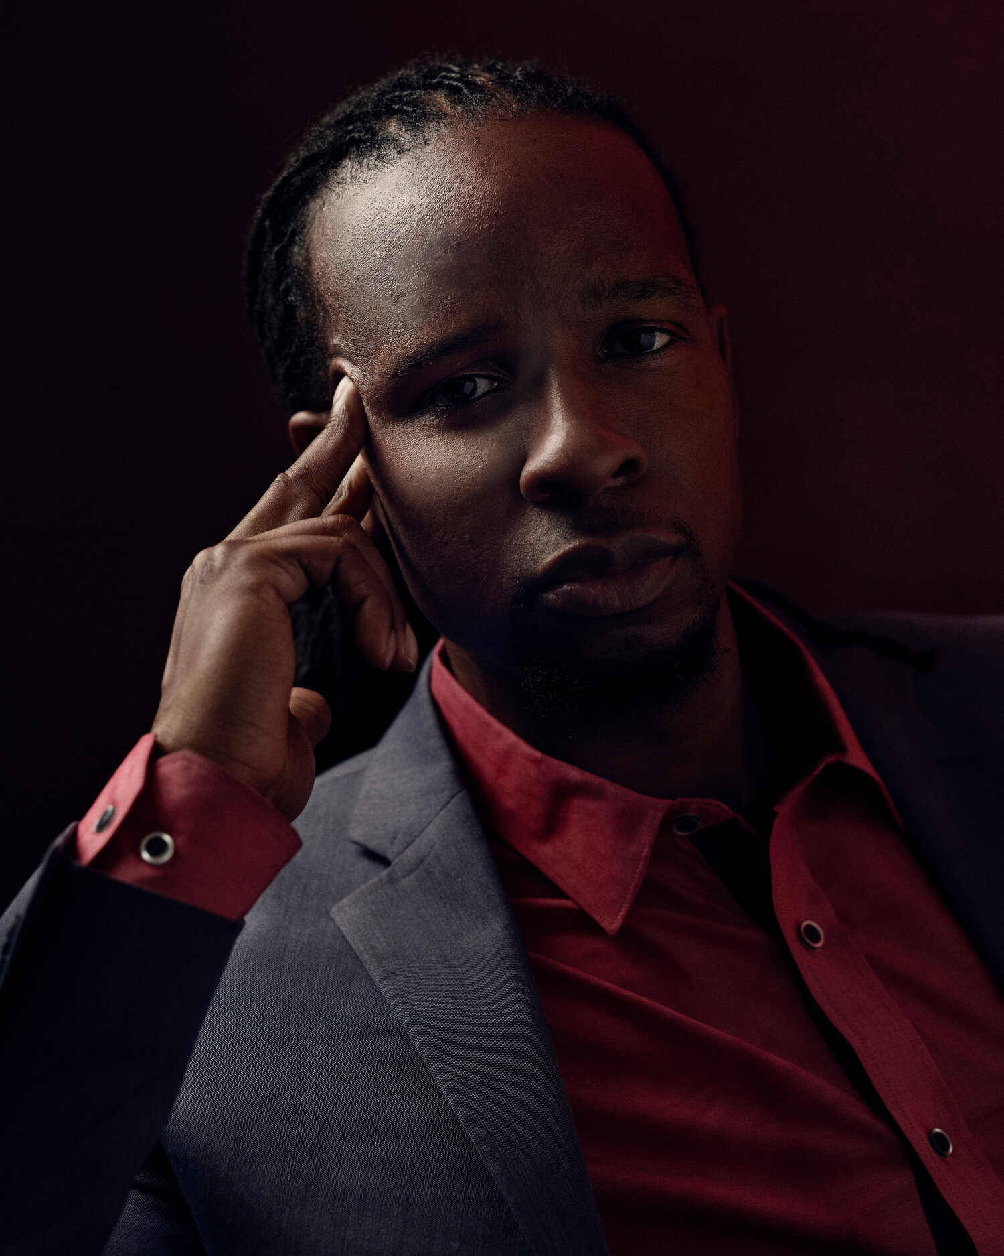
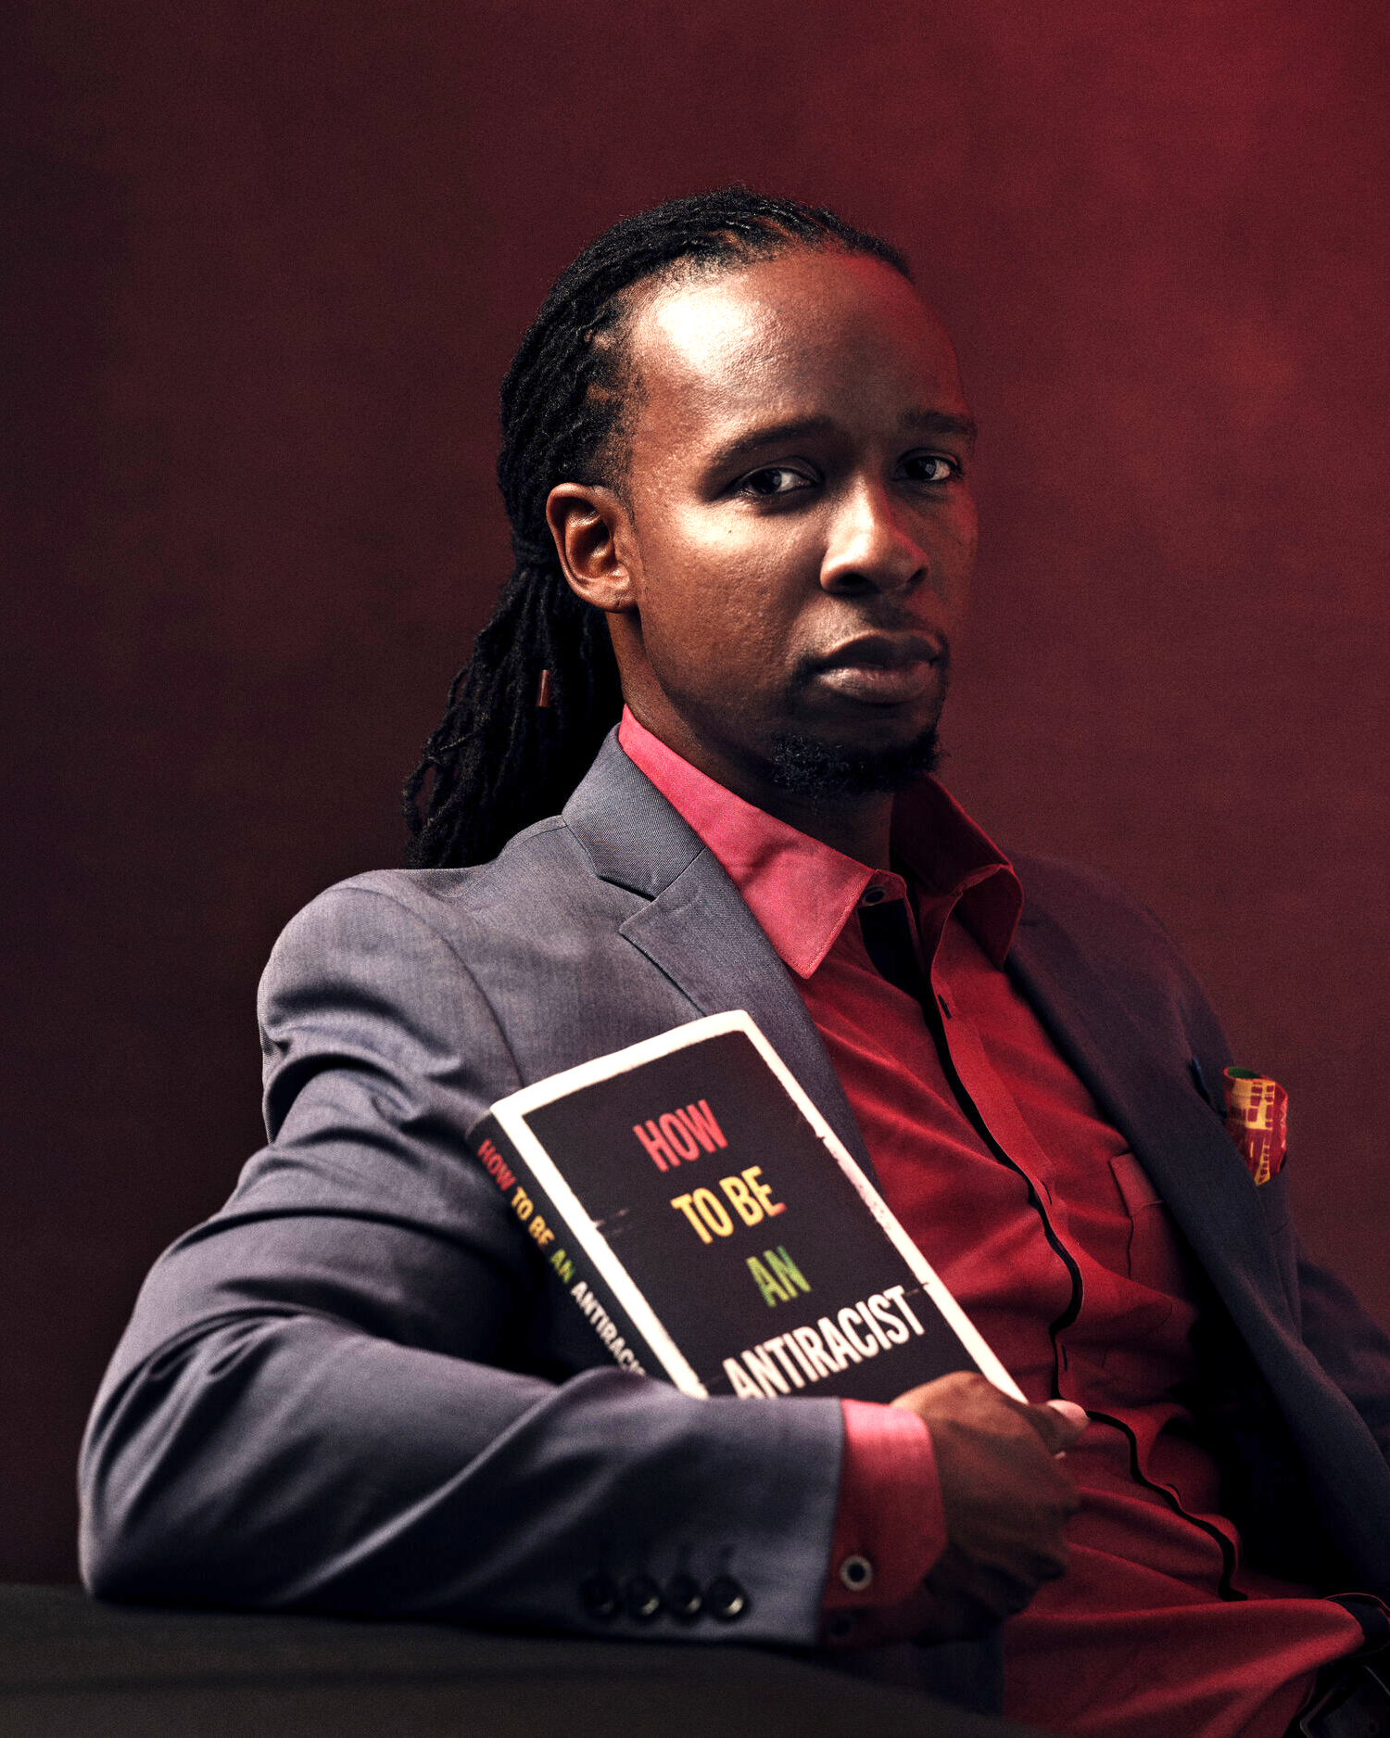
IBRAM X. KENDI
Andrew W. Mellon Professor in the
Humanities and the founding director of the
Boston University Center for Antiracist Research
#1 New York Times best-selling author,
How to Be an Antiracist

Slide 2
RACIST
One who is supporting a
racist policy through their
actions or inaction or
expressing a racist idea.

Slide 3
ANTIRACIST
One who is supporting
an antiracist policy through
their actions or expressing
an antiracist idea.

