Slide 1
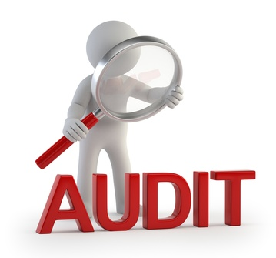

Preparing for an FDA Clinical Investigator Inspection
Terry Sousa, RN, MSN, CCRC, CIP
Manager, Quality Improvement
Office of Clinical Research

Slide 2

The FDA called! We’re being audited!!

Slide 3
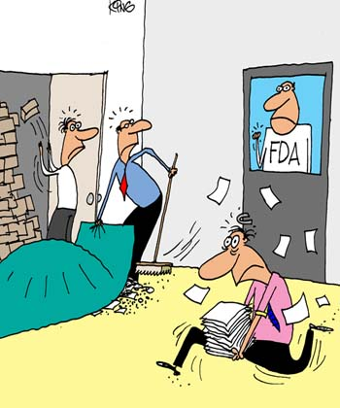
“You -- close these investigations, You -- Hide those protocols, and You -- Get the person who wrote the response to the last audit."

Slide 4
Don’t Panic!
Understand the purpose of an FDA inspection
Notify the appropriate people
Preparation is easy if you are ready for an audit at all times

Slide 5
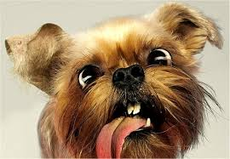
Why me, why now?

Slide 6
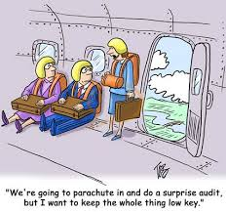
Purpose of FDA inspection
“The FDA inspection is designed to determine compliance with FDA regulations and statutory requirements governing the use of investigational products and human subject protection.”
Pre-inspection announcement usually occurs within 5 days of site visit. This is a courtesy. FDA may conduct unannounced inspections.

Slide 7
Types of Inspections
Surveillance inspections – also known as routine inspections: to verify accuracy and reliability of data sent to FDA
For-cause inspection: As a result of complaint, sponsor concerns, termination of a clinical site, inconsistencies or inaccuracies in data submitted as part of an application

Slide 8

The inspection typically involves:
Interviewing site personnel
Comparing site data with sponsor or FDA data
Evaluating systems to protect human subjects
Determining adherence to the investigational plan
Touring the investigational site including IDS
Copying documents

Slide 9
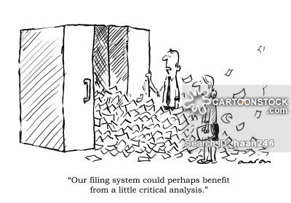
Preparing for the Audit
Know the IRB policies and procedures
Know the protocol like the back of your hand
Documents should be organized, complete and readily available
Maintain all correspondence: letters, faxes, emails, phone contacts, memos
Obtain access to electronic records – print documents if necessary
Take sticky notes off files, clean up and de-clutter all study binders
Perform a self assessment by completing the QI Checklist tools
If your site has SOP’s, the FDA will likely review those

Slide 10
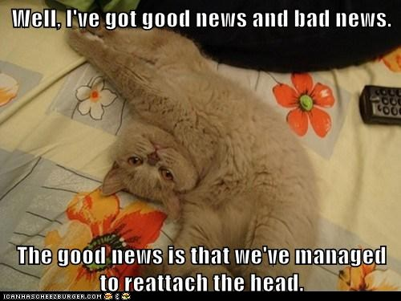
Notify the appropriate parties
Contact IRB – complete an RNI on the eIRB system
Call the Sponsor
Office of Clinical Research – contact Meg Johnson
Investigational Pharmacy
Institutional officials as appropriate

Slide 11
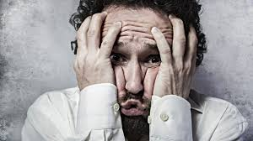
FDA Arrives
Stay cool and calm
Be courteous and responsive to FDA personnel
First impressions mean everything, be professional!

Slide 12

Beginning of the audit
Form 482 – Notification of Inspection (allows the field inspector the right to enter and inspect the clinical site)
Inspector will show you his credentials. Ask for them if they are not provided.

Slide 13
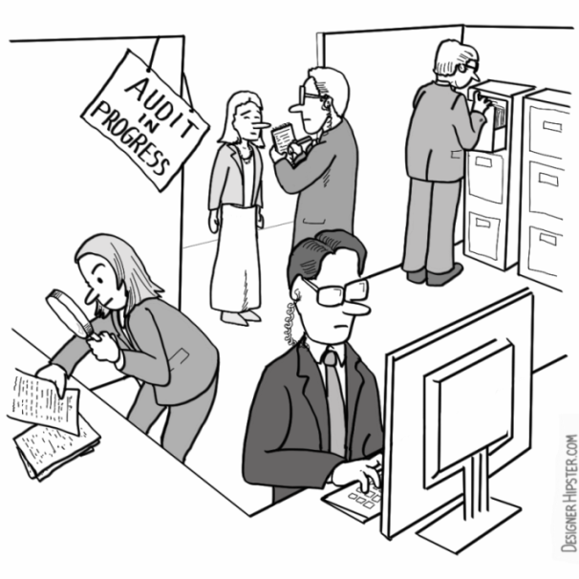
During the Audit
Retrieve information as requested. Let them ask for what they need, offer no more.
Have someone available on hand, but don’t hover
Set them up in a quiet conference room or space
Be prepared to provide a tour of the facility
Realize the inspector may have done a Google search on study progress and clinicaltrials.gov registration.
Take notes of what the inspector is auditing. If asked to make copies, make a copy for yourself

Slide 14
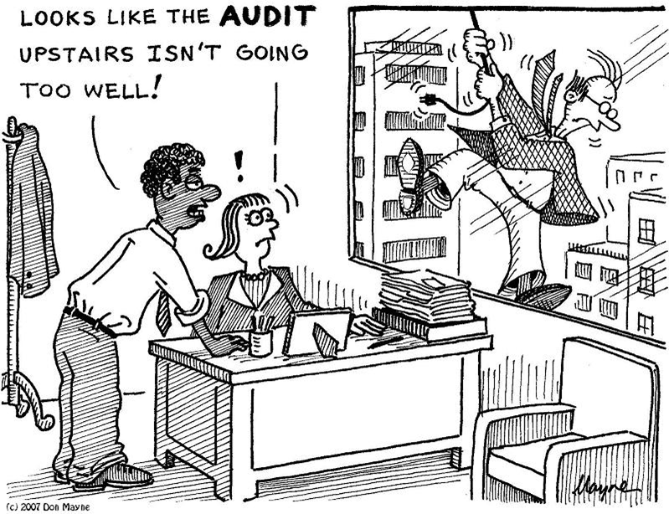
End of Each Day
You may ask about the progress of the audit
Take this opportunity to ask questions or to clarify misunderstandings
Make sure everything is returned back to you on the final day

Slide 15
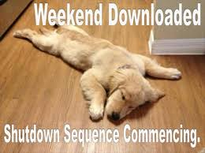
Inspection Conclusion
The Field Inspector conducts a closeout meeting with the clinical investigator
The Field Inspector may issue a Form 483 Inspectional Observations, which sites significant deviation from the regulations.
The Form 483 sites the inspector’s opinion and does not represent a final FDA determination

Slide 16
Common Deficiencies that may prompt a Form 483
Failure to follow the investigational plan/protocol
Failure to maintain case histories
Inadequate drug/device accountability
Failure to obtain adequate informed consent
Inadequate SAE reporting
Failure to submit progress reports
Failure to follow IRB approval requirements

Slide 17

I got a Form 483?!? Now what?

Slide 18
Post Inspection Process
Take time with the inspector at the conclusion of the inspection to review the Form 483
  Gain an understanding of observations noted and assure their accuracy
  Understand the broader message the agency is sending (ie is the investigator supervising the study appropriately?)
  Identify and discuss any errors in observations
  Ask questions! Don’t be defensive.
  Demonstrate awareness of applicable regulations
Respond formally in writing
  Not required, but FDA highly recommends and it demonstrates good practice
  Respond within 15 days or the agency does not have to consider the response in their decisions for subsequent actions
  If convincing information is provided regarding an observation, it may be deleted from the 483.

Slide 19
Post Inspection Process (cont’d)
Escalation of the findings
Upon returning to the FDA District Office, the inspection team writes an Establishment Inspection Report (EIR) which elaborates and expands on the inspection observations.
The EIR is reviewed, and if the conditions it describes are serious enough in the minds of the reviewing officials, a Warning Letter may follow.
A Warning Letter indicates that higher level FDA officials have reviewed the inspection findings and conclude serious violations may exist.
A poorly written 483 response may increase the likelihood of a subsequent Warning Letter.
Warning Letters are issued for significant violations that may lead to enforcement action if not promptly and adequately addressed.

Slide 20
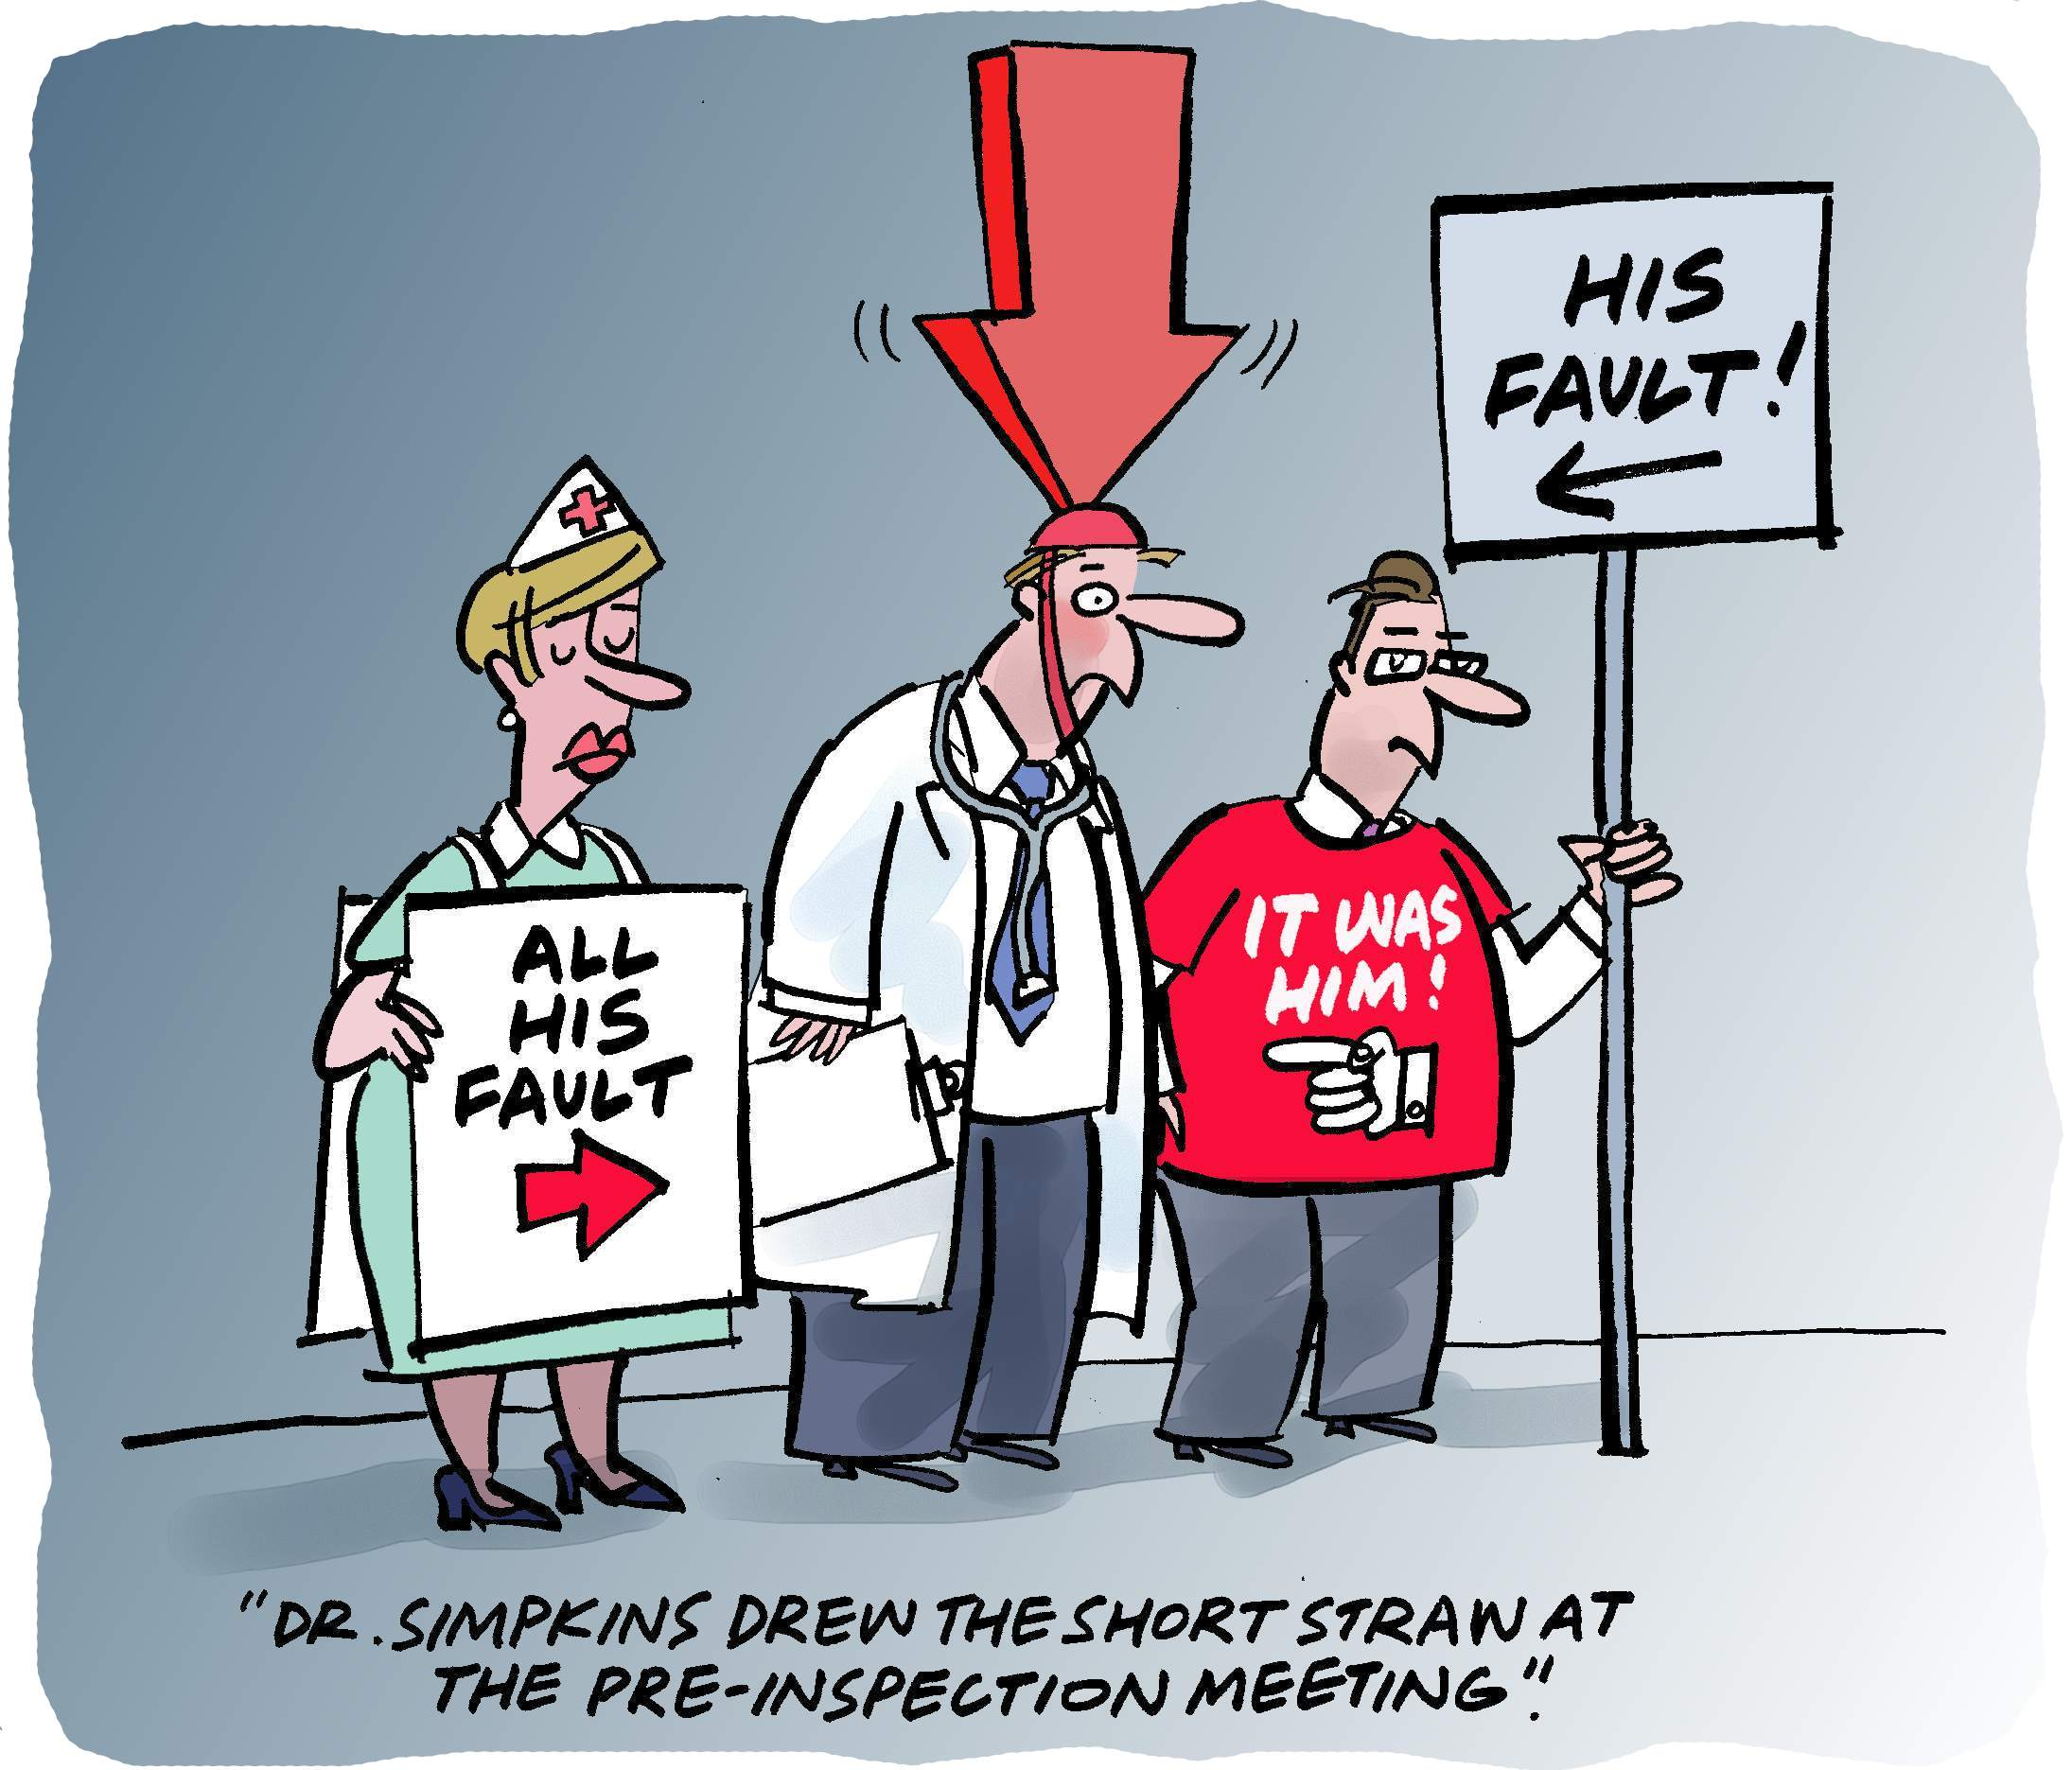
The buck stops with the Investigator

Slide 21
References
Information Sheet Guidance for IRB’s, Clinical Investigators, and Sponsors.
FDA Inspections of Clinical Investigators.
http://www.fda.gov/downloads/RegulatoryInformation/Guidances/UCM126553.pdf
UMass QI Self Assessment tools:
http://www.umassmed.edu/ccts/human-research/hrpp-qaqi/
QI Manager, Office of Clinical Research
Teresa.Sousa@umassmed.edu
508 856-1960

