Slide 1

  Translating Basic Discoveries
  into
  Applied Technologies
  and
  Product Candidates
Peter H Reinhart

Slide 2
What is IALS?
The Institute for Applied Life Sciences (IALS) catalyzes the translation of basic science into candidate medical devices, biomolecules, and delivery vehicles beneficial to human health and well being
IALS establishes collaborations with industry
IALS trains a workforce skilled in the discovery, prototyping, and manufacture of medical devices and biomolecules

Slide 3
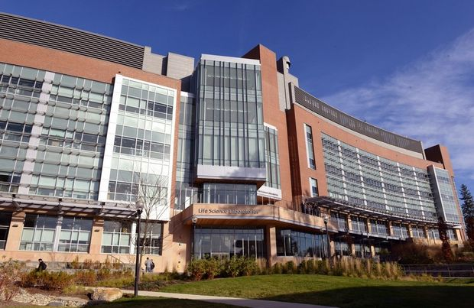
IALS – The Infrastructure
IALS was created by investments from the MLSC and the University
New Building & Fit-out (Life Science Laboratories, 6 floors)
Equipment to Establish Core Facilities
Faculty and professional staff hires
LSL-North
Houses Interdisciplinary Research ‘Clusters’
18 Core Facilities have started operations
LSL-South (To be completed Q3, 2016)
Houses >20 new Core Facilities
New faculty and professional staff related to biomedical devices and product development
Contains industry collaboration space, new faculty space, and professional staff for Core Equipment Facilities

Slide 4
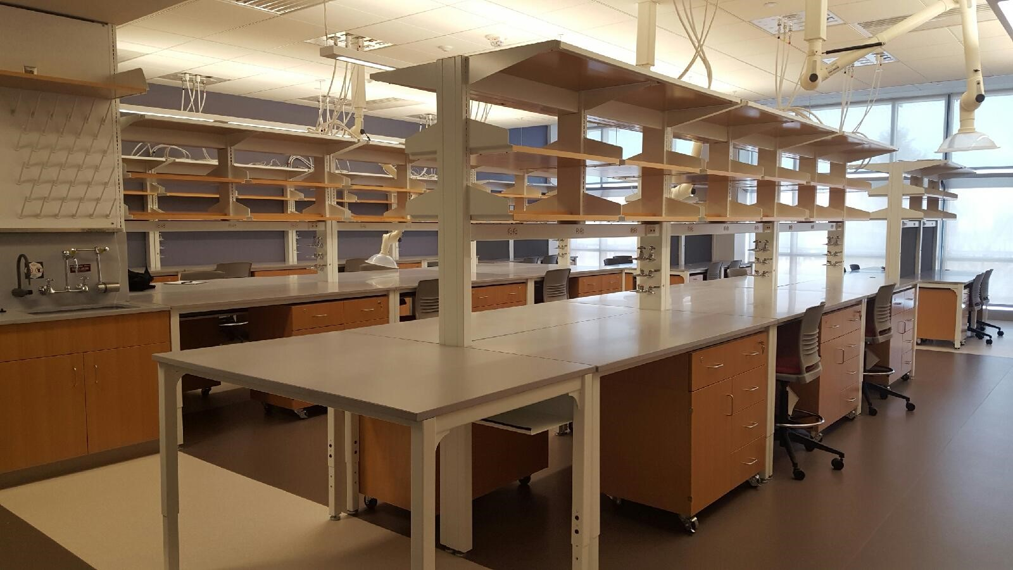
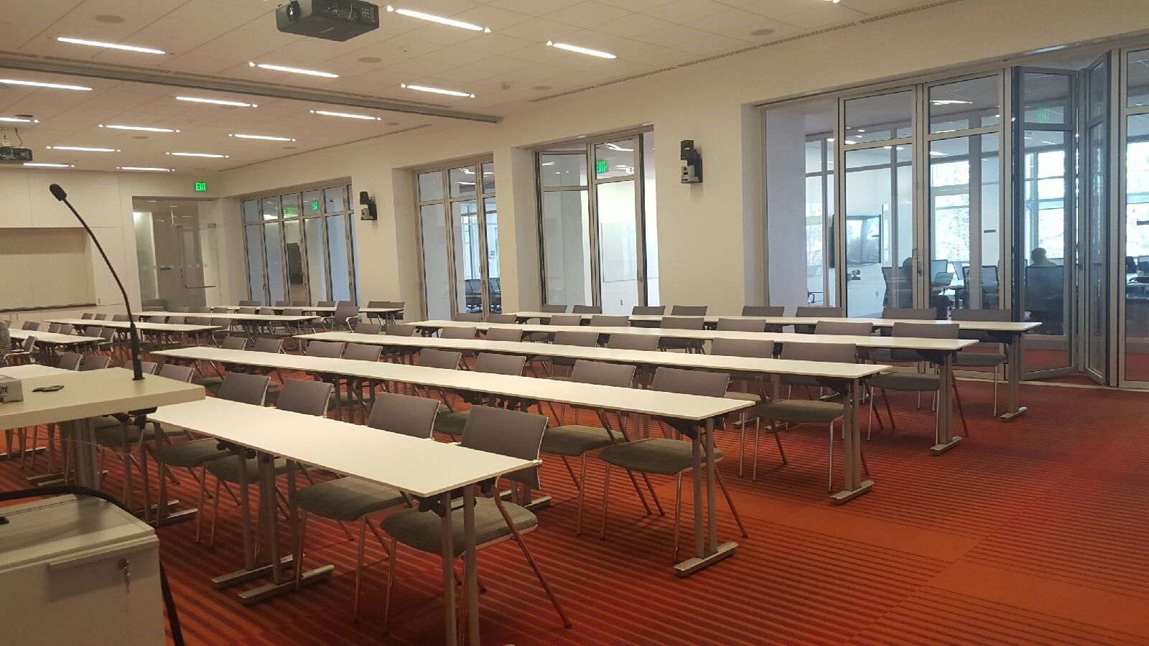
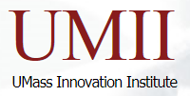
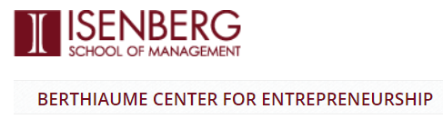

IALS by the Numbers…
~180 Faculty
~21 Departments
~30 Core equipment facilities
3 Centers (M2M, CBD, CPHM)
New Contracting & IP Offices:
Tech Transfer Office
UMass Innovation Institute
Berthiaume Center for Entrepreneurship, Isenberg School

Slide 5
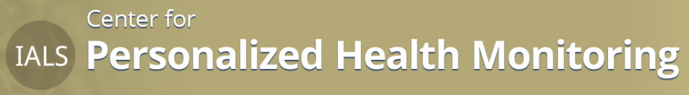
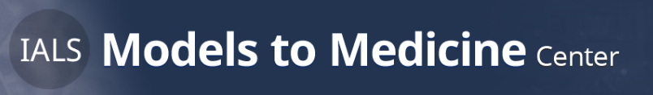
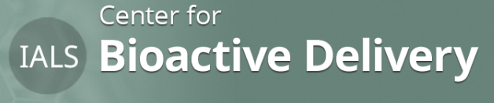
IALS is made up of Three Centers:
Each Center has Prioritized Research Programs
Design, prototype, and manufacture low-cost, wearable, devices and acquire and validate human behavioral data
Human Motion, Sleep, Energy, & mHealth
Manufacturing & Prototyping
Test Bed for Low-Cost Sensor Platforms
Design & Integration
Testing & Analytics
Outcome Monitoring
Identify and validate new pathways, therapeutic targets and lead molecules, as diagnostics and therapeutics
Cancer
Cellular Dynamics
Developmental Mechanisms of Neural Function & Disease
Genetics, Genomics & Epigenetics
Infection & Immunity
Integrated Plant-Microbe Genomic Systems
Protein Homeostasis
Membranes in Biology & Medicine
Develop innovative delivery vehicles with optimal performance characteristics for drugs and nutritional bioactive molecules
Carrier Technologies
Carrier/Bioactive Cargo Combinations
Nutraceuticals

Slide 6
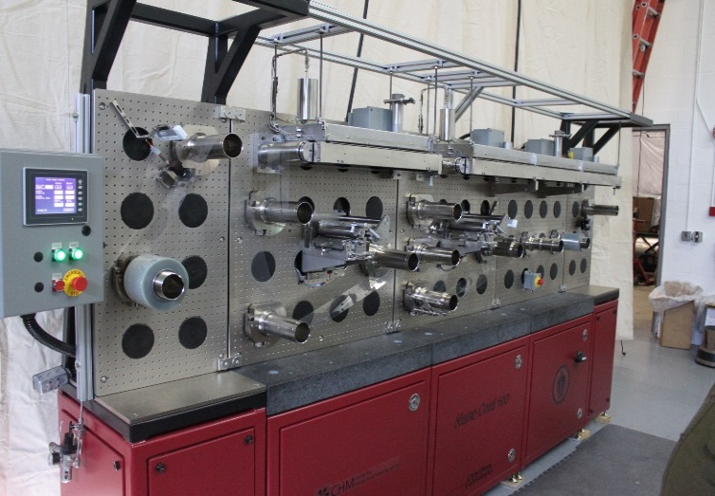
Centralized Core Equipment Facilities:
  Centralized >30 Core Facilities
    One-stop shopping to access all facilities
    Fast contracting
    Competitive rates
  State of the Art Capabilities
    Sleep labs, exercise intervention labs, human living science labs, and sleep monitoring labs established
    mHealth Labs integrates “Analytics + Wearables + Testbeds” allowing mobile health to achieve full potential
    Siemens 3T MRI/S instrument
    Carpe Diem R2R manufacturing equipment
    Whole-room calorimeters for human energy metabolism studies
    Microscopy ‘Center of Excellence’ sponsored by Nikon
IALS CORE FACILITIES
Roll to roll test frame for the development of modular R2R processes and equipment
http://www.umass.edu/ials/core-facilities
Evo 2200 Plus R2R Pick and Place/Bonding
Tool for Hybrid Integration

Slide 7
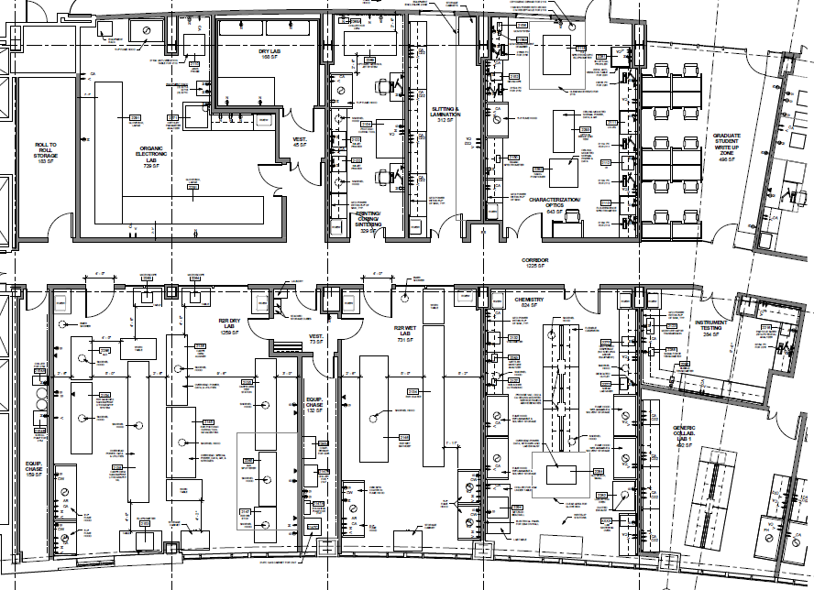
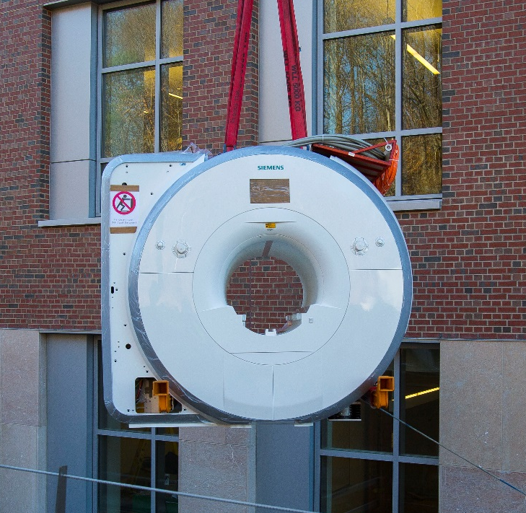
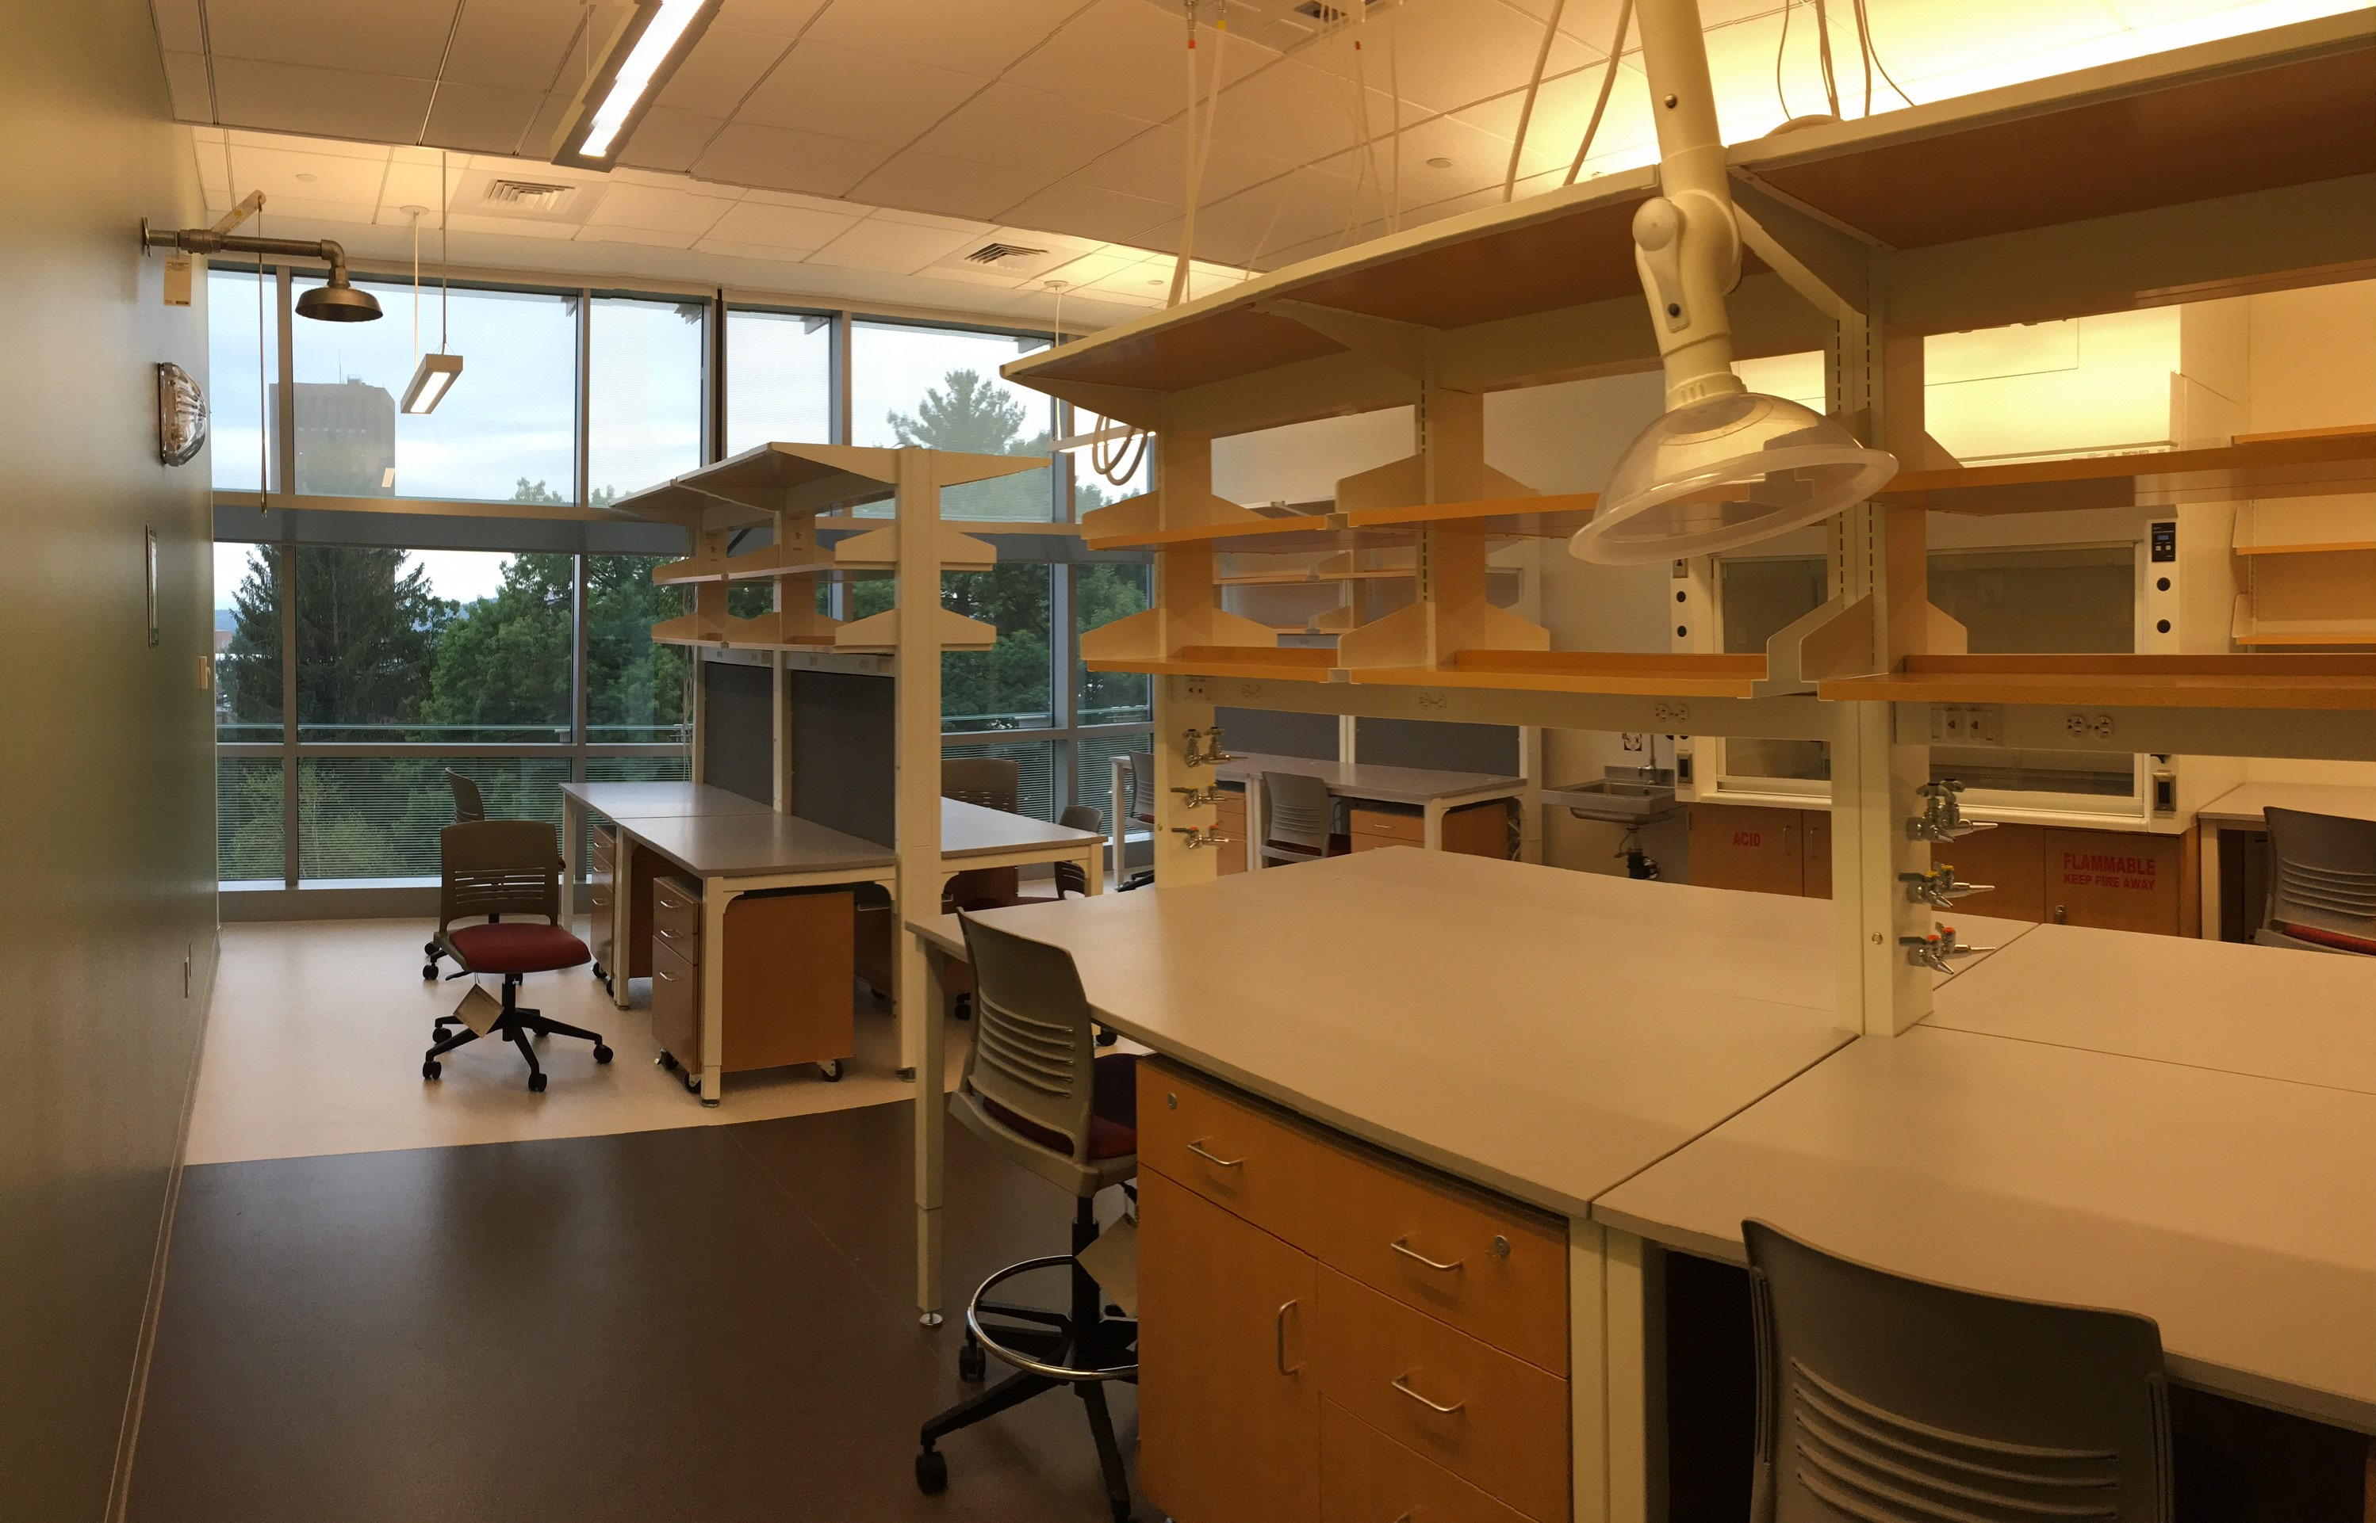
Assets: Core Facilities and ‘Collaboratories’:
Capabilities available to Industry
Slit/Laminate
Print
Cure
Sinter
Optics
Lab
Organic Electronics
Class 10,000 R2R
Clean Room Facility
Chemistry
Collaboratory
IALS Core Facilities available to Industry partners
‘Collaboratories’ support on-site industry projects, and incubation of new ‘start-ups’

Slide 8
More than 30 Core Facilities Available
Device Fabrication / Engineering
AddFab, 3D Printing
Device Characterization
Device Fabrication (Clean Room)*
Electronic Materials *
Electron Microscopy *
High Frequency Sensors
Nanofabrication (Clean Rom)
Sensor Integration
R2R Manufacturing (Clean Room)
X-ray Scattering Facility
Atomic Force Microscopy *
Human Health
Exercise Testing/Training Lab
Human Technology Interaction Lab
Living Science Core
Mobile Health
MRI/S 3T Human subjects
Room Calorimetry
Sleep Monitoring Research
Discovery
Animal Imaging
Biophysical Characterization *
Bioproduction/Separation
Cell Culture
Raman Scanning Confocal
Flow Cytometry *
Genomics *
High Throughput Screening Light Microscopy *
Mass Spectroscopy *
NMR *
Nutraceuticals
Mass Green High Performance Computing Center*
For access information: contactials@umass.edu or (413) 577-4578

Slide 9
IALS will Establish a ‘Portfolio’ of Interdisciplinary Projects
Biomedical / Manufacturing Industry &
Multi-Investigator Grant Applications
Portfolio Projects
Institute of Applied Life Sciences
Translational
Biochemistry
Microbiology
Neuroscience
Polymer Science
Computer Science
Animal & Vet Science
Electrical Engineering
Kinesiology
Chemistry
Mechanical Engineering
Basic
IALS spans many departments and colleges to develop a partnering portfolio

Slide 10
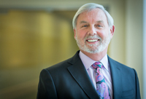

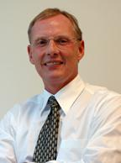

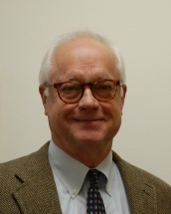
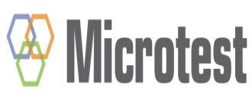
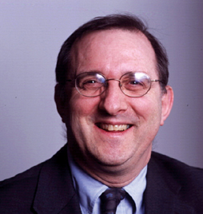
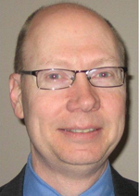
Developing a Strategy and Portfolio
IALS Industry Advisors
Charles “Chuck” Sherwood
CEO, Anika therapeutics
Will Melton
Exec Dir,
Development (ret)
Steve Richter
Avista / Microtest
Mark Trusheim
Co-Bio Consulting
Robert Gottlieb
Co-Bio Consulting

Slide 11
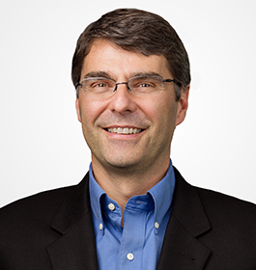
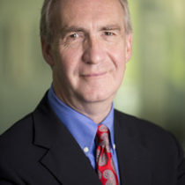
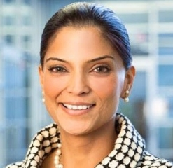
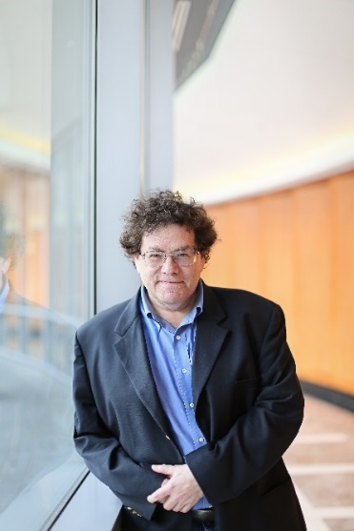
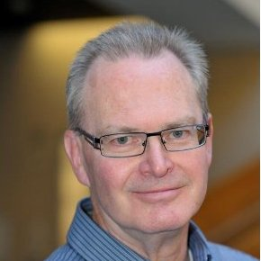
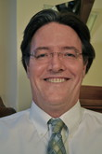
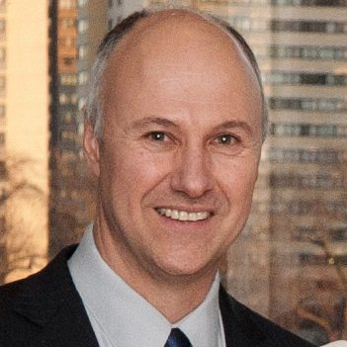
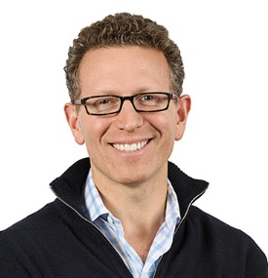
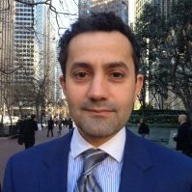
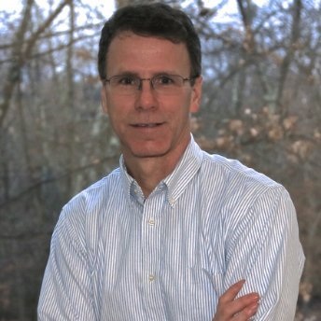
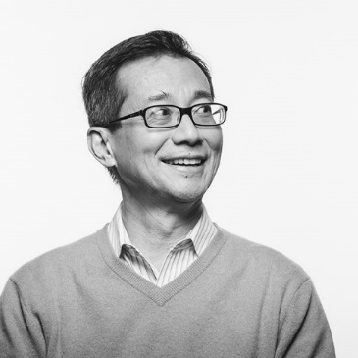
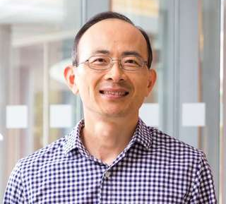
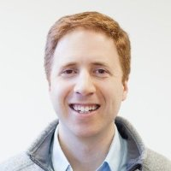
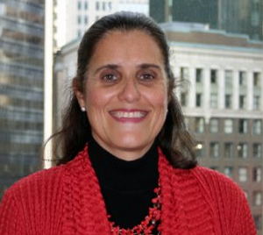
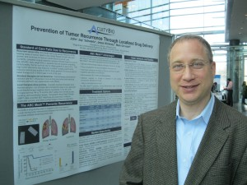
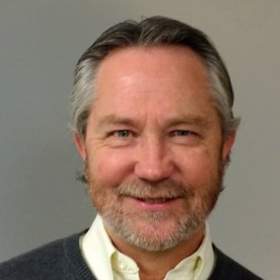
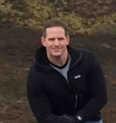
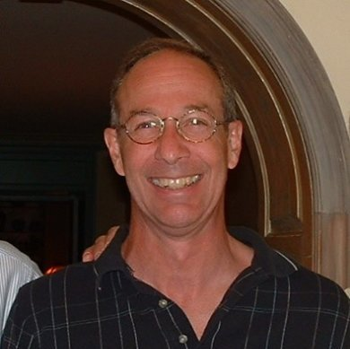
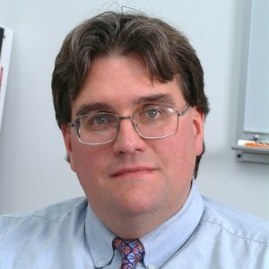
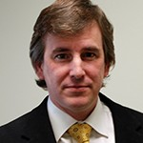
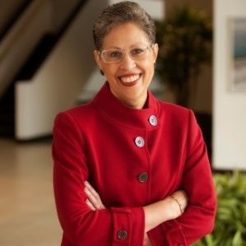
Pressure Test Project Ideas…
Center Industry Advisors
Mark Namchuk,
Alkermes
“Ronnie” Farquhar
Morningside Ventures
Rajni Aneja
Novartis
Steve Projan
MedImmune
Richard Korsmeyer
Pfizer
“Larry” R. Dick,
Takeda
Steve Faraci
Cyta Therap
Jason Rhodes
Atlas Venture
Christo Shalish
Warp Drive Bio
Herren Wu
MedImmune
Matt Diamond
Misfit
Richard Gregory
Immunogen
Gene Liau
Precision BioSciences
Christina DeMur
Entrepreneur in Residence
“Jay” Schwartz
AcuityBio
Mark Boden
Boston Scientific
Chris Palmer
US Naval Command
Peter Given
Keurig Green
Mountain
Dan Baril
Baril Corporation
“Bob” Miller
Sanofi
Susan Windham-Bannister
Biomedical Growth Strategies

Slide 12
IALS and the Centers
Research Theme Development
Center Leaders & Steering Committee
M2M Leadership
Peter Chien (BMB and Chemistry), Director
Jeanne Hardy (Chemistry), Co-Director
Shelley Peyton (Chemical Engineering), Co-Director
M2M Steering Committee
Courtney Babbitt (Biology)
Ana Caicedo (Biology)
Peter Chien (Biochemistry & Molecular Biology)
Lila Gierasch (Biochemistry & Molecular Biology)
Jeanne Hardy (Chemistry)
Mike Henson (Chemical Engineering)
D. Joseph Jerry (VASCI)
Barbara Osborne (VASCI)
Shelly Peyton (Chemical Engineering)
Peter Reinhart (IALS)
Heather Richardson (Psychological & Brain Science)
Maria Santore (Polymer Science & Engineering)
Celia Schiffer (UMMS)
Jessica Schiffman (Chemical Engineering)
Pat Wadsworth (Biology)
Wilmore Webley (Microbiology)

Slide 13
IALS and the Centers
Research Theme Development
Center Leaders & Steering Committee
CPHM Leadership
Jim Watkins (PSE), Director
Sundar Krishnamurty (MIE), Co-Director
Patty Freedson (Kinesiology), Co-Director
CPHM Steering Committee
Joseph Bardin, ECE
Patty Freedson, Kinesiology (not attending)
Deepak Ganesan, Computer Science
Robert Jackson, Jr., Electrical & Computer Engineering
Jeffrey Morse, Mass NanoTech Institute
Rebecca Spencer, Psychology & Brain Sciences
Richard Van Emmerik, Kinesiology
Jane Kent, Kinesiology
Jim Watkins, PSE
Sundar Krishnamurty, MIE
Annette Wysocki, Nursing

Slide 14
IALS and the Centers
Research Theme Development
Center Leaders & Steering Committee
CBD Leadership
S. Thai Thayumanavan (Chemistry)
Barbara Osborne (VASCI)
CBD Steering Committee
Gregory Tew (Chemistry)
Eric Decker (Food Science)
Neil Forbes (Chemical Engineering)
Vince Rotello (Chemistry)
Todd Emrick (PSE)
Barbara Osborne (VASCI)
S. Thai Thayumanavan (Chemistry)

Slide 15
IALS – Seed Grants Overview
  Purpose:
To catalyze translational science facilitating development of innovative products/services and enabling competitive external translational funding (such as SBIRs and STTRs).
  For 2016, up to 6 Translational Proof of Concept Grants:
    Up to $50K for 12 months, with 6-month review
    Designed to generate proof-of-concept evidence towards development and significant private sector or SBIR/STTR funding
    Industry, UMMS collaboration encouraged
    May support CROs or other IALS facilities and personnel costs

Slide 16
IALS – Prioritized Seed Fund Applications
Katherine Boyer: “Device (Misfit/Shine) Detection of Change in Physical Activity: Evidence and Translation for a new Clinical Outcome Tool” (Misfilt/Shine Matching Funds)
Michelle Farkas: “Harnessing Macrophages as Cell-Based Delivery Agents for Cancer Imaging and Treatment”
Jeanne Hardy: “Furoxan-based Caspase-6 Inhibitors for Treatment of Neurodegeneration”
Karen Kalmakis: “Real-time continuous cortisol monitoring: An innovation for stress self-management”
Vince Rotello: “Nanoparticle-stabilized nanocapsules (NPSCs) delivering RNA Therapeutics for Non-Hodgkin's Lymphoma”
Yubing Sun: “Self-powered integrated blood separation and SERS-based immunoassay (SIBSI) device for point of care analysis of pancreatic cancer biomarkers”
Jim Watkins: “Autonomous Sensor Platforms for In-Home and On-Body Health Monitoring of Movement, Temperature, Breath, and Sweat” (Sekisui Chemical Matching Funds)

Slide 17
IALS: What does IALS offer?
Enable Translational Research Themes – “Translational Research Theme Support”, access to ‘IALS Seed Grants’ to catalyze industry collaborations, and ‘IALS Core Facility Grants’ for use of Core Labs.
Translational Equipment: access to ~30 managed Core Equipment Facilities
Multi-Investigator Grant Support: to develop industry alliance ‘pitches’ and federal/state/foundation grant writing/submission support
Start-up Company Education: faculty & student mentoring in translational approaches and Entrepreneurship (in collaboration with Isenberg School of Business, Berthiaume Center for Entrepreneurship, and Entrepreneurs-in-Residence)
Start-up Company Support: from concept to preliminary data/prototypes to solving legal/IP/conflict-of-interest issues, to incubating the startup, value-inflections, and fundraising – with UMII and Technology Transfer
Access to ‘Collaboratories’ for establishing spin-out companies
Provide Access to Industry Partners - IALS is developing industry partners for collaborations and Industry Sponsorships
Project Management and industry pitch support for prioritized multi-investigator projects

Slide 18
IALS: Learnings and Thoughts…
Translational Team Science - Culture Shift? Many faculty want to focus on individual ‘basic science’, think of this as an either-or proposition
Translational projects often require a ‘Team Approach’: Science as a team sport is often not rewarded in an academic setting.
Clinical Development: Need clinical input (UMMS, Baystate etc.) from ‘stressed’ organizations.
Accountabilities: Are different for collaborative translational programs – for both federal/foundation funding and industry relationships
Rewards Structures not well set up for translational programs: Partnerships and ‘Milestone’ achievements not as recognized as publications, teaching records, and traditional grant funding
Business development & project management needs: These capabilities are well established in industry, much less so in academic environments
IP Strategy: Developing an IP plan estate is important for project development and partnering
Communicate, communicate, communicate…
Notes:
IGNITE: Innovation Grants to Nurture Initial Translational Efforts
CREATE: Cooperative Research to Enable and Advance Translational Enterprises

Slide 19




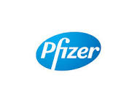
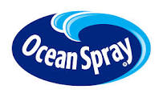

IALS: Snapshot
Building Fit-out: Building completion in September, 2016, and Opening Event October 21st, 2016
Translational Infrastructure: Created core equipment facilities, staffing for each core, state-of-the-art equipment, and collaboratories.
Seed Grants: Established POC and Core seed grant program
Partnerships: More than 15 Industry Partnerships in place even ahead of full operations
Funding: Numerous federal, state, foundation, and industry grants to advance internal and partnered projects
Start-ups: Multiple ‘Spin-out’ companies established, numerous others in planning stages
IP: Significant IP estate of provisional and issued patents

Slide 20
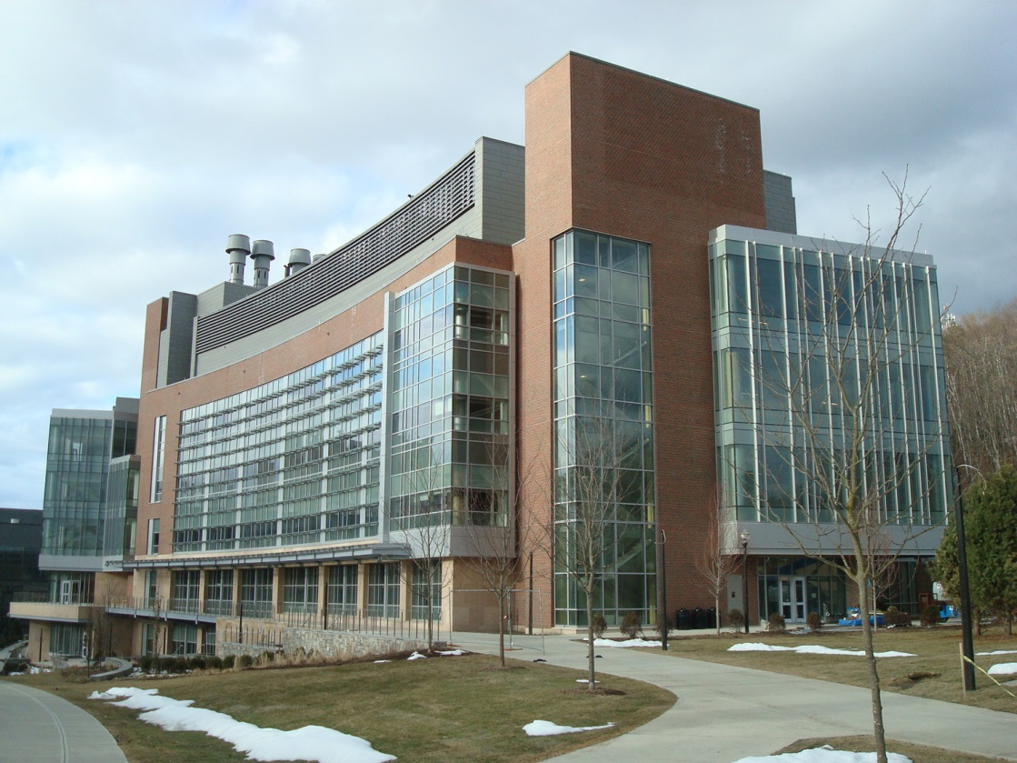
Developing a Translational Pipeline for Therapeutics, Diagnostics, and Devices Candidates
Further Questions?
Web: www.umass.edu/ials
Email: contactials@umass.edu
Phone: (413) 577-4578

