Slide 1



The Center for Microbiome Research and
Our Approach to Team Science
Beth A. McCormick, PhD
Professor and Vice Chair,
Microbiology and Physiological Systems
Founding Executive Director,
The Center for Microbiome Research
University of MA Medical School
Doyle Ward, PhD
Associate Professor, UMMS
Microbiology and Physiological Systems
Director of Operations,
The Center for Microbiome Research
Jeffrey Blanchard, PhD
Associate Professor, UMA
Biology
Co-Director
The Center for Microbiome Research

Slide 2
Overview
Introduction to the microbiome and microbial ecosystems
Mission and objectives of the CMR
CMR operations and project management
Project spotlights
Education Initiatives

Slide 3
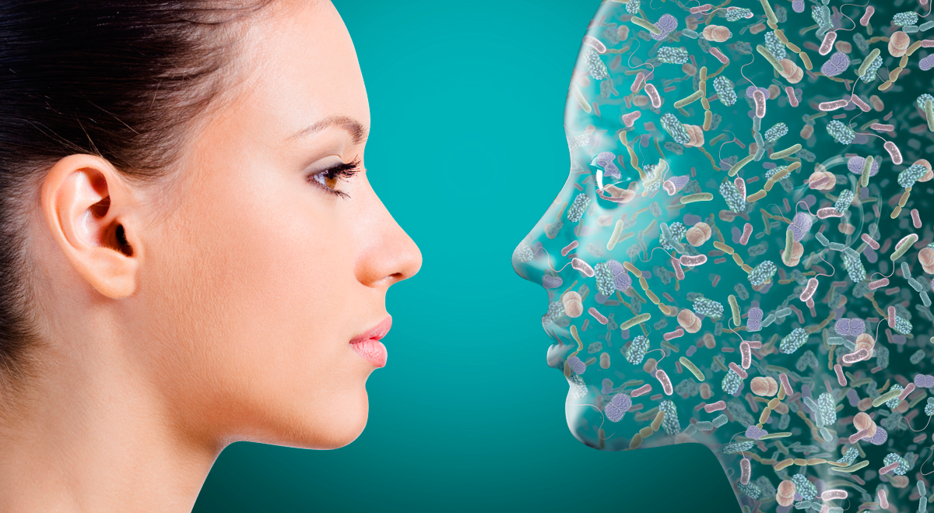
Eco-system on two legs
"Our Self-Portrait: the Human Microbiome" by Joana Ricou Illustration by Steven H. Lee

Slide 4
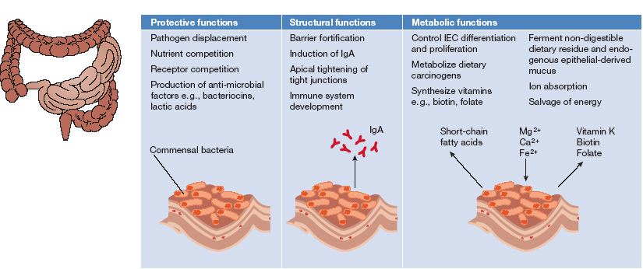
Functions of the Intestinal Microbiota
Notes:
The native colonizing bacteria perform various protective, structural, and metabolic functions on the intestinal mucosa, leading to the concept of the microbiota as a “virtual organ within an organ.” In fact, the microbiota have been called a “metabolic organ,” exquisitely tuned to our physiology that performs functions that we have not had to evolve on our own.”
Although the myriad functions of the native microbes colonizing humans are just beginning to be understood, it is believed that certain other microbes that are consumed and added to our microbial mix—known as probiotic bacteria—may use these same mechanisms to enhance or stabilize normal colonizing microbes

Slide 5
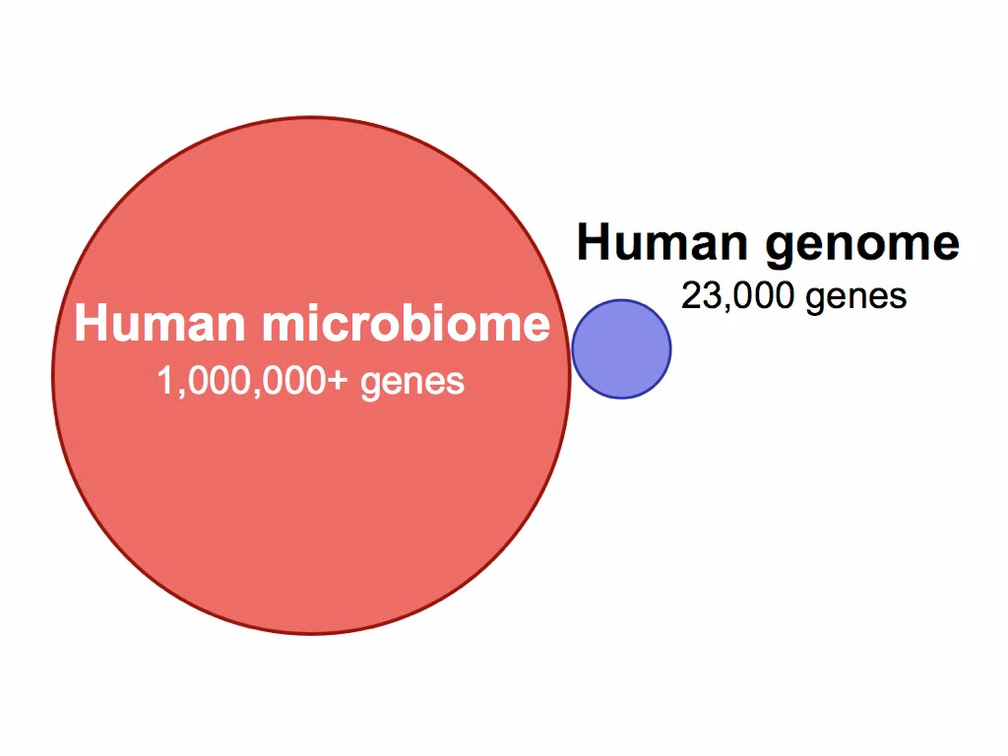
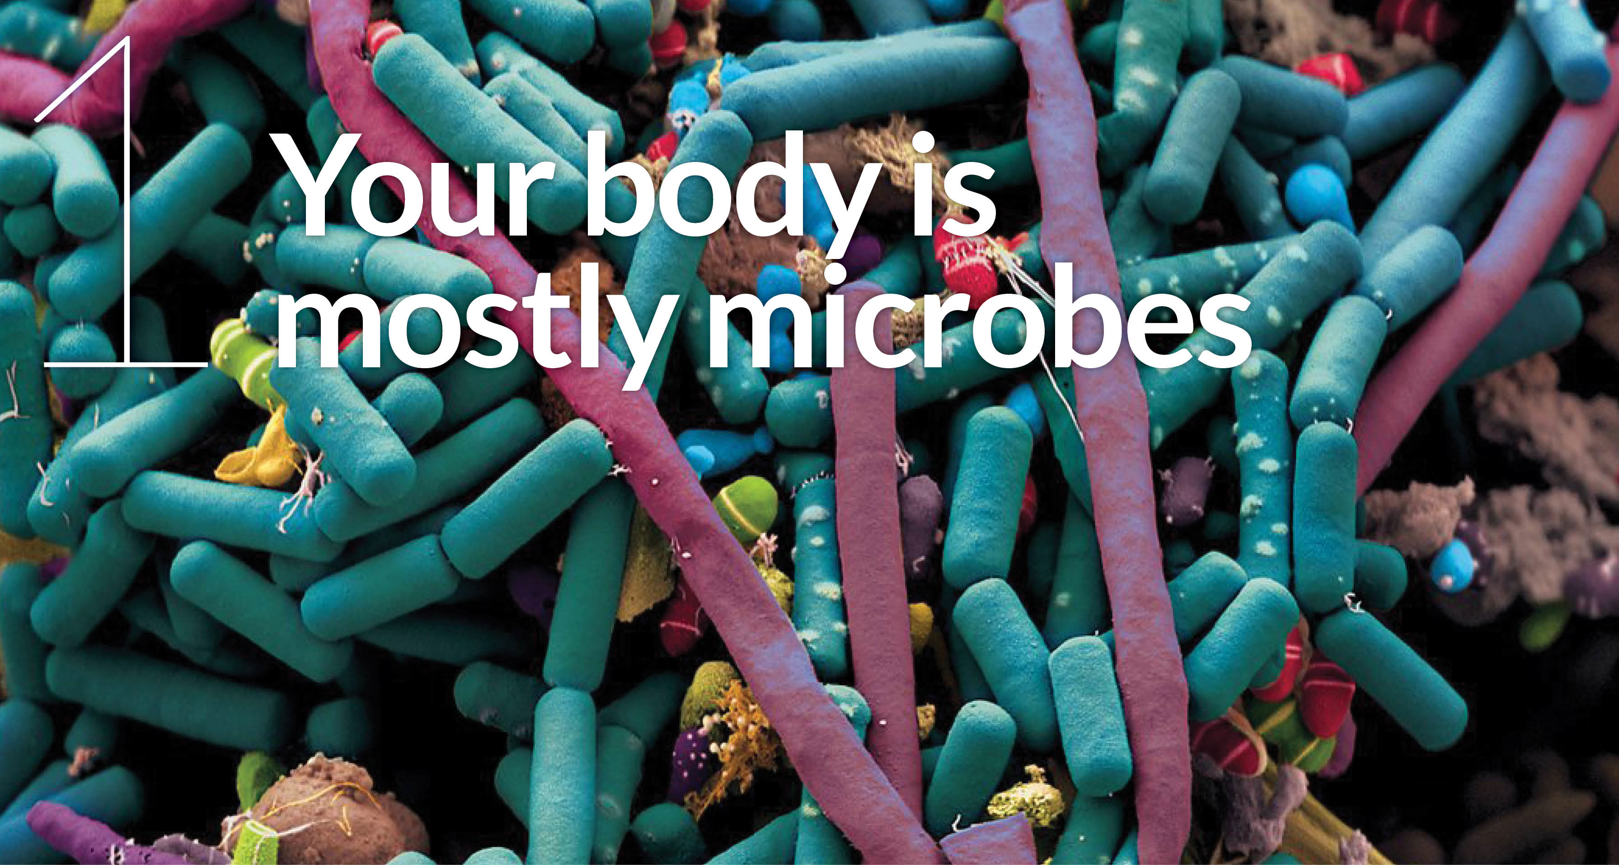
The second genome
Science and Society By Matt Crenson, December 2013
Bacterial cells outnumber your body cells 10:1 and comprise up to 4-6 lbs of your body mass

Slide 6
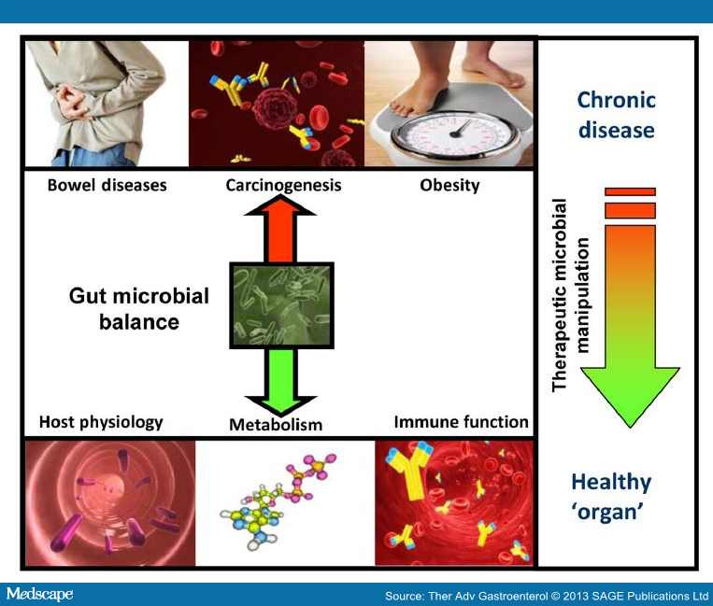
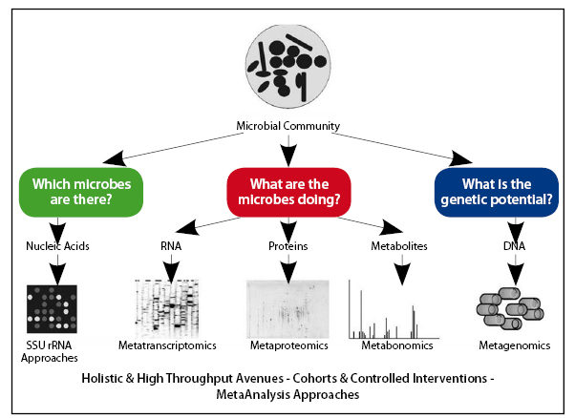
Intestinal Microbiota:
Role in Health and Disease
De Vos, WM. SelfCare 2012;3(S1):1-68

Slide 7
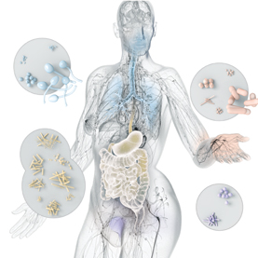
Alterations in the microbiome:
Immune status
Nutritional status
  Body weight/Obesity
  Nutrient absorption
  Autoimmune status
  Diabetes
  Cardiovascular disease
  Respiratory disease
Wound repair/fibrosis
Cognition/mood
Autism
Others

Slide 8
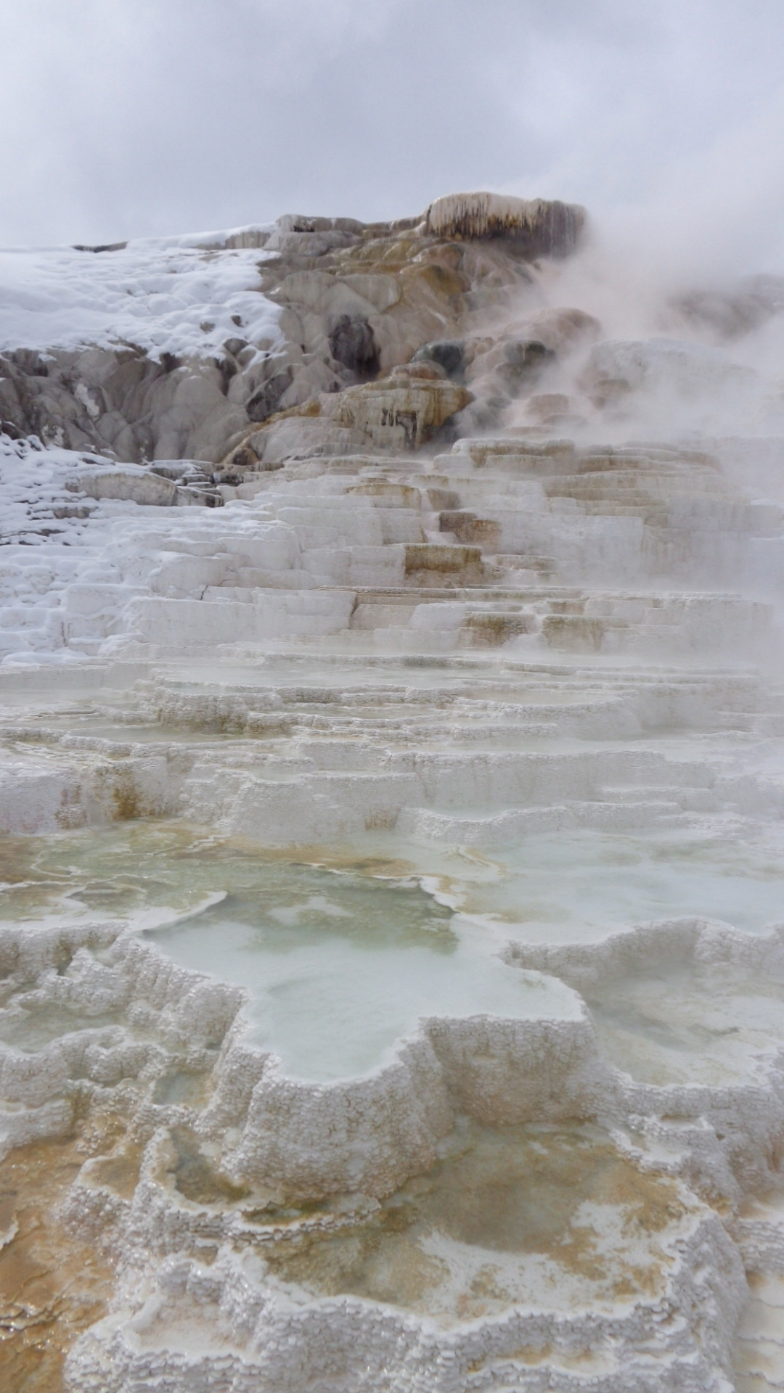
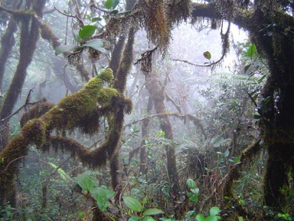
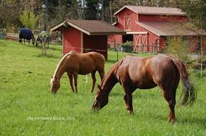
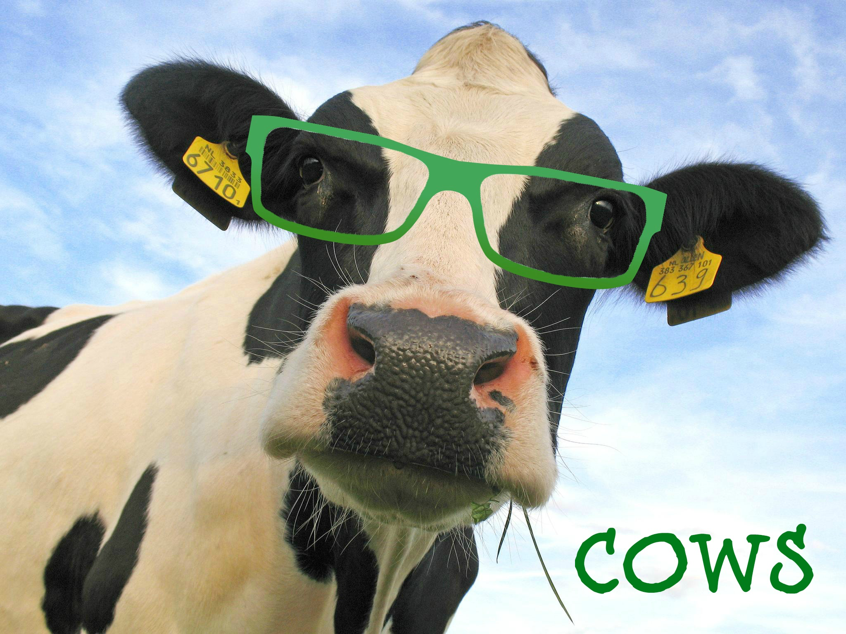
Environmental and Veterinary Sciences
Hot springs
Rain Forrest

Slide 9
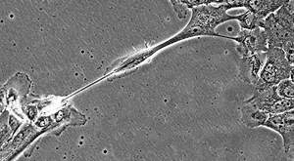
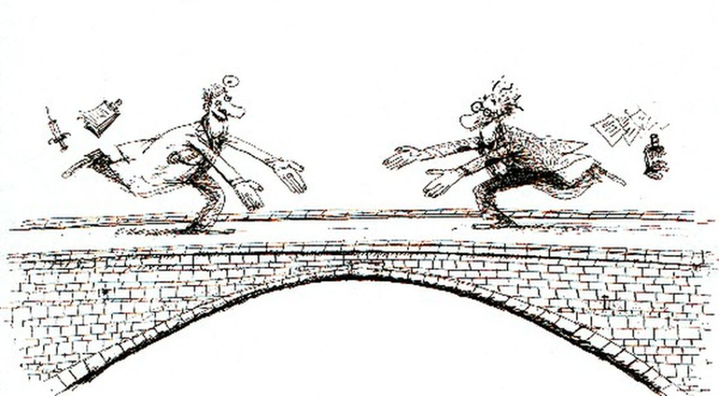
Microbiome sciences creates synergy
Clinical scientists
Statisticians
Clinicians
Engineers
Big Data management
Bioinformaticists
Product development
Regulatory/Legal affairs
Researchers/Scientists
Computer scientists
Entrepreneurs
Academicians
Mathematical modelers

Slide 10
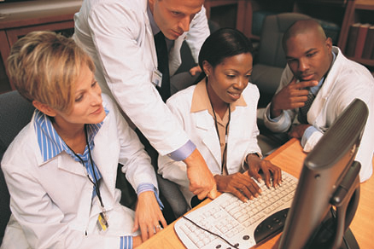
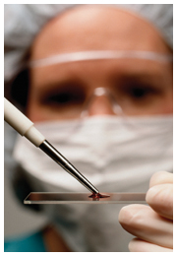

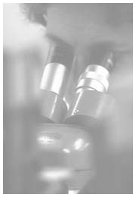
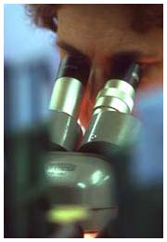
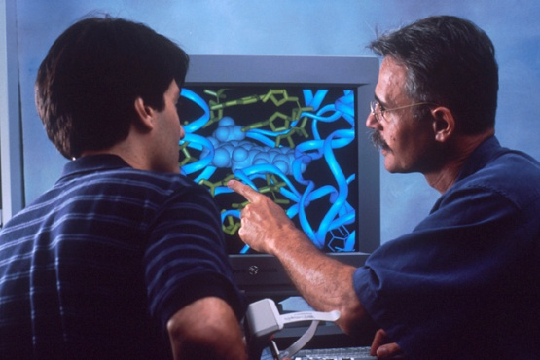
Impetus for the Center for Microbiome Research
Mission:
Define the interactions between the host, the microbes, and the unique environments that drive these ecological systems.
Objectives:
Provide infrastructure and resources to support all aspects of a Microbiome research enterprise at UMass.
Advance computational and bioinformatic resources to stimulate new partnerships across diverse research platforms.
Bridge interaction between basic scientists, clinical researchers, clinicians, and engineers/computer scientists within UMass.
Catalyze breakthrough discoveries in human, animal, and environmental health.

Slide 11


Sharing a Common Vision
Team Science
Connectivity
Partnerships
CMR Philosophy
Bridging
Institutions
Collaboration
Center for Clinical & Translational Science
- UMMS
Conquering Disease
Clinical Research Center
-UMMS
Institute for Applied
Life Sciences
-UMA
MassBiologics
- UMMS
Clinical integration
-UMMS
UMA Integrative Faculty:
Microbiology
Mathematics & Statistics
Biology
Chemical Engineering
Food Science
Veterinary & Animal Science
Program in Systems
Biology
- UMMS
Computing &Data
Visualization Center
- UMD
MGHPCC -
High performance computer cluster
Program in Bioinformatics
& Integrative Biology
-UMMS
Quantitative Health
Science
-UMW

Slide 12
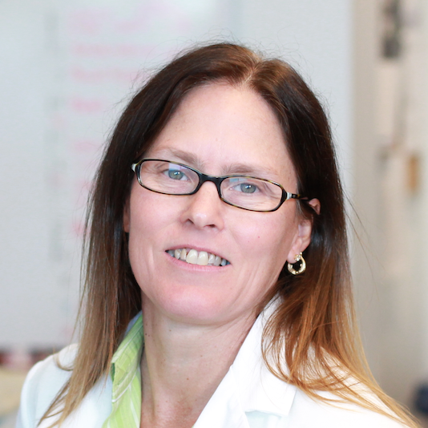
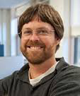
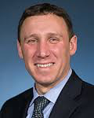
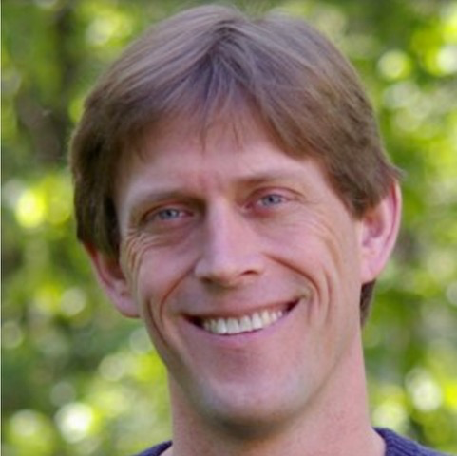
Leadership
Director:
Beth A. McCormick, Ph.D.
UMMS
Co-Directors:
Jeffrey Blanchard, Ph.D.
UMA
Randall Pellish, M.D.
UMMS
Director of Operations:
Doyle Ward, Ph.D.
UMMS

Slide 13

Operations and Project Management
Cluster Organization
  Chair
  Multi-campus faculty
  Different Departments
  Multi-disciplinary
Trainees
  Multi-campus
  Graduate and Medical Students
  Post-doc scholars
Integrated resources
  Multi-campus
  Multi-disciplinary
  Non-overlapping
Industry Partners
Research Resource
Cluster
Bioinformatics & Statistical
Analysis Cluster
Medical Informatics
Cluster
Industry/Organization Partners

Slide 14
Operations and Project Management Workflow
Scientists, Researchers
Clinicians
Beth McCormick, PhD
Doyle Ward, Ph.D
Jeffrey Blanchard, Ph.D.
Randy Pellish, MD
Industry
• Contact CMR leaders
• Define project and scope of work
• Assess resource needs
• Move the project forward
Research Resource
Cluster
Chair: David Sela, Ph.D.
UMA
Bioinformatics & Statistical
Analysis Cluster
Medical Informatics
Cluster
Jeffrey Bailey, MD., Ph.D.
UMMS
Thomas Houston, MD., MPH
UMMS

Slide 15
Operations and Project Management Workflow
Scientists, Researchers
Clinicians
Beth McCormick, PhD
Doyle Ward, Ph.D
Jeffrey Blanchard, Ph.D.
Randy Pellish, MD
Industry
• Contact CMR leaders
• Define project and scope of work
• Assess resource needs
• Move the project forward
Research Resource
Cluster
Chair: David Sela, Ph.D.
UMA
Bioinformatics & Statistical
Analysis Cluster
Medical Informatics
Cluster
Jeffrey Bailey, MD., Ph.D.
UMMS
Thomas Houston, MD., MPH
UMMS

Slide 16
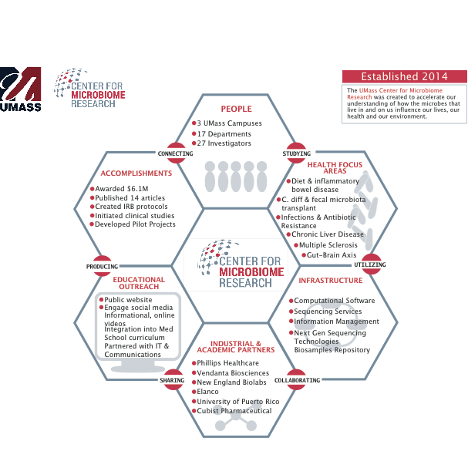

Slide 17
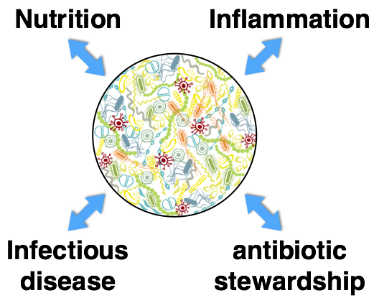
Microbiome interactions with health and disease
The microbiome is central to human health, especially in areas of high concern in the healthcare environment

Slide 18
The CMR is actively pursuing research
in multiple disease areas
Crohn’s disease
Liver disease
Ulcerative colitis
Healthcare acquired infections
Gut-brain
C. Difficile |Fecal Transplants
Diet interventions
Multiple sclerosis
Necrotizing enterocolitis
ALS/Rhett Syndrome
Population studies:
Nursing homes

Slide 19
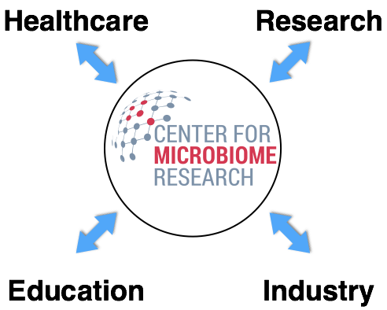
CMR collaborations are engaging a broad swath of the UMass community
trainees – Ph.D |MD| MD fellows

Slide 20
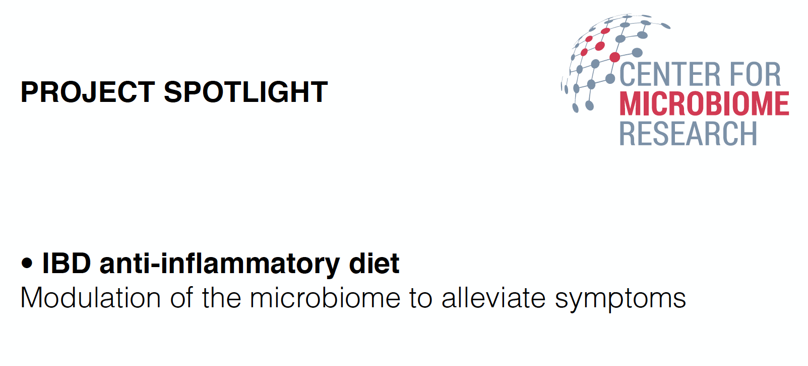
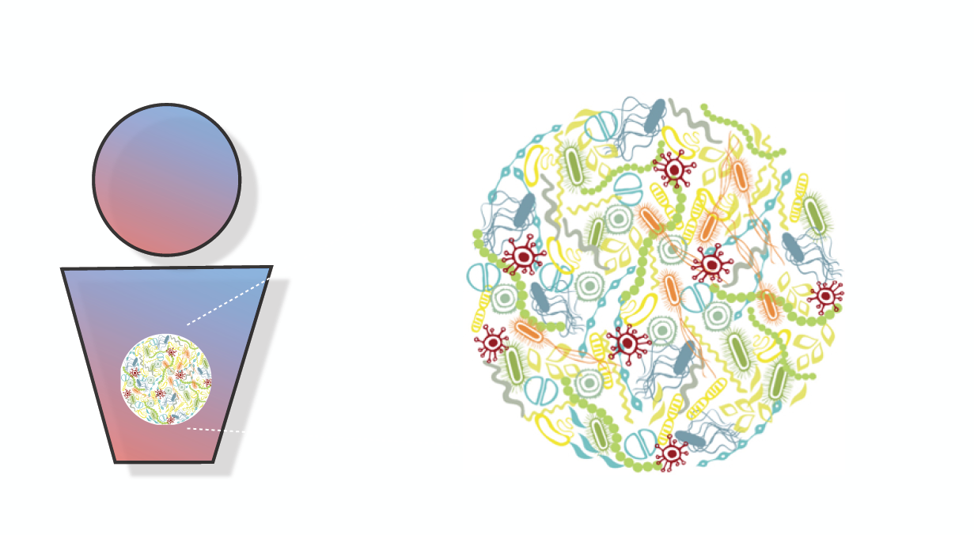
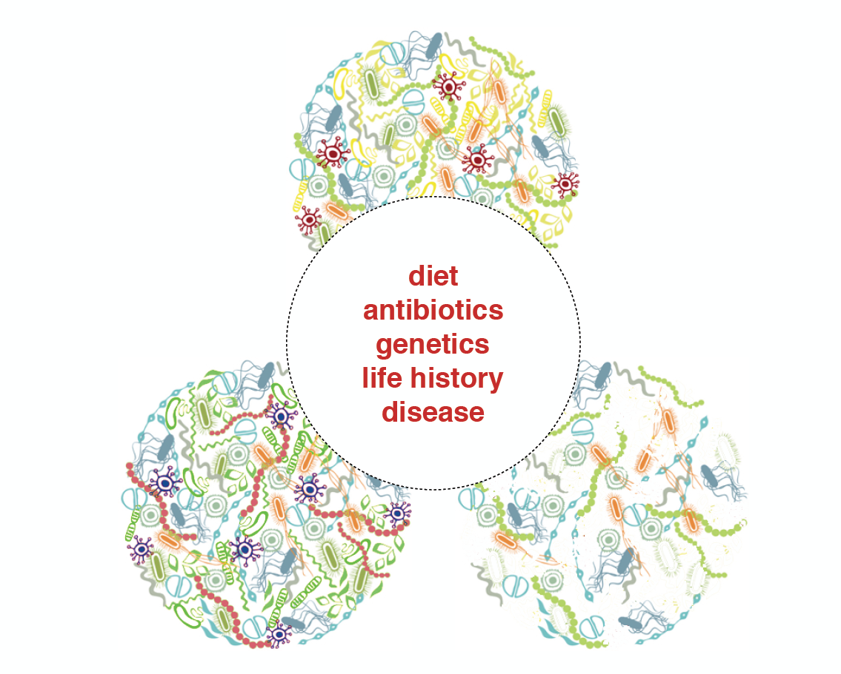
Composition
Diversity

Slide 21
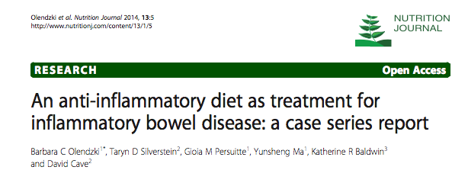
Conducting trials to treat inflammatory diseases
• Modulation of the microbiome to alleviate symptoms
to reduce inflammation
- IBD
Crohn’s Diseae
Ulcerative colitis
• Study Interests
- Bacteria associated with inflammation
- Dietary components to manipulate microbiota
- Metabolic pathways
Novel drugs or drug targets

Slide 22

Who is involved and how it came about?
Beth McCormick, Ph.D.
Doyle Ward, Ph.D.
Ana Maldonado, Ph.D.
Barbara Olendzki, RD
David Cave, MD
Anne Foley – Clinical Coordinator
Vanni Bucci, Ph.D.
Gastroenterology
Mathematical
Modeling
Microbiome
Diet/Nutrition
Opportunities:
• Basic Research
• Clinical outcomes and integration
• Patient samples – i.e, Ana: Developing organoids

Slide 23
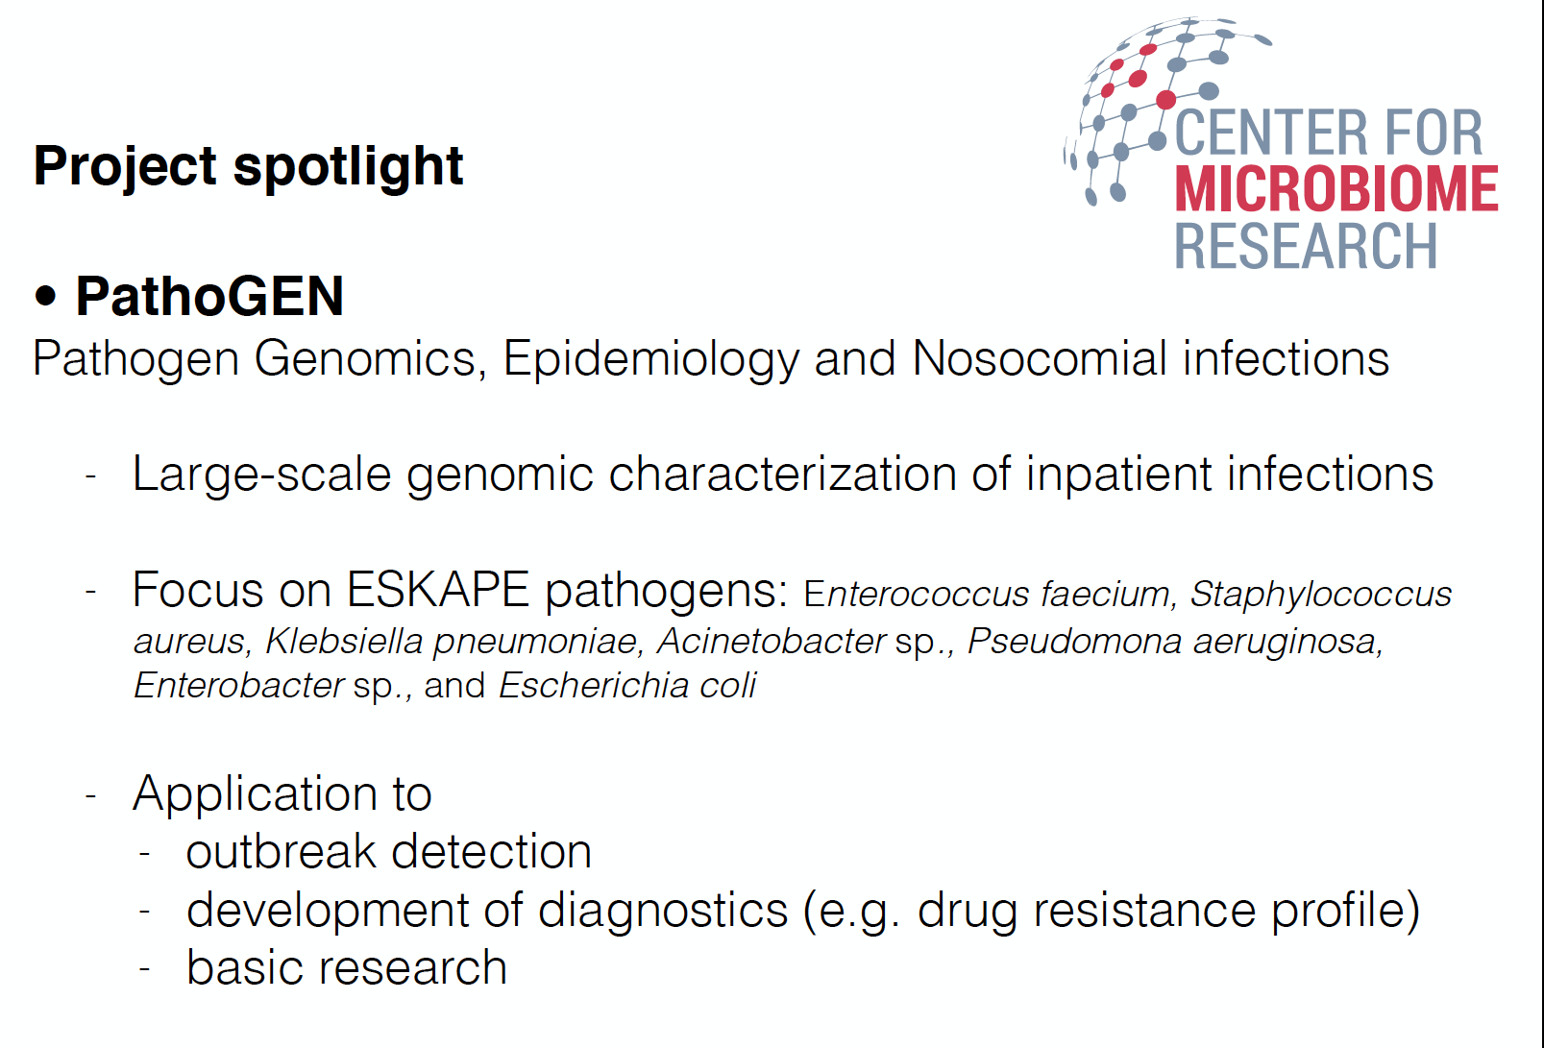

Slide 24
Who is involved and how it came about?
Doyle Ward, Ph.D.
Richard Elison, MD
Jomol Mathew, Associate CIO
Margaret Koziel, MD
David Sela, Ph.D.
Infection Control
and Disease
Information
Technology
Medical
Informatics
Hospital
Analytics
Opportunities:
• Resources: Diagnostic and clinical partnership
• Big Data management
• Build out new basic research programs
• Innovating technologies that drive the “microbiome machine”
• Creation of a stronger research community

Slide 25
PROJECT SPOTLIGHT
The Microbiome and Multiple Sclerosis
Goal: Translate the differences in intestinal flora into markers that could predict disease progression and eventually to find treatments that could stall the progression/ evolution of the disease, multiple sclerosis.
• Study Interests
- Investigate the role of the microbiome in the progression of MS.
- Determine whether differences in gut microbiome could be promoting different clinical outcomes in MS patients
-Identify bacteria and or secondary metabolites specifically associated with having MS (either Relapsing remitting MS or Secondary progressive MS) or with disease progression, from RRMS to SPMS.

Slide 26
Who is involved and how it came about?
Carolina Ionette, MD., Ph.D.
Beth McCormick, Ph.D.
Doyle Ward, Ph.D.
Ana Maldonado, Ph.D.
Rafi Aroian, Ph.D.
Infectious Disease
Intestinal round worm
Inflammation
Microbiome
Multiple Sclerosis
Opportunities:
• Clinical samples – (Biorepository and European clinical cohorts)
• Diagnostic indicators
• Animal modeling
• Potential clinical intervention/trials

Slide 27
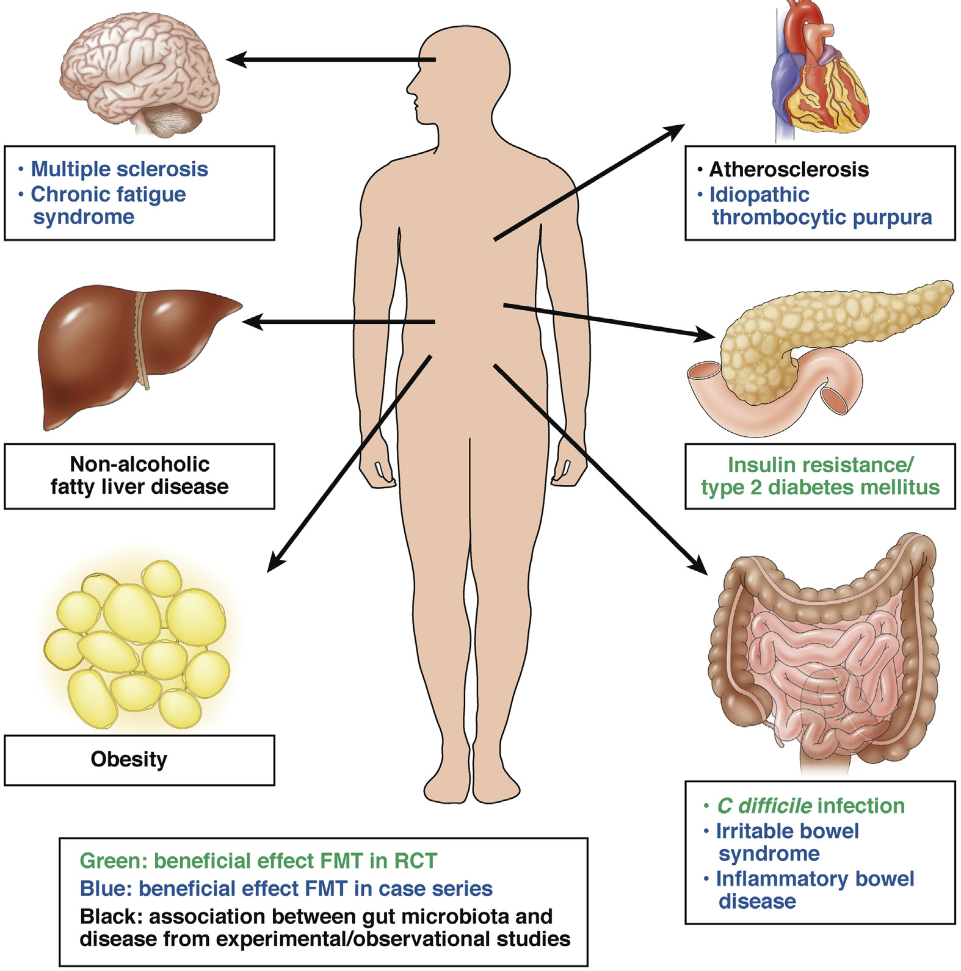
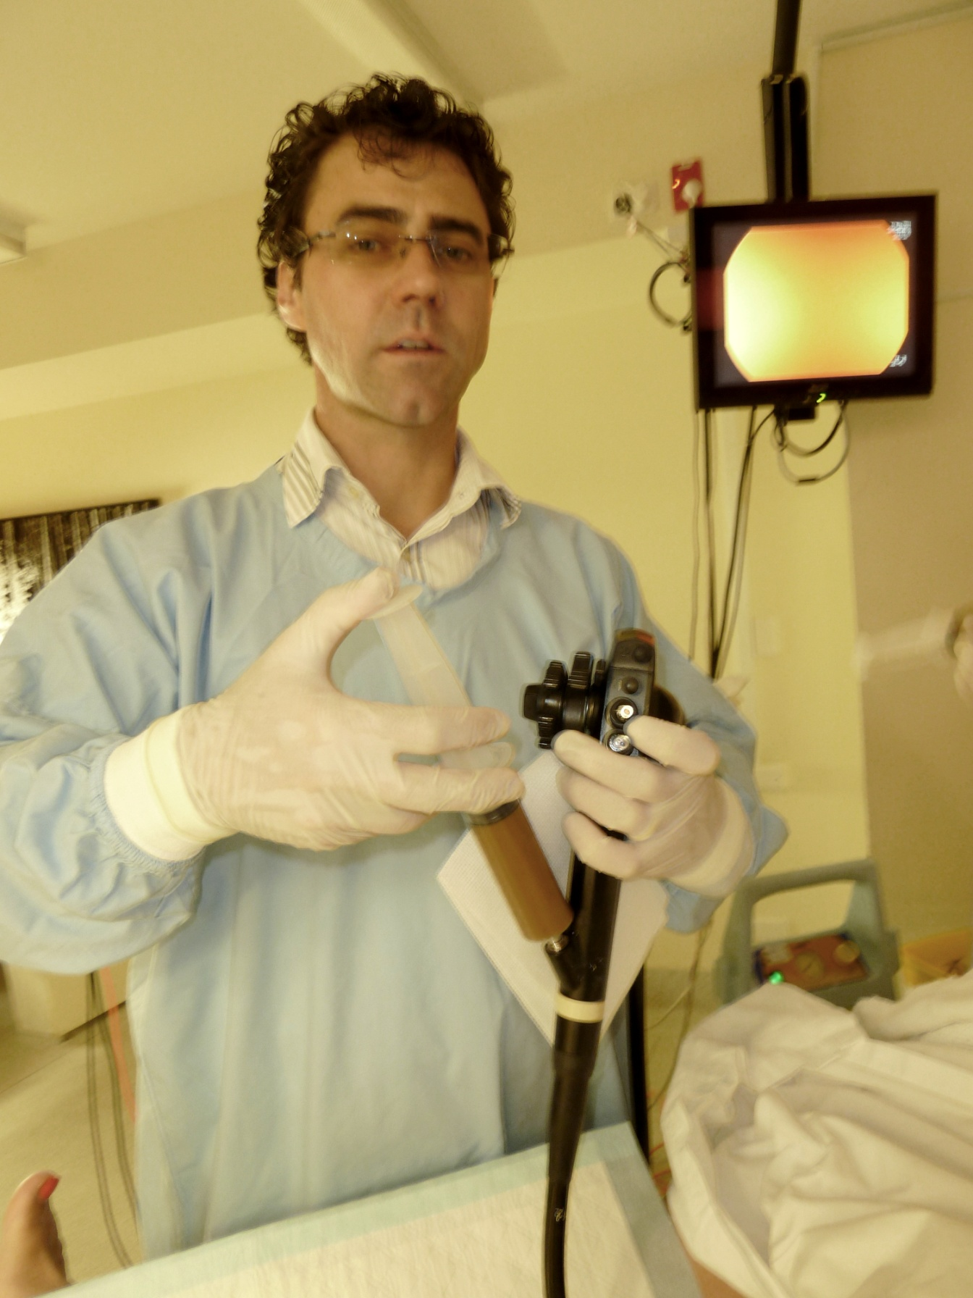
Expert is the area of fecal microbiota transplant (FMT)
Untapped potential Microbiome Research
  IRB-approved protocol for FMT for the Treatment of Recurrent Clostridium difficile infection
  Incubating proposals for specific patient populations
    Autologous FMT for C. diff infection in solid organ transplant patients
    FMT in various forms of inflammatory bowel disease
    Microbiome characterization in forms of inflammatory bowel disease
    Microbiome characterization in various autoimmune related disease

Slide 28
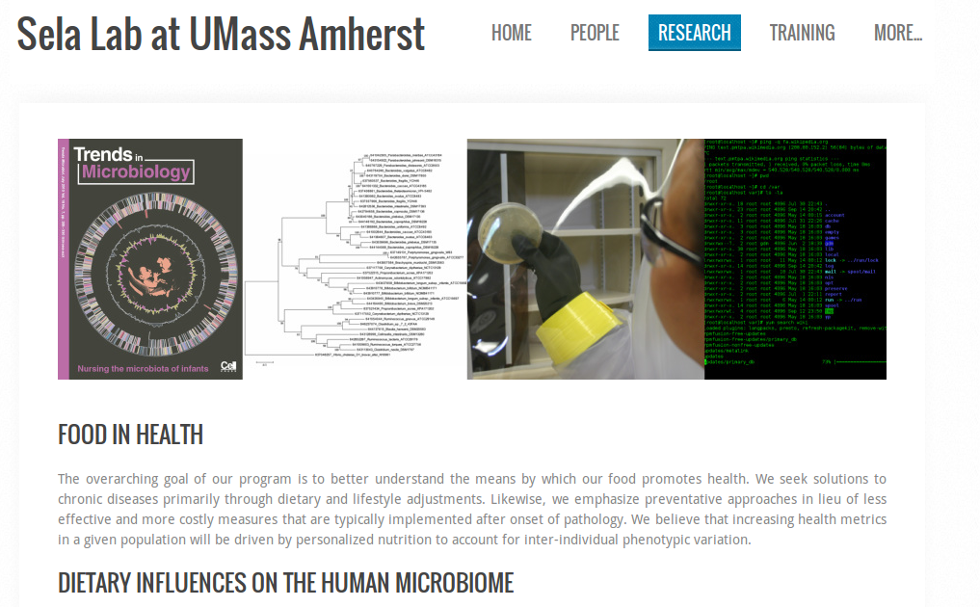

Slide 29
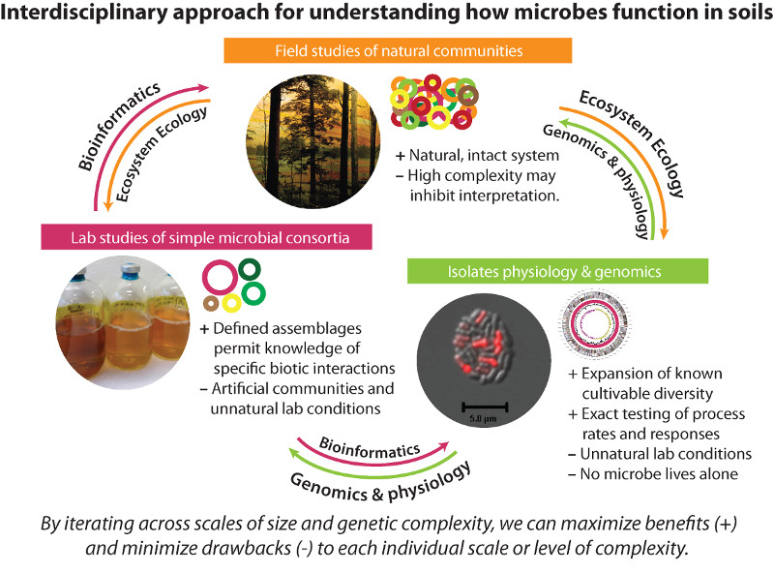
DeAngelis Lab

Slide 30
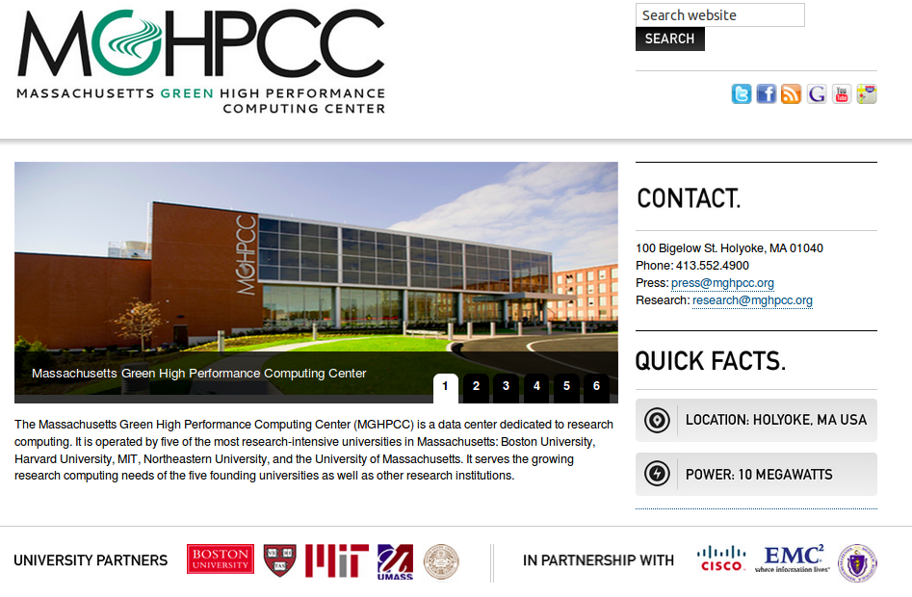

Slide 31


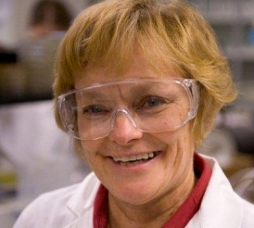
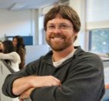
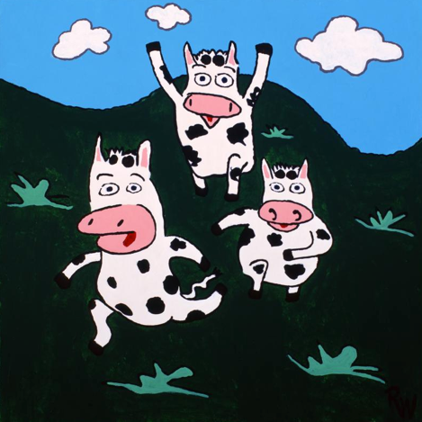
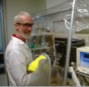
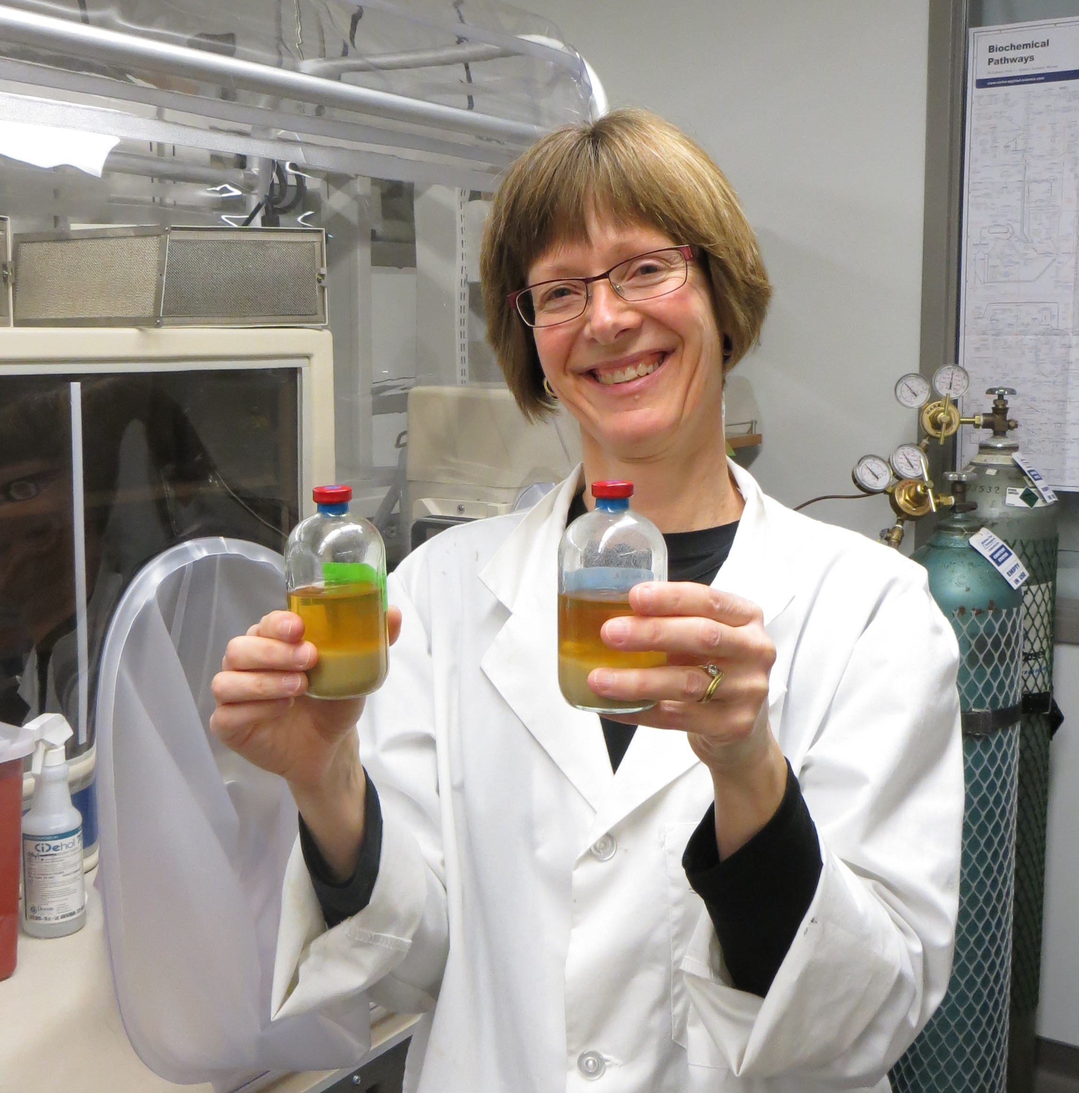
Reconciling ruminant livestock needs with economic and environmental concerns
Microbial consortia that increase fiber digestion are in animal trials
Microbe power!
Sue Leschine
Jeff Blanchard
Tom Warnick
Mary Hagen
Notes:
This project has been a great opportunity for us at UMass to take our expertise in anaerobic microbiology, strain isolation, and bioinformatics and couple it with Elanco’s expertise in ruminant biology and livestock production.
We have a great team that complements each other well in terms of our different backgrounds and expertise and this allows us to approach our project from a variety of angles and also assess our accomplishments from a variety of different viewpoints.
31

Slide 32
CMR Excellence in Education
Course
Development
Professional
Workshops
Training Events
Industry/Organization Partners

Slide 33
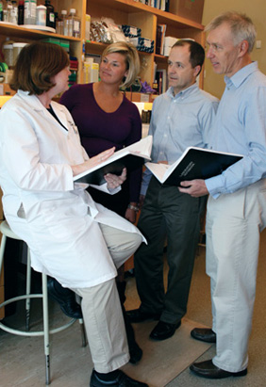
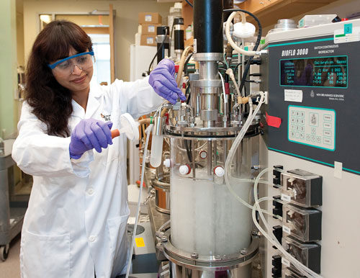
Industry Collaboration + Training
Collaborative Research Projects with Industry
  Professional Development Offices at UMW and UMA
    Cynthia Fuhrmann, UMW
    Shana Passano, UMA
  Industry Match
  Create 3-5 projects
    Sponsored research
    Preliminary data

Slide 34
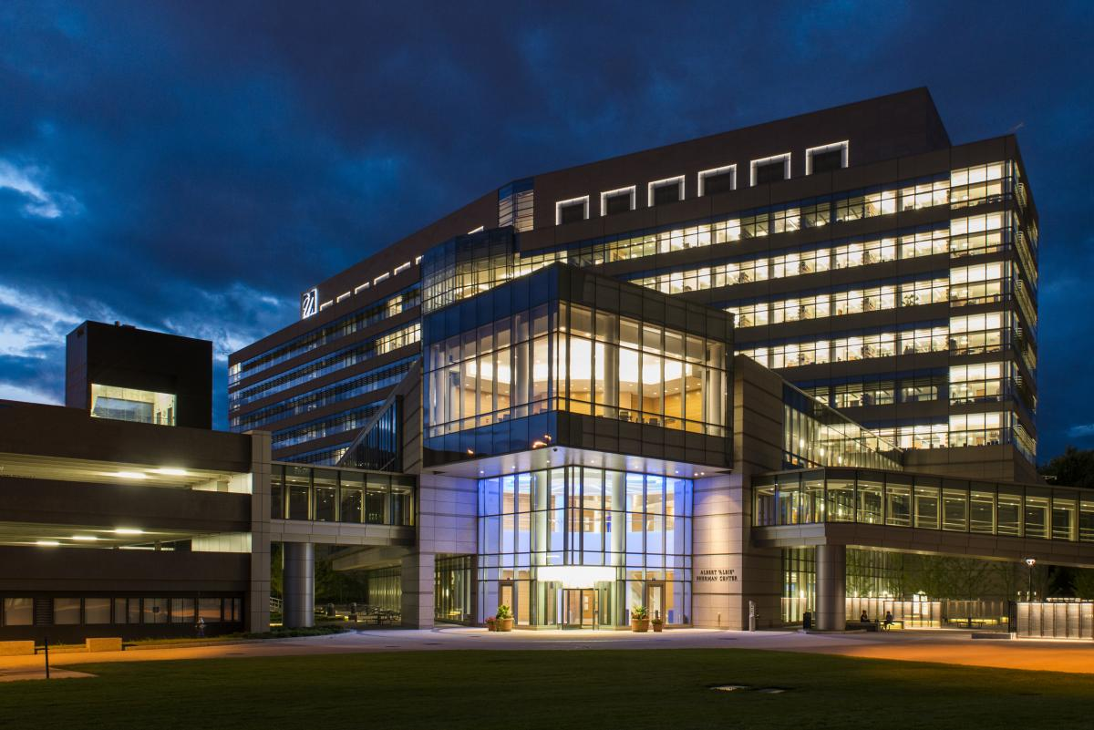
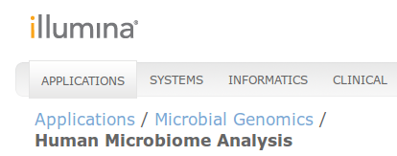
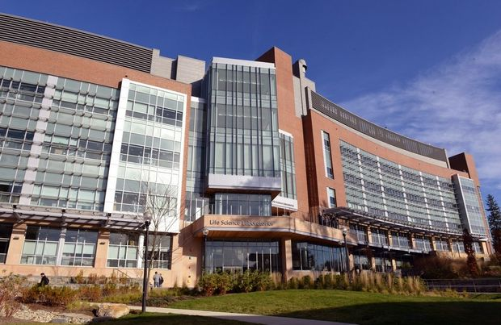
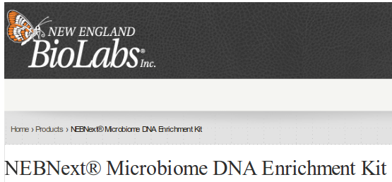
Industry Collaboration + Training
Professional Development Workshops for Academic and Industry Research Scientists
  UMass Professional Development Office
    Computational Methods in Microbiome Research
    Anaerobic Microbiome Reseach
UMW - Albert Sherman Center
UMA -Life Sciences Laboratories

Slide 35


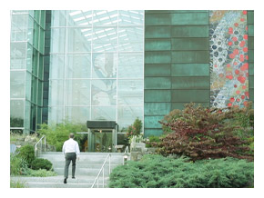

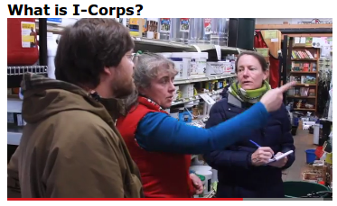
Industry Collaboration + Training
= Economic Impact
Career Path Seminar Series
Career Exploration Events
Industry Site Visits
New England Biolabs

Slide 36
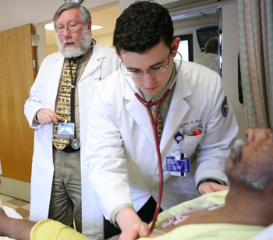
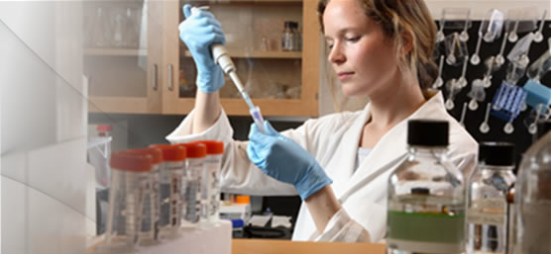
Medical/Graduate Student Educational Initiatives
Medical/Graduate student didactics and infectious disease interest group
Resident and fellow (M.D., (Ph.D) opportunities in microbiome research; Patrick Lowe – MD., Ph.D. student
Gastroenterology fellow training in FMT
Institutional “Microbiome Interest Group” for clinicians and researcher collaboration
Regional industry collaborative and professional development workshops

Slide 37

Ali and Fatima - St. Peter Marian HS
The effect of FMT on the microbiome of IBD patients

