Slide 1







Transdisciplinary, translational team science: What is the optimal role for nurse scientists?
Webinar
Wednesday, May 11, 2016
10:00 – 11:00 am

Slide 2
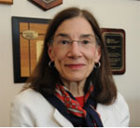
Transdisciplinary, Translational Team Science: What is the Optimal Role for Nurse Scientists?
Laura L. Hayman, PhD, MSN, FAAN
Associate Vice Provost for Research & Graduate Studies
University of Massachusetts Boston
Adjunct Professor of Medicine, Division of Preventive and Behavioral Medicine
University of Massachusetts Medical School

Slide 3
Goals for Webinar
Increase awareness of scientists from many disciplines within and across the UMass system regarding the current and potential roles of nurse scientists within the context of team science and the UMass Center for Clinical and Translational Science (UMCCTS)
Encourage and increase engagement and active participation of nurses in our UMCCTS

Slide 4
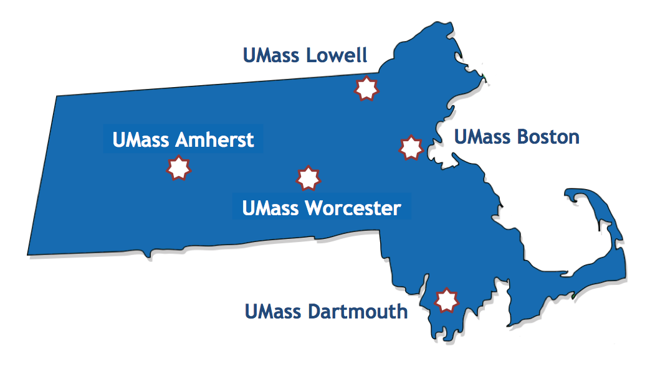
MAJOR AIMS
Accelerate the translation of basic discoveries into practical, cost effective solutions that improve human health
Develop and support the next generation of leaders in clinical and translational research

Slide 5
Strategic Goal
Workforce Development
Build a translational science workforce with the skills and knowledge to advance translation of discoveries

Slide 6
Team Science
Draws on diverse disciplinary perspectives to better understand and enhance the processes and outcomes of scientific collaboration
Utilizes a variety of conceptual models as programmatic frameworks for describing, organizing and evaluating team science

Slide 7
Team Science
Transdisciplinarity: an integrative process in which researchers work jointly to develop and use a shared conceptual framework that synthesizes and extends discipline-specific theories, concepts, methods or all three to create new models and language to address a common research problem.
Stokols D, et al., Am J Prev Med. 2008: 35, (2S):S77-89

Slide 8
Team Science
Places emphasis on interprofessional collaboration in clinical and public health practice and healthcare

Slide 9

Translational Research Model
Basic Science
Discovery
Clinical
Application
Clinical
Practice
Population
Health
Global
Health
TI
T2
T3
T4
Translation to
Humans
Translation to
Patients
Translation to
Practice
Translation to
Population Health
Animal Models
Preclinical Studies
First in Human
Phase I Trials
Efficacy and Safety
Phase 2/3 Clinical Trials
Clinical Outcomes
Research
Cost Effectiveness
Research
Population Outcomes Research
Social Determinants
of Health
Prevention Research

Slide 10
Nursing Science agenda: Major themes
National Institute of Nursing Research (NINR)
(1985-2015)
Grady PA & Gough LL. Internal J of Nurs. Scholarship. (2015). 47 (6) 512-21

Slide 11
Nursing Science Research Agenda: Major Themes
Symptom Science- Promoting Personalized Health Strategies
Emphasis on a life course approach in promoting personalized health strategies and providing a better understanding of chronic illness and improving quality of life.
Focuses on understanding the biological and genetic basis of symptoms to improve the management of pain, fatigue, sleep disorders and other symptoms
Characterizing symptom clusters- symptoms that are interrelated and may provide better outcomes than targeting individual symptoms
Understanding the mechanisms contributing to these symptom patterns have potential to guide and inform personalized strategies and improve patient outcomes
Grady PA & Gough LL. Internal J of Nurs. Scholarship. (2015). 47 (6) 512-21

Slide 12
Nursing Science Research Agenda: Major Themes
Wellness- Promoting Health & Preventing Disease
Life course science approach with emphasis on health behaviors and the contexts in which they develop and/or modified
Units of analysis/intervention include individuals, families & communities
Designs and methods: Descriptive/ observational, intervention (RCTs), community-based participatory research
Conceptual Frameworks include nursing models, behavioral science models, public health models and conceptually coherent integrated frameworks
Grady PA & Gough LL. Internal J of Nurs. Scholarship. (2015). 47 (6) 512-21

Slide 13
Nursing Science Research Agenda: Major Themes
Self-Management- Improving Quality of Life for Individuals with Chronic Illness
Emphasis on helping individuals (and their caregivers) manage chronic conditions and better understand and manage their health behaviors by developing effective approaches to deal with their specific illness and associated conditions (i.e., diabetes, cancer, asthma, COPD, arthritis, inflammatory bowel disease, obesity).
Self management is viewed as an approach where providers, patients and families enter into partnerships to manage care across all aspects of treatment (McCorkle et al., 2011).
Facilitators of and barriers to self-management on patient, provider and systems levels also emphasized.
Grady PA & Gough LL. Internal J of Nurs. Scholarship. (2015). 47 (6) 512-21

Slide 14
Nursing Science Research Agenda: Major Themes
End-of Life and Palliative Care- The Science of Compassion
Focuses on science to assist individuals, families and healthcare professionals in managing the symptoms of life-limiting conditions and planning for end-of-life (EOL) decisions.
Emphasis on improving communication between patients, family members and healthcare professionals
Grady PA & Gough LL. Internal J of Nurs. Scholarship. (2015). 47 (6) 512-21

Slide 15
Nursing Science Research Agenda: Major Themes
Cross-Cutting Areas:- Promoting Innovation : Technology to Improve Health
NINR Intramural Research- NIH Symptom Science Model and Precision Medicine
Grady PA & Gough LL. Internal J of Nurs. Scholarship. (2015). 47 (6) 512-21

Slide 16
Nursing Science Research Priorities and Future Directions
Biological Systems and Symptom Science
Biobehavioral Nursing Science
Data Science
Translation of Effective and Sustainable Interventions
Investing in Nurse Scientist Training
Grady PA & Gough LL. Internal J of Nurs. Scholarship. (2015). 47 (6) 512-21

Slide 17
Nurse Scientists within the Umass System

Slide 18
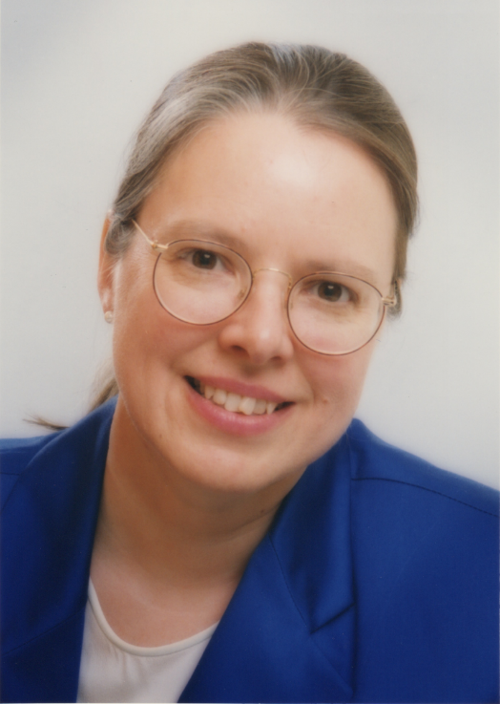
Annette Wysocki, PhD, RN, FAAN
Associate Dean for Research
University of Massachusetts Amherst
She received her Ph.D. from the University of Texas at Austin and her baccalaureate and master’s degrees from East Carolina University. She completed two postdoctoral fellowships at UT-Southwestern in Dallas, Texas and Weill-Cornell Medical College in New York City. Her program of research is focused on understanding the biological mechanisms responsible for delayed healing in chronic wounds. She combines the use of clinical materials, such as wound fluid and tissue, with the powerful tools of basic science to discover the mechanisms underlying the pathophysiology of delayed healing.

Slide 19
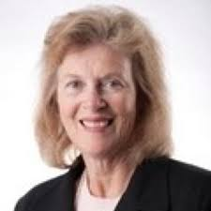
Donna M. Zucker, RN, PhD, FAAN
Associate Professor, College of Nursing
University of Massachusetts Amherst
Dr. Zucker received her Ph.D. from the University of Rhode Island, her master’s degree from UMass Amherst and is recognized as an expert in behavioral treatment for stress in offenders both in the US and abroad. Her program of research is focused on symptom identification and management of adverse events in person with hepatitis C particularly those in treatment, in recovery or incarcerated. She has developed an expertise in two areas: communicable disease prevention and behavioral modification for persons with substance abuse.

Slide 20
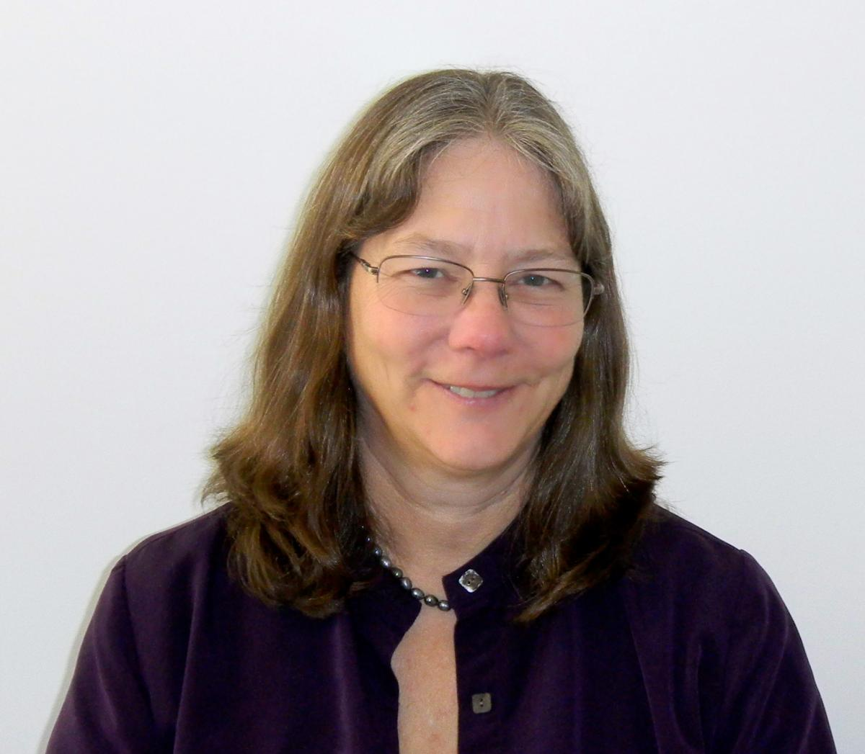
Cynthia Jacelon, PhD RN-BC CRRN FAAN
Associate Professor, College of Nursing
University of Massachusetts Amherst
Professor Cynthia S. Jacelon’s area of research and expertise is promoting dignity, function, self-management of chronic health problems, and independence in older adults. In her research, she has explored the role of elders in affecting the outcomes of their hospitalization, the processes used by community-dwelling elders to manage chronic health problems, the meaning of dignity to elders, and the role of smart environments in promoting independence in elders.

Slide 21
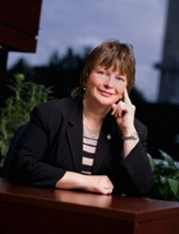
Carol Bova, PhD, RN, ANP
Professor and Director of the PhD Program
Graduate School of Nursing
University of Massachusetts Medical School
Worcester, MA
Dr. Bova ‘s program of research has focused on the emerging primary care needs of HIV-infected adults; in particular she has conducted funded studies that focus on women with HIV infection, HIV/HCV co-infection, the interaction of substance abuse, mental illness and HIV infection, adherence behaviors, and patient-provider trust. Recently completed and ongoing research focuses on HIV Stigma, Testing Attitudes and Health Care Access Among African-Born men living in the U.S. (Bova et al., J Immigrant Health, 2016;18: 187-93).

Slide 22
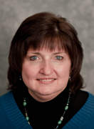
Jean E. Boucher PhD, RN, ANP_BC, AOCNP
University of Massachusetts Medical School
Worcester, MA
Dr. Jean Boucher received her PhD in Nursing from the University of Massachusetts, Amherst/ Worcester Collaborative Program. Her current areas of research interest focuses on quality of life in colorectal cancer patients and their partners, chemotherapy-induced diarrhea, patient-centered care for prostate cancer including partner adjustment in relationships, and genetic predisposition for cancer. She serves as Co-Investigator for a UMass Medical School Interprofessional Educational Grant with PI Dr. Jennifer Reidy on Goals of Care Conversations for Advanced Care Planning and EOL care using simulation training to prepare nurse practitioner and physician providers

Slide 23
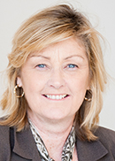
Barbara Mawn
Ph.D. Program Director; Professor of Nursing
University of Massachusetts Lowell
Barbara received her PhD in Social Policy from Brandeis University. Her research interests are in Health promotion and health disparities. Populations of interest include: occupational health workers in the USA and Thailand; persons with chronic illness including HIV, diabetes and cancer.

Slide 24
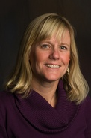
Kristen Sethares, PhD, CNE
Graduate Program Director of PhD; Professor, Adult & Child Nursing
University of Massachusetts Dartmouth
Dr. Sethares is a cardiovascular nurse clinician and scientist who has focused her program of research on
selected aspects of heart failure self care. Her research has included emphasis on benefits of and
barriers to heart failure self care as well as predictors of treatment delay in heart failure patients and
consequences for outcomes. Her current collaborative research is designed to identify symptom clusters in
heart failure patients.

Slide 25
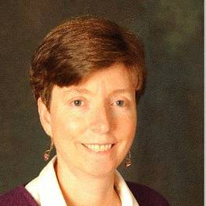
Suzanne G. Leveille, PhD, RN
Professor of Nursing; Interim Associate Dean for Research
College of Nursing and Health Sciences
University of Massachusetts Boston
Suzanne Leveille is an epidemiologist with an extensive background in gerontological nursing. As the lead investigator with theMOBILIZE Boston Study II, Professor Leveille is pursuing a number of research questions relevant to chronic pain as a cause of falls and disability in this population-based cohort study of older adults funded by the National Institute on Aging. As a faculty member with the Division of General Medicine and Primary Care, Beth Israel Deaconess Medical Center, Professor Leveille is studying ways to empower patients through use of patient internet portals. She is also collaborating on a number of projects involving geriatric physical impairments, the role of neighborhood environment in geriatric falls, and pain management in older adults.

Slide 26
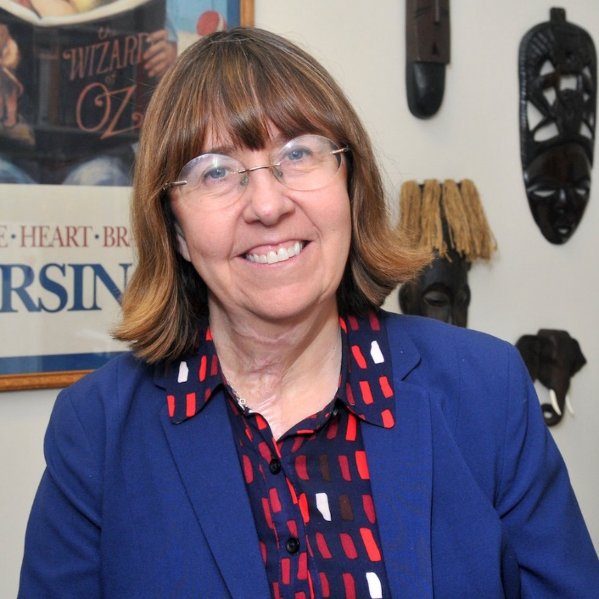
Teri Aronowitz, PhD, FNP
Assistant Professor, Department of Nursing
University of Massachusetts Boston
Dr. Aronowitz’s clinical and research interests focus on promoting sexual health across the life course with emphasis on adolescents and young adults from diverse populations. Recently funded by the Substance Abuse Mental Health Service Administration (SAMSHA), she is conducting an academic-community partnership study designed to use evidence-based strategies to decrease substance abuse and other behaviors that place marginalized youth at risk for sexually transmitted diseases. Dr Aronowitz has developed and will be testing the LUMBA project, a mother/preadolescent daughter randomized controlled trial aimed at increased sexual communication to delay sexual debut.

Slide 27
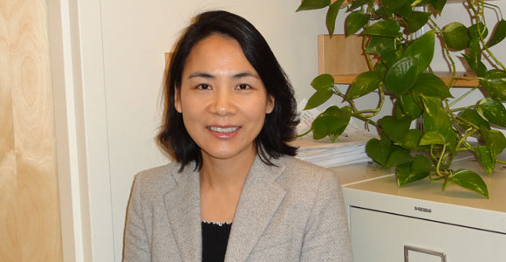
Ling Shi, PhD, Associate Professor
Department of Nursing
University of Massachusetts Boston
Dr. Shi’s current research focuses on the association between lifestyle factors and cardiometabolic risk. She has led several data analysis projects on dietary, physical activity and other lifestyle factors related to cardiometabolic risks. Recently completed and ongoing research (with Drs Moore Simas, Hayman, Lichtenstein) is designed to examine the effects of soy protein and isoflavone supplementation on glucose metabolism and lipid profiles in pregnant women at risk for gestational diabetes. Dr. Shi also provides statistical consulting for the NHLBI-funded program “Recipient Epidemiology and Donor Evaluation Study—III (REDS III)."

Slide 28
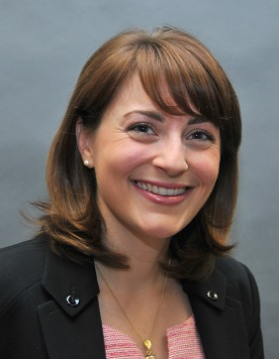
Emily Jones, PhD, RNC-OB
Assistant Professor, Department of Nursing
University of Massachusetts Boston
Robert Wood Johnson Foundation Nurse Faculty Scholar
Dr. Jones’ research interests center on reducing cardiometabolic risk among childbearing women, particularly Native American women with previous gestational diabetes. Her research, funded by the Robert Wood Johnson Foundation, focuses on identifying interventions that will increase women’s self-efficacy to carry out lifestyle behaviors aimed at preventing Type 2 Diabetes and cardiovascular disease. Dr. Jones has volunteered with the Center for Women in Politics and Public Policy at UMass Boston on projects addressing the health disparities of childbearing women. She is also partnering with the Institute for New England Native American Studies at UMass Boston in order to address the numerous health disparities encountered by American Indians in Massachusetts.

Slide 29
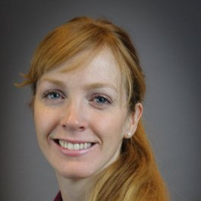
Amanda Constance Green, PhD, RN
Postdoctoral Research Fellow
University of Massachusetts Medical School
Dr. Amanda Green earned her PhD in Nursing at UMass Boston in 2015. She is a nurse scientist with interest and developing expertise in population health, behavioral medicine and health policy and has been an integral part of multidisciplinary research teams at major academic medical centers, including Dana Farber Cancer Institute, Boston Children’s Hospital, Beth Israel Deaconess Medical Center, and University of Massachusetts Memorial Hospital. Currently as a post-doctoral fellow in the Prevention and Control of Cancer: Post-Doctoral Training in Implementation Science (PRACCTIS) program at the University of Massachusetts Medical School, she is focusing on provider and patient behaviors and implementation processes of evidence-based tobacco cessation interventions for health promotion

Slide 30
Transdisciplinary Collaboration & team science across the UMCCTS
Research Navigator Program: Led by Nate Hafer, PhD provides consults to investigators and links them to collaborators, resources, education programs & funding opportunities.
UMCCTS Small Conference Grants (SGS) provides seed money that leverages the convening capacity of UMCCTS to create new transdisciplinary teams to address a “pressing” health need.
Conferences may be a single think tank or monthly meetings over the course of a year- must be focused on preparation of a proposal for extramural funding.
Pilot Funding Opportunities: funded via a mix of CTSA grant, institutional funds and/or partnerships or other mechanisms but administered by the UMCCTS.

Slide 31
Thank you!
Contact Information: laura.hayman@umb.edu

