Slide 1

Perioperative Surgical Home
PSH™
Urology Pilot
Kick-off Retreat
January 13th 2015
Notes:
Good afternoon and Welcome to the kick-off retreat of the UMass/UMass Memorial Medical Center Perioperative Surgical Home Pilot. Thanks you all for attending – It is not easy to for 47 busy clinicians, managers, leaders to free up time to gather together at an afternoon retreat. And yet your are all here. Your presence is a statement of commitment to improving the way we deliver care for our patients. And I believe it signals our impending success.

Slide 2
Welcome
Dr. Judith Steinberg, MD, MPH
Deputy Chief Medical Officer
Commonwealth Medicine
University of Massachusetts Medical School
Notes:
I am Dr. Judy Steinberg – I am an internist and infectious disease physician. I am also the Deputy CMO of Umass’s Commonwealth Medicine. Okay – how many of you know what Commonwealth Medicine is – a very common finding when I come speak at the med school. It is the public service, consulting, and health policy arm of the medical school. It is founded on a close partnership with our state’s health and human services agency, in particular MassHealth. Over the last few years, I have been leading teams at CWM that have supported the design and implementation of new patient centered care delivery models that are incentivized by value-based payments. , such as the Patient Centered MEDICAL home. ( first the statewide multipayer MA PCMHI and more recently MassHealth’s primary care payment reform and the duals demonstration.)

Slide 3
Retreat Objectives
Present rationale for Perioperative Surgical Home (PSH) and its alignment with University of Massachusetts Memorial Medical Center (UMMMC) 2020 Vision and Strategic Plan
Discuss Perioperative Surgical Home Pilot: Patients, Teams, Process for Change and Outcomes
Identify next steps and timeline for implementation of Perioperative Surgical Home Pilot
Notes:
Let’s take a look at the objectives of today’s retreat

Slide 4
Agenda
Start 1:00 PM
Welcome
Why Perioperative Surgical Home Pilot
Alignment with UMMMC Vision/Strategy
Overview of Pilot
Team Breakout Sessions
Report on Breakout Sessions
Timeline and Next Steps
End 5:00PM
Notes:
And here is the agenda, which is in your packets.
We will begin with a plenary presentation by Drs. Kaur, Sokoloff and Faris, providing an overview of the PSH and the UMass PSH prilot. Then Dr. Tosi will share with us how the PSH is alignment with the medical center's vision and strategy.
We’ll then here more details about the pilot as a jumping off point for the work of our retreat – the break out session. the pilot teams will begin a discussion of new processes in their areas to meet the objectives of the PSH and measures that can be used to monitor implementation and determine impact
Then we will have report backs from the 5 pilot teams
We will finish up with a review of the planned implementation steps and timeline and then wrap up;
Also in your packets, besides the retreat presentations, there are some articles and presentations that will be helpful to better understand the PSH and to help guide the work of the pilot teams. There is also a handout for the breakout session activity.
With that, let’s move on to the opening plenary, with the first presentation, by Dr, shubi Kaur.

Slide 5

“I Have a Dream”

Slide 6
Why PSH™
Shubjeet Kaur, MD M.Sc.HCM
Professor and Executive Vice Chair of Anesthesiology
University of Massachusetts Medical School
UMass Memorial Medical Center

Slide 7
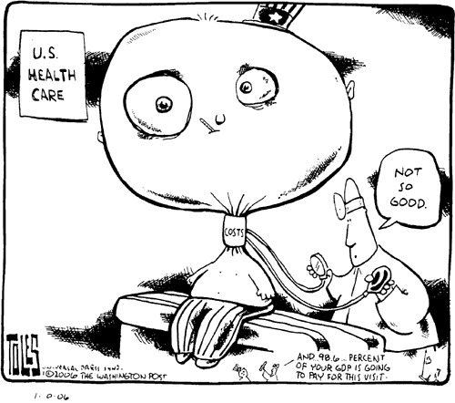

Slide 8
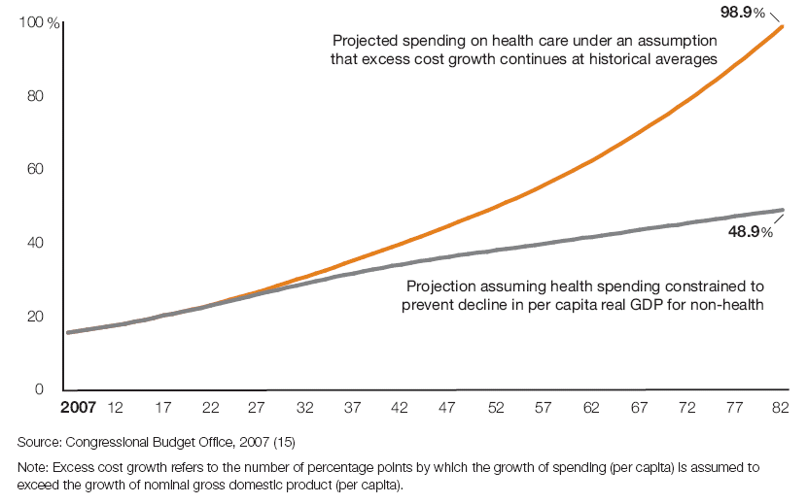
Unsustainable : Projected
Health Care Spending as % GDP

Slide 9
National and Surgical Health Care Expenditure
2 Trillion
60%
Munoz et al Ann Surg. Feb 2010

Slide 10
Institute of Medicine
Three Landmark Reports
The First
1999
To Err is Human
98,000 patients die each year as a result of preventable medical error

Slide 11
Institute of Medicine
Three Landmark Reports
The Second
2001
Crossing the Quality Chasm: A New Health System for the 21st Century
Call for Action
Closing the Quality Gap- Volume to Value

Slide 12
Institute of Medicine
Three Landmark Reports
The Third
2012
The Health Care Imperative: Lowering Cost and Improving Outcomes

Slide 13
IOM Report: WASTE
Eliminate Waste=Control Cost

Slide 14
Waste Identified in IOM Report
Missed Prevention Opportunities
Adm Expenses
High Pricing

Slide 15
Waste Identified in IOM Report
Inefficient
Delivery of Services
Un-needed
Services
Fraud

Slide 16
IOM Report 2012
Improved Delivery of Service
Savings
130 Billion

Slide 17
Complex Process
Surgery
Decision
Postop
Pre-op
Discharge
Intra-op

Slide 18
Variation
Value
Non V
Wait
Duplicate
Just Because
Cancel

Slide 19
Atul Gawande
“Our Struggle is with….complexity…how much you have to …have in your head…There are a thousand ways things can go wrong.
We are inconsistent and unreliable because of the complexity of care

Slide 20
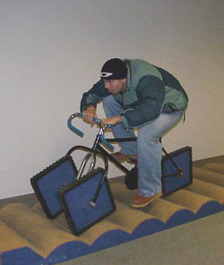
TIME for CHANGE

Slide 21
CHANGE
VOLUME
VALUE

Slide 22
Porter’s Value Paradigm As Applied To Health Care
OUTCOMES
COST
VALUE
Patient Experience
Perspective
M. Porter
NEJM 363;26 2010

Slide 23
PSH™- A Link
Decrease Waste
Improve Quality
Value
Patient Experience

Slide 24
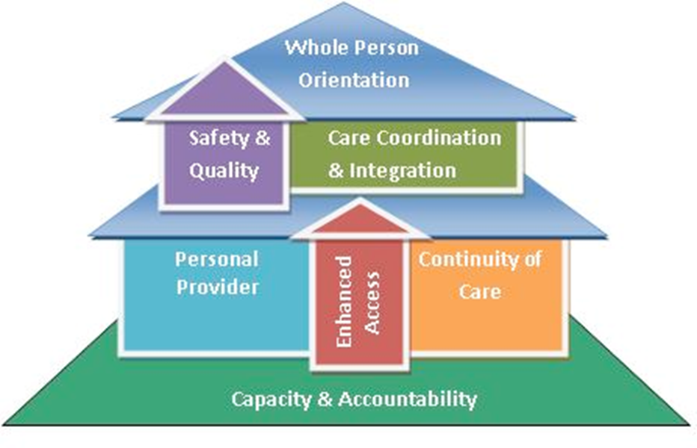
THE PARALLEL
PATIENT CENTERED MEDICAL HOME

Slide 25

Patient Centered Primary Care Collaborative
Grundy et al Cost and Quality Review 2012

Slide 26
Cost and Quality Report 2012
PCMH
IMPROVES OUTCOMES
ENHANCES PATIENT EXPERIENCE
DECREASES HOSPITAL AND ER UTILZATION

Slide 27
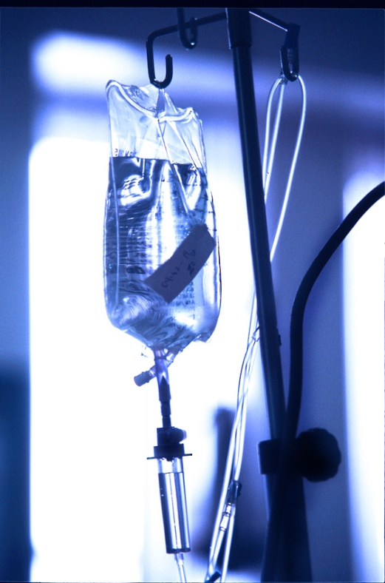
THE PRECEDENT
CRITICAL CARE
ANESTHESIOLOGY

Slide 28
Evolution of Critical Care
1970s
Resistance from Surgeons
Open Units
Concerns about Reimbursement
1980s
Anesthesia Critical Care Fellowships
Payment Reform
NOW
Leaders in Critical Care
Closed Units

Slide 29
PROPONENT
Personal Interest
Panel Discussion ASA 2012 Annual Conference
ASA
Trademarked Name: Perioperative Surgical Home™
Established Committee to Lead the Work
ASA Committee for Future Models of Anesthesia Practice- 2012

Slide 30
Perioperative Surgical Home™
Model Brief
American Society of Anesthesiologists
All Rights Reserved
Issued by ASA CFMAP August 2013
Request for Funding
Multicenter National Learning Collaborative
Started July 2014

Slide 31
PILLARS
Coordinated Care
Team Based
Patient Satisfaction
Improved Outcomes
Lower Cost

Slide 32
Core Principle of PSH™
Respect
Patient
Providers
Process

Slide 33
Perioperative Surgical Home (PSH)
The PSH is a patient-centered, physician-led multidisciplinary, and team-based system of coordinated care for the surgical patient.
  The PSH spans the entire surgical experience from decision for the need for surgery to discharge from a medical facility and beyond.
  The goal of the PSH is to enhance value and help achieve the Triple Aim: a better patient experience, better health care, and a lower cost.
"The aggregate benefits to the specialty and to patient care will be substantial and game-changing, even if a minority of anesthesia groups are in a PSH in the first few years."
Perioperative Surgical Home

Slide 34
How Would This Work?
Shared Decision Making
Coordinate Care
Intra-op Care
Post-op Care
Discharge Planning
PCMH
PSH™
Patient Safe & Satisfied

Slide 35
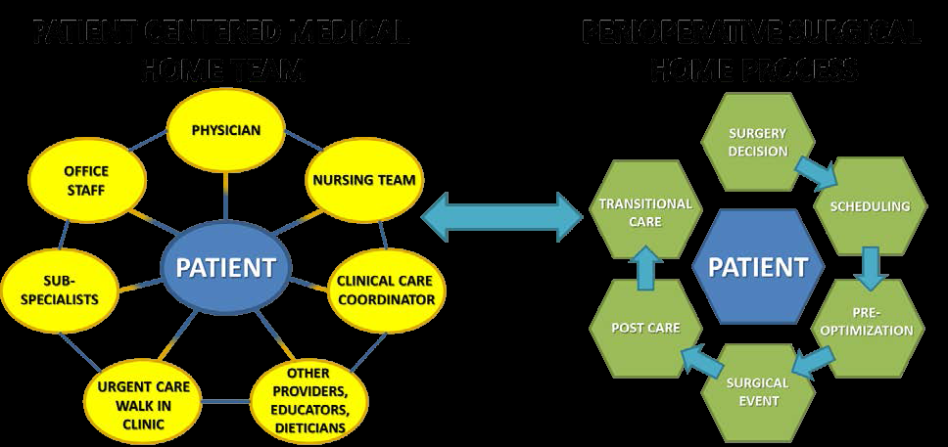
Connection between PCMH and PSH

Slide 36
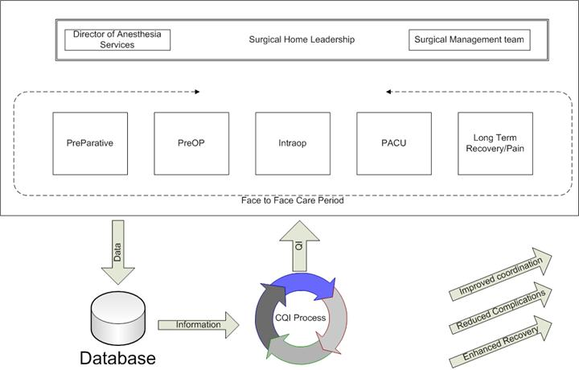
PSH How is it Different?
Perioperative Surgical Home

Slide 37
Current vs. Perioperative Surgical Home
Patient has a problem – Is there a surgical solution?
Perioperative Surgical Home
Business as usual
Minimized readmissions
Minimized complications
Evidence based care
Avoidable readmissions
Avoidable complications
Unsubstantiated variation
or
Current costs continue
Current patient experience
Current return to work
Costs decreased
↑ satisfaction / ↓ suffering
Increased productivity

Slide 38
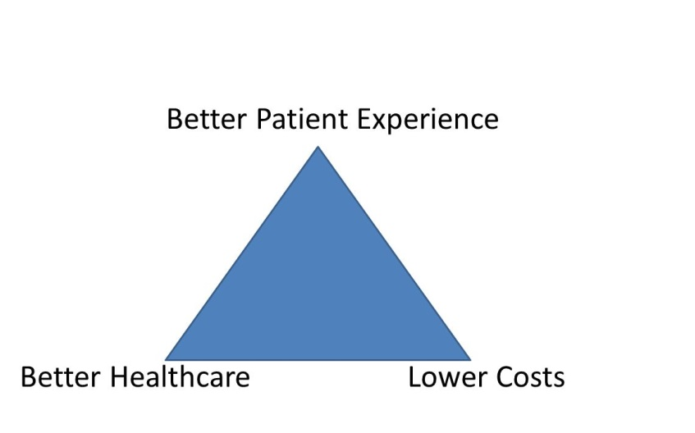
How PSH Aligns with Triple Aim
  Early and continued patient engagement
  Optimal pre-op testing and preparation
  Intraoperative efficiency
  Improved patient satisfaction
  Improved clinical outcomes and fewer complications
  Application of evidence-based principles
  Lower cost for Physician Preference Items
  Post-procedural care initiatives
  Care coordination and transition planning
Perioperative Surgical Home

Slide 39
PSH and Accountable Care:
Two Sides of the Same Coin
Accountable Care
Hospitals
PCMH
PCP
PSH
Patient
Care Coordination
PCMH
Specialists
PCP
Public Health
PCMH
Health IT Infrastructure
Perioperative Surgical Home
Notes:
39

Slide 40
Future Payment Model approaches
Bundled Payments
Shared Savings
“S” Code for Management fee
Co-management
Risk Sharing / ACO
Capitation / ACO
Perioperative Surgical Home

Slide 41
Alignment with our Health Sciences System
LEAN Transformation
ACO 2015
Focus on Transitions of Care

Slide 42


Best Place To Give Care – Best Place to Get Care

Slide 43
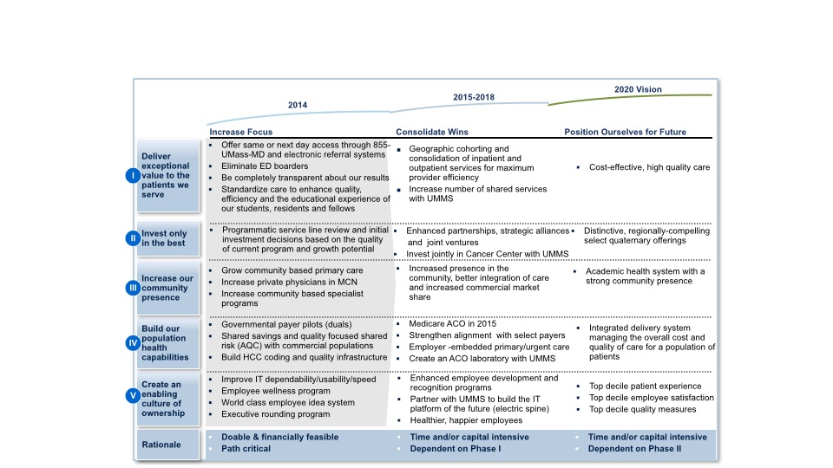
UMMHC 2020 Vision
We will become the best academic health system in New England based on measures of patient safety, quality, cost, patient satisfaction, innovation, education and caregiver engagement.

Slide 44
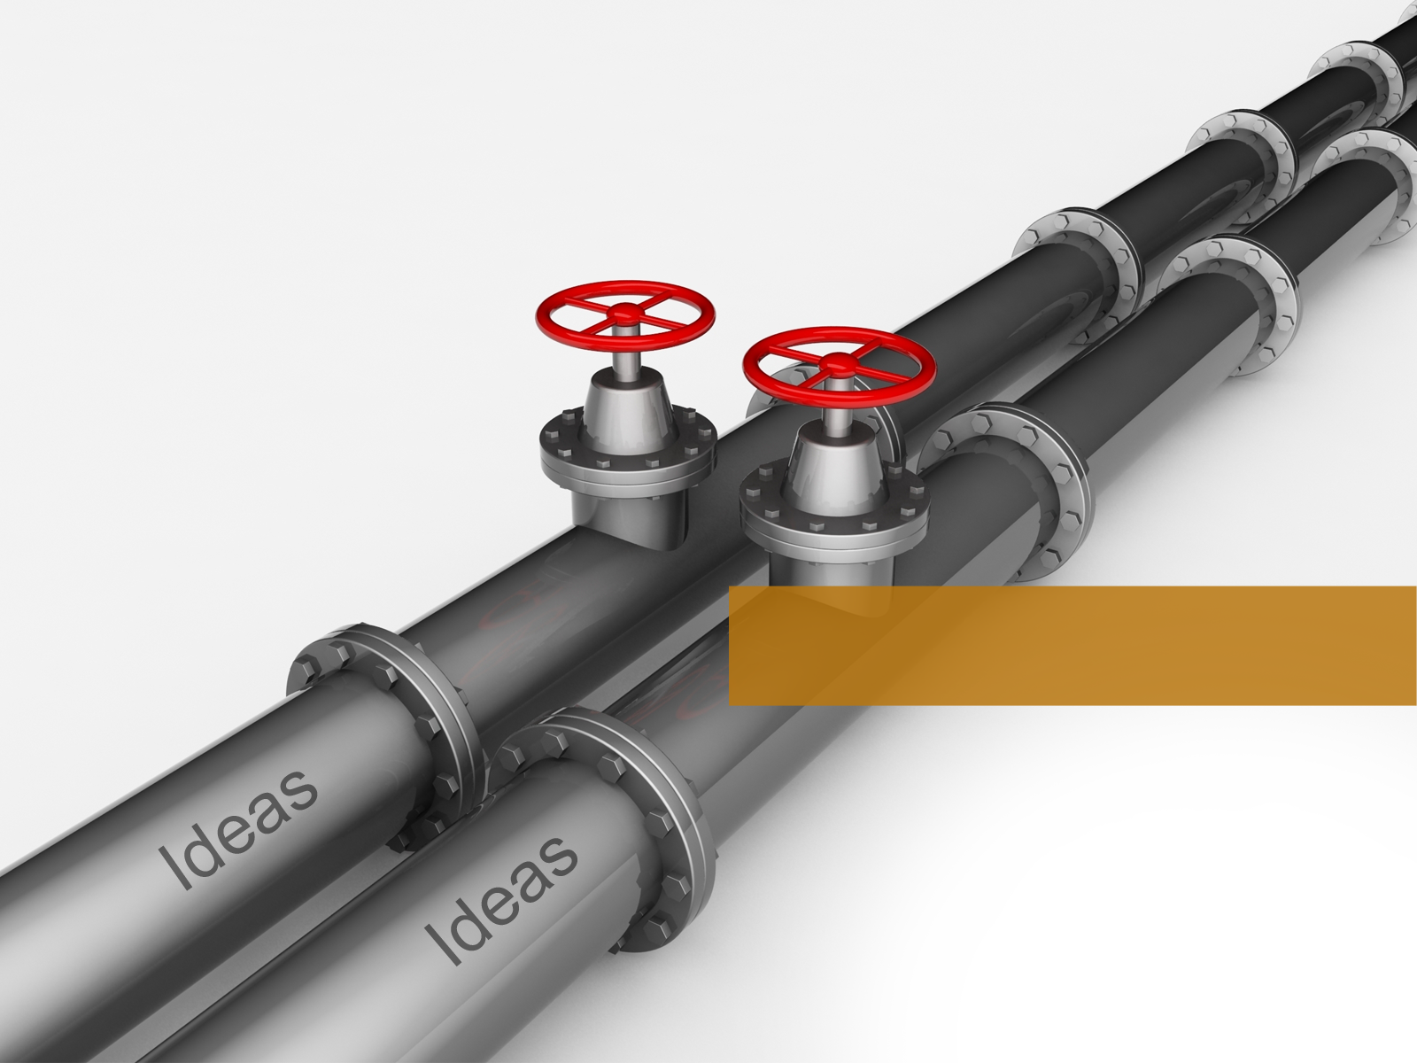
HOW TO OPEN THE VALVES?

Slide 45

Create a Shared Vision
and Common Direction

Slide 46
TEAM WORK
RESPECT
SUCCESS

Slide 47


Peri-operative Surgical Home
Why Urology?
Mitchell H. Sokoloff, M.D., F.A.C.S.
Professor and Chair, Department of Urology
University of Massachusetts Medical School
UMass-Memorial Health Care

Slide 48
Department of Urology
    “Embracing and advancing innovation in urologic care, research, and education.”
    — Mission Statement 2014

Slide 49
Urology Reinvention
In the process of creating a new department and establishing a new departmental culture
Overarching vision: “To become a leader in establishing policy and practice in urologic care by 2020”

Slide 50
Urology Reinvention
Welcome the opportunity to provide innovative state-of-the art, patient-focused, and cost- conscious approaches to surgical care
Melds well with national initiatives, including those of the AUA (American Urological Association)”

Slide 51
Why UM/UMMHC Urology?
Aligned with PSH philosophy
Adult practice is almost completely limited to a single campus (Memorial)
History of collaboration in in-patient care given lack of residents
Supports other initiatives underway with objective of improving OR and in-patient care at Memorial campus

Slide 52
Urologic/Oncology Focus
The pilot will start with urologic oncology
    most complicated and involved cases
    forefront of innovation with regards to comprehensive, team-based, patient-centered, coordinated care focused on cost-containment
More details to follow with regard to specific cases and faculty

Slide 53
Urology
    Treating for today, teaching for tomorrow, innovating for the future

Slide 54
Why the Anesthesiology CCM Team at Memorial Campus
Khaldoun Faris, MD
Clinical Associate Professor, Anesthesiology and Surgery
Medical Director, SICU

Slide 55

Nothing endures but change
Heraclitus of Ephesus 600 BCE

Slide 56
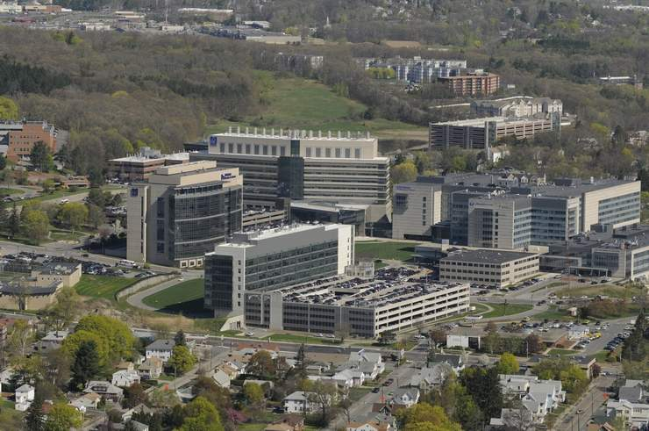
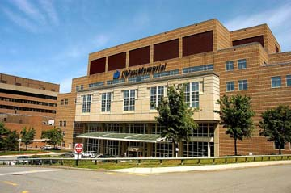

Slide 57
Experience
In peri-operative medicine
    CCM, surgical and medical patients
    Pain management
    Preoperative medicine
In team playing
    Multidisciplinary teams in the ICUs
    CCOC
    e ICU
In change
    CCOC
    Department

Slide 58
Staff
Eight anesthesiologist intensivists
    Four PSE
    Three Memorial OR
    Three Acute pain service
    Eight SICU
Provide continuum of care
    PCP - PSE – SACU – OR – PACU – ICU – floor – discharge – post discharge – PCP

Slide 59
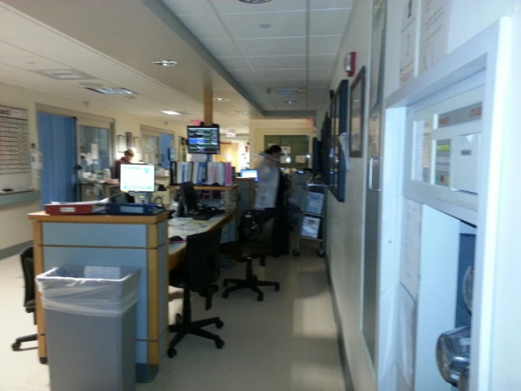
Location
Memorial SICU
Ideal size, 9 beds
    Similar to UAB PSH location
    Allows for covering 2-5 floor patients
Almost 100 % covered by Anesthesiology CCM team
Home of Dept. of Urology
Home of the critically ill urology patients

Slide 60
Collaboration
Our specialty only works in the environment of collaboration
UMass leadership supports collaboration
New leadership in Urology embraces collaboration
The more collaboration the better the outcome

Slide 61
Embracing Change
Nothing endures but change
    Economical forces, less resources
    Political forces, expanding coverage and improving outcome
    Patient forces, better outcome and more satisfaction
Future models of practice
PSH equals affordable care

Slide 62
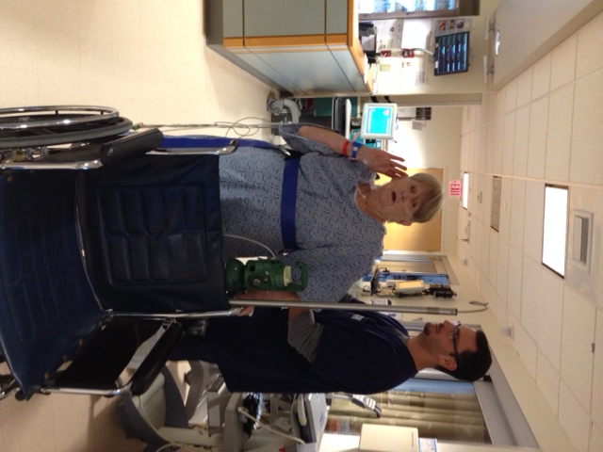
Conclusion
Our goal is a patient centered care, that is efficient, safe, and of the highest quality
PSH is the model to achieve this goal
The society and the patients are watching
And listening

Slide 63
Dr. Stephen Tosi MD
Chief Physician Executive, UMMHC
President, UMass Memorial Medical Group

Slide 64
Peri-operative Surgical Home Pilot
Patients and Teams
Mitchell H. Sokoloff, M.D., F.A.C.S.
  Professor and Chair, Department of Urology
Khaldoun Faris, MD
  Clinical Associate Professor, Anesthesiology and Surgery & Medical Director, SICU

Slide 65
Objectives
Coordinated, comprehensive, team-based, and
patient-centered
Provide seamless transitions of care with focus
on standardization, cost effectiveness, and quality and safety

Slide 66
Which Faculty?
Initially: Drs. Sokoloff, Yates, and Berry
Expand to: Drs. Steiger, Bamberger and Bernhard (depending on volume of cases)

Slide 67
Patients
Complex urology patients
    Mostly cancer patient
    Require admission to the hospital
    Not necessarily to the ICU
The urology/anesthesiology CCM teams will follow the patients from the time of PCP referral to the time of return to PCP
    PCP - PSE – SACU – OR – PACU – ICU – floor – discharge – post discharge – PCP

Slide 68
Which Patients?
Radical Prostatectomy (open and robotic)
Radical Nephrectomy (open, lap, and robotic)
Partial Nephrectomy (open, lap, and robotic)
Radical Cystectomy (open and robotic)
Retroperitoneal LN Dissection (RPLND: open)
Specific faculty: Drs. Sokoloff, Yates, and Berry

Slide 69
Pilot Approach: Teams
Five different teams
      Preoperative team
      Intraoperative team
      Postoperative team
      Post discharge team
      Quality and safety team
Team leads and members: physicians, affiliate physicians, nurses, managers, other stakeholders

Slide 70
Team Responsibility
Identify roles and responsibilities of members
Evaluate the current practice and recommends the changes needed to achieve the ideal practice
Review process and outcome measures and ways to collect the data
    ASA Newsletter 10/2014

Slide 71
Measures
Clinical process measures
Efficiency process measures
Safety outcome measures
Economic outcome measures
Patient-centered outcome measures
American Society of Anesthesiologists Article October 1, 2014 Volume 78, Number 10
The PSH: Clinical Safety, Internal Efficiency, and Economic and Patient-Centered Metrics Howard A. Schwid, M.D. Zeev N. Kain, M.D., M.B.A. Richard P. Dutton, M.D., M.B.A

Slide 72
Measurable Outcomes
Efficiency (resources, staffing, supplies, equipment)
Decrease in cost
Decrease in hospital stay, increase in recovery
Decrease in complications and readmissions
Increase in physician and staff satisfaction
Increased coordination and communication
Increase in patient satisfaction
Increase quality of care

Slide 73
Department of Urology
    “Embracing and advancing innovation in urologic care, research, and education.”
    — Mission Statement 2014

Slide 74
Governance of the Pilot
Committee | Meeting Frequency
Project Team Leadership | Every other week
Teams | Weekly
All Team Meeting | Monthly
Steering Committee (multi-stakeholder) | Quarterly
Shared Learning
Project Team Leadership: Drs. Kaur, Sokoloff, Faris, Steinberg, CWM consultants, & Team Leads

Slide 75
Team Break-Out Sessions
Introduce Teams
Team Discussion: Each team to:
      Review and modify suggested process changes
          What is current process?
          What is ideal future state?
      What do we need to operationalize new protocol/roles and responsibilities of team members?
      Review outcomes for each process

Slide 76
Teams
Pre-Op Team
Leads: Theofilis Matheos, Alexander Berry
Suzanne Ashton
Jane Baron
Alok Kapoor
Melinda Miville
Barbara Steadman
Intra-Op Team
Leads: Mitchell Sokkoloff, Maksim Zayaruzny, Joann Geslak
Antonio Aponte
Kathleen Barber
Pamela Benton
Pam Haggerty
John Jepson
Pat Kusz
Michael Puim
Devein Walmsley
Post-Op Team
Leads: Jennifer Yates, Khaldoun Faris
Gus Angaramo
Lauren Bersey
Wendy Hodgerney
Johhny Isenberger
Jenna L’Herueux
Erin Legier
Christopher St. Amand
Post Discharge Team
Leads: Manilo Grant, Tess Gessler
Deborah Caneen
Christine Coulomobe
Craig Lilly
Maija Sumner
Quality and Safety Outcomes
Leads: Shubjeet Kaur, Stephen Heard, Mitchell Sokoloff
Jerone Allison
Shrayn DeMango
Khaldoun Faris,
Ellen Felkel-Brennan
Alok Kapoor
Mary Naples
Lori Pelletier
Lauren Russell
Matthias Walz
Kathleen Whyte

Slide 77
Central Tenets of Perioperative Surgical Home
Patient and family centeredness and shared decision making
Evidence-based care
Standard Work
Attention to quality and safety
Coordination and communication across perioperative care and medical neighborhood

Slide 78
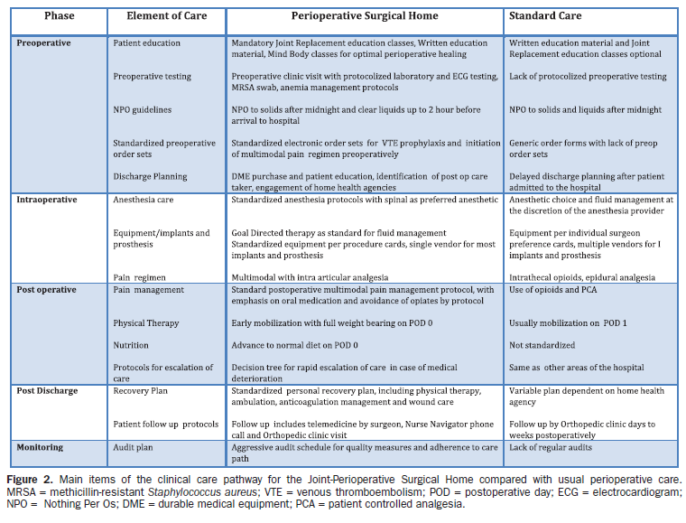
Joint Replacement PSH - UCI

Slide 79
Timeline for the Perioperative Surgical Home Pilot
January 13, 2015 - March 1, 2015: Teams meet weekly to hone their processes
Week of March 30, 2015: Implementation kick-off meeting
March 30, 2015 - Official launch date of PSH pilot
March 30, 2016 - End of PSH pilot

Slide 80
Governance of the Pilot
Committee | Meeting Frequency
Project Team Leadership | Every other week
Teams | Weekly
All Team Meeting | Monthly
Steering Committee (multi-stakeholder) | Quarterly
Shared Learning
Project Team Leadership: Drs. Kaur, Sokoloff, Faris, Steinberg, CWM consultants, & Team Leads

Slide 81


