Slide 1

Perioperative Surgical Home Pilot
Launch Kick-off Meeting
April 15, 2015

Slide 2
Welcome
Dr. Judith Steinberg, MD, MPH
Deputy Chief Medical Officer
Commonwealth Medicine
University of Massachusetts Medical School

Slide 3
PSH Pilot Launch Kick-off Meeting Objectives
Present overall goals, team processes for change and team process measures for the PSH Pilot
Present Pilot outcomes measure slate and process for data collection
Identify next steps for implementation of the PSH Pilot

Slide 4
Agenda
Welcome
Pilot Goals
Pre-op Team
Intra-op Team
Post-op Team
Post Discharge Team
Outcomes Team
Next Steps

Slide 5

“I have a Dream”

Slide 6


Perioperative Surgical Home
PSH™
Urology Pilot
Kick-off Retreat
Jan 13th 2015

Slide 7


Slide 8



Slide 9
Perioperative Surgical Home
PSH™
Urology Pilot
Launch Meeting
April 15th 2015

Slide 10
Shubjeet Kaur MD, M.Sc.HCM
Professor and Chair of Anesthesiology
University of Massachusetts Medical School
UMass Memorial Medical Center
Worcester, MA

Slide 11
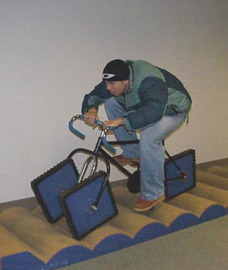
HARD Work

Slide 12


Thank You

Slide 13
What is the PSH?
The PSH is a patient-centered, physician-led interdisciplinary, and team-based system of coordinated patient care
  Spans the entire experience from decision of the need for any invasive procedure—surgical, diagnostic, or therapeutic—to discharge from the acute-care facility and beyond

Slide 14
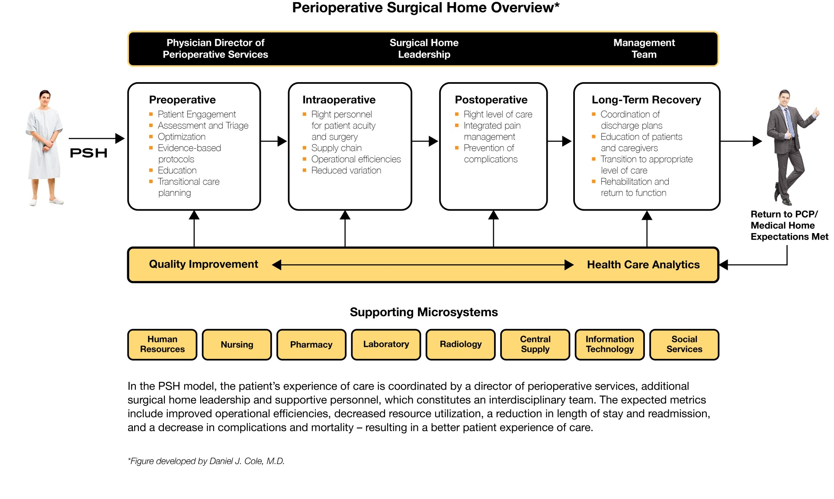
PSH Overview

Slide 15
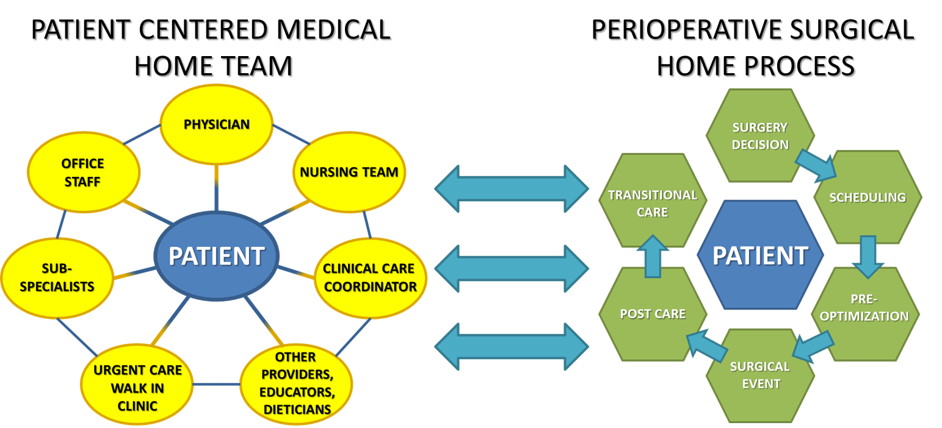
Creating Consistent, Seamless Care
Patient-Centered Medical
Home Team
Perioperative Surgical
Home Process

Slide 16
Key Components of the PSH
Patient Experience
Cost Analysis
Quality Metrics
Performance Improvement
Data Management
Collaboration: Surgeons, Hospital Administration, Other Stakeholders
Outcomes Tracking

Slide 17
ASA National Learning Collaborative
Launched July 2014

Slide 18
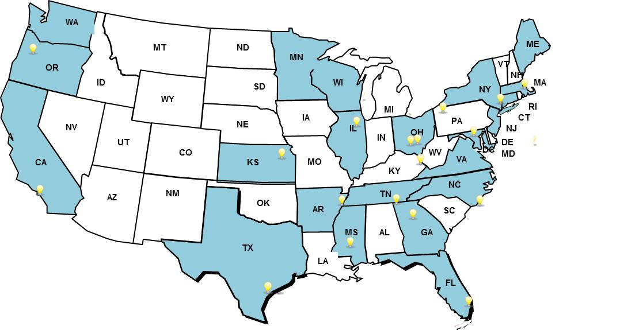
Learning Collaborative Members
A diverse group of health care organizations that includes:
18 Academic Medical Centers
16 Community Hospitals
7 Group Practices/ASCs
3 Pediatric Hospitals

Slide 19
Pilot PSH Projects
Ortho/Total Joint (18)
Colorectal/ERAS/ERIN (5)
Idiopathic Spinal Fusion (4)
Urology (2)
Adenoidectomy-Tonsillectomy (1)

Slide 20
Measuring the Impact of the Model
Selected common metrics with the goals of:
  Quantifying the impact of the model on costs, quality, and patient experience
  Identifying high-performing models and best practices
  Driving performance improvement across pilot projects
Identified potential metrics for the following domains:
  Clinical and safety outcomes
  Patient centered outcomes
  Internal efficiency outcomes
  Economic outcomes
Classified the metrics by surgical phase:
  Pre-operative
  Intra-operative
  Post-operative
  Post-discharge
  Across the surgical stages

Slide 21
Identifying the PSH Primary Metrics
Evaluated the 148 identified metrics and narrowed the list down to the 20 most meaningful and feasible metrics
 | Clinical & Safety Outcomes | Patient Centered Outcomes | Internal Efficiency Outcomes | Economic Outcomes | TOTAL
Pre-Operative | 1 | 1 | 1 | 0 | 3
Intra-Operative | 0 | 2 | 1 | 0 | 3
Post-Operative | 3 | 1 | 1 | 0 | 5
Post-Discharge | 1 | 1 | 1 | 0 | 3
Across the Surgical Stages | 3 | 0 | 0 | 3 | 6
TOTAL | 8 | 5 | 4 | 3 | 20

Slide 22
PSH Primary Metrics
PSH Primary Metrics:
13 metrics – 11 clinical; 2 survey
24 sub-metrics – 16 clinical; 8 survey
ID Name
PSH-IE1 PSH First Case Delayed on Day of Surgery (IP and OP)
PSH-IE2 PSH Day of Surgery Case Cancellations (IP and OP)
PSH-IE3 Timeliness of Outpatient PSH Surgical Case Discharge
PSH-IE4 Average Length of Stay for Inpatient PSH Surgical Cases
PSH-CS1 Outpatient PSH Surgical Case Mortality
PSH-CS2 Discharge Disposition of Inpatient PSH Surgical Cases
PSH-CS3 Unplanned Upgrade of Care for Inpatient PSH Surgical Cases
PSH-CS4 Unplanned Upgrade of Care for Outpatient PSH Surgical Cases
PSH-CS5 Non-mortality Complications for Adult Inpatient PSH Surgical Cases
PSH-CS6 Non-mortality Complications for Pediatric Inpatient PSH Surgical Cases
PSH-CS7 Inpatient PSH Surgical Case Mortality
PSH-PC1 PSH Patient Experience at Discharge
PSH-PC2 PSH Patient Experience 30 Days Post-discharge

Slide 23

Local Context- Alignment

Slide 24
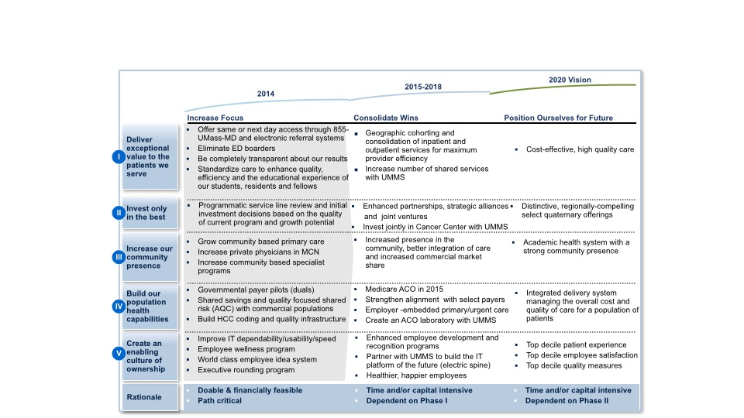
UMMHC 2020 Vision
We will become the best academic health system in New England based on measures of patient safety, quality, cost, patient satisfaction, innovation, education and caregiver engagement.

Slide 25

Staying Focused

Slide 26
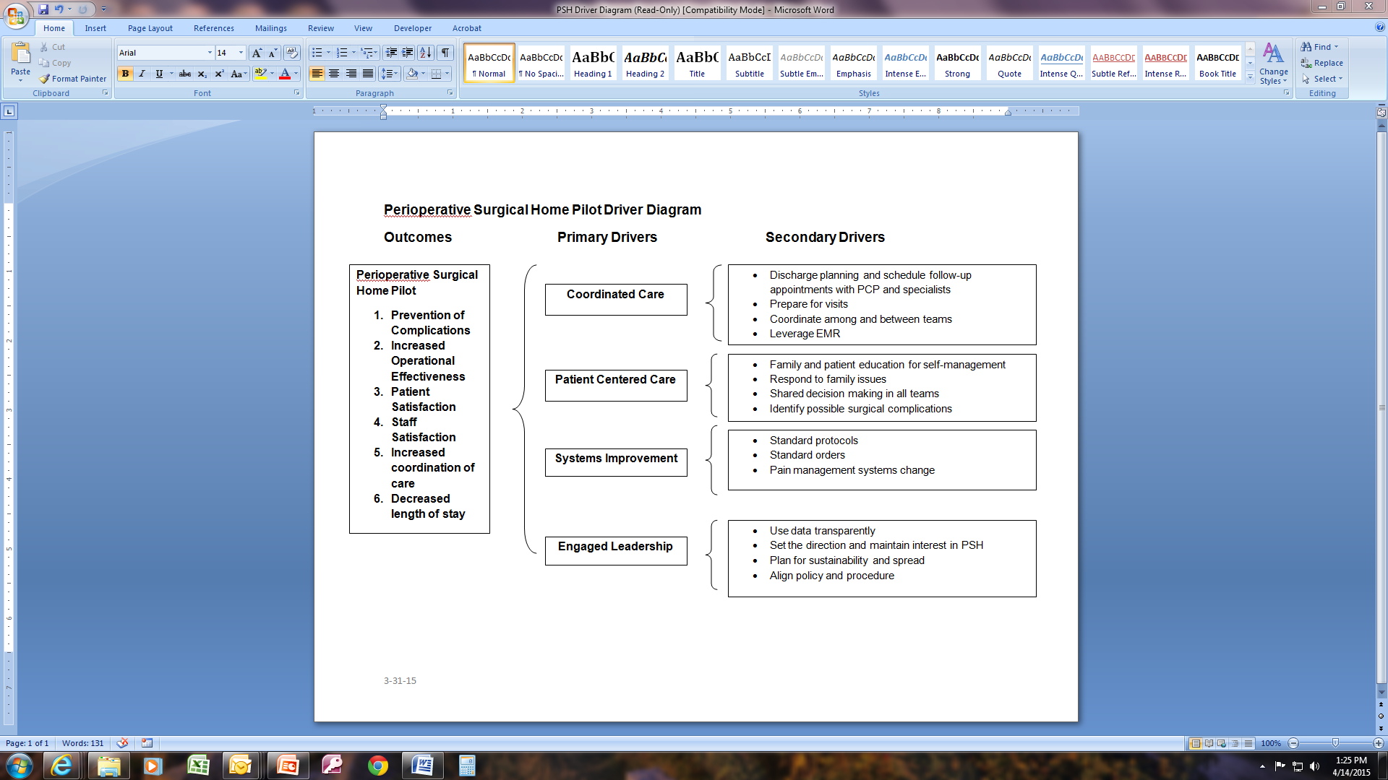
Driver Diagram

Slide 27
Perioperative Surgical Home Pilot
Pre-operative Team

Slide 28
Pre-Operative Team
Suzanne Ashton
Jane Baron
Alexander Berry
Edward Clune
Alok Kapoor
Theofilos Matheos
Melinda Miville
Barbara Steadman

Slide 29
Goals of Team
Coordinated care
Patient centered care
Systems improvement

Slide 30
Process Improvement or Change #1
Surgeon Visit
  PSE appointment booked
    Scheduling department instructed to give PSE appointment at least 10-14 days out prior to surgery
  Surgeon’s office provides patient informational sheet
    Sheet describes purpose of PSE, length of PSE appointment, directions to PSE, instructions centered around anticoagulation drugs, instructions to notify PCP of upcoming surgery
    Prior to patient arrival surgeon’s office faxes down surgical consent and pre-operative order sets ( to be placed in patient’s chart in PSE)
    Pre-op team documents receipt of above

Slide 31
Process Improvement or Change #2
Standardize the pre-operative work-ups and lab ordering.
The team will do periodic chart reviews to determine this was done.

Slide 32
Process Improvement or Change #3
Anesthesiologist to evaluate patient
  Any outstanding issues or pending labs/studies to be followed up by pre-op team
    “Green Sheet” on patient chart will designate missing information that needs to be addressed
    Surgeon to be notified of any potential problem which needs to be followed up
    Completed chart to be hand delivered to SACU for others to review it.
    Recommend assigned anesthesiologist call patient ahead of surgery

Slide 33
Process Improvement or Change #4
Patient teaching materials are being compiled
  paper handouts on surgery
  Power point on a video
  Materials on mindfulness and stress reduction
  Instructions for incentive spirometer and smoking cessation

Slide 34
Process Improvement or Change #5
Patient questionnaire: SF-12
  To be given to patient to be filled out while in PSE waiting room and at 1 month follow-up at surgeon visit
  Either paper/pencil version or on iPAD
  Include patient experience questions in 1 month follow-up
  Compare results of pre-op survey with 1 months follow-up

Slide 35
Preparation for Launch
What we need:
Finalize patient materials and power point
Questionnaire set up

Slide 36
Perioperative Surgical Home Pilot
Intra-operative Team

Slide 37
Intra-Operative Team
Pamela Benton
Joann Geslak
Andrea Graber
Pamela Haggerty
Michael Puim
Mitchell Sokoloff
Maksim Zayaruzny

Slide 38
Goals
Systems Improvement: Increase OR Efficiency
  Decrease OR Times: operative and turnaround
  Decrease Cost
Enhance Patient Safety and Experience
Improve Surgical Outcomes
  Diminish Complication Rate
  Reduce LOS, Readmission
Increase Physician and Staff Satisfaction
Coordination with Pre-op and Post-op Processes

Slide 39

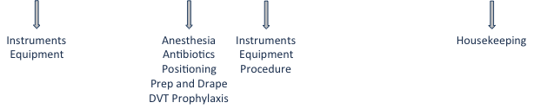
Process Improvement
Instruments
Equipment
Anesthesia
Antibiotics
Positioning
Prep and Drape
DVT Prophylaxis
Instruments
Equipment
Procedure
Housekeeping
Dedicated Teams

Slide 40
Finalization Prior to Launch
Finalize OR Instruments and Equipment
Standardize Some Parts of Operative Cases
Dedicated OR Staff Education
Create Time Study Checklist

Slide 41
Metrics/Measures
Team Process Measures
Time and Efficiency
Pilot Outcome Measures
OR Utilization (Collection Methods Established)
OR Expense (Collection Methods Established)
Patient Outcomes (Chart Review)
Physician and Staff Satisfaction
(Questionnaires Need to be Developed)

Slide 42
Perioperative Surgical Home Pilot
Post-Operative Team

Slide 43
Post-OperativeTeam
Gus Angaramo
Lauren Bersey
Khaldoun Faris
Wendy Hodgerney
Johnny Isenberger
Erin Legier
Jenna L'Heureux
Christopher St Amand
Nikol Varvaresou
Kimberly Williams
Jennifer Yates

Slide 44
Post-operative Team Goals
Address urology service coverage gaps
Standardize postoperative patient care
Improve communication:
  Between providers
  Between patient and providers
Streamline discharge
Minimize risk of readmission
Create educational program for providers

Slide 45
Process Improvements
Optimizing coverage
Standardized orders for post-op patients
Staff education
Patient and family education
Streamlining discharge

Slide 46
Optimizing Coverage
Completed:
      Dedicated urologic coverage weekdays 7am-7pm
In Process:
      Improving weekend dedicated daytime coverage
Weekend coverage resources:
    - Urology midlevel providers
    - Hospitalist NP providers
    - Residents

Slide 47
Standardized Orders
Standardized orders created for
  Cystectomy
  Radical Prostatectomy
  Nephrectomy
Review process
Next step:
  Forms Committee

Slide 48

Staff Education
Staff education
  PACU and SACU
  South 5
  Urology clinic staff
  Hospitalist NP
Measure
  Delivery of lecture topics
  Staff satisfaction

Slide 49
Staff Education
Educational Outreach to Perioperative Stakeholders
South 5 Educational Sessions:
Bladder cancer and Cystectomy (2 sessions in January and February)
Prostate Cancer and Radical Prostatectomy
Kidney Cancer, Radial and Partial Nephrectomy
Urology Clinic Lunch and Learn:
Bladder cancer and Cystectomy (December 2014)
Renal cancer and Radical/Partial Nephrectomy (scheduled April 2015)
Prostate cancer and Radical Prostatectomy
PACU Staff Educational Sessions – pending new PACU/SACU manager
Bladder cancer and Cystectomy
Prostate Cancer and Radical Prostatectomy
Kidney Cancer, Radial and Partial Nephrectomy
Ureteroscopy and Shock wave lithotripsy
BPH Surgical Management:
Hospitalist Nurse Practitioner Team
Care of the Urologic Postoperative Patient (scheduled and delivered March 11, 5:30 pm)

Slide 50
Patient and Family Education
Patient and family education
  Post-discharge instructions sheets
Measure:
  Patient satisfaction
  Readmissions
  Staff satisfaction

Slide 51
Optimizing Discharge Flow
Anticipate needs for discharge
Prepare caretakers
Preoperative teaching
Measures
  Patient satisfaction
  Caretaker satisfaction
  Complication risk
  Overall flow for hospitalized patients
  Discharge readiness vs. Actual discharge
Align with institutional initiatives

Slide 52
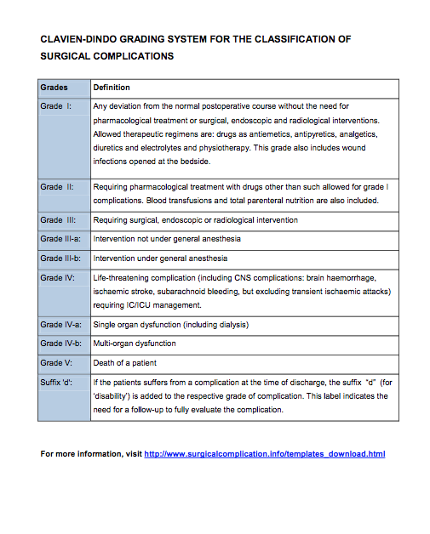
Minimize Risk of Readmission
Optimize postoperative education
  Patients and Providers
Record complications to pinpoint areas for improvement

Slide 53
Preparation for Launch
Platform for communication
Preoperative patient education
Our team process measures vs. pilot outcome measures

Slide 54
Perioperative Surgical Home Pilot
Post-discharge Team

Slide 55
Post Discharge Team
Christine Coulombe
Tess Gessler
Masilo Grant
Craig Lilly

Slide 56
Goals of Post Discharge Team
Coordinated and continuous care
  Collaboration with the other PSH teams to develop continuity
  Ensure continuity with PCP and Surgeon follow-ups
Patient centered care
  Questionnaires designed to monitor:
    post-discharge progress
    early detection of complications
    patients’ experience
Improving patient outcomes
  Early detection and reporting of complications and care coordination
Systems improvement
  Track follow up appointments and readmissions

Slide 57
Process Improvement or Change #1
Coordinated and Continuous Care
Collaborating with other PSH groups to ensure continuity of care
  Examining areas in which there is overlap/ lack of overlap between groups to ensure agreement
  Developing a universal tracking system to monitor patient progress through the Perioperative Surgical Home
Tracking PCP and Surgeon follow-ups
  Questionnaires at follow-up appointments
  Questions about follow-up appointments

Slide 58
Process Improvement or Change #2
Patient Centered Care
Post Discharge Questionnaires
  Post-discharge day 1-2 questionnaire will assess for potential issues early in the discharge course and cover such issues as pain, activities of daily living, medications, etc.
  Post-discharge one month questionnaire for follow-up
  Patient satisfaction questions added to post-discharge questionnaires
Reporting of issues to providers
  Specific highlighted answers are triggers to notify the surgeon, so that issues are managed early, to avoid complications and potentially decrease hospitalizations
Progress will be measured by:
      Quantifying the response rate and results of our questionnaires in conjunction with the Outcomes group

Slide 59
Process Improvement or Change #3
Systems Improvement
Developing a means to track hospital readmissions
  Discharge planning records and checking EMR – enter into Redcap
Tracking follow up appointments
  Document follow-up appointments in EMR
  Ensure Primary Care follow up 2-3 day and 4-6 weeks follow-up
Progress will be measured by:
    Quantifying percentage follow-up attained

Slide 60
Preparation for Launch
What we will need:
Collaboration with other teams:
  pre-op: questionnaires, follow-up appointments and initial patient assessment
  post-op: discharge date, assessment, contact information, updated PCP name and number
Questionnaire from pre-op to match (as best possible) post-discharge questions
Tool to document patient responses, such as Redcap
A means to track patients who are discharged directly to home (as opposed to SNF, Rehab, etc)

Slide 61
Using REDCap for the Pilot
REDCap may be used to:
  Monitor a patients progress through the Perioperative Surgical Home
  Create surveys or questionnaires
  Use as a collection tool for our pilot outcome and team process measures data
  Create reports

Slide 62
Perioperative Surgical Home Pilot
Outcomes Team

Slide 63
Outcomes Team
Arlene Ash
Alok Kapoor
Ellie Duduch
Sharyn DeMango
Khaldoun Faris
Stephen Heard
Shubjeet Kaur
Ann Lawthers
Christine Motzkus-Feagans
Mary Naples
Mitchell Sokoloff
Spiro Spanakis
Matthias Walz

Slide 64
Outcomes Team
Goals:
  Determine measures for overall pilot
  Develop data collection process
  Analyze data and create reports

Slide 65
Outcome Measures
Patient Questionnaires
  Pre-op: SF12
  1-2 days post discharge questionnaire plus patient experience questions
  One month post discharge: SF12, plus post discharge questions, plus patient experience questions
  3 months post discharge?

Slide 66
Outcome Measures
Team to collect Clavien-dindo classification
  Deviations from normal postoperative course

Slide 67
Outcome Measures
Team to collect NSQIP complications
  Pneumonia
  Unplanned intubation
  Prolonged mechanical ventilation (>48 hours)
  DVT
  PE
  SSIAKI
  MI
  Stroke
  UTI
  Septic shock
  Bleeding – transfusion
  Failure to rescue
  Delirium

Slide 68
Outcome Measures
Pain Scores
  From Inpatient EMR
  From post discharge questionnaire

Slide 69
Outcome Measures
From Inpatient EMR
  Length of Stay
  Re-admission rate
  Mortality 30 day
  Discharge Location

Slide 70
Outcome Measures
Cost of Care from Finance

Slide 71
Outcome Measures Parking Lot
  Staff experience questionnaire
  Exercise fitness
  Transfusions
  Time to ambulation and full nutrition

Slide 72
Analysis of Data
  Record data into RedCap
  Assistance from Christine Motzkus-Feagans
  Some data can be compared to historical controls
  Other data will be tracked over time and examined for signs of improvement (e.g. Poisson test)
  IRB submission

Slide 73
Perioperative Surgical Home Pilot
Next Steps

Slide 74
Next Steps
  Launch Date 5-4-15
  Teams to implement processes
  Develop Redcap system to monitor implementation of processes: collect data
  Finalize patient questionnaires and steps for collection
  Pilot Outcomes Measures data collection and reporting

Slide 75
Next Steps
  Meetings
  Individual Team Meetings every other week
  Leadership meetings every other week
  All team monthly meetings for shared learning

