Slide 1


Department of Anesthesiology
Faculty Meeting
April 21st 2015
S Kaur MD, M.Sc.HCM

Slide 2
Welcome
Notes:
Welcome all to the first Faculty Mtg as the New Chair of the Department
Delighted to see everyone here and such strong attendence

Slide 3



Thank You
Building on a Strong Foundation
Notes:
Emphasize the work done by prior leadership
Thank Dr Heard and many others for laying a strong foundation for us to build on
Acknowledge contributions of our Business Administrator – behind the scene advocacy on our behalf
Thank residency PD and many others

Slide 4

Vision
Roadmap to the Future
Notes:
Here to share vision for the future
Road map that we can create together
Left title blank- speak about creating a shared vision
Emphasize team for success

Slide 5


Key to our Success
Notes:
Key to success right here in this room- all of you
Mention my new leadership team
Acad Vice Chair, Clinical VC
Residency PD, Assoc PD

Slide 6
PILLARS
Patient Care
Education
Faculty
Development
Research
Notes:
Vision is around the 4 core pillars of our Department’s Mission
Vision as a Chair is aligned along those key areas
Rigorous nine month search process for Chair
Lot of time to reflect
Successful candidate for Chair at other places- two written job offers for Chair
Staying here is a conscious choice- an honor to lead you all
Clear vision for the future

Slide 7

Patient Care
Outcomes
COST
VALUE
Notes:
Patient care –our number one priority
The reason we went into medicine- to serve
Professor Porter-Harvard Business School- Defined Value
Value in Health Care

Slide 8
Patient Care
Patient &Provider
Satisfaction
Operational
Effectiveness
Fiscal
Viability
Notes:
Equally important Patient and Provider Satisfaction
Satisfied and engaged Providers- better patient care
Operational effectiveness- not just efficiency- doing the right things at the right speed
Fiscal viabilty- accountability- Make ourselves indispensable to the organization-to our patients

Slide 9
UMass Memorial Health Care
UMMHC
Hospitals
Member Hospitals
Affiliates
Medical Group
UMMMG
Employed Physicians
CMG
Community Medical Group
UMMC
UMass Memorial Medical Center
Marlboro Hospital
Health alliance
Clinton
University Campus
Memorial Campus
Hahnemann/ASC
SEC
EAE
Pain Clinic
Notes:
The complexity of our Clinical system
Areas in green where we provide Anesthesia Coverage
Grown to 55 Faculty 50 CRNA and over 30 Residents
Areas in yellow –growth opportunities
Areas/sites in yellow present growth opportunities

Slide 10

New Opportunities
Health
Alliance
PSH™
Lake-side 3
Notes:
Lakeside 3 ICU-CT and Vascular Surgery ICU- we don’t cover it presently
PSH- Urology Pilot
Health alliance- currently Sheriden
The CEO at Health alliance should want us not just because we are a part of the system but because we bring the best value

Slide 11
Alignment
UMMS/UMMHC
Regional Context
National Context
Notes:
Alignment of vision with our System ( school and clinical system
Regional
National

Slide 12

Notes:
We need to be headed in the same direction- even if we don’t travel in the same car

Slide 13
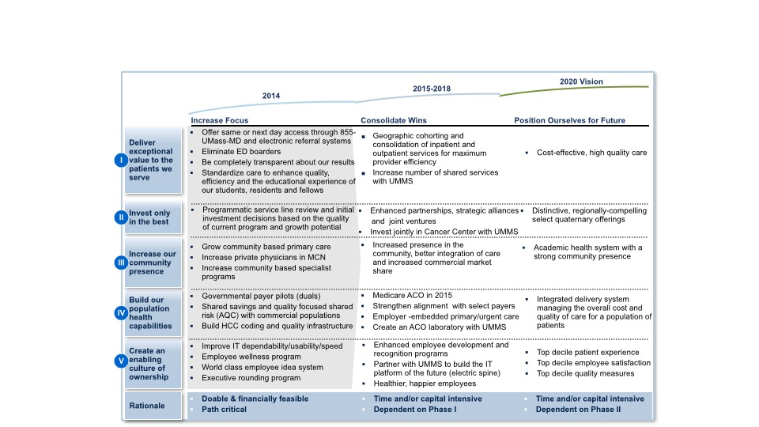
UMMHC 2020 Vision
We will become the best academic health system in New England based on measures of patient safety, quality, cost, patient satisfaction, innovation, education and caregiver engagement.
Notes:
How many of you have seen the UMMHC 2020 vision
Let me highlight the key points

Slide 14


Best Place To Give Care – Best Place to Get Care
Notes:
How many of you have seen this
Notice the order in which the things are listed
Best place to give care ( for the providers)
Then it can become the best place to get care ( for patients)
give example of airplane- oxygen mask- put your own oxygen mask - then you can take good care of other

Slide 15
System Goals
Operating Margin
Reduce ED Boarders
Physician
Communication
Access
Notes:
Are you familiar with our system goals for this year- areas where we aspire to make progress
outline details and emphasize as a Chair my role to communicate/ be a conduit between my faculty and system leadership

Slide 16
Excellence in Education
Residents
Medical Students
SRNA
Fellowships
Notes:
Education- our primary academic mission
what drew me to Umass initially- love for teaching- training the next generation of caregivers- shaping the future
Twice received Teacher of the year award from our residents- my most prized recognition
Education includes- Residency, Med students, SRNA and Faculty- life long learning

Slide 17
Residency Program
Curriculum
Redesign
Rotation
Redesign
Evaluation
Milestones
Recruitment
Placement
Leverage
Alumni
Notes:
Discuss the five areas of focus
Socialize the plan to have an education retreat

Slide 18
Bridge to Medical Students
Anesthesia Interest Group
3rd Year Rotation
4Th Year Elective
Notes:
Revitalize the Anesthesia Interest group
opportunity to create a superb experience for our 3rd year and 4th yr students

Slide 19
Simulation
Technical Skills
High Fidelity
MOCA Certification
Notes:
Simulation- three layers
Sherman Center- the best and biggest Simulation Ctr in the NE- we are very lucky

Slide 20
FACULTY
Retain
Develop
Recruit
Notes:
I consider the Faculty to be the backbone of our Department
Our genotype will determine our Phenotype
We are who we retain develop and recruit
Emphasize the order in which I have put this
Recognize the talent within
Meeting with every faculty member 1:!
Your vision for your self
My vision for the Dept
Seek alignment
Your success is my success

Slide 21
FACULTY
Wellness
Empowerment
Promotions
Notes:
My belief in wellness- work life balance
Empowerment- you are not a passive passenger but a driver of your destiny- and our department’s future
Academic growth and promotions for faculty

Slide 22
Drivers of Strategy
Performance Metrics
Faculty Compensation Plan
Individual Score Cards
Departmental Balanced Score Card
Notes:
Data driven
Faculty Comp plan that aligns with our goals and recognizes contribution in the 4 key areas
Feedback-objective and subjective
Team score card

Slide 23
Research
Curiosity
Innovation
Scholarly
Work
Notes:
strong clinical and education platform for research
Not aspiring for our dept to do basic science research
Emphasize curiosity, innovation- in health care delivery models and education
Scholarly work
Be role models for our residents
How many go into academia?

Slide 24
Research
Infrastructure
Mentorship
Clinical
Devices
Perioperative
Outcomes
Notes:
infrastructure- we have a clinical trial team
Dr Heard’s role- mentor and experience
Goal of establishing periop outcomes research
Collaborate with surgical partners

Slide 25
Role as Chair
Listen
Educate
Communicate
Represent
Advocate
Support
Align
Position
Notes:
How do I see my role of Chair
Talk about each and then mention accountability

Slide 26
Leadership Philosophy
Humility
Humor
Honesty

Slide 27
Leadership Compass
Respect
Fair &
Consistent
Professionalism
Notes:
My leadership compass- fair consistent- always respectful
Professionalism
Expect same from you- minimize destructive gossip
Honesty Humilty and Humor- my foundation
One for all and all for one

Slide 28
Leadership < > Teamwork
Vision
Formulate
Share
Strategy
Leadership
Team
Stakeholders
Tactics
Retreat
Resources
Execution
Discipline
Timeline
Sustain
Notes:
Have shared my vision
Created a leadership team
Buy in from stakeholders
Education retreat then other areas
Resources- Chair package
Without execution- this is just an illusion

Slide 29
Your Help is Invaluable
Thank you
Notes:
Your help is invaluable to bring this to fruition

